Slide 1
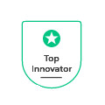



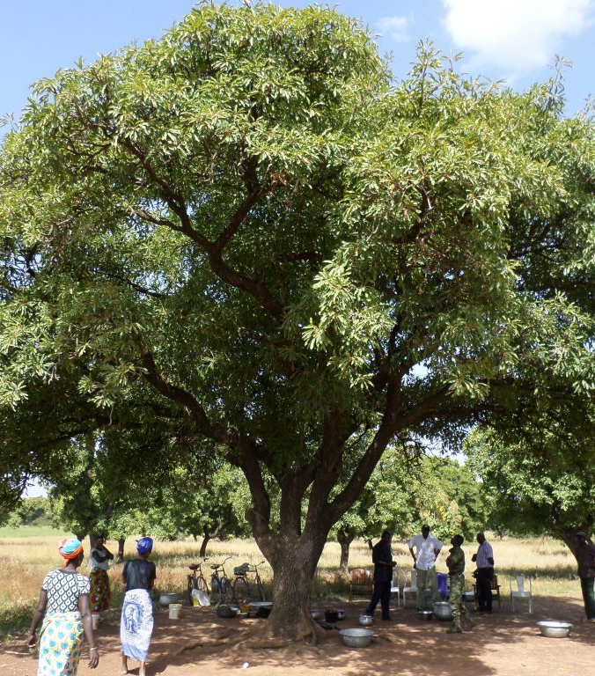

Serious Shea Senegal : Summary Business Model for the Great Green Wall
CONFIDENTIAL
The content of this document has not been approved by an authorized person within the meaning of the Financial Services and Markets Act 2000. Reliance on this document for the purpose of engaging in any investment activity may expose an individual to significant risk of losing all of the property or other assets invested.
June 2023

Slide 2
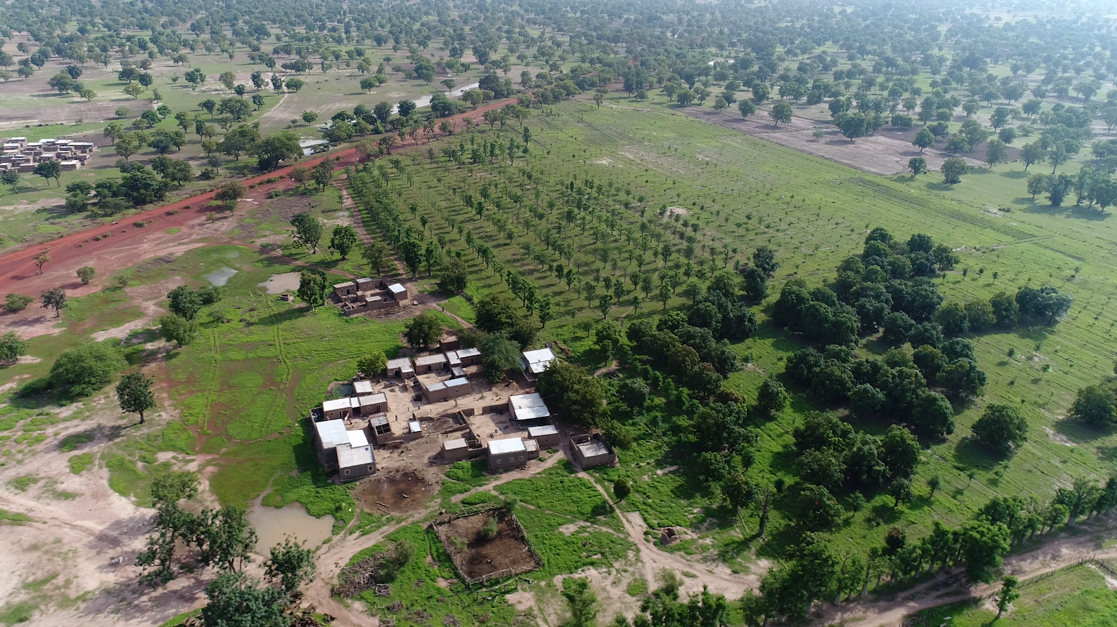

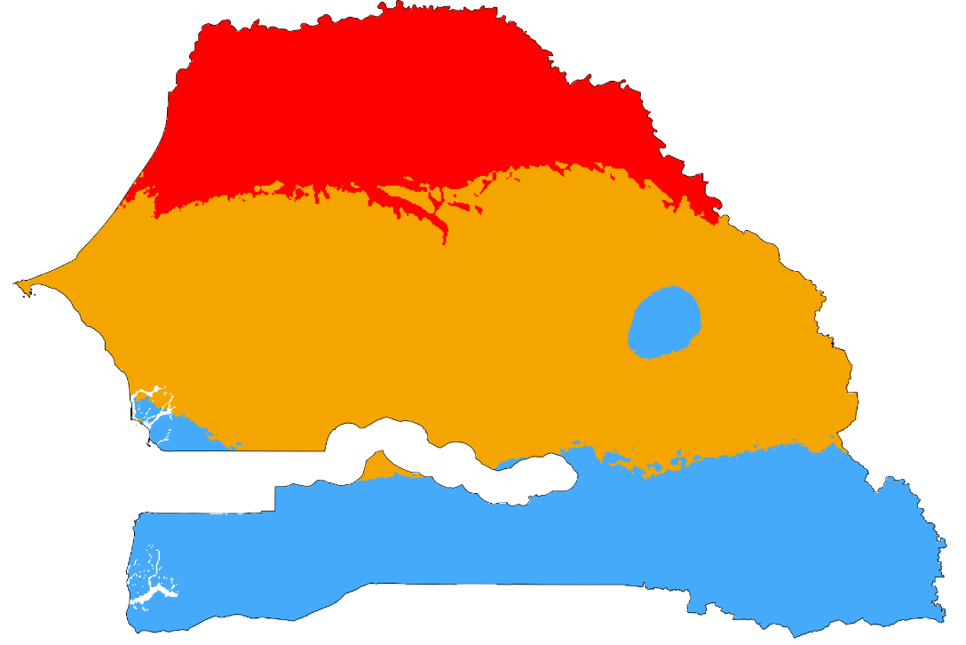
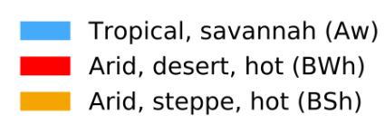

1. INTRODUCTION TO SERIOUS SHEA & THE GREAT GREEN WALL
Since 2007 Africa has been united in building the Great Green Wall — an 8,000 kilometer strip of reforested land across the continent from Senegal to Djibouti and the biggest living natural wonder in the world. The initiative is planting trees along this 3 million km2, semi-arid ecological transition zone, called the Sahel, to act as a buffer to prevent the Sahara Desert from expanding south. Combating desertification and land degradation will enable the local people to work their lands, providing food security, jobs, and a reason to stay for the millions who live along this tree wall. Within the Sahel Region, the Great Green Wall Initiative is initially focusing on the most urgent areas that are at highest risk of desertification or have the highest potential for preventing the spread of desertification while at the same time improving conditions for the local communities.
A decade since starting The Great Green Wall initiative is only 15% underway. Support from within Africa and the World is urgent for climate resilience, for nature and for communities. The transition to clean energy is critical so the trees planted do not end up as charcoal from burning wood fuel for food processing and in kitchens and so added value processing remains in the region to boost the rural economy with action to protect the native forests.
01
The Great Green Wall Regeneration, Deforestation-free, Zero-carbon Value Chain Business Model as proposed by Serious Shea Senegal, won the United Nations and World Economic Forum endorsed TRILLION TREES SAHEL and GREAT GREEN WALL CHALLENGE in 2021 as a TOP INNOVATOR which is leading the way. After 2 years of feasibility studies, technical preparations, and building linkages between the private sector, local communities, the public sector and international investors, Serious Shea has launched its Great Green Wall Challenge starting from Senegal in the western most part of the Sahel.
Serious Shea Senegal’s innovative approach is:
^{Science based}
^{Socially inclusive}
^{Partnership based}
Built on local skills development;
Well managed with people and technology.
Management technologies include clean energy processing, Circular Economy waste recycling for biogas and soil conditioners, soil water retention gels, QR coded supply chain, planet.org/nicfi satellite land-use & carbon information, drone data verification, Chain Zy (aka Blockchain) time stamp so financial and ESG information cannot be altered.
02
02
SENEGAL
Köppen-Geiger Climate Classification
Population: 18 million people
Area: 196712 km2 (@20 M ha)
Climate: Aw Tropical savanna - Bsh Warm semi-arid - Bwh Warm dessert
GDP: US$ 27.7 Billion
Employment: 60%+ Food Crop Production
(World Bank Statistics @ latest available date) Rural Energy Access 38% UN SE4all-africa.org
The current reliance of wood fuel in rural communities is such that e.g. 20kg wood are used for every 1kg of shea butter processed from shea fruit and nut collection.
Serious Shea is Smoothing the Way to a Better Future | Green Solutions | WEF https://youtu.be/02ZuQH6-5JA

Slide 3
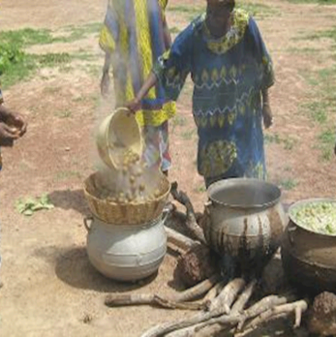

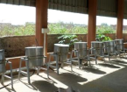







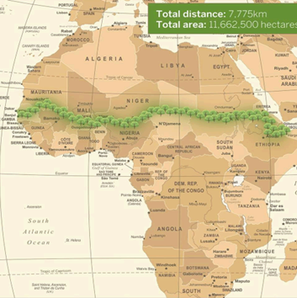
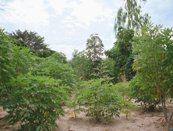
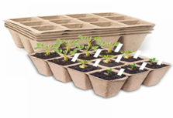
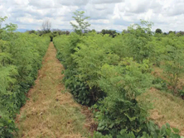








2. INVESTMENT PITCH DECK
PLANTATIONS & DEFORESTATION FREE ZERO-CARBON AGRI-FOOD VALUE CHAIN
1
2
3
4
5
1- Plantations €38M p.a.
agri-food €20M p.a.
2- 4.2M T Carbon (tCO2e) sequestered Years 1-10
3- 1M ha trees; 4000T p.a. processed shea, mango, moringa, baobab, other
4- 750 Serious Shea Partners (50% + women) plantations & processing
5- 135,000 households 50%+ women 2x income 20% shares
Activities
Profile
^{€ 25 M investment}
^{€ 50 M pa. revenues Year 10;}
40% Carbon Pre-payments; 60% Debt
Nurseries & Native Forest Plantations
Clean Energy Processing for shea butter, dried mangoes, baobab & moringa powder and oils

Slide 4
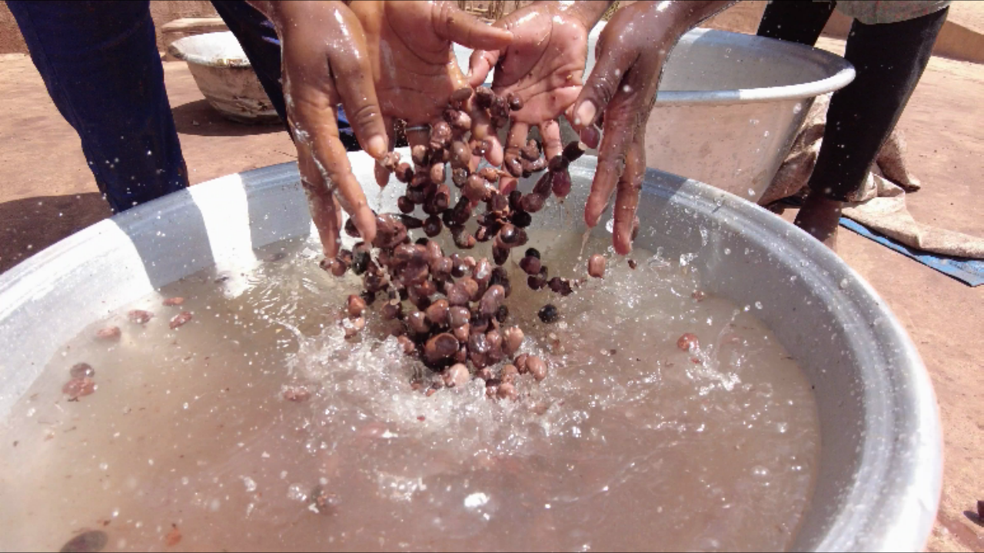

3. FINANCE AND MARKETING THROUGH PARTNERS
Financing Partners
40% Carbon Pre-payments (Equity); 60% Debt; 2% Project Finance Phase 1.
Business and Industry (carbon offsets)
Agri-food value chain partners
Customers
Business and Industry (carbon offsets)
Imisk food distribution channels
Natural cosmetics (L'Occitane, Body Shop and other cosmetics groups through existing market relations and surveys by Agritech Group & Serious Shea Burkina Faso)
Target Audiences
Certified Carbon Offsets Worldwide
Heath Foods (bulk for retail) Middle East, US, Europe
Shea butter and oils (bulk for retail) Middle East, US, Europe

Slide 5
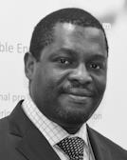
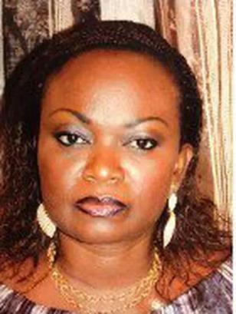
4. VEHICLE GOVERNANCE
80% SHARES; GOLDEN ORGANICS GLOBAL; BLENDED FUND MANAGER
William Kwende, CEO Golden Organics & Serious Shea Executive Chairman is also Founder & CEO of Agritech Group which has organized the collection of shea nuts and other African commodities for the major international markets in Europe and Asia since 2010 (e,g 5-10 000 T /year shea nuts). Agritech Group has processed and exported shea butter for several years, produced and planted millions of trees in arid lands, and successfully certified a carbon generating project. William has a masters in Business Planning from Quantic School of Business and Technology, and was co author of the Serious Shea Project which won the WEF-Uplink 1t.org Sahel and Great Green Wall Challenge in 2021. William has since played a major international role to advance the GGW initiative including at DAVOS 2022, with the African Union, the European Parliament, the UNFCCC and with public and private investors.
20% SHARES; SENEGAL WOMEN’S & YOUTH GROUP COMMUNITY FUND DELIVERED THROUGH COOPERATIVE INSTRUMENTS
Fatou Mboup, Team Leader for Senegal Cooperatives and Value Chains, specialized in communications and marketing at Nice Cabuccia Visa International College (France). She has 20 years experience in communications and public relations including in companies such as Canals Plus Horizons, MATFOURCE and ABM.

Slide 6

9. CONTACT
William Kwende
E-mail: MD@golden-organics.com

