Slide 1
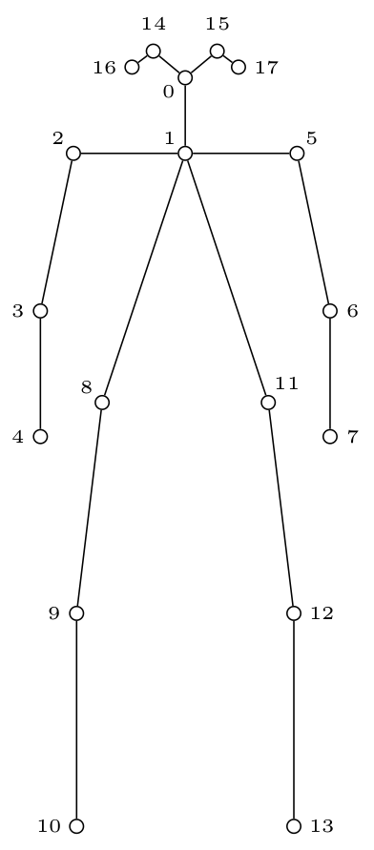
Humanitude Teaching System
Portable
    – On-site data gathering
    – Expandable
3D Skeleton
    – Invariant to setup
    – Improved keypoints
Tracking
    – Patient vs Practitioner
Notes:
Portable
We can do data gathering on-site in real-world conditions, as well as set up a larger system in the lab for a controlled environment and high quality data (ROS-TMS)
The system can also be expanded, to use N kinects in for example B-Sen.
3D Skeleton
Fully open source system that runs on linux 16.04
The 3D joint angles and interpersonal position are invariant to how the cameras are placed. This means we can use the same trained models no matter how the cameras are set up. We can also provide a wide variety of test data to create a robust neural network, which leads the detected features to be independent of the capturing system. The system makes it easy to use different RGBD sensors. The only changes needed to be made to the program would be the interface to the camera.
Keypoints are also improved both by constraining them to predefined lengths determined by industry standards. The system has also implemented some thresholds which allows for individual difference in limb length.
The sysem also guarantees to place a full skeleton where each keypoint is tagged with a certainty score. So, if the keypoint is not actually observed, this score is 0. The location of the unobserved points are guessed based on the parent keypoint.
Tracking
This allows us to distinguish between the patient and the practitioner. It is important to separate the individuals so we can see which part is active during different motions.
Tracking is currently done by finding the CoM of each skeleton per frame, and assigning the closest match to the previous frame. Future work for this module is implementing a Kalman filter to both smooth the motions of the individuals and tracking the CoM.

Slide 2
Future Work
Learning network?
  Input:
    Time series 3D angles and position
    Which technique was attempted
    Feedback from teacher
  Output:
    Prediction, Incorrect/Correct treatment
    What technique was attempted
    Differences between student and learned technique
Learning by play?
  A game-like approach
  Stepwise instructions are given and recognized
Notes:
If we are going to utilize machine learning methods to teach the Humanitude Method, it is helpful to break down the different problems so they become simple classification problems.
We propose a LSTM network to classify a subset of selected techniques. For example, one class could be “help up from chair” another could be “lift a box”. After analyzing these time-series motions, the network makes a guess as to which technique it saw. Alternatively, we could tell it which technique it was supposed to be, and it should be able to tell us what we did wrong/correctly.
We will input the time series 3D angles for each person and their position relative to each other. We will also have to know which technique is being shown, and we’ll have to be careful to stop the recording when the technique is finished.
Another approach could be to learn the most common mistakes students make, and have a teacher flag the wrong motions in the program and deliver feedback. However, this approach seems too complex, and there are too many classes (any possible mistake) to learn in this case.
A third approach is to manually create step by step motions for each technique. i.e. “First, place the patients legs underneath the chair.” Then, when the system recognizes that the patient is in this in the given position, it gives us the next instruction, “Reach out your hands, and ask the patient to place them in yours.” this requires the information in each technique to be programmed in close collaboration with an instructor. A drawback here, is that nothing new is learned, but the system is probably one of the easiest and most reliable to implement.

