Slide 1
Online shop

Slide 2
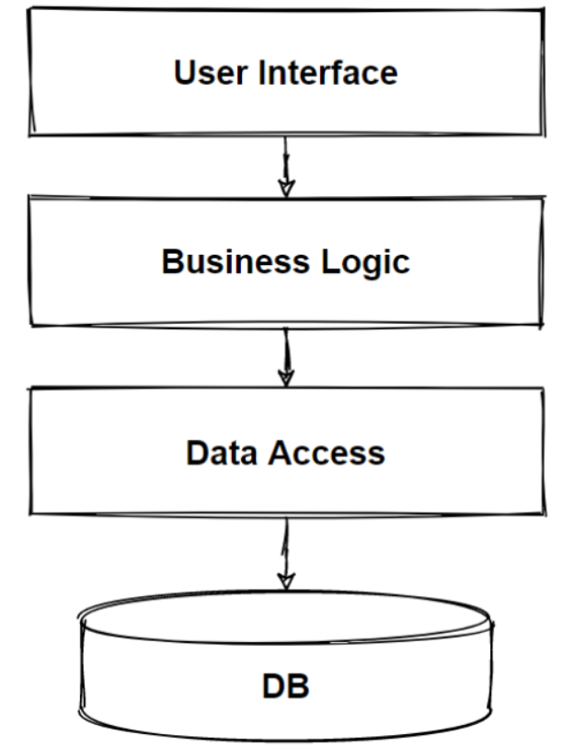
Monolithic Architecture

Slide 3
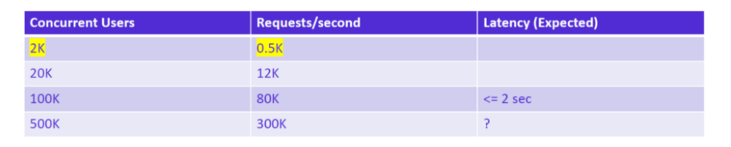
Request per Second and Acceptable Latency

Slide 4
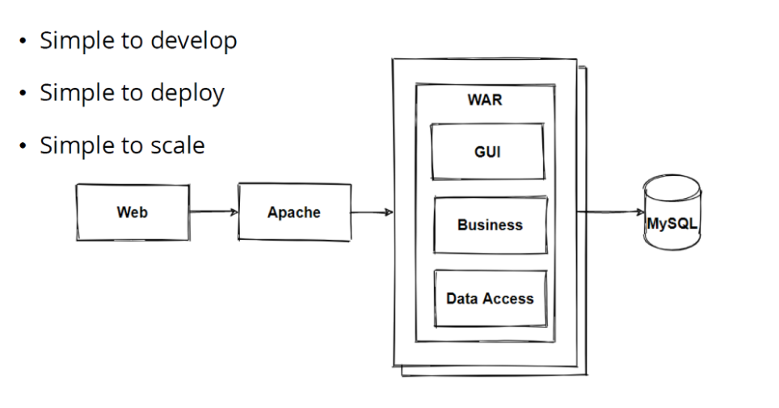

Slide 5
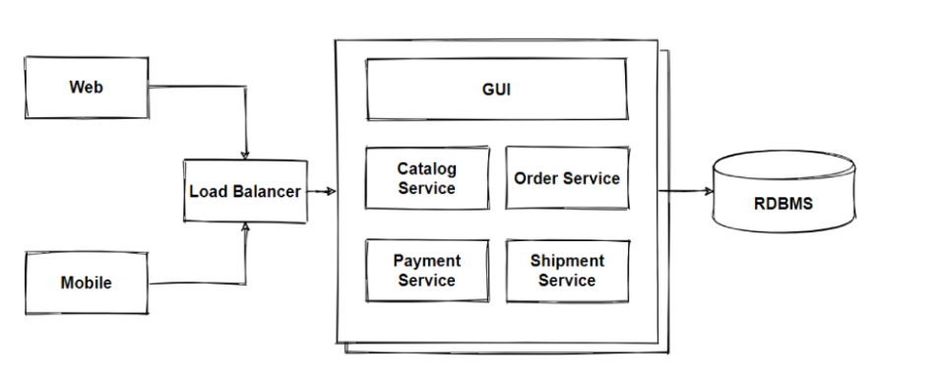

Slide 6
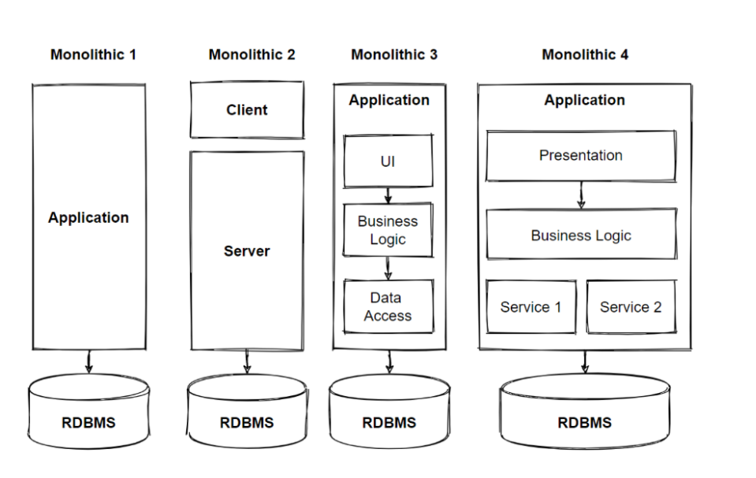

Slide 7
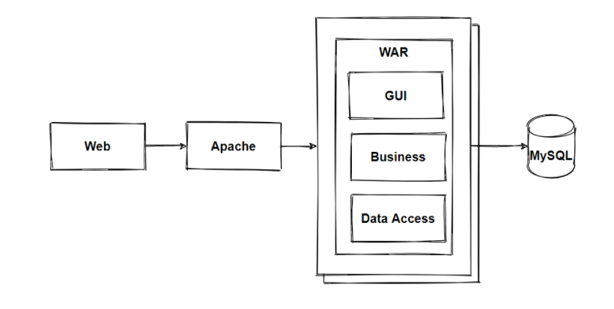

Slide 8
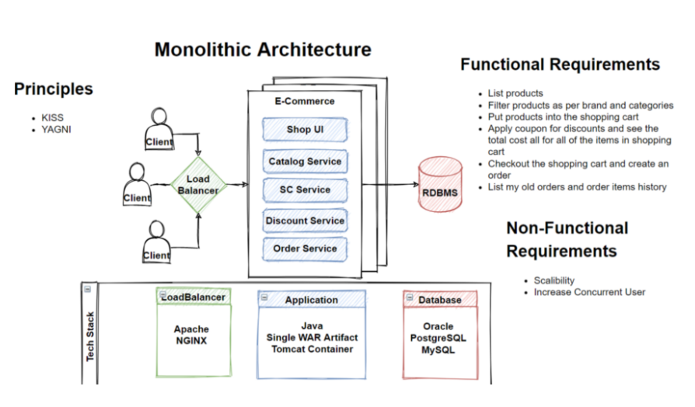

Slide 9
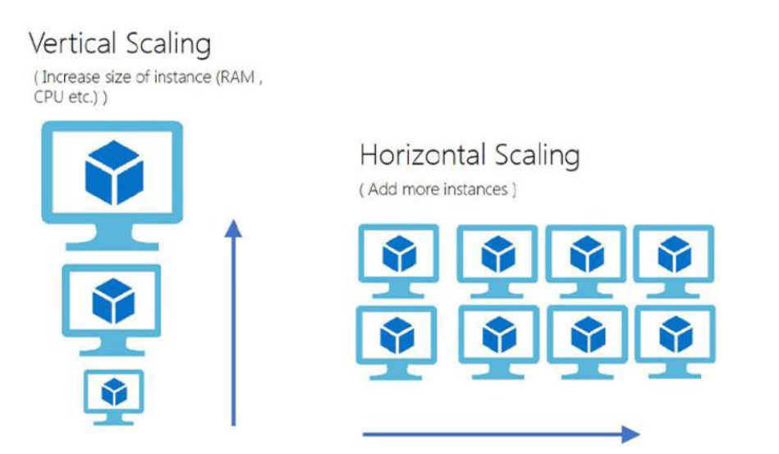

Slide 10
What is scalability ?
Scalability is simply measured by the number of requests an application can handle successfully. It can be measured by the number of requests and it can effectively support simultaneously. Once the application can no longer handle any more simultaneous requests, it has reached its scalability limit.
When your business to grow, in order to prevent downtime, and reduce latency, you must scale your resources accordingly. You can scale these resources through a combination of the network bandwidth, CPU and physical memory requirements, and hard disk adjustments.

Slide 11
What’s the main difference?
Vertical scaling is basically makes the nodes stronger. If you have 1 server, make the server stronger with adding more hardware. Make optimization the hardware that will allow you to handle more requests.
Vertical scaling keeps your existing infrastructure but adding more computing power. Your existing code doesn’t need to change — you simply need to run the same code on machines with better specs. Vertical scaling means adding more resources to a single node and adding additional CPU, RAM, and DISK to cope with an increasing workload.
Horizontal scaling basically means splitting the load between different servers. Horizontal scaling simply adds more instances of machines without changing to existing specifications. By scaling out, you can share the processing power and load balancing across multiple machines.
Horizontal scaling means adding more machines to the resource pool, rather than simply adding resources by scaling vertically. Vertical scaling gives you the ability to zoom into add more servers to your network, but it also requires you to zoom out by adding a bit more power, CPU, and RAM to the existing infrastructure.

Slide 12
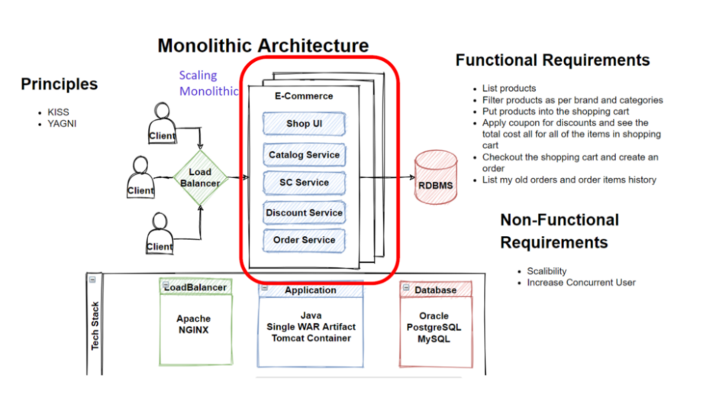
NGINX is one of the popular open-source load balancing software that widely using in the software industry.

Slide 13
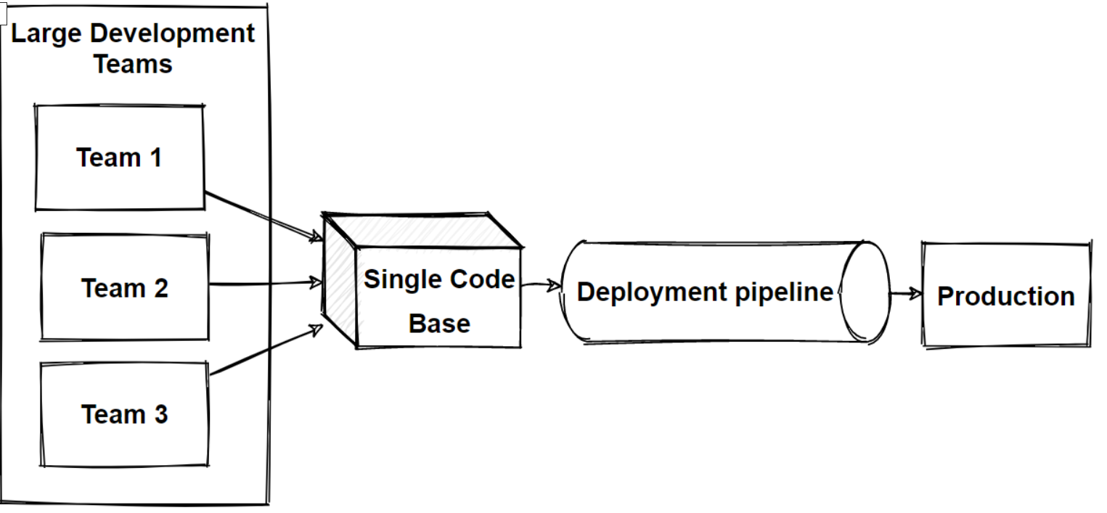

Slide 14
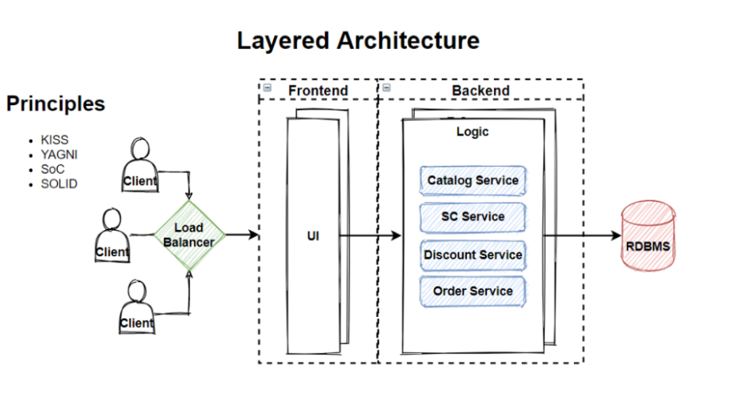

Slide 15
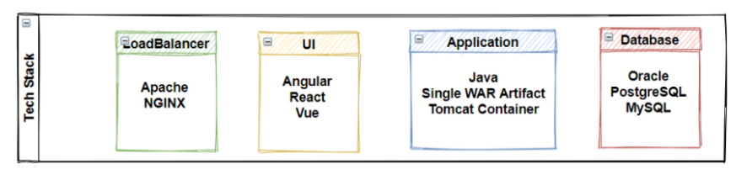
Technology choices — Adapting Technology Stack

