Slide 1
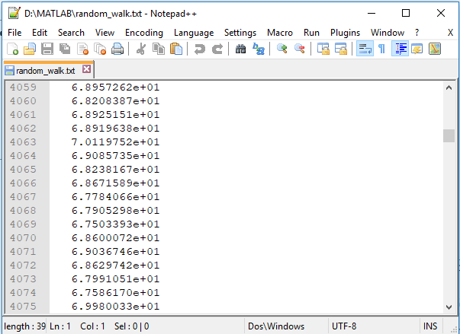
This presentation assumes you have the following files in your Matlab path.
consensus_search.m
muinvn.m
generate_example.m
random_walk.txt

Slide 2
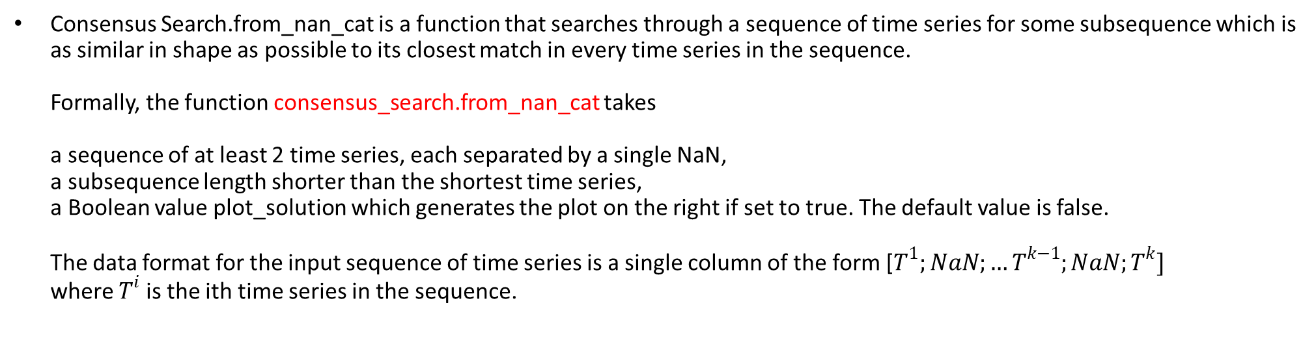
Consensus Search.from_nan_cat is a function that searches through a sequence of time series for some subsequence which is as similar in shape as possible to its closest match in every time series in the sequence. Formally, the function consensus_search.from_nan_cat takes a sequence of at least 2 time series, each separated by a single NaN, a subsequence length shorter than the shortest time series, a Boolean value plot_solution which generates the plot on the right if set to true. The default value is false. The data format for the input sequence of time series is a single column of the form [$T^{1};NaN;…T^{k−1};NaN;T^{k}]$ where $T^{i}$ is the ith time series in the sequence.

Slide 3
The following line [sol,obj] = consensus_search.from_nan_cat(T,subsequence_len,true); returns a solution struct and a consensus_search object. The solution struct sol contains the fields nearest_neighbor_dists, nearest_neighbor_indices, and radius. If our consensus motif was discovered from the jth subsequence in the ith time series, then sol.nearest_neighbor_dists(i) will equal 0 and sol.nearest_neighbor_indices(i) will equal j. obj contains the mean, standard deviation, and other summary statistics used in the search. It also holds a cell array form of the original time series. It also contains a few extra utilities to help visualize the results. You can visualize subsequence results using the following functions obj.plot_ts(time_series_index, axis); obj.plot_ss(time_series_index, subsequence_index, axis); Both functions are identical with the exception that one plots the entire time series for each index and the other only plots the appropriate subsequence. If an axis handle is provided, results are added to the same plot. If no axis handle is provided, either function will open a new window. If more than one index is supplied, the results will occupy the same plot. If an invalid axis handle is provided, these will throw a runtime error.

Slide 4

Below I will describe a set of utility functions. Given a constructed consensus_search object obj, the following class functions apply.
obj.plot_ts([$i_{1}…i_{k}$], ); adds the time series indexed by $i_{1}…i_{k}$ in the construction of our search object to a new plot.
obj.plot_ss([$i_{1}…i_{k}$], [$j_{1}…j_{k}$]); adds the subsequences indexed by $j_{ℓ}$ in time series $i_{ℓ}$ for $ℓ=1…k$
>> obj.plot_ts([1, 3, 8]) % In this example I wanted to see the first, third, and eigth time series
>> obj.plot_ss([1, 3, 8],[1, 10, 50]) % In this example I wanted to see the first subsequence from the % first time series, the tenth subsequence from the third time series, and the fiftieth % subsequence from the eight time series.

