Slide 1
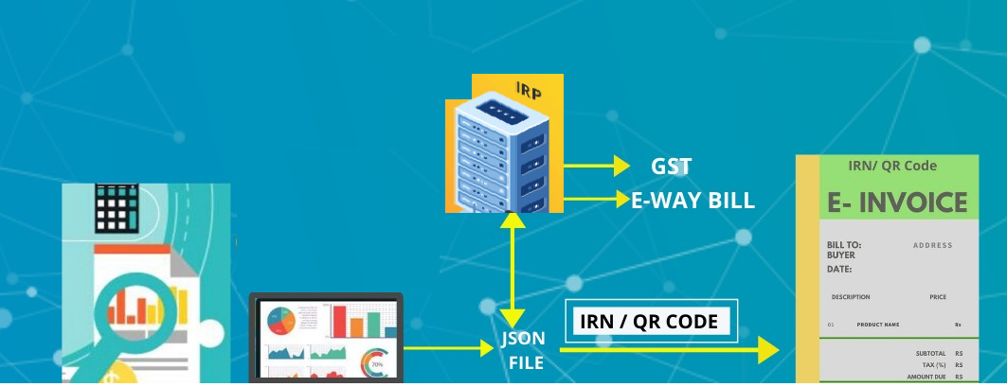



e-Invoicing in TallyPrime Fully connected solution to simplify your e-invoicing
e-Invoice
Prepared by
TallyCare
Notes:
E-invoicing Stands for Electronic Invoice
Electronic Invoicing is an electronic authentication mechanism under GST. Under the mechanism, all the B2B invoices generated by a business will have to be authenticated on the GSTN portal, electronically.

Slide 2
Agenda
01
04
Domain update on GST e-invoicing
Readiness on Queries & Response
02
05
e-Invoice Generation Life Cycle
e-Invoicing terminology vs Tally Terminology
03
06
Product Demo of TallyPrime
TallyHelp and video links

Slide 3
Domain update on GST e-invoicing

Slide 4
e-Invoicing?
e-Invoice
e-Invoicing means the registration of all taxable invoices (B2B) on the central portal (IRP) of the tax department.
Businesses can continue creation of invoices using their existing billing/accounting software.
Once the invoices are created in the current system using different modes (API/Portal/Mobile/Tools etc.) then the invoice can be sent to central portal (IRP) for registration
Once the invoices are registered, the IRP will generate a unique Invoice reference number (IRN) and sends the signed invoice information using which QR code need to be printed on the invoice
Legally it is mandated to print the QR code & IRN in the Tax invoice

Slide 5



What is IRN?
Invoice Reference Number (IRN) is a unique number (also known as hash) generated by the e-invoice system using a hash generation algorithm.
For every document e.g., an invoice or debit or credit note to be submitted on the e-invoice system, a unique 64-character Invoice Reference Number (IRN) shall be generated
IRN will be formed by combining the following details together (in simpler words link the following details together) and computing SHA 256 hash
Supplier GSTIN
Financial Year of the Invoice
Document Type (Invoice, Credit Note, etc.)
Invoice Number or Document Number

Slide 6



Applicability & Implementation dates?
?
Equal / Greater than
₹ 100 Cr.*
Equal / Greater than
₹ 20 Cr.*
Equal / Greater than
₹ 5 Cr.*
Equal / Greater than
₹ 500 Cr.*
1st Jan’21
1st Apr’22
Equal / Greater than
₹ 50 Cr.*
Equal / Greater than
₹ 10 Cr.*
1st Aug’23
1st Oct’20
1st Apr’21
1st Oct’22
* Turnover (PAN) in last 3 preceding Financial years (Starting 2017-18)
Notes:
1) In case if you are not clear with the Eligibility & Applicability for your business, then you can refer a previous year 3b Report for 12 month to know your total turn over.

Slide 7





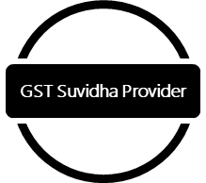

Pre-activity to e-invoice
Taxpayers will receive a communication from the department
Note: Taxpayers who are above Rs.5 Crore but not enabled for e-Invoicing can get enabled voluntarily by clicking Registration -> e-Invoice Enablement.
On receiving the communication Taxpayer will login to IRP portal
Complete registration process by providing required details
Select their preferred GSP in case of API-based e-invoice generation
Note: Customer has enrolled for the e-Way facility from Tally – Not required to Register
Start generating e-invoice from date of applicability

Slide 8

Documents to be reported to e-invoice system?
B2B/ B2G Tax Invoice
Export Invoices
Reverse Charged Invoices (Outward Supplies for reverse chargeable items/services)
Credit Notes
Debit Notes (only in case of Sales price escalation ie., Sales Ledger is used in debit Note)

Slide 9

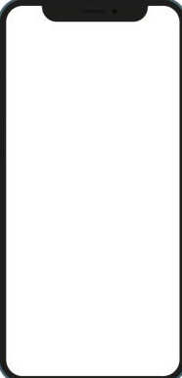



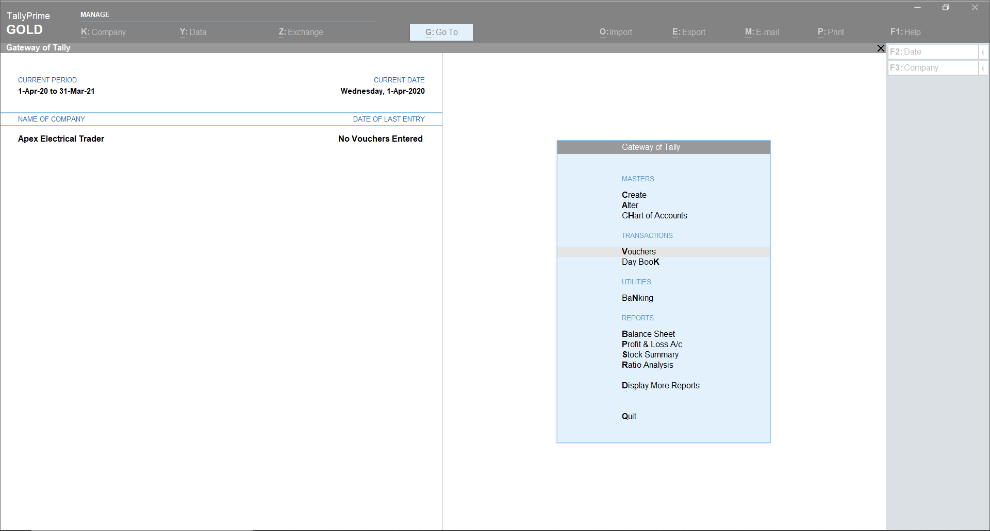

Various modes of generating e-invoice
IRP Portal
GSP
Business Portal
Direct Entry on Portal
API
(ERP)
Mobile Based
(Large Taxpayers
>500Cr. Turnover)
Offline/excel tool

Slide 10

Offline Tool- Excel
Particulars | Format A | Format B | Format C | Format D
No. of worksheets? | One | Two | Three | One
Contents of each sheet? | Invoice & item details | Invoice Details Item Details | Invoice Details Item Details Payment & Invoice reference details | All the details in Format C clubbed into one single sheet
When is it expected to be used? | One or 2 items with limited no. of invoices | Large volume of invoices with large number of items | Large volume of invoices, large number of items and additional information for each invoice | Large volume of invoices with large number of items, with additional information for each invoice
Nature of transactions? | B2B & B2G | B2B & B2G | B2B, B2G, Exports | B2B, B2G, Exports

Slide 11
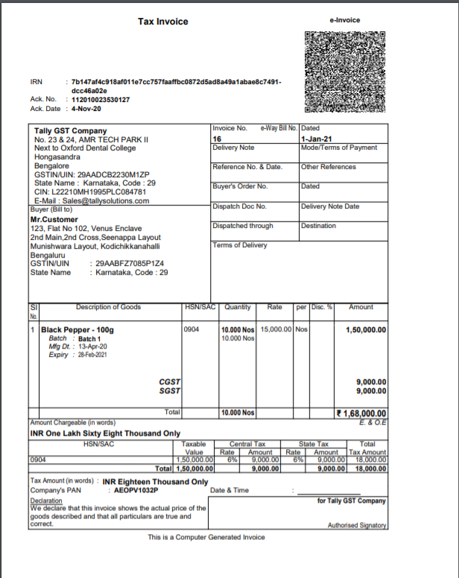
E-invoice Details – QR code
GSTIN of Supplier
GSTIN of Recipient
Invoice number, as given by Supplier
Date of generation of invoice
Invoice value (taxable value and gross tax)
Number of line items
HSN Code of main item (line item having highest taxable value)
Unique IRN (Invoice Reference Number/hash)
IRN Generation Date

Slide 12
Key facts of E-Invoice
Invoice without IRN or QR code is not a Legal Document
IRN is mandatory for generating e-way bill
Using the IRN, e-way bill can be generated on IRP portal or in e-way bill portal
For invoices that do not require registration on IRP (B2C Invoices) for those e-way bill can be generated through e-way bill portal, like earlier
Invoices registered on E-invoice portal can not be modified. Any errors can be corrected only by cancelling it and issuing new invoice
E-invoice can be cancelled within 24hrs of e-invoice generation
In case of both e-way bill and e-invoice need to be cancelled, e-way need to be cancelled first and then IRN
New invoice with a fresh invoice no. will have to be raised and uploaded on IRP, since same invoice number cannot be used for generation of IRN
Taxpayer can use department provided mobile app to verify authenticity of invoice.
Notes:
There are 3 take ways from this slide
1) I will have 3 days from invoice creation date to report to IRP for IRN generation. within 3 day you need to show it the IRP for authenticating.
2) After I upload and get IRN generated, I don’t have an option modify in case if you have done any mistake. But I have option to cancel the invoice within 24hr of IRN generated.
3) While you raised the fresh invocice against the canceltion that you done. Please make sure you will not use the same invoice no while uploading.
Can

Slide 13
e-Invoice Generation Life Cycle

Slide 14


e-Invoice- Life Cycle- Generation
Invoice is raised by the Supplier
Invoice is uploaded to IRP (within 72 hours, however currently allowed up to GST Return filing)
(With/without e-Way Bill details)
IRN is generated successfully
Invoice is printed with IRN details and QR Code
Handed over to buyer
E-way bills can be generated along with e-Invoice through the IRP portal IRN is mandatory for generating e-way bill Using the IRN, an e-way bill can be generated on the IRP portal or in the e-way bill portal For invoices that do not require registration on IRP (B2C Invoices) those e-way bills can be generated through the e-way bill portal

Slide 15
e-Invoice Life Cycle - Others
Modification
E-invoices once generated can not be modified on IRP
Cancellation
E-invoice can be cancelled on or before next day midnight (11:59:59 pm) of its generation
E-invoice will have to be cancelled for such invoices
A new invoice will have to be raised and uploaded on IRP, since the same invoice number cannot be used for the generation of IRN
Beyond that debit note or credit note can be raised to nullify the invoice information
Sending to GST Returns
Once uploaded to IRP, invoice information will be auto-populated to:
GSTR 1 of supplier
GSTR 2A/ 2B of recipient
Suppliers can modify invoice details in GST returns; however, these modifications will be applied only to GST Returns, and not to e-invoice

Slide 16




What’s up next?
Product walkthrough

Slide 17
Product walkthrough…
Registering Tally as GSP for e-Invoicing
Onetime Configuration for e-Invoicing
e-Invoicing Setup in TallyPrime through F11
Update ISO Currency Code (For Exporters)
Single Invoice Upload for IRN Generation
Bulk Invoice upload for IRN Generation
Cancellation of e-invoice
Get IRN Info
Prevention, Detection, and Correction
e-Invoice / IRN Register
Q&A

Slide 18
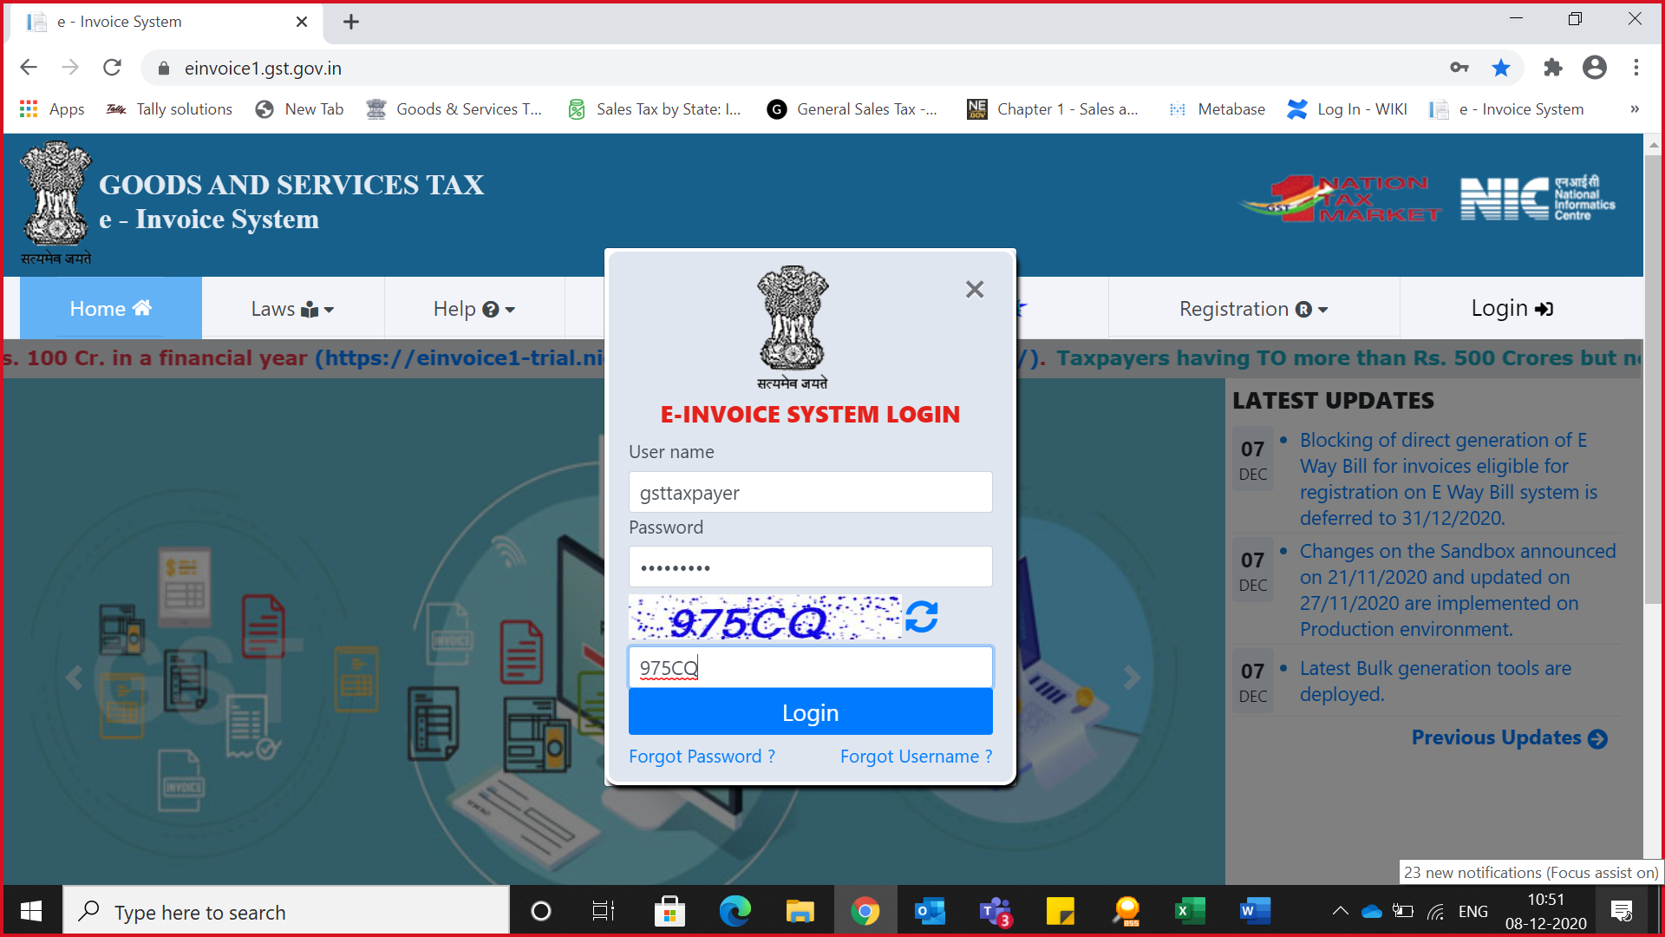
Registering Tally as GSP for e-Invoicing...

Slide 19
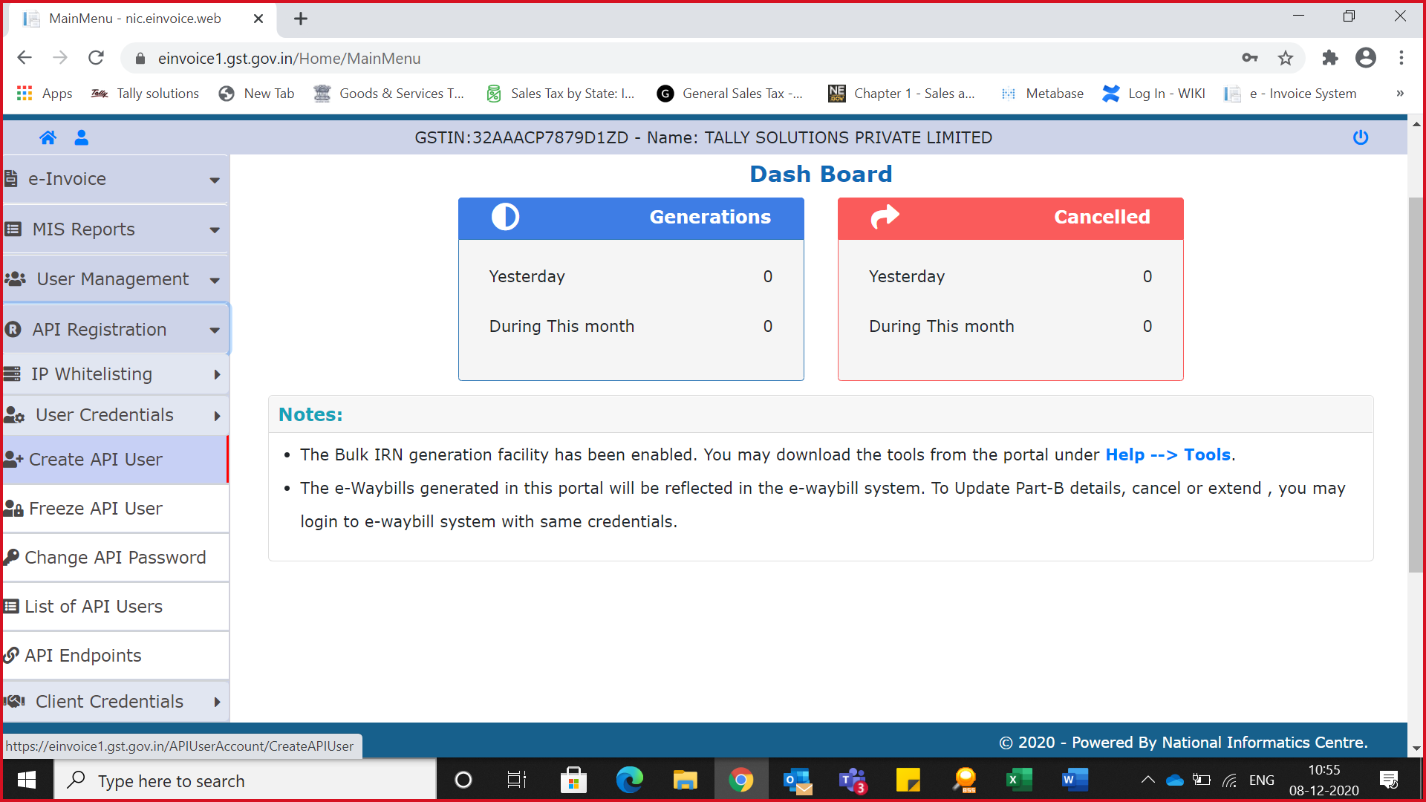
Registering Tally as GSP for e-Invoicing...

Slide 20
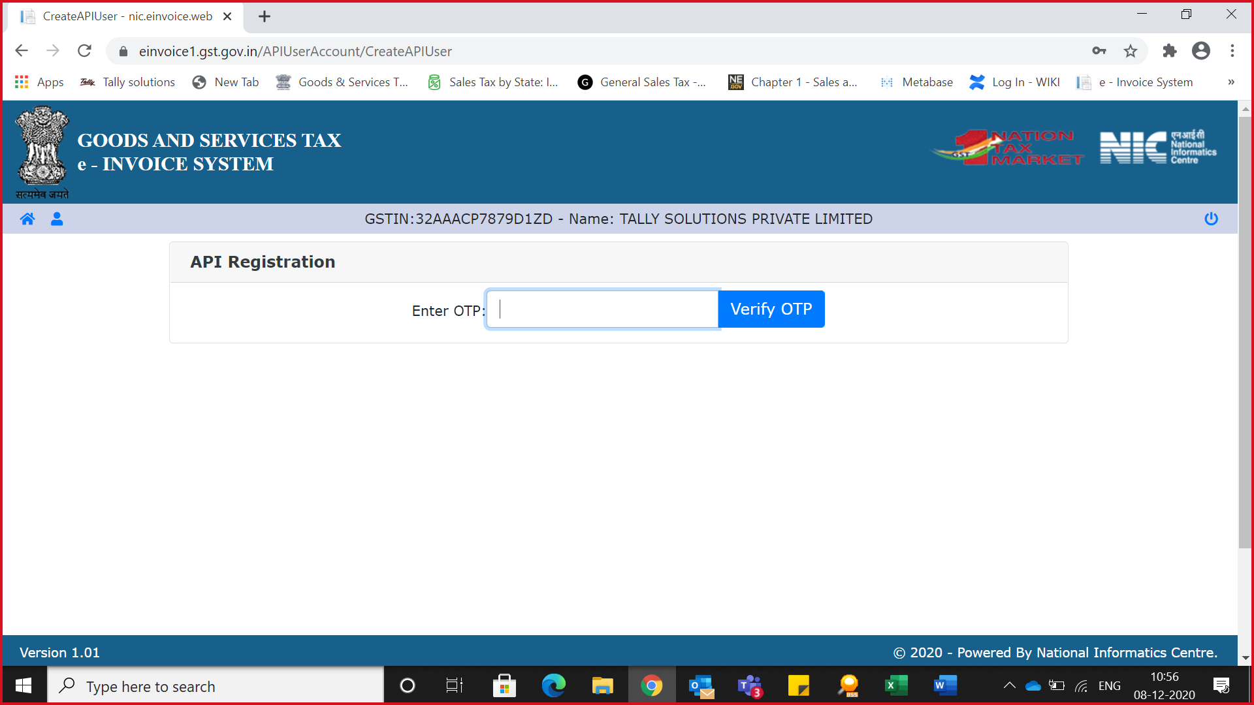
Registering Tally as GSP for e-Invoicing...

Slide 21
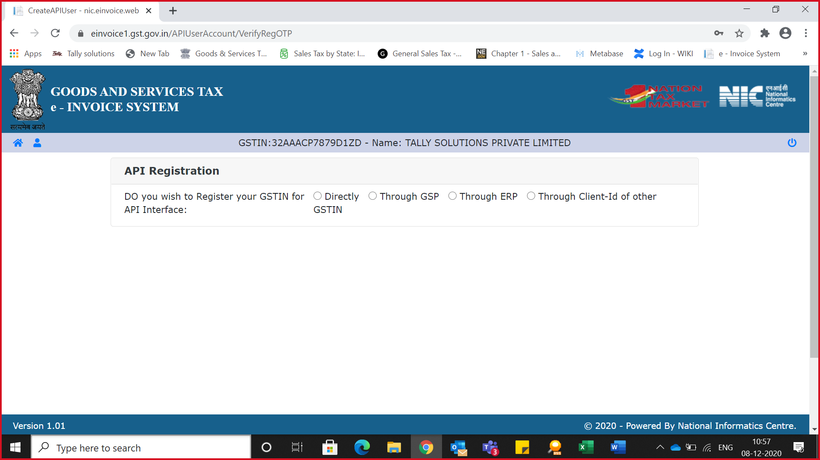
Registering Tally as GSP for e-Invoicing...

Slide 22
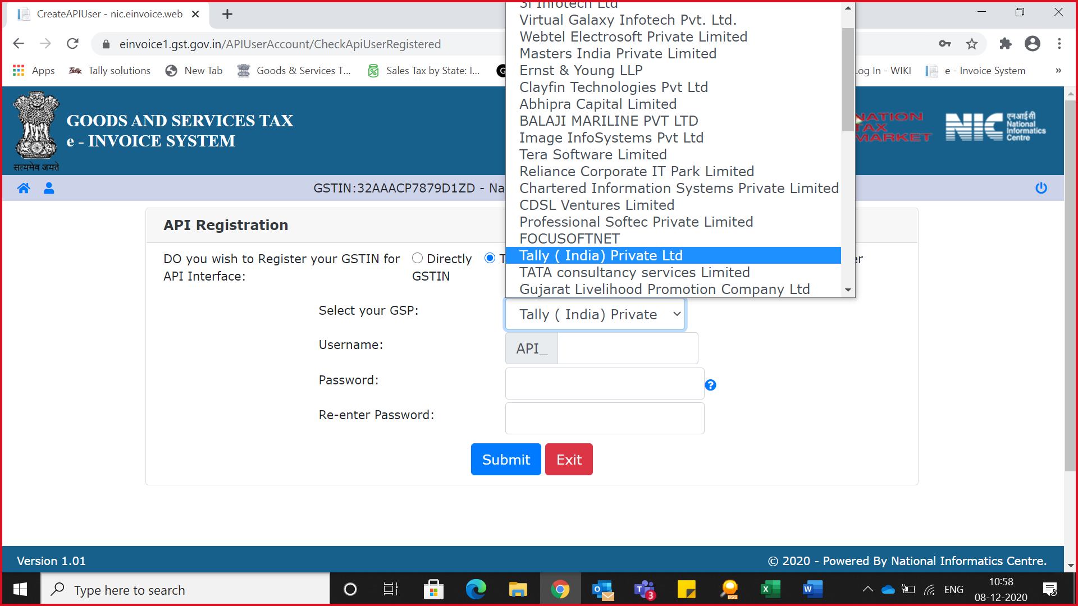
Registering Tally as GSP for e-Invoicing...

Slide 23
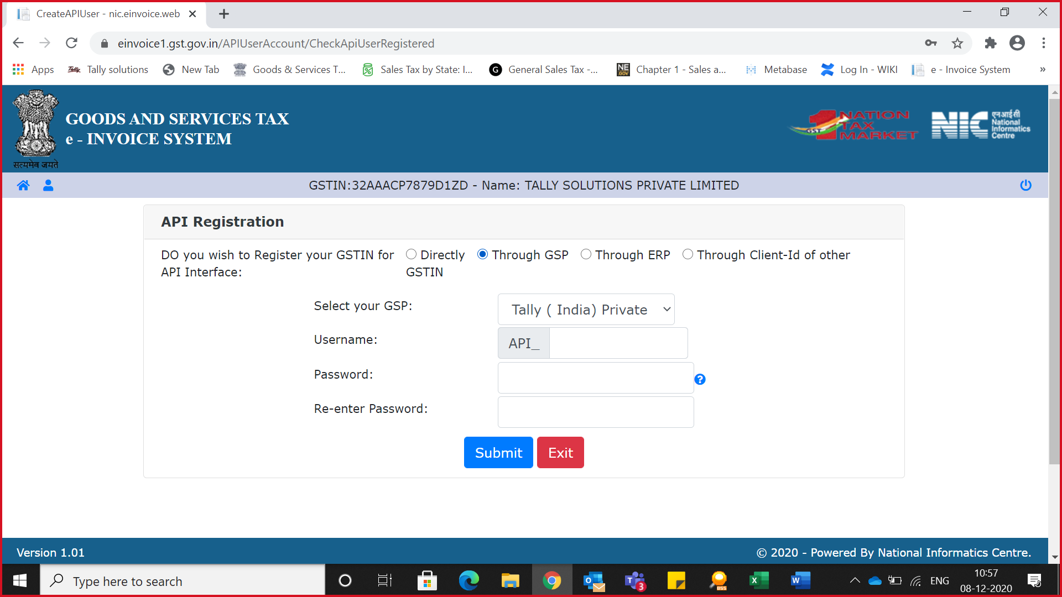
Registering Tally as GSP for e-Invoicing...

Slide 24
Product walkthrough…
Onetime Configuration for e-invoicing
e-Invoicing Setup in TallyPrime through F11
Update ISO Currency Code (For Exporters)
Single Invoice Upload for IRN Generation
Bulk Invoice upload for IRN Generation
Cancellation of e-invoice
Get IRN Info
e-Invoice through offline mode (JSON)
Prevention, Detection, and Correction - e-Invoice / IRN Register
Q&A

Slide 25
Single Invoice Upload for IRN Generation
Single Invoice Upload for IRN Generation
e-Invoice with Goods for a single party
e-Invoice with Service for a single party
e-Invoice with separate buyer & consignee
e-Invoice with different despatch details (for company)
e-Invoice for RCM Goods / Service as a Service Provider
e-Invoice for Export Goods / Service who resides outside India
e-Invoice for service to a foreign party & and billing to local or interstate party
e-Invoice for Transportation Services (HSN: 9965 & 9968) by Mail/Courier Inside India

Slide 26
Bulk Invoice Upload for IRN Generation
Through this facility, users can upload multiple invoices and generate multiple IRNs at one go. This facility can be used by taxpayers, who can prepare bulk requests for IRN through TallyPrime or through JSON files to upload it on the e-invoice system and generate IRN in one go. This avoids duplicate data entry into the e-invoice system and avoids data entry mistakes.
01
02
03
04
Select the required transactions or Ctrl+Spacebar to select all Transactions
Press S (Send) to send the details
Record e-Invoice Transactions then Press Alt+Z (Exchange) > Send for e-Invoicing
Enter e-Invoice Credentials for bulk generation
Process for Bulk IRN Generation

Slide 27
Cancellation of e-invoice - Online
The IRN, once generated cannot be modified or deleted. However, if IRN is generated with the wrong information, it can be cancelled. The cancellation is required to be done within 24 hours from the time of generation, else need to issue Credit Note and issue fresh Invoice. Once cancelled, the same document can’t be reported again for the generation of the IRN
01
03
05
Process to Cancel
02
04
Goto > IRN generated from e-Invoice system
Cancel/ Mark transaction as optional to avoid effects on Final Reports
Goto > IRN Cancellation section
Alt+Z (Exchange) > Send for e-Invoicing.
F10 (Cancel IRN)
Reason for cancellation and enter the Remarks
Enter e-Invoice Credentials for Single/Bulk Cancellation
Ctrl+F10 (Mark as Cancelled) can be used to update the status in TallyPrime if cancellation is done directly on the portal. Transactions will be listed as “Marked IRN as cancelled” under IRN Cancellation & and Step 5 will hold good for Marked as Cancel too.

Slide 28
Cancellation of e-Invoice - Offline
Ctrl+F10 (Mark as Cancelled) can be used to update the status in TallyPrime if cancellation is done directly on the portal. Transactions will be listed as “Marked IRN as cancelled” under IRN Cancellation
Goto > IRN generated from e-Invoice system
Ctrl+F10 (Marked as Cancelled)
Go to IRN Cancelled > Marked as IRN Cancelled
Cancel/ Mark transaction as optional to avoid effects on Final Reports
The Undo Cancellation can be done only for the e-invoices cancelled in TallyPrime, and it does not undo the cancellation updated in the e-Invoice portal.
If a voucher is not canceled on the e-Invoice portal, then it should not be marked as canceled in TallyPrime
Undo can be performed for transactions listed under Pending for IRN Cancellation, Exported for IRN Cancellation, or Marked as IRN Cancelled.
Alt+F10 (Undo IRN Cancellation)
Process for offline cancellation
Undo Cancellation

Slide 29

e-Invoice through offline mode (JSON)
TSS is not valid or elapsed?
Do not have continuous access to the Internet?
You don’t want to send your invoice details directly to the portal?
Alt+Z (Exchange) > Send for e-Invoicing.
TallyPrime allows you to export the details of your e-invoice to a JSON file and then upload it on IRP at your convenience.
What's Next
Select the required transactions or Ctrl+Spacebar to select all transactions and press X (Export)
Export from Tally
Open the IRP home page Log in with username and password
e-Invoice > Bulk Upload
Browse the JSON file and click Upload to generate IRN
To update IRN / QR Code
Goto e-Invoice report, > For IRN generation section> Exported
Alt+S (Manually Update IRN Info) – Only IRN will get updated
To get QR Code with IRN press Alt+L (Get IRN Info – TSS Required)
Select the format as JSON in Export menu
Upload them on IRP and generate IRN information
Note: If the data size is more than 2 MB, then the information will be split into multiple files, each of which will be less than 2 MB.

Slide 30
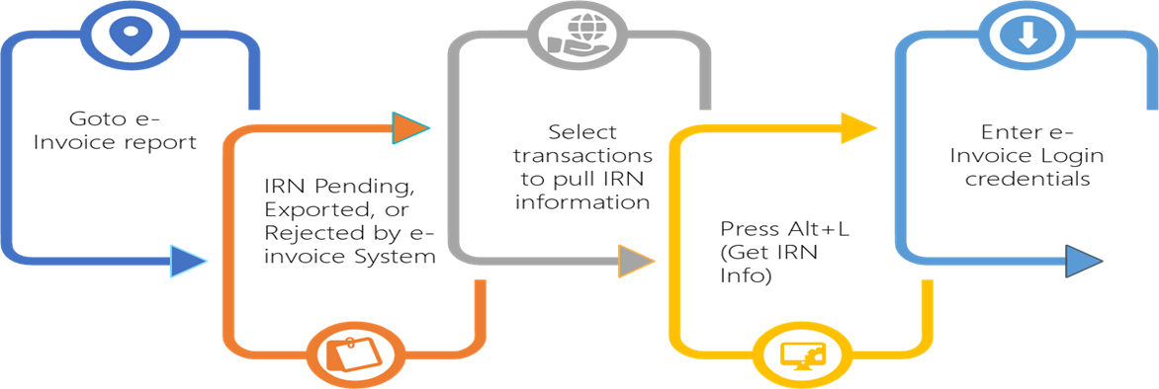
Get IRN
Using other software (or directly on IRP)
Note: Get IRN information can be used only within 72 hours of e-invoice generation, post that IRP portal will push/auto-populate those entries to GSTR-1.
Generated or cancelled the IRN in offline mode
GET IRN allows you to pull IRN from IRN system for transactions listed in Pending for IRN Generation, Exported, or Rejected by e-Invoice System

Slide 31
Prevention, Detection, and Correction
e-Invoice report allows user to view the e-invoice status of your transactions and take the next steps accordingly.
Uncertain Transactions (Corrections needed)
Missing/Invalid Information
Rejected by e-Invoice System
Pending for Exchange with e-Invoice System
A) Information required for e-Invoice not provided
B) Mismatch in e-Invoice Details
Exported
Alt+R (Mark as Resolved) post correction
Voucher Information Mismatch with QR Code
IRN Generated
IRN Cancelled
User-Excluded Transactions
Offline Method Transactions
Highlights the changes in Red for user corrections?
a) IRN cancelled on IRP system b) Marked as Cancel (Status Updating manual)

Slide 32
Important Updates to know

Slide 33
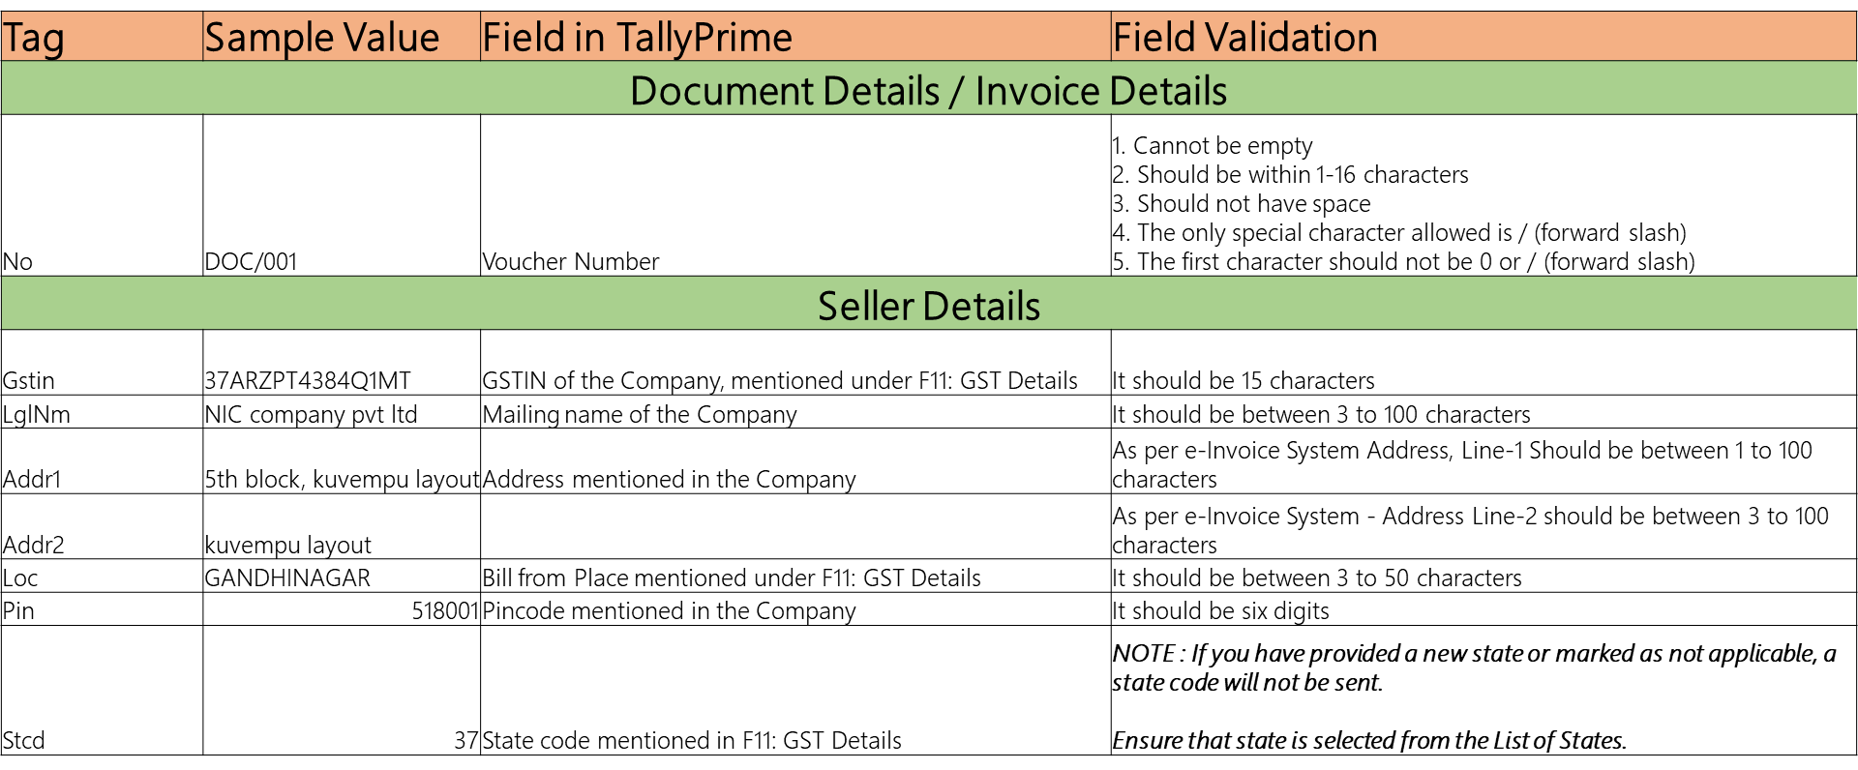
Mandatory details for smooth e-Invoicing

Slide 34
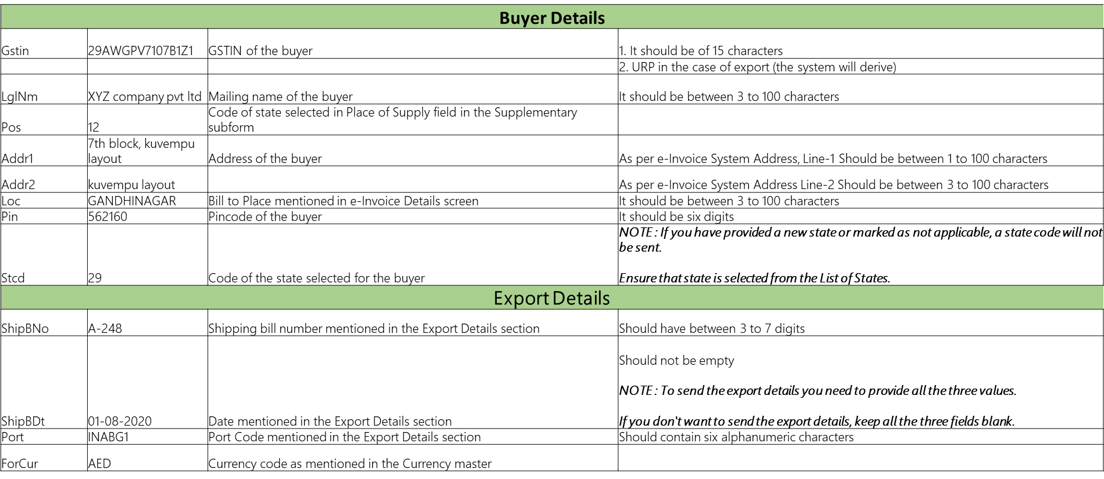
Mandatory details for smooth e-Invoicing

Slide 35
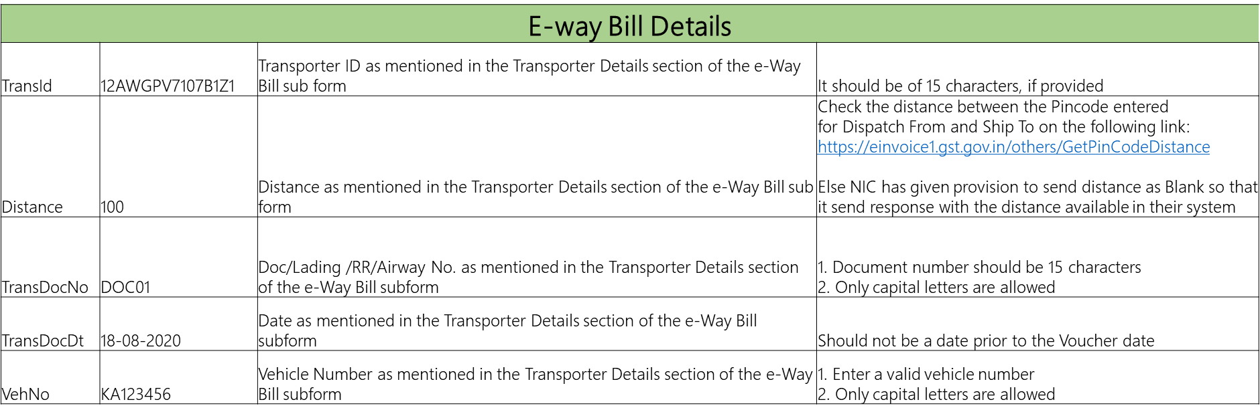
Mandatory details for smooth e-way Bill

Slide 36
Readiness on Queries & Response

Slide 37
Questions & Response – Rule / Process related
Nature of Query | Response / Resolution
I have already registered in EWB portal, Whether I need to register again on e-Invoice portal. | No, Users who are already registered on the e-way bill portal need not to again register on the e-invoice system. User can use EWB login credentials to login at e-invoice system.
Where can I get the master code information for e-invoice validation for Country, UQC, Currency, State, HSN | The master codes are available under Search -> Master Codes. https://einvoice1.gst.gov.in/Others/MasterCodes
Do we need to generate e-Invoice on RCM services or goods as a service provider? | Yes, if you are eligible for e-Invoicing, all the invoices including RCM invoices issued by the Supplier must be registered.
Whether shipping bill number and date is mandatory to generate e-Invoice? | No, shipping bill number or date is not mandatory for preparing e-invoice.
I have crossed, the notified turnover during this year, do I need to upload e-Invoice for this year? | No, e-Invoice is applicable only if the notified turnover is crossed in the previous years.
Is e-Invoice applicable if my customers are of SEZ type? | Yes, its applicable. If the customer is of type SEZ, then e-Invoice may be generated using transaction type as SEZWP / SEZWOP by the Supplier.
Is there any time limit to raise credit note against e-Invoice? | No, there is no time limit to prepare the credit notes or debit notes against the e-Invoice.
Client ID is not mapped | Client ID which is required during e-Invoice Sandbox registration to experience instead of going live. Please use AACCT29GSPB5H8G. How to Use the e-Invoice Sandbox Feature in TallyPrime | TallyHelp (tallysolutions.com) In case of connecting live data to IRP server, please use GSP option to register and generate user credentials

Slide 38
Questions & Response
Nature of Query | Response / Resolution
What are the type of Invoices for which e-Invoice can be generated? | Regular sales invoices for B2B, and TallyPrime supports e-invoicing for POS, debit notes, credit notes, receipts and journal vouchers are supported for e-invoicing when they are used for sales.
Cancel E-invoicing | 4 simple steps to cancel a) F10:Cancel e-Invoice b) Provide Remarks c) Send for exchange d) Cancel voucher to avoid final report impacts or need to retain the details, then we can mark the same as Optional.
Is it possible to change the place of QR code and IRN printed in Invoice? | By default, we cannot change the location of e-Invoice details and QR Codes, however, it is possible through customization..
E-Invoice generation for Debit Note / Credit Note / Purchases | As per the e-invoicing rules it is required only for taxable supplies because corresponding buyer should be able to take ITC in authenticated way. In this case as already the seller has generated e-invoice for said transactions, it is not required to generated as a buyer. E-invoice is needed for Taxable sales / services rendered for B2B customers. However, in case of sales price / amount is de-escalated a debit note has been raised, then through E-invoice report, we can raise E-invoice.
Time limit for Cancel E-invoice | As cancellation is allowed for 24hrs of E-invoice, user can send request for cancellation else raise credit note. For example, when there is a change in the rate of an item, or if the party has cancelled the order. In such cases, you may want to cancel the invoice. As per department regulations, invoice cancellation must be done within 24 hours of IRN generation.
Can I generate an e-Invoice for URD / B2C? | As per the e-invoicing rules, it is required only for taxable supplies because the corresponding buyer should be able to take ITC in an authenticated way. Since for URD / B2C customers, there is no ITC credit, it is not required to generate an e-invoice for them.
E-invoice for Nil Rated / Exempted | As per the e-invoicing rules it is required only for taxable supplies because corresponding buyer should be able to take ITC in authenticated way. Since Nil/Exempt supplies have no ITC impact, it is not required to generate e-invoice for Nil rated or wholly exempted transactions. As, the portal is currently allowing this as they have not built the validation, our team is in touch with NIC for necessary changes from their end. In case if your business needs E-invoice for NIL Rated / Exempted Goods or there is business practice (some CAs also suggesting/ NIC portal also permits) and you wish to generate e-Invoice for B2B supplies irrespective of taxable/Nil/Exempt, then we recommend you raise it from portal for such Invoices manually.

Slide 39
Questions & Response
Nature of Query | Response / Resolution
Not getting e-Invoice option while saving the voucher | If the invoice is done other than B2B The goods/service recorded in the invoice might be other than Taxable Goods Invoice is out of the applicability date
Application error while generating e-Invoice from Tally? | Possible use case; An-Invoice system does not allow transactions with negative values in quantity, rate, taxable value, tax, or invoice total. In the case of sales return, you need to use Credit Notes for generating e-Invoice, and not sales with negative quantity and value. Server might be anticipating a higher load, hence recommend to mark as resolved and resend. If the same error, please try after some time
Voucher information mismatch with QR code (Release 2.1) In Release 3.0 – it shows the mismatch in Red Color for easy identification and correction | Post generation of E-invoice, the invoice goes to Voucher information mismatch with QR code due to some information modification. Some of the patterns identified are; 1. Voucher / Document Number changed due to voucher insertion or voucher deletion or special character – Recommend auto manual numbering, avoid deletion or avoid special character except – or /. 2. Voucher modified with any fields like HSN Code, Quantity, Rate, Amount, adding or removing ledger including changes in GST amount 4. Invoicing rounding difference 5. Invoice has done with alternative unit conversion, but it considering the Main unit in e-invoice portal 6. Invoice generated in invoice mode and later changed to voucher mode, is also shown under mismatch
Why Excel template is not provided for generating e-Invoice | Department has provided 4 Excel formats (A/B/C and D) based on different requirements (multiple items/ multiple invoices etc.). It is cumbersome for an end user to choose appropriate Excel templates based on invoices and choose different Excel templates based on purpose (Generation/Cancellation). Also, after exporting to Excel again additional steps of validation, and generation of JSON is required. Also, these templates get updated periodically and you may face version and compatibility issues based on operating system and office suites used in your organization.

Slide 40
Questions & Response
Nature of Query | Response / Resolution
Duplicate IRN | Attempting for same voucher number, check for Voucher Number already exists in Daybook or shown under unused Numbers (in Release 3.0) Check in IRP portal said number is already registered, record using unused number and use GET IRN (within 3 days), greater then 3 days record sales > record credit note & re-issue fresh invoice
My supplier says they have generated IRN for the invoice. But, in GSTR-2A, details of IRN are not appearing against those invoices, why? | It may be possible in a situation where the details auto-populated into GSTR-1 from e-invoices from actual documents issued, might have changed in any respect and the same are edited/deleted/re-uploaded by the supplier while filing GSTR-1. In such cases (i.e. where the details are modified by the supplier), the re-uploaded/modified details will be visible. However, the ‘Source’, ‘IRN’, and ‘IRN date’ will be reset to blank in respective tables of GSTR-1 and the said details won’t get reflected in GSTR-2A/2B/4A/6A. So, non-appearance of IRN details in GSTR-1/2A alone shouldn’t be assumed to mean that such invoices were not reported to IRP.
Some of the e-invoices reported and issued have not been auto-populated in GSTR1. What to do? | There seems to be an issue from GST portal, in such instances of discrepancy or related feedback can be shared via the GST Self Service Portal - https://selfservice.gstsystem.in/
Tables in my GSTR-1 got auto-populated with data from e-invoices. However, I want to delete all that and upload data afresh on my own. How can I do this? | On Portal Online: You can use the ‘RESET’ button available at the bottom of the GSTR-1 dashboard. Click this to delete complete details from GSTR-1 tables (including the records auto-populated from e-invoice). To delete select records, go inside the relevant table of GSTR-1, select record/s, and click ‘Delete’ in the action column (in the ‘Processed Invoices/Documents’ table). Using Offline Utility: You can delete the records by following the below steps: For the relevant tax period, download the GSTR-1 JSON > Open JSON in GSTR-1 offline tool > Select the respective table from the ‘Select Section’ drop-down > Click the button ‘Delete Section Data’ and press ‘Yes’ > Alternatively, you can check to select records or tick the Select All check box and hit the DELETE button (available below the table) > You will get confirmation that records in the selected section/table are marked for deletion > On click of delete, the record shall be marked for delete > View Summary and Generate JSON File Upload the generated JSON on GST portal > After processing of uploaded JSON, all/selected records will get deleted in the respective tables

Slide 41
e-Invoicing terminology vs Tally Terminology
e-Invoice terminology | Tally Terminology | Length
Field Location | Bill from place (Rel 2.1) & Invoice bill from place (Rel 3.0) – F11:Company Feature | 3 to 50 (Alpha)
Field document number | Invoice Number / Voucher Number | 16 (Alpha-Numeric) with / or -
State field is required | For all Invoices – its company State field (F11 > Enable Goods and Services Tax (GST) > Check State in Bill from place) For specific Invoice – its Party (Party Details / Consignee Details using Ctrl+I (More Details or Dispatch From Details section under e-Invoice Details using Ctrl+I (More Details)
Field Address 1 Field Address 2 | For All invoices – its company addresses For specific Invoices – Its Party master – Check ledger master or party details for buyer and consignee – 1st Line / 2 refers to 2nd line | Address 1 – 1 to 100 (Alpha Numeric) Address 2 – 3 to 100 (Alpha Numeric)
Field Legal Name | For all transactions – its company: Mailing Name For specific Invoice – Its Party: Mailing Name | 3 to 100 (Alpha Numeric)
Field Product Description | Stock Item name | 3 to 100 (Alpha Numeric)
Field POS | Place of Supply – Its Party Details check Place of Supply
Recipient pin code | Buyer PIN code – Check party master or party details screens with PIN code | 6 digits
Recipient should be SEZ | Buyer details – Registration type should be SEZ
State code does not match | For All Transactions – State name is not selected in the list in F11 For specific Invoices – State name is not selected properly in Party details / Place of supply
GSTIN is inactive or cancelled | Verify GSTIN status / If cancelled or inactive Registration type should be Unregister & e-Invoice Not required

Slide 42
Tallyhelp & Video links for e-Invoicing
Title | Tallyhelp Article link | Video Link
e-Invoicing in TallyPrime | https://help.tallysolutions.com/tally-prime/gst-regular-sales/e-invoicing-in-tallyprime/ | https://www.youtube.com/watch?v=9QcLx5OfG_Q
Rgister for e-invoice and choose your GSP. | https://help.tallysolutions.com/tally-prime/gst-regular-sales/e-invoicing-in-tallyprime/ | https://www.youtube.com/watch?v=6rKYheqN0LI
Generate e-Invoice online using TallyPrime. | https://help.tallysolutions.com/tally-prime/gst-regular-sales/e-invoicing-in-tallyprime/ | https://www.youtube.com/watch?v=wXHCtP1xo3Q
Generate e-invoice offline using TallyPrime | https://help.tallysolutions.com/tally-prime/gst-regular-sales/e-invoicing-in-tallyprime/ | https://www.youtube.com/watch?v=6vhURCnsnek
Bulk upload of e-invoices generated using TallyPrime. | https://help.tallysolutions.com/tally-prime/gst-regular-sales/e-invoicing-in-tallyprime/ | https://www.youtube.com/watch?v=fZ_SY7ci_OQ
Cancel a generated IRN using TallyPrime. | https://help.tallysolutions.com/tally-prime/gst-regular-sales/e-invoicing-in-tallyprime/ | https://www.youtube.com/watch?v=09xwqG6p1Ww
e-Invoice reports in TallyPrime. | https://help.tallysolutions.com/tally-prime/gst-regular-sales/e-invoicing-in-tallyprime/ | https://www.youtube.com/watch?v=7UE1urxw8K0
Get the latest IRN info for transactions eligible for e-Invoicing in TallyPrime. | https://help.tallysolutions.com/tally-prime/gst-regular-sales/e-invoicing-in-tallyprime/ | https://www.youtube.com/watch?v=lGonUlHq70U
Undo the cancellation of e-Invoices in TallyPrime to update the e-Invoice report. | https://help.tallysolutions.com/tally-prime/gst-regular-sales/e-invoicing-in-tallyprime/ | https://www.youtube.com/watch?v=LrVXmBtKKwg
e-Invoice Sandbox feature in TallyPrime. | https://help.tallysolutions.com/tally-prime/gst-regular-sales/e-invoice-sandbox/ | https://www.youtube.com/watch?v=QtjX-RHAcEQ
e-Invoice Rejections & Resolutions | https://help.tallysolutions.com/tally-prime/gst-regular-sales/reasons-for-rejection-of-e-invoice-and-resolutions/ | https://www.youtube.com/watch?v=6dDTT5h9wwY
e-Invoice Sandbox FAQ's | https://help.tallysolutions.com/tally-prime/gst-regular-sales/e-invoice-sandbox-faqs/
Generate e-Invoice for Export Sales | https://help.tallysolutions.com/tally-prime/e-invoice-tallyprime/e-invoicing-in-tallyprime/#e-invoice-foreign-party | https://www.youtube.com/watch?v=KDbBI0fpPXY
Resolve e-Invoice Rejections when UQC is not Selected in Stock Item in TallyPrime 3.0 |  | https://youtu.be/YDCrxYKImVU

