Slide 1
License Management in TallyPrime

Slide 2
Agenda
01
Intro to Tally licensing
05
Educational scenarios
02
06
License management on customer portal
Licensing operations
03
TSS
07
FAQs
04
08
Troubleshooting Top errors
Tally virtual user

Slide 3


Intro to Tally licensing – License Editions & Options
Editions to buy
Regular
Silver/Single User
TallyPrime
Rental
Usage options
Gold/ Multi-User
Educational

Slide 4
Licensing operations – Activation
Activation
Single-site activation
1
Used to create individual accounts for each license owned
Gateway service is installed & activated
For 1st time access to software
Multi-site activation
2
Used to create one account for multiple licenses owned
Product walkthrough

Slide 5
Licensing operations – Use license from network
1
Mainly used by Gold users
2
Used to connect LAN client.node system with Server to access the license
3
Client & Server should be in same LAN & IP range
4
Configure license manually or connect to active license
Product walkthrough

Slide 6


License operation - Surrender
To shift the license server to different system, folder or drive
To upgrade Operating system/windows
To stop using the license temporarily
Surrender
Reasons
To carry out any maintenance activity in the server
Release upgrade in different folder
Product walkthrough

Slide 7
License operation - Reactivation
Shifting license server
Reactivation
For subsequent activation post Surrender
Tally reinstalled due to system format or crash
Reasons
Operating system is updated. Eg: Windows 8 to windows 11
Product walkthrough

Slide 8
License operation - Updation
License is inactive
Rental validity is extended
Update
To bring in latest license changes made by user in application
TDL updation
Updation of TVU licenses
When to update the license
Add-on updation
License details like change of E-mail id or account id
TSS is renewed
License edition upgraded

Slide 9

Tally Software Subscription (TSS)
0 1
Release upgrades
What is TSS
TSS is a subscription for a collected services to add value to the business with latest technology & abiding to statutory laws
0 2
E-invoicing & E-way bill
0 3
TSS Validity
TRiB
Remote access
Data sync
Banking & E-payments
12 months from the date of subscription
0 4
TVU

Slide 10
Tally Software Subscription (TSS) – Renewal charges
India
Silver - INR 4,500 +18% GST (INR 810)
Gold - INR 13,500 +18% GST (INR 2,430)
Auditor - INR 6,750 +18% GST (INR 1,215)
MENA (Middle east)
Silver - AED 468
Bangladesh
Silver - USD 81
Gold - KSH 34,560 +16% VAT (KSH 5,529)
Gold - AED 1,404
Gold - USD 243
Africa
Silver - KSH 11,520 +16% VAT (KSH 1,843)
Indonesia
Silver - Rp 1.890.000
Gold - Rp 5.670.000
Other International
Silver - USD 126
Gold - USD 378

Slide 11
Tally Software Subscription (TSS) – Renewal methods
India & International Customers
Online from Tally web
Reach TallyCare
Via Partner

Slide 12



Tally Virtual User (TVU)
WHAT IS TVU?
USAGE
TVU transfer
It is a licensing policy allowing user to access & use Tally license anytime anywhere via RDP, Cloud & other virtual technologies
Silver – 1 TVU license
Gold – 10 free TVU license (additional license are payable)
TPS – 20 free TVU licenses
User can transfer TVU licenses from one license to another
Licenses must be merged into an account before transferring TVUs from one TP license to another

Slide 13
License turning educational – Server machine
Reasons
System format/hard disk changes
Windows updated
Rental license expired
Tally.LIC file not available/deleted
Ineligible release upgrade
TGS is inactive/offline
TGS is stopped/not working/intermittent stoppage
License is compromised

Slide 14
License Educational – Client/Nodes
TGS not configured
LAN issues\unable to reach server\Wi-fi connection
License compromised
LAN/IP range is different
Windows firewall restriction
Reasons

Slide 15
License turning educational - Reasons
Server Machine
Client/ Nodes
System format/hard disk changes
Windows updated
Rental license expired
Tally.LIC file not available/deleted
Ineligible release upgrade
TGS is inactive/offline
TGS is stopped/not working/intermittent stoppage
License is compromised
TGS not configured
LAN issues\unable to reach server\Wi-fi connection
License compromised
LAN/IP range is different
Windows firewall restriction

Slide 16
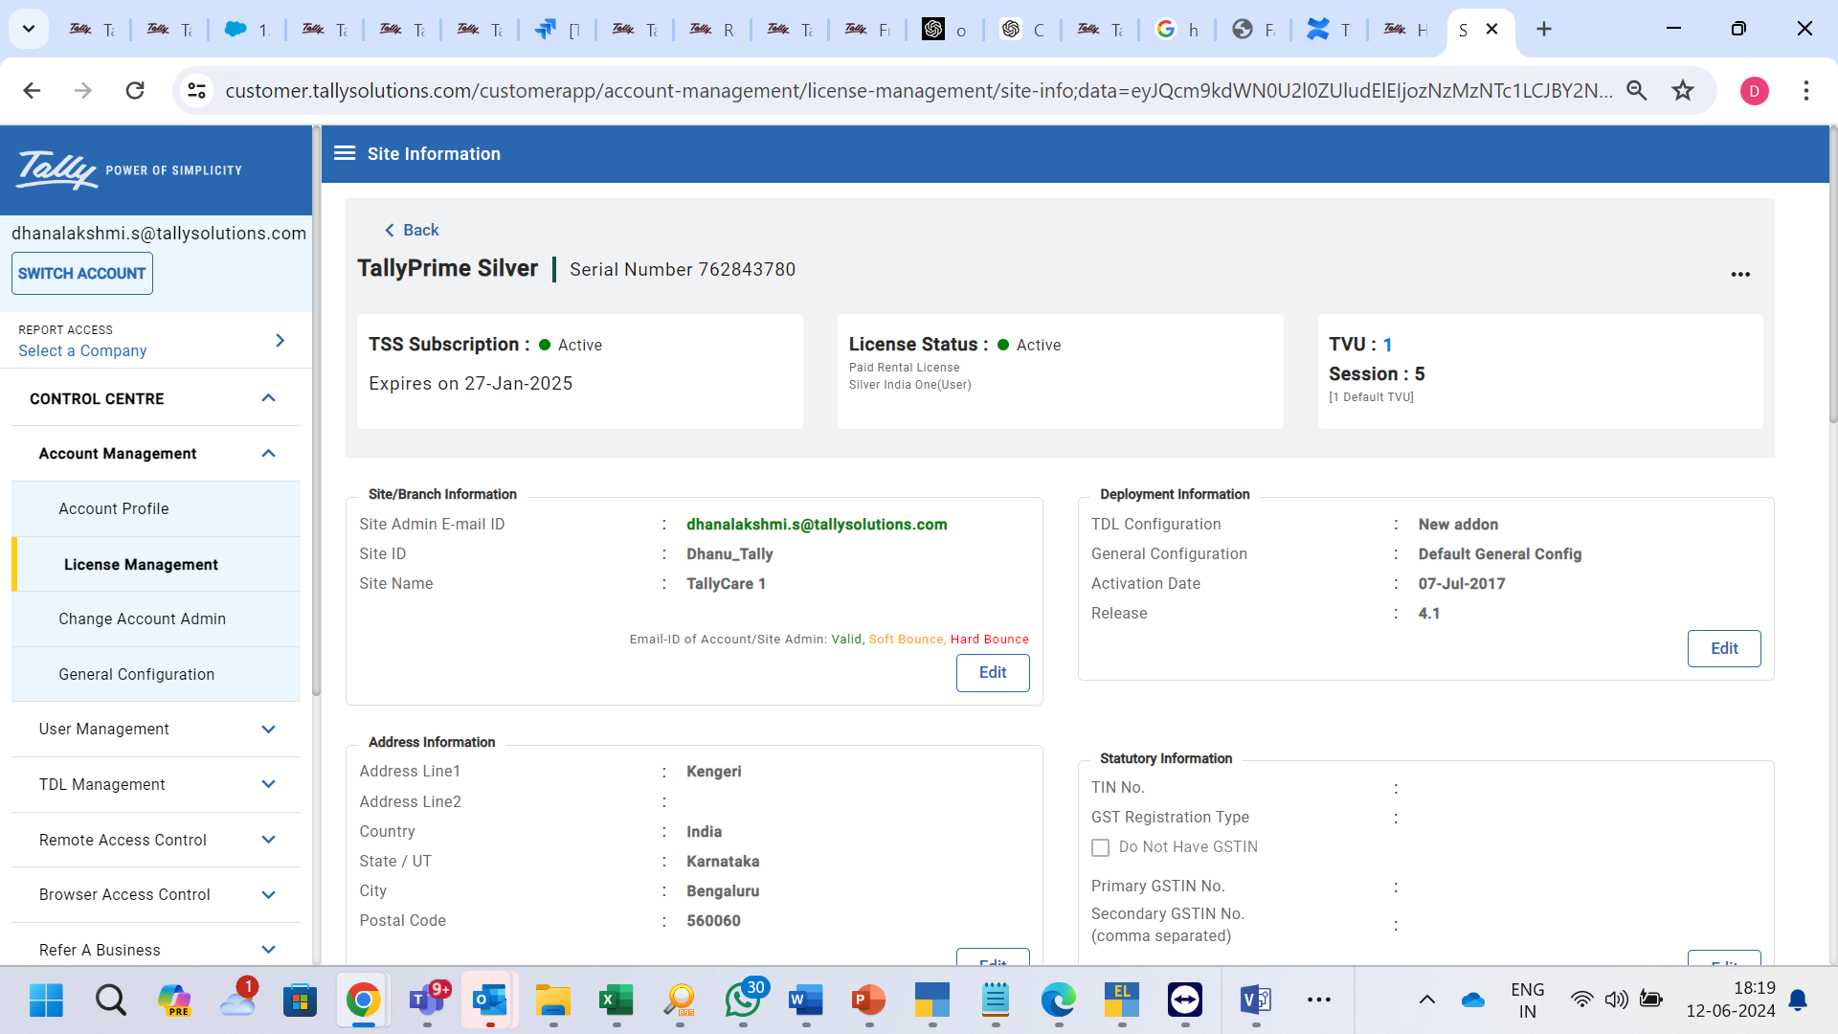
License management on Customer portal
Manage the account
Change the account details
Manage the license
Tally. Net users' management
TDL /Add-on management
Let’s look at License related options

Slide 17









License management on Customer portal
Check license status & confirm the site license
View license details
Edit Site license details like site admin mail id, site id & site name
TDL configurations to the license
Manage the TVU sessions

Slide 18
FAQs at TallyCare

Slide 19
FAQs
01.
I want to change the license server; I want to shift license from one pc to another.
Step 1: Take the data backup
Step 2: Surrender the license from existing server
Step 3: Reactivate the license
02.
My system was formatted/ hard disk was crashed; how do I use the license?
Step 1: Reactivate the license, auto surrender the license during reactivation

Slide 20
FAQs
03.
I want to surrender the license.
Step 1: Take the data backup
Step 2: Surrender the license from existing server by navigating to license info screen> press Ctrl+F7: Surrender
04.
Can I use TallyPrime license in Tally.ERP 9?
Step 1: Install Tally.ERP 9 release in another folder of server machine or the client system
Step 2: Open Tally.ERP 9 > Start up screen appears > Configure existing license> point to TallyPrime gateway service

Slide 21
FAQs
05.
I have 2 licenses with me, I want to activate on the same server system
Step 1: Install TallyPrime in 2 different folders or drives as per user choice.
Step 2: Activate the 1st license , license will be available in default port 9999.
Step 3: Install the gateway server in 10000 or different port
Step 4: Configure the license in second license to port 10000 and save
Step 5: Reactivate the 2nd license, it will be activated in 10000 port.
06.
Should I have valid TSS to run the application in licensed mode?
NO

Slide 22
FAQs
07.
My license is rejected either by admin or mistakenly. How can I use the license?
Step 1: Check the license status for the serial number in CRM
Step 2: If the site ID is rejected, activate the license mentioning new site ID
Step 3: Unlock the license
08.
Will the multi-license become unusable if the admin has not confirmed the license?
NO. However, Tally.net capabilities like Remote access, sync does not work.

Slide 23
FAQs
09.
My license is turning educational frequently, why?
Step 1: Check the license status & detailed license operations for the serial number in CRM
Step 2: If the license is getting reactivated on different systems, educate the customer on the license configuration and suggest to reactivate on license server & configure on rest PCs in case of Multi-user.

Slide 24
Top 5 Errors reaching TallyCare

Slide 25

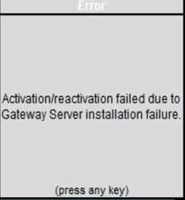

Top error codes during License operation
1
Error – Gateway server installation failure
Activation
Reactivation
Occurrence
Gateway server is restricted in firewall
Right permission for gateway serv
Reason
Windows firewall exception
Write permission for gatewayserver.exe
Deleting gateway server dump files from Tally folder
Changing the gateway port/delete the existing gateway services
Solution

Slide 26
Top error codes during License operation
2
Error code 6457 – TSS expired
Reactivation
Occurrence
License is not eligible for the upgrade due to TSS expiry date
Reason
Use the eligible release
Renew TSS & upgrade
Solution

Slide 27
Top error codes during License operation
3
Error code 13
Activation
Reactivation
Occurrence
Reason
Unable to write on licensing file
Remove read only from Lic file/login from admin level
Restart the system
Try changing the gateway port
Solution

Slide 28
Top error codes during License operation
4
Error code 01
Reactivation
Occurrence
Reason
Tally.lic file is available in C drive
Delete all the available Tally.LIC file
Reactivate
Solution

Slide 29
Top error codes during License operation
5
Connectivity errors – 802 to 809
Activation
Reactivation
Occurrence
Reason
Client network is unable to reach Tally server
Ping to check the communication in cmd(ping tallynet.tallyenterprise.com –t) & TRACERT commands
Add Tally.exe & Tally gatewayserver.exe & port in firewall exception list
Check if the proxy details configured are correct
Solution

