Slide 1
HTML Projects
HTML/CSS Calculator by Soumesh
HTML/CSS Portfolio Project by Soumesh
CSS Glass Animation by Soumesh
QBasic Programs
Write a program to get the multiplication of 2 numbers
Math Questions Game by Soumesh
Rock paper Scissor game by Soumesh
Calculator by Soumesh
Write a program to print name, roll no and class using input statement
Write a program to get the addition of 2 numbers
Gorillas game
Try your luck
I also made some games on scratch ☺

Slide 2
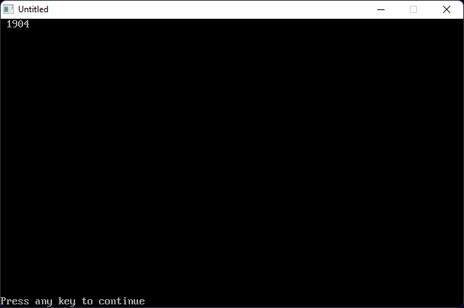
Write a program to get the multiplication of 2 numbers
Click here to see the code

Slide 3
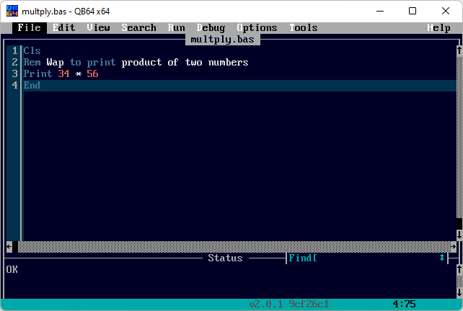
Cls
Rem Wap to print product of two numbers
Print 34 * 56
End
Click here to see output

Slide 4
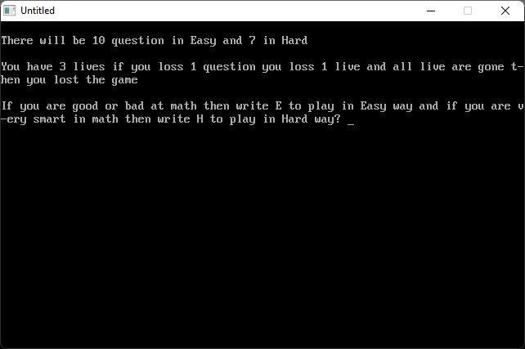

Math Questions game by Soumesh
You will get 10 questions in easy and 7 questions in hard.
You have to win the game and you can also find some Easter egg if you are lucky☺
Download
Click here to see the code

Slide 5
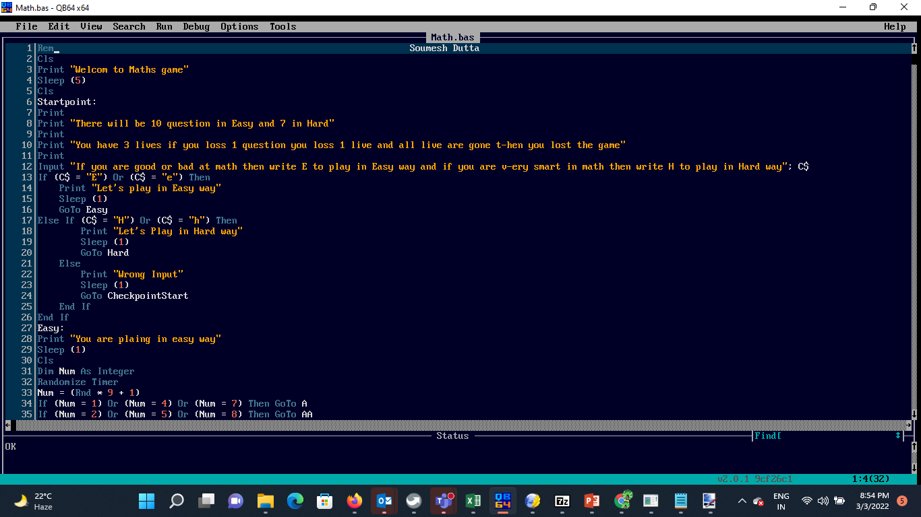
Rem Soumesh Dutta
Cls
Print "Welcom to Maths game"
Sleep (5)
Cls
Startpoint:
Print
Print "There will be 10 question in Easy and 7 in Hard"
Print
Print "You have 3 lives if you loss 1 question you loss 1 live and all live are gone t-hen you lost the game"
Print
Input "If you are good or bad at math then write E to play in Easy way and if you are v-ery smart in math then write H to play in Hard way"; C$
Click here to see output

Slide 6
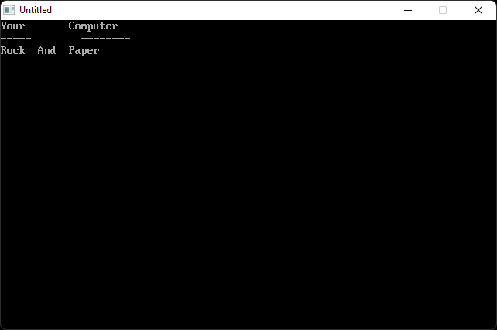
This is Rock,paper And Scissor.
You can play it if you want to it is fun play☺
Download
Click here to see the code

Slide 7
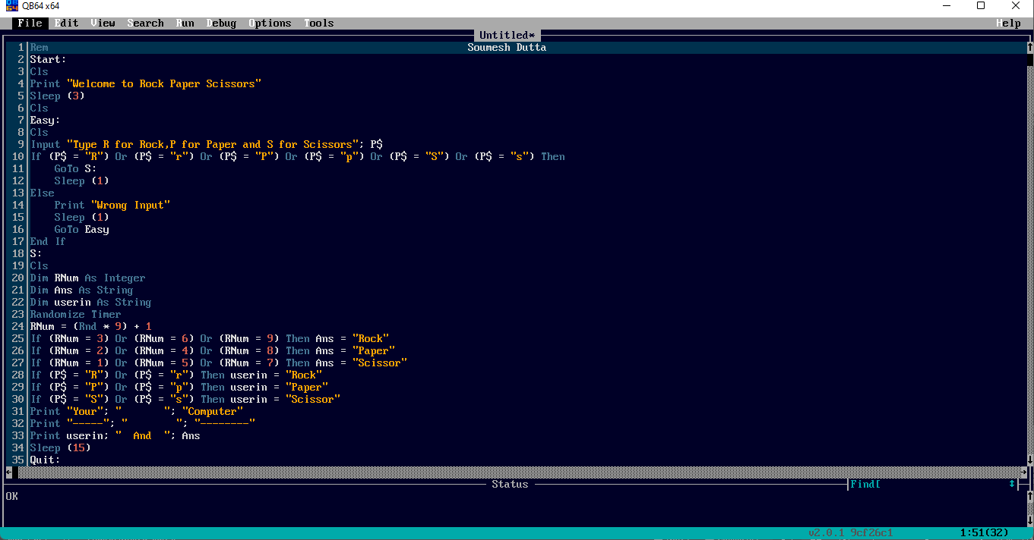
Rem Soumesh Dutta
Start:
Cls
Print "Welcome to Rock Paper Scissors"
Sleep (3)
Cls
Easy:
Cls
End If
Click here to see output

Slide 8
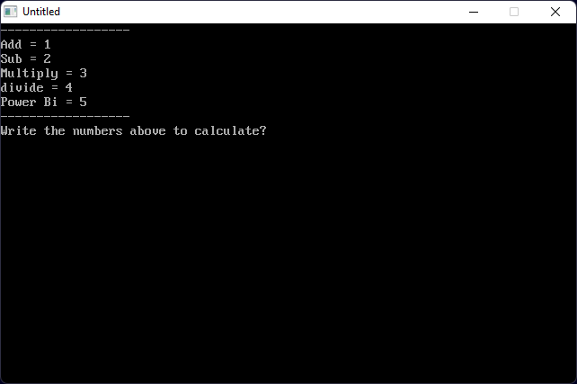
This calculator to circulate math problems ☺
Download
Click here to see the code

Slide 9
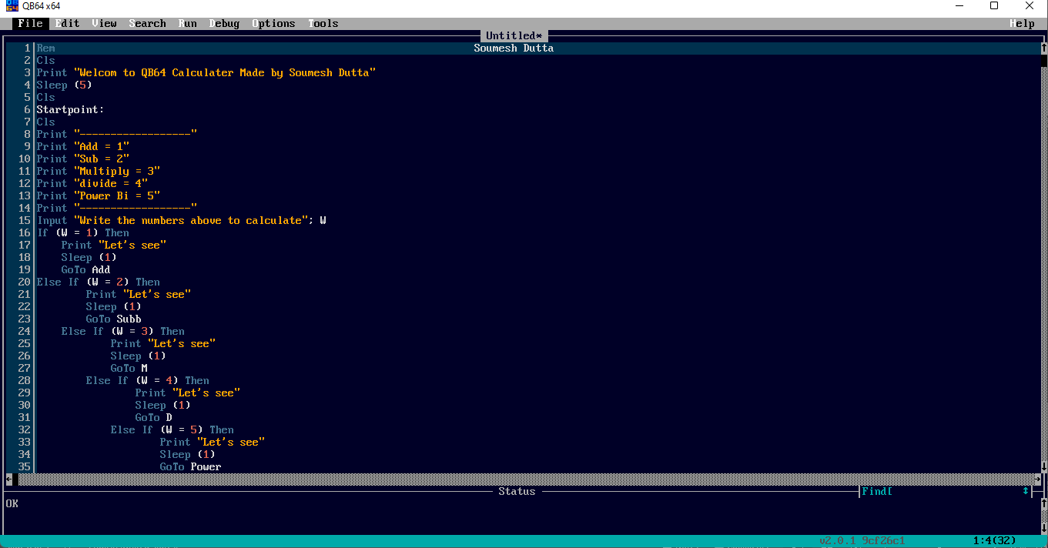
Rem Soumesh Dutta
Cls
Print "Welcom to QB64 Calculater Made by Soumesh Dutta"
Sleep (5)
Cls
Startpoint:
Cls
Click here to see output

Slide 10

Write a program to get the addition of 2 numbers
Click here to see the code

Slide 11
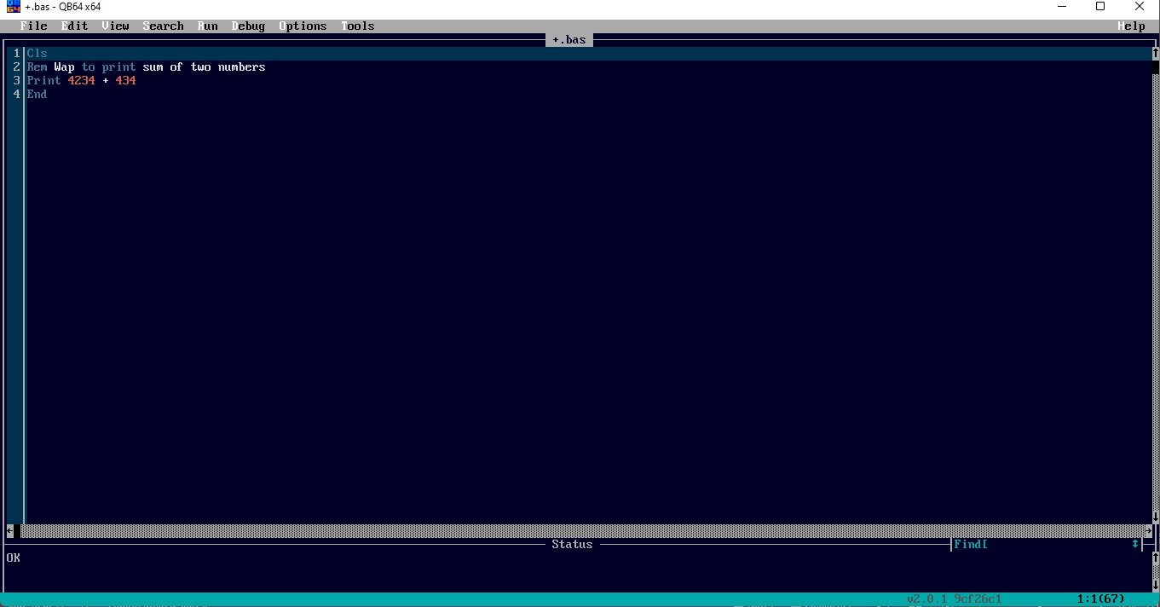
Cls
Rem Wap to print sum of two numbers
Print 4234 + 434
End
Click here to see output

Slide 12
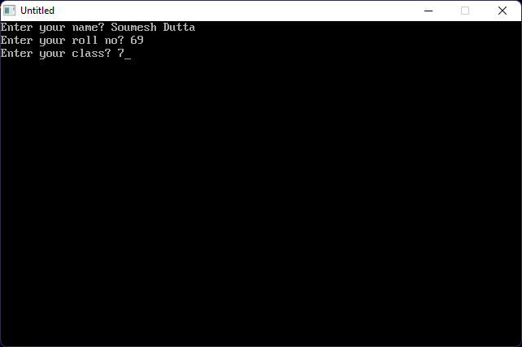
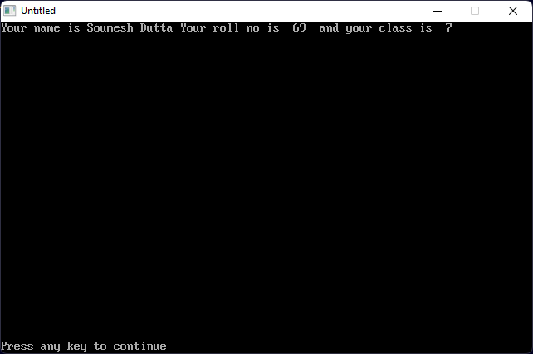
Write a program to print name,roll no and class using input statement
Click here to see the code

Slide 13
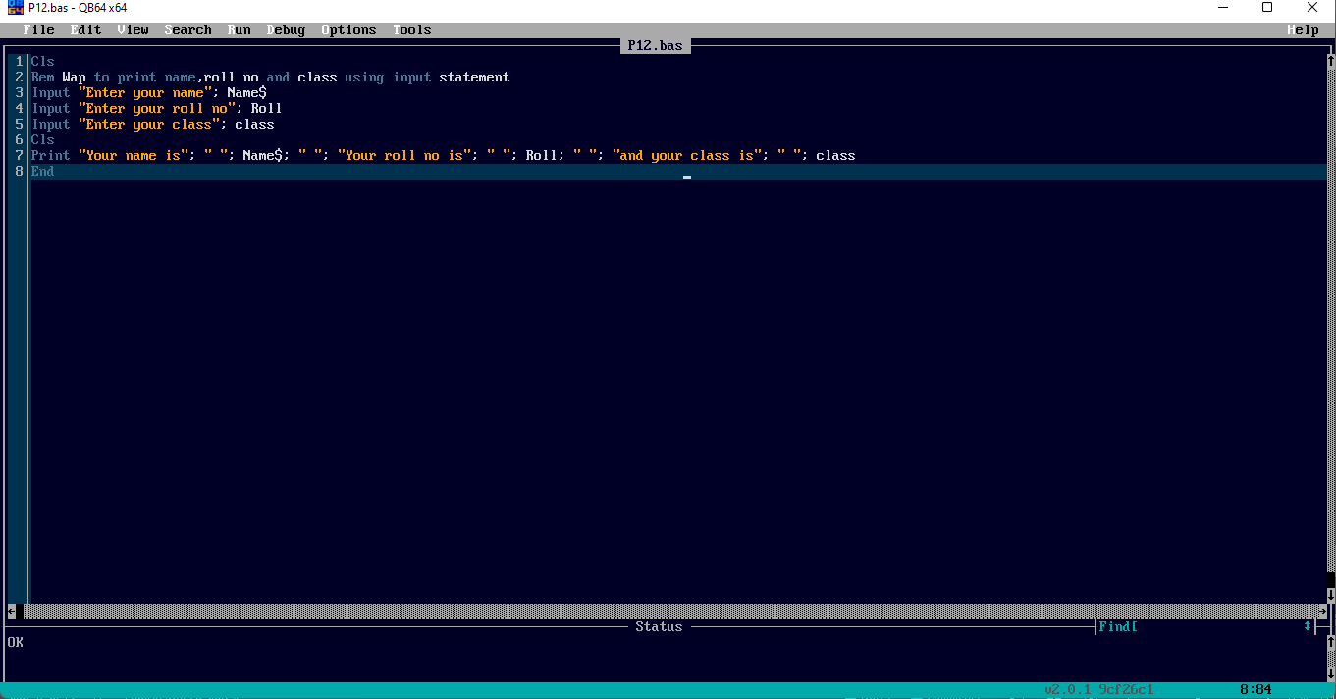
Cls
Rem Wap to print name,roll no and class using input statement
Input "Enter your name"; Name$
Input "Enter your roll no"; Roll
Input "Enter your class"; class
Cls
Print "Your name is"; " "; Name$; " "; "Your roll no is"; " "; Roll; " "; "and your class is"; " "; class
End
Click here to see output

Slide 14
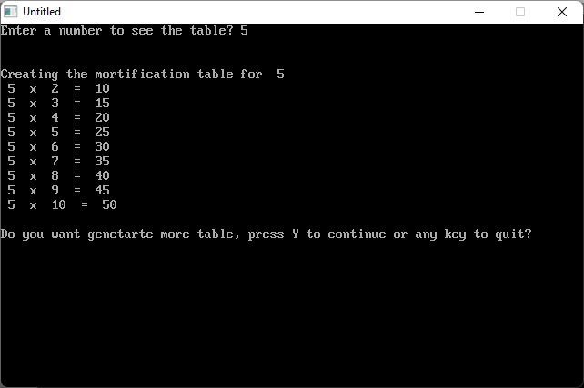
Write a program to print name,roll no and class using input statement
Download
Click here to see the code

Slide 15
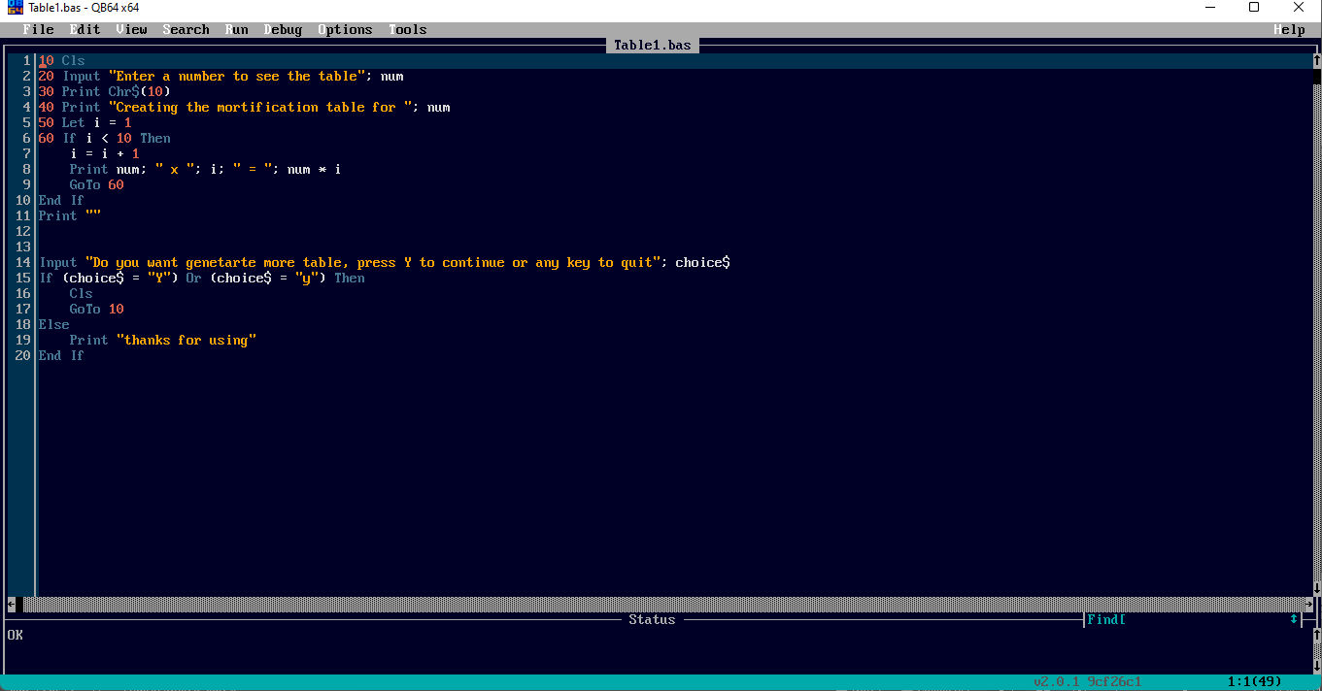
10 Cls
20 Input "Enter a number to see the table"; num
30 Print Chr$(10)
40 Print "Creating the mortification table for "; num
50 Let i = 1
60 If i < 10 Then
i = i + 1
Print num; " x "; i; " = "; num * i
GoTo 60
End If
Print ""
Input "Do you want genetarte more table, press Y to continue or any key to quit"; choice$
If (choice$ = "Y") Or (choice$ = "y") Then
Cls
GoTo 10
Else
Print "thanks for using"
End If
Click here to see output

Slide 16
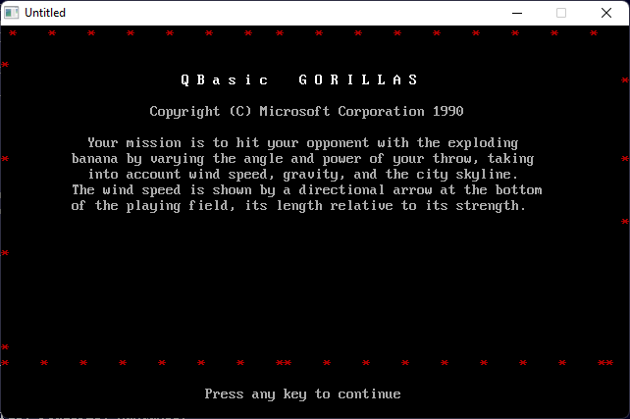
This is gorillas game this is a fun game you can play it, just click download button to play☺
Download
Click here to see the code

Slide 17
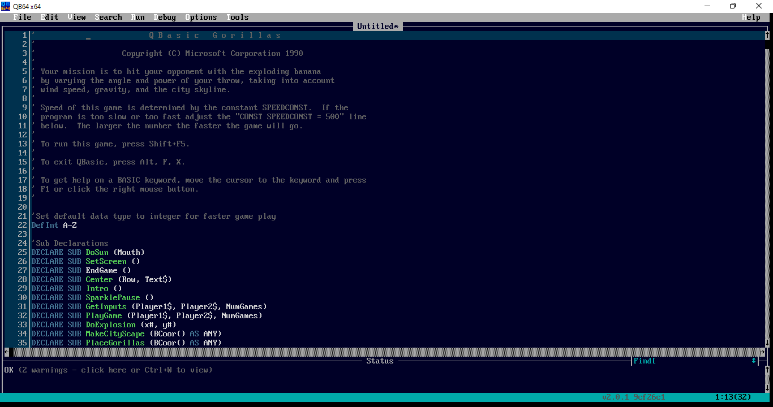
' Q B a s i c G o r i l l a s
'
' Copyright (C) Microsoft Corporation 1990
'
' Your mission is to hit your opponent with the exploding banana
' by varying the angle and power of your throw, taking into account
' wind speed, gravity, and the city skyline.
'
' Speed of this game is determined by the constant SPEEDCONST. If the
' program is too slow or too fast adjust the "CONST SPEEDCONST = 500" line
' below. The larger the number the faster the game will go.
Click here to see output

Slide 18
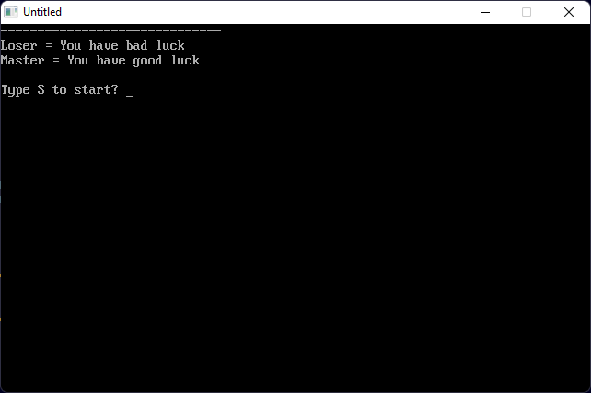
This is try your luck
You can try your luck and if you feel lucky so you have to try this ☺
Download
Click here to see the code

Slide 19
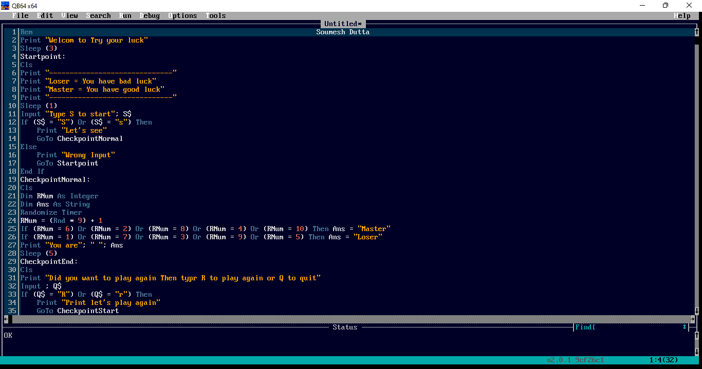
Print "Welcom to Try your luck"
Sleep (3)
Startpoint:
Cls
Print "------------------------------"
Print "Loser = You have bad luck"
Print "Master = You have good luck"
Print "------------------------------"
Sleep (1)
Input "Type S to start"; S$
If (S$ = "S") Or (S$ = "s") Then
Print "Let's see"
GoTo CheckpointNormal
Else
Print "Wrong Input"
GoTo Startpoint
End If
Click here to see output

Slide 20
I also made some games on scratch☺

