Slide 1


Transfer Learning Theory and it’s Applications using Tensorflow & Keras
Babak Badnava
PyCon 2018

Slide 2
Overview
Problem ?
Solution ?
Approaches
Final Part
TL in Practice

Slide 3
Traditional ML
Problem ?
Solution ?
Approaches
Final Part
TL in Practice
Task A
Task B
Task C
Model A
Model B
Model C

Slide 4
Problem Definition!
Problem ?
Solution ?
Approaches
Final Part
TL in Practice
Complex problems
Insufficient labeled data
Long training time

Slide 5
Solution ?
Problem ?
Solution ?
Approaches
Final Part
TL in Practice
Assumptions ?
Related data for different task
Previously learned tasks
Solution ?
Use them

Slide 6
Transfer Learning framework
Problem ?
Solution ?
Approaches
Final Part
TL in Practice
Source Task A
Source Task B
Model A
Model B
Model C
Knowledge
Target Task

Slide 7
Transfer Learning and Neural Networks
Problem ?
Solution ?
Approaches
Final Part
TL in Practice
Pre-trained models
Trains with large dataset
Use for specific task
Fixed feature extractor
Autoencoders
Freezing pre-trained model
Fine-tuning

Slide 8
Pre-trained models on ImageNet in Keras
Problem ?
Solution ?
Approaches
Final Part
TL in Practice
Xception
VGG16
VGG19
ResNet50
InceptionV3
……

Slide 9
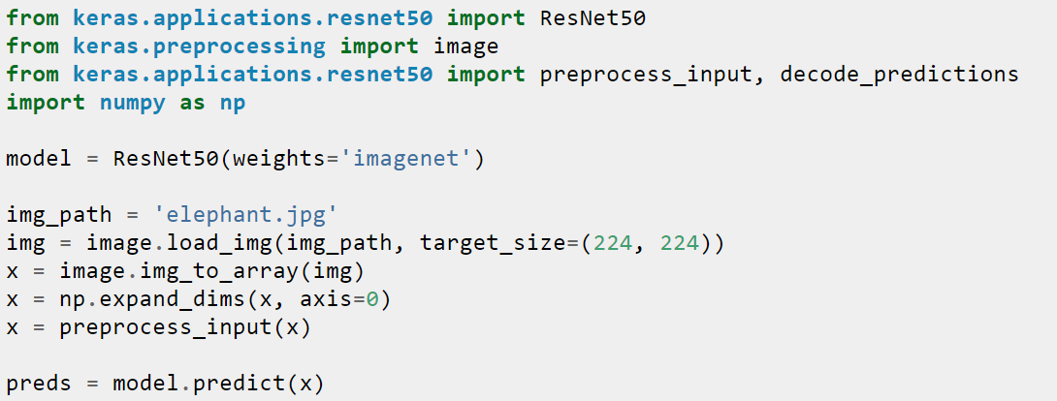
ResNet50 for specific task
Problem ?
Solution ?
Approaches
Final Part
TL in Practice

Slide 10
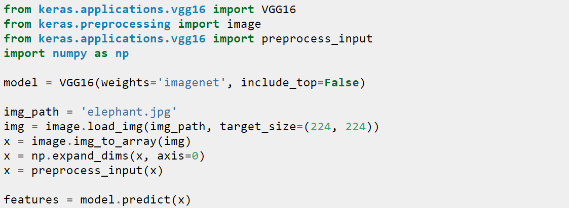
Extract features with VGG16
Problem ?
Solution ?
Approaches
Final Part
TL in Practice

Slide 11
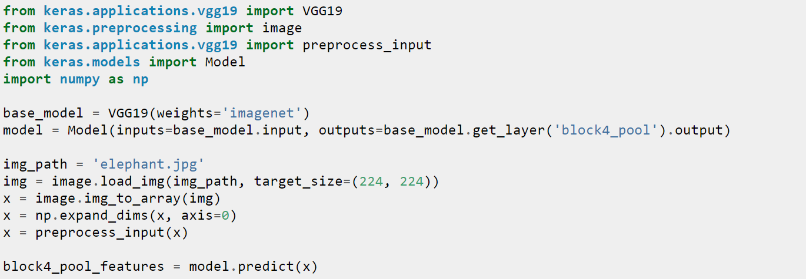
Extract features from an intermediate layer with VGG19
Problem ?
Solution ?
Approaches
Final Part
TL in Practice

Slide 12
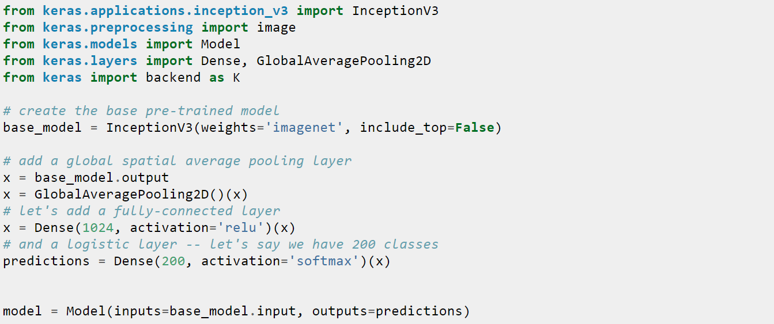
Fine-tune InceptionV3 on a new set of classes
Problem ?
Solution ?
Approaches
Final Part
TL in Practice

Slide 13
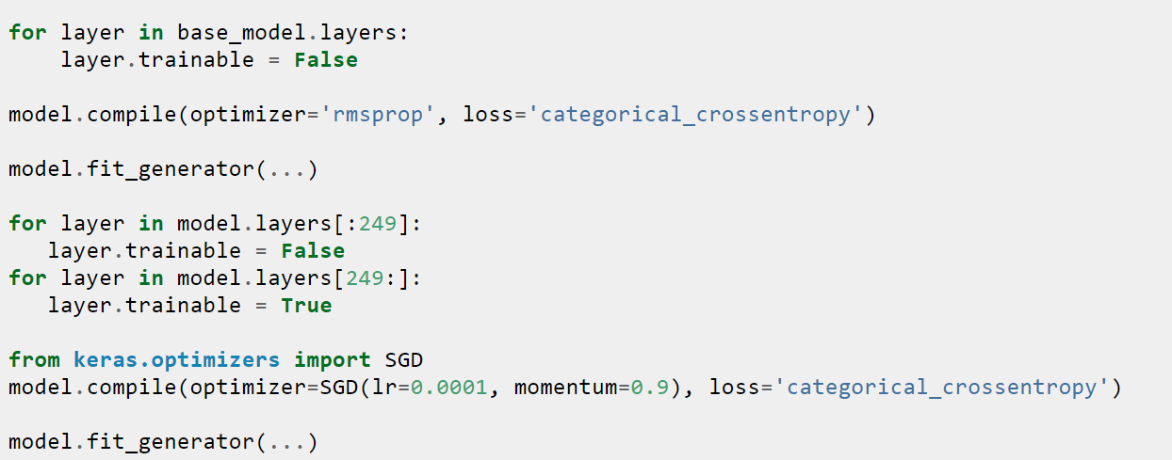
Fine-tune InceptionV3 on a new set of classes(2)
Problem ?
Solution ?
Approaches
Final Part
TL in Practice

Slide 14
TensorFlow-Slim
Problem ?
Solution ?
Approaches
Final Part
TL in Practice
lightweight high-level API of TensorFlow
Many pre-trained models such as:
Inception
ResNet V1 50
ResNet V1 101
VGG 16

Slide 15
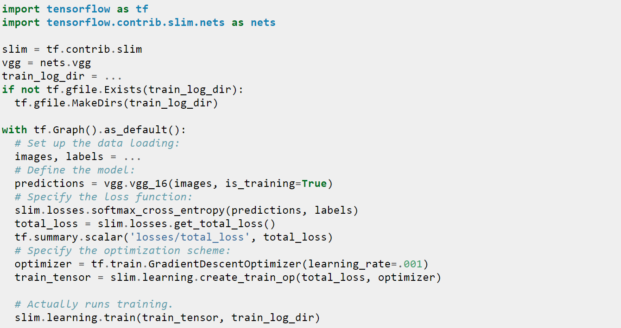
Pre-trained models
Problem ?
Solution ?
Approaches
Final Part
TL in Practice

Slide 16
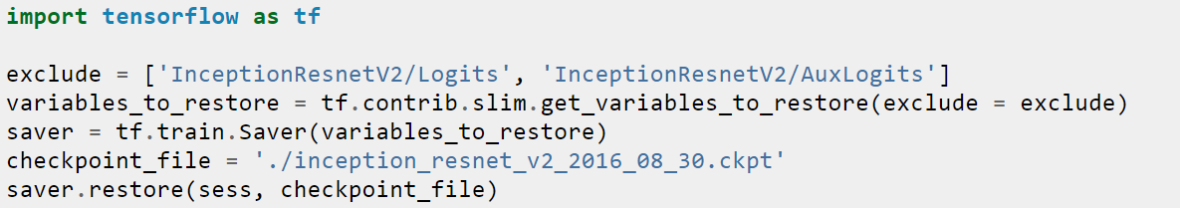
Transfer a specific layer
Problem ?
Solution ?
Approaches
Final Part
TL in Practice

Slide 17
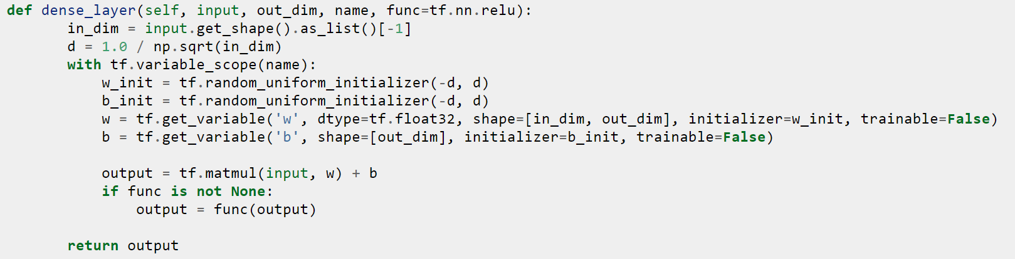
Freeze a layer
Problem ?
Solution ?
Approaches
Final Part
TL in Practice

Slide 18
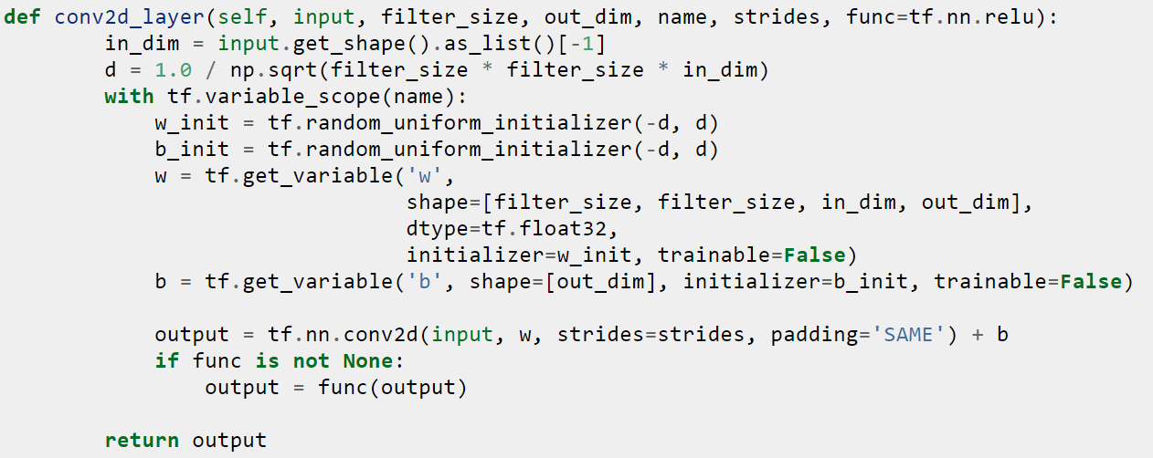
Freeze a layer
Problem ?
Solution ?
Approaches
Final Part
TL in Practice

Slide 19
Applications
Problem ?
Solution ?
Approaches
Final Part
TL in Practice
Learning from simulations
Autonomous cars
Robotics
Adapting to new domains
Semi supervised learning

Slide 20
When and which?
Problem ?
Solution ?
Approaches
Final Part
TL in Practice
 | Similar dataset | Different dataset
Small dataset | Highest level features + classifier | Lower level features + classifier
Large dataset | Fine tune | Fine tune

Slide 21
Thanks for attention. Questions?

