Slide 1
Software Project Effort Prediction
Using Machine Learning Regression models to predict size of software projects Babak Ansari-Jaberi babakansari@yahoo.com
3251 - Statistics for Data Science – Term Project
© 2018 School of Continuing Studies, University of Toronto

Slide 2
Objective Put the knowledge into a practical use
Enhance software projects delivery date prediction accuracy.
Use historical data to predict the size and effort required to complete a project.
Introduce predictive modelling capabilities to the development team.

Slide 3
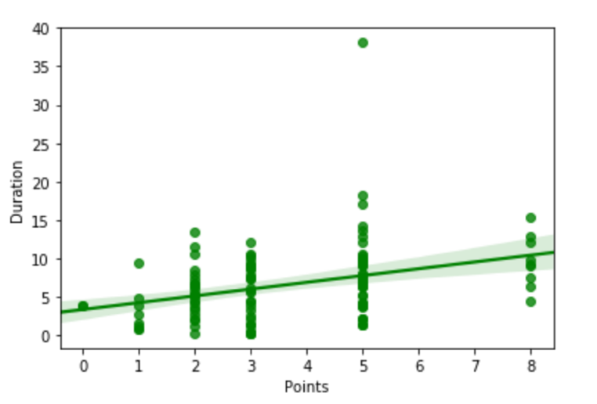
Introduction
Software Development Life Cycle
The projects are divided into smaller deliverable units called User Stories that could bring value to the stakeholders
User Stories needed to be Prioritized based on their business values
The amount/Size of work required for each User Story is given by the development team.
The Size is a number to weight the complexity and effort required to complete a User Story
Development duration based on point size:
2 points Duration 5 ± 3 days
3 points Duration 6 ± 4 days
5 points Duration 7 ± 4 days
8 points Duration 10 ± 3 days
Lifecycle:
Pre-refinement meeting (T-Shirt sizing)
Refinement/Estimation meeting (Point sizing)
Planning (Commit based on capacity)
Correlation between Size and Duration

Slide 4
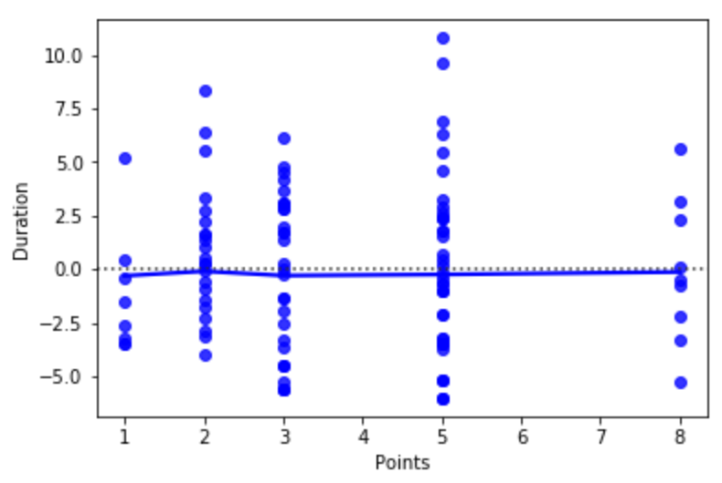
Point sizing challenges
Sizing is done by development team based on their past experiences.
Currently it relies on team guesstimates that may not consider all the past data (E.g. That is ± 4 days for each item that could increase for an epic or a project)
It is time consuming as it is hard to recall every single task done in the past for the same or a similar work item
The following residual diagrams shows how scattered is the prediction even though the points are sparse evenly:

Slide 5
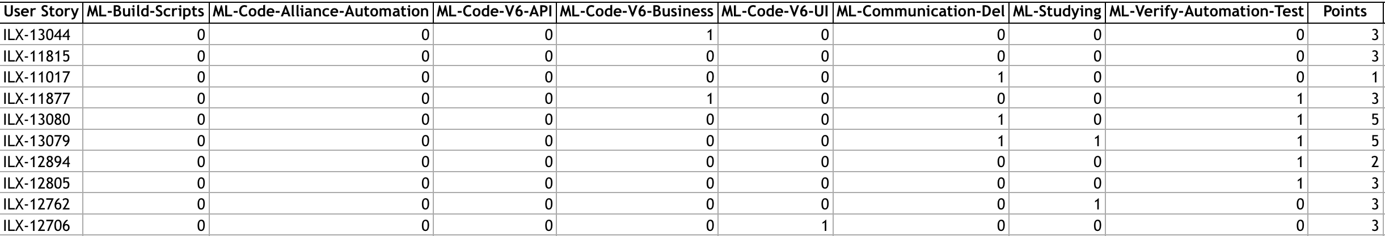
Data Prepration
Research and data preparations
Define activities per User Stories that could have impact on point estimation (Sizing).
There were no feature to extract but creating from ground up.
Communicate with Jira to fetch defined labels from User Stories in realtime and prepare data set
The challenge is the quantity and quality of the data.
99 records with 16 feature columns and one point size target

Slide 6
Select Algorithm
Select the supervised learning algorithm
Point estimates are weighted values but they are limited to 5 values and are not continues.
Essentially; the values are like 1 very small, 2 small, 3 medium, 5 large and 8 very large.
Use Multiclass classification for the point sizes (Use One Hot Encoder for the points)
Get the data from JIRA and save as the training dataset (Select 55 for training and 37 for testing)
Select classifiers capable of handling Multiclass classification with probability prediction (Logistic Regression, SVC, LinearSVC and Ada Boost using one of the selected algorithm)
Feed the classifiers to One Vs Rest Classifier for Multiclass classification

Slide 7
Model Training & Testing
Train the model and optimize
Tune the selected algorithms using Grid Search CV
Evaluate the selected algorithms with best parameters and score:
Analysis test and prediction distribution
Scatter plot the prediction vs test values
Diagnostic ability of the classifiers using Use Roc Curve
Also take Estimator and Cross Validation scores into consideration
Repeat until get a desirable result for all the selected algorithms

Slide 8
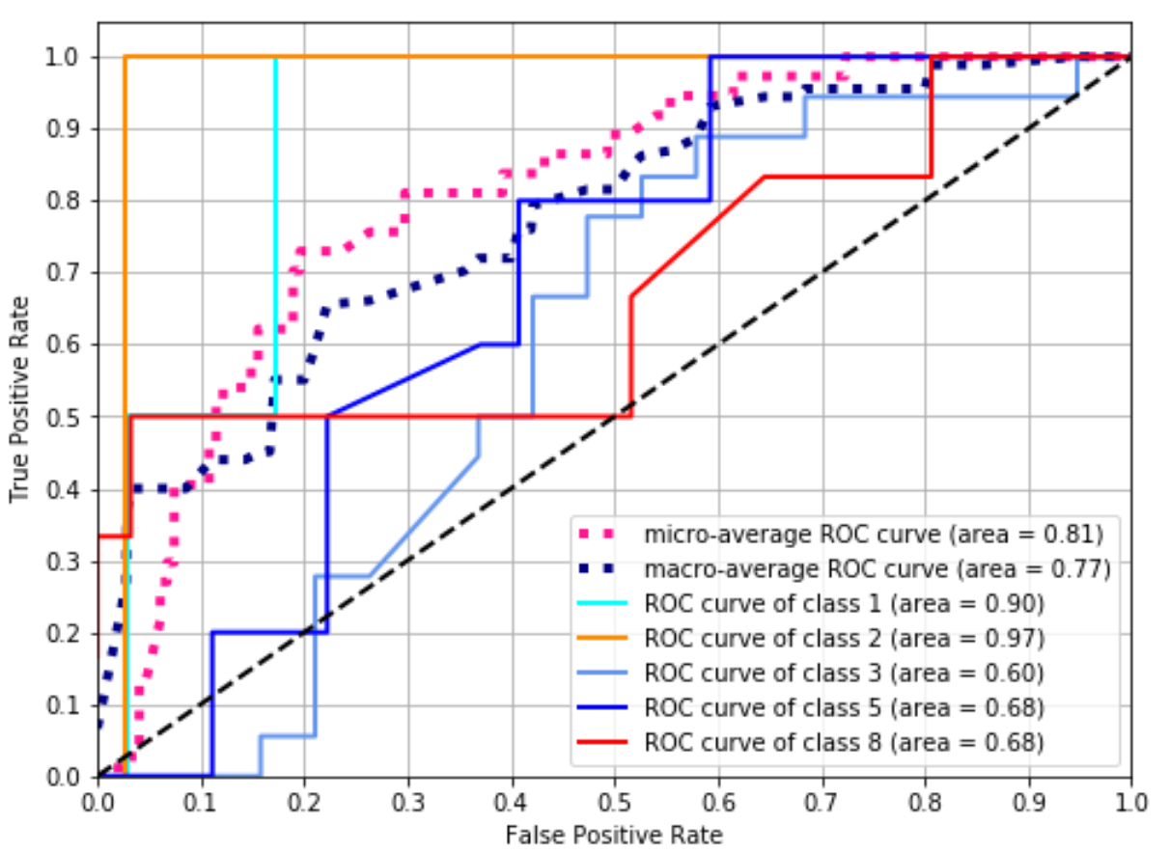
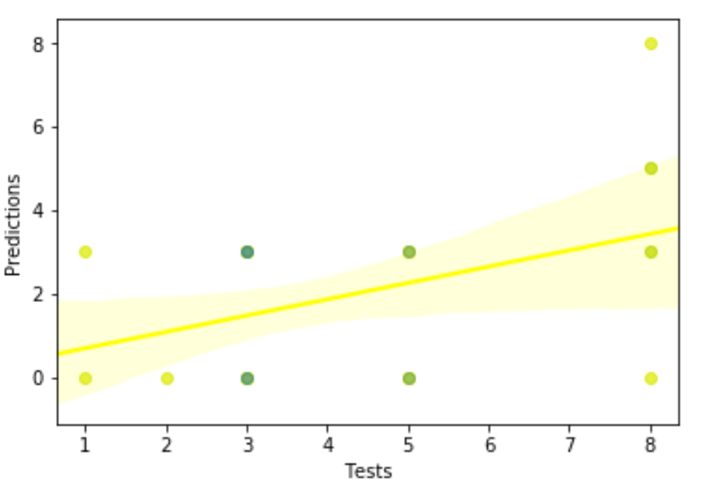
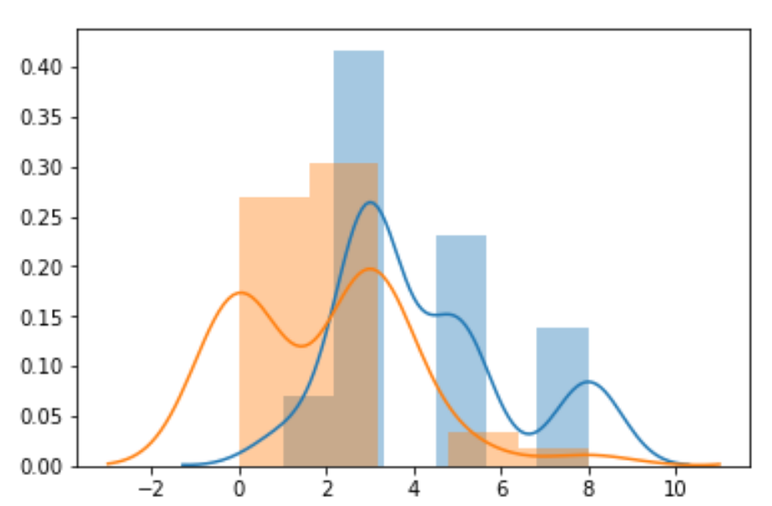
Logistic Regression
Logistic Regression Evaluation
Estimator Score:
Training: 0.36
Test : 0.3
Cross Validation Score:
0.22 (+/- 0.15)

Slide 9
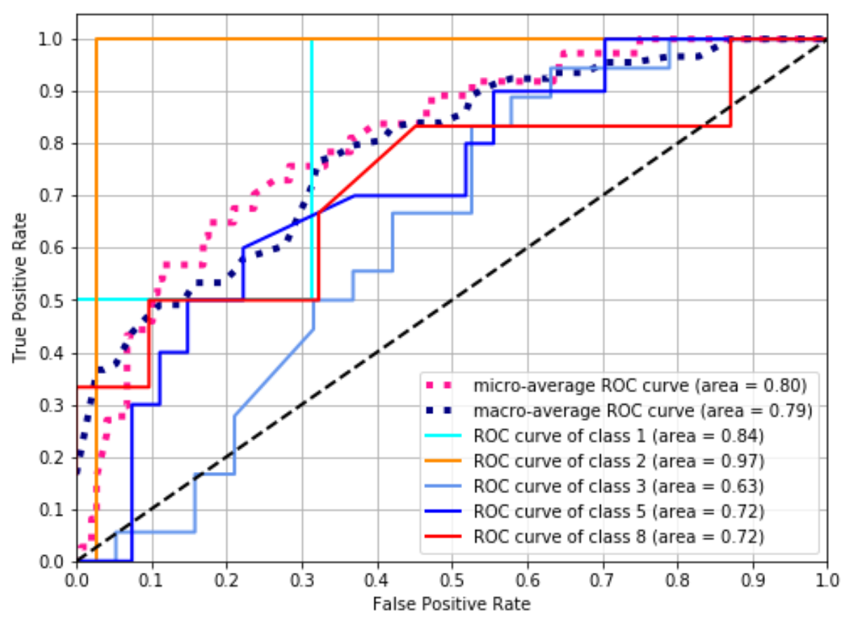
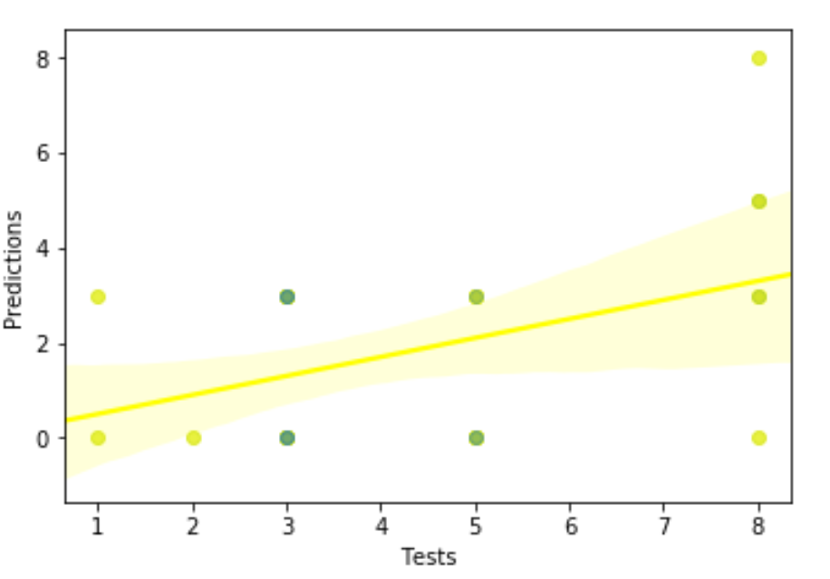
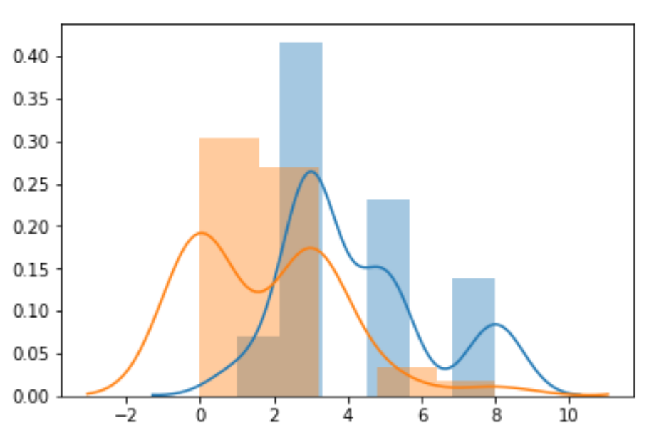
SVC
SVC Evaluation
Estimator Score:
Training: 0.31
Test : 0.27
Cross Validation Score:
0.15 (+/- 0.1)

Slide 10
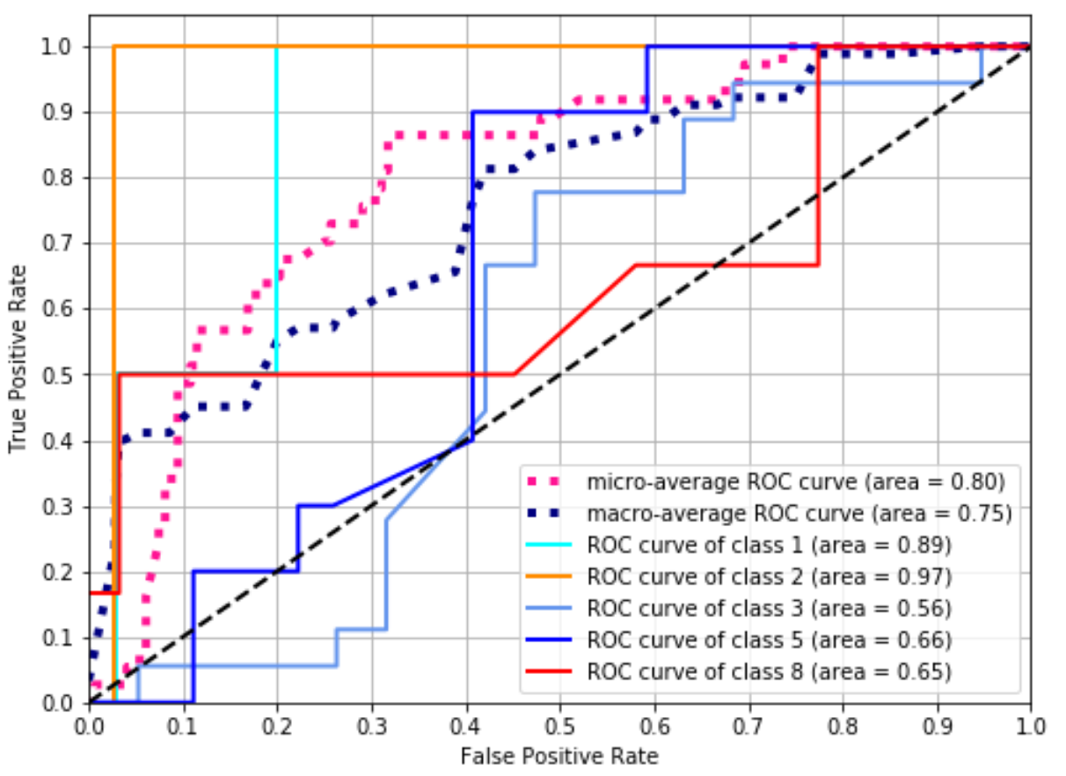
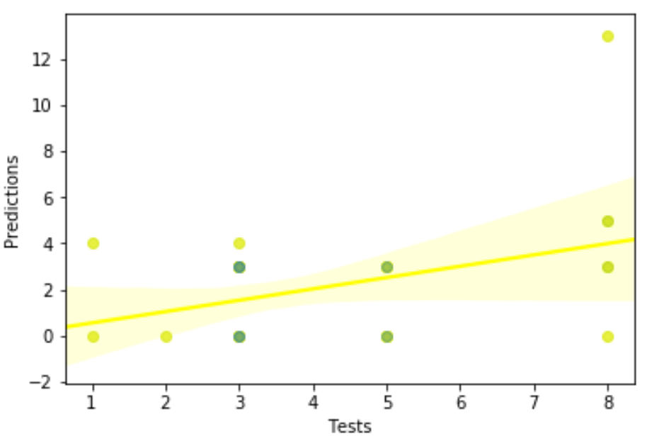
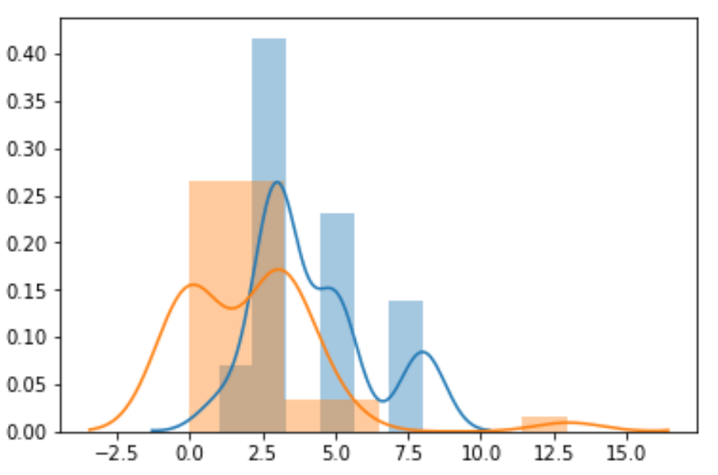
Ada Boost Classifier
Ada Boost using Logistic Regression Evaluation
Estimator Score:
Training: 0.38
Test : 0.24
Cross Validation Score:
0.17 (+/- 0.13)
________________________

Slide 11
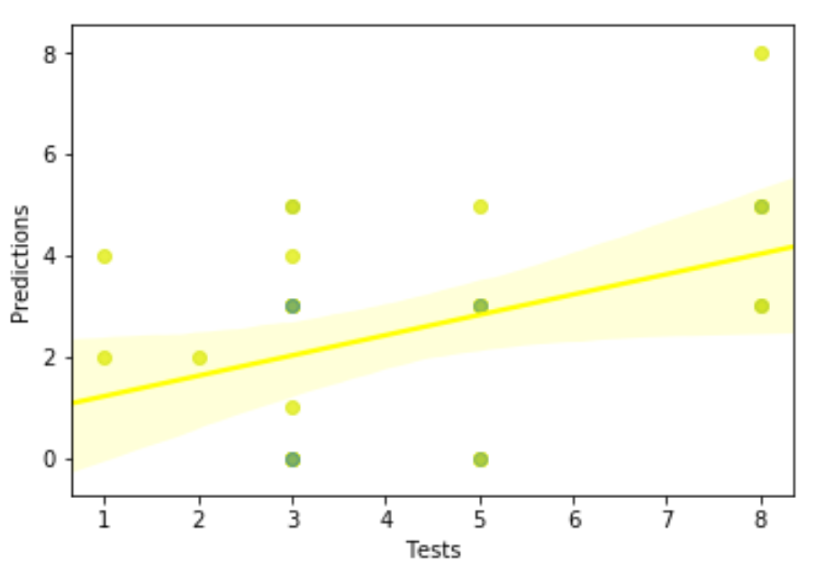
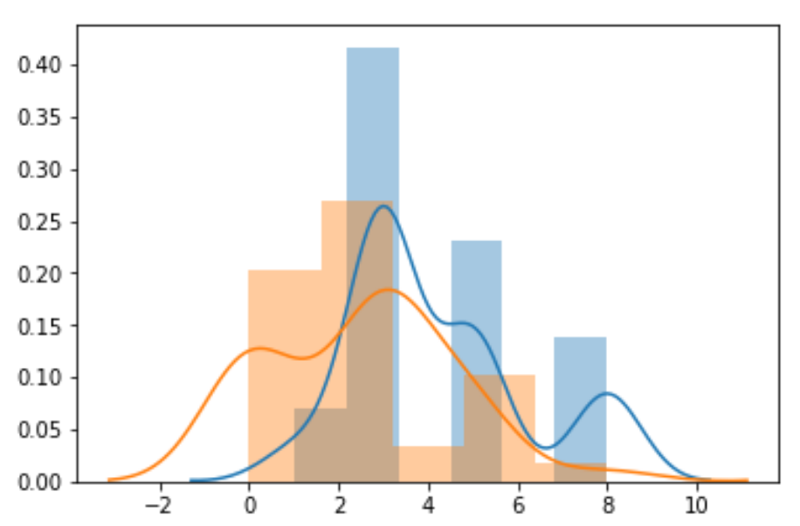
Linear SVC Classifier
Linear SVC Evaluation
Estimator Score:
Training: 0.45
Test : 0.27
Cross Validation Score:
0.31 (+/- 0.14)
________________________

Slide 12
Prediction
Use all algorithms to predict
All algorithms seems to perform well with this data quality & quantity
Get a User Story number that is labeled and feed to all algorithms
LogisticRegression and SVC seems to perform very well
Example of the result for actual 3 point User Story:
LogisticRegression prediction is 3 points with 43.0% probability
SVC prediction is 3 points with 36.0% probability
LinearSVC prediction is 0 points
AdaBoostClassifier prediction is 3 points with 50.0% probability
The best value could be selected from the given results for each classifier

Slide 13
Usage plan
Usage plan in actual estimation meeting
On every planning meeting:
Train the model for the past couple of sprints (had three)
Team identify the labels and assign them to the User Story
Discuss and vote the point size as before
Use the model to do the prediction and compare with the manual vote

