Slide 1
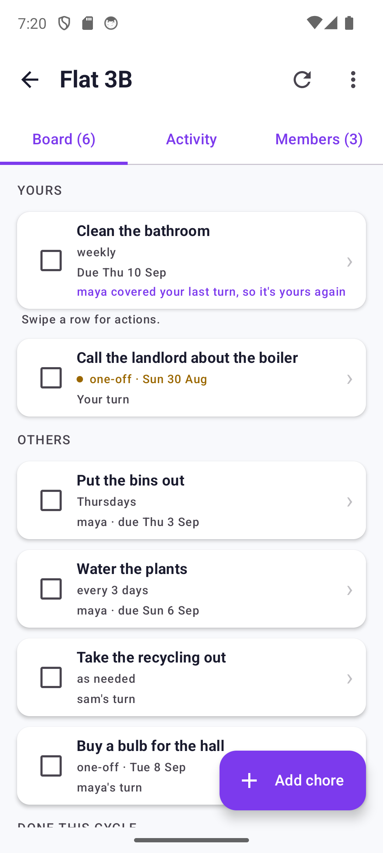
TaskFlow
The household chore board, screen by screen
Captured on the emulator at 360dp against a running backend on 3 September 2026, after the v2 UI pass. Every screen here is the app as it actually builds and runs.
Notes:
Re-shot after v2 UI phases 1-6. The household is seeded: three flatmates, four chores across all three schedule types, three one-off tasks, two completed cycles a week apart, one overdue one-off, one person away.

Slide 2
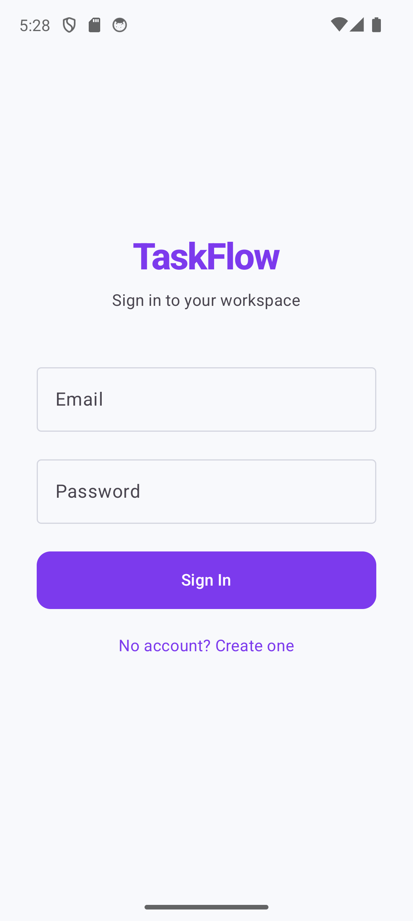
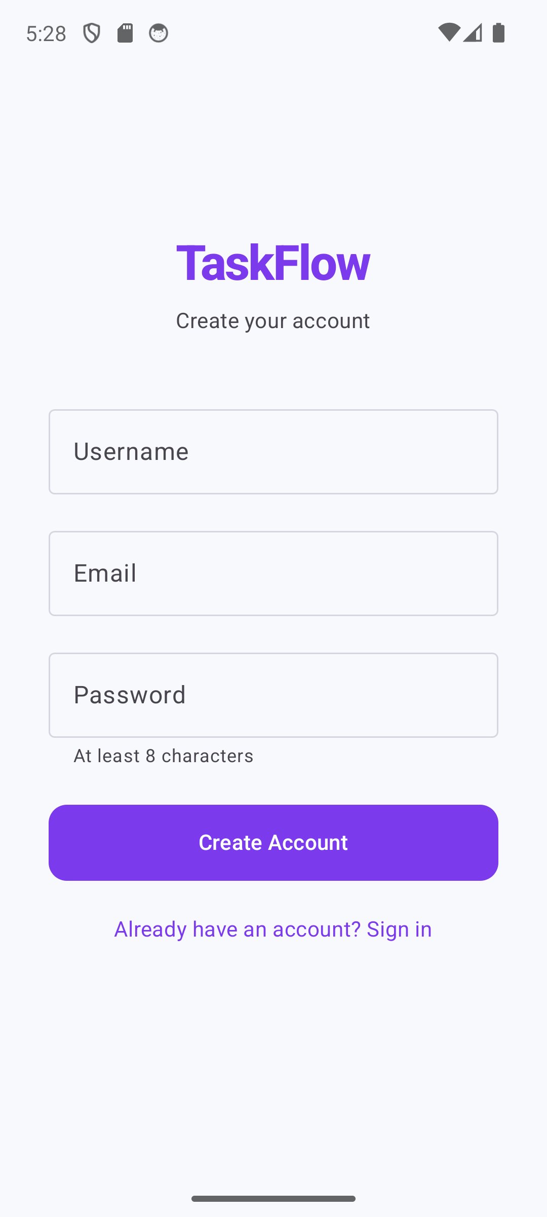
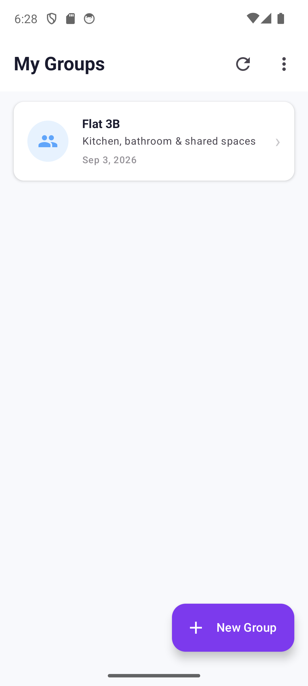
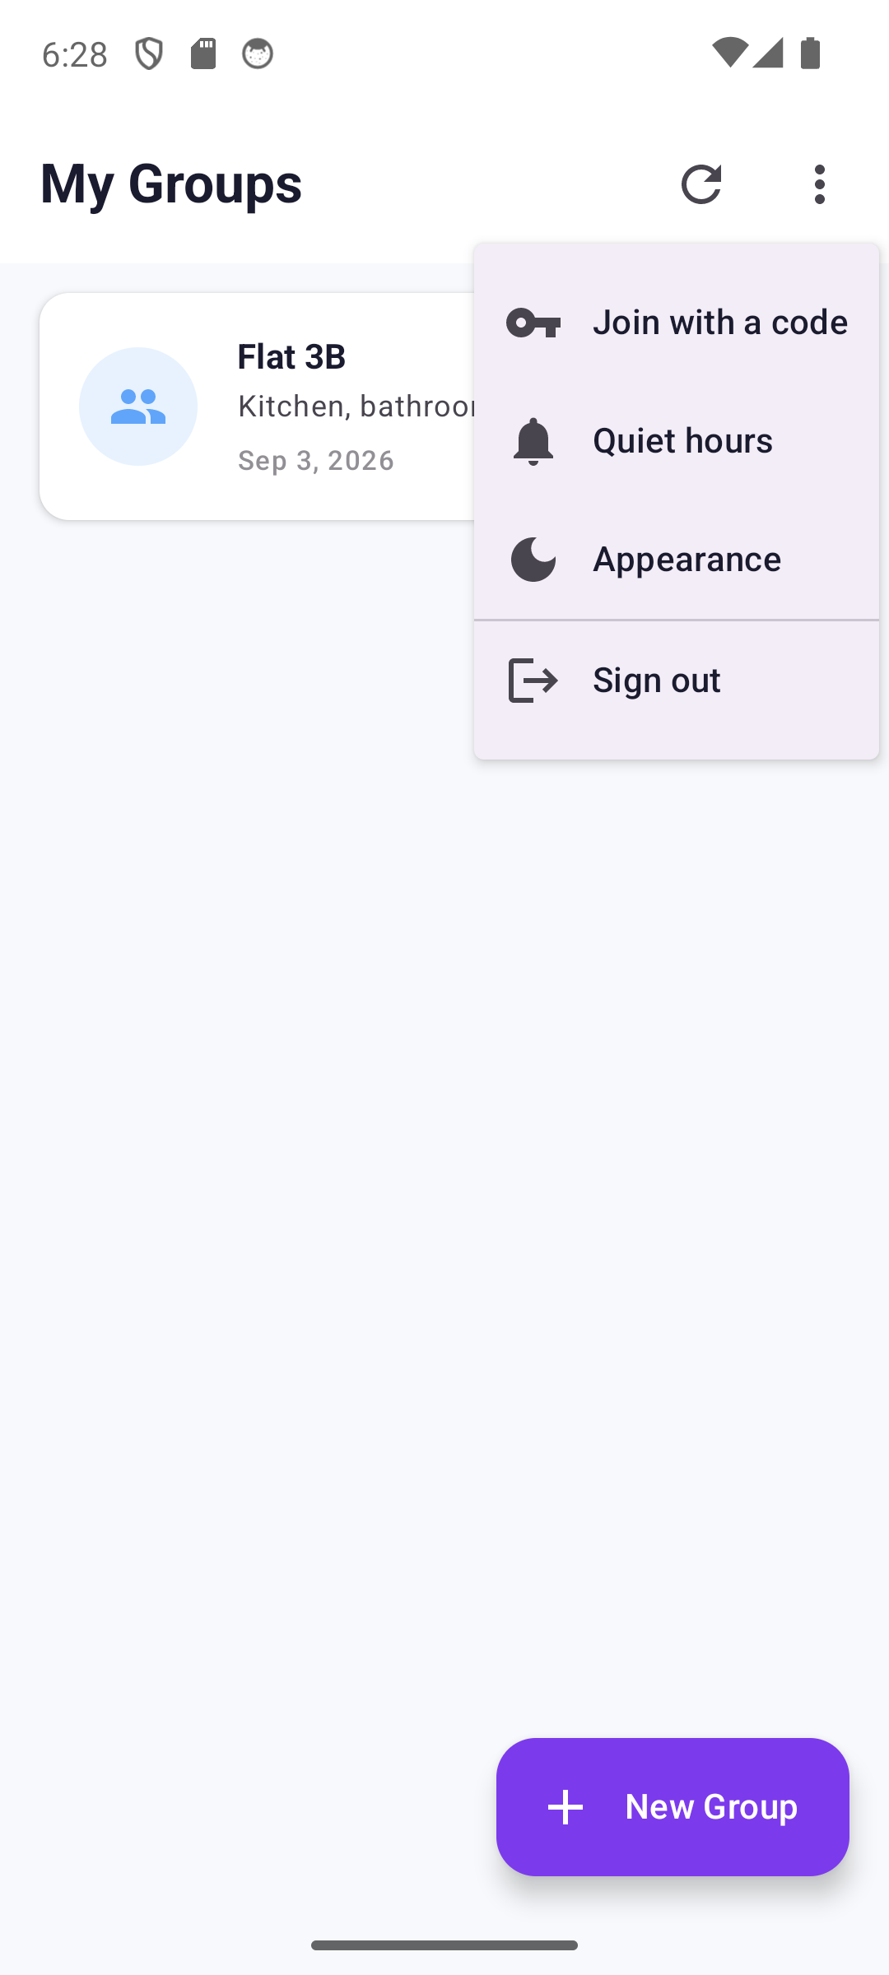
Getting in
One household, so signing in lands straight on its board. The group list is one Back away.
Sign in
Create an account
My Groups
The person's menu
The app's violet, not the wallpaper's
Scrolls clear of the keyboard
Reached by Back from the board
Quiet hours and appearance: both per person

Slide 3
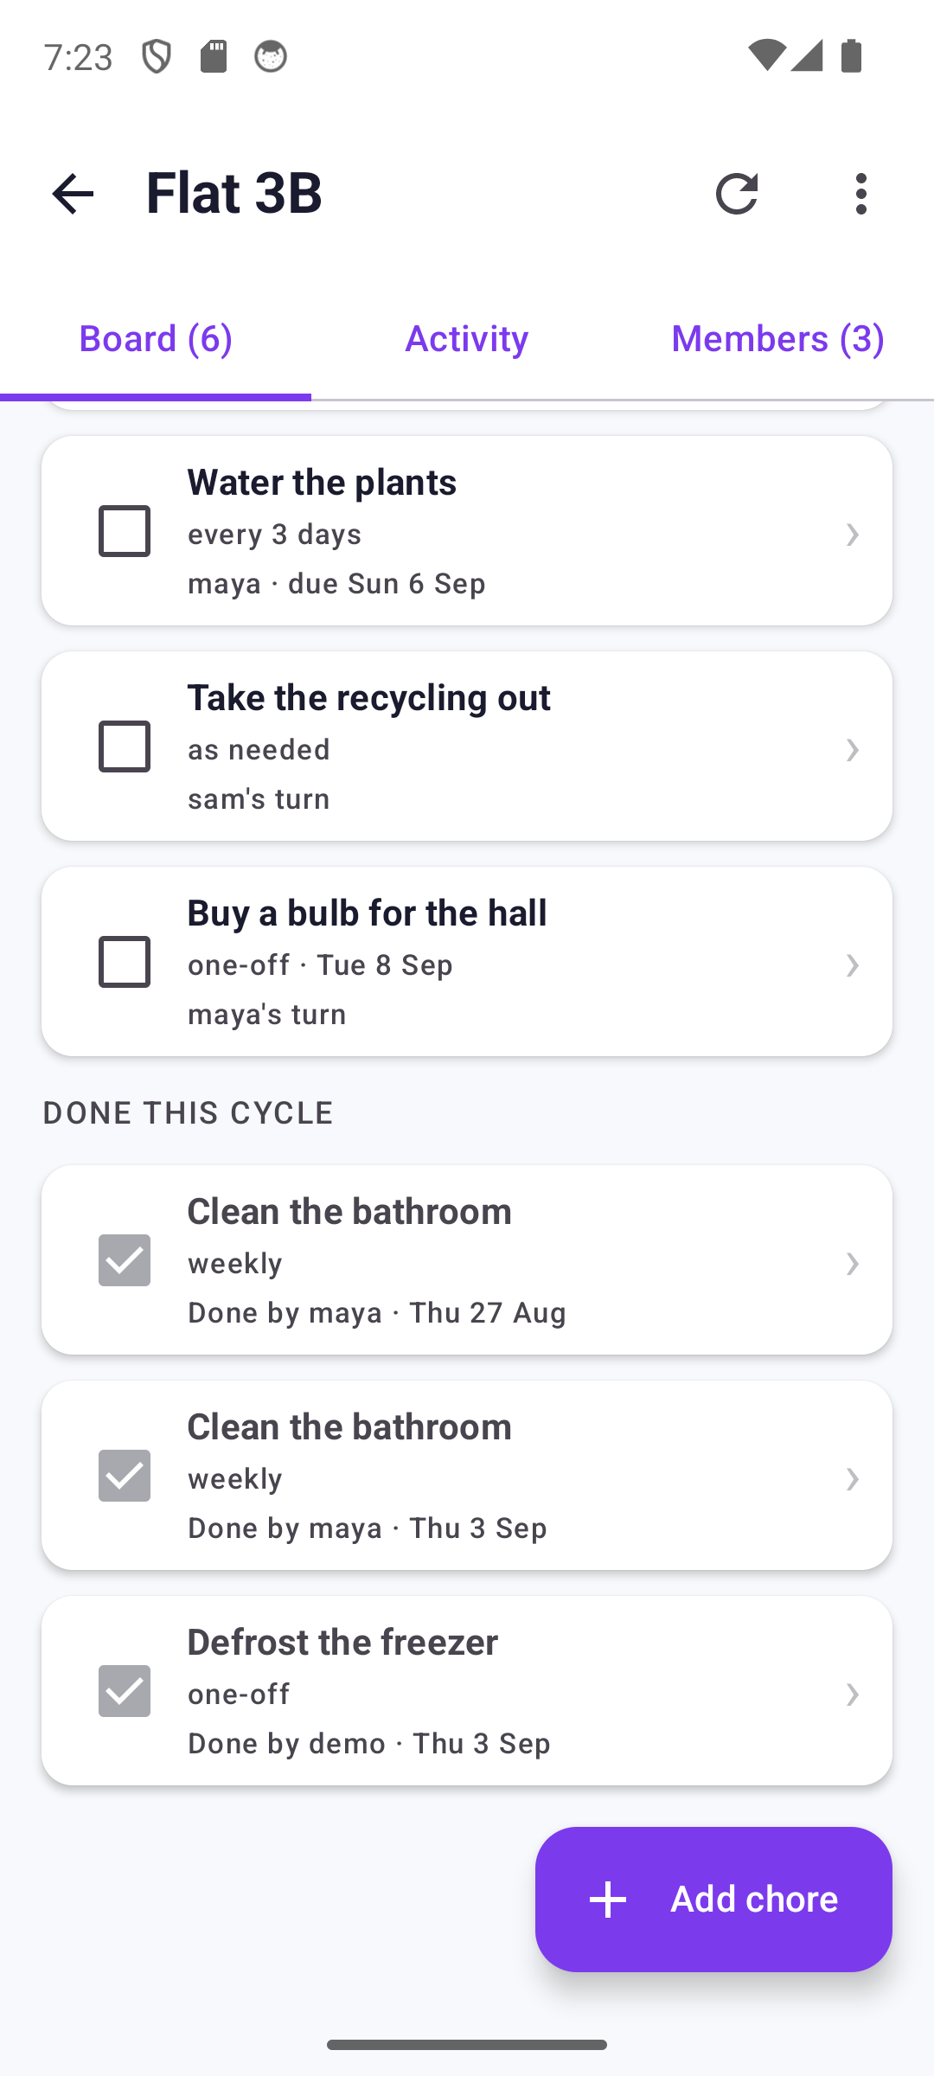
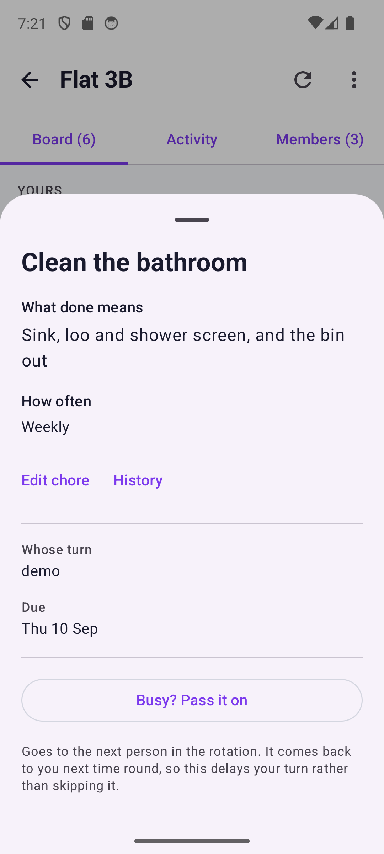
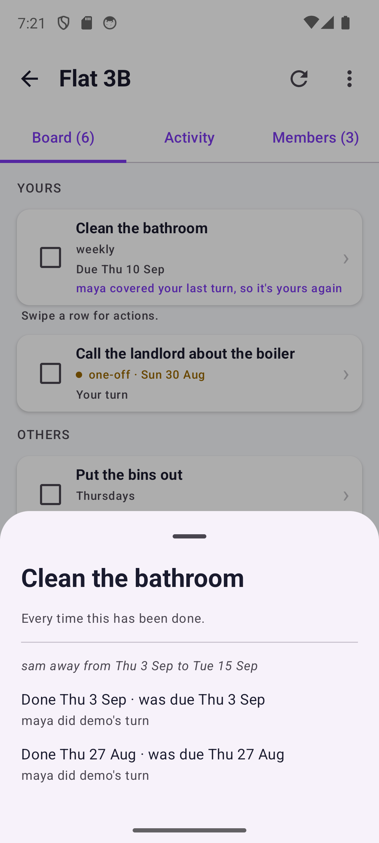
The board is the screen
Yours, Others, Done this cycle. Grouped by whose it is, not by status. Overdue is amber, never red.
The board
Done this cycle
A chore, opened
One chore's history
Three lines a row: what, when, whose
Completions sink, with who and when
The done-line, the schedule, whose turn
Two dates, no verdict on either

Slide 4
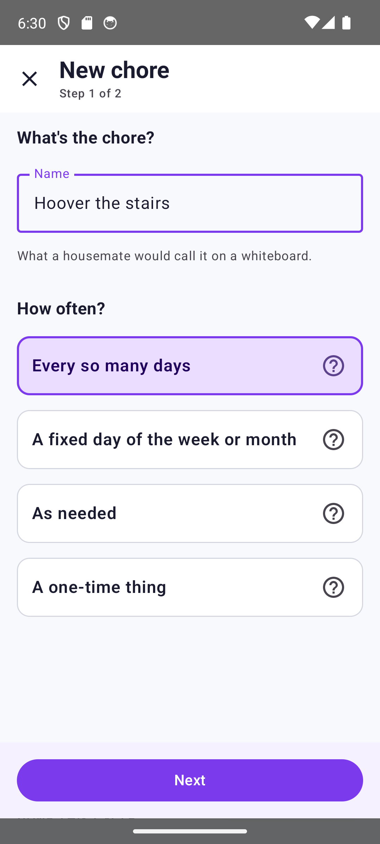
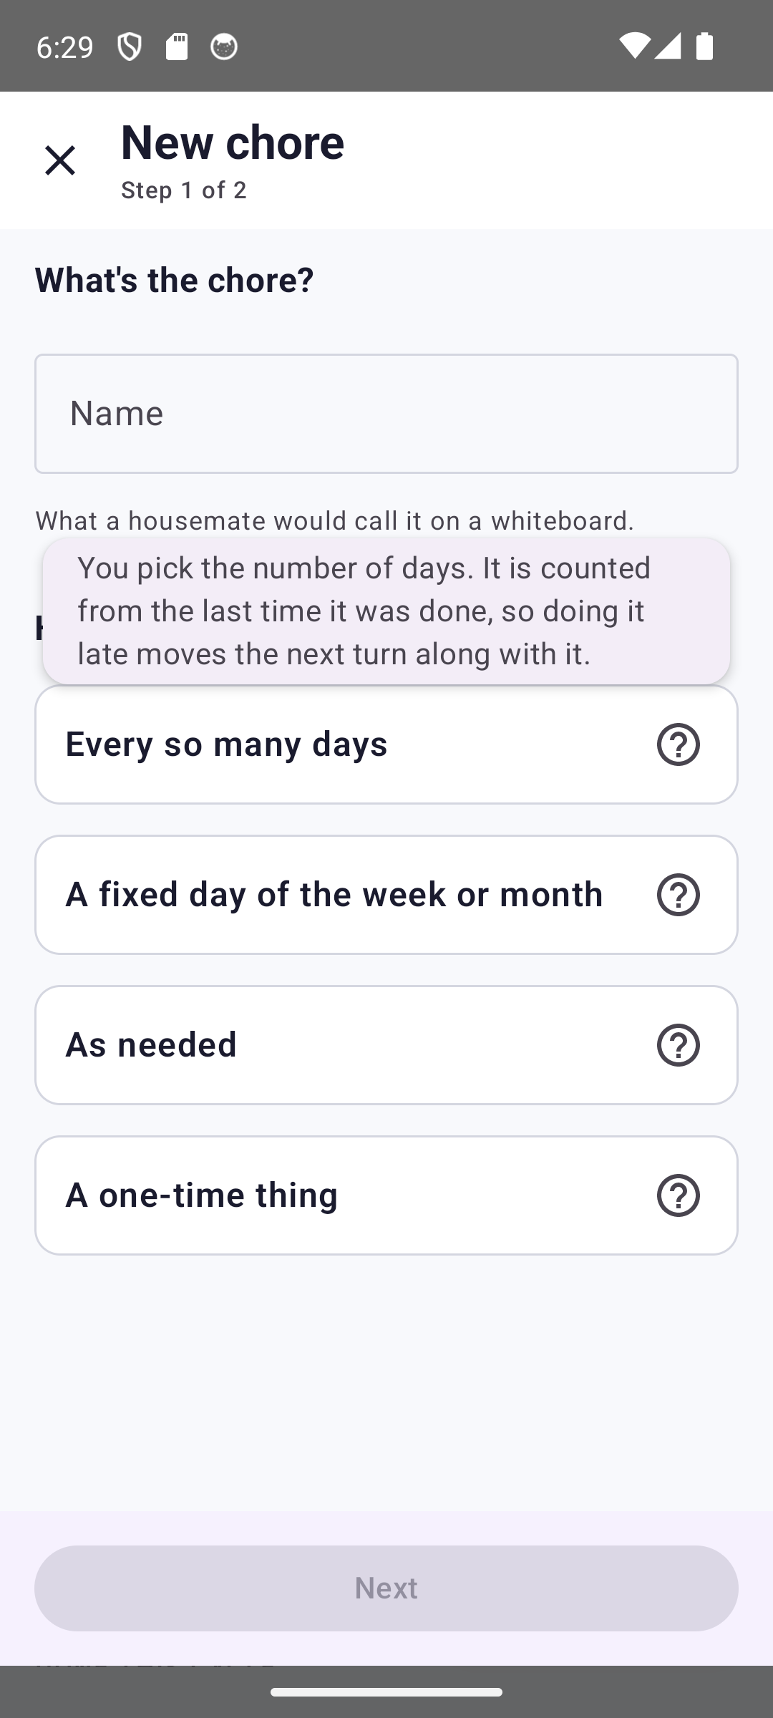
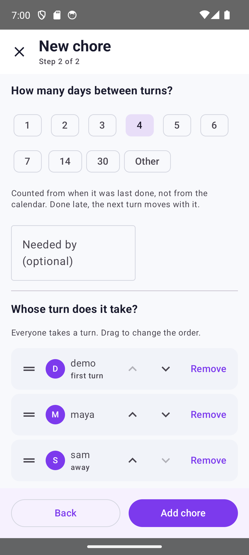
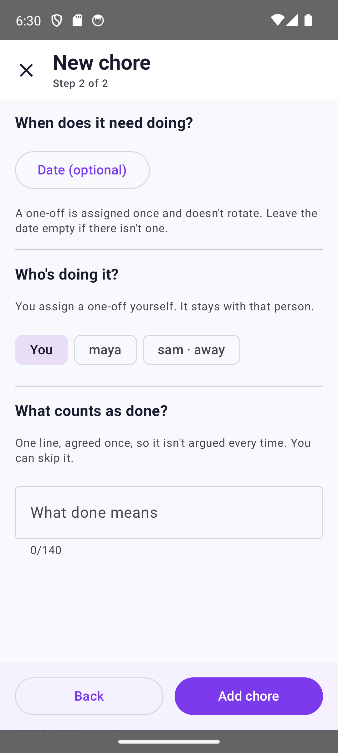
Adding a chore asks two questions
How often, then everything that answer implies. Nothing about days is asked of a one-off.
Step 1: how often
The explanation, on ask
Step 2: repeating
Step 2: one-off
Four short answers, no schedule jargon
Behind a '?', so the choice stays short
Interval, then the order of turns
One person, one date, no rotation

Slide 5
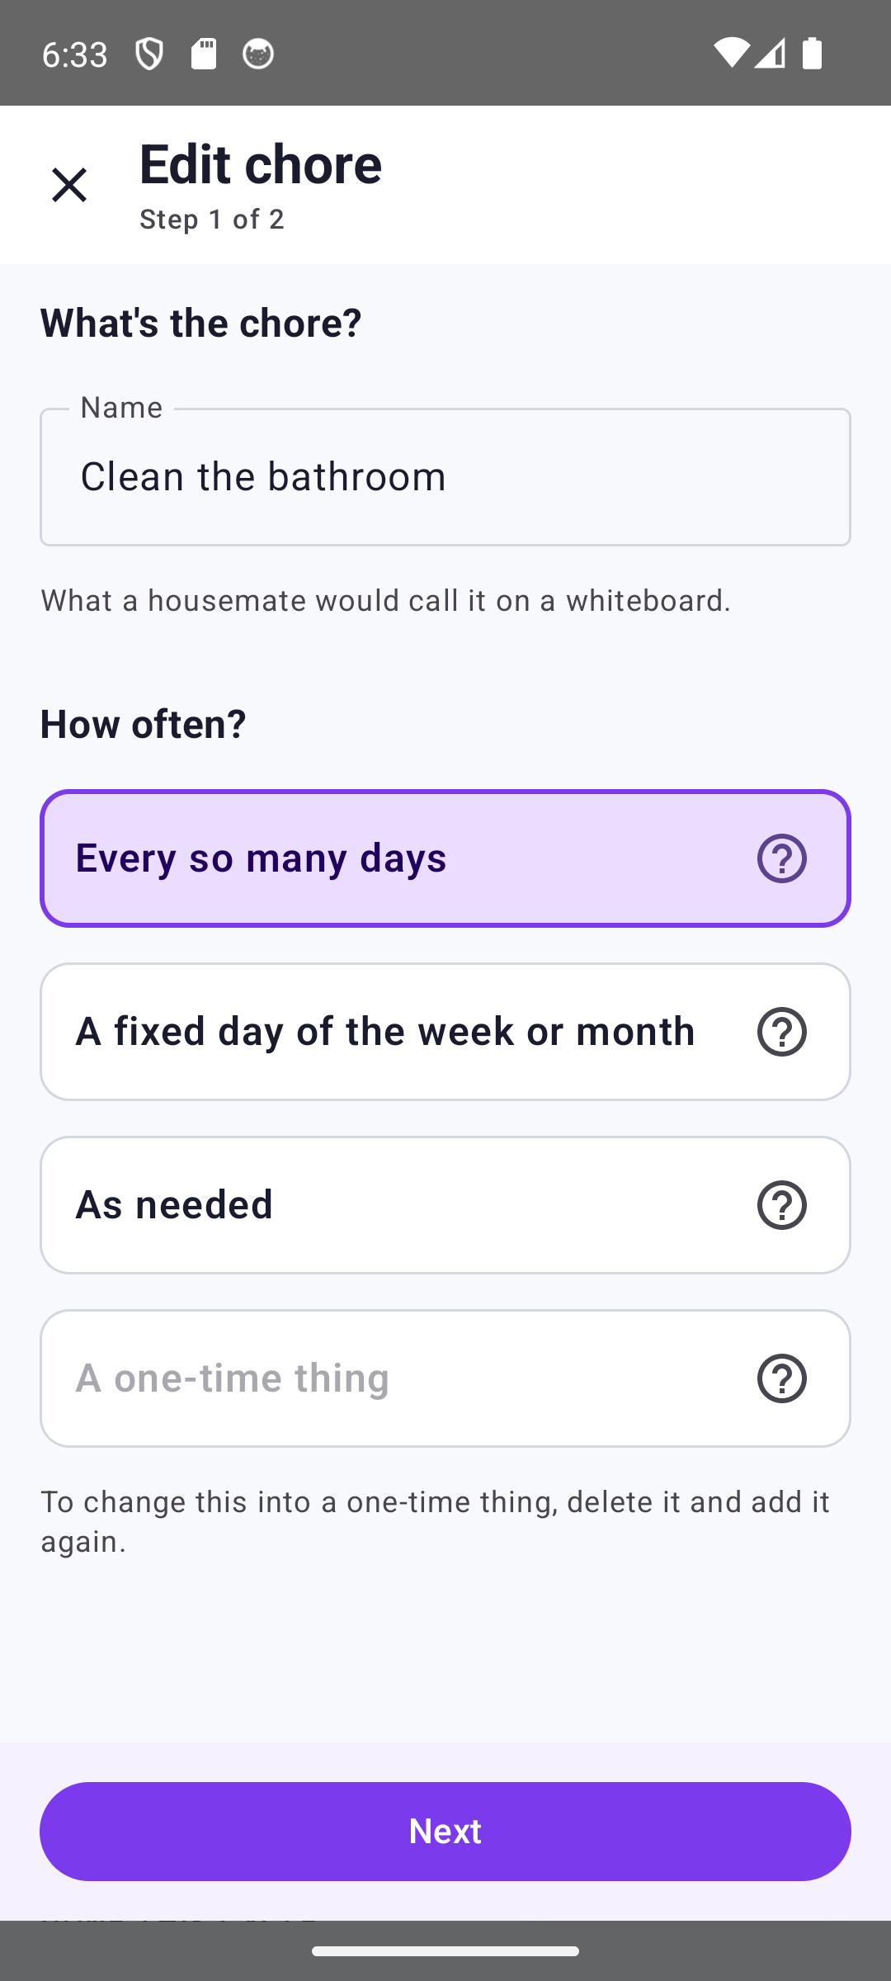
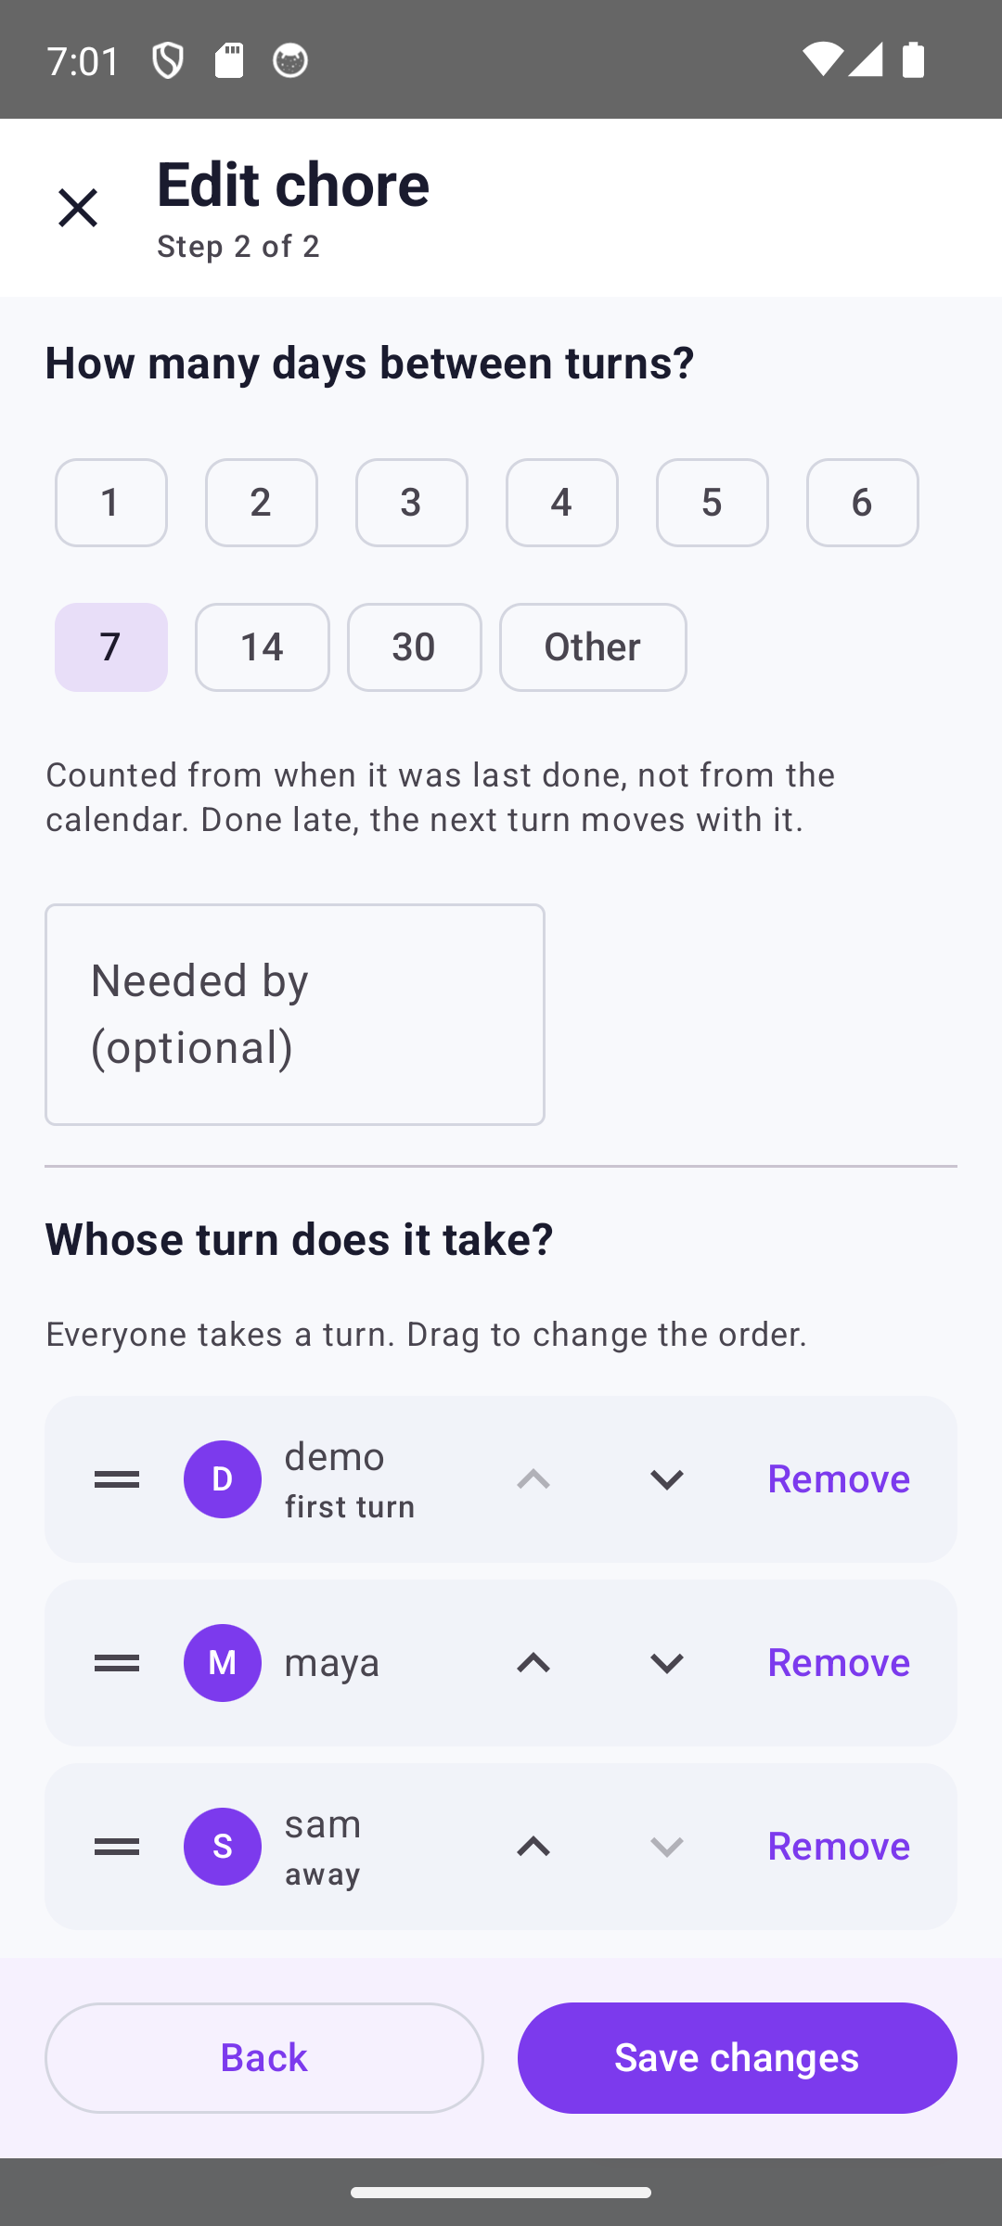
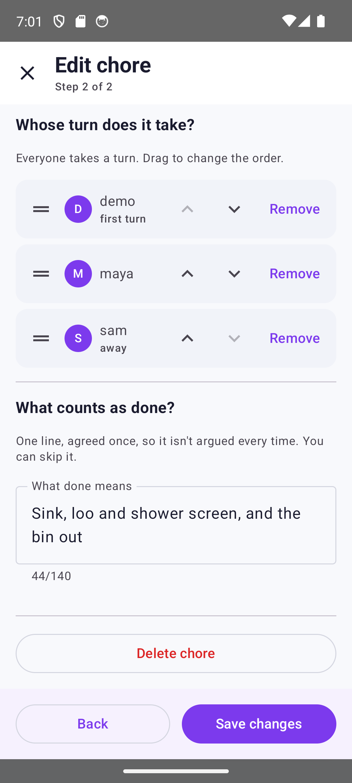
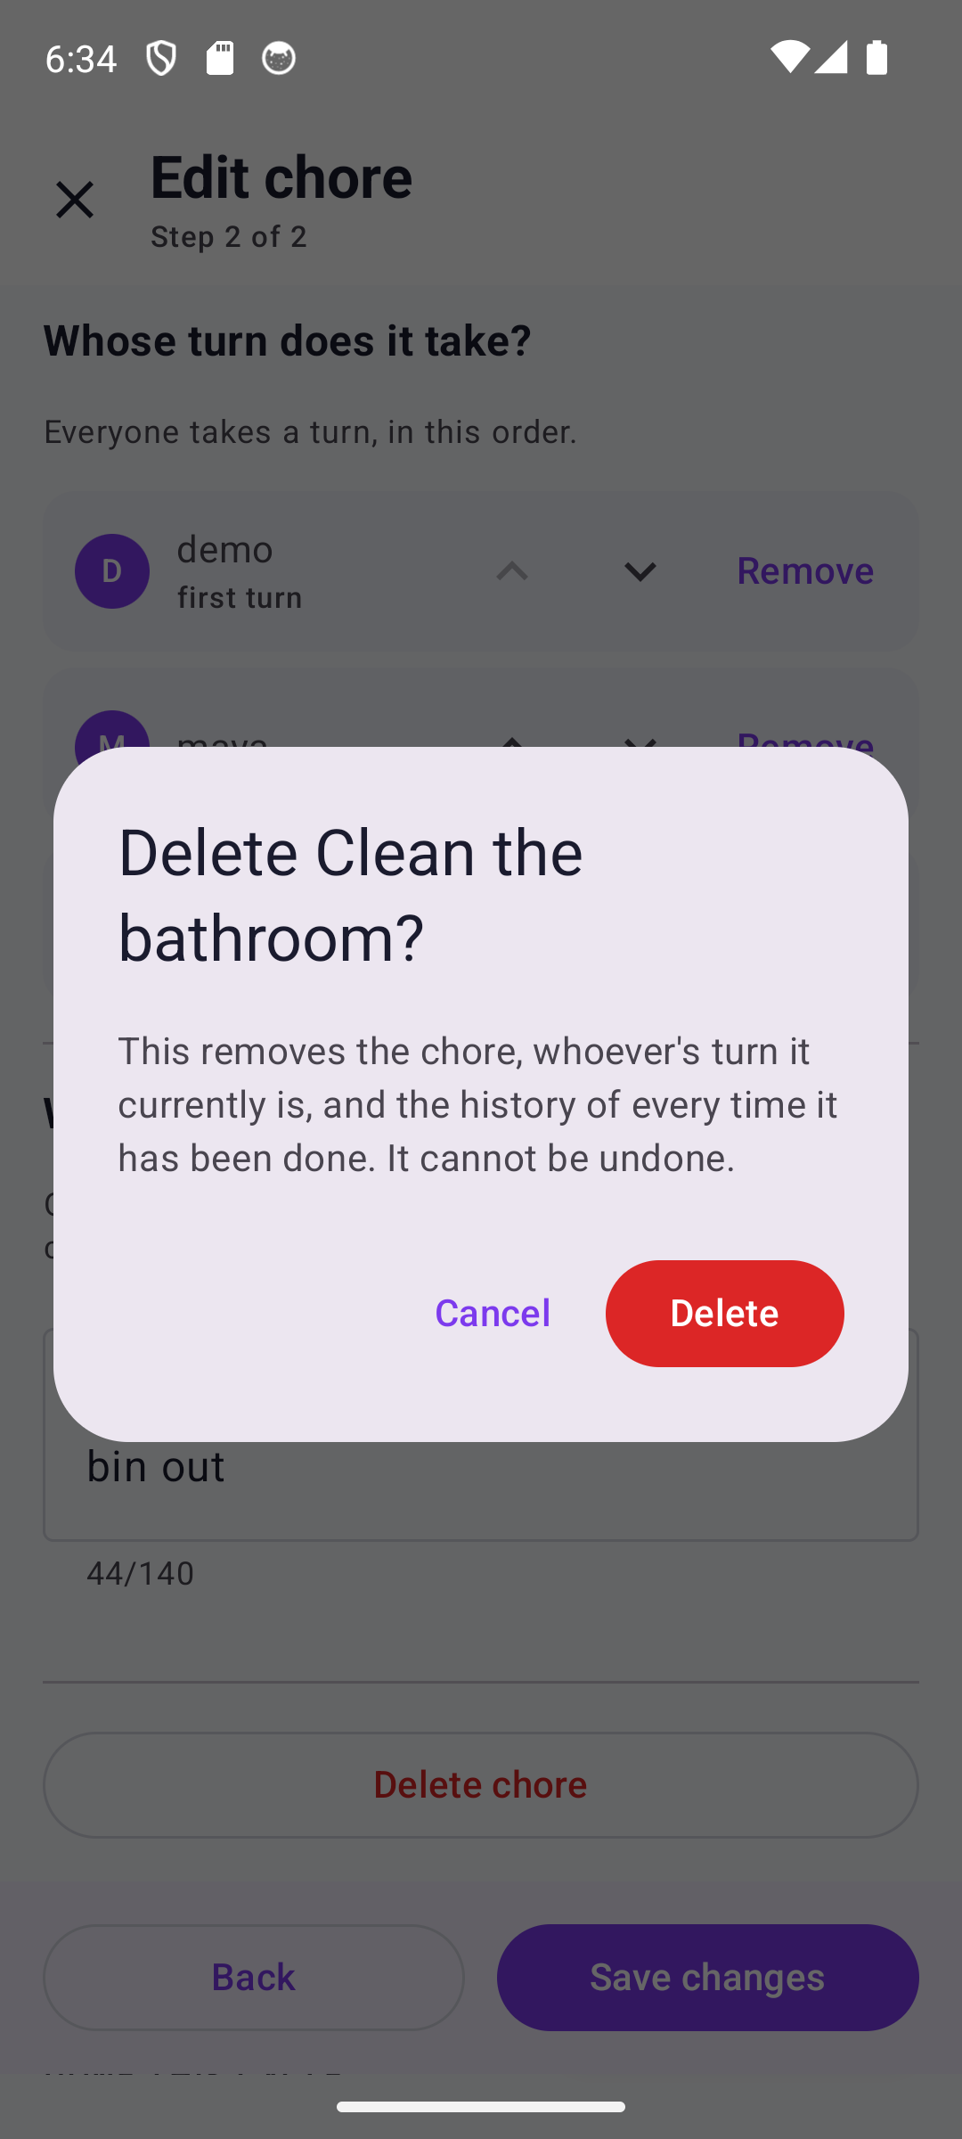
Changing it, and removing it
Editing is the same two screens, prefilled. A schedule change re-dates the open turn rather than stranding it.
Edit, prefilled
The same step 2
Delete lives here
What delete costs
The one kind it cannot become is explained
Rotation and done-line as they stand
At the end of editing, not on the row
Names the history it takes with it

Slide 6
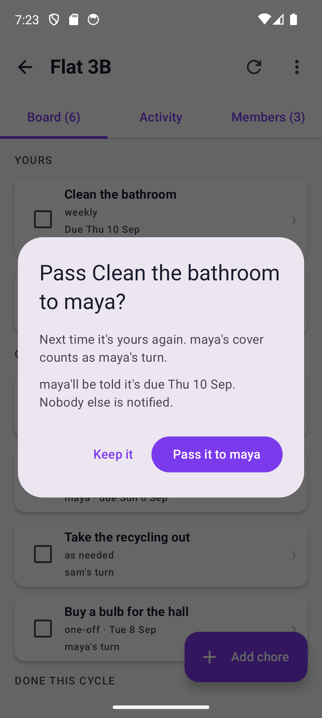
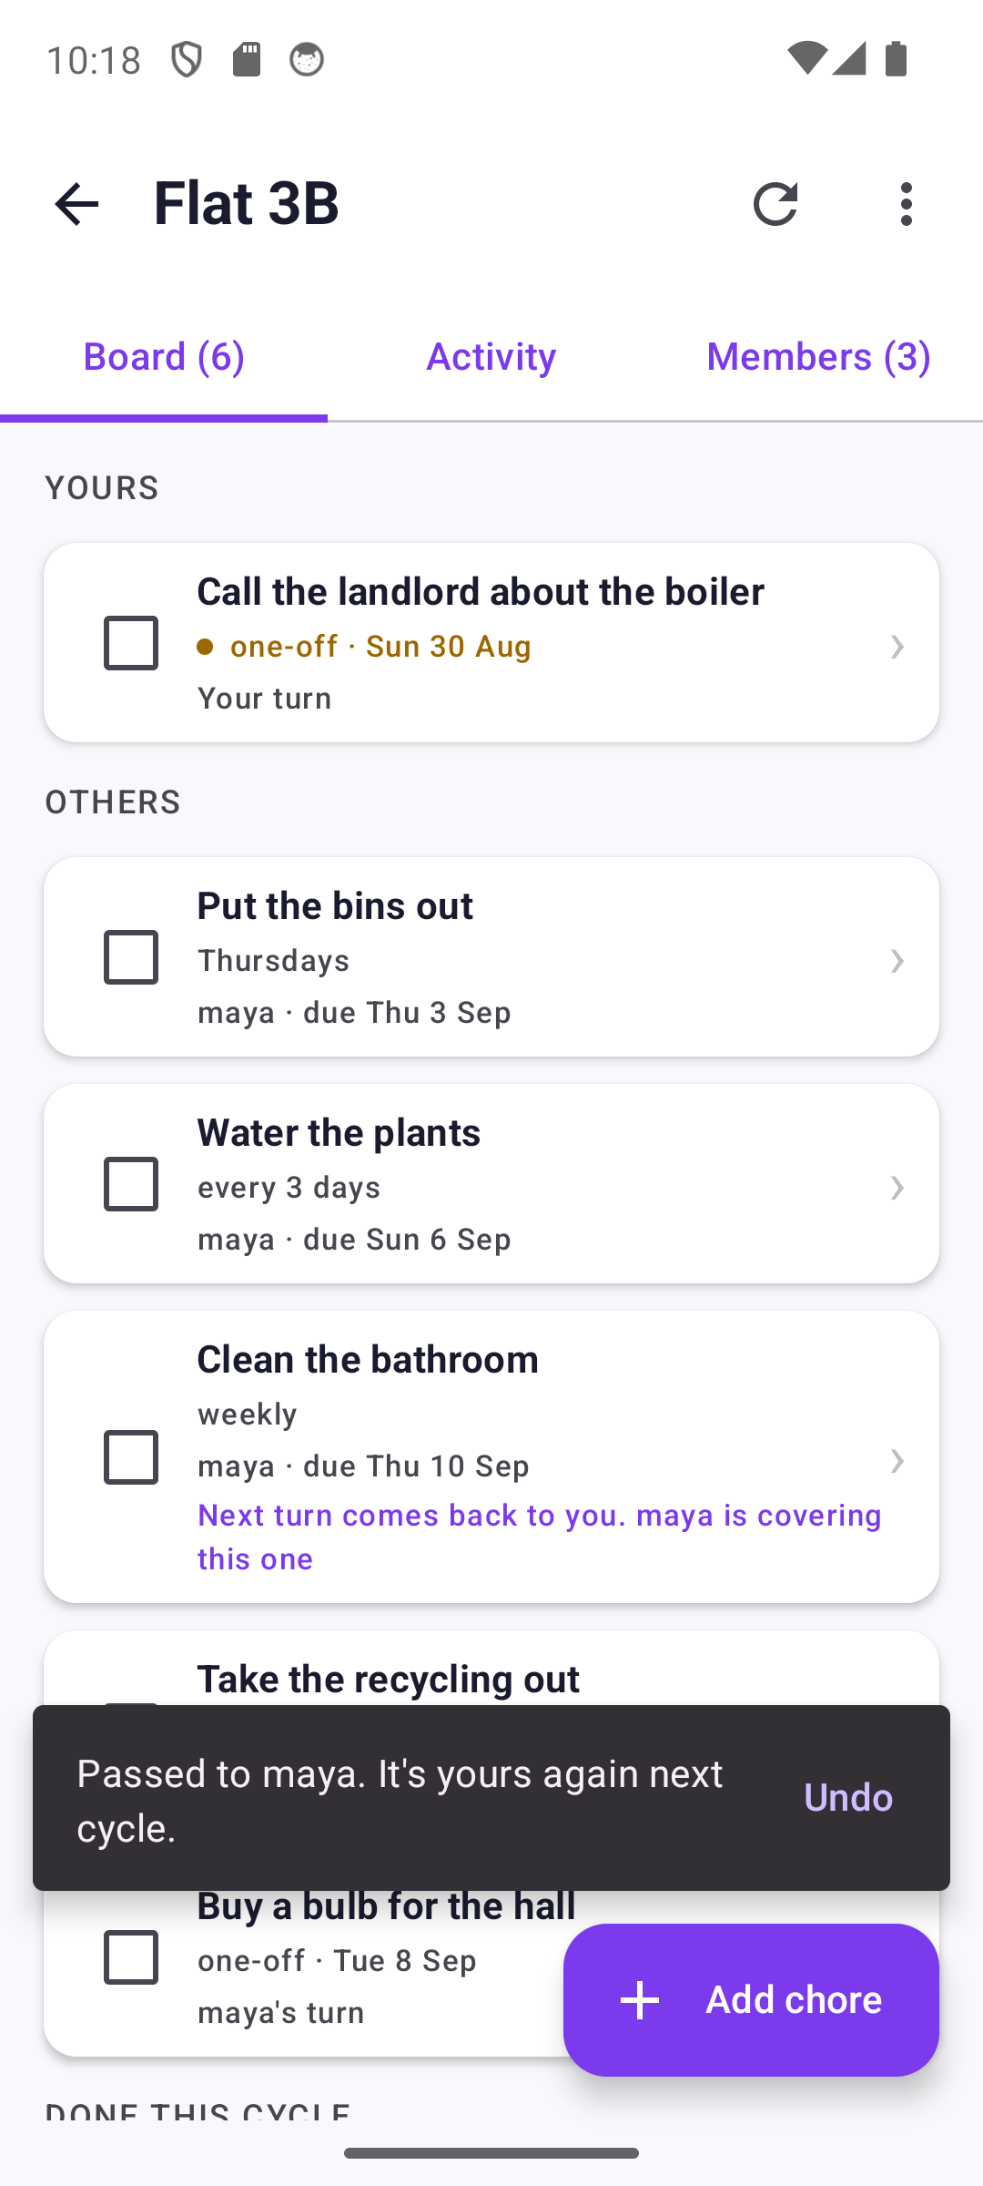
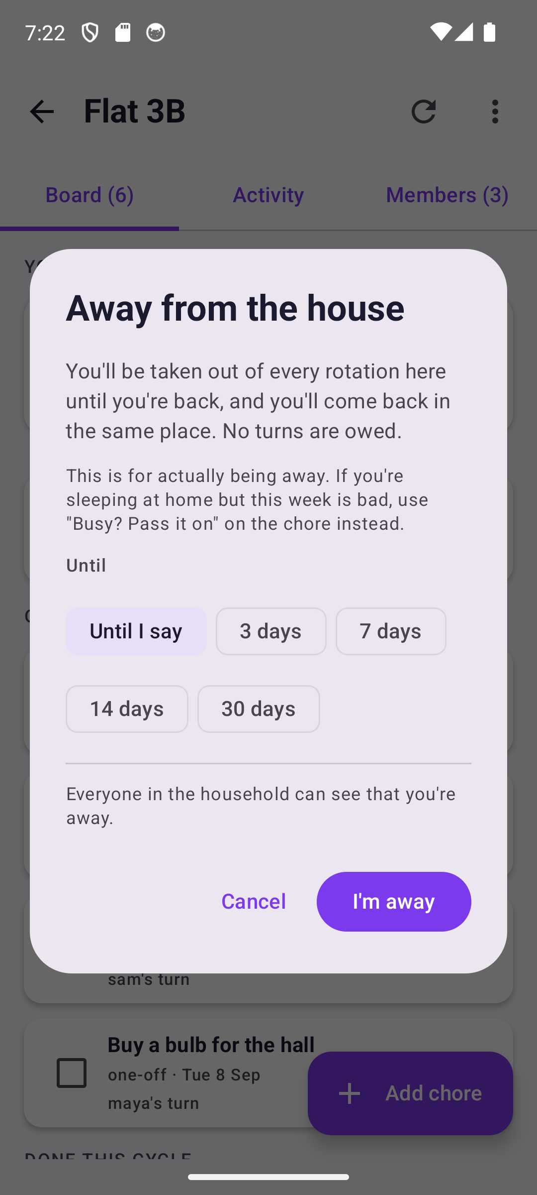
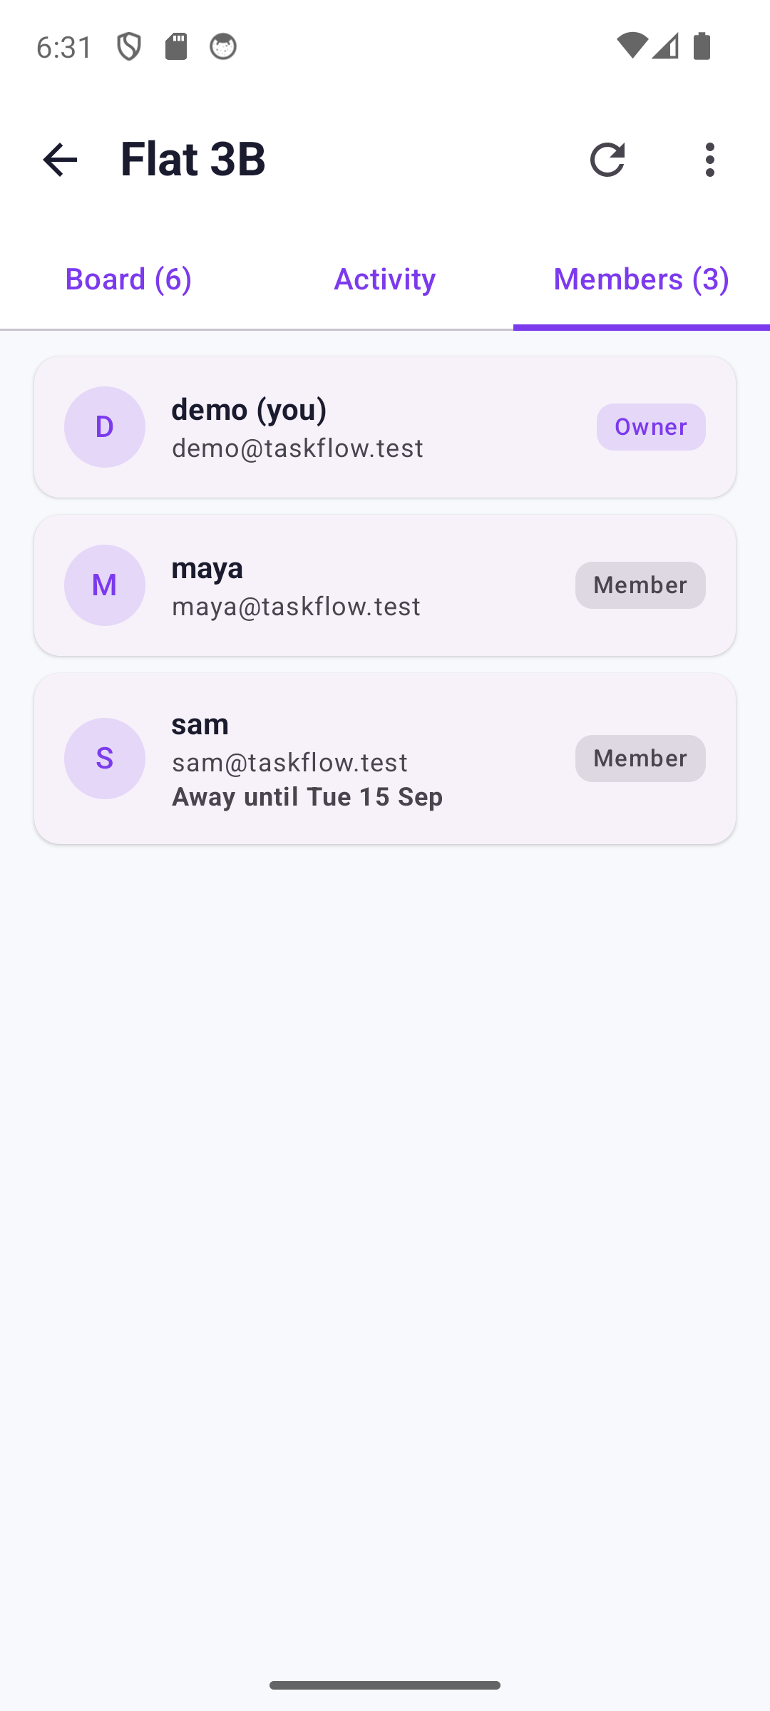
Busy, away, and whose turn
The only two exits from a turn besides doing it. Neither cancels what you owe.
Passing it on
After the pass
Going away
The household
Says who is told, and that nobody else is
It moves, it returns next cycle, and Undo catches a mis-swipe
States the rule before you commit
Away is shown; a pass never is

Slide 7
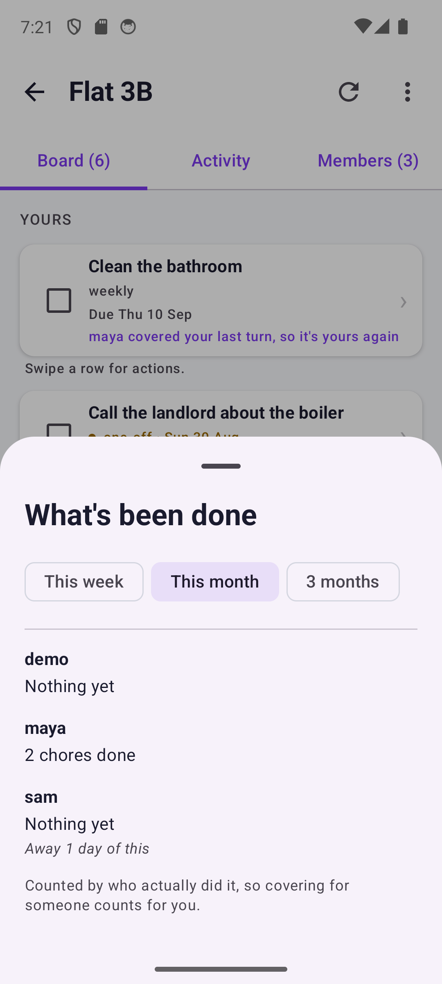
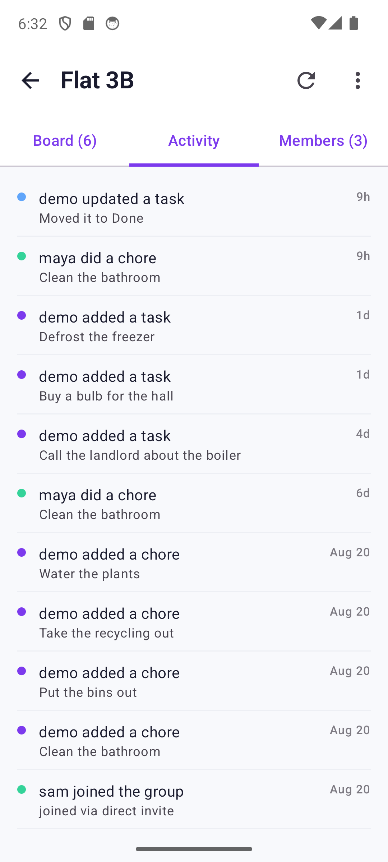
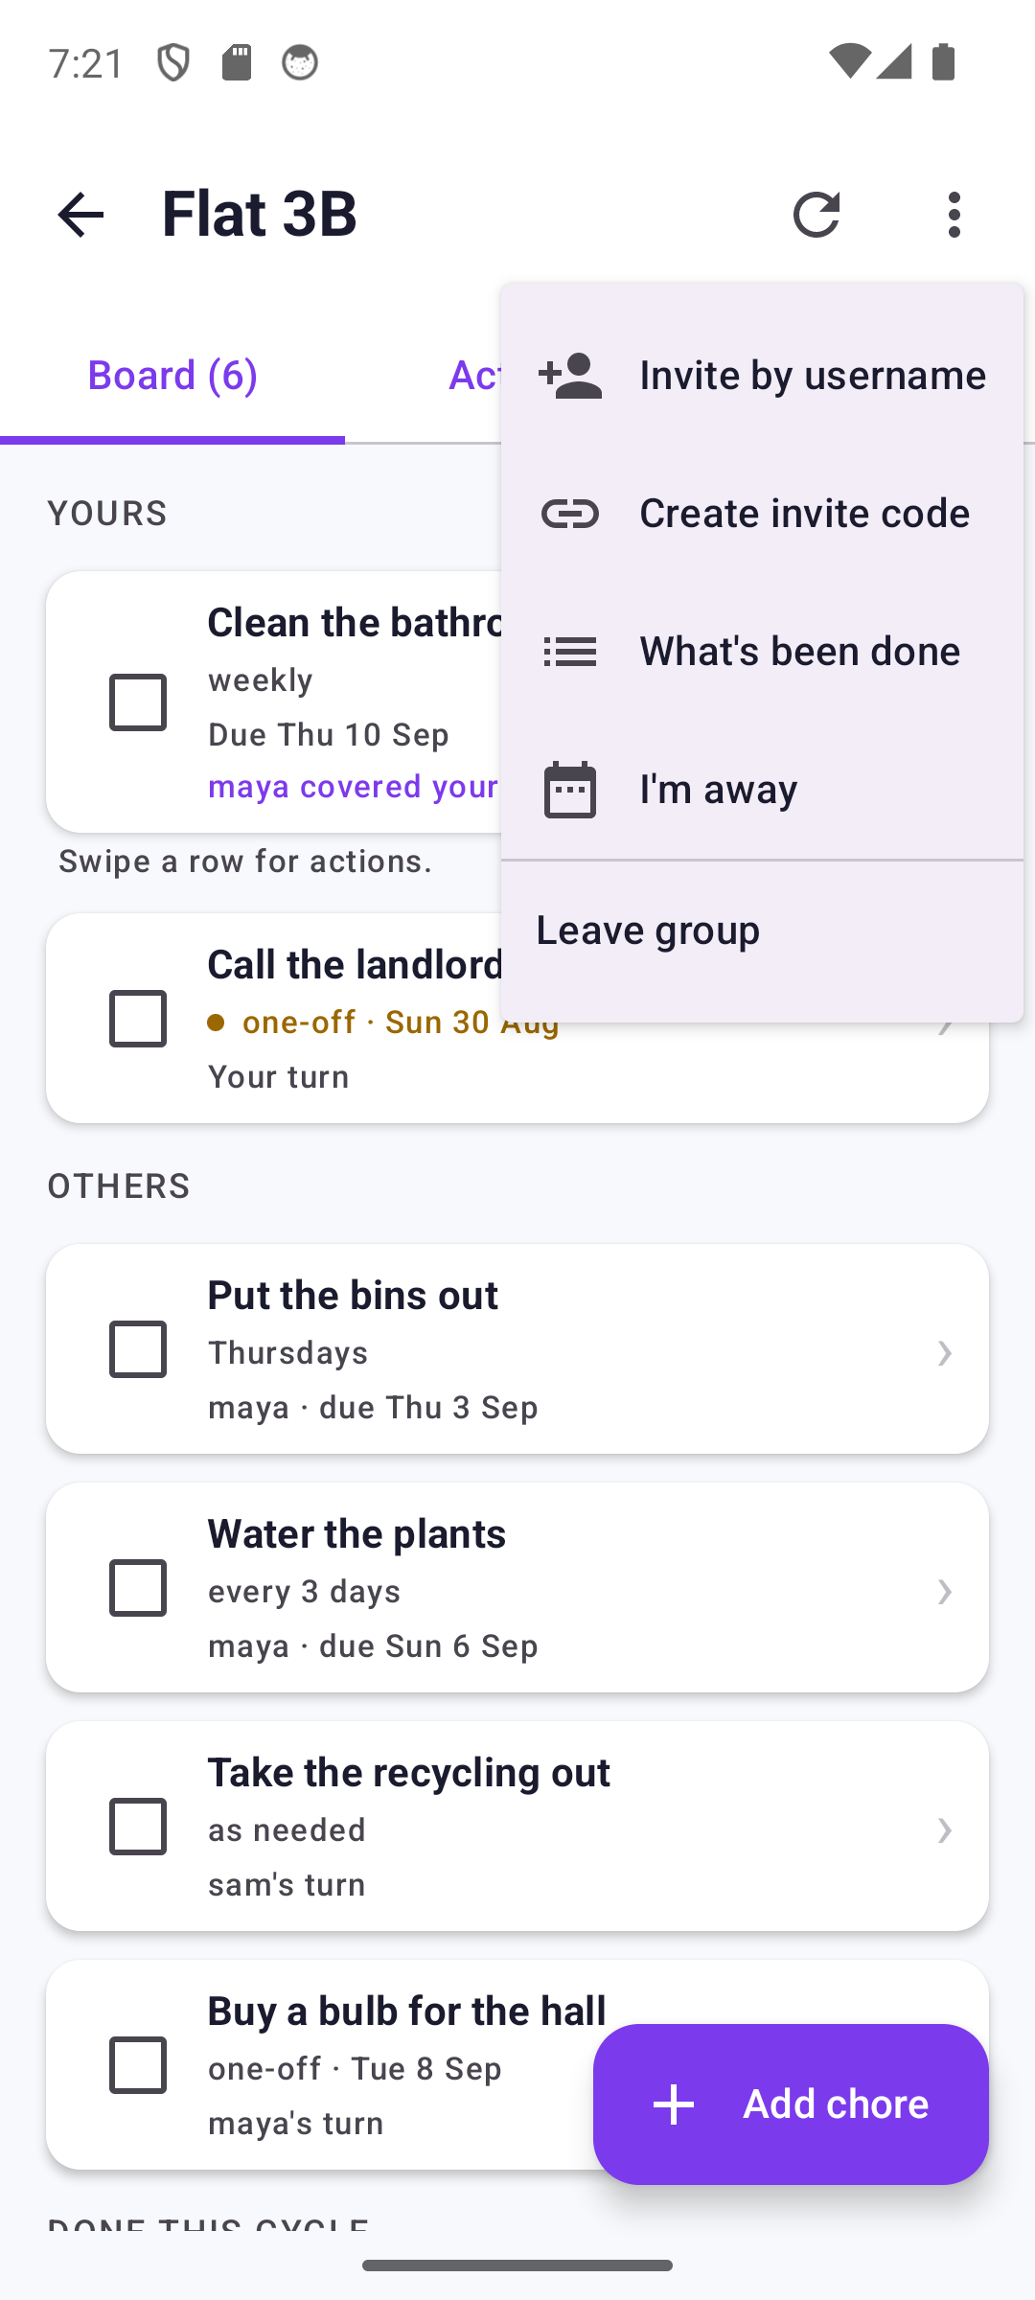
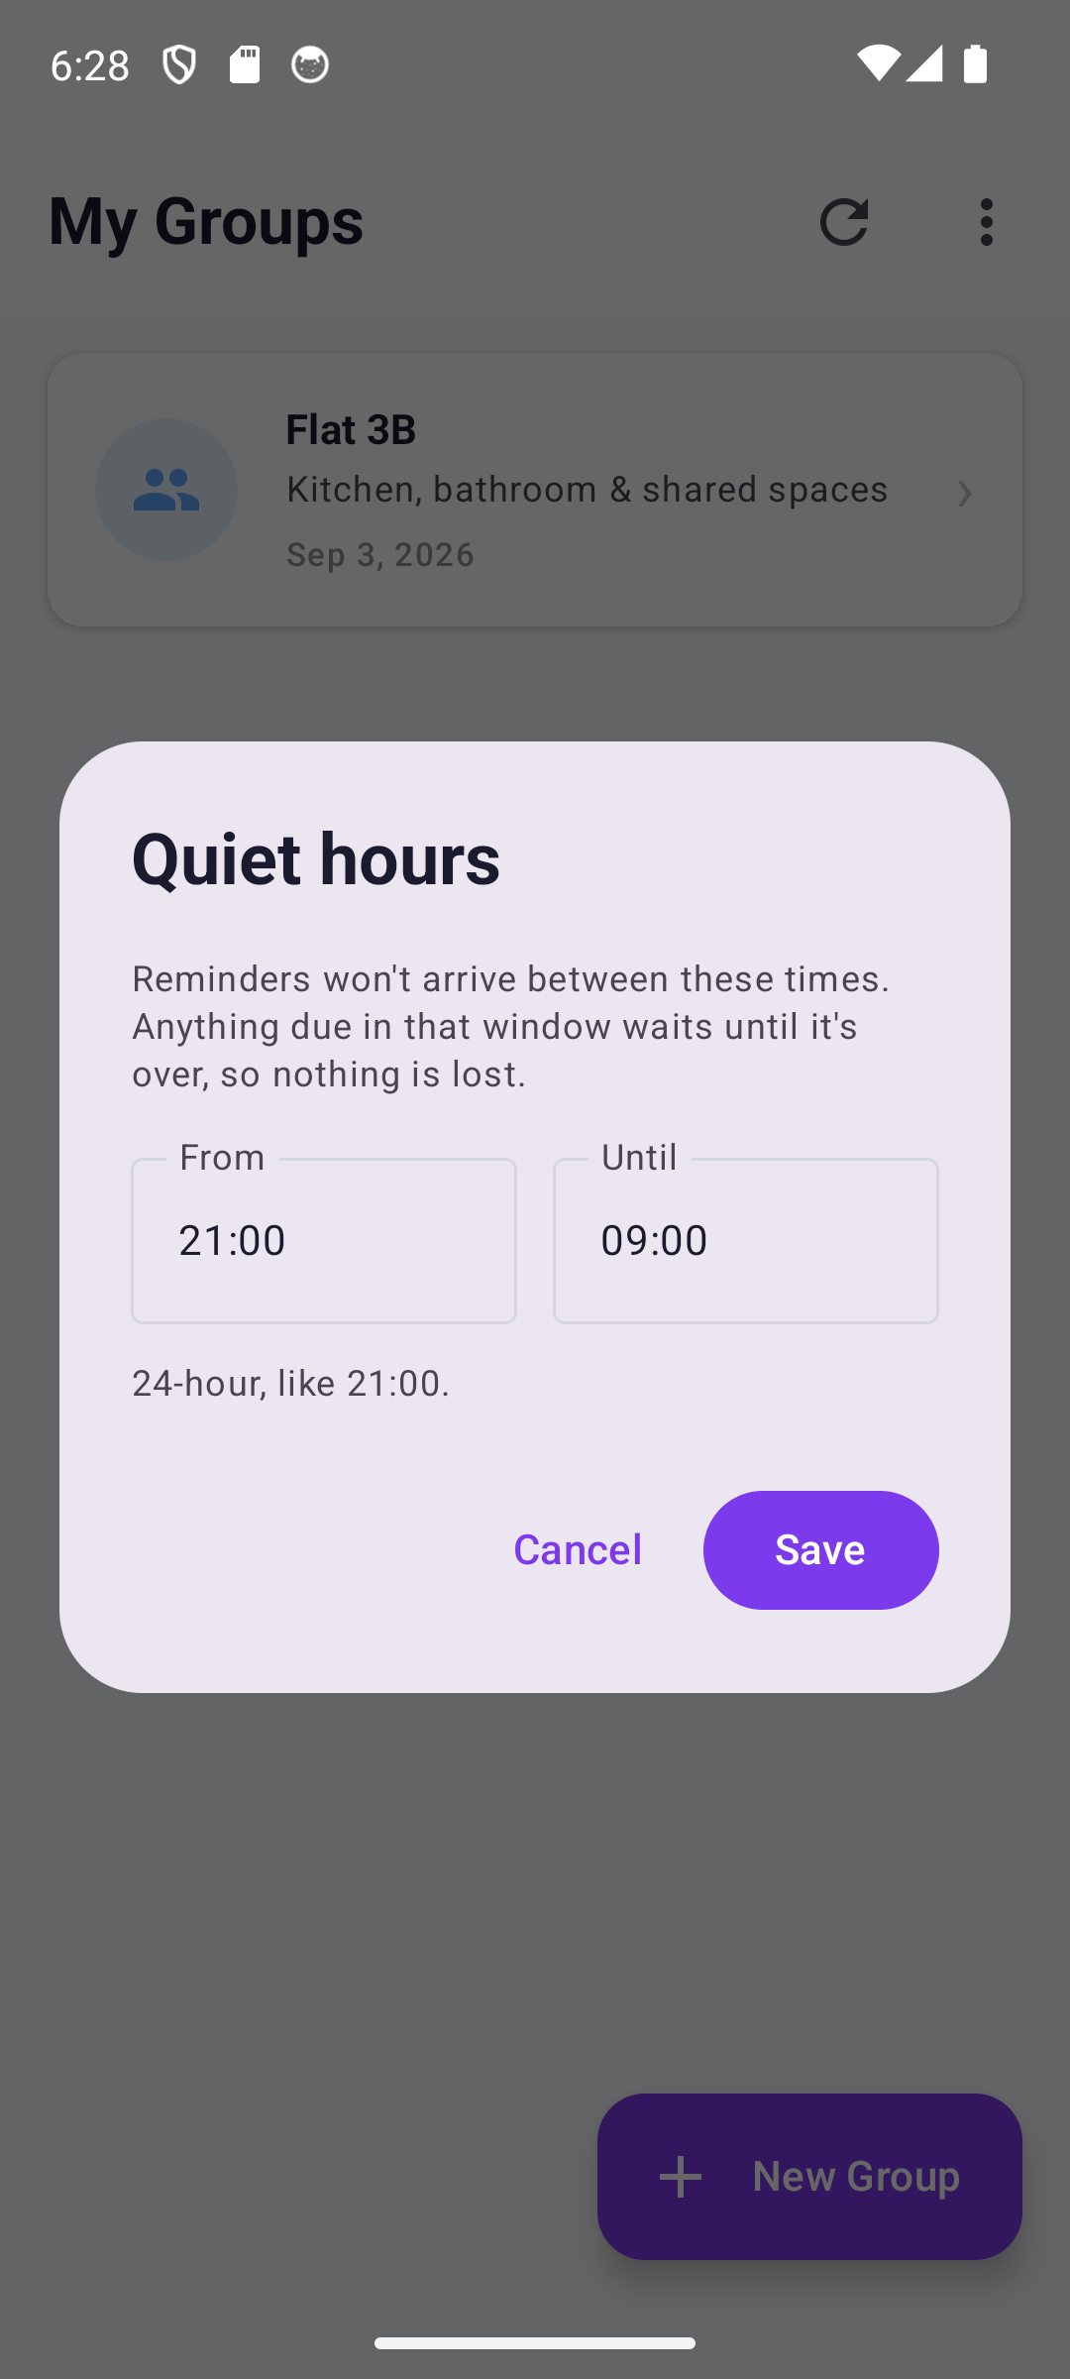
What has happened
A record the household can point at. It counts, it does not rank, and it names no one as late.
What's been done
Activity
The group's menu
Quiet hours
Counts, zeroes included, days away noted
Every group-visible change, in words
Inviting, the record, and going away
Held, not dropped: nothing is lost

Slide 8
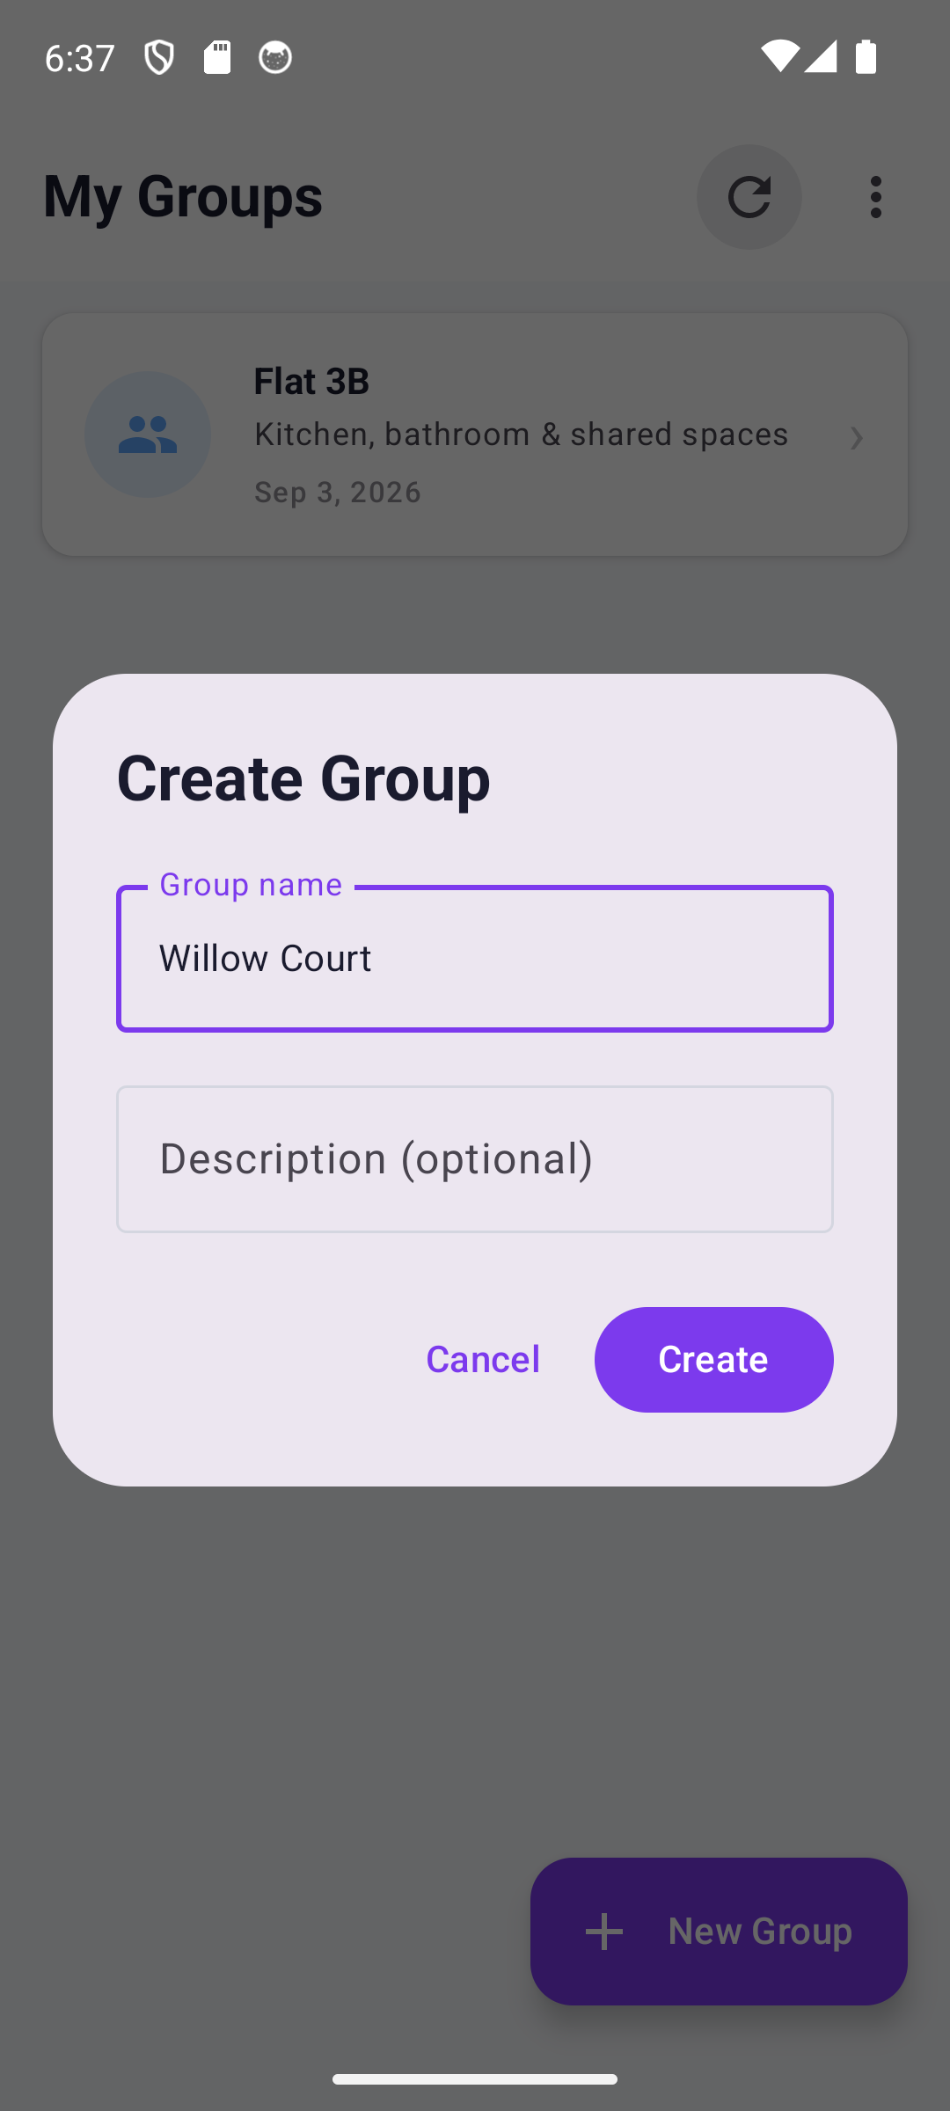
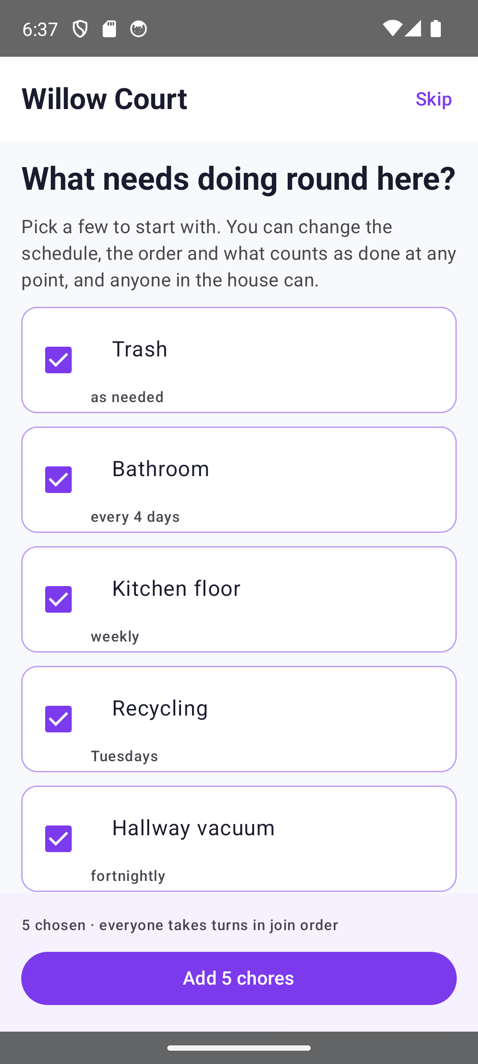
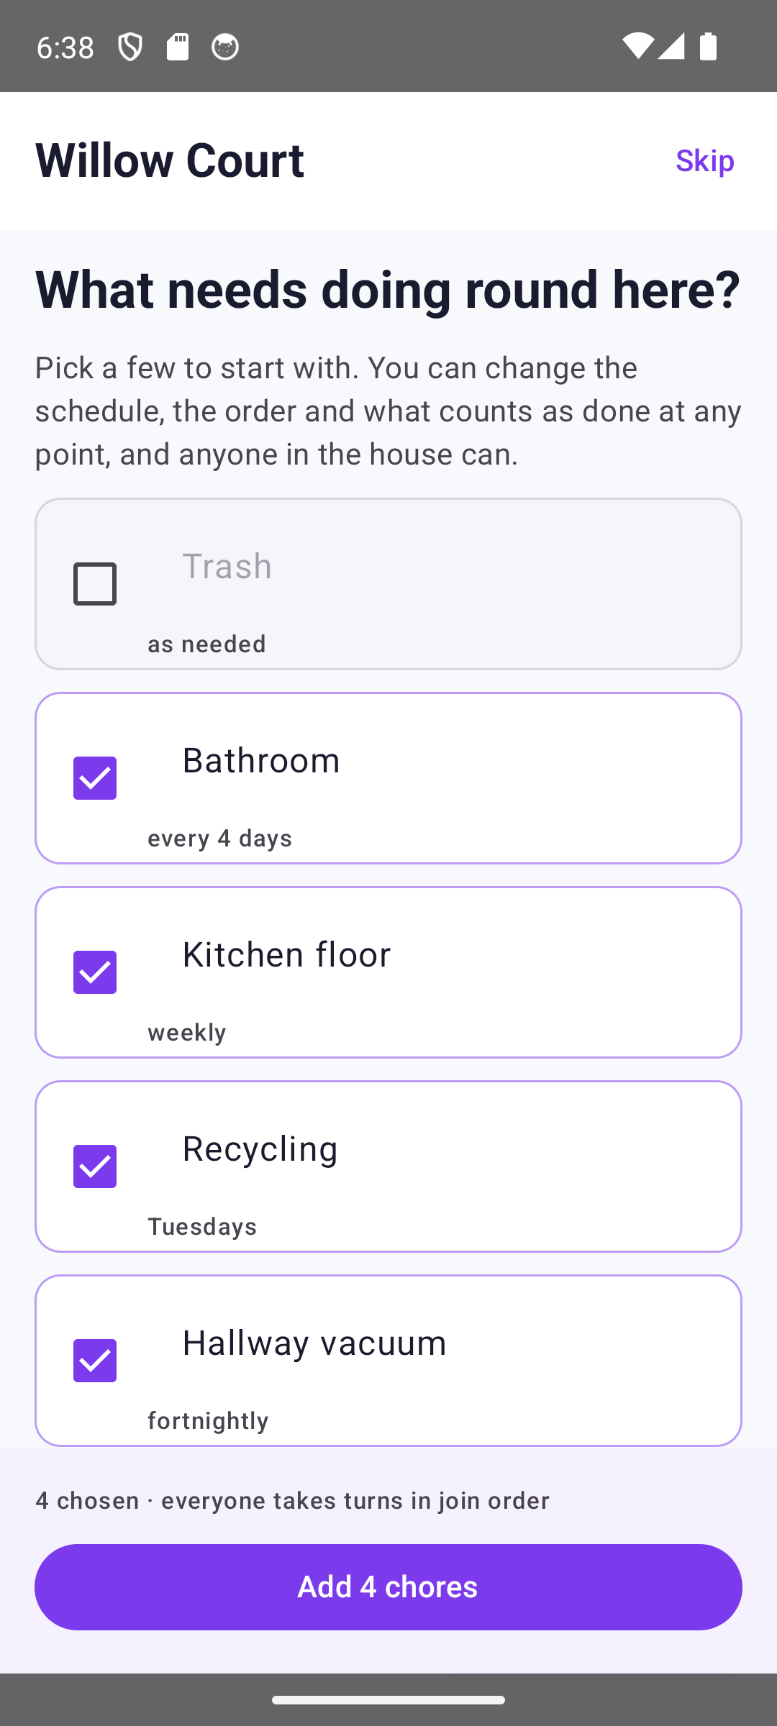
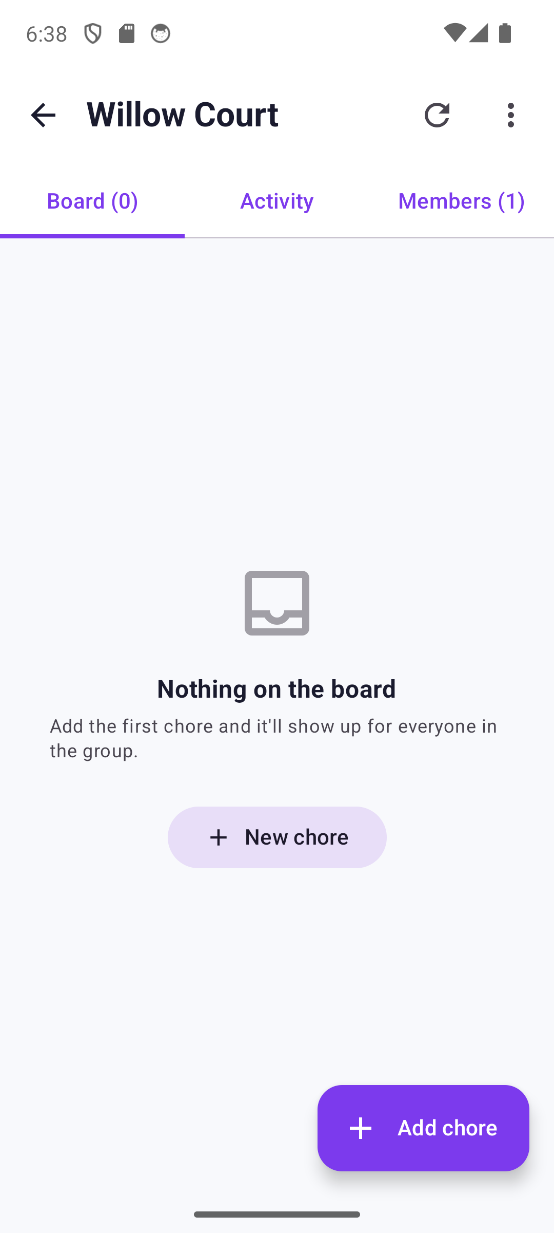
A household that has just started
An empty board teaches nothing, so a new group is offered chores to argue with rather than a blank page.
Naming the household
Five to start with
Take one off
Or skip entirely
Two fields, one of them optional
Renameable, because names are local
The count follows what you actually chose
The empty board says what to do next

Slide 9
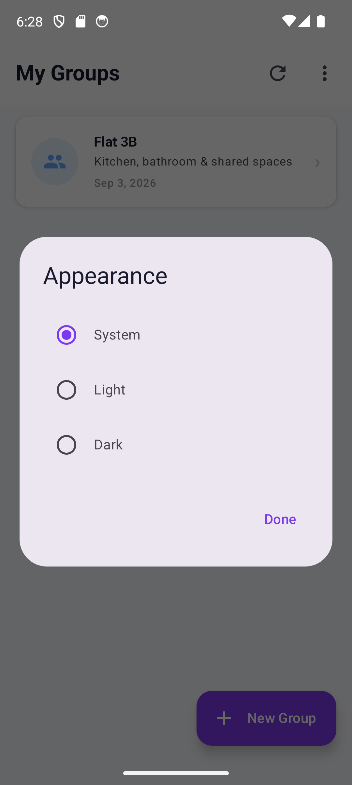
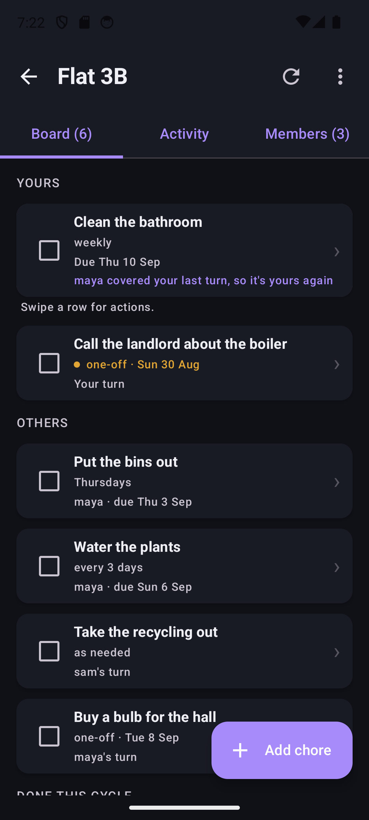
Light or dark, the household's choice
One setting per phone. The overdue amber is picked from the theme, so it stays legible in either.
Appearance
The board in dark
System, light or dark; kept on the device
Amber still amber; still nothing red

