Slide 1
A Geometric Economic Forecast Model
Jan., 2020

Slide 2
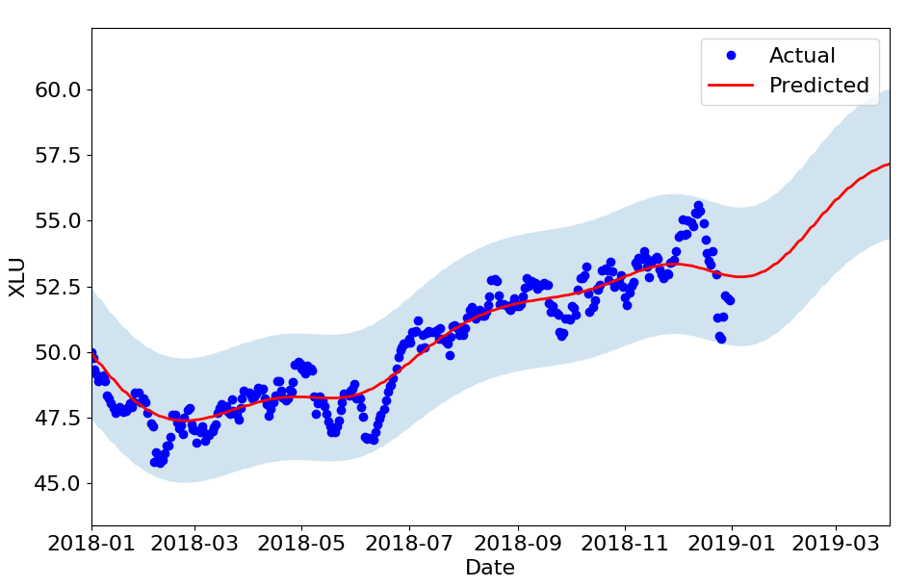
XLU ~ A0 + A1 * SP500 + A2 * 30-Year-T-Bond
Training data
Macro economic factors unknown

Slide 3
Background
Prediction of macro economic data:
  Qualitative approaches
  Blue Chip Economic Indicators
    Forecasts of several indicators including GDP, S&P500
  Blue Chip Financial Forecasts:
    Forecasts of interest rates
Based on surveys: Polls top US business economists

Slide 4
Economic Universe
Can we relax dependence on rather qualitative forecasts of macro economic drivers?
Logical relationship between economic data, as opposed to causal connections:
  No concept of economic drivers
  Instead, look for a structure/pattern in co-varying of economic signals

Slide 5
January 2018
December 2018

Slide 6
Economic path

Slide 7
Economic Universe
This can be generalized to any dimension
Economy as a multi-dimensional space with hundreds of dimensions:
  Macro economic factors
  Price of ETFs, funds, etc...
  Price of futures contracts
  Price of options
This is an economic universe

Slide 8
Learning about structure of economic universe by studying observed economic path, i.e. historical data of its dimensions

Slide 9
Economic Universe as a Manifold
Can we study the structure of this economic universe?
  Differential geometry
  Concept of Manifolds

Slide 10
Manifolds
Intuitively, a manifold is a space equipped with a measure of distance, a metric.
B
A
Shortest path: geodesic
A flat space: zero curvature

Slide 11
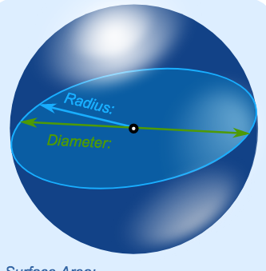
Curved Manifolds
B
A
Shortest path: geodesic
A curved space: non-zero curvature

Slide 12
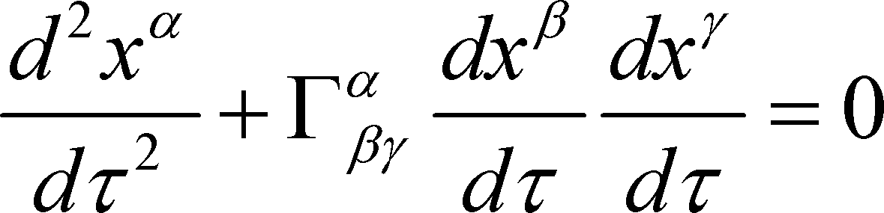
Economic Manifold
Can we find a manifold for which the “economic path” is a geodesic?

Slide 13
Economic Manifold
We find the manifold, that is we estimate the metric structure based on past data
Then we can forecast the future of economic path by solving a differential equation

Slide 14
Example
As an example, built a 31-dim model:
  15 indices
  11 ETFs
  7 futures contract
Training data:
  Intraday, minute-based
  Jan. 01 2017 – Dec. 31, 2017
  Tested on out-of-sample data for 3 days

Slide 15
ETFs
QQQ: PowerShares QQQ
SPY: SPDR S&P 500 Growth ETF
DIA: SPDR Dow Jones Industrial Average ETF
MDY: SPDR S&P MidCap 400 ETF
IWM: iShares Russell 2000 Index Fund
OIH: Market Vectors Oil Services ETF
SMH: Market Vectors Semiconductor ETF
XLE: Energy Select Sector SPDR Fund
XLF: Financial Select Sector SPDR Fund
XLU: Utilities Select Sector SPDR Fund
EWJ: iShares MSCI Japan Index Fund

Slide 16
Indices
INDU: Dow Jones Industrial Average
NDX: Nasdaq 100 Index
SPX: S&P 500 Index
COMPX: Nasdaq Composite Index
RUT: Russell 2000 Index
OEX: S&P 100 Index
MID: S&P 400 Midcap Index
SOX: PHLX Semiconductor Sector Index
RUI: Russell 1000 Index
RUA: Russell 3000 Index
TRAN: Dow Jones Transportation Average
HGX: PHLX Housing Sector Index
TYX: 30-Year Treasury Bond
HUI: NYSE Arca Gold BUGS Index
XAU: PHLX Gold/Silver Sector Index

Slide 17
Futures
ES: E-mini S&P 500 Continuous Contract
NQ: E-mini Nasdaq 100 Continuous Contract
YM: E-mini Dow Futures Continuous Contract
RTY: E-mini Russell 2000 Continuous Contract
EMD: E-mini S&P MidCap 400 Continuous Contract
QM: E-mini Crude Oil Futures Continuous Contract
US: 30 Year U.S. Treasury Bonds Continuous Contract

Slide 18
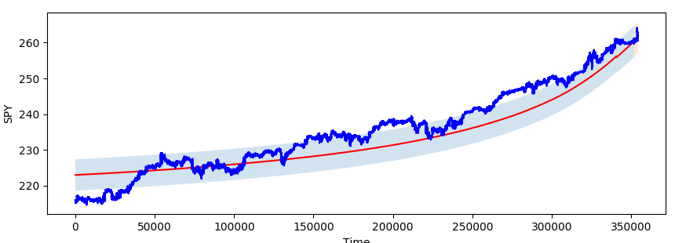
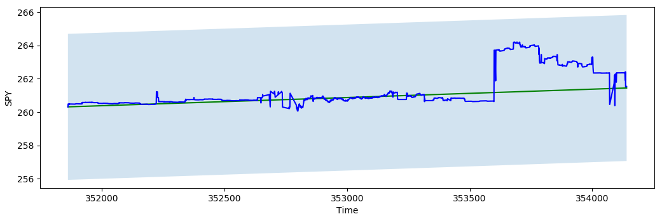
SPY
Out of sample: 3 days
Minutes

Slide 19
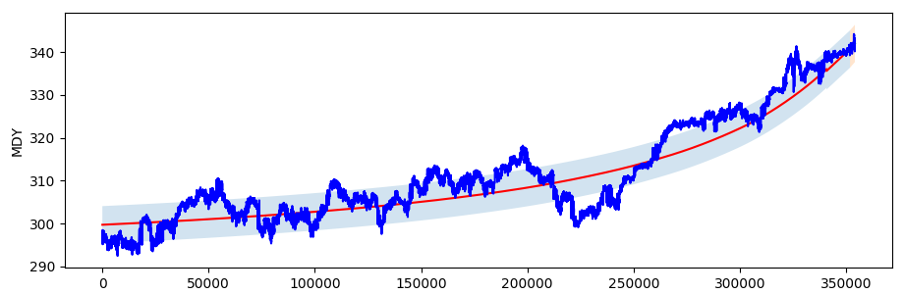
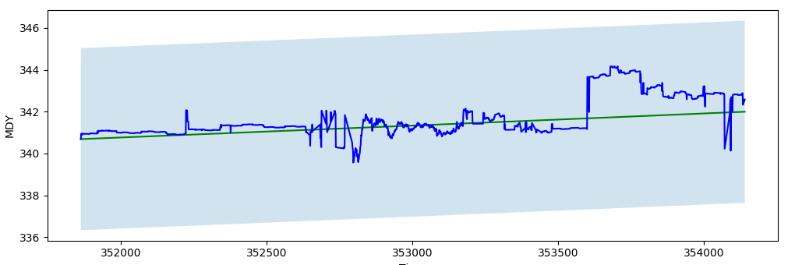
MDY
Out of sample: 3 days
Minutes

Slide 20
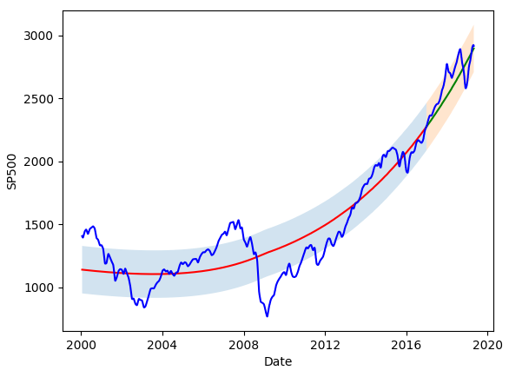
Long-Term Models

Slide 21
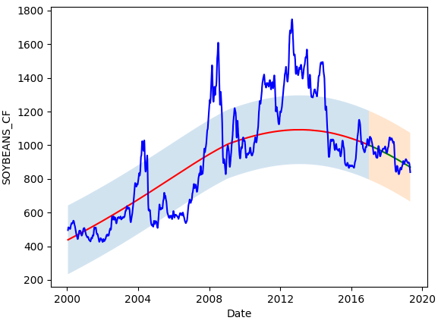
Long-Term Models

Slide 22
Applications
Can be used to forecast macro economic indices
Can be used to build trading models

Slide 23
Proposed Trading Algorithm
We can build models to predict trends of security prices
This helps us decide on taking long or short positions
Proposed algorithm:
  Minimize Mean Absolute Deviation (MAD) of portfolio
    This minimizes portfolio 'historical' volatility
  Use trends predicted as constraints of optimization

Slide 24
Definition of Return
Price of asset i at time t

Slide 25
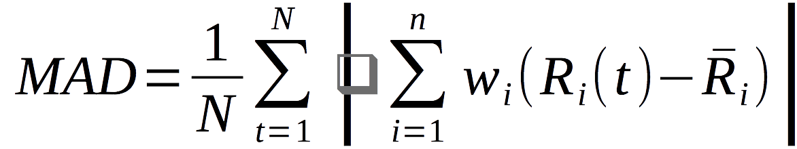
Definition of MAD
Number of assets
Number of times in data
Portfolio weight for asset i
Return on asset i at time t

Slide 26
1) A model is built on a daily basis:
    27 ETFs, 7 future contracts
2) A portfolio of these 11 ETFs, daily, by minimizing MAD, subject to the trend constraints.
    A distinct set of portfolio weights (long or short positions) is calculated everyday
    Portfolio is adjusted once a day
Current Date
2017-01-15
2018-01-15
2018-01-18
Training Data
Oos
Forecast
Past Data
Future

Slide 27
AGQ ProShares Ultra Silver
BIB ProShares Ultra Nasdaq Biotechnology
BOIL ProShares Ultra Bloomberg Natural Gas
DDM ProShares Ultra Dow30
DIG ProShares Ultra Oil & Gas
ERX Direxion Daily Energy Bull 3X ETF
FINU ProShares UltraPro Financial Select Sect
MVV ProShares Ultra MidCap400
ROM ProShares Ultra Technology
RXL ProShares Ultra Health Care
SAA ProShares Ultra SmallCap600
SPY SPDR S&P 500 ETF
TQQQ ProShares UltraPro QQQ
UBT ProShares Ultra 20+ Year Treasury
UCC ProShares Ultra Consumer Services
UCO ProShares Ultra DJ-AIG Crude Oi
UGE ProShares Ultra Consumer Goods
UGL ProShares Ultra Gold
UJB ProShares Ultra High Yield
UPW ProShares Ultra Utilities
URE ProShares Ultra Real Estate
USD ProShares Ultra Semiconductors
UST ProShares Ultra 7-10 Year Treasury
UWM ProShares Ultra Russell2000
UXI ProShares Ultra Industrials
UYG ProShares Ultra Financials
UYM ProShares Ultra Basic Materials

Slide 28
Futures
ES: E-mini S&P 500 Continuous Contract
NQ: E-mini Nasdaq 100 Continuous Contract
YM: E-mini Dow Futures Continuous Contract
RTY: E-mini Russell 2000 Continuous Contract
EMD: E-mini S&P MidCap 400 Continuous Contract
QM: E-mini Crude Oil Futures Continuous Contract
US: 30 Year U.S. Treasury Bonds Continuous Contract

Slide 29
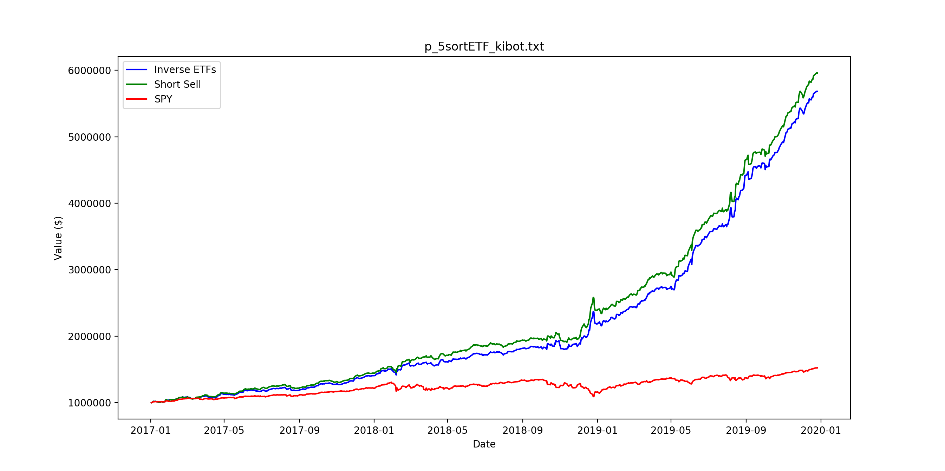
Mean daily return: 0.24%
Standard deviation: 0.73%

Slide 30
Statistical Analysis
Mean daily return: 0.24%
Standard deviation: 0.73%
Rate of positive daily returns: 64.7%
Rate of successful trend predictions: 62.7%

Slide 31

Automation
1) An automated ecosystem is setup on Google cloud
  Reading updated historical data from a data provider
    www.kibot.com
  Building the model shortly before markets open
  Optimizing to get portfolio weights
2) A script is developed that reads the portfolio weights from cloud and implements them in E-Trade

Slide 32
Practical Issues
Value of an asset: price of latest trade
When adjusting portfolio bid/ask prices

