Slide 1
A Manifold Based Economic Forecast Model
Nov. 01, 2019

Slide 2
Three Trading Strategies
1) Minimize Mean Absolute Deviation of portfolio
    MAD measures portfolio volatility
    Builds a portfolio
    Automated-Trading.txt (lines 12-53)
2) Use Moving Average Convergence / Divergence
    MACD measures velocity of security price
    Helps make a decision: long vs. short
    Automated-Trading.txt (lines 59-127)
3) Use Mean and Std. Dev. of last 20 days
    MSDEV
    Helps detect under / over priced : long / short
    Etrade.txt

Slide 3
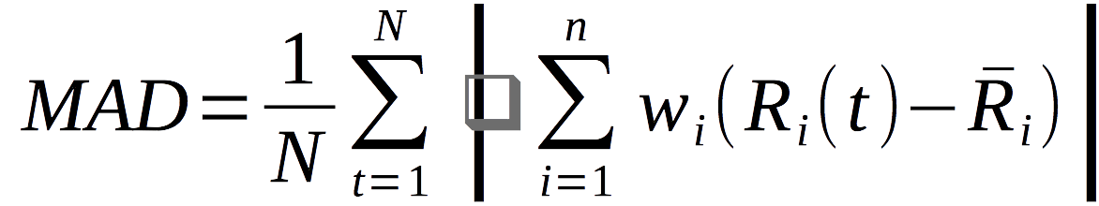
1) Definition of MAD
Number of assets
Number of times in data
Portfolio weight for asset i
Return on asset i at time t
Mean Absolute Deviation

Slide 4
Definition of Return
Price of asset i at time t

Slide 5
2) Definition of MACD
Exponential moving average
Fast period
(short-term)
Slow period
(long-term)
EMA of MACD
Price
Price
Moving Average Convergence / Divergence

Slide 6
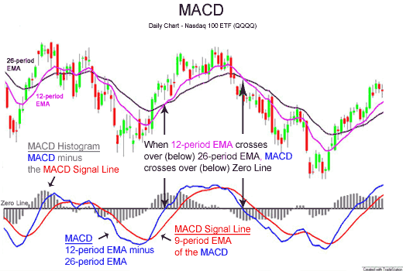
en.wikipedia.org/wiki/MACD

Slide 7
2) MACD strategy
Close position if it is long and
Price
Long with a fixed predefined quantity if position = 0 and
Price

Slide 8
3) Mean and Standard Deviation
Number of times
Mean
Variance
Standard Deviation

Slide 9
3) MSDEV strategy
Long if under-priced:
Short if over-priced:

Slide 10
Backtesting
Backtested using Quantopian:
www.quantopian.com
Provides a python based API for backtesting
The API resembles the old API of E-Trade
    E-Trade has now moved to a REST API

Slide 11
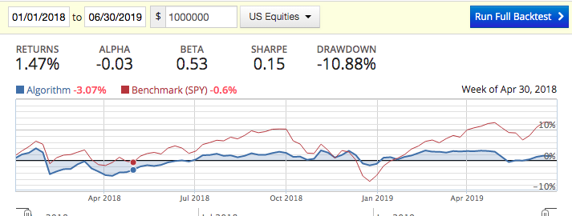
1) MAD minimization Results
Minimizing MAD, 11 ETFs
First half of 2018, comparison to SPY

Slide 12
ETFs
QQQ: PowerShares QQQ
SPY: SPDR S&P 500 Growth ETF
DIA: SPDR Dow Jones Industrial Average ETF
MDY: SPDR S&P MidCap 400 ETF
IWM: iShares Russell 2000 Index Fund
OIH: Market Vectors Oil Services ETF
SMH: Market Vectors Semiconductor ETF
XLE: Energy Select Sector SPDR Fund
XLF: Financial Select Sector SPDR Fund
XLU: Utilities Select Sector SPDR Fund
EWJ: iShares MSCI Japan Index Fund

Slide 13
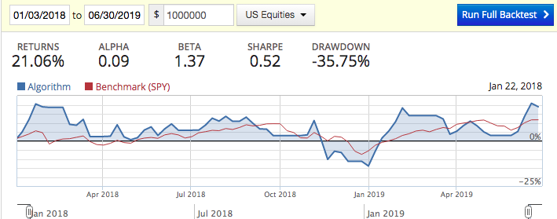
2) MACD Results
Trade SPY, short/long based on MACD
First half of 2018, comparison to SPY

Slide 14
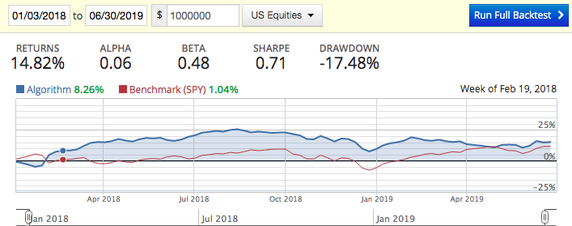
3) Mean/Std. Dev. Results
Trade SPY, short/long based on mean and standard deviation
First half of 2018, comparison to SPY

Slide 15
An Economic Forecast Model

Slide 16
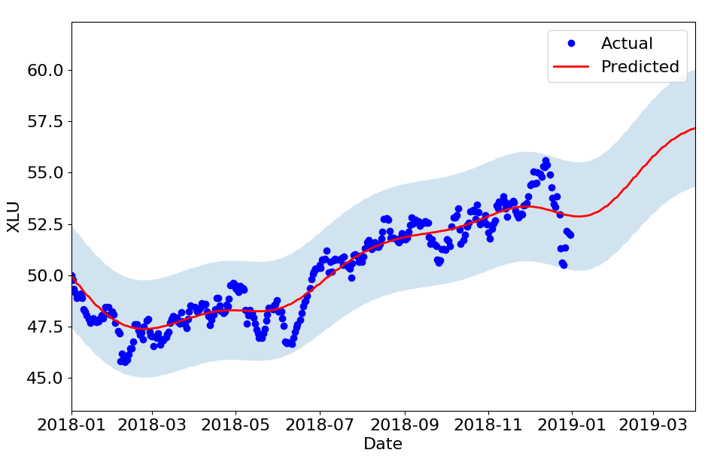
XLU ~ A0 + A1 * SP500 + A2 * 30-Year-T-Bond
Training data
Macro economic factors unknown

Slide 17
Background
Prediction of macro economic data:
  Qualitative approaches
  Blue Chip Economic Indicators
    Forecasts of several indicators including GDP, S&P500
  Blue Chip Financial Forecasts:
    Forecasts of interest rates
Based on surveys: Polls top US business economists

Slide 18
Economic Universe
Can we relax dependence on rather qualitative forecasts of macro economic drivers?
Logical relationship between economic data, as opposed to causal connections:
  No concept of economic drivers
  Instead, look for a structure/pattern in co-varying of economic signals

Slide 19
January 2018
December 2018

Slide 20
Economic path

Slide 21
Economic Universe
This can be generalized to any dimension
Economy as a multi-dimensional space with hundreds of dimensions:
  Macro economic factors
  Price of ETFs, funds, etc...
  Price of futures contracts
  Price of options
This is an economic universe

Slide 22
Learning about structure of economic universe by studying observed economic path, i.e. historical data of its dimensions

Slide 23
Economic Universe as a Manifold
Can we study the structure of this economic universe?
  Differential geometry
  Concept of Manifolds

Slide 24
Manifolds
Intuitively, a manifold is a space equipped with a measure of distance, a metric.
B
A
Shortest path: geodesic
A flat space: zero curvature

Slide 25
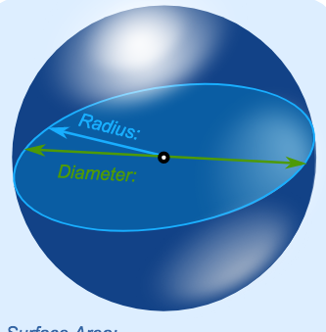
Curved Manifolds
B
A
Shortest path: geodesic
A curved space: non-zero curvature

Slide 26
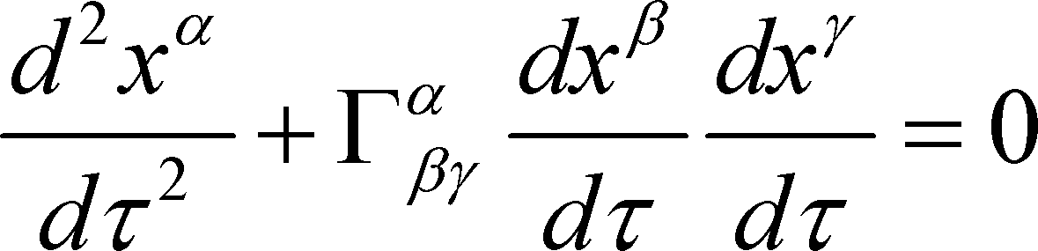
Economic Manifold
Can we find a manifold for which the “economic path” is a geodesic?

Slide 27
Economic Manifold
We find the manifold, that is we estimate the metric structure based on past data
Then we can forecast the future of economic path by solving a differential equation

Slide 28
Example
As an example, built a 31-dim model:
  15 indices
  11 ETFs
  7 futures contract
Training data:
  Intraday, minute-based
  Jan. 01 2017 – Dec. 31, 2017
  Tested on out-of-sample data for 3 days

Slide 29
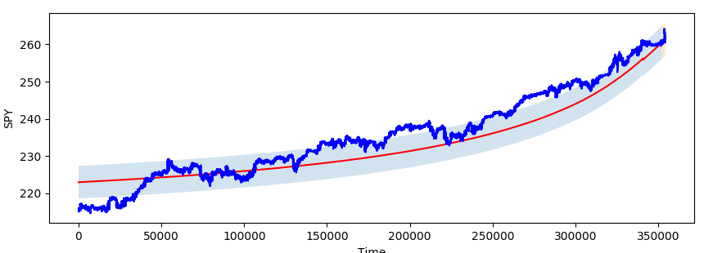
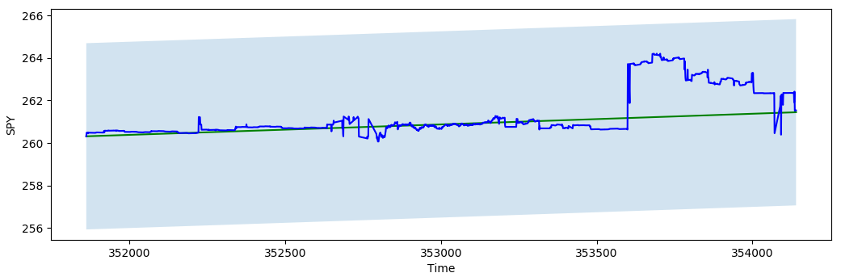
SPY
Out of sample: 3 days
Minutes

Slide 30
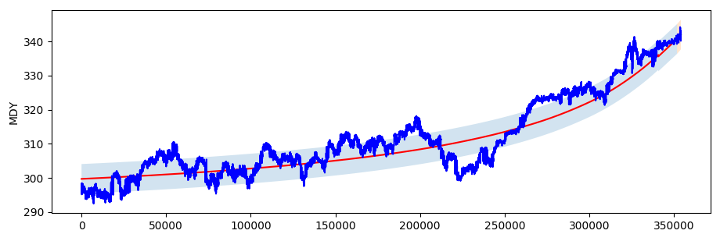
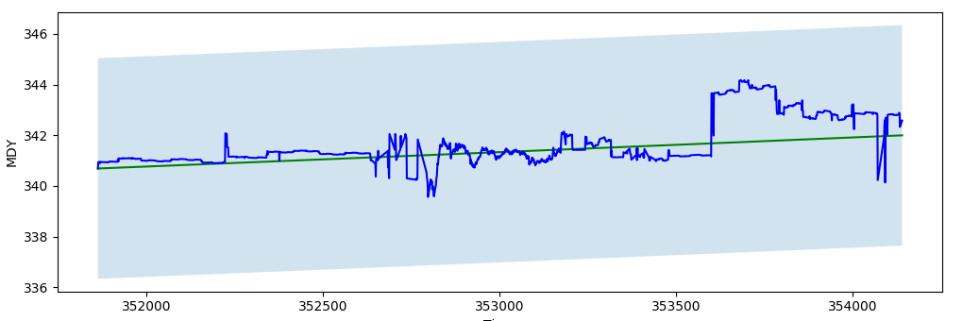
MDY
Out of sample: 3 days
Minutes

Slide 31
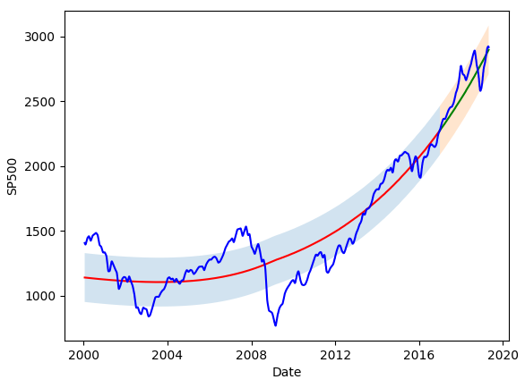
Long-Term Models

Slide 32
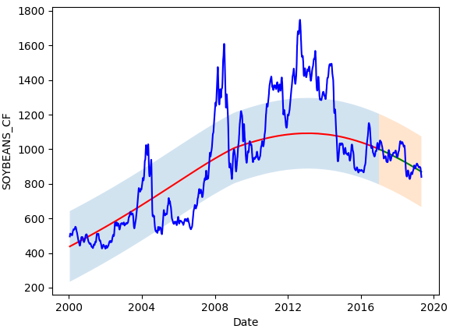
Long-Term Models

Slide 33
Applications
Can be used to forecast macro economic indices
Can be used to build trading models

Slide 34
Proposed Trading Algorithm
We can build models to predict trends of security prices
This helps us decide on taking long or short positions
Proposed algorithm:
  Minimize Mean Absolute Deviation (MAD) of portfolio
    This minimizes portfolio volatility
  Use trends predicted as constraints of optimization

Slide 35
Definition of MAD
Number of assets
Number of times in data
Portfolio weight for asset i
Return on asset i at time t

Slide 36
Definition of Return
Price of asset i at time t

Slide 37
1) A model is built on a daily basis:
    11 ETFs, 15 indices, 7 future contracts
2) A portfolio of these 11 ETFs, daily, by minimizing MAD, subject to the trend constraints.
    A distinct set of portfolio weights (long or short positions) is calculated everyday
    Portfolio is adjusted once a day
Current Date
2017-01-15
2018-01-15
2018-01-18
Training Data
Oos
Forecast
Past Data
Future

Slide 38
Indices
INDU: Dow Jones Industrial Average
NDX: Nasdaq 100 Index
SPX: S&P 500 Index
COMPX: Nasdaq Composite Index
RUT: Russell 2000 Index
OEX: S&P 100 Index
MID: S&P 400 Midcap Index
SOX: PHLX Semiconductor Sector Index
RUI: Russell 1000 Index
RUA: Russell 3000 Index
TRAN: Dow Jones Transportation Average
HGX: PHLX Housing Sector Index
TYX: 30-Year Treasury Bond
HUI: NYSE Arca Gold BUGS Index
XAU: PHLX Gold/Silver Sector Index

Slide 39
ETFs
QQQ: PowerShares QQQ
SPY: SPDR S&P 500 Growth ETF
DIA: SPDR Dow Jones Industrial Average ETF
MDY: SPDR S&P MidCap 400 ETF
IWM: iShares Russell 2000 Index Fund
OIH: Market Vectors Oil Services ETF
SMH: Market Vectors Semiconductor ETF
XLE: Energy Select Sector SPDR Fund
XLF: Financial Select Sector SPDR Fund
XLU: Utilities Select Sector SPDR Fund
EWJ: iShares MSCI Japan Index Fund

Slide 40
Futures
ES: E-mini S&P 500 Continuous Contract
NQ: E-mini Nasdaq 100 Continuous Contract
YM: E-mini Dow Futures Continuous Contract
RTY: E-mini Russell 2000 Continuous Contract
EMD: E-mini S&P MidCap 400 Continuous Contract
QM: E-mini Crude Oil Futures Continuous Contract
US: 30 Year U.S. Treasury Bonds Continuous Contract

Slide 41
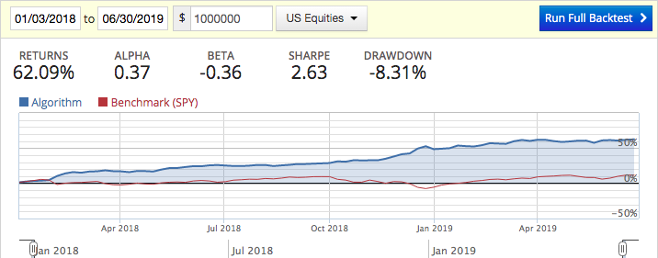
MAD + Manifold Model
January 2018 to July 2019, comparison to SPY
Backtested using www.quantopian.com
Good performance
Good performance

Slide 42
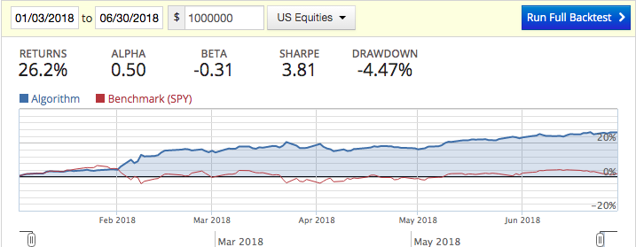
First half of 2018, comparison to SPY
Good performance, main boost

Slide 43
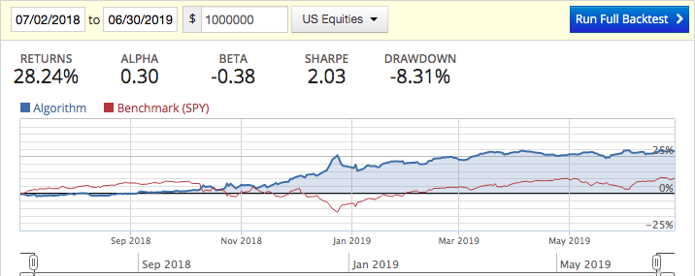
July 2018 to July 2019, comparison to SPY

Slide 44
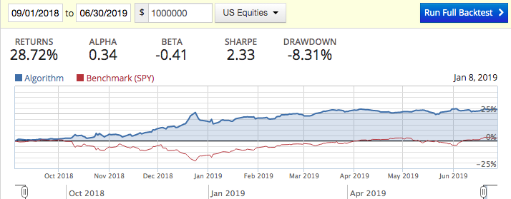
September 2018 to July 2019, comparison to SPY

Slide 45
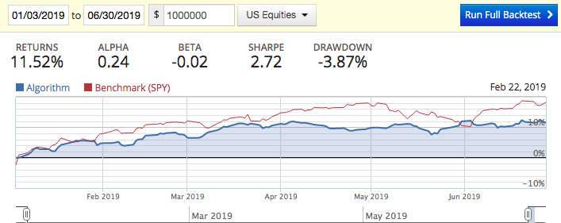
Some Bad Results :)
First half of 2019
Poor performance
Poor performance

Slide 46
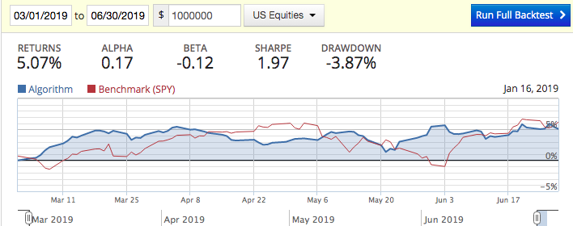
Second quarter of 2019

