Slide 1
Basic elements of a CUDA program

Slide 2
Basic steps of a CUDA program
Initialization of data from CPU
transfer data from CPU context to GPU context
Kernel launch with needed grid/block size
Transfer results back to CPU context from GPU context
Reclaim the memory from both CPU and GPU
Kernel launch with needed grid/block size

Slide 3
Elements of a CUDA program
Host code (main function)
Device code
Code that is going to run in CPU
Code that is going to run in GPU

Slide 4
function name
argument list
return type
int hello_world (int x, float y, char * name)
__global__
void hello_cuda (int x - - - - -)

Slide 5
Grid is a collection of all the threads launch for a kernel
Grid
Block
Threads in a grid is organized in to groups called thread blocks

Slide 6
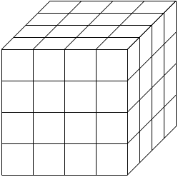
Y
Z
4
4
X
4

Slide 7
Kernel_name <<<
number_of_blocks,
thread_per_block >>> (arguments)

Slide 8
dim3 variable_name ( X, Y, Z)
variable_name.x
variable_name.y
variable_name.z

Slide 9
Z
X
4
Y
32
dim3 block( 4, 1, 1)
dim3 grid( 8, 1, 1)
Kernel_name << grid, block >>>()

Slide 10
16
X
8
2
4
Y
dim3 block( 8, 2, 1)
dim3 grid( 2, 2, 1)
Kernel_name << grid, block >>>()

Slide 11
Limitation for block size
Z
X
y <= 1024
z < =64
Y
x <= 1024
x * y * z < = 1024

Slide 12
Limitation for number of thread block in each dimension
65536
65536
2³² -1

