Slide 1
Resource partitioning and latency hiding

Slide 2
What is latency ?
number of clock cycles between instruction being issued and being completed
Arithmetic instruction latency
Memory operation latency

Slide 3
Operation | Tesla GT200 | Fermi GF106 | Kepler GK104 | Maxwell GM107
ADD/SUB | 24 | 16 | 9 | 6
MAX/MIN | 24 | 18 | 9 | 12
MAD | 120 | 22 | 9 | 13
MUL | 96 | 20 | 9 | 13
Div | 608 | 286 | 141 | 210
Rem | 728 | 280 | 138 | 202
AND, OR, XOR | 24 | 16 | 9 | 6

Slide 4
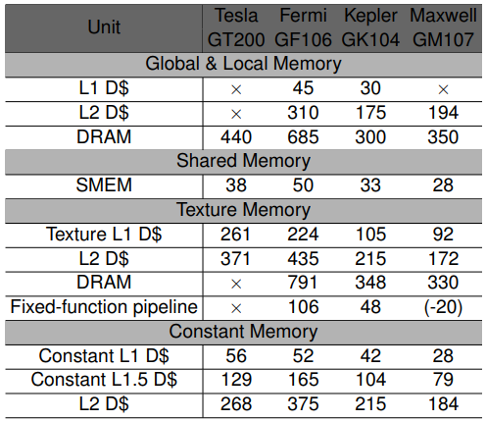

Slide 5
Latency hiding
The execution context of each warp processed by and SM are maintained on-chip during the entire lifetime of the warp.
Therefore switching from one execution context to another has no cost.

Slide 6
Execution cycle
1
2
3
20
21
W1
W2
W3
W20
W1

Slide 7
can execute 4 warps parallelly in one SM
1 SM -> 128 cores
4 x 20= 80
13 * 80 = 1040
To hide the latency of per SM
To hide the latency of per device

Slide 8
How about memory latency
Lets consider DRAM latency of Maxwell architecture as 350 cycles .
GTX 970 have bandwidth of 196 GB/s
Nvidia-smi -a -q -d CLOCK
3.6 GHz memory clock
196 / 3.6 = 54 Bytes/cycle

Slide 9
54 byte/cycle
SM1
SM2
DRAM
SM3
SM4

Slide 10
54 * 350 = 18900 Bytes
18900 / 4 = 4725 threads
4725/ 32 = 148 warps
148 / 13 -> 12 warps per SM

Slide 11
Categorizing CUDA applications
Bandwidth bound applications
Computation bound applications

