Slide 1
Introduction to parallel computing

Slide 2
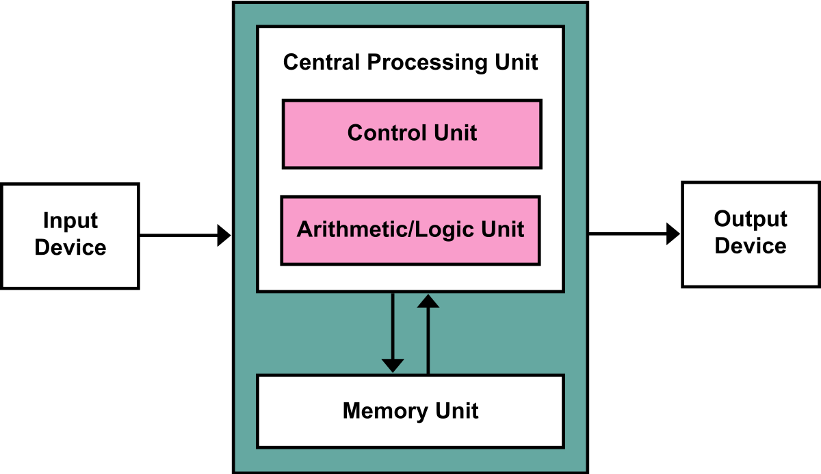

Slide 3

Process
A process is an instance of a computer program that is being executed
Hard drive
Int a =0 ;
a = gervalue();
If(a < 10)
A++
RAM
Mem

Slide 4
Context
Collection of data about process which allows processor to suspend or hold the execution of a process and restart the execution later.
Memory addresses
Program counter states

Slide 5
Processor
Process 1
Process 2
Process 3
Time

Slide 6
Thread
Thread of execution is the smallest sequence of programmed instructions that can be managed independently by a scheduler.
Thread is component of a process. Every process have at least on thread called main thread which is the entry point for the program.

Slide 7
Multiple threads
Multiple cores

Slide 8
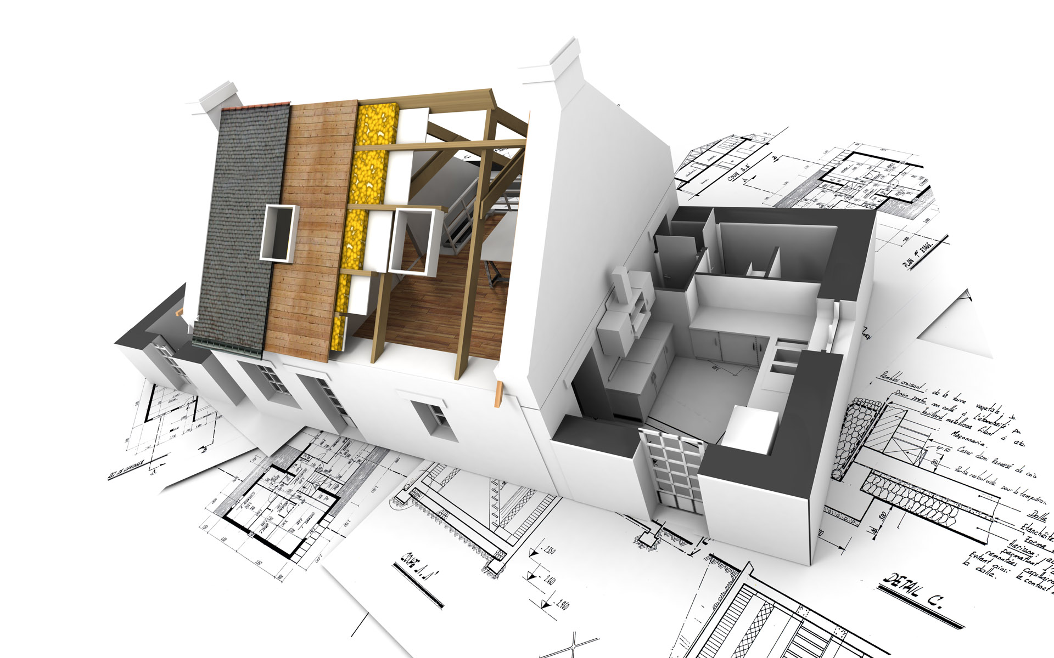

Slide 9
Tasks in hand
Planning
lay a foundation
Brick laying
Water and sewer pipe laying
Plumbing and roofing
House wiring
painting
Carpet laying or marbling the flor
Furnishing.
Gardening

Slide 10

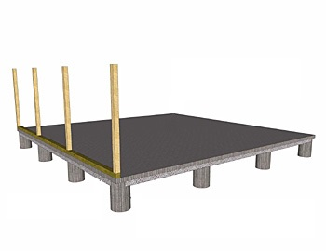






Time

Slide 11
Task
Program end
Program initiation

Slide 12
Task level and data level parallelism
Different task on same or different data
Same task on different data

Slide 13
Parallelism vs concurrency

Slide 14
Process 1
Processor
Process 2
Process 3
Process 1
Processor
Process 2
Processor
Process 3
Processor

