Slide 1
Super computing, heterogeneous computing and GPU

Slide 2
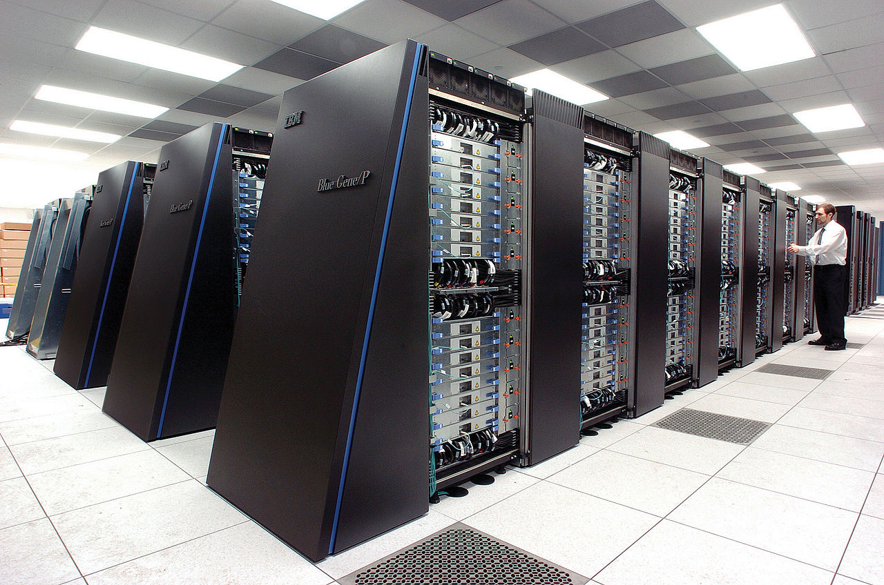
A supercomputer is a computer with a high level of performance compared to a general-purpose computer. Performance of a supercomputer is measured in floating-point operations per second

Slide 3
Usage of super computers
Bio medical research
Aerospace simulation
Genetic research
Earth resource explorations.
Physics simulations

Slide 4
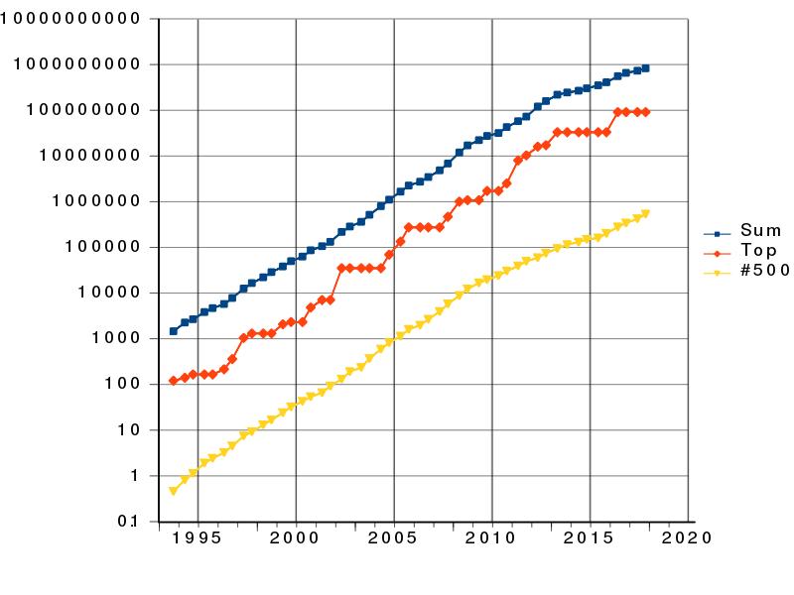

Slide 5
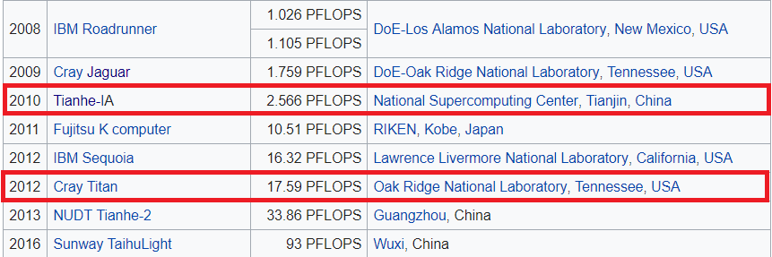

Slide 6
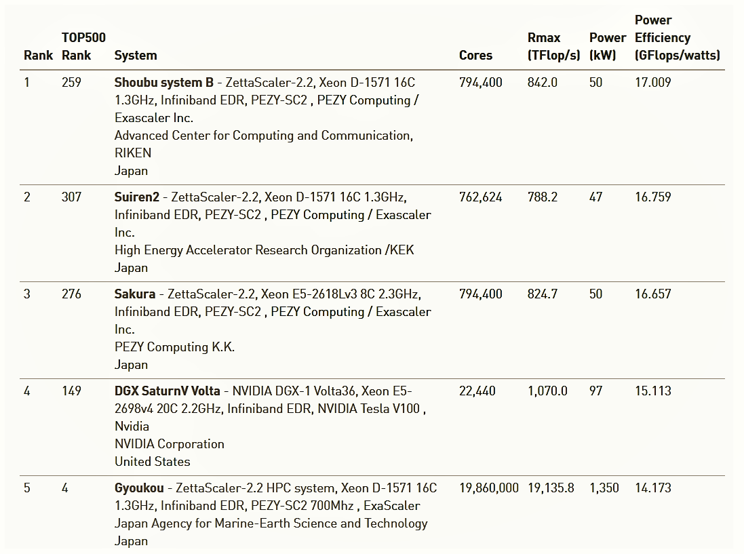

Slide 7
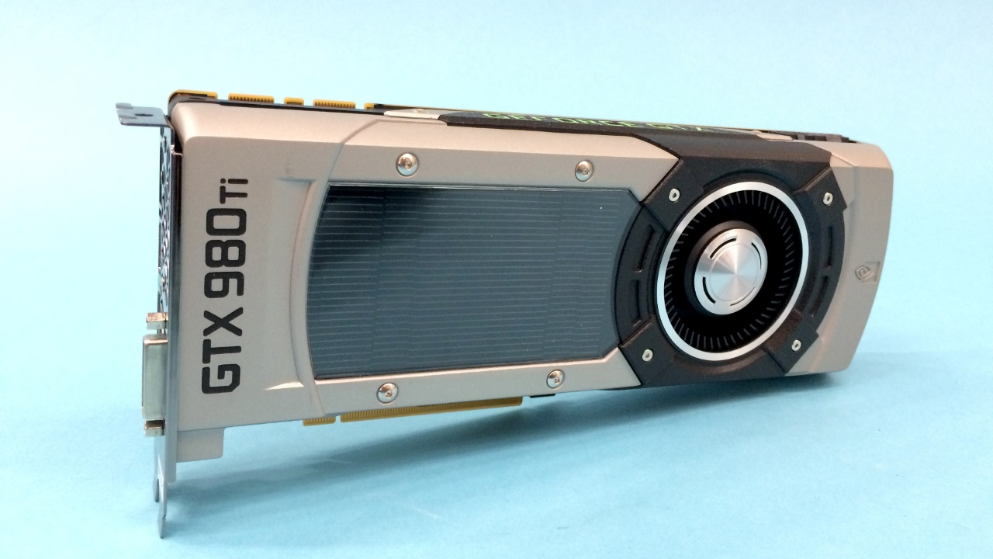
GPUs
The graphics processing unit (GPU), as a specialized computer processor, addresses the demands of real-time high-resolution 3D graphics compute-intensive tasks.

Slide 8

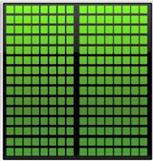
CPU
GPU
Latency device with high lock speed
Smaller number of cores
Have optimization hardware like branch predictors
Through put device with low lock speed
Have Thousand of cores
Does not have optimization hardware like branch predictors

Slide 9
GPU | CPU
Context switching done by hardware | Context switching done by software
Can switch between thread if one thread stalls | For memory instruction latencies with L1 and L2 cache misses, thread are going to stall
Thread schedulers and dispatch units are implemented in hardware | Work item creation done in software.

Slide 10
Heterogeneous computing
Heterogeneous computing refers to systems that use more than one kind of processor or cores. These systems gain performance or energy efficiency not just by adding the same type of processors, but by adding dissimilar coprocessors, usually incorporating specialized processing capabilities to handle particular tasks.

Slide 11
