Slide 1
Understanding the Device

Slide 2
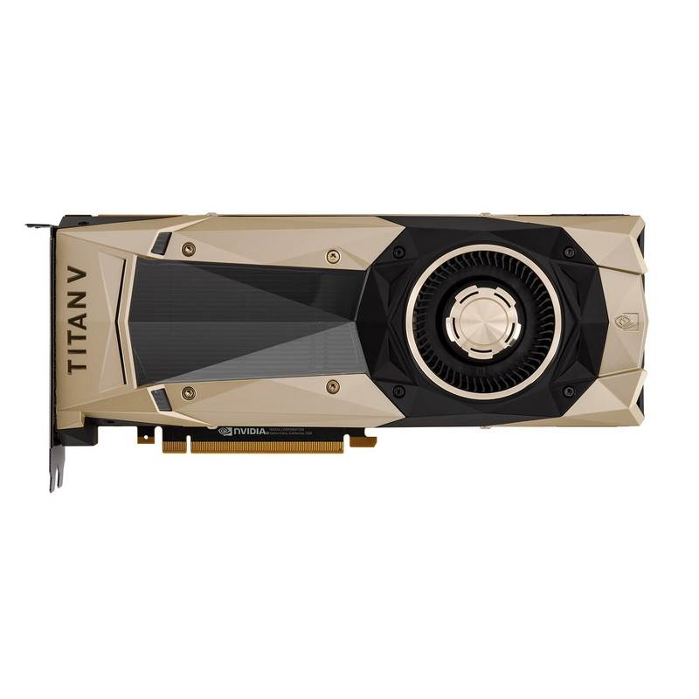
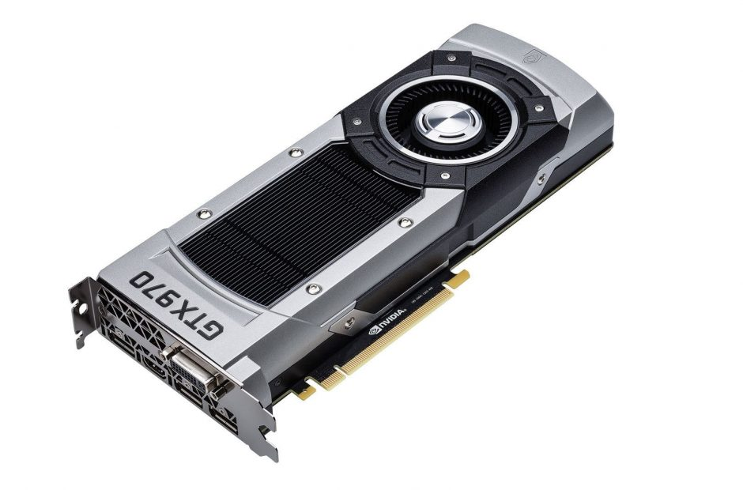

Slide 3
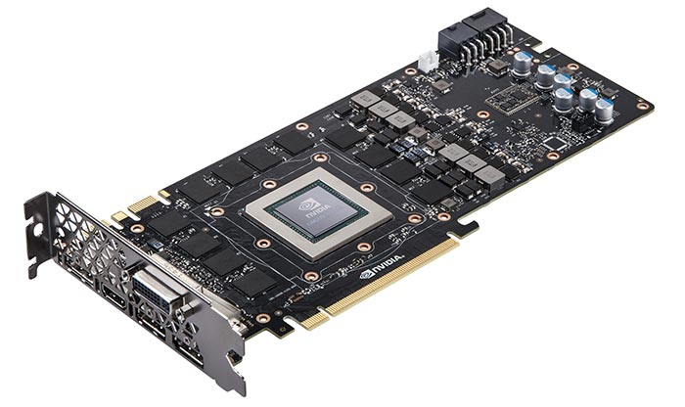

Slide 4
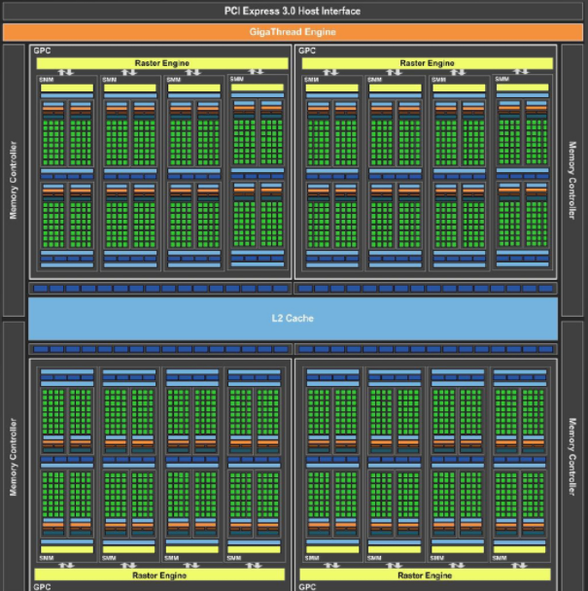
Memory controllers
Memory controllers
L2 cache
Memory controllers
Memory controllers

Slide 5
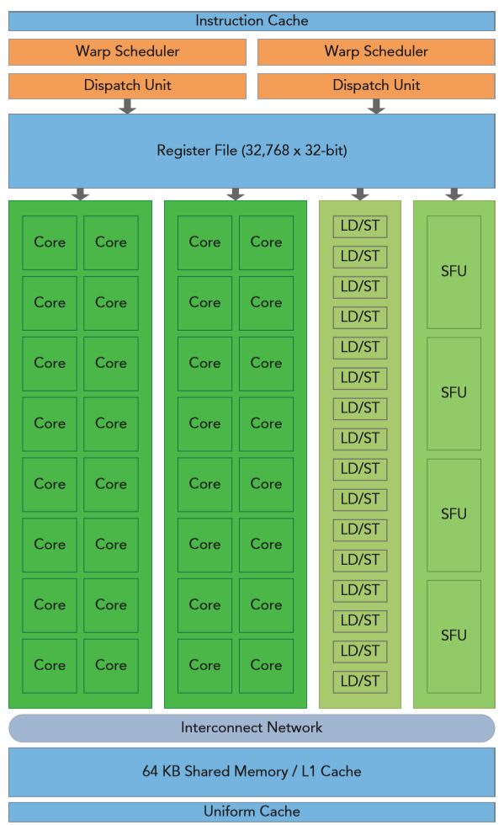
Warp schedulers
Registers
CUDA cores
Core
L/S
SFU
Shared memory
Registers
Load/Store units
Warp schedulers
Special function units
Shared memory and cache

Slide 6
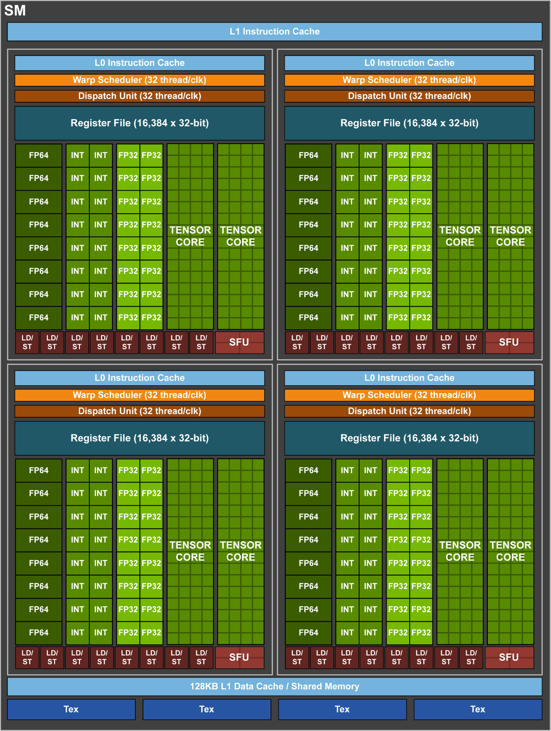
FP64
FP32
TC
Int

Slide 7
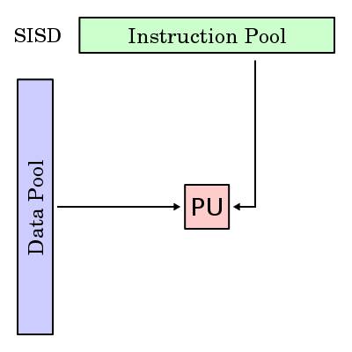
Computer architectures classification
Single instruction single data
SISD

Slide 8
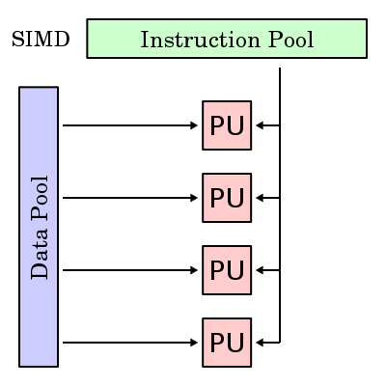
Single instruction multiple data
SIMD

Slide 9
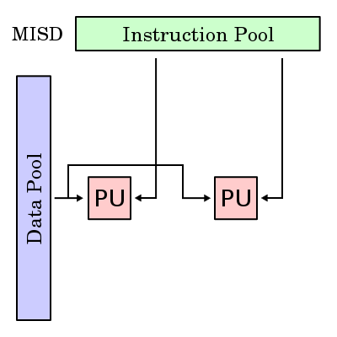
Multiple instruction single data
MISD

Slide 10
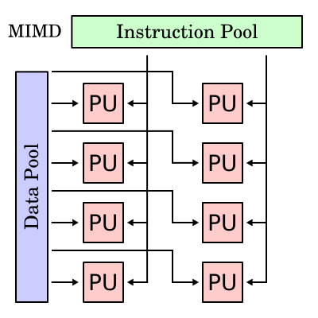
Multiple instruction multiple data
MIMD

Slide 11
SIMT
Single instruction multiple threads
CUDA follows SIMT architecture

Slide 12
In CUDA
Thread blocks is going to execute in single SM. Multiple thread block can be execute simultaneously on same SM depending on resource limitation on SM
But one thread block cannot be executing in multiple SM. If device cannot run single block in one SM, then error will return for that kernel launch.

Slide 13
