Slide 1
Zero copy memory

Slide 2
Zero copy memory
Zero-copy memory is pinned memory that is mapped into the device address space. So that both device and host have direct access to that memory

Slide 3
Advantage of zero copy memory
Leveraging host memory when there is insufficient device memory
Avoiding explicit data transfer between the host and device
Improving PCIe transfer rates

Slide 4
Zero copy memory
cudaError_t cudaHostAlloc
(void ** pHost, size_t count, unsigned int flags);
cudaFreeHost ( void ** pHost)

Slide 5
Same as pinned memory
cudaHostAllocDefault
cudaHostAllocPortable
cudaHostAllocWriteCombined
cudaHostAllocMapped
pinned memory that can be used by all CUDA contexts
written by the host and read by the device
host memory that is mapped into the device address space

Slide 6
cudaError_t cudaHostGetDevicePointer
(void ** pDevice, void * pHost, unsigned int flags);

Slide 7
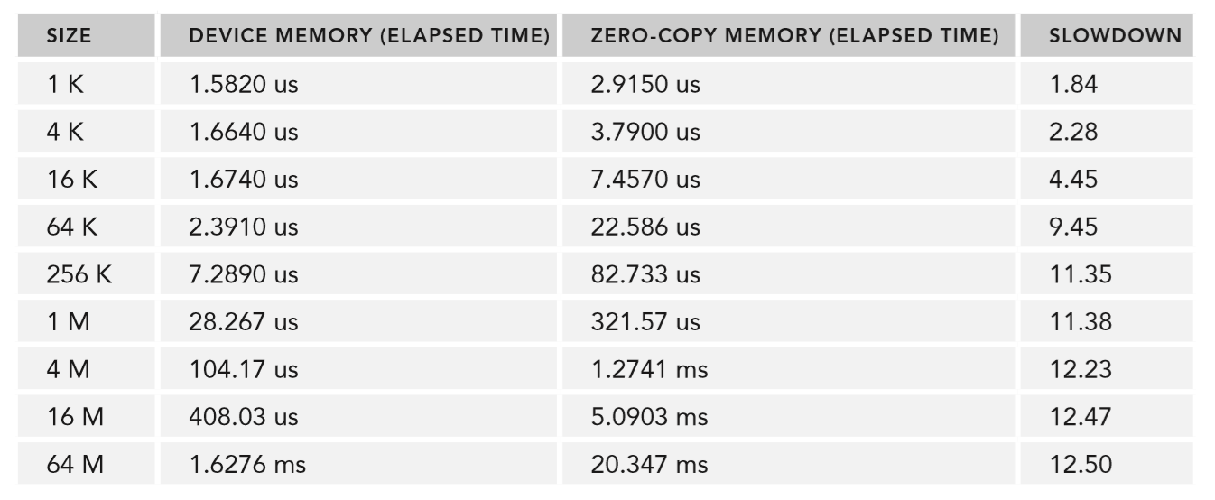

Slide 8
Warning
when using zero-copy memory to share data between the host and device, you must synchronize memory accesses across the host and device

