Slide 1

Swami Keshvanand Institute Of Technology Management & Gramothan, Jaipur
Presented On
Online Prison Management

Slide 2
Online Prison Management
Project Team Members:
Mr. Kamal Jangir
Mr. Brijesh Babal
Mr. Narender Saharan
Mr. Mukesh Khichar
Mrs. Anjana Sangwan
Project Mentor:
Acedmics :
Computer Science Batch (A) 2015-16
Semester- 7th
Project: Minor Level

Slide 3

Contents
Introduction
About Technology
Requirements
Working Of Project
Database Design
Features

Slide 4
Introduction
This project is aimed at developing a prison management system that is a collection of registers and reports for the effective management of prisons. This system will contain the modules like nominal roll, case register, parole register, Interview requests, In-out register and an automated release diary generator.

Slide 5
Technology
HTML : Hyper Text Markup Language ,V5
This is the markup language ,basically used to provide the web page GUI.
Pure HTML code withholds only Front End .
Latest Version HTML 5 uses many flexible Input tags.
JAVA SCRIPT : Scripting Language
Used to provide Validation.
Other use is for Dynamic web Component
creation.

Slide 6
Technology
JAVA : Secured Programming Language
JAVA has the unique features of Clasification and Security.
JAVA technology’s JSP(Java Server Pages) used for web development.
JSP has JAVA and HTML Combination to serve the web Requirements.
Pure HTML code JSP page is called Template.
JSP is Basically has the concept of Servlet’s Http
Servlet Interface.
HttpServlet inteface provides POST and GET
methods of Http Session.

Slide 7
Technology
My Sql : Database Query Language
This is the query language used for data-manuplation in Database.
Database is the Back-End.
For make a connection between front and back-ends java provides JDBC Driver in mysql package.
This Driver requires Username, Password and Connection Url.
Java provides Connecton and PreparedStatement Interfaces for connecting between front and back-ends.
Mysql query used for : Insertion, Updation,
Deletion, Select data into Database for a
secure Management.

Slide 8
Requirements
Hardware :
IBM-PC And Servers.
Software :
RSA –IDE By IBM technology Solutions.
Windows 8.1
Tomcat Apache 8
Mysql 5
My Eclipse 2014
Google Chrome Browser 2015

Slide 9
Technical Terms
Front End :
HTML 5, CSS , JS, JSP(Templates).
Back End:
MySql Database Version 5.
Programming :
JSP, Servlet, Java.

Slide 10
Working
Step 1. Login Page (Jailor and End-User)
Step 2. Login As Jailor:
Navigation Menu GUI.
Home : Request and Release Diary Navigation.
Report : Prisoner and Staff Report.
View: Search for specific prisoner and Visitor.
Response : Email and Staff listing.
Release : Release Diary Navigation.
Wanted : Listing of Escaped Prisoners.
Profile : Profile View, Updating
Usernameand Password .

Slide 11
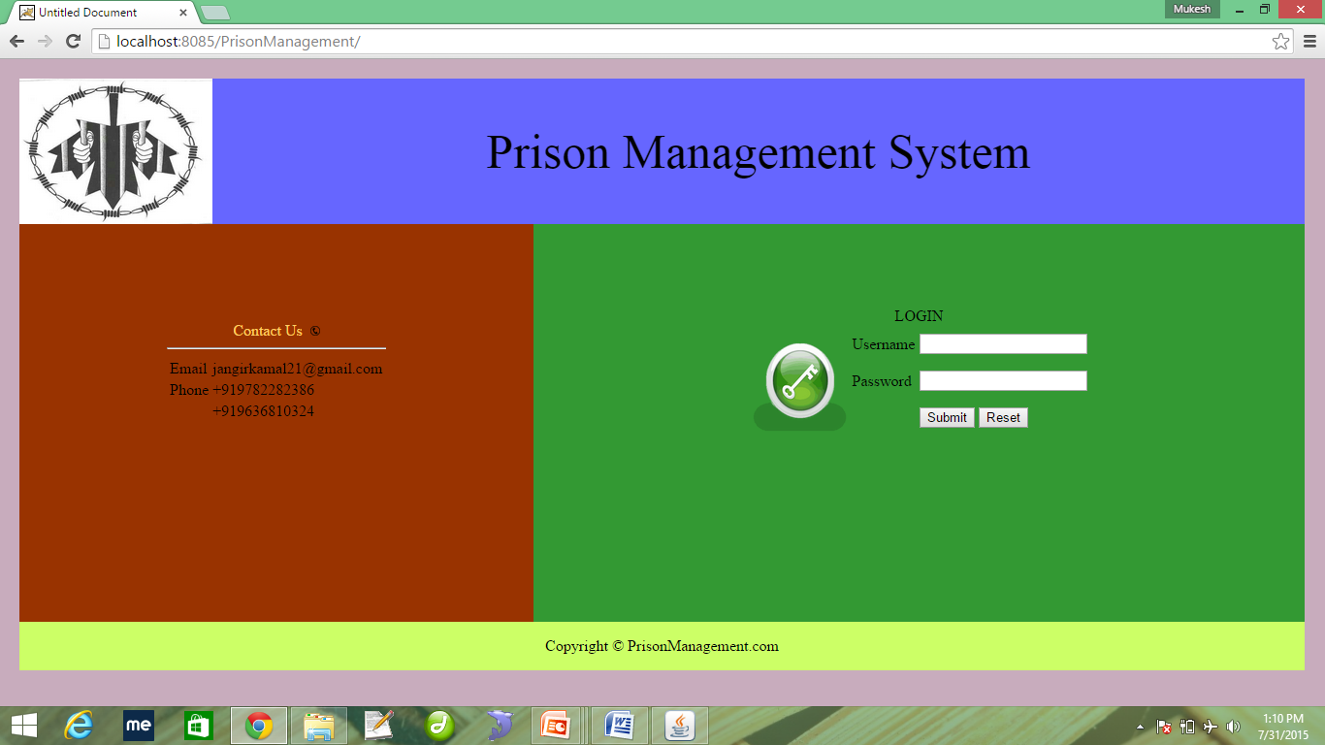
Working

Slide 12
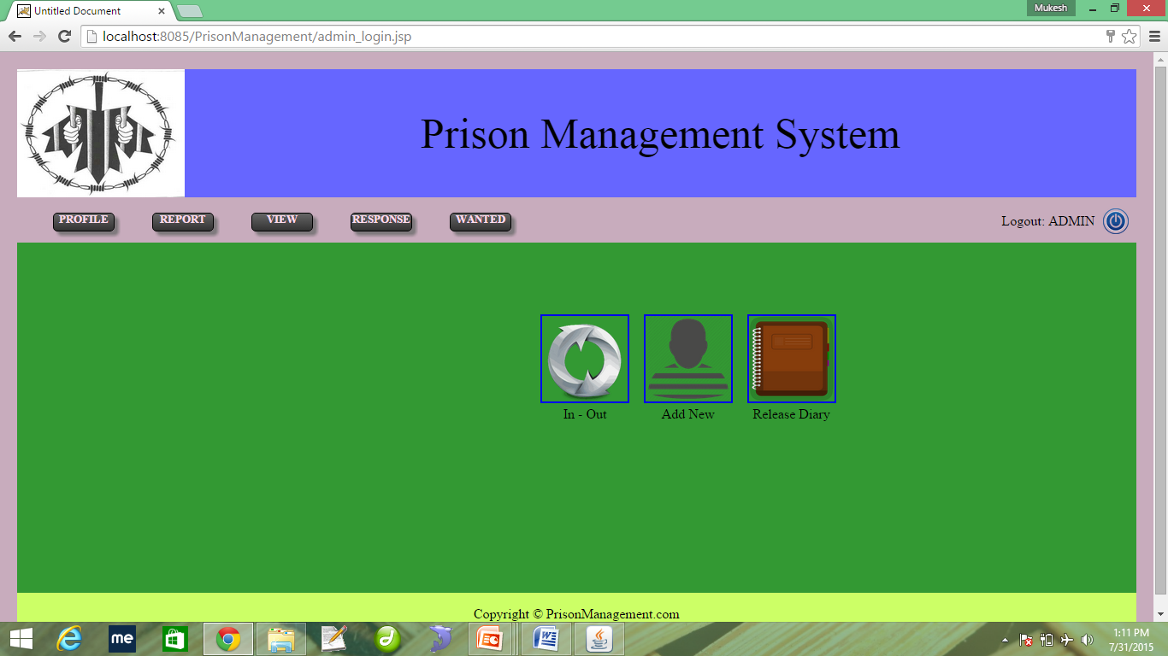
Working

Slide 13
Working
Step 3. Login As Staff:
Navigation Menu GUI.
Home : In-Out register, Add New Prisoner, Release Diary.
Search : All Prisoner and By ID.
Release : Release Diary.
Profile : Profile Updates.
Modify : Update Data(Nominal, Case, Payroll)
: Add New (Prisoner, Case ,Payroll)
: Delete Prisoner.

Slide 14
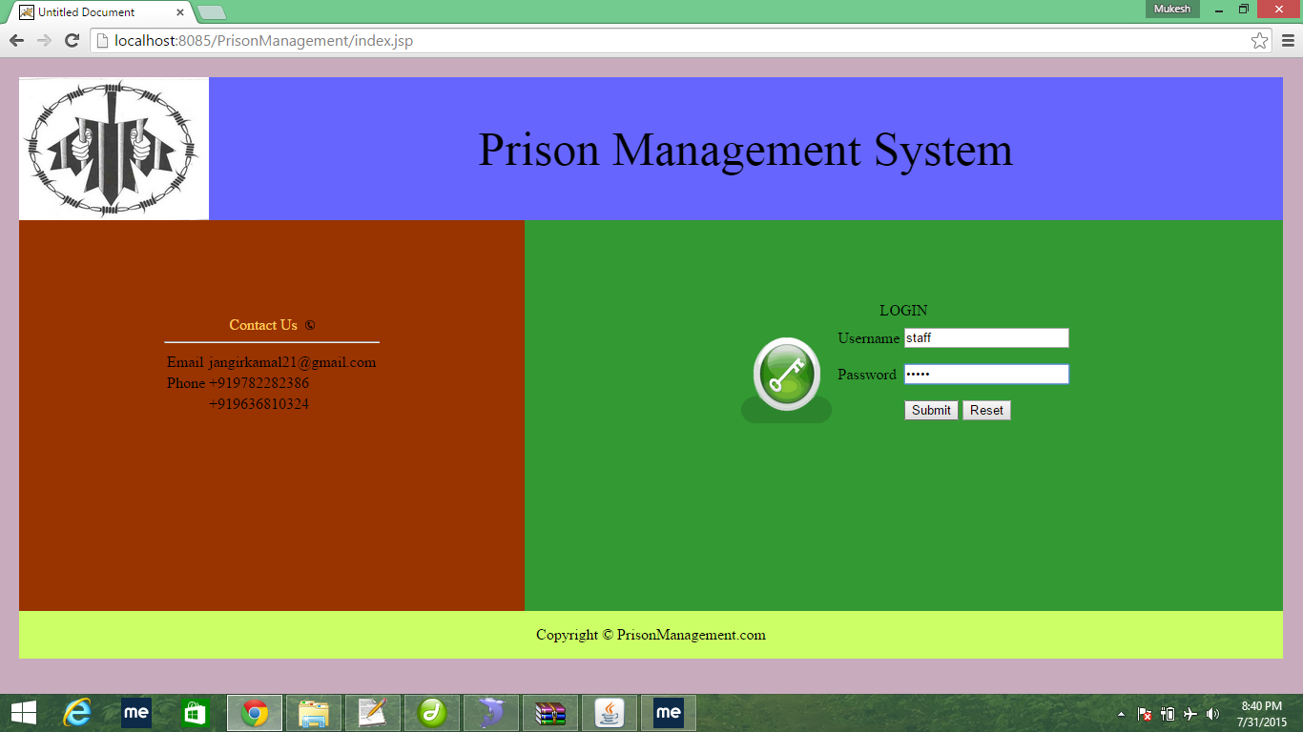
Working

Slide 15
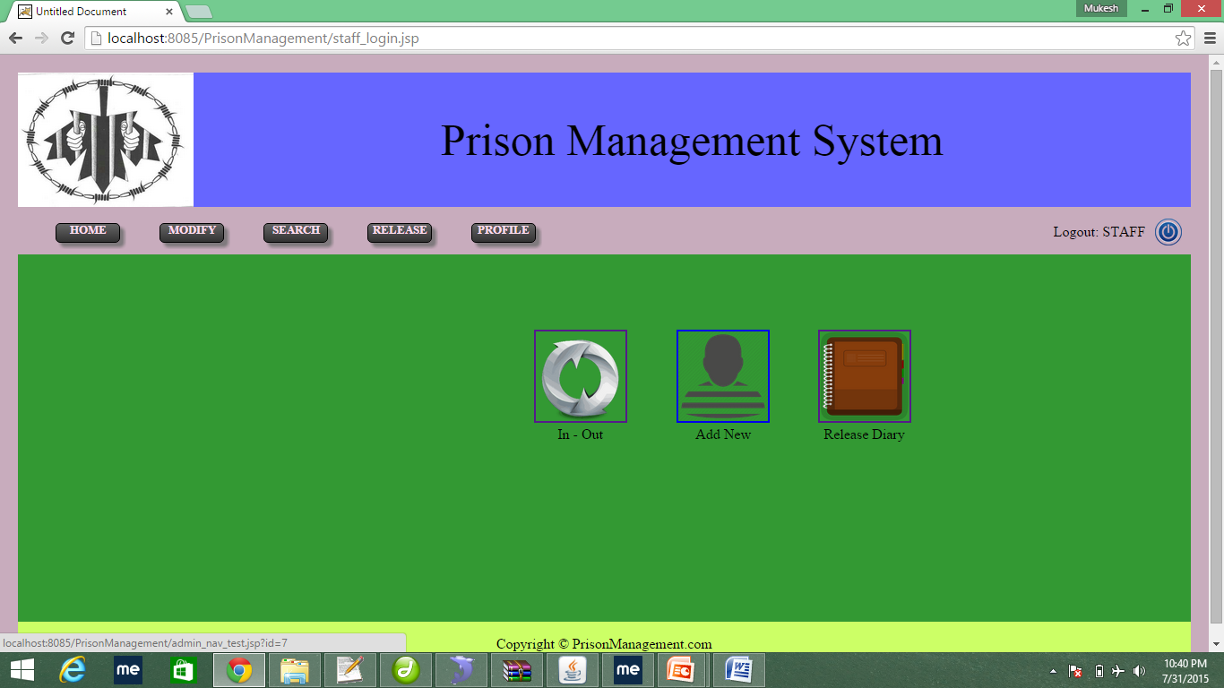
Working

Slide 16
Working
Step 4. Logout
Redirected to the Index Page.
If any Error occurred than StackTrace is printed in server and page get time-out.

Slide 17
Database Design
Prison :
Nomial :Prisoner Information.
Payroll : Payroll Information.
Visitor : In-Out Entry.
Station : NearBy Zonal Police Station.
User_table : Username, Password and Details.
Navigation : Navigation (Dynamic retrival).
Panel : (Dynamic Connected Navigation).
Staff : Staff Information.
City : Zonal City for Police Stations.

Slide 18
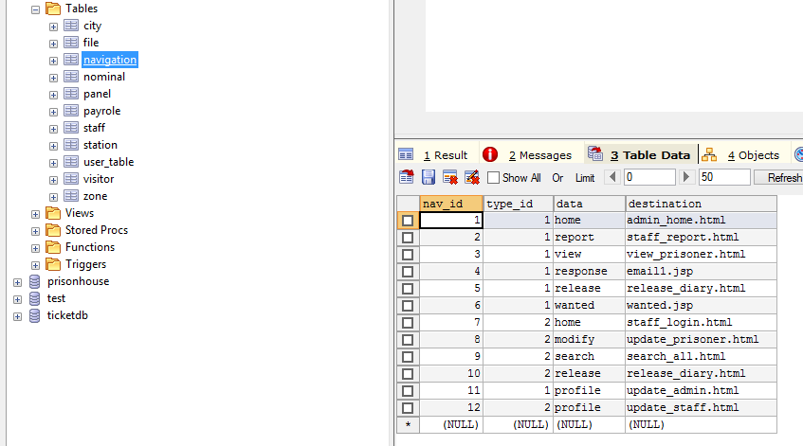
Database Design

Slide 19

Database Design
User_table Snapshot

Slide 20
Features
Dynamic Tabbed Menu : fast Retrival
Secure Java Code.
Secure Access.
Emailing.
Image Store in Database.

Slide 21

THANK YOU

