Slide 1
A Resource-Constrained Surveillance System For Resource-Constrained Environments
Babangida Zachariah (100881093)

Slide 2
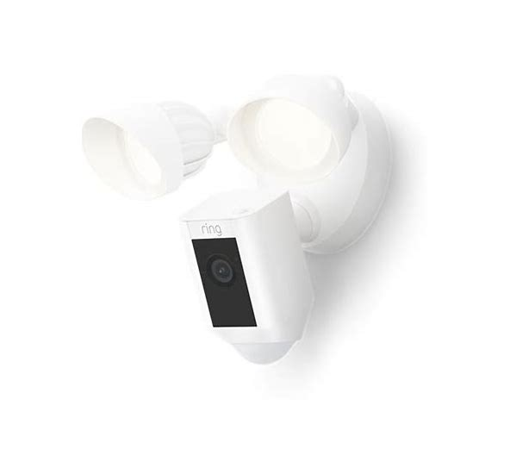
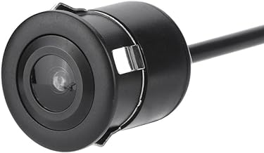
Introduction – What?
Security of critical asset is an important factor in every setting [1]
Surveillance
Wireless home security cameras
Wired home security cameras
Video doorbells
Floodlight cameras
Night-vision cameras
Voice assistant-enabled camera
2

Slide 3
Surveillance – Why?
Visual surveillance systems record, transmit and store videos [2]
Excess bandwidth
Excess memory
Budgetary constraints
Limited bandwidth
Limited memory
Computing power
2

Slide 4
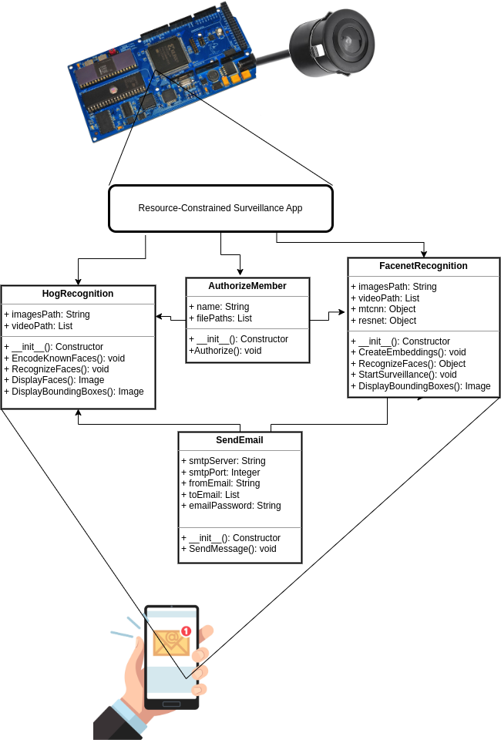
Surveillance – How?
OpenCV
face_recognition
Histogram of Oriented Gradients (HOG)
FaceNet [3]
Multi-task Cascade Convolutional Neural Networks (MTCNN) [4]
VGGFace2 model
2

Slide 5

References
[1] Calba, C., Goutard, F.L., Hoinville, L. et al. Surveillance systems evaluation: a systematic review of the existing approaches. BMC Public Health 15, 448 (2015). https://doi.org/10.1186/s12889-015-1791-5
[2] Gouglidis, A., Green, B., Hutchison, D. et al. Surveillance and security: protecting electricity utilities and other critical infrastructures. Energy Inform 1, 15 (2018). https://doi.org/10.1186/s42162-018-0019-1
[3] F. Schroff, D. Kalenichenko and J. Philbin, "FaceNet: A unified embedding for face recognition and clustering," 2015 IEEE Conference on Computer Vision and Pattern Recognition (CVPR), Boston, MA, USA, 2015, pp. 815-823, doi: 10.1109/CVPR.2015.7298682.
[4] Zhang, K., Zhang, Z., Li, Z., and Qiao, Y. (2016). Joint face detection and alignment using multitask cascaded convolutional networks. IEEE Signal Processing Letters, 23(10):1499–1503.
<number>

