Slide 1
Lesson 1: Introduction To Python
Ashley B. Cohen
Notes:
Hello, my name is Ashley Cohen and I want to welcome you to the first biovcn python lesson and tutorial

Slide 2
What Is Python?
Notes:
So, the first thing I want go over is what python is and what distinguishes it from other coding languages

Slide 3
What is Python?
an object based higher coding language
https://python.org/
data
function
New or altered data
Notes:
Object -a collection of data (variables) and methods (functions) that act on those data
We can think of python objects much like the schematic of a mathematical function you have seen your high school algebra text book.
Higher language- more abstraction from computer language
So more similar to say human speech than binary

Slide 4
Pros Free/Open Source Don’t have to compile Easy to interpret More broadly applied than other languages (advanced web frameworks, web-based applications, desktop applications) Coding style can be object-oriented and event-driven (classes) or more procedural (set step-by-step instructions/common tasks placed in functions). Cons Slower than other languages for memory heavy uses Non-flexible indentation/white-spacing in scripts
Overall, pros greatly outweigh cons!
Notes:
Now I am going to go through the Pros and Cons of python to hopefully convince you that it is the language for you

Slide 5
How is Python used in bioinformatics?
Many bioinformatics software are python scripted
Much advanced bioinformatics data sorting and statistics functions are available as python libraries
https://qiime2.org/
https://biopython.org/
Notes:
How is python used in bioinformatics? Pretty much everywhere…

Slide 6
Technology for this course
Jupyter served via MyBinder Notebooks
Notes:
Before we can learn some python, we need to familiarize ourselves with the technology we will be using in this course

Slide 7
Jupyter served via MyBinder Notebooks Console (both Python and IPython) Scripting language sensitive text editor Safety net Download button
Notes:
To roadmap you through the important features of the binder, and I am going to go through these individually

Slide 8
Console (both Python and IPython) and text editor
A console, also known as a command line, is an interface where the user can enter commands a line at a time.
Most lengthy or complicated codes are written in a text editor, but the code itself is run from the console.
Through the MyBinder interface, a user can write or view a code in the text editor and run the code from a console as they would do natively on their computer

Slide 9
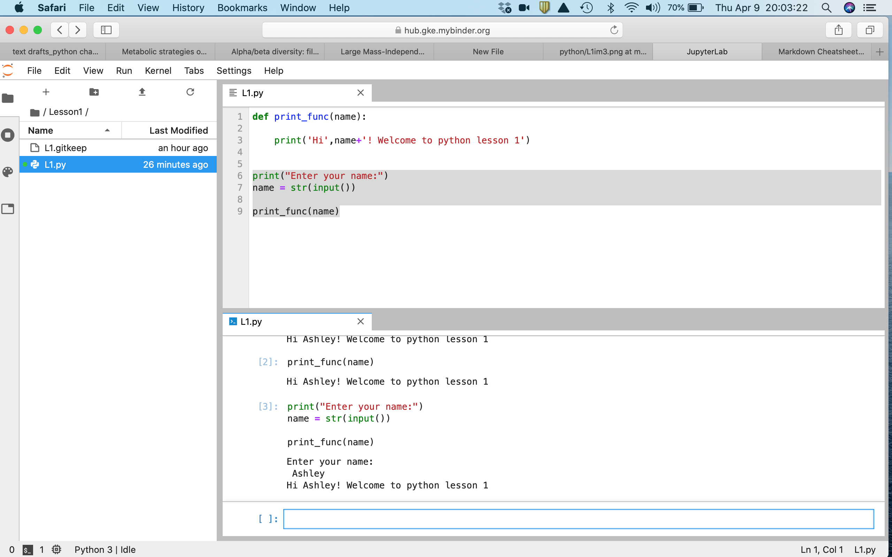
Console (both Python and IPython) and text editor
Text Editor
Console

Slide 10
Scripting language sensitive text editor
The most basic examples of a text editor, a user interface to write plain text and save .txt files, are TextEdit (Mac) and Notebook (Windows).
Microsoft word or other text editors with formatting are a no-no! The code behind the program that formats the text interferes with your code.
It is beneficial to have formatting or color coding to visually interpret your code. This can be done in text editors especially made to be sensitive to scripting language
Notes:
And the text editor itself

Slide 11
Scripting language sensitive text editor
User defined function
Python Function
Python keyword
String (text)
Object/data

Slide 12
Safety-net Download button
The MyBinder interface allows the user to back up their scripts by downloading as a python file to their own computer.
This has the additional benefit that if a user does not have a scripting language-sensitive text editor on their computer, they can compose script and then download to run natively.

Slide 13
Getting familiar with python in Jupyter/MyBinder Hands on tutorial
Notes:
Now I am going to move on to

