Slide 1
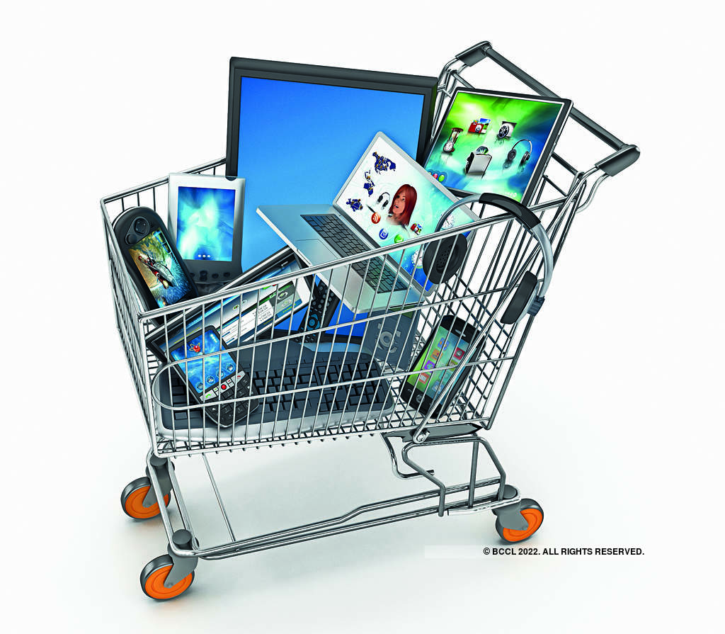

Sales Product Data ANALYSIS.
Prepared By:
Versacorp Group
Workshop 1/2
14:00 - 1600

Slide 2

About The Data
This dataset is about a sales analysis of an online store.
Sales analysis is the process of mining your data to evaluate your sales team's performance in relation to its goals. It provides insights into the top performing and failing products/services, selling issues and market opportunities, sales forecasting, and revenue-generating sales activities.
The products sold are mostly technological products and accessories such as Laptops, iPhones, charging cables, etc.
The dataset is available on Kaggle.
The duration of the data collected is from January to December 2019.
Data for each months are available in separate spreadsheets.
Link to the data set: https://www.kaggle.com/datasets/knightbearr/sales-product-data

Slide 3
KEY VARIABLES
Order ID - this is exclusively used to track orders. Each order receives its own Order ID that will not be duplicated. This number can be useful to the seller when attempting to find out certain details about an order such as shipment date or status.
Product - The Product that have been sold.
Quantity Ordered - is the total number of items ordered.
Price Each - The price of each products.
Order Date - Date of request by the customer.
Purchase Address – This is the customer’s details, usually includes a PO number, which is useful in matching shipments with purchases; a shipping date; billing address; shipping address; and the request items, quantities and price.

Slide 4
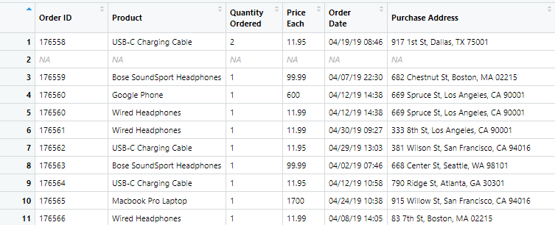
DATA VIEW

Slide 5
Purpose of the study
The goal is to isolate metrics that matter most for the company so that management can make educated decisions and boost productivity.
To get insight on data to boost sales.
To analyze sales by mining existing data.
To shed light on the company’s best and worst selling items and services.

Slide 6
POTENTIAL INSIGHTS FROM THE DATASET
What month HAD the highest number of sales? What was the total amount earned during that month?
Which city had the HIGHEST sales volume?
What time should advertisement be MADE to increase sales?
What products are often sold together?
What product sold the most, AND Why?
What product HAD THE HIGHEST sales?
What Day of the week haD the most sales?
How many product EACH WAS SOLD IN each city?
Sales of each product sold in each month
HOW MANY ORDERS WERE FOR EACH PRODUCT FOR ALL THE MONTHS?
WHICH PRODUCT GENERATED THE HIGHEST SALES?

Slide 7
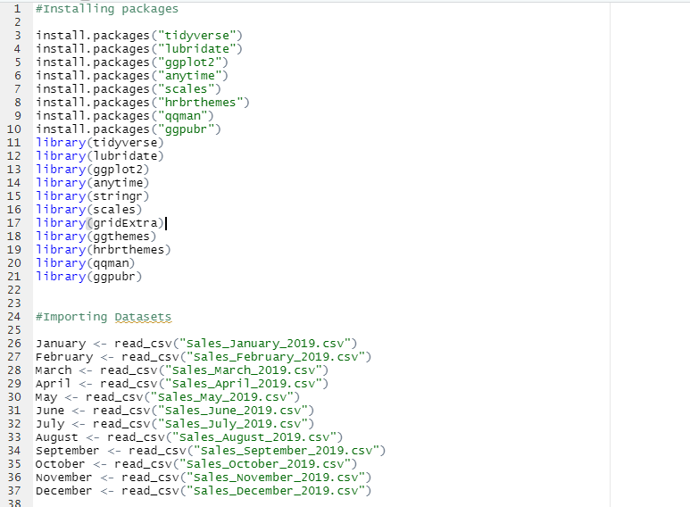
Data preparation
Installation of packages.
Importation of Datasets.

Slide 8
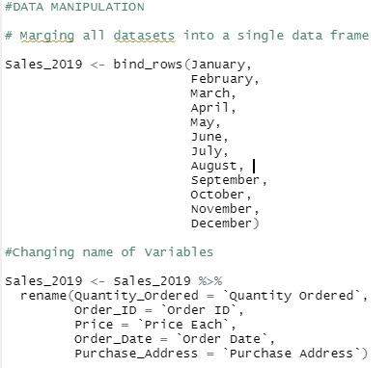
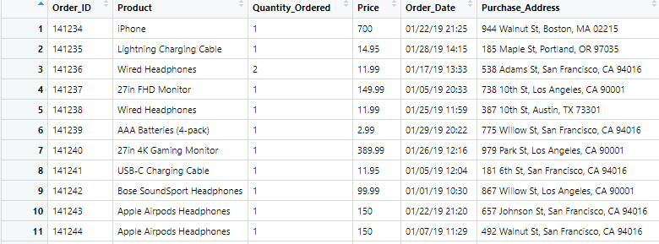
Data manipulation
Merged datasets (January – December) into a single data frame using bind_rows function.
Changed variable names to match R variable name structure.

Slide 9

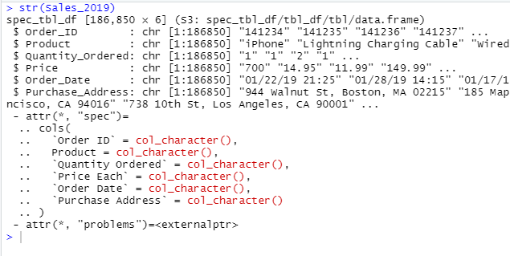
Data manipulation
Checked the datatype of each variable using stringr function.

Slide 10
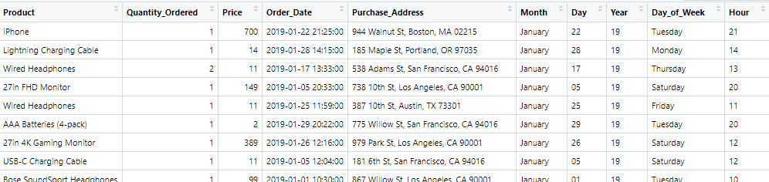
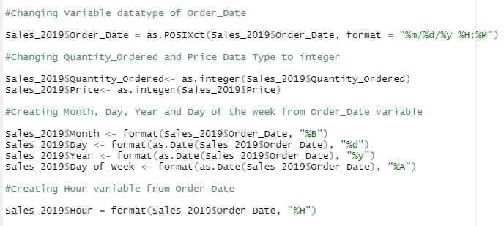
DATA MANIPULATION
Changed variable datatype;
Order_Date – as.POSIXct
Quantity_Ordered – as.integer
Price – as.integer
Created Month, Day, Year, Hour and Day of the week from Order_Date.

Slide 11
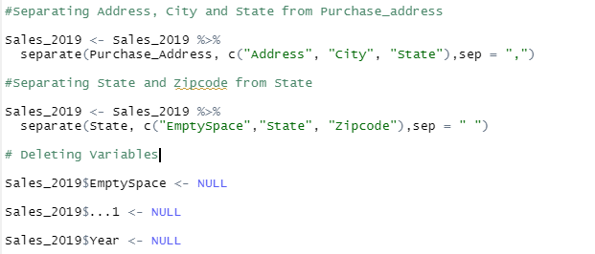
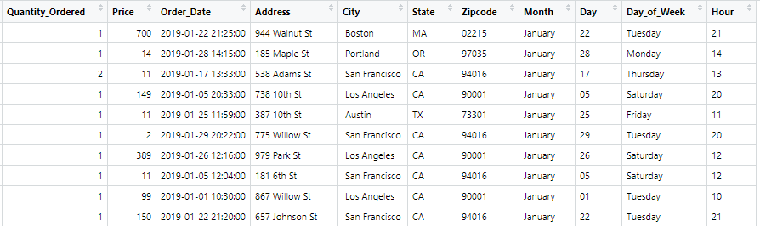
DATA MANIPULATION
Separated the Purchase_Address variable to create
City,
State,
Zipcode.
Deleted the irrelevant variables.

Slide 12
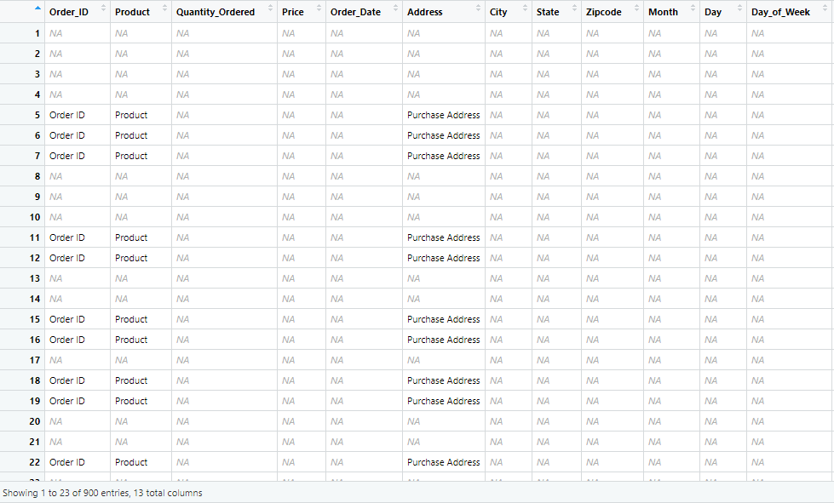
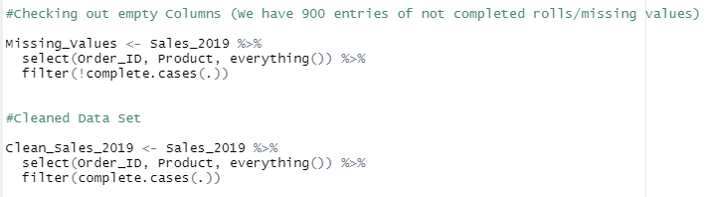
DATA MANIPULATION
Filtered out the missing values.
We have 900 entries of missing rows.
Created new df (Clean_Sales_2019)

Slide 13
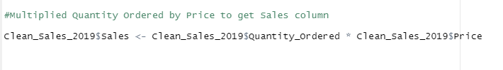
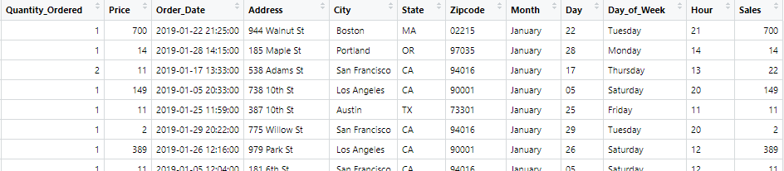
DATA MANIPULATION
Created new variable “Sales” by multiplying
“Quantity_Ordered” by “Price”.

Slide 14
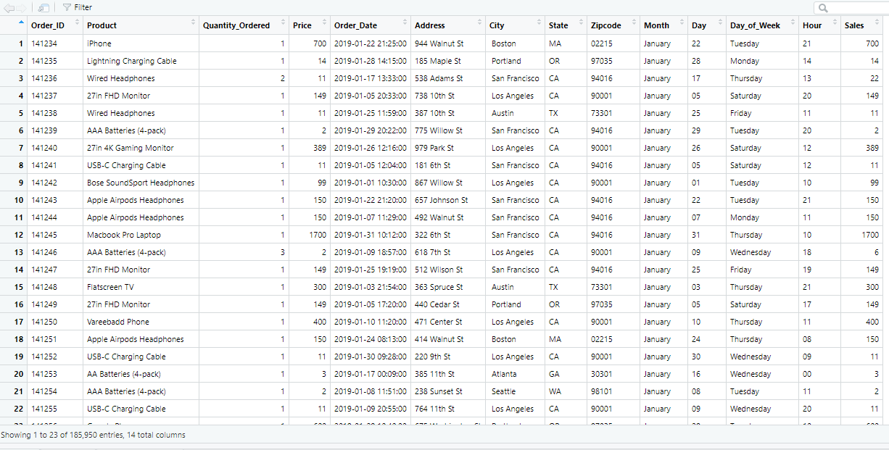
FINAL VIEW OF DATA
The final data has 14 variables and 185,950 entries

Slide 15
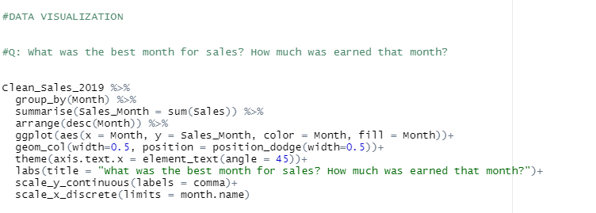
DATA VISUALIZATION
The data was grouped by “Month” then summarized by the sum of Sales.
ggplot function was used to plot the graph.

Slide 16
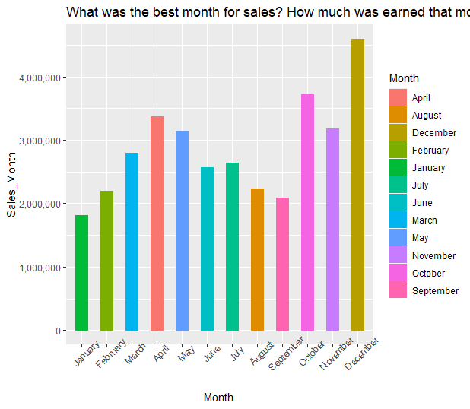
What month HAD the highest number of sales? What was the total amount earned during that month?
From the chart, December had the most sales.
$4,591,824 was earned during the month of December.
The least sales was recorded in January with $1,813,956.

Slide 17
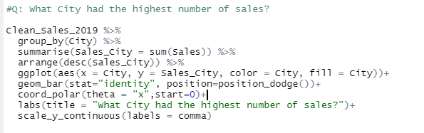
DATA VISUALIZATION
The data was grouped by “City” then summarized by the sum of Sales.
ggplot function was used to plot the graph.

Slide 18
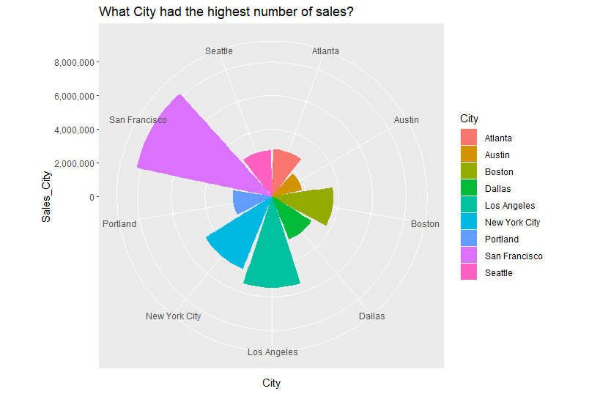
Which city had the HIGHEST sales volume?
San Francisco had the highest sales with total sales reaching $8,262,203.
Los Angeles recorded $5,426,973 which is the second highest sales volume.
The least sales was recorded in Austin with $1,811,054.

Slide 19
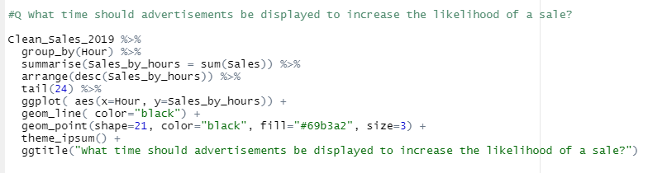
DATA VISUALIZATION
The data was grouped by “Hour” then summarized by the sum of Sales.
ggplot function was used to plot the graph.

Slide 20
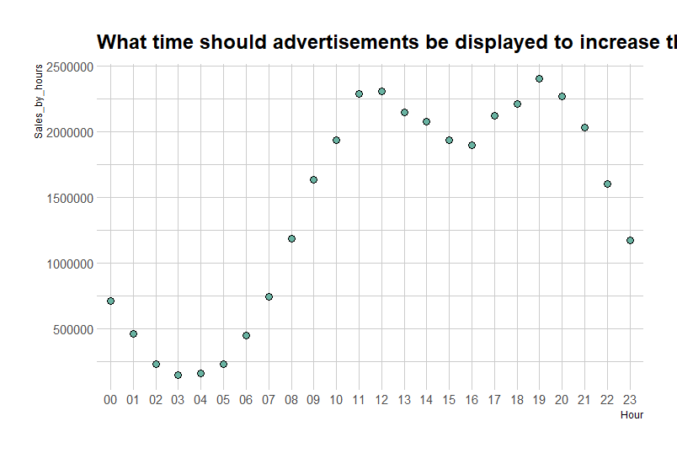
What time should advertisement be MADE to increase sales?
From the graph, it shows that sales starts to increase around 9:00 and sales begins to drop significantly around 22:00.
We would suggest to the organization to display advertisement between the hours 9:00 – 22:00 as this increases the likelihood of sales of the advertised products.
Sales significantly increase during this time period because this is when people are most active.

Slide 21
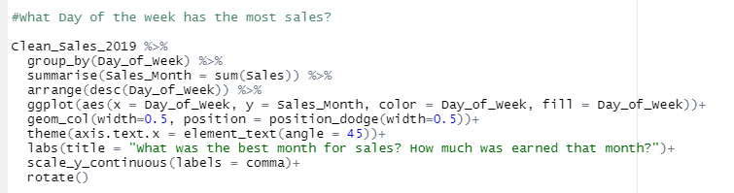
DATA VISUALIZATION
The data was grouped by “Day_of_week” then summarized it by the sum of Sales.
ggplot function was used to plot the graph.

Slide 22
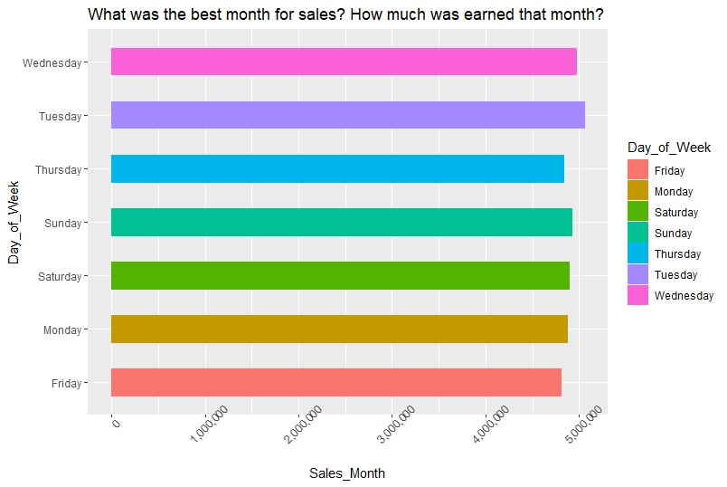
What Day of the week has the most sales?
Tuesday has the most sales followed by Wednesday.
However, there is no significant difference in sales during the rest of the week.

Slide 23
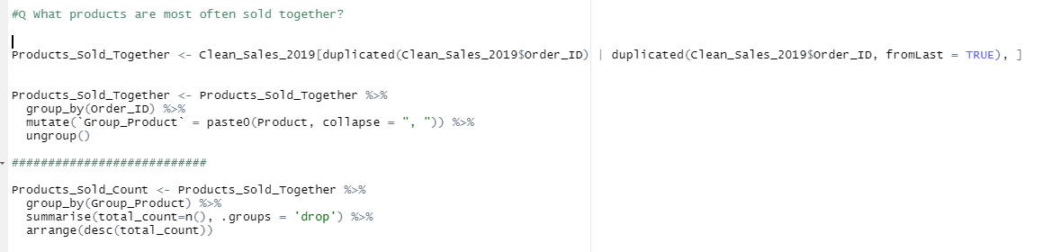
DATA VISUALIZATION
All duplicated “Order_ID” were selected and a new dataframe called “Products_Sold_Together” was created.
The new dataframe was grouped by “Order_ID” and mutate function was used to create “Group_Product”.
Grouped by “Group_Product” and summarized by the number of instances it occurred.

Slide 24
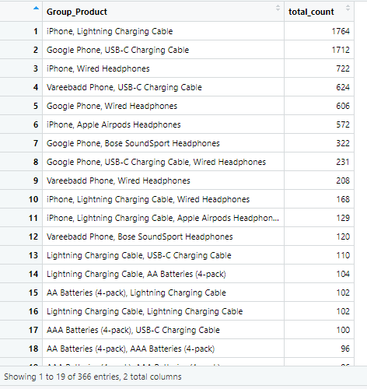
What products are most often sold together?
iPhone and Lightning Charging Cable are mostly purchased together with 1764 orders closely followed by Google Phone and USB-C Charging Cable with 1712 orders.
We have a total of 366 entries.
Next slide shows a plot for the top 5.

Slide 25
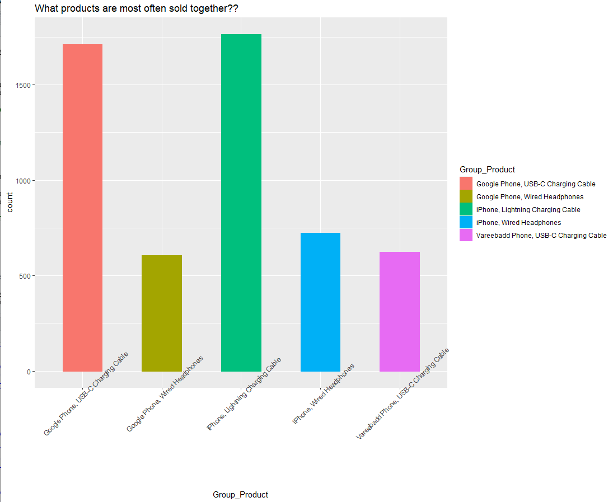
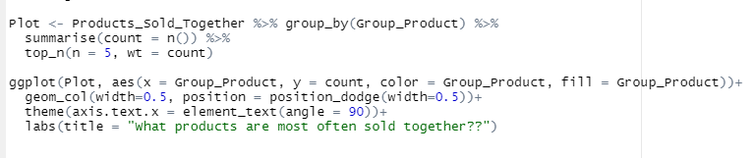
What products are most often sold together?
The data was grouped by “Group_Product” and summarized by count focusing on the top 5 (top_n(n=5)).
ggplot was used to plot the graph.

Slide 26
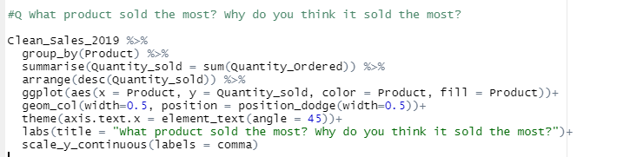
DATA VISUALIZATION
The data was grouped by “Product” then summarized by the sum of “Quantity_Ordered”.
ggplot function was used to plot the graph.

Slide 27
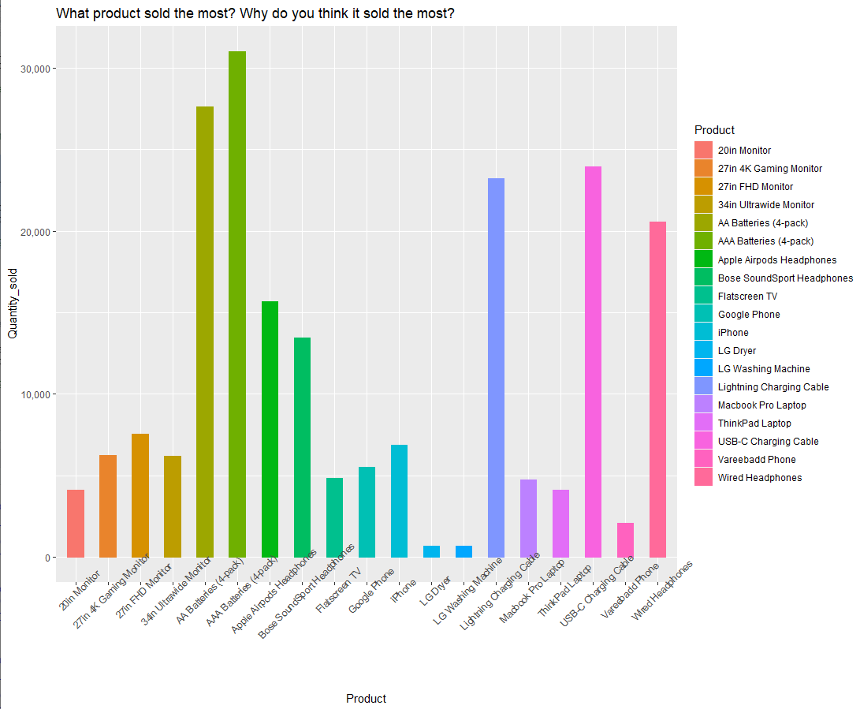
What product sold the most AND Why?
AAA Batteries (4-pack) sold the most with a total count of 31017 pieces sold.
Most small electronic devices, like TV remote controls, kitchen timers, graphing calculators, and bathroom scales, use triple A batteries.
AAA batteries are essential items for each household, and this might have been the reason it sold the most.
Lightning Charging Cable, USB-C Charging Cable, and Wired Headphones are also part of the products that were mostly purchased

Slide 28
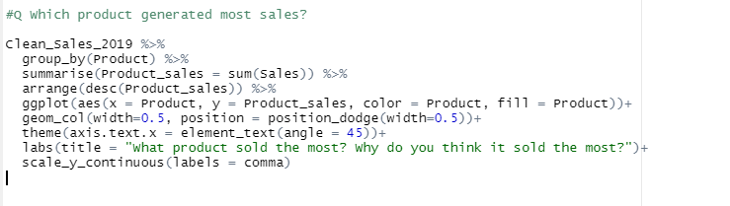
DATA VISUALIZATION
The data was grouped by “Product” then summarized by the sum of Sales.
ggplot function was used to plot the graph.

Slide 29
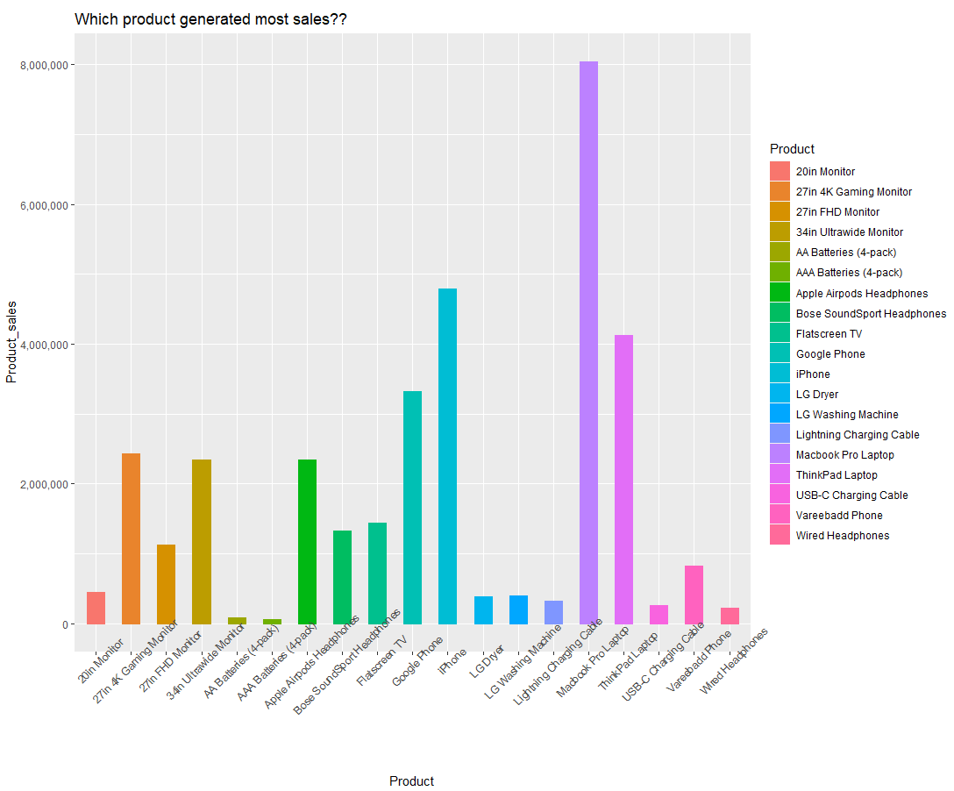
What product HAD THE HIGHEST sales?
Macbook Pro Laptop generated the most sales.
The cost of each Macbook Pro Laptop is $1700.
The Macbook Pro Laptop generated the most sales because they are the most expensive item, and a significant number (4728) of them were sold.

Slide 30
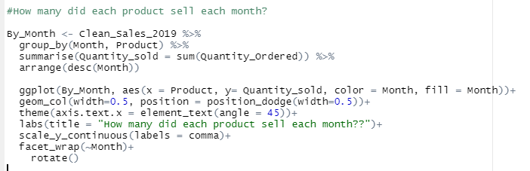
DATA VISUALIZATION
The data was grouped by “Product” and “Month” then summarized by the sum of Quantity_Ordered.
ggplot function with facet_wrap was used to plot the graph.

Slide 31
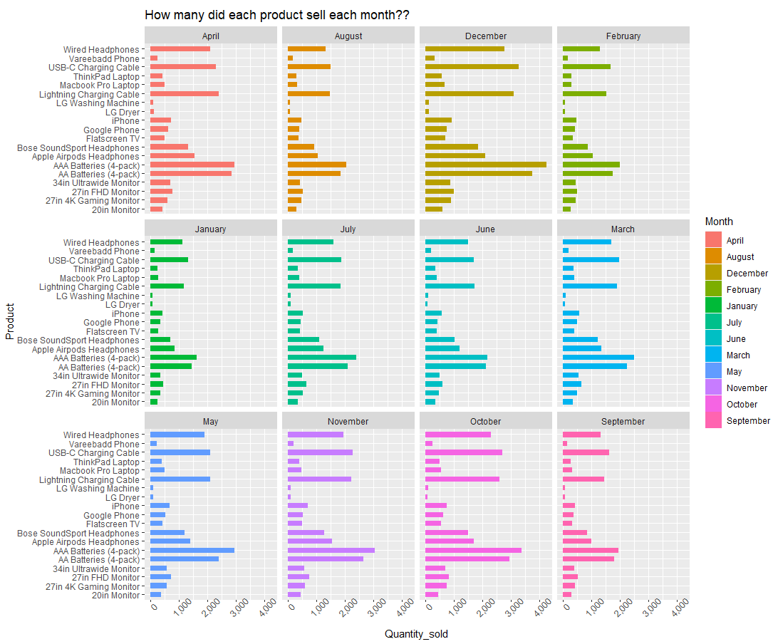
HOW MANY ORDERS WERE FOR EACH PRODUCT FOR ALL THE MONTHS?
Consistently across all the months, we can see the items with lowest price were mostly sold.
AAA Batteries (4-pack), Lightning Charging Cable, USB-C Charging Cable, and Wired Headphones are mostly ordered due to the relatively low price.

Slide 32
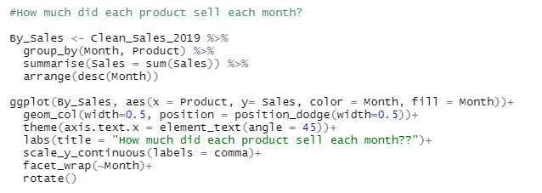
DATA VISUALIZATION
The data was grouped by “Product” and “Month” then summarized by the sum of Sales.
ggplot function with facet_wrap was used to plot the graph.

Slide 33
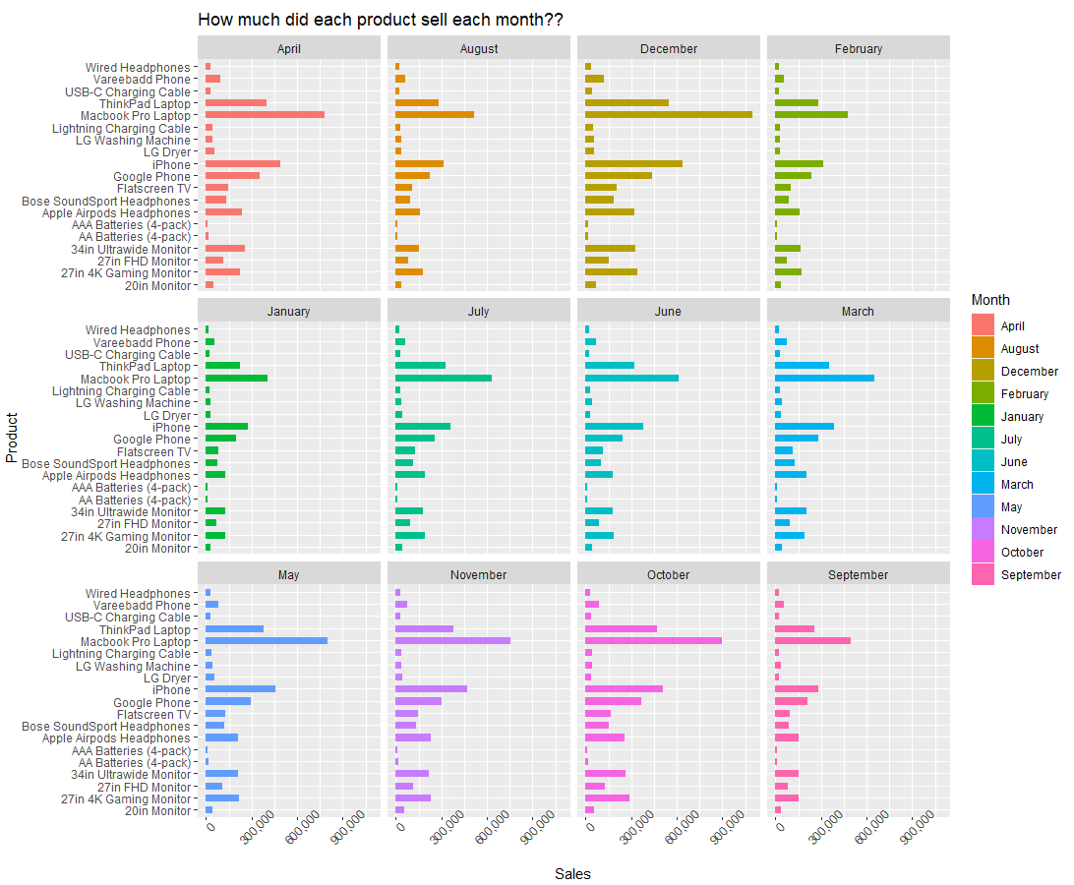
How Much did each product sell each month?
Macbook Pro Laptop generated the most sales in each month.
The cost of each Macbook Pro Laptop is $1700.
It was able to generate the most sales because of its price. It is the most expensive product.

Slide 34
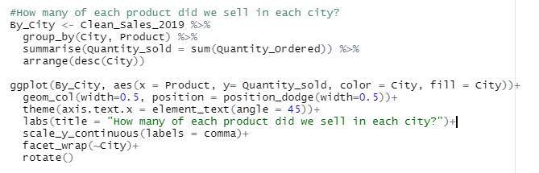
DATA VISUALIZATION
The data was grouped by “City” and “Product” then summarized by the sum of Quantity_Ordered.
ggplot function with facet_wrap was used to plot the graph.

Slide 35
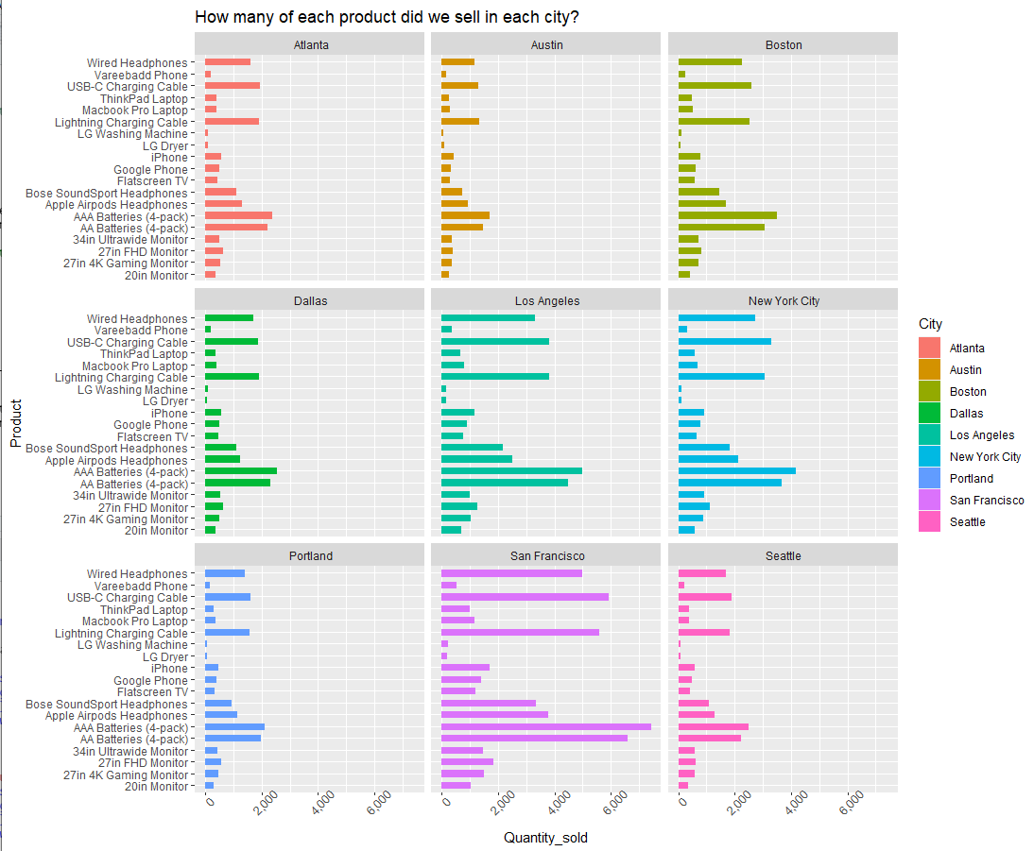
How many product EACH WAS SOLD IN each city?
The products with the lowest price has been the mostly ordered item across all cities.

Slide 36
RECOMMENDATIONS AND CONCLUSION.
From the potential insights we checked using the data provided, we would recommend the following.
To increase sales, advertisement of least selling products should be targeted between the rush hours (9:00 – 22:00).
To get more sales, products such as LG Washing Machine, LG Dryer, Flatscreen TV, and ThinkPad Laptop etc., should be discounted as these items had lower orders.
Promos can be targeted to cities with lower sales such as Austin.
Promos can as well be introduced in January to increase sales turnover.
Advertisements (such as black Friday) can also be introduced in December as we can achieve more sales.

Slide 37
LIMITATIONS OF THE ANALYSIS.
Due to certain variables not provided by the dataset, we could not do more in-depth analysis to determine the following;
Highest revenue generating product based on the cost price and selling price.
The relationship between the City with the most sales and products ordered.
The data provided was only for a year, therefore we could not compare the sales generated by year.

Slide 38
PROFESSIONAL ISSUES THAT CAN AFFECT ONLINE STORES.
Cybersecurity is of paramount importance for online retailers because of the sensitive nature of customer information. A look at some of the most pressing problems
Cybersecurity
Competition
Order fulfillment
Customer experience

Slide 39
legal ISSUES THAT CAN AFFECT ONLINE STORES.
Doing business on the web is rapidly becoming the norm. More than half of all businesses now exist only in the digital realm, with e-commerce representing the majority of their revenue. However, just because something can be done online, that doesn't imply you can avoid legal implications.
Incorporation Problem
Trademark Security Problem
Copyright Protection Issue

Slide 40
ETHICAL ISSUES THAT CAN AFFECT ONLINE STORES.
Knowing the difference between good and wrong only scratches the surface of ethics. It all comes down to the beliefs and practices we uphold.
Unreliable Customer Service.
Counterfeit Products.
Online Piracy.

Slide 41

THANK YOU.

