Slide 1
DEPLOYING S/W ACROSS DOMAIN OR TO A PARTICULAR OU
Software installation

Slide 2
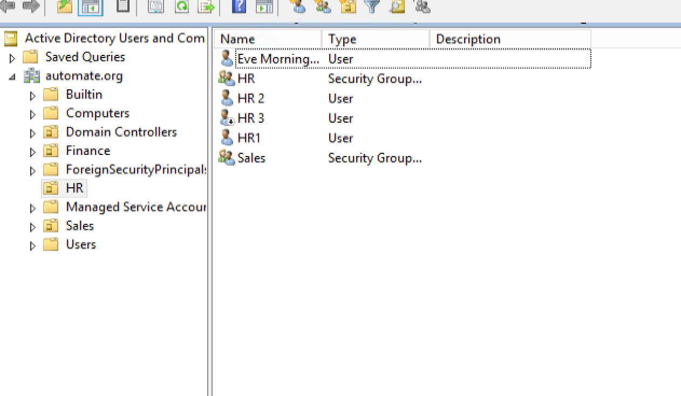
1. Create User in Hr group

Slide 3
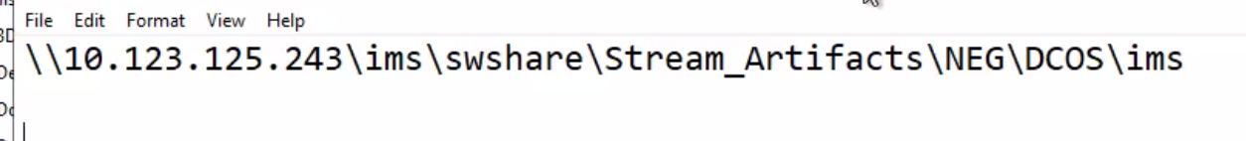
Go to Path

Slide 4
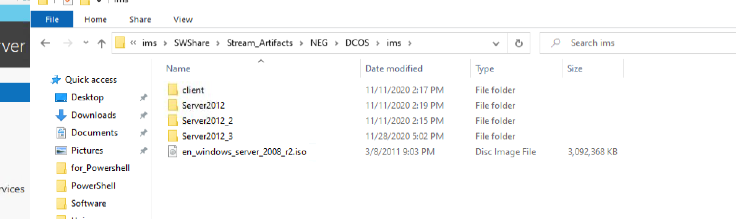
Copy iso file to c:

Slide 5
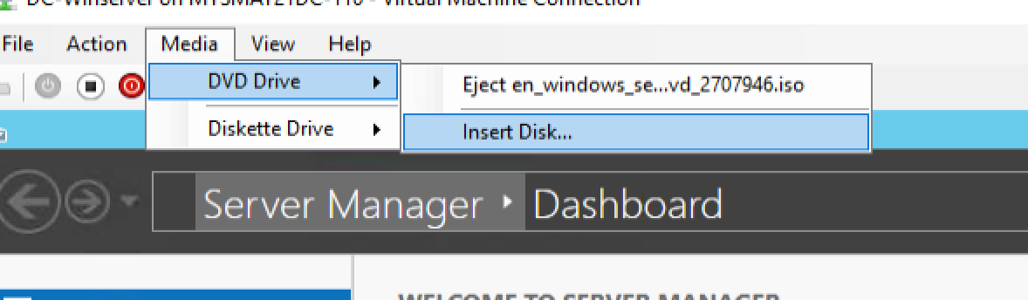
Main vm screen. Insert 2008 r2 iso

Slide 6
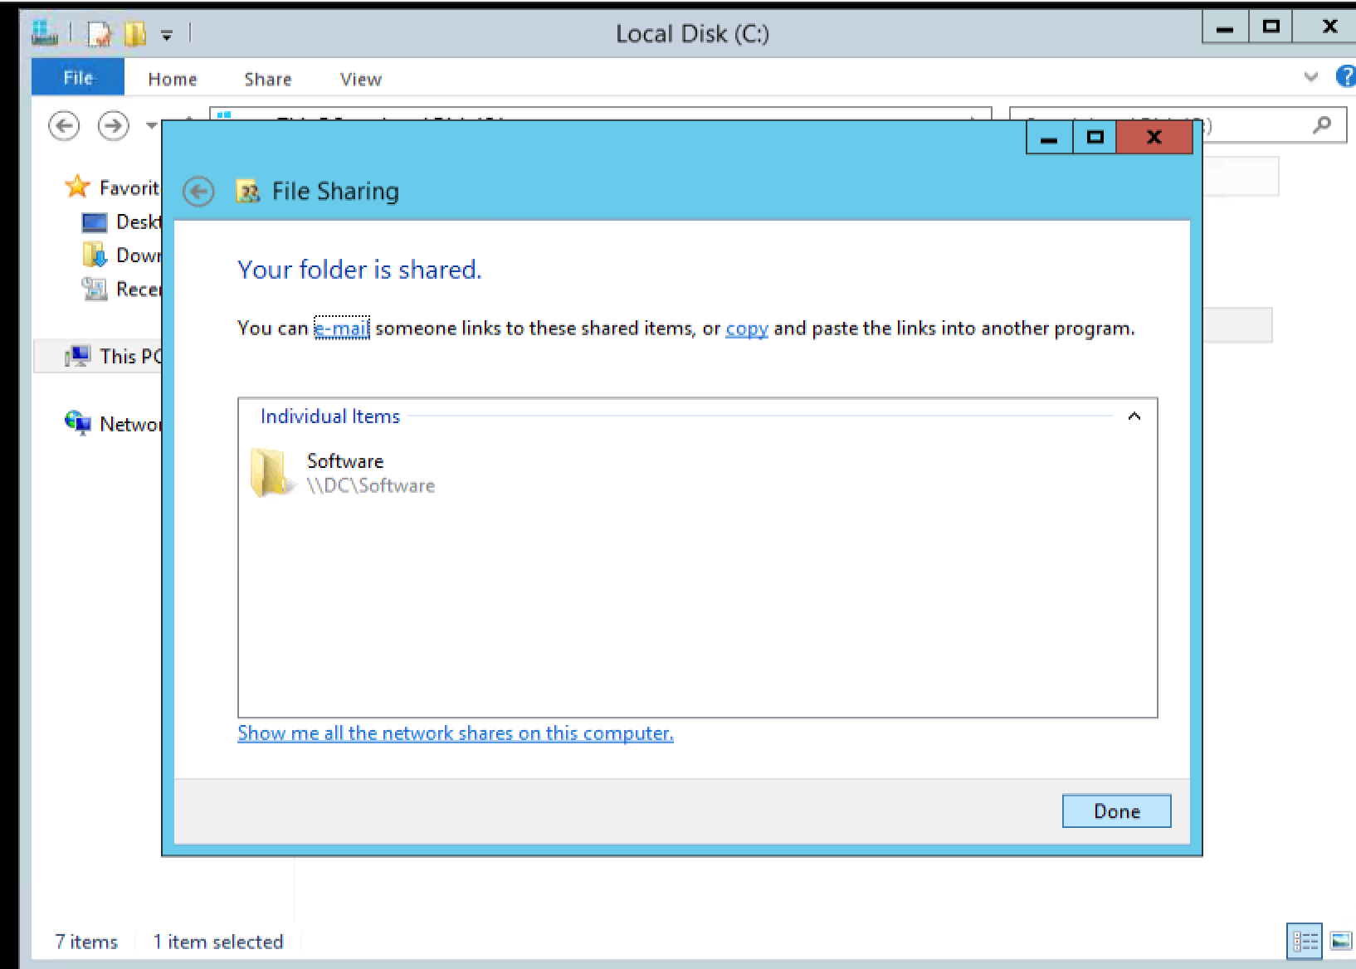
Create software folder in dc and share with everyone

Slide 7
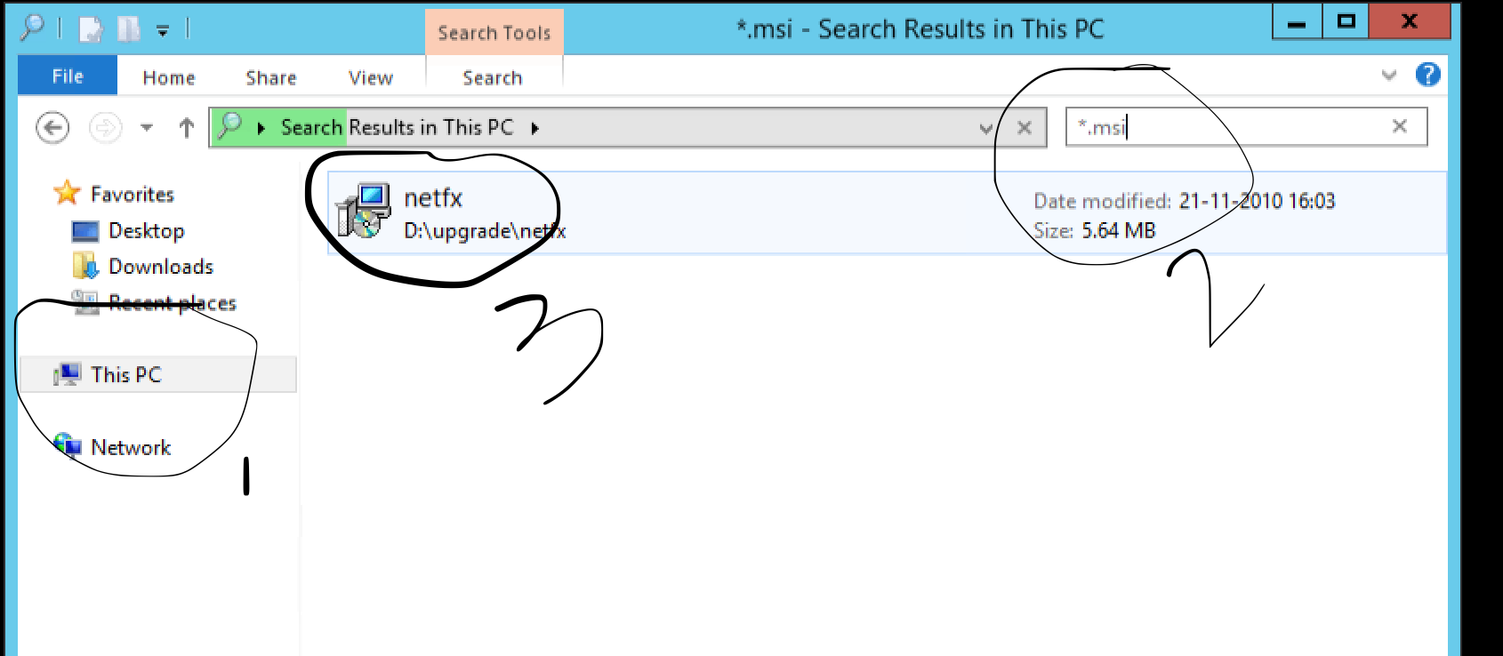
This pc-Search-*.msi. (Copy to Software folder)

Slide 8
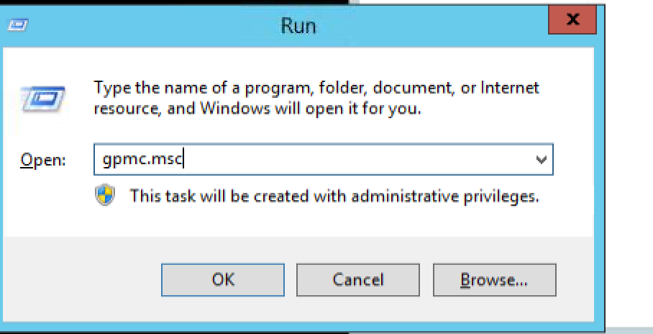
Run-gpmc.msc (Group Policy Management Console)

Slide 9
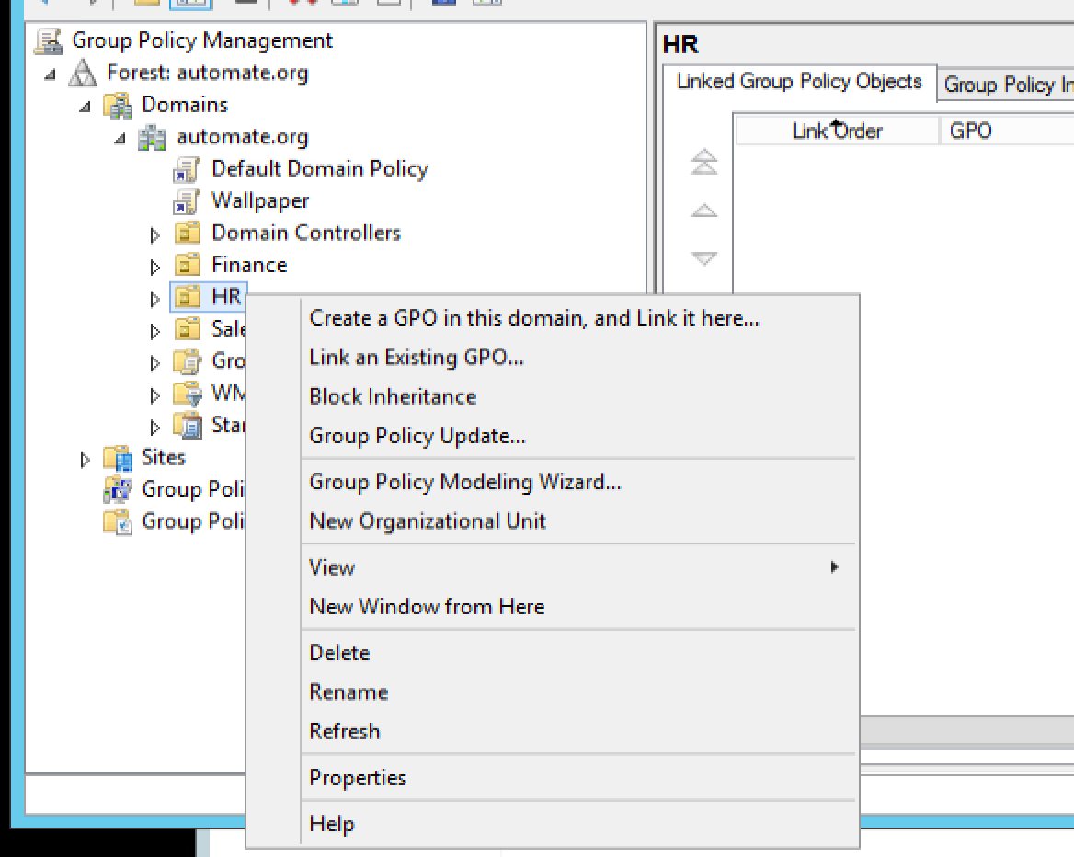
Right click HR-create GPO

Slide 10
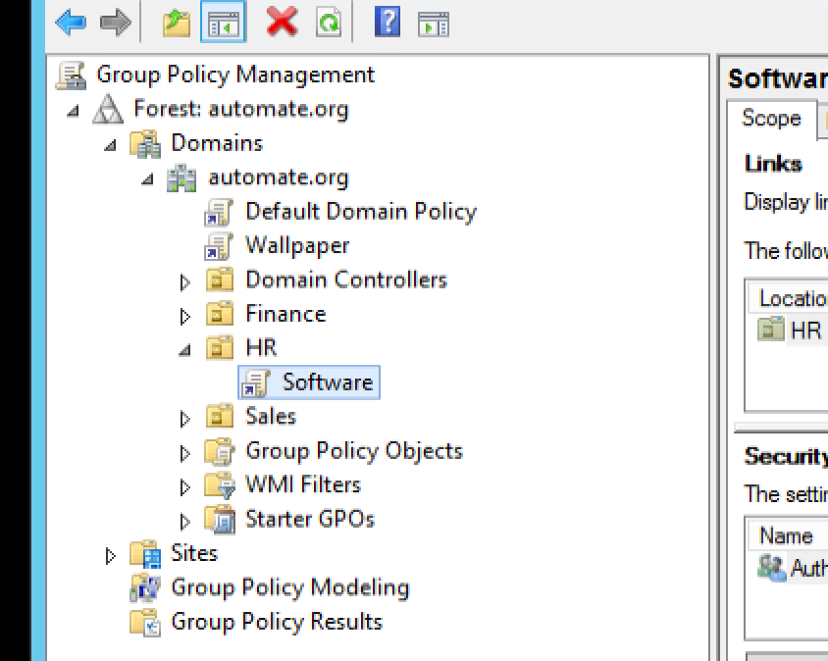
After giving name it will appear here.

Slide 11
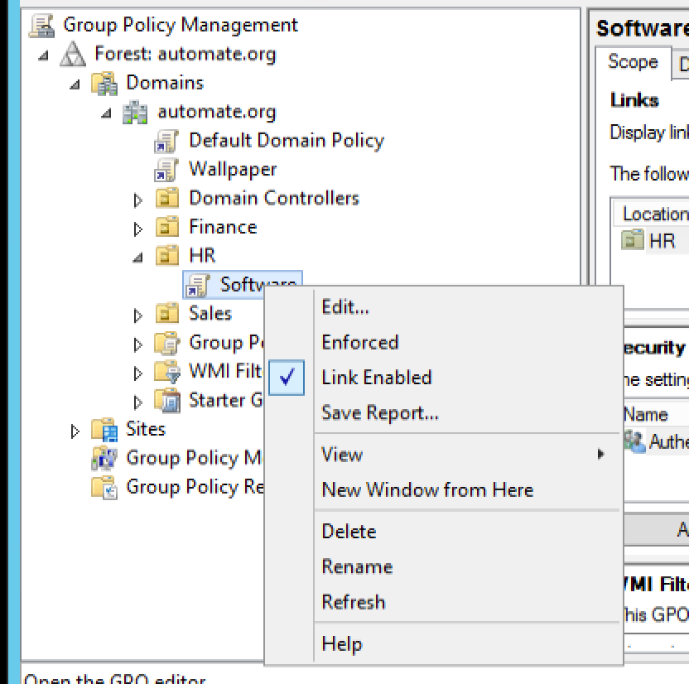
Right click on software click edit

Slide 12
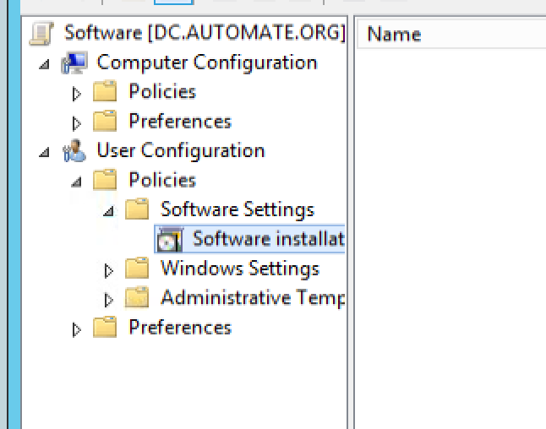
Userconfig-policies-sw setting-sw installation

Slide 13
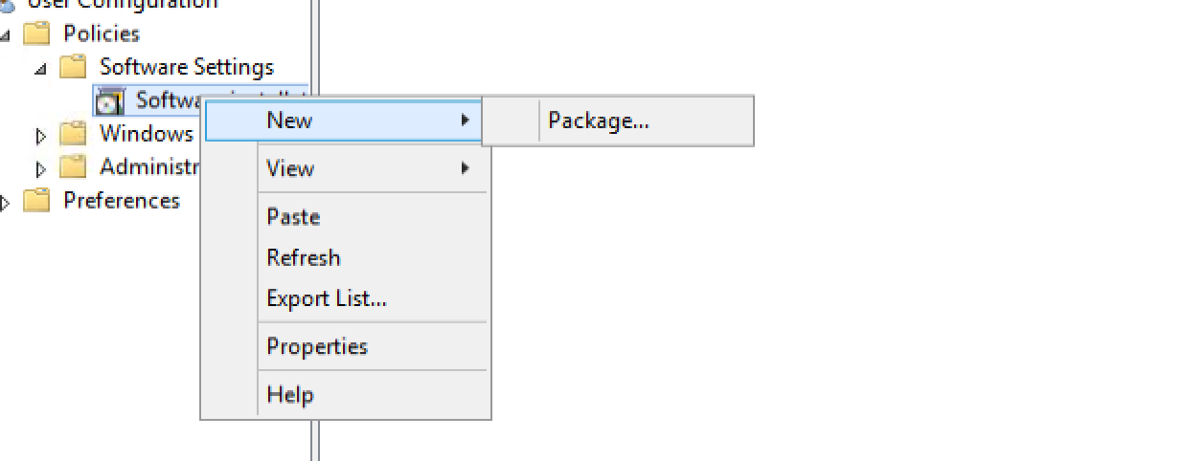
Right click –new-package

Slide 14
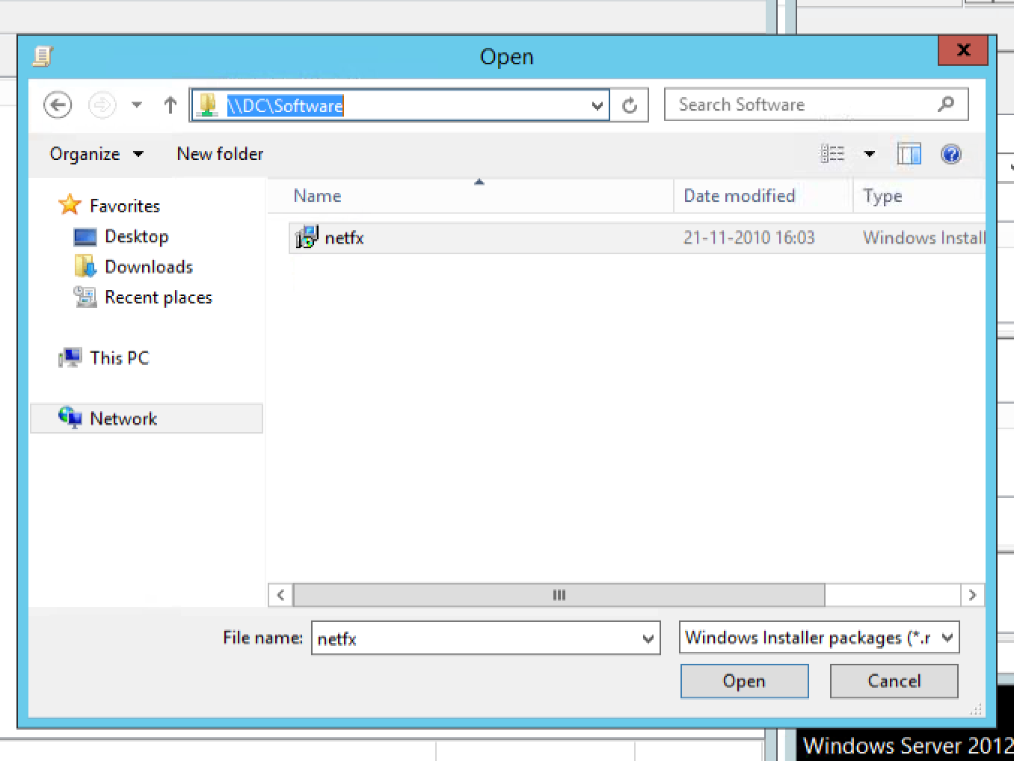
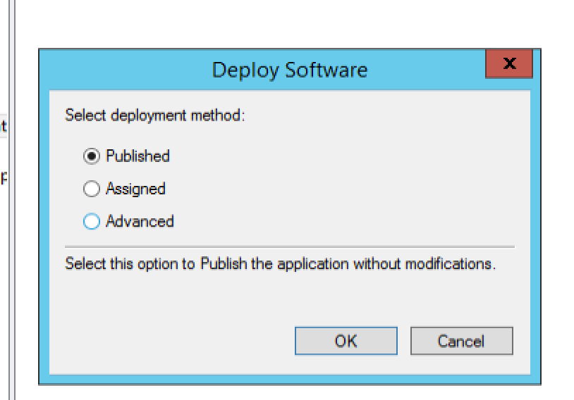
Select path..(shared) – open –Published

Slide 15
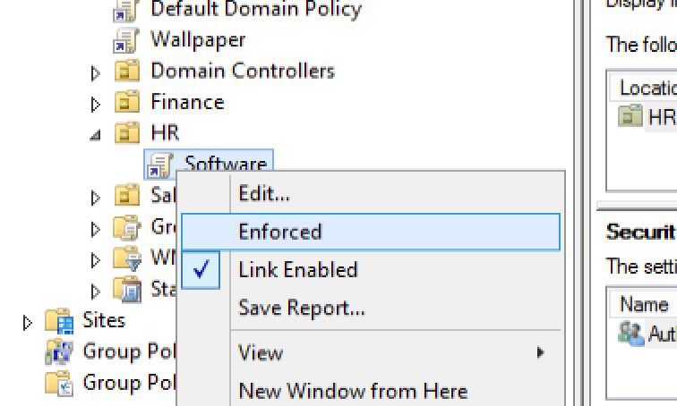
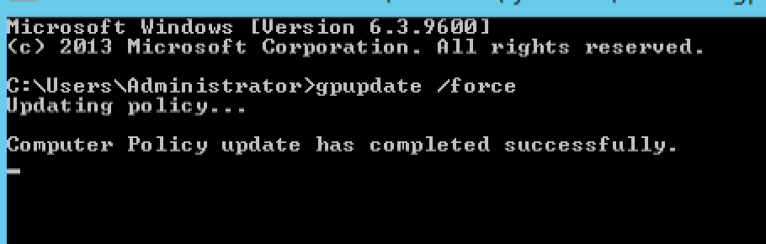
Select enforced. Gpupdate(cmd)

Slide 16
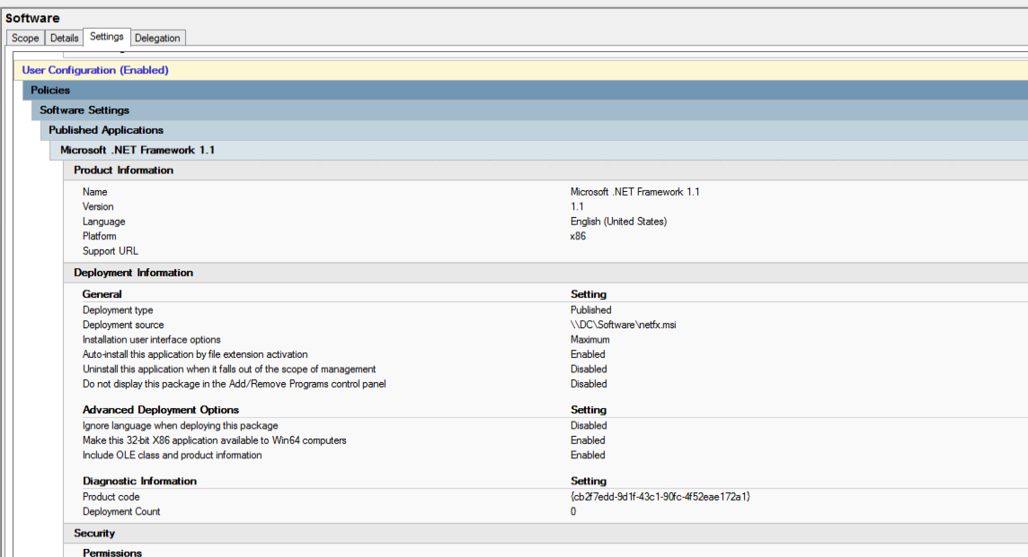
Verify –(exam ss pattern)

Slide 17
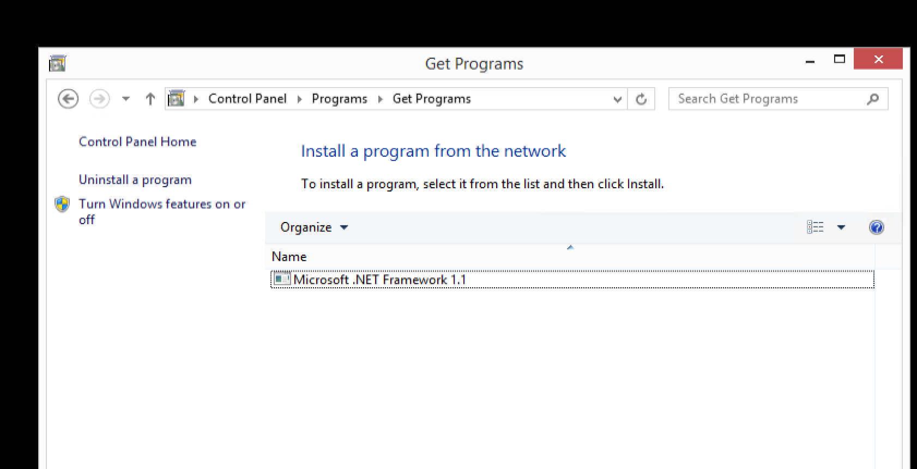
Login as hr in client machine-Control panel-get programs-verify.

Slide 18
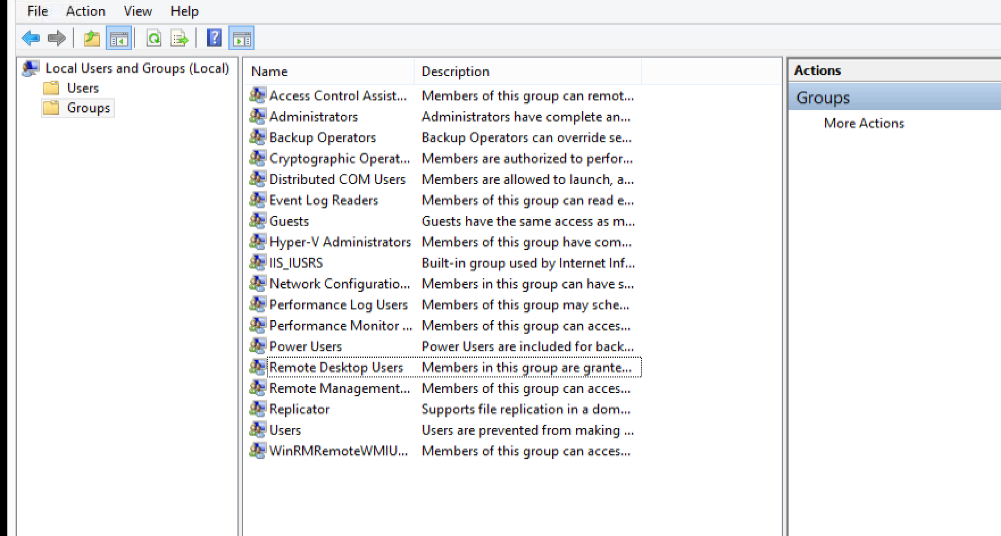


TIP: remote desktop error
Login to admin from client machine
Lusrmgr.msc
Group policies
Add to allow remote desktop and remote management

