Slide 1
ADSI

Slide 2
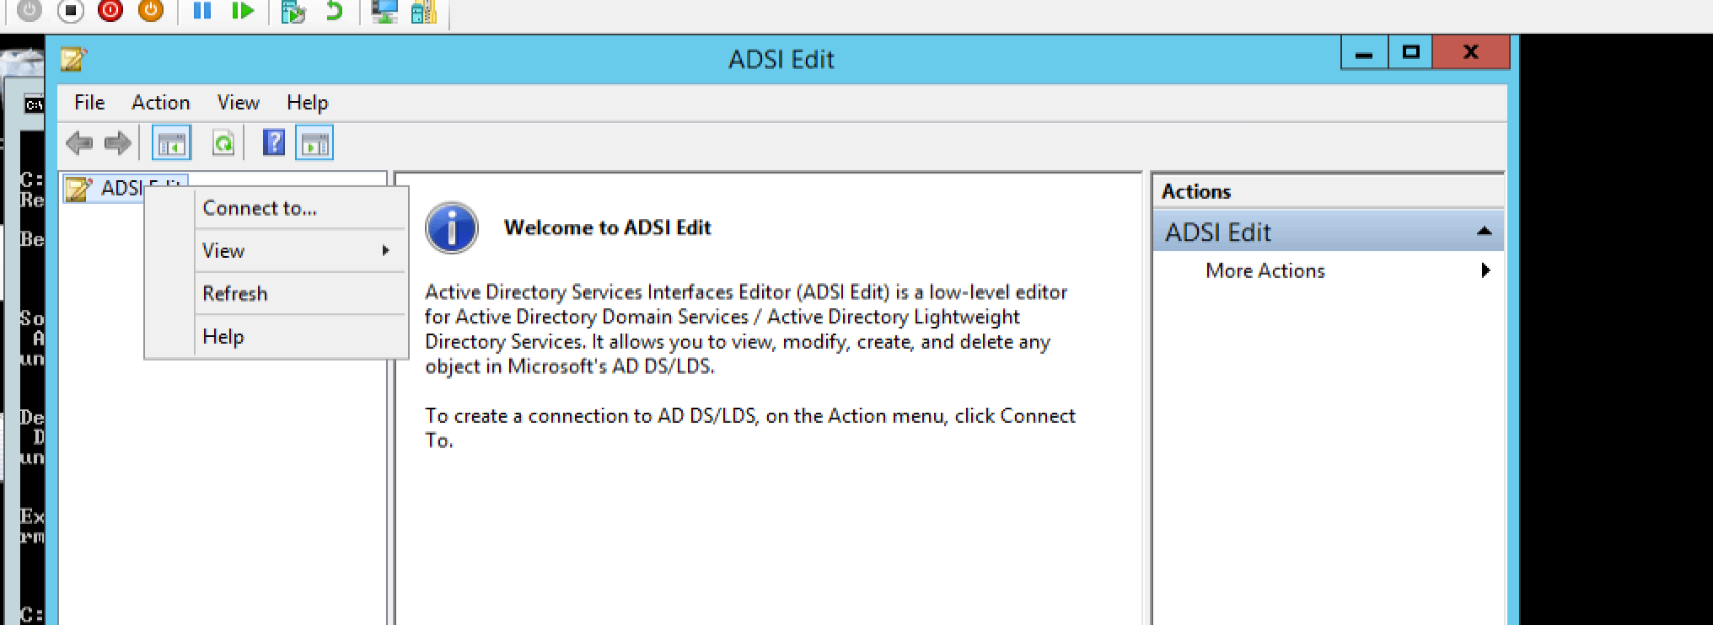
OPEN ADSI edit

Slide 3
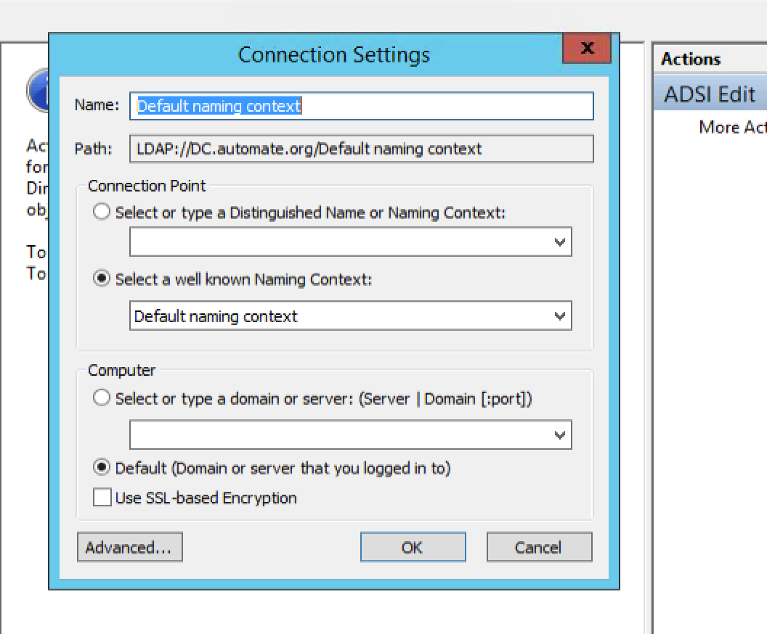
Give name click OK

Slide 4
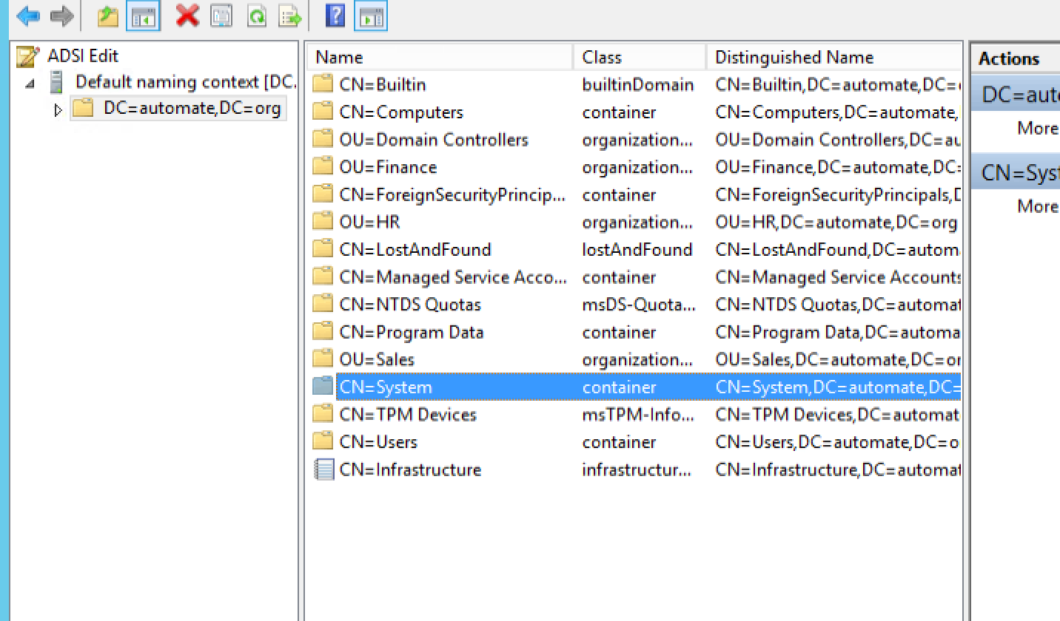
Open system

Slide 5
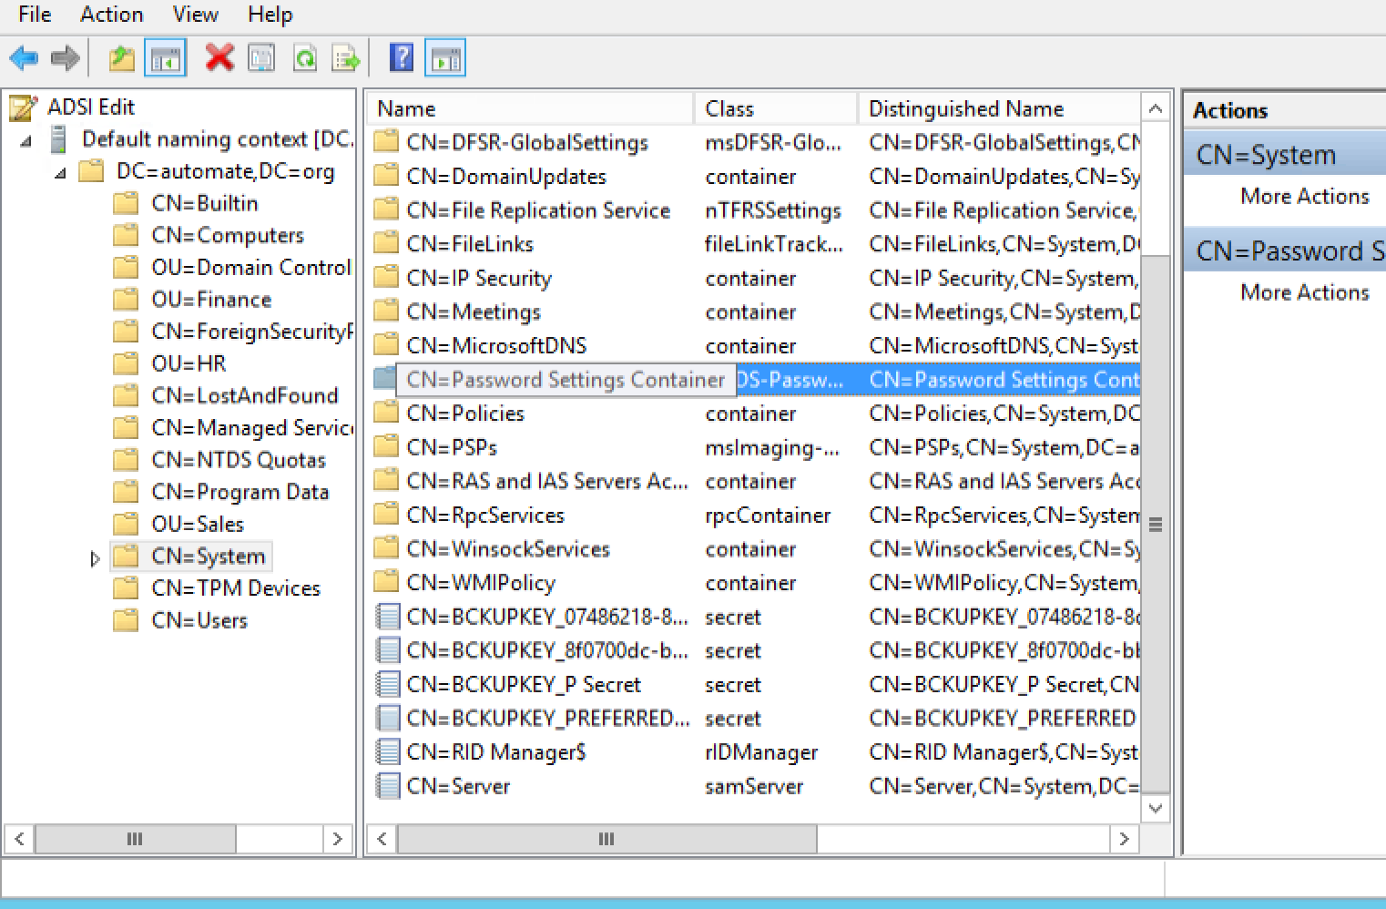
Open Password settings container

Slide 6
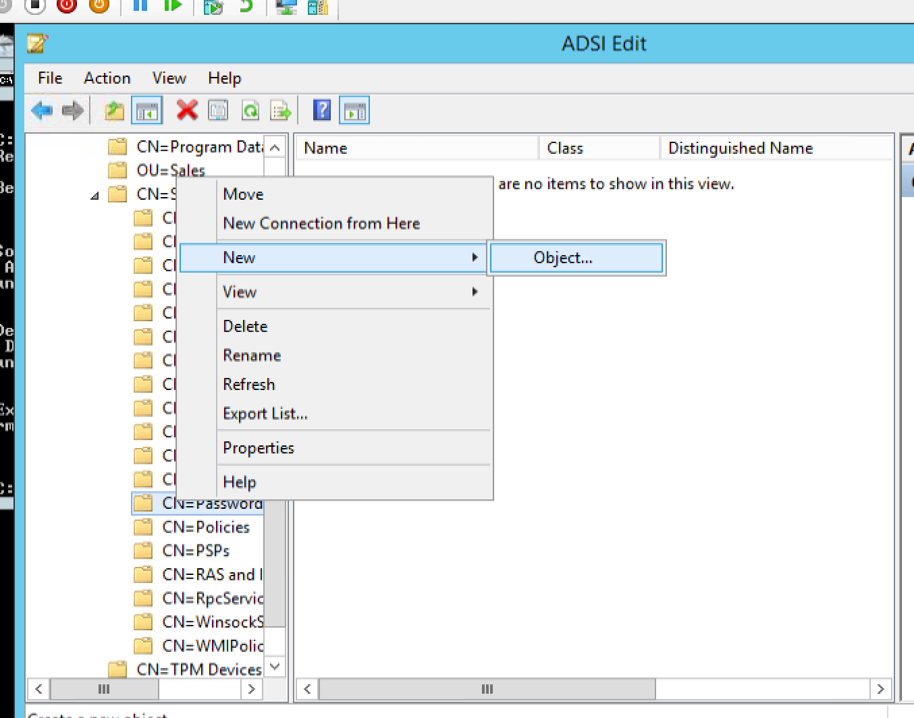
(Right click)Create new object

Slide 7
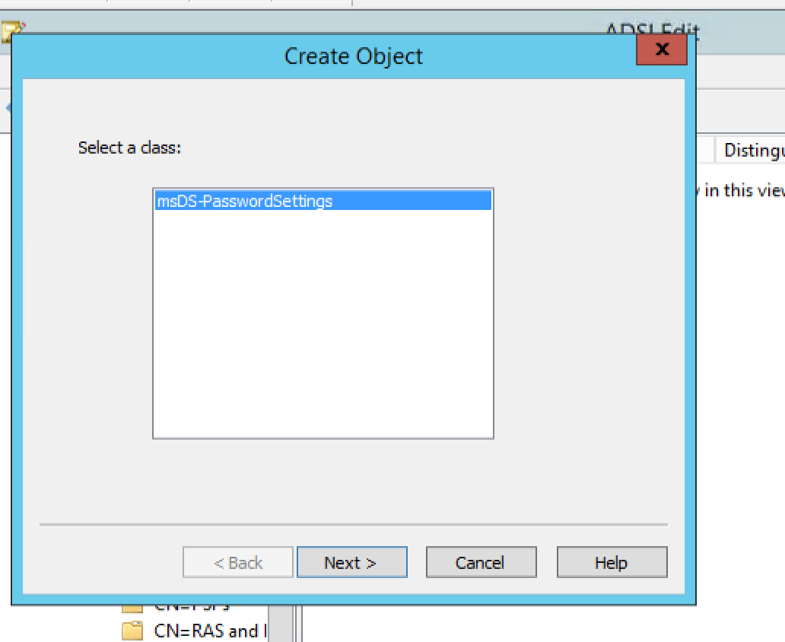
Next..

Slide 8
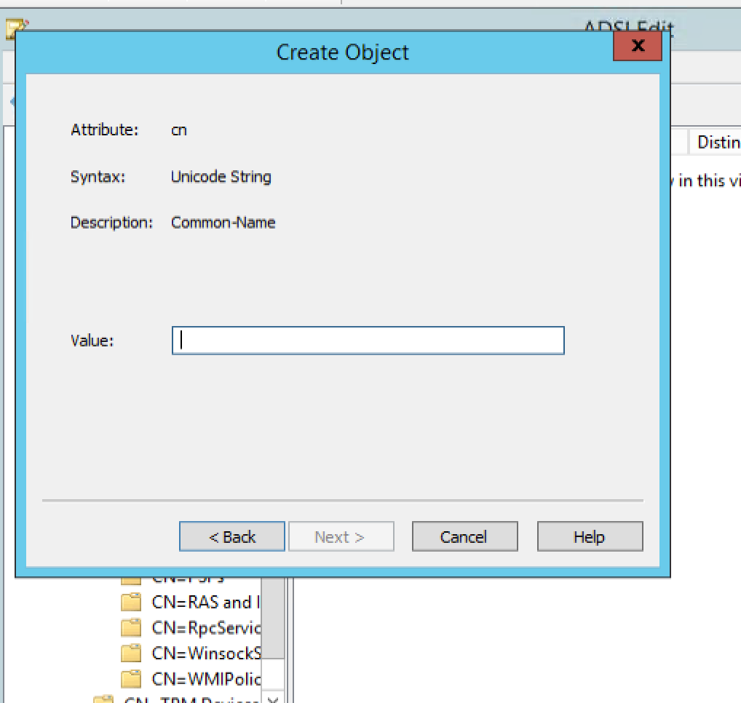
Give name (password policy1)

Slide 9
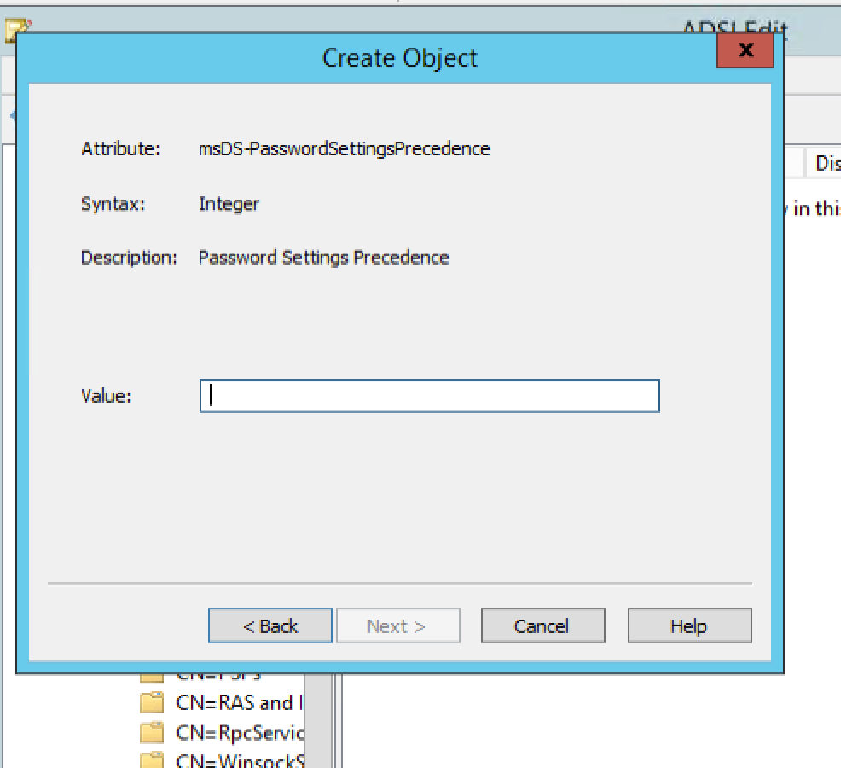
Enter 1 as value

Slide 10
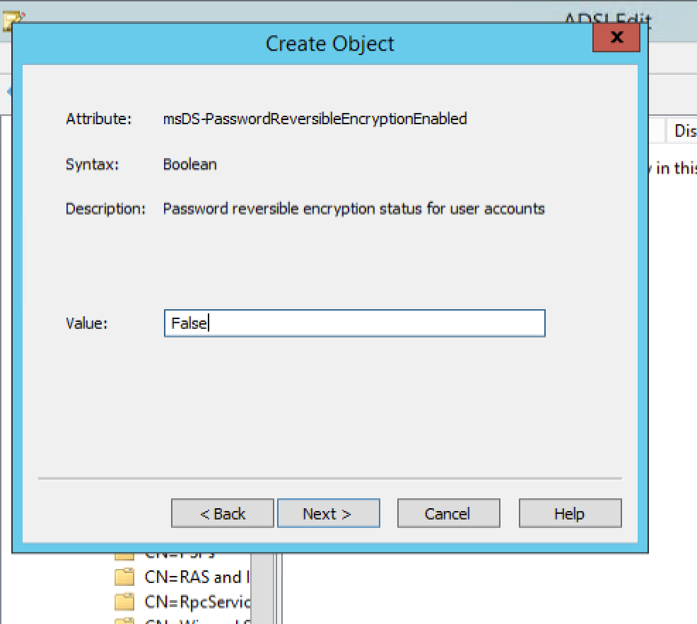
GIVE FALSE

Slide 11
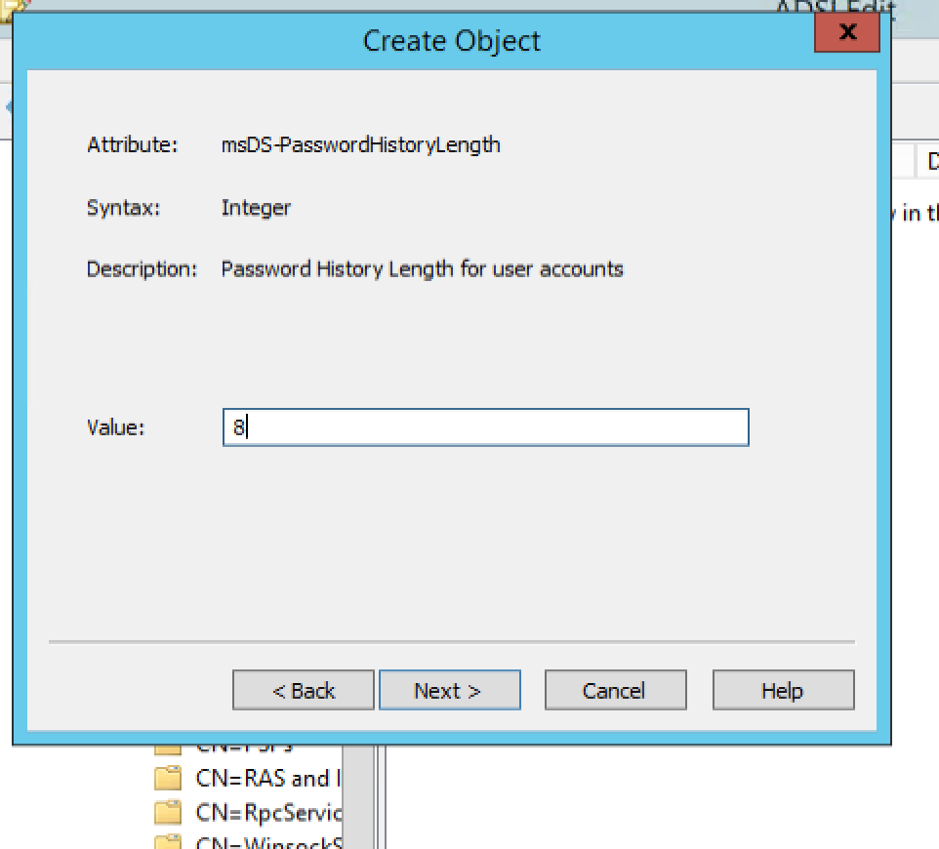
Add min length

Slide 12
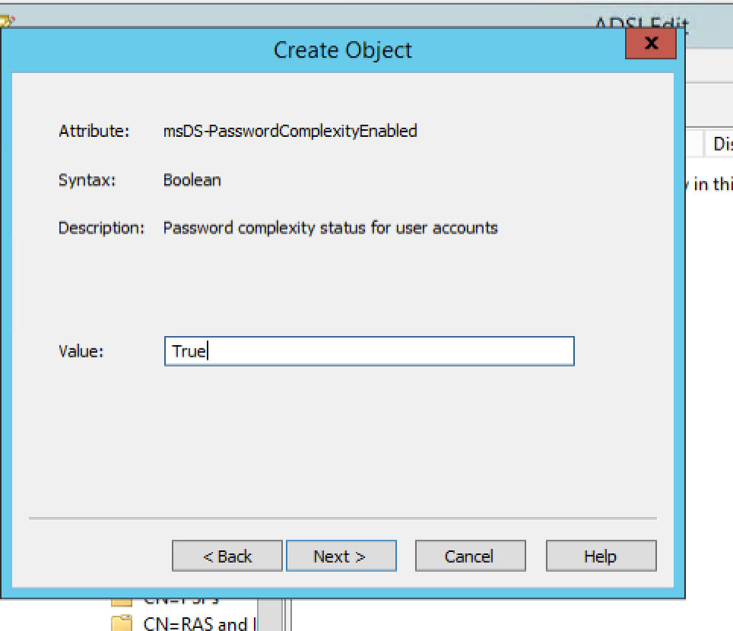
True or false

Slide 13
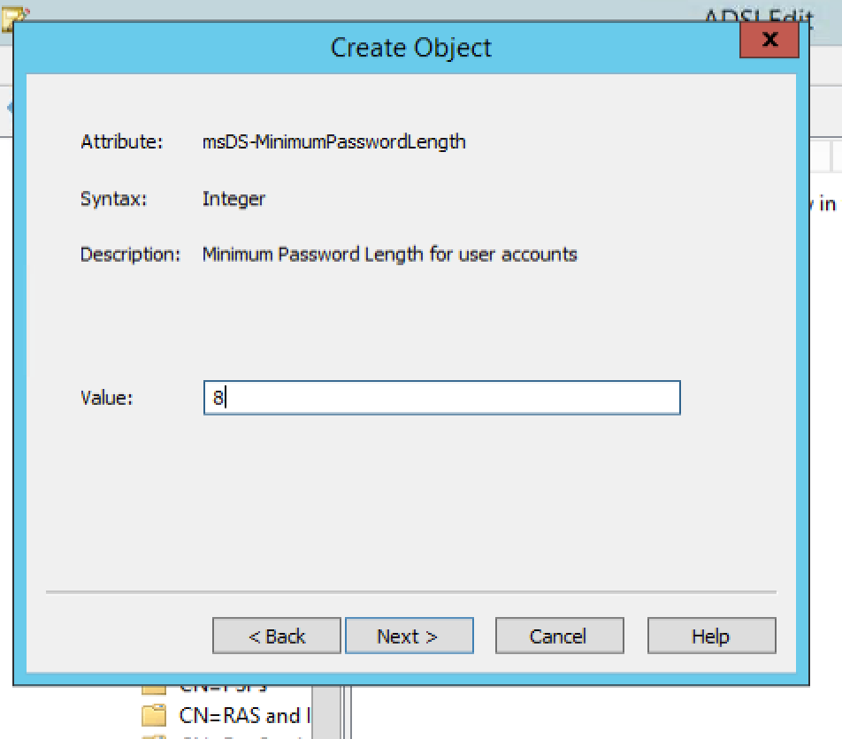
Min length of password

Slide 14
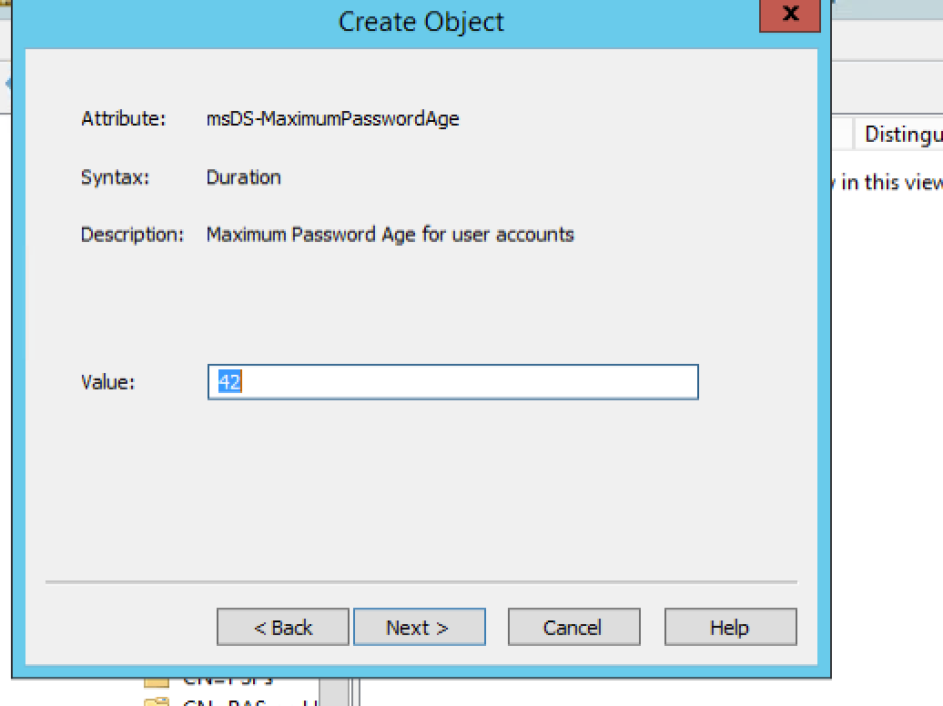
MAX length

Slide 15
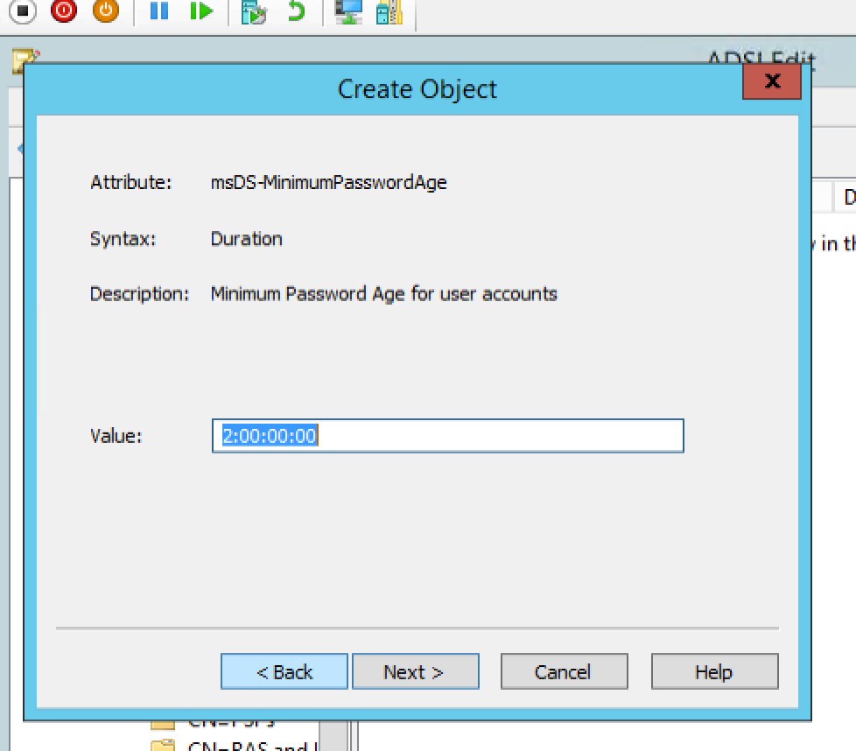
Min duration (dd:hh:mm:ss)

Slide 16
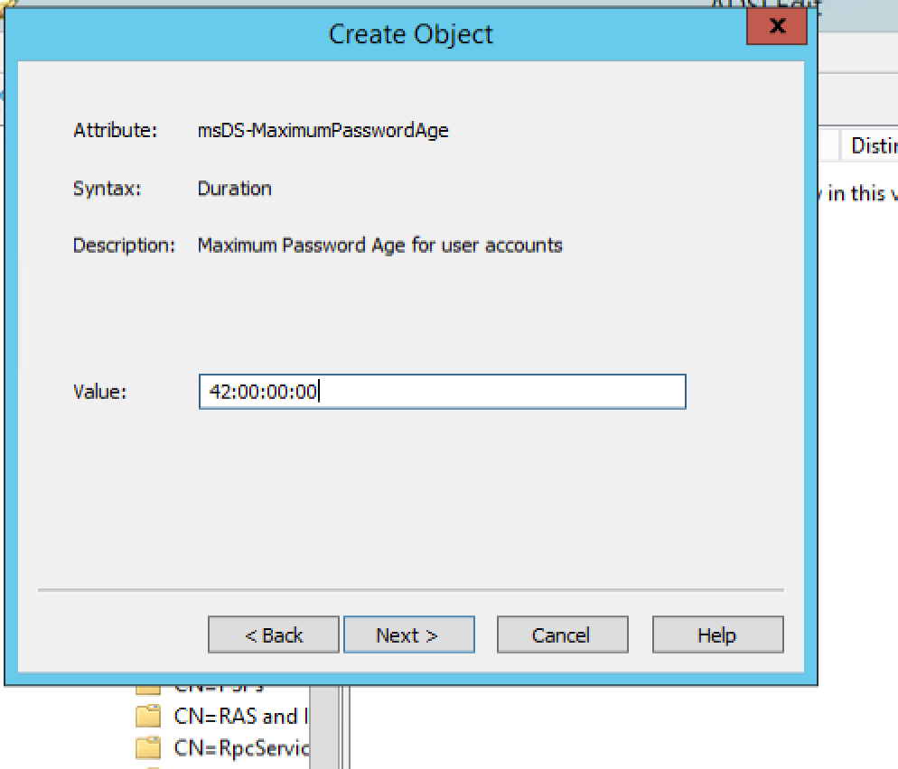
Max duration (dd:hh:mm:ss)

Slide 17
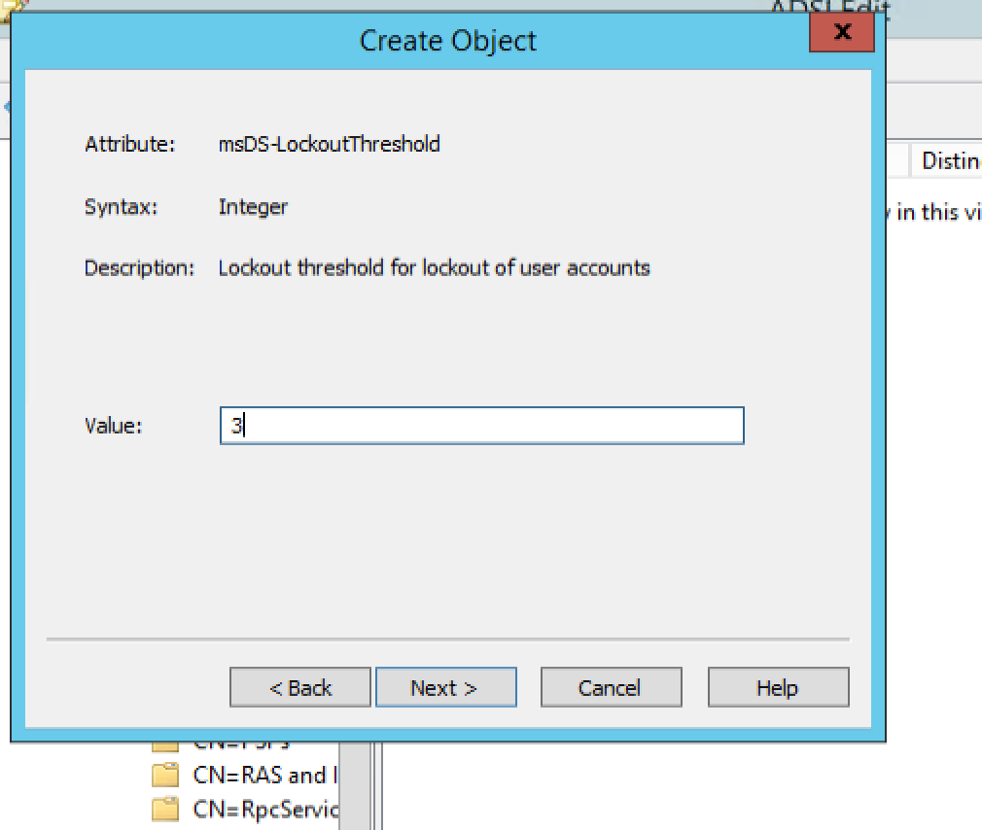
Number of invalid attempts (locked after x attempts)

Slide 18
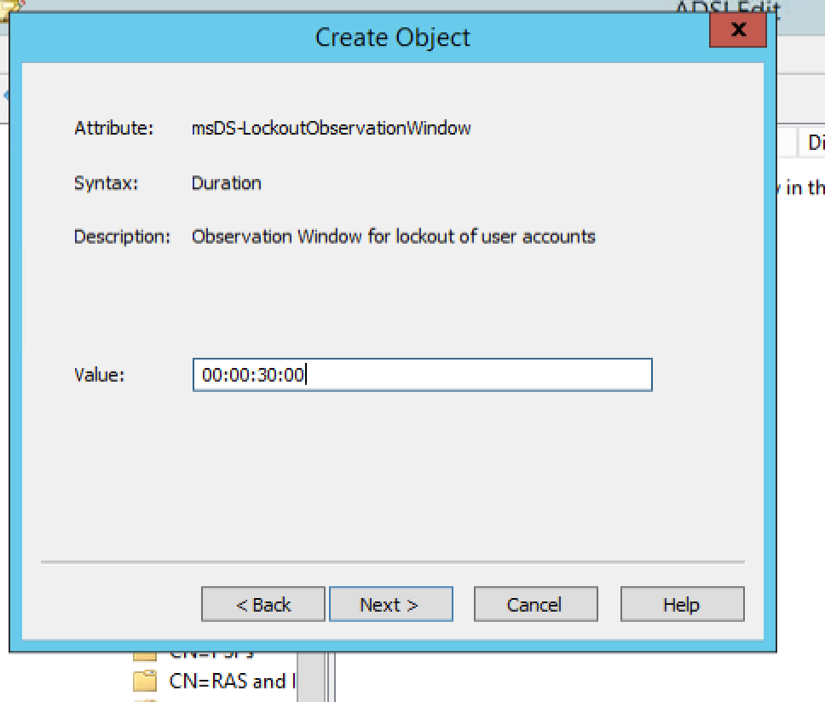
Wait time after lockout

Slide 19
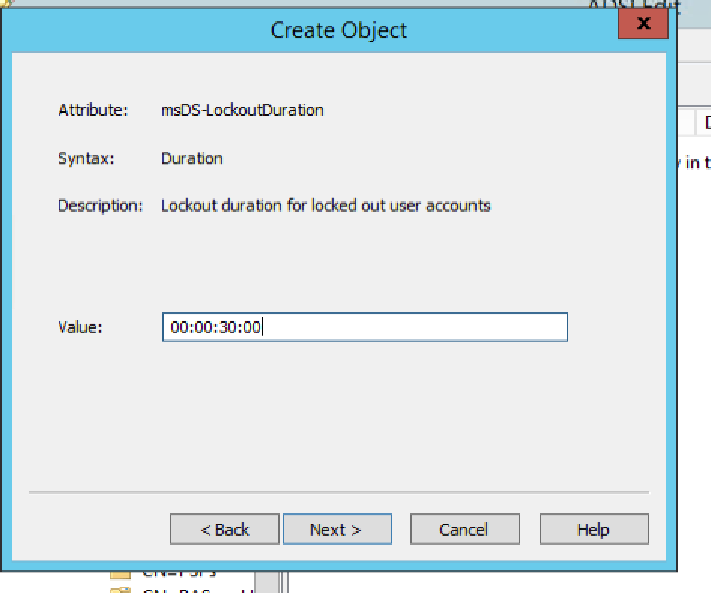
Wait time until next attempt

Slide 20
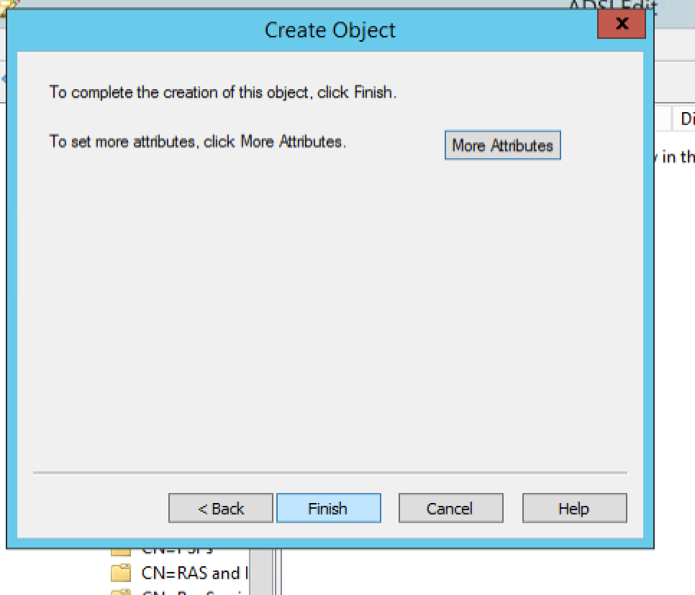
Finish

Slide 21
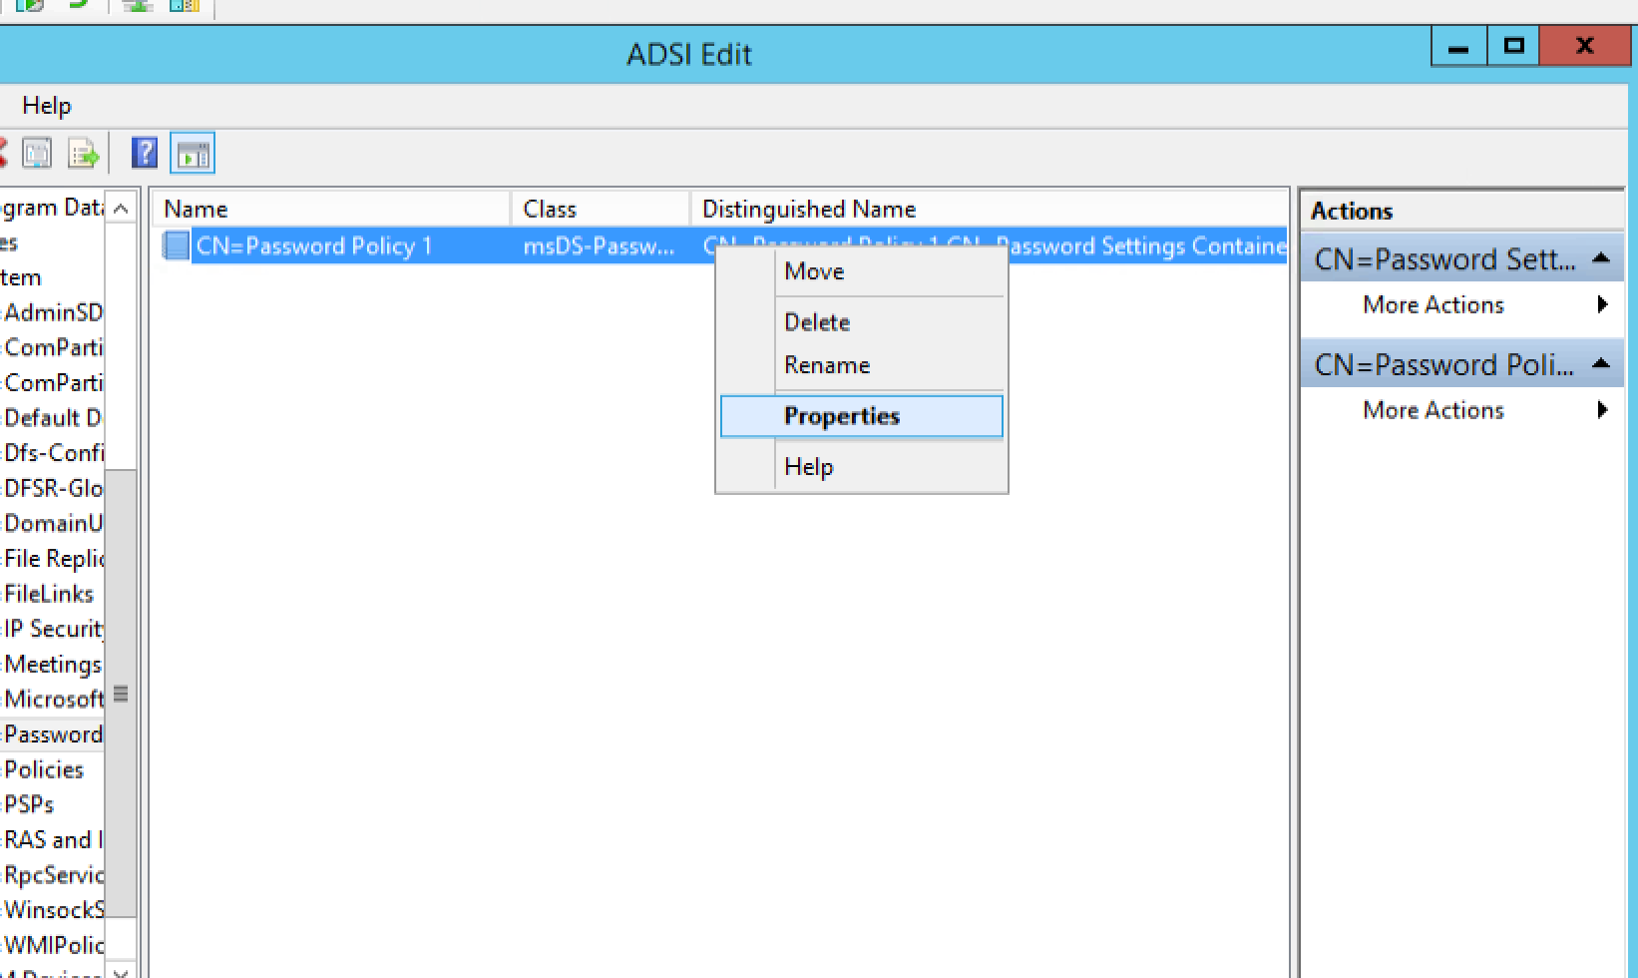
Properties

Slide 22
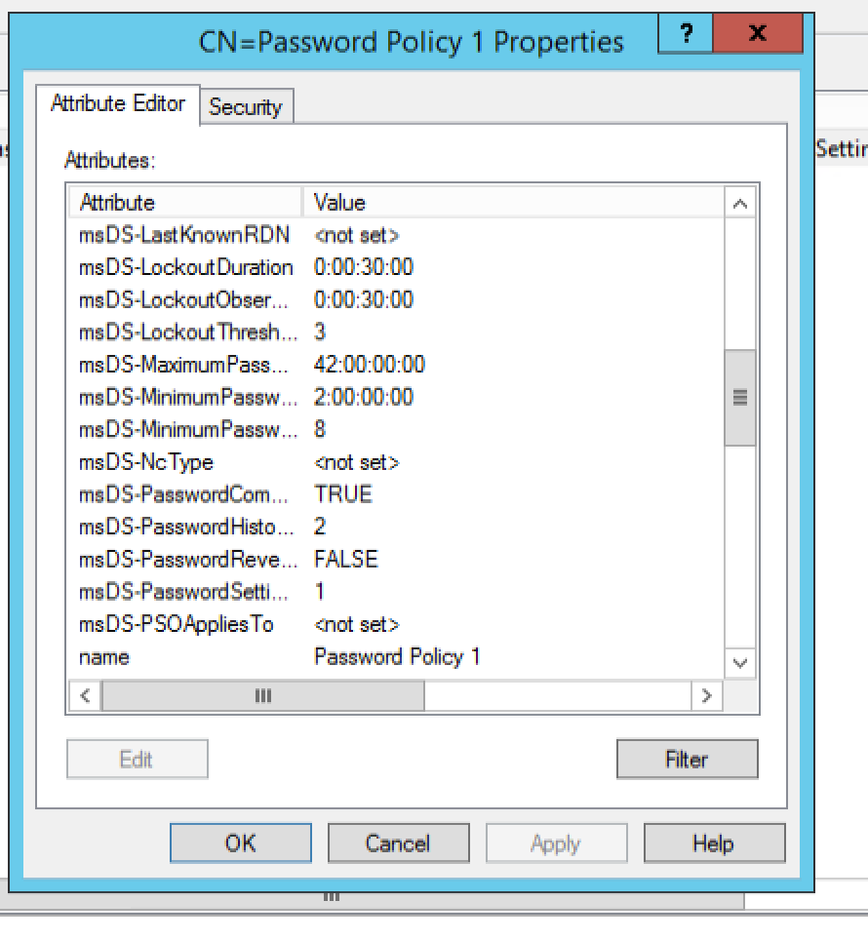
SS FOR EXAM (scroll)

Slide 23
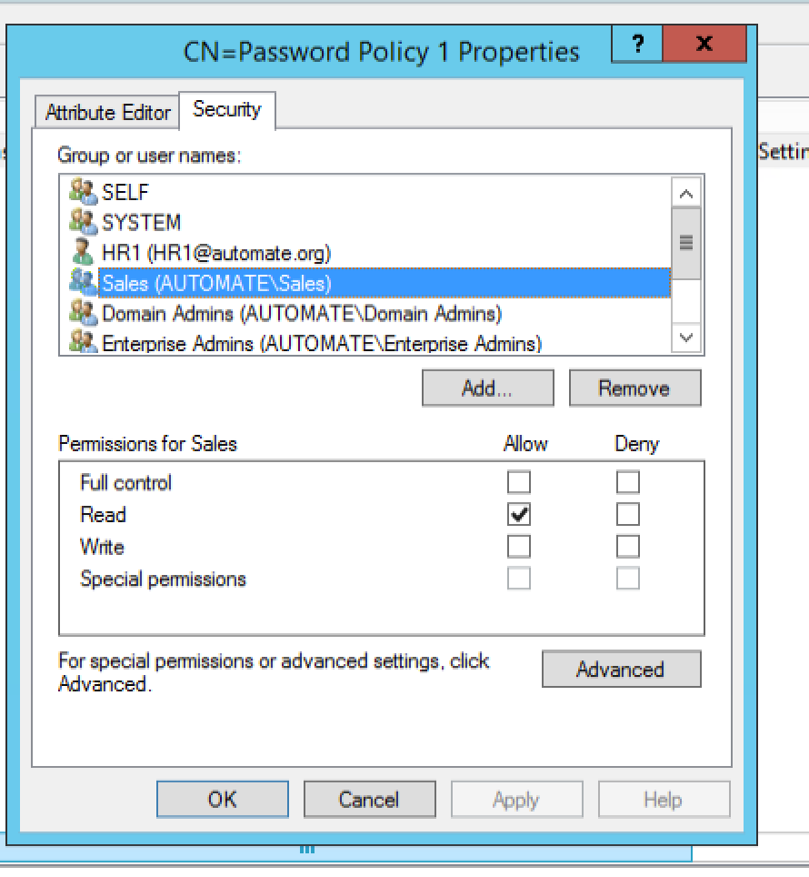
If asked change/add users/groups.

