Slide 1
BACKUP DEMO

Slide 2
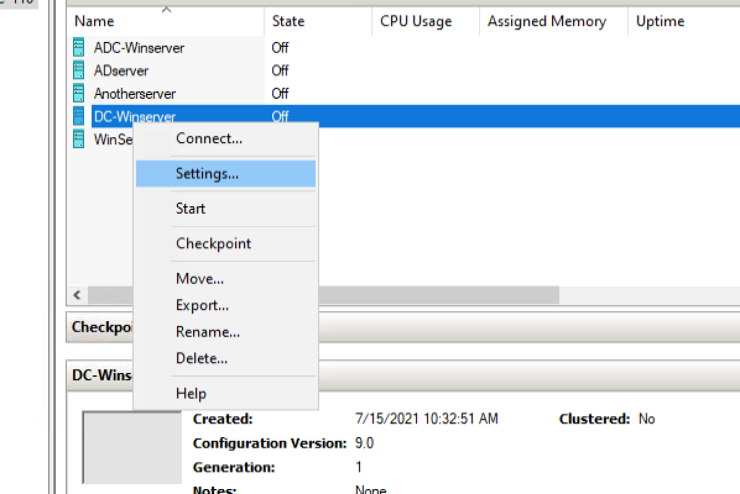
OPEN VM SETTING (TURN OFF SETTINGS)

Slide 3
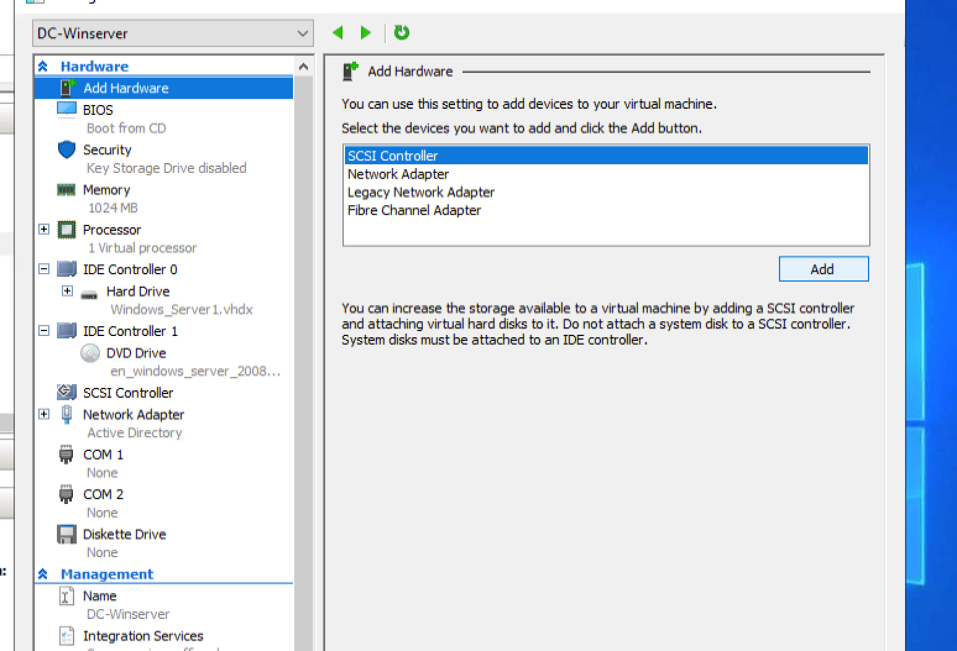
ADD SCSI CONTROLER

Slide 4
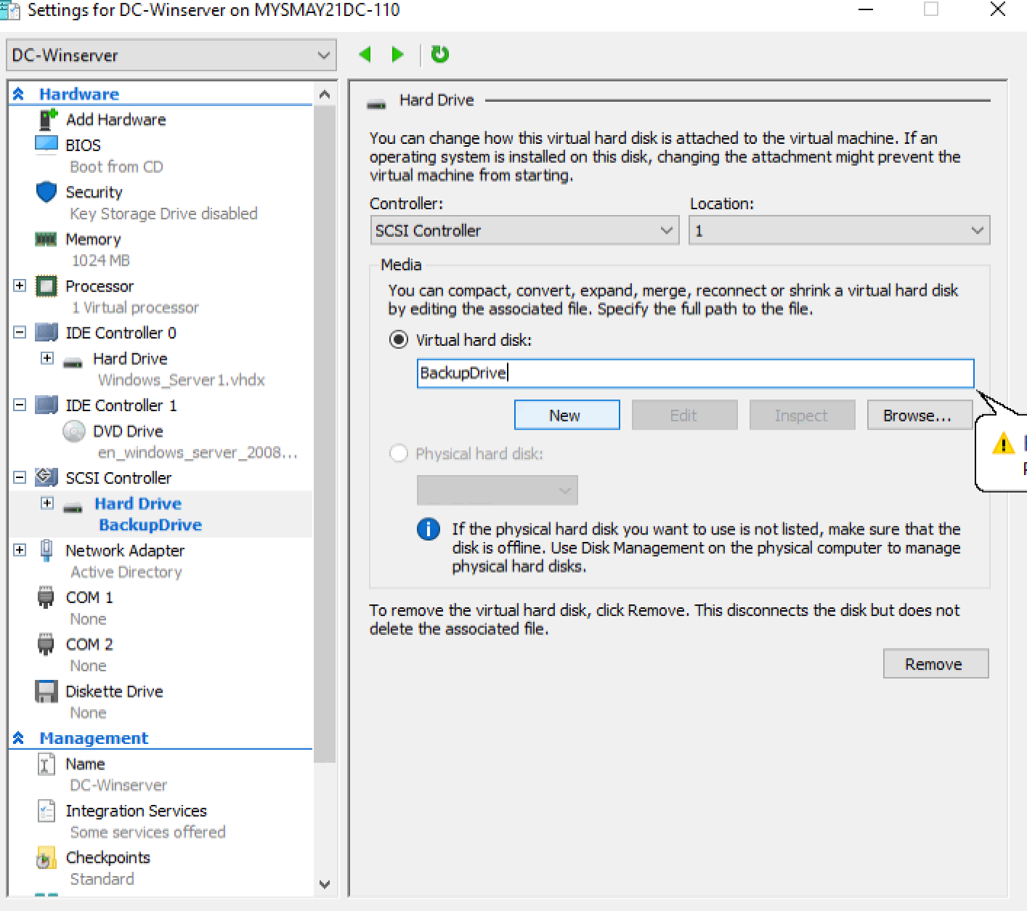
ADD NEW VIRTUAL HARDDISK

Slide 5
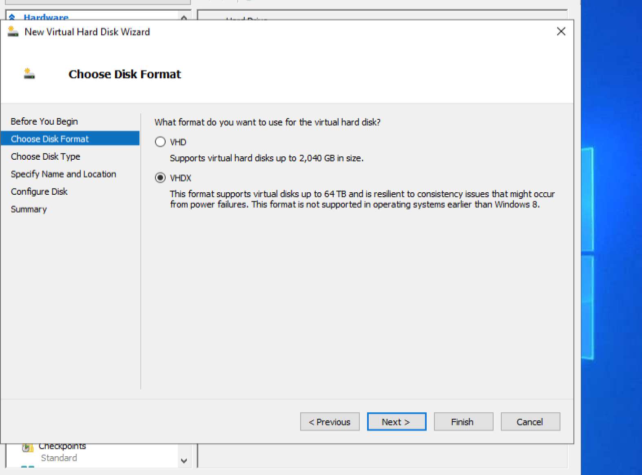
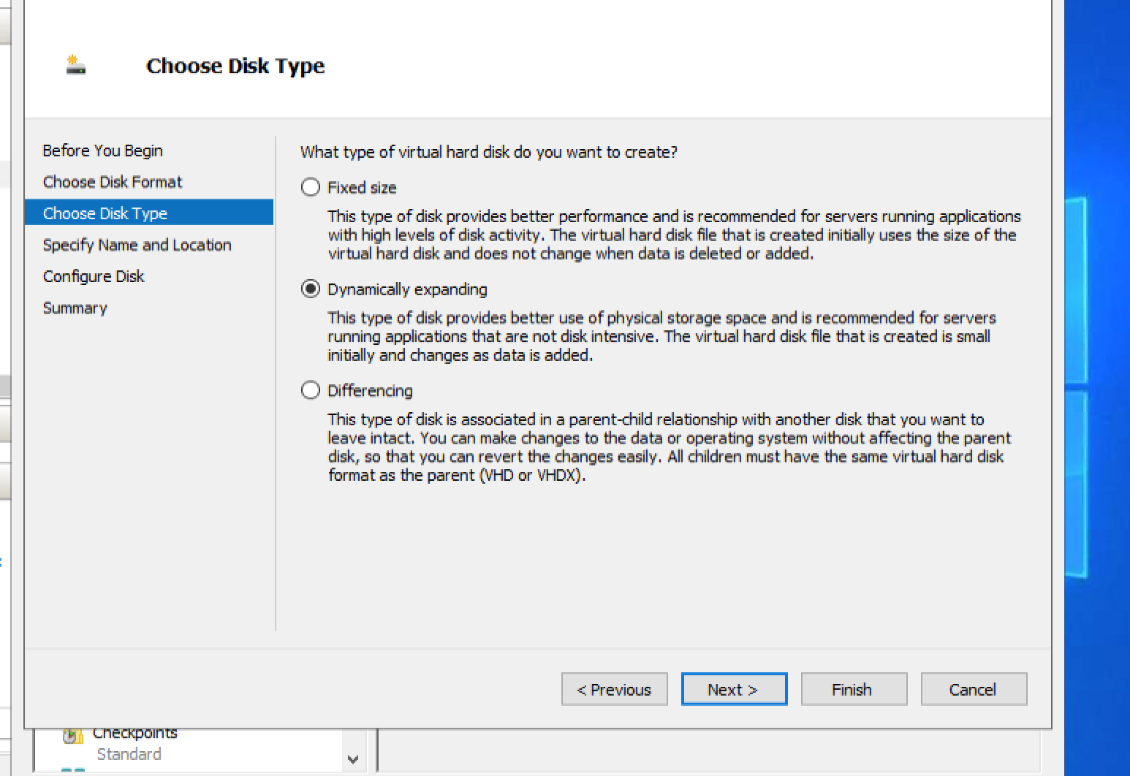
VHDX. ----- DYNAMIC OR FIXED

Slide 6
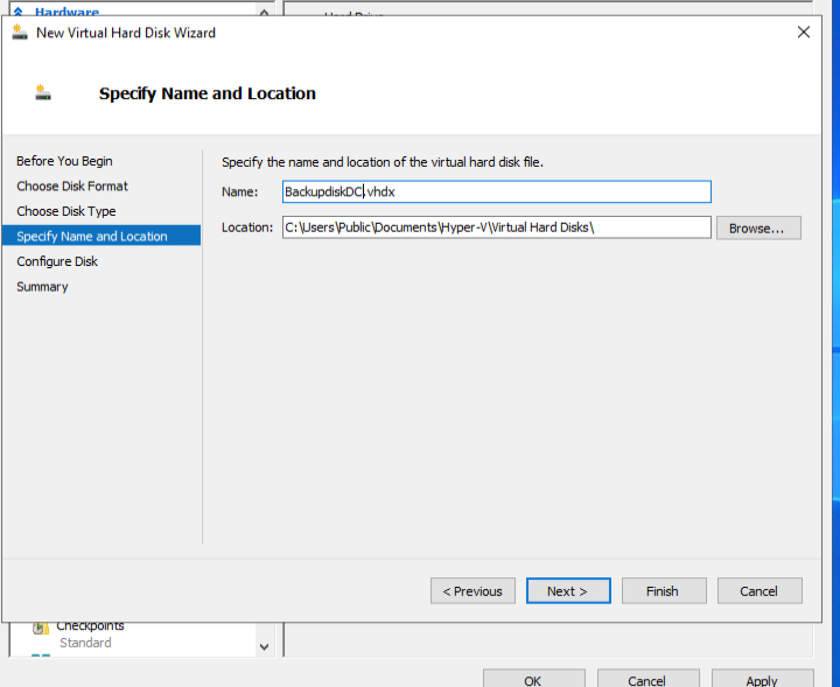
Change name --- next --- 15GB SIZE

Slide 7
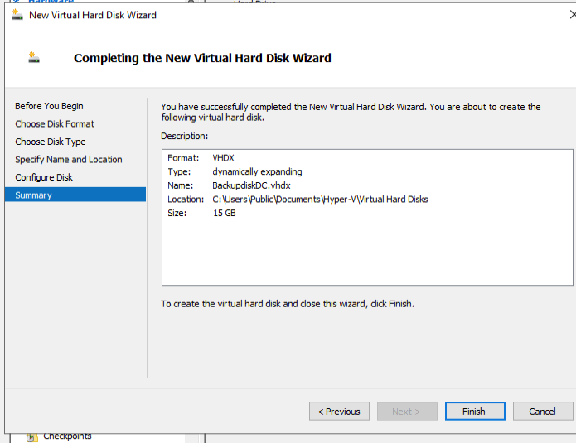
Final

Slide 8
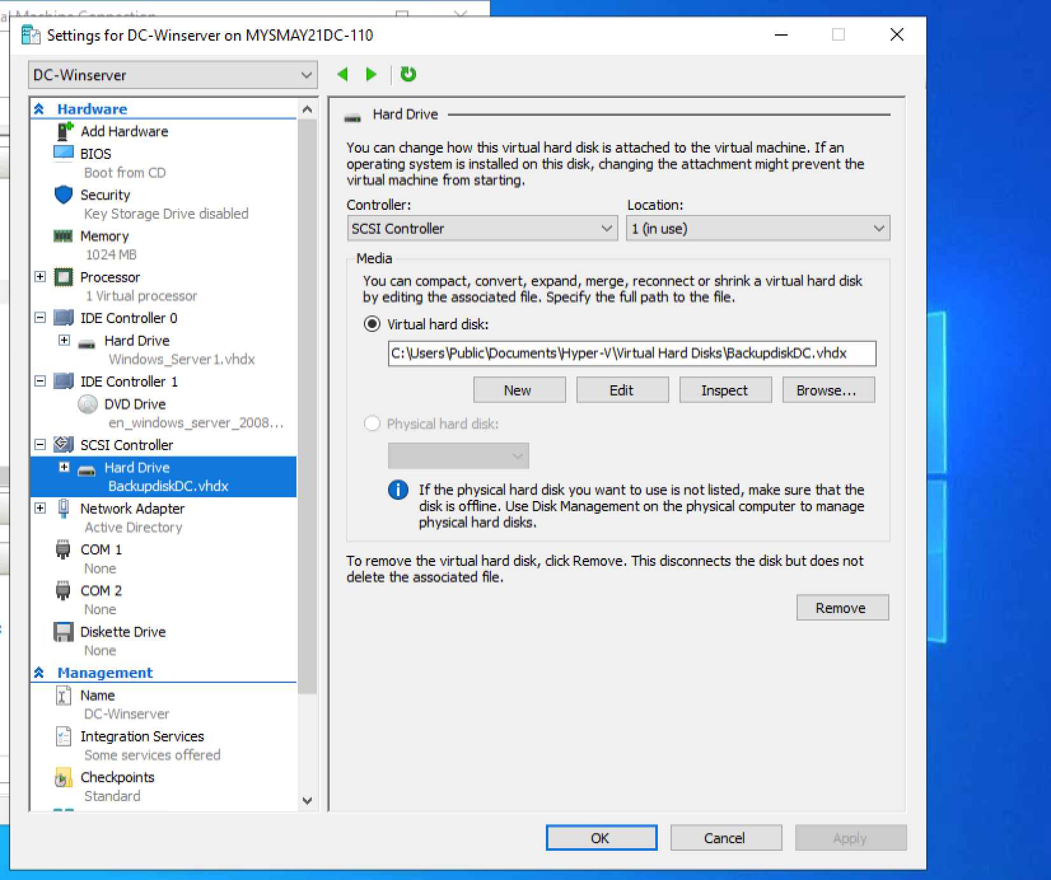
APPLY ---OK. START MACHINE

Slide 9
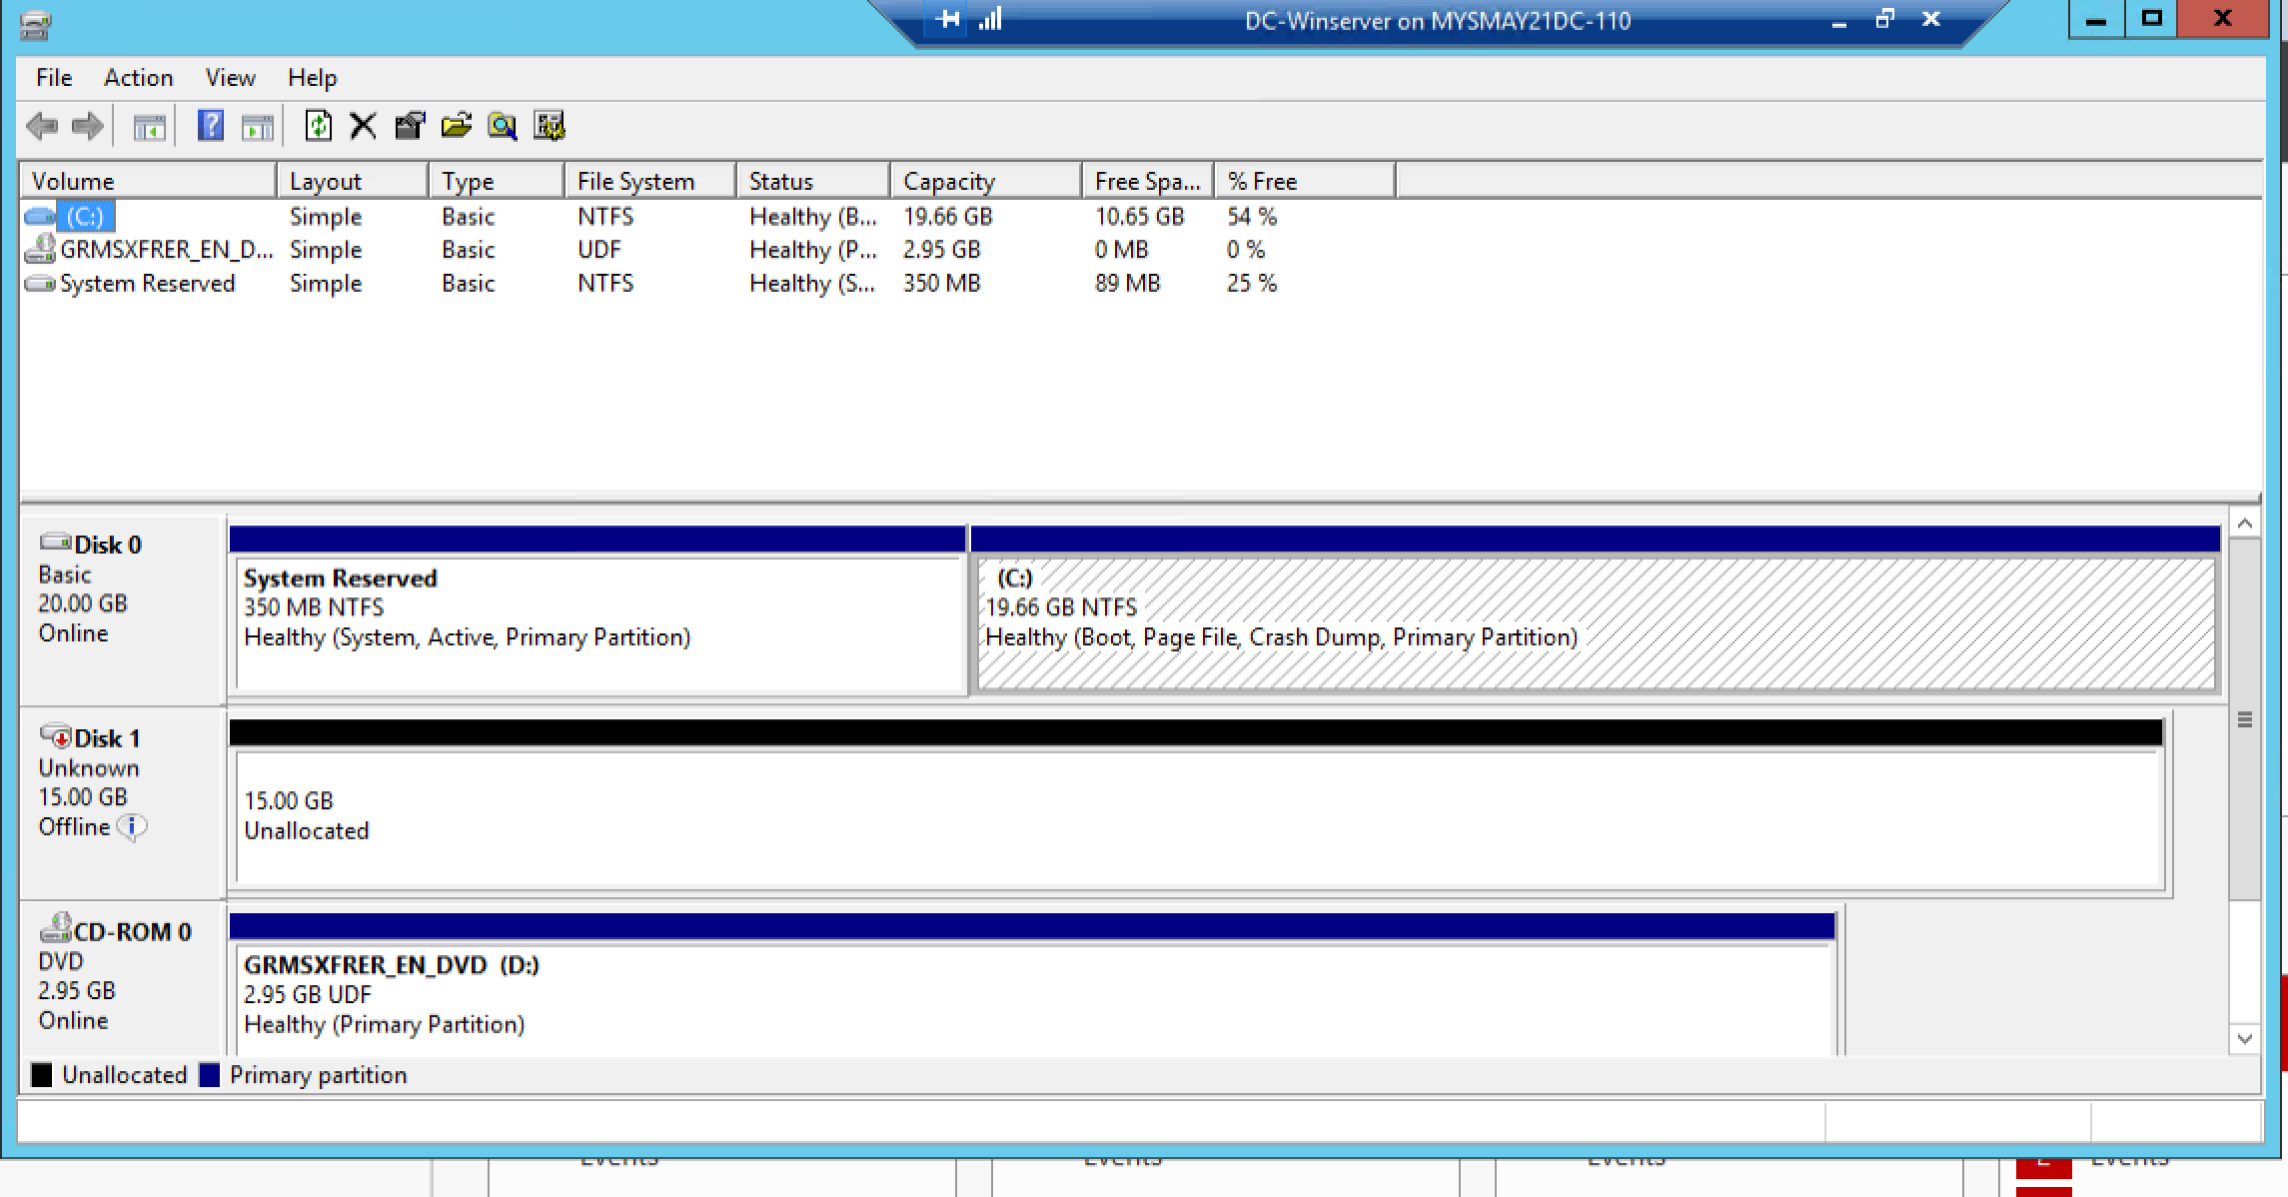

OPEN VM – DISK MANAGEMENT
NEW DRIVE VISIBLE

Slide 10
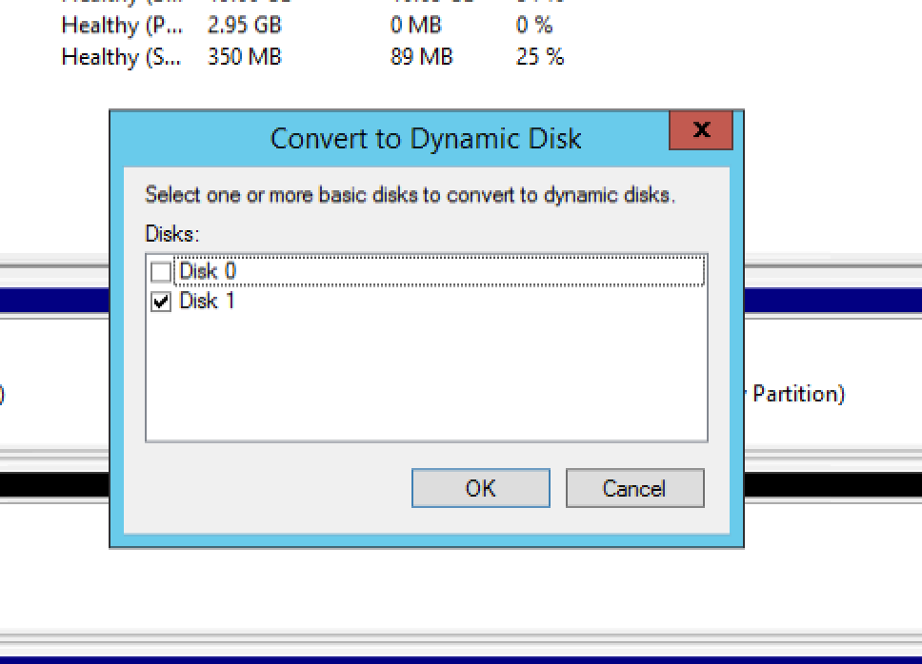
Online-convert to Dynamic disk

Slide 11
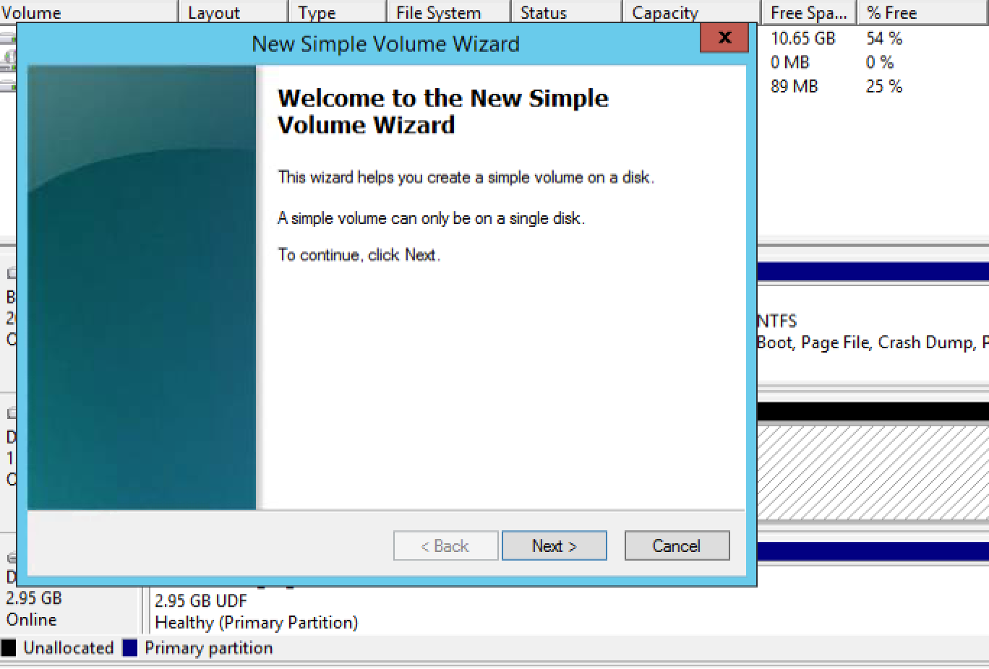
New simple volume

Slide 12
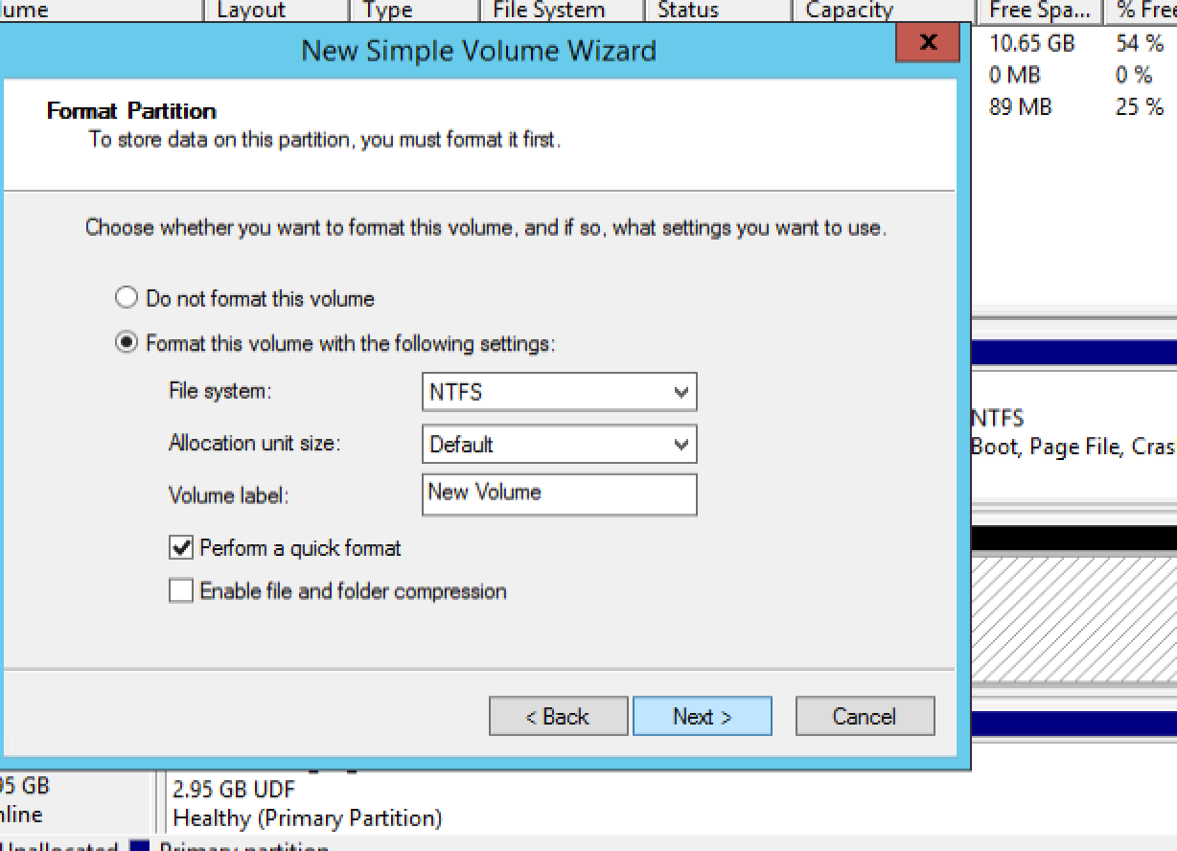
Final

Slide 13
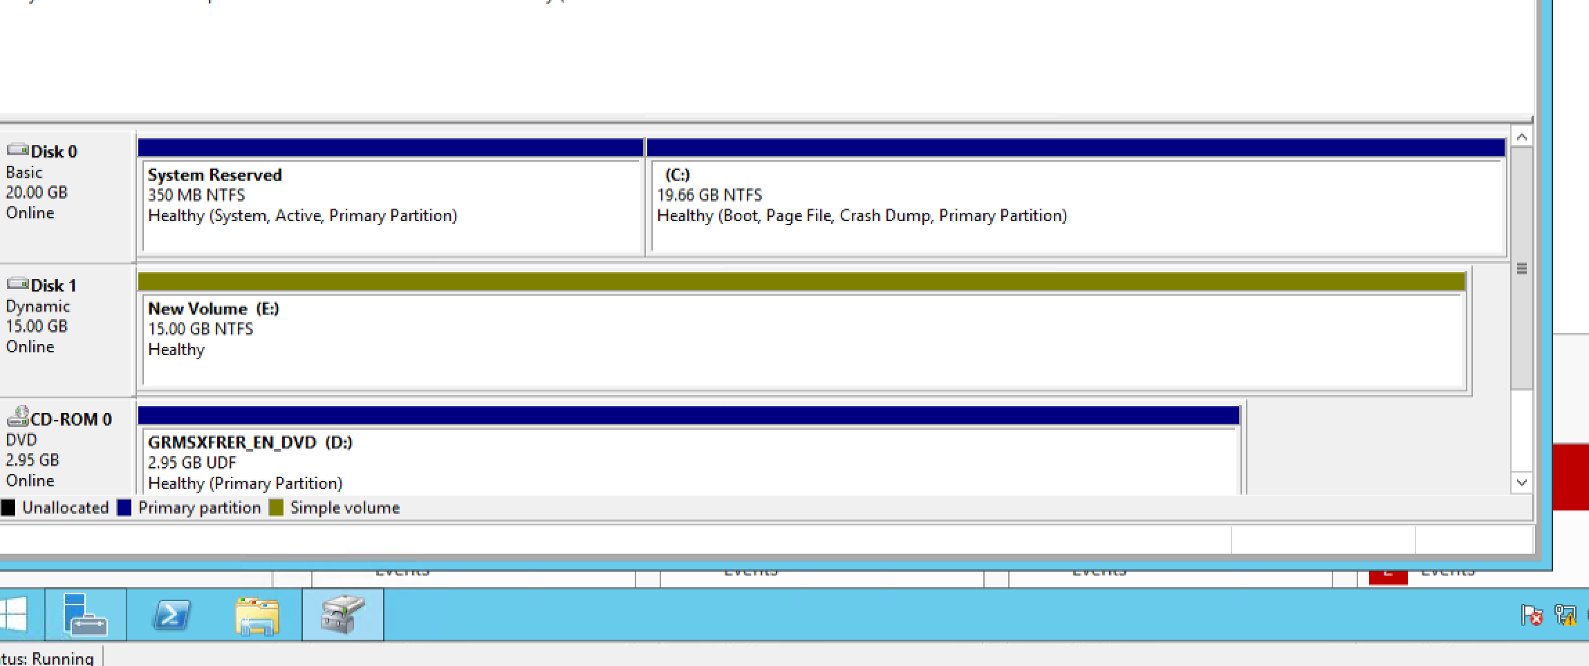
Should look like this

Slide 14
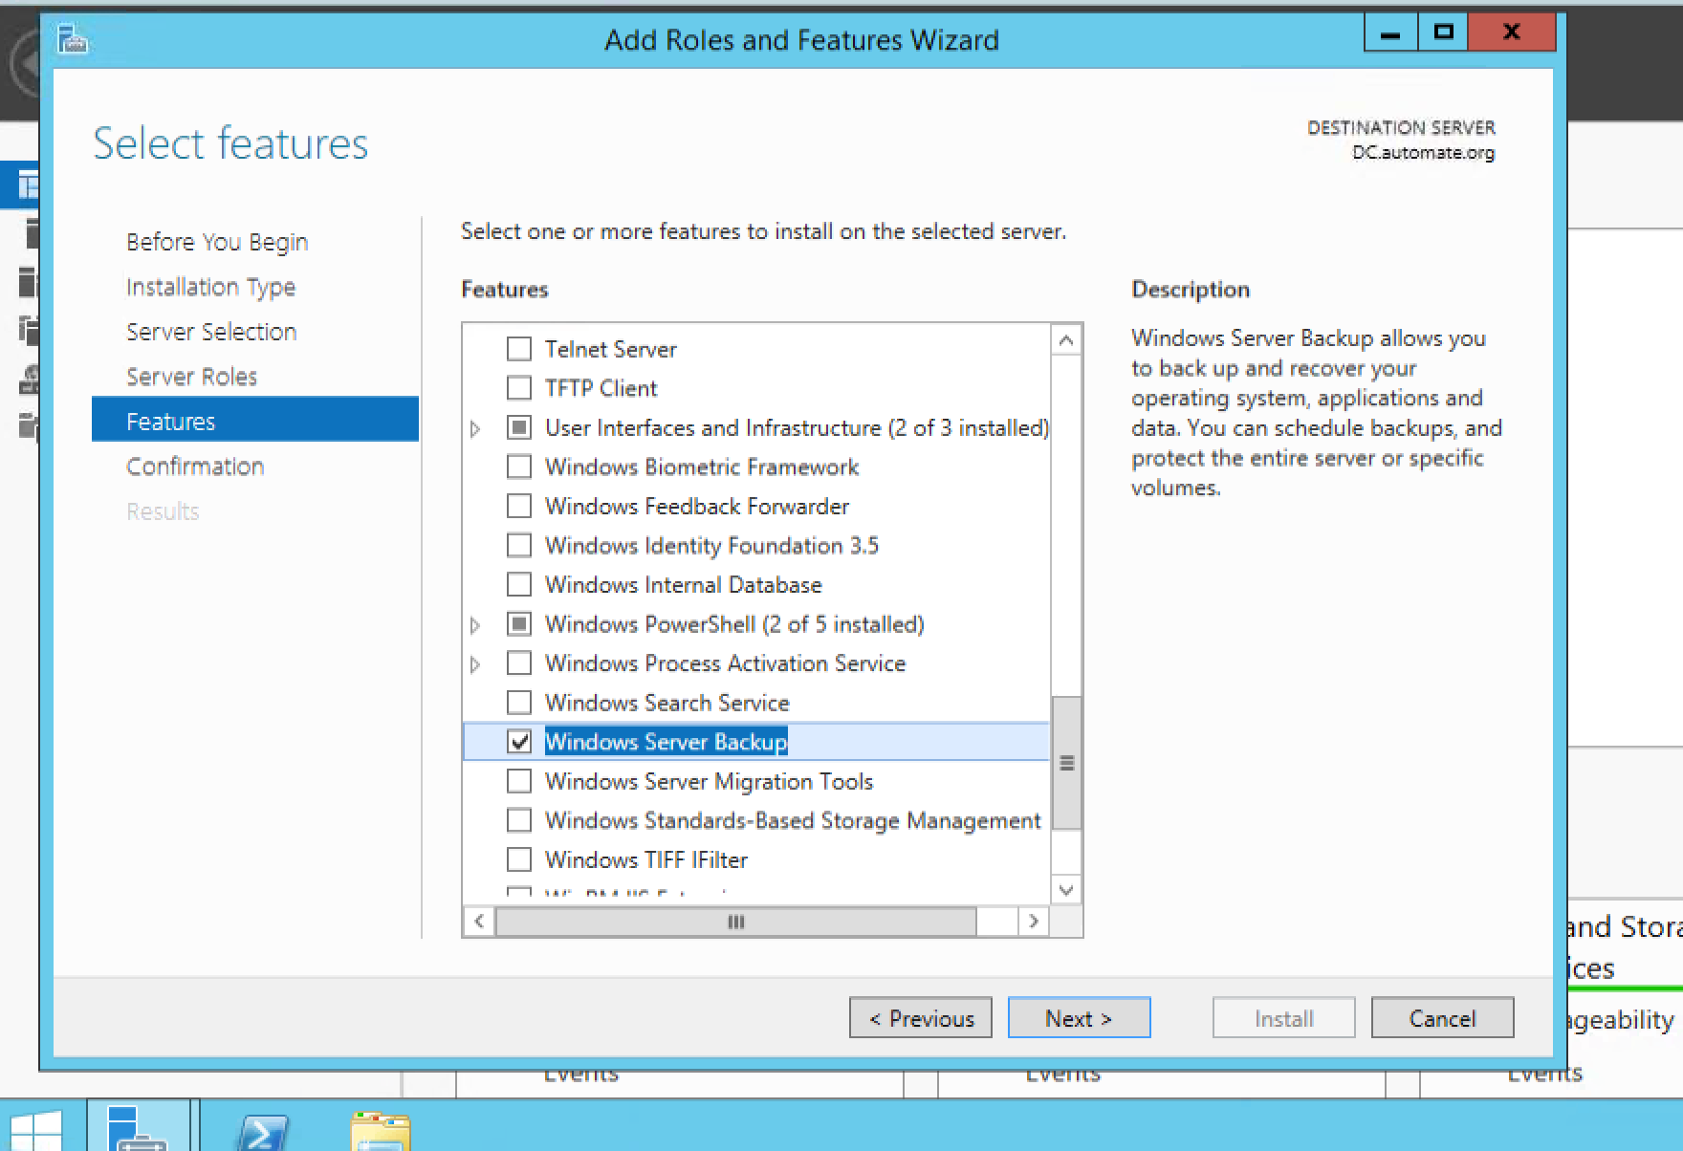
Add FEATURE (NOT ROLE)

Slide 15
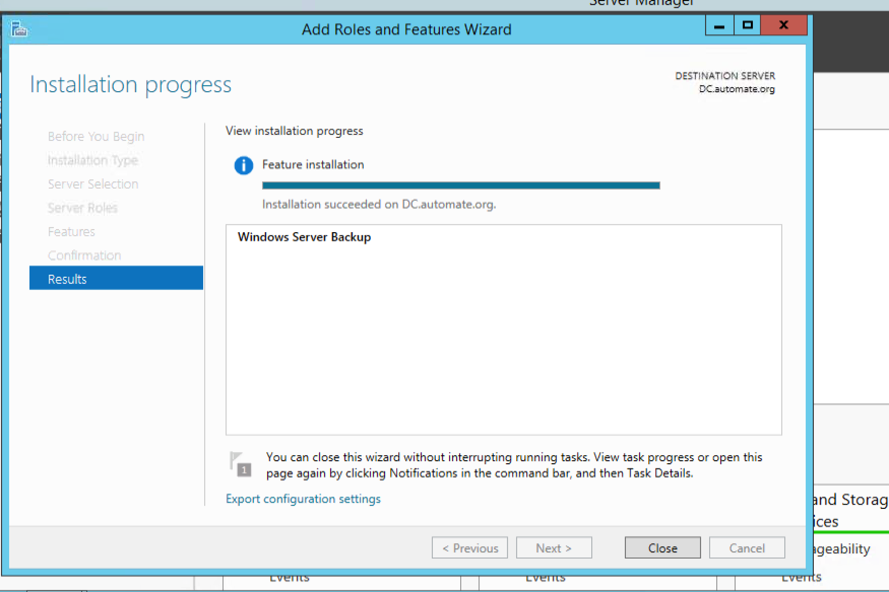
Close

Slide 16
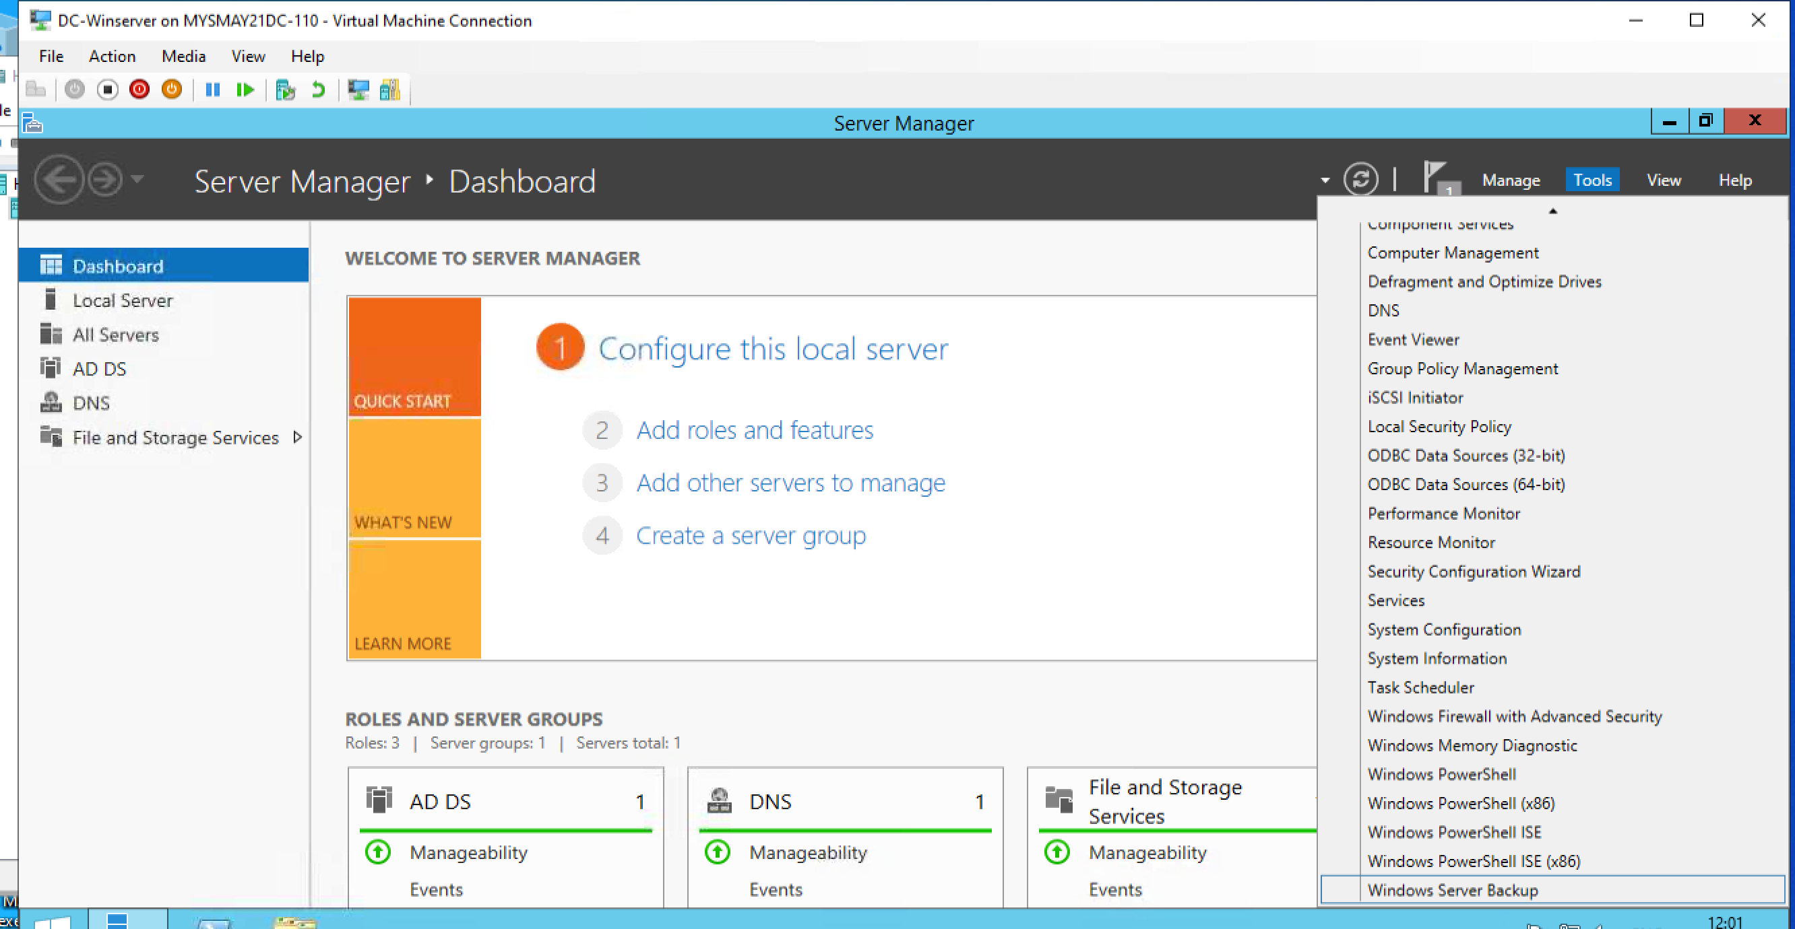
Open tools ---windows server backup

Slide 17
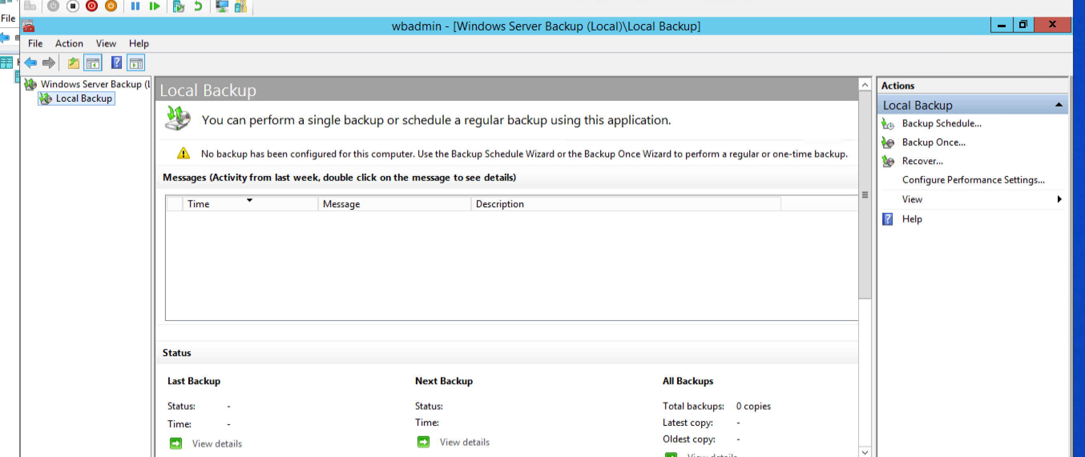
Local backup

Slide 18
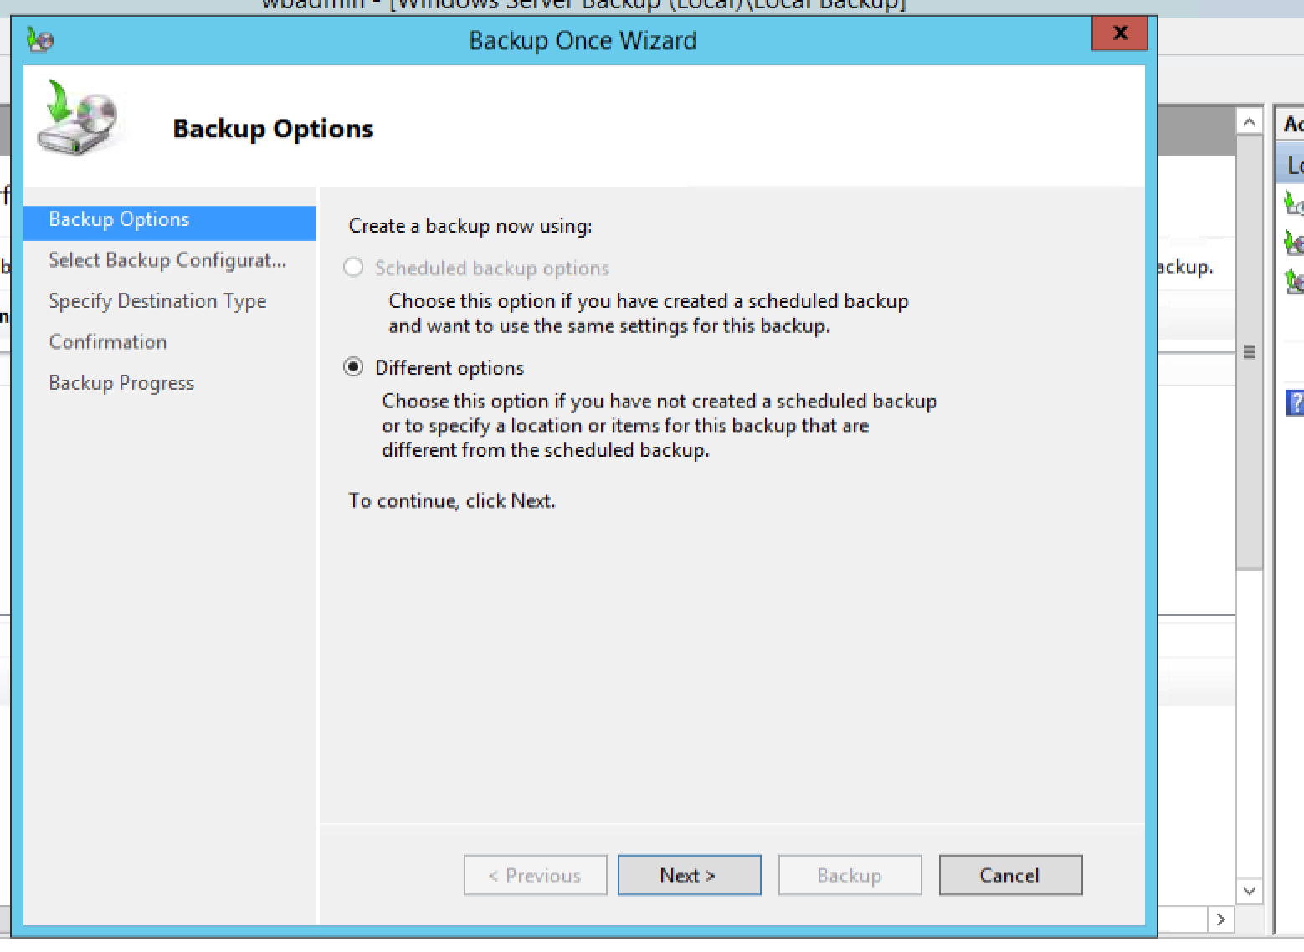
Select backup once for now

Slide 19
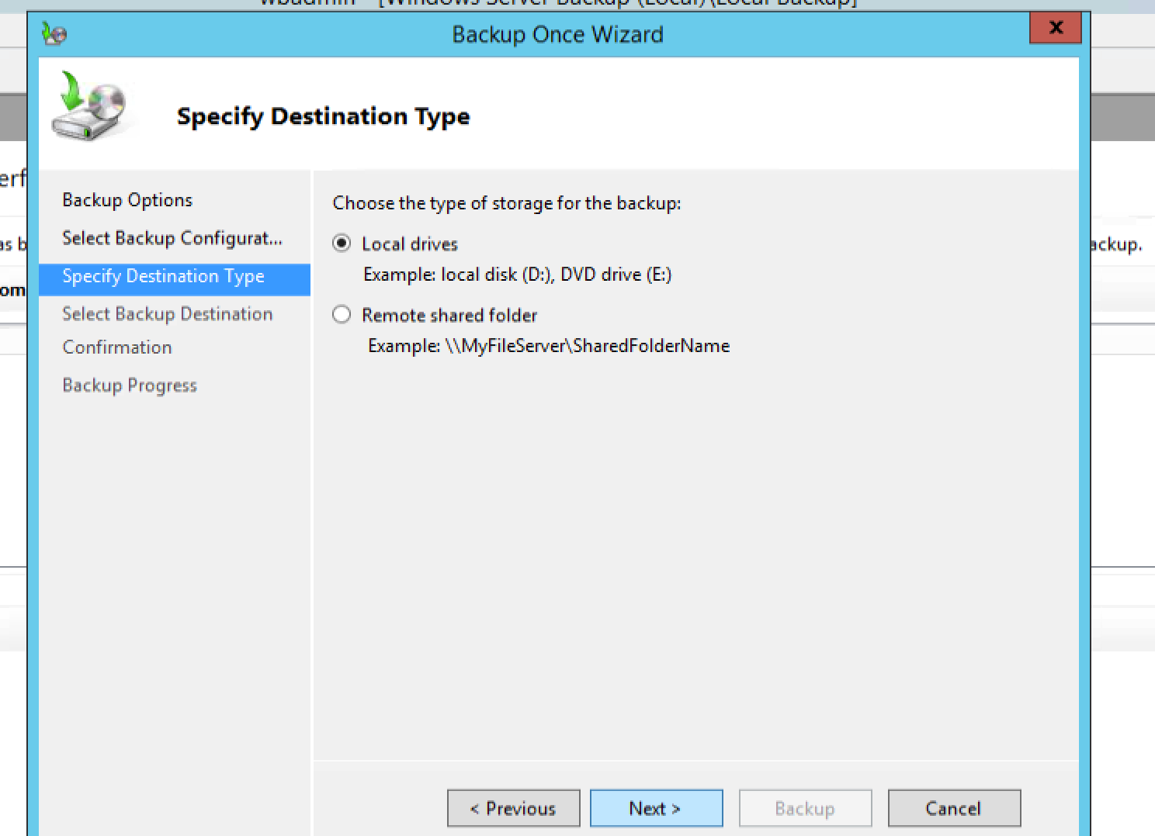
Keep local drives only for now

Slide 20
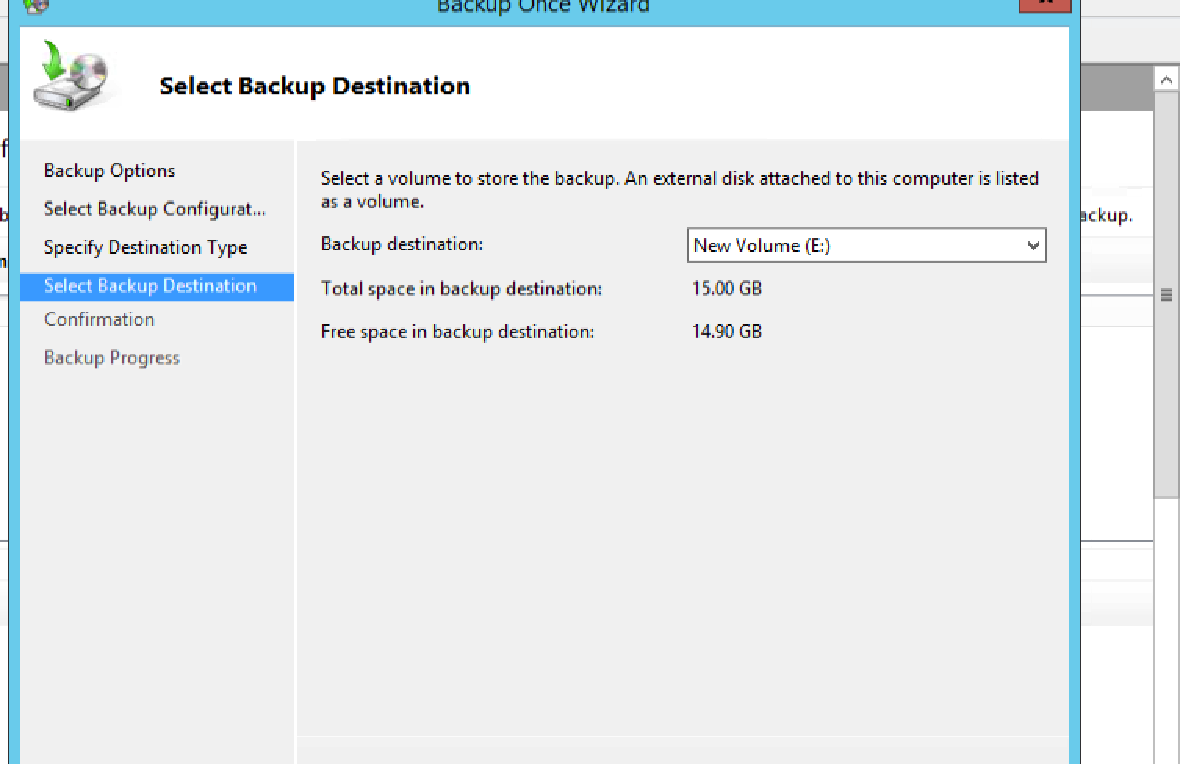
Select path and drive

Slide 21
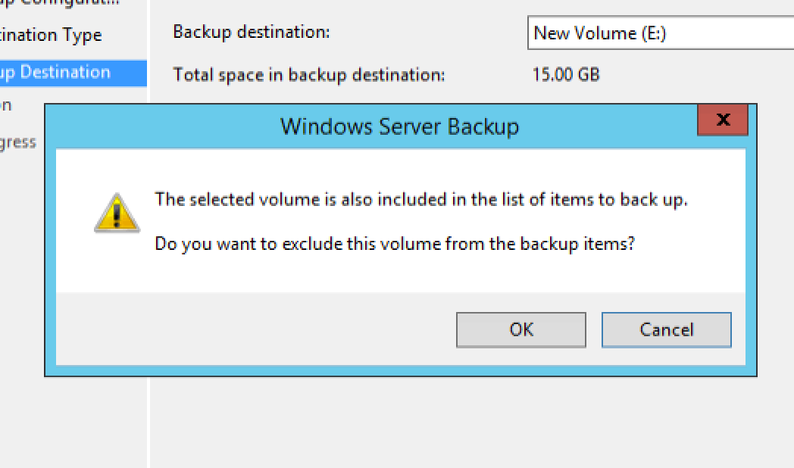
ok

Slide 22
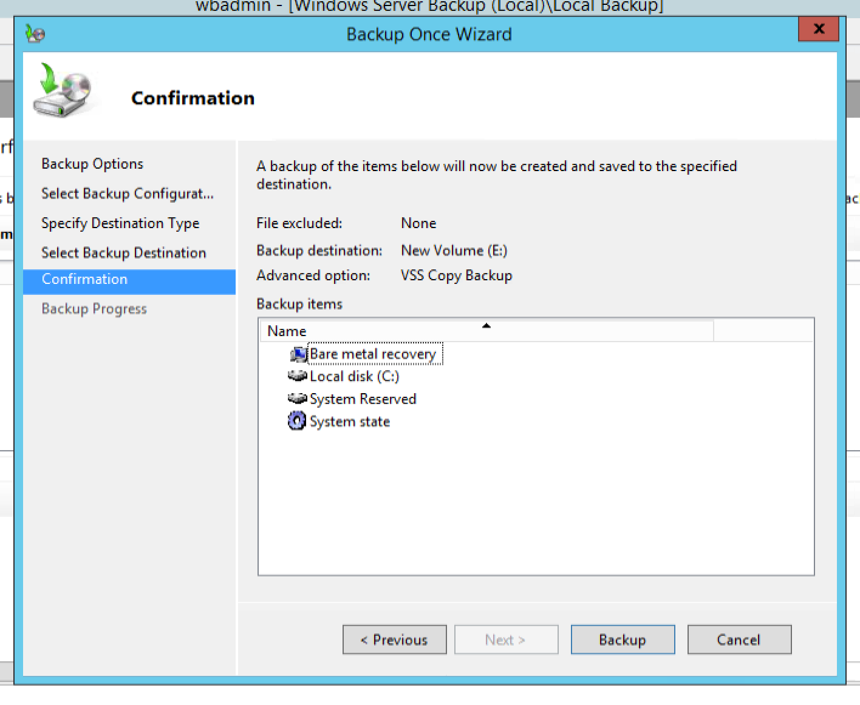
GIVE THIS SS FOR EXAM

Slide 23
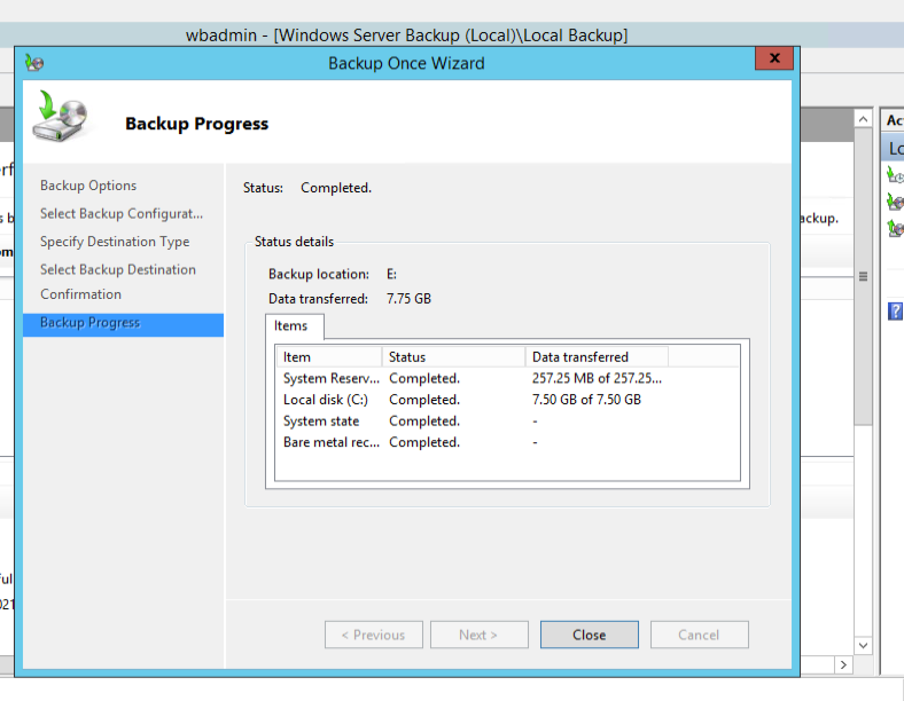
DONE!!

