Slide 1
REMOTE ROUTING AND ACCESS DEMO

Slide 2
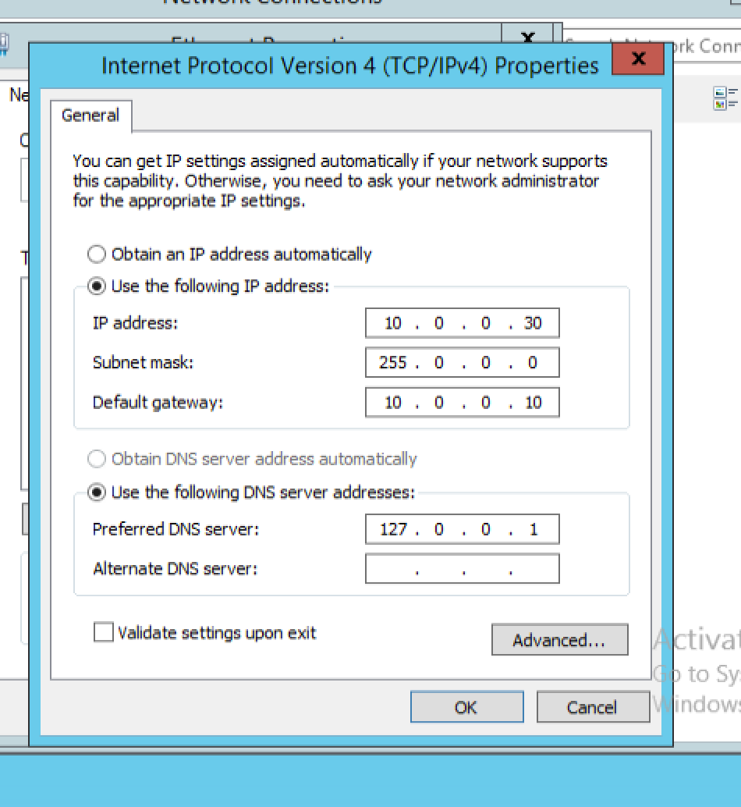
CHANGE IP FOR DC

Slide 3
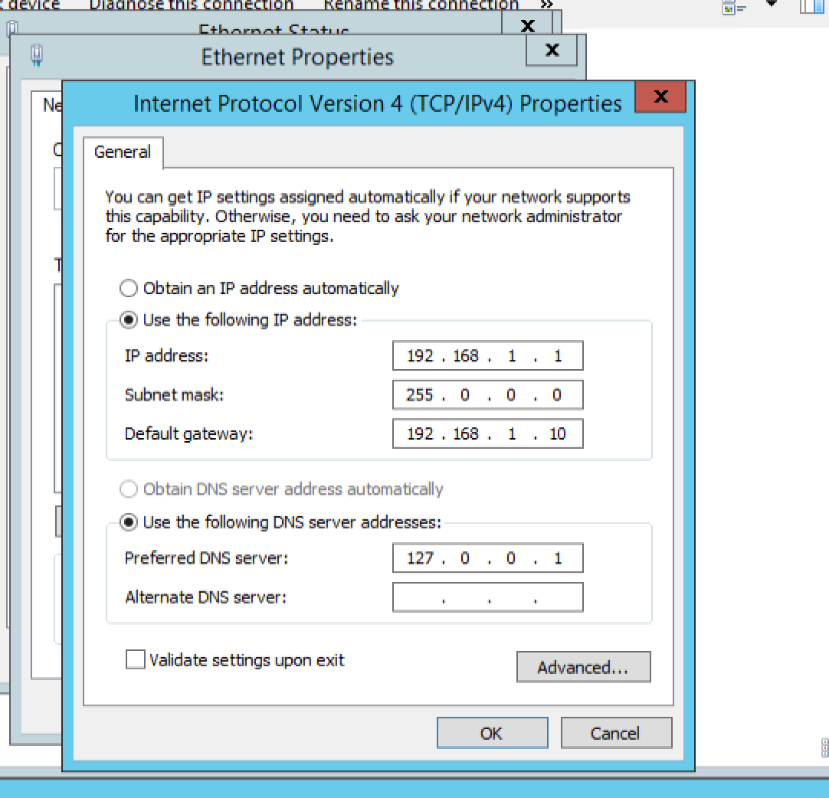
CHANGE IP FOR ADC

Slide 4
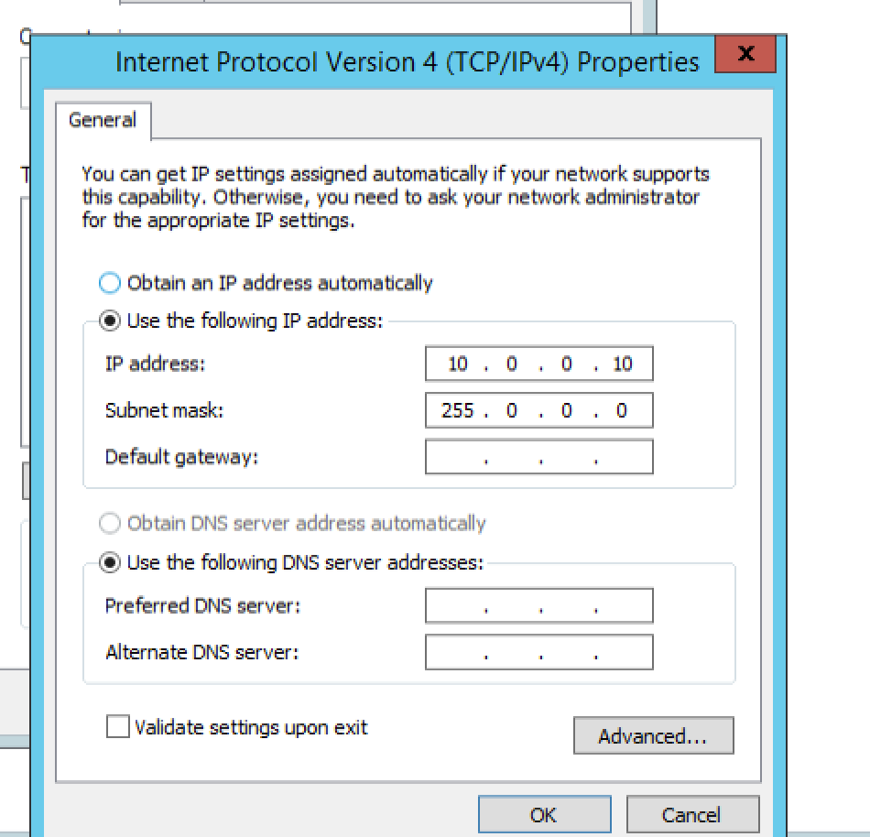
SETUP SERVER(FOR ROUTER)
Turn firewall off
Set ip Ethernet
:

Slide 5
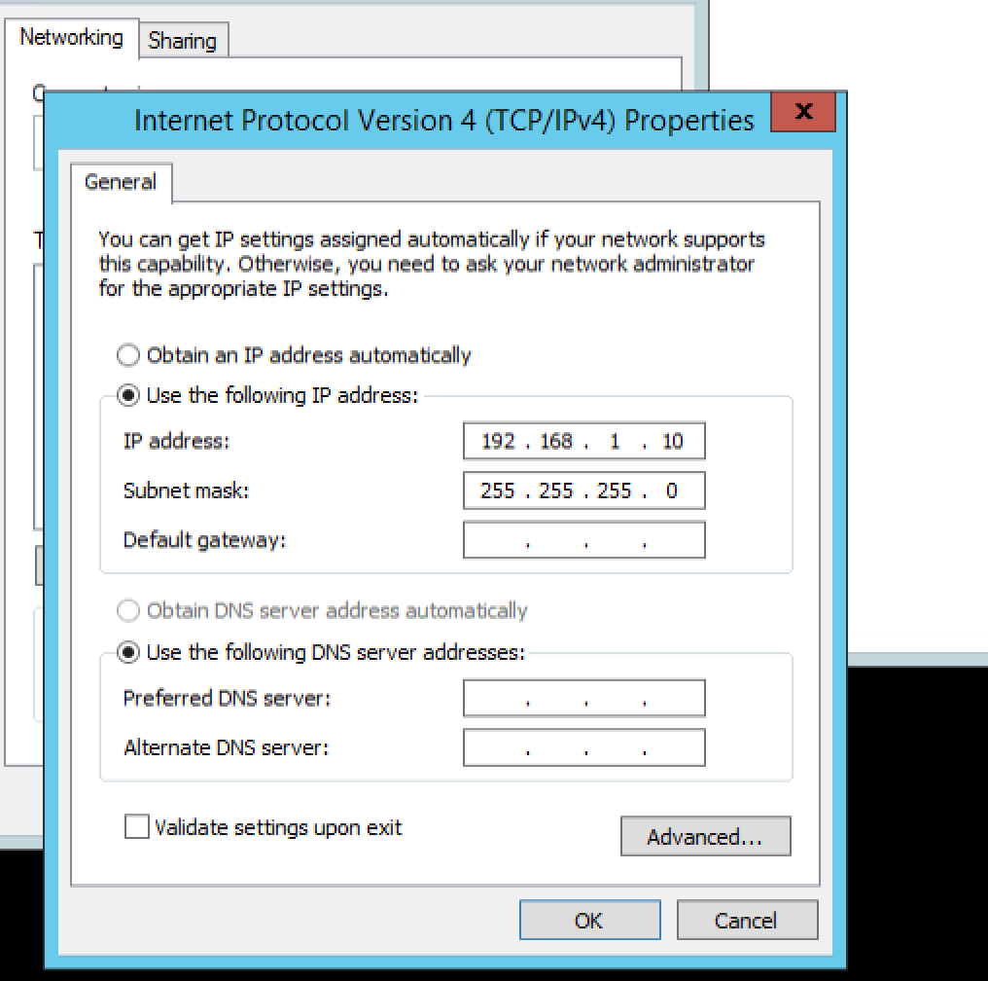
SETUP ETHERNET 2

Slide 6
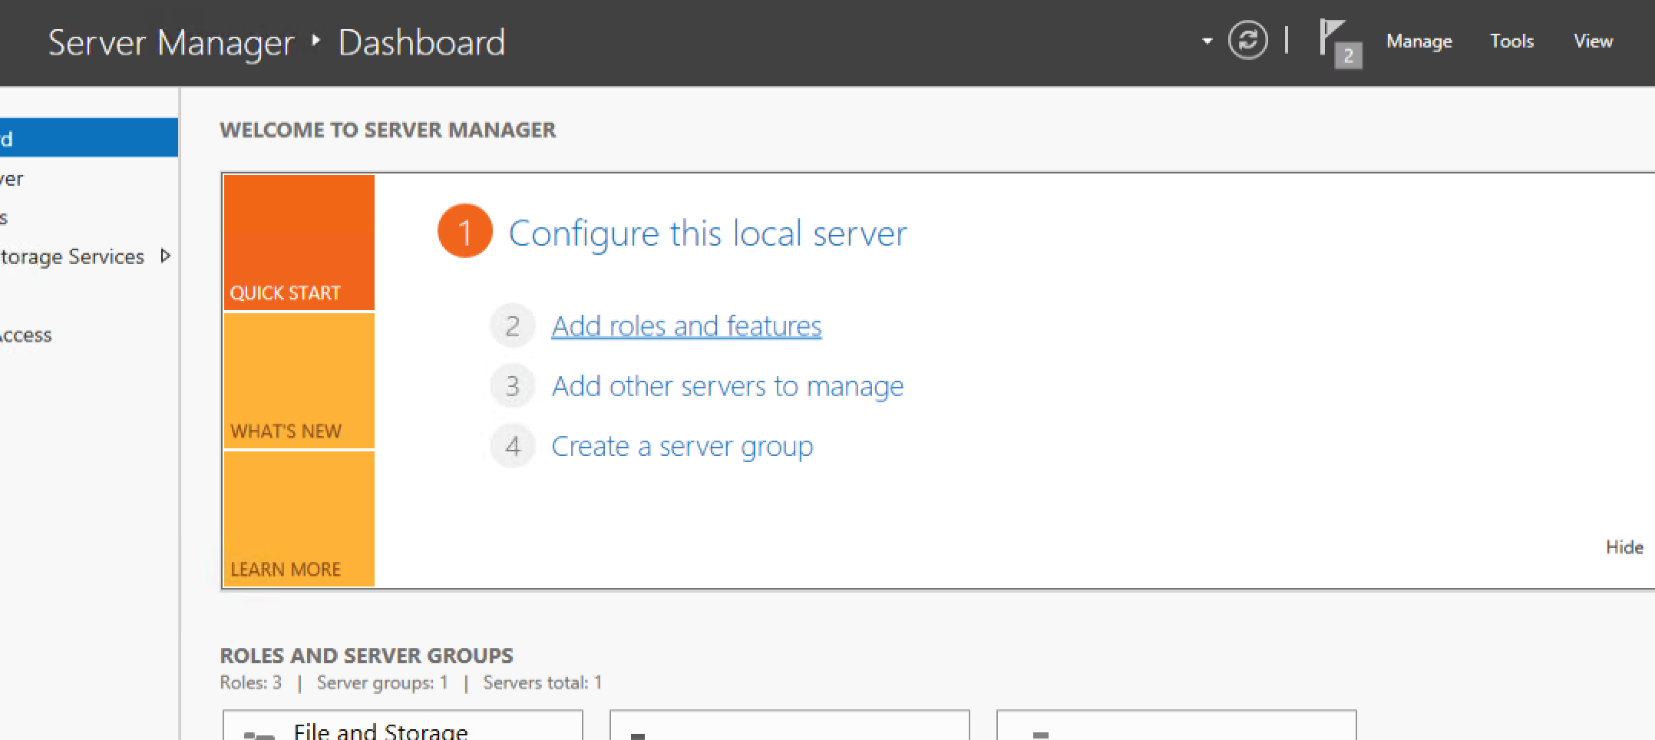
ADD ROLES

Slide 7
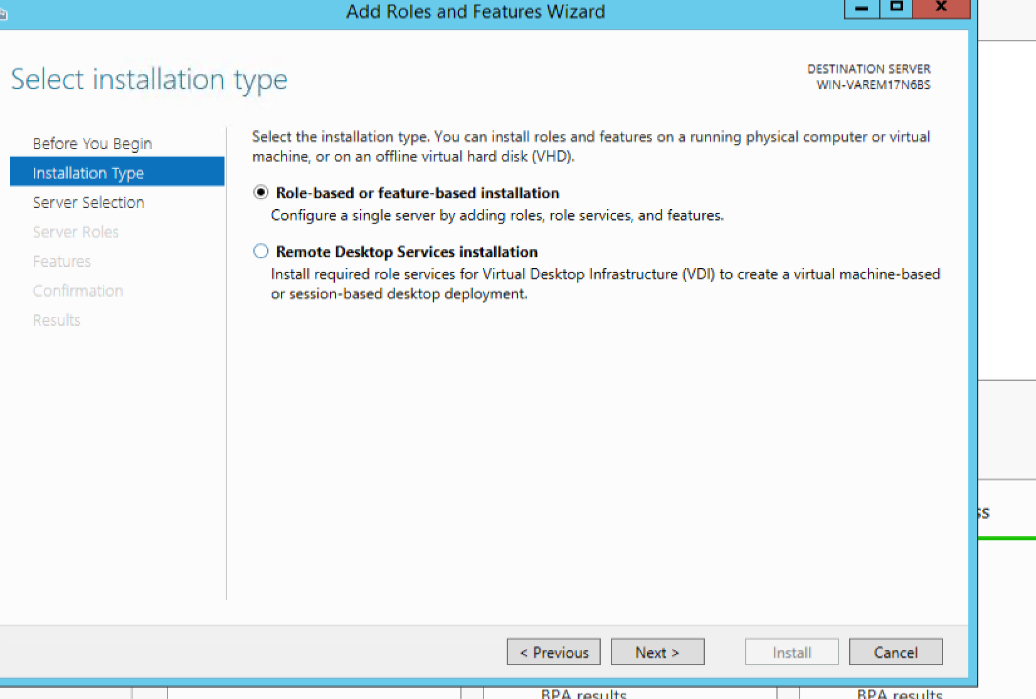
NEXT

Slide 8
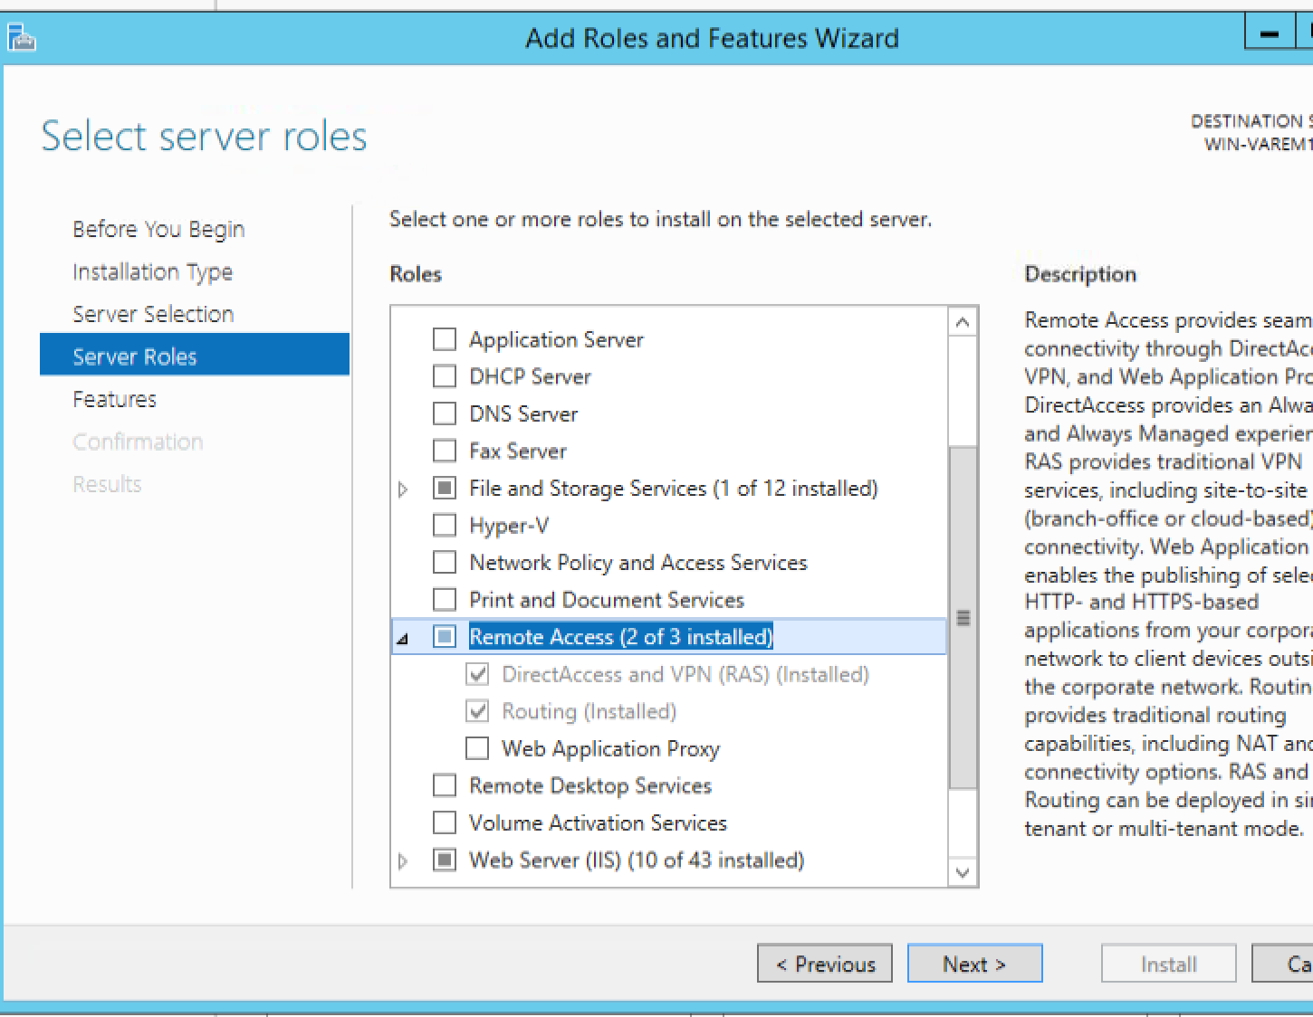
SELECT REMOTE ACCESS (install the rest no changes)

Slide 9
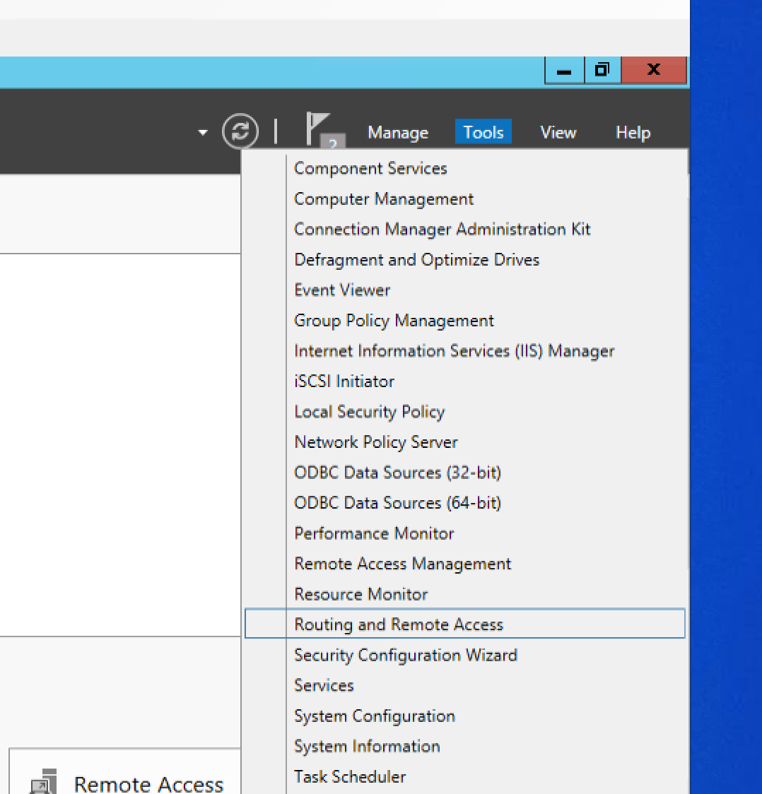

Slide 10
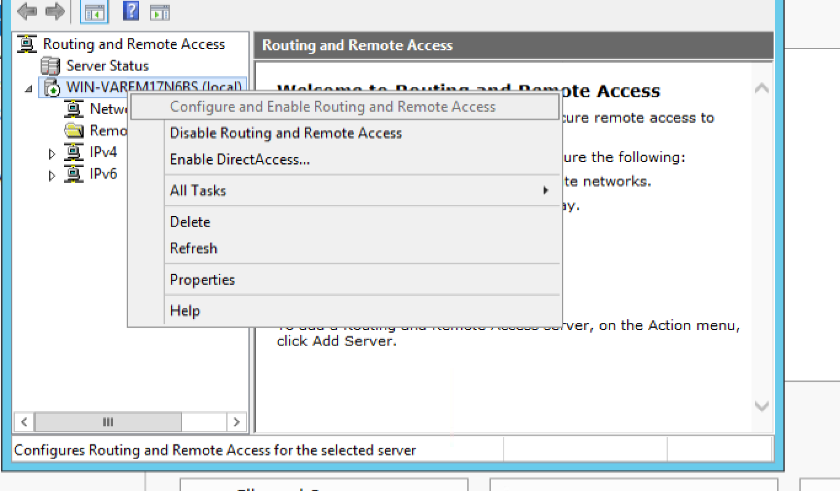

Slide 11
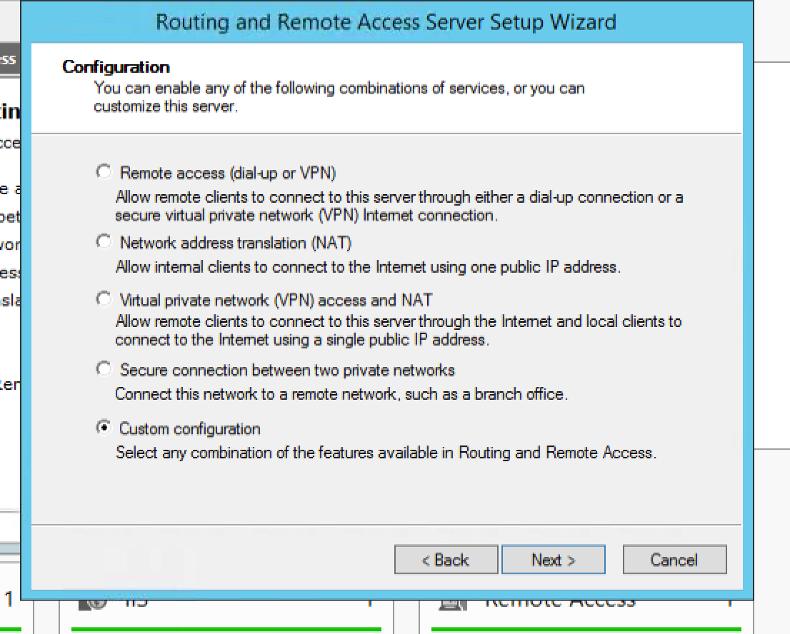

Slide 12
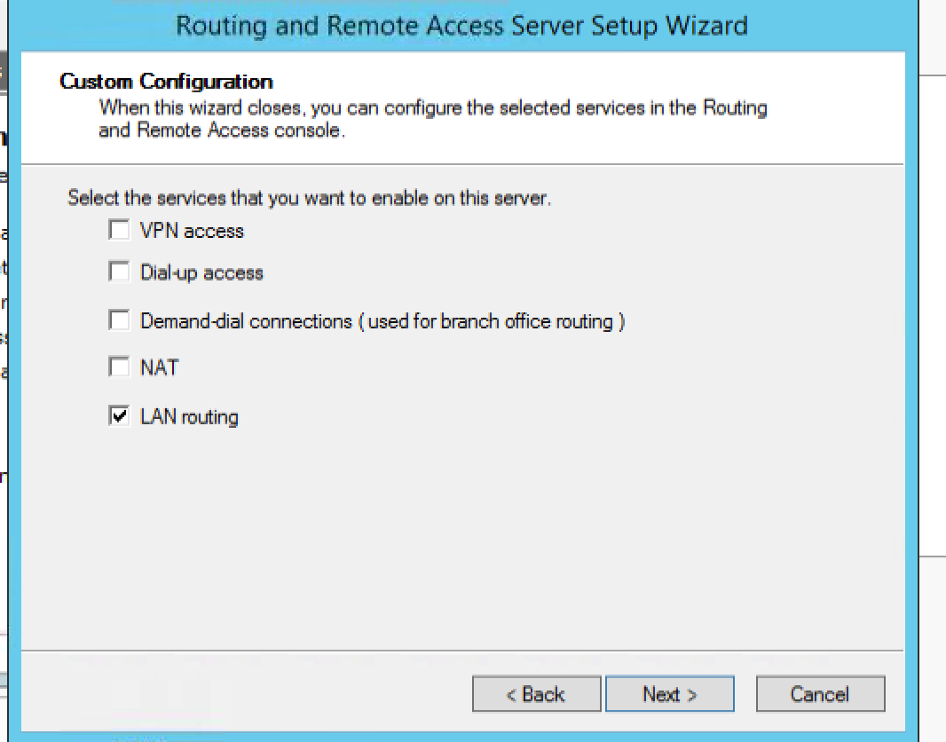

Slide 13
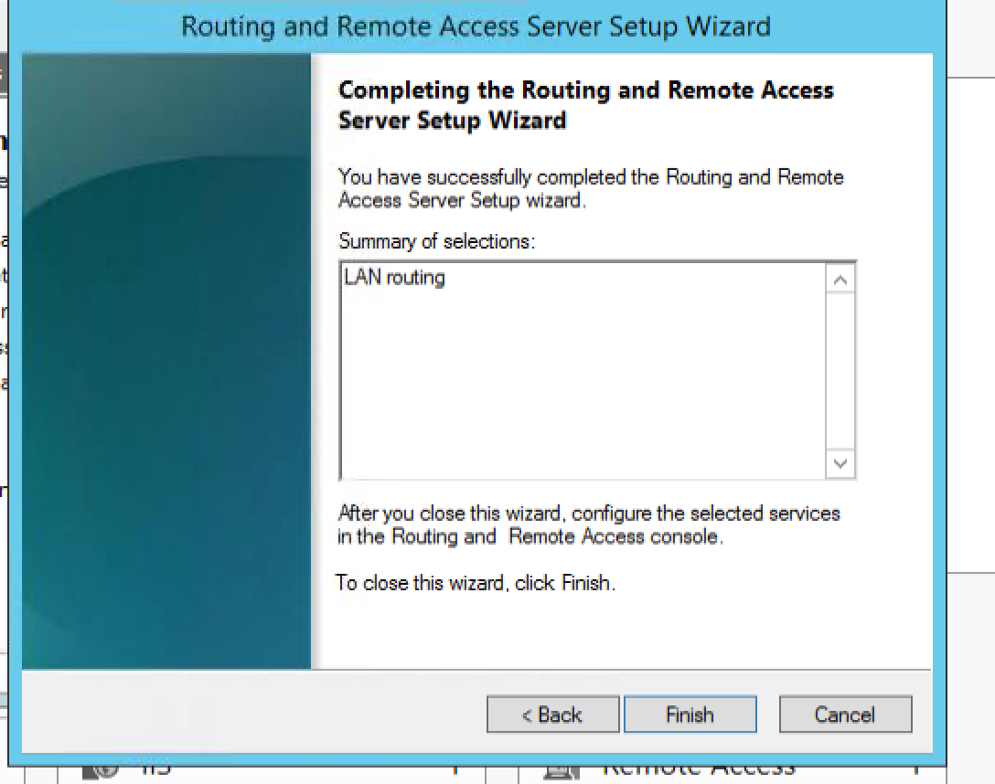

Slide 14
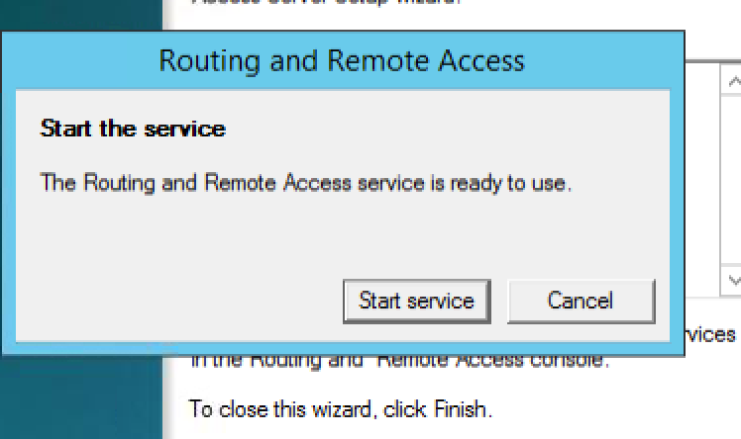

Slide 15
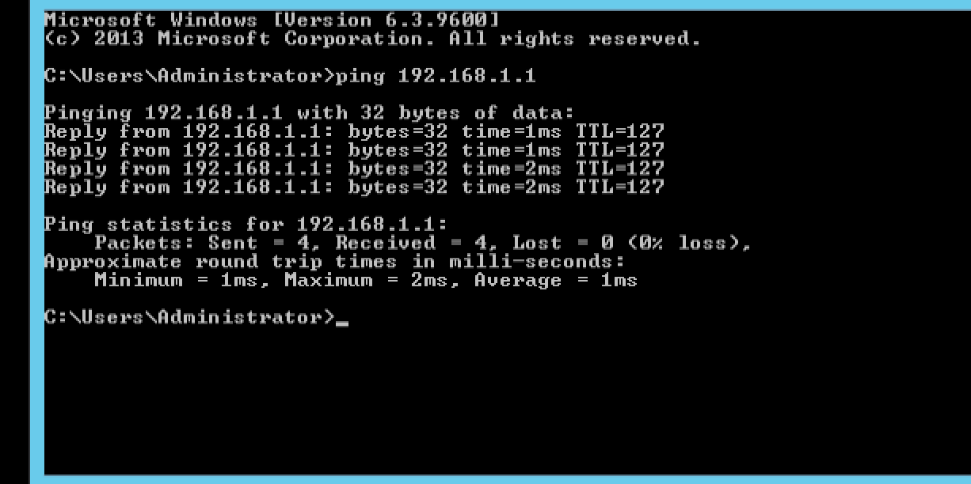
PING 192.168.1.1 from DC for succesfull Router addition.

