Slide 1
MANUAL TRANSFER FSMO

Slide 2
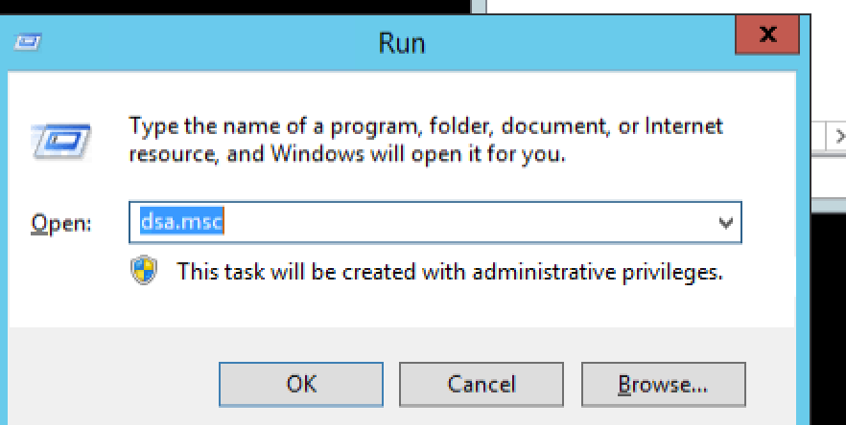
DC -run

Slide 3
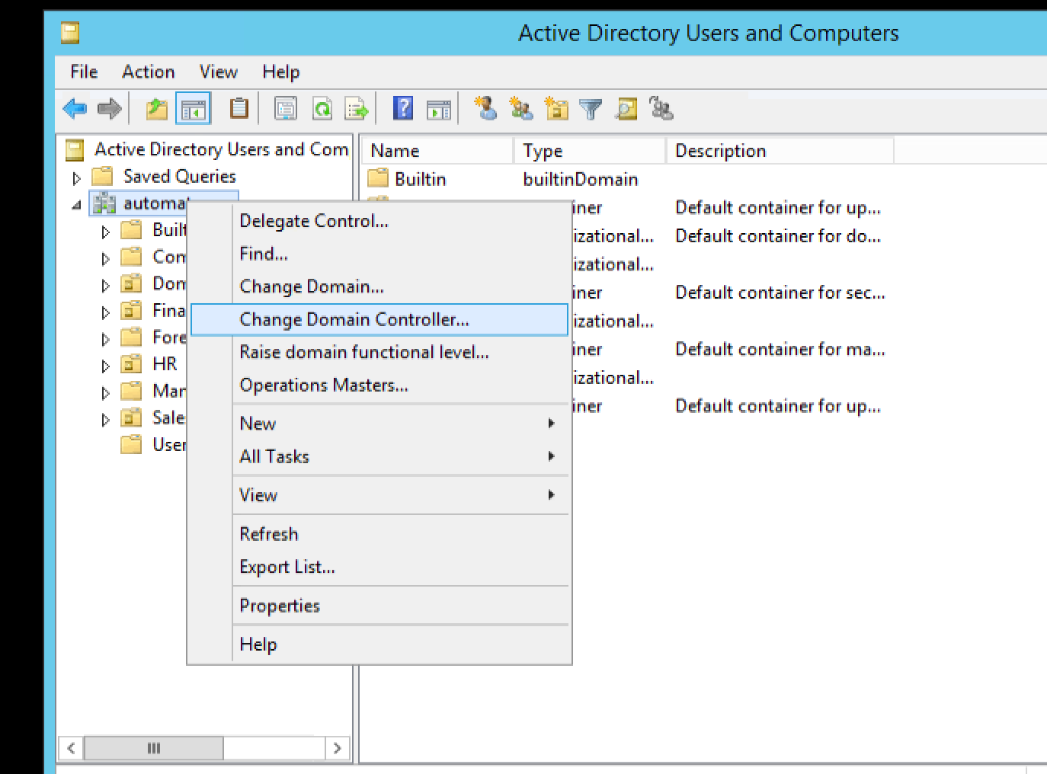
Automate.org --- Change Domain Controller

Slide 4
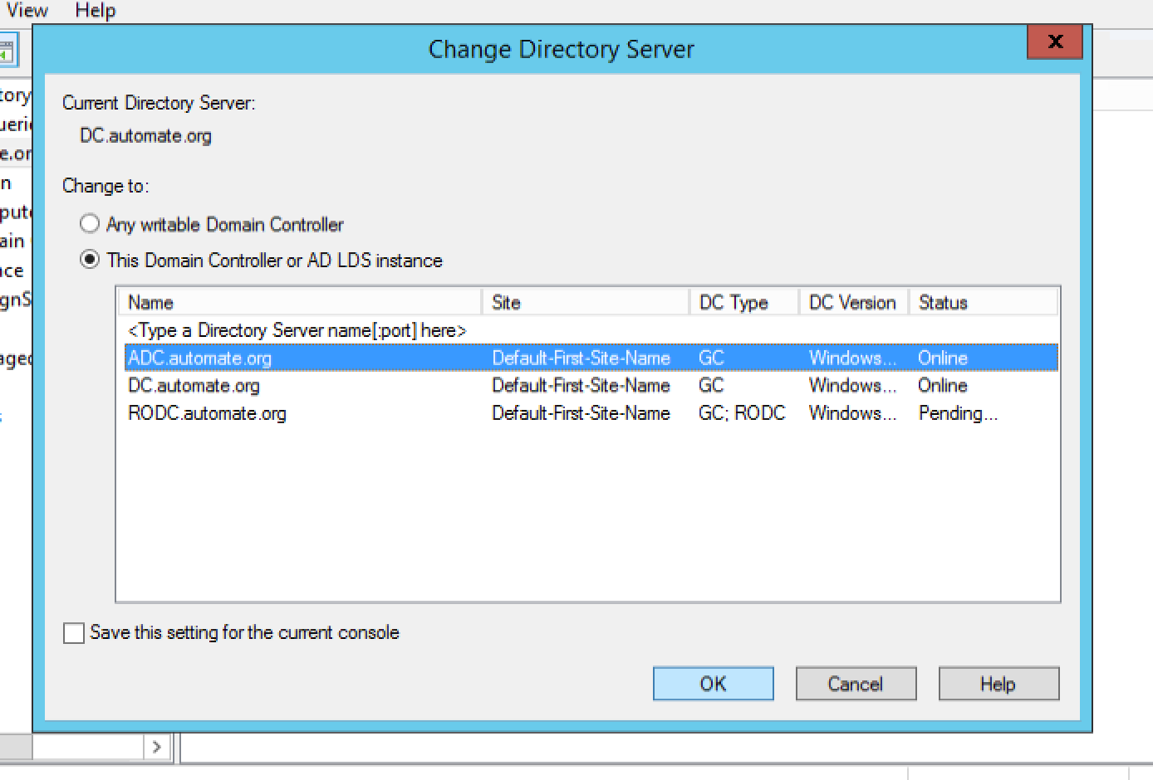
Select the dc you want to transfer control to

Slide 5
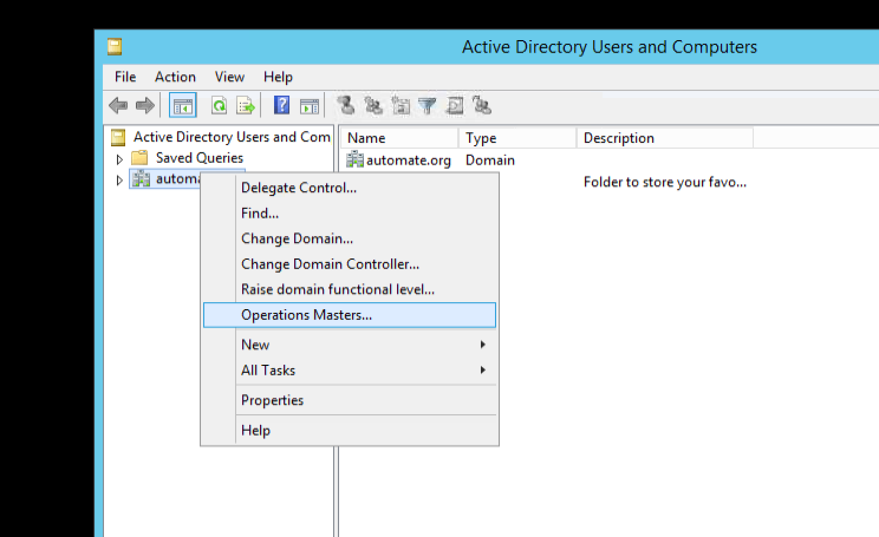
Automate.org --- Operations Masters

Slide 6
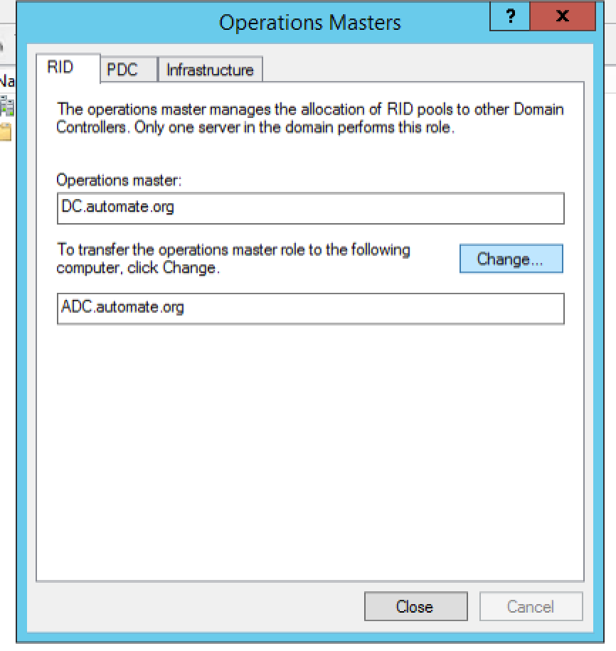
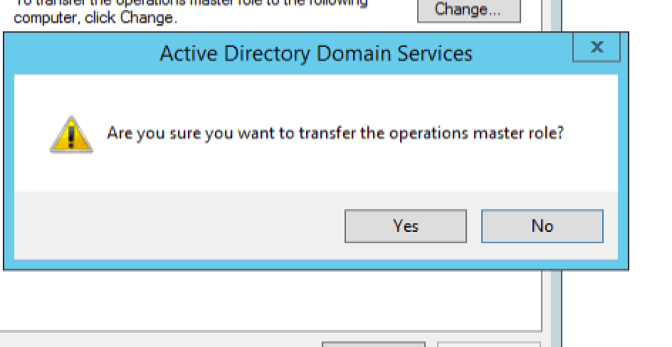
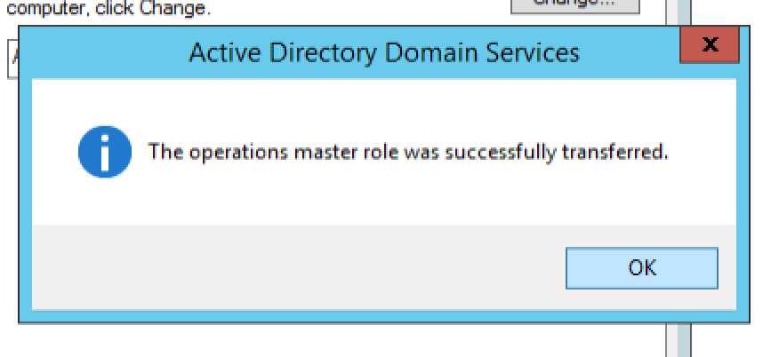


Change from to.

Slide 7
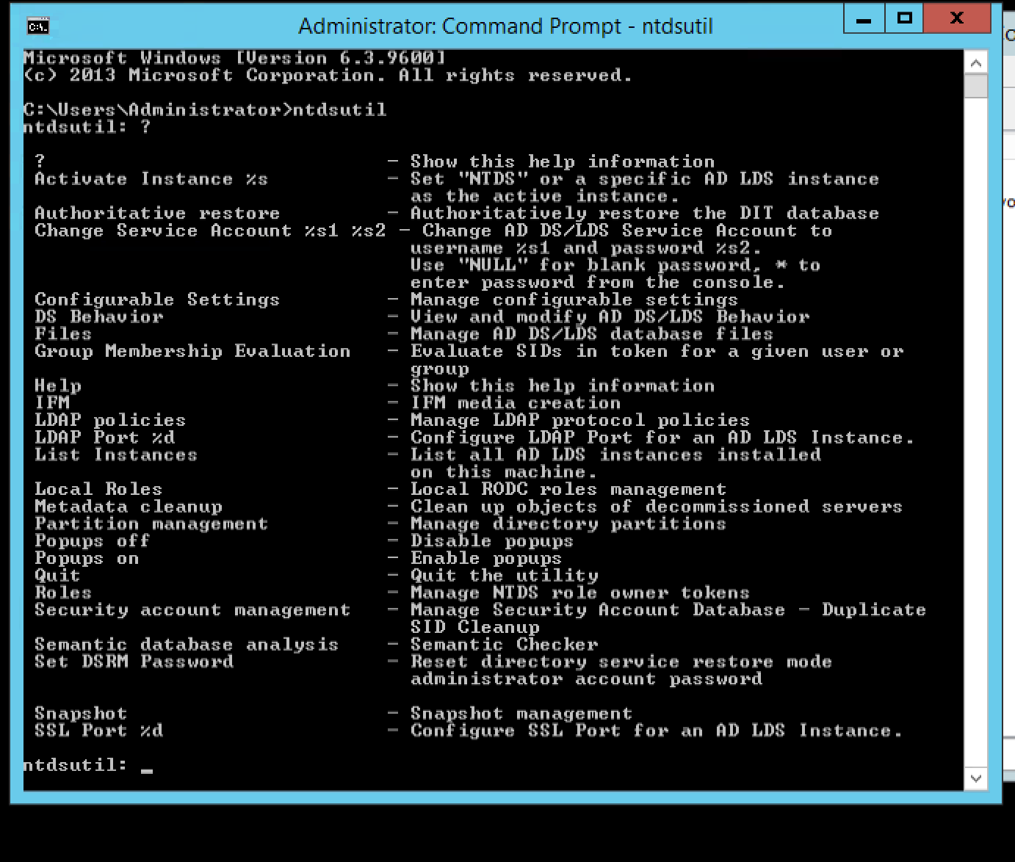
ntdsutil --- ? (gives all options)(informative only) type---roles

Slide 8
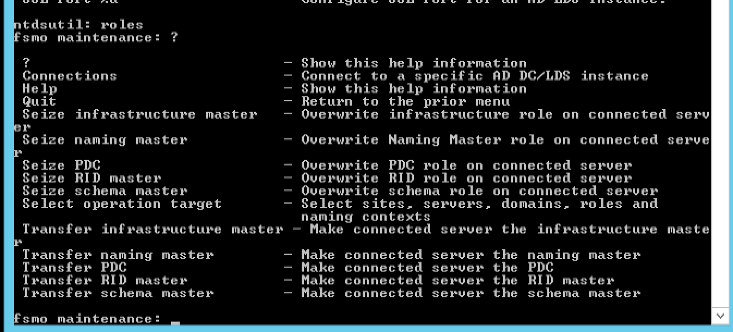
roles --- ? (options for fsmo maintenance)(informative only) type --- connections

Slide 9
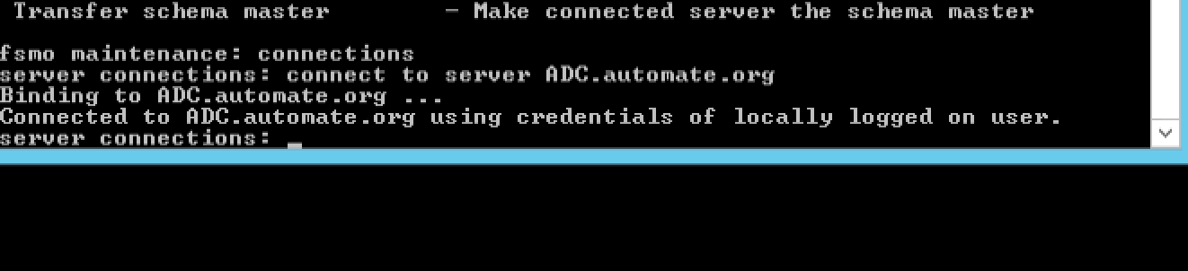
Connect to server ADC.automate.org

Slide 10
