Slide 1
FSMO DEMO

Slide 2
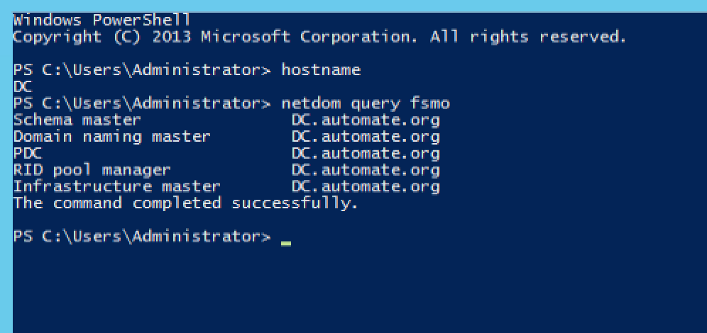
Netdom query fsmo

Slide 3
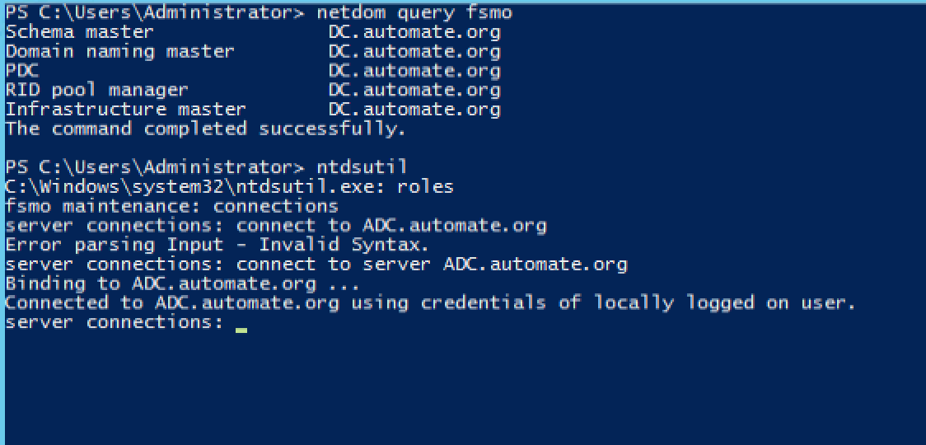
ntdsutil roles connections connect to server ADC.automate.org

Slide 4
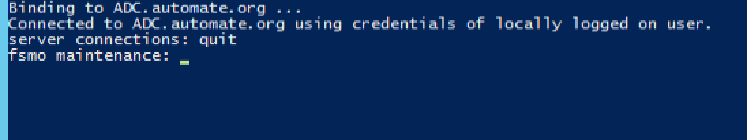
quit

Slide 5
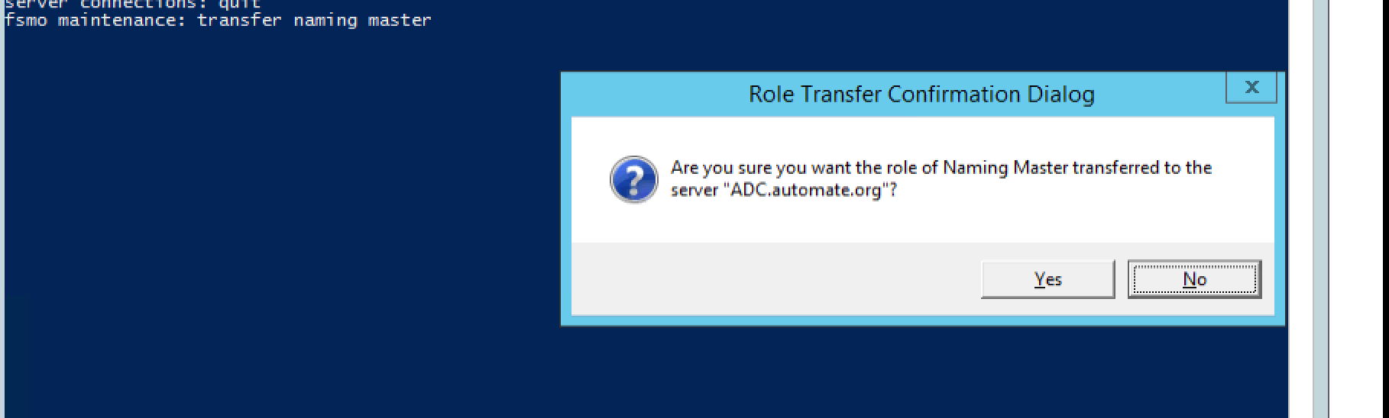
Transfer naming master

Slide 6
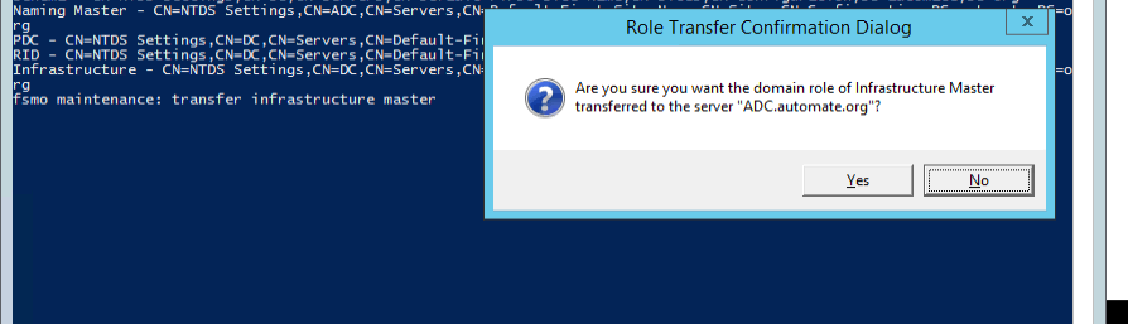
Transfer infrastructure master

Slide 7
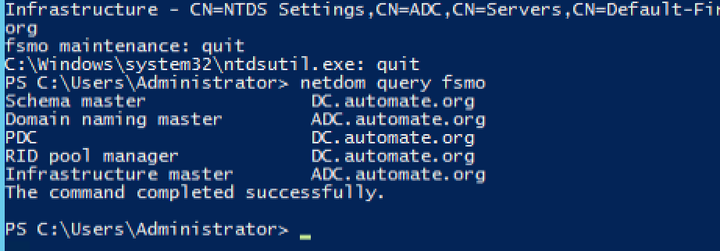
quit quit netdom query fsmo –confirm!

