Slide 1
FOLDER REDIRECTION

Slide 2
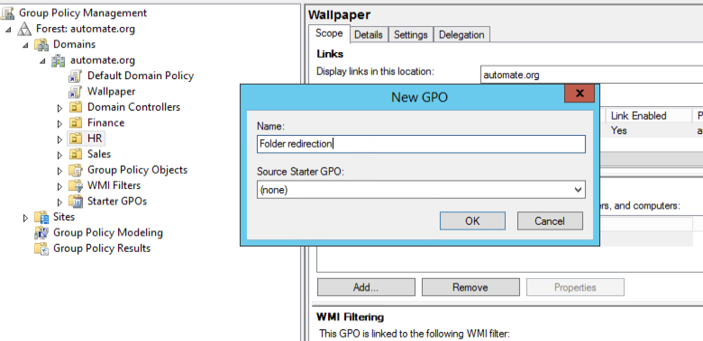
Hr-rightclick-create

Slide 3
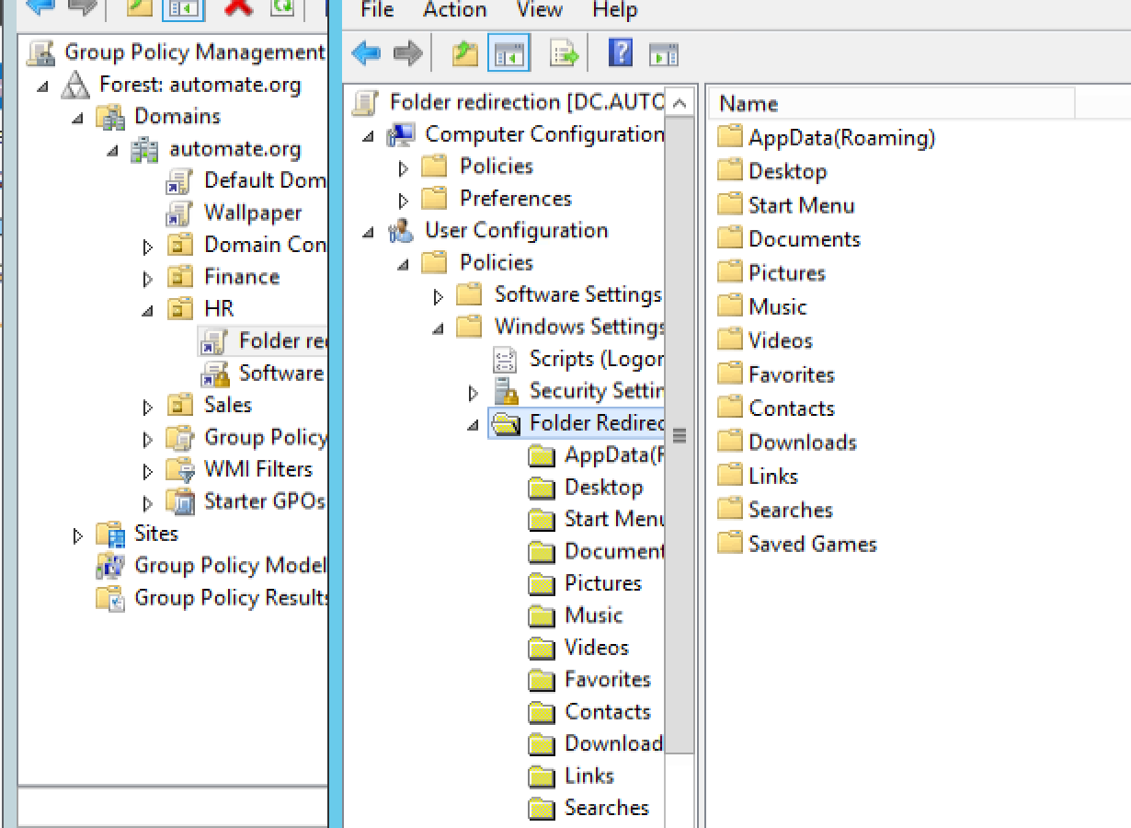
Hr-folder redirection policy-edit-userconfig-windows-folder redirection

Slide 4
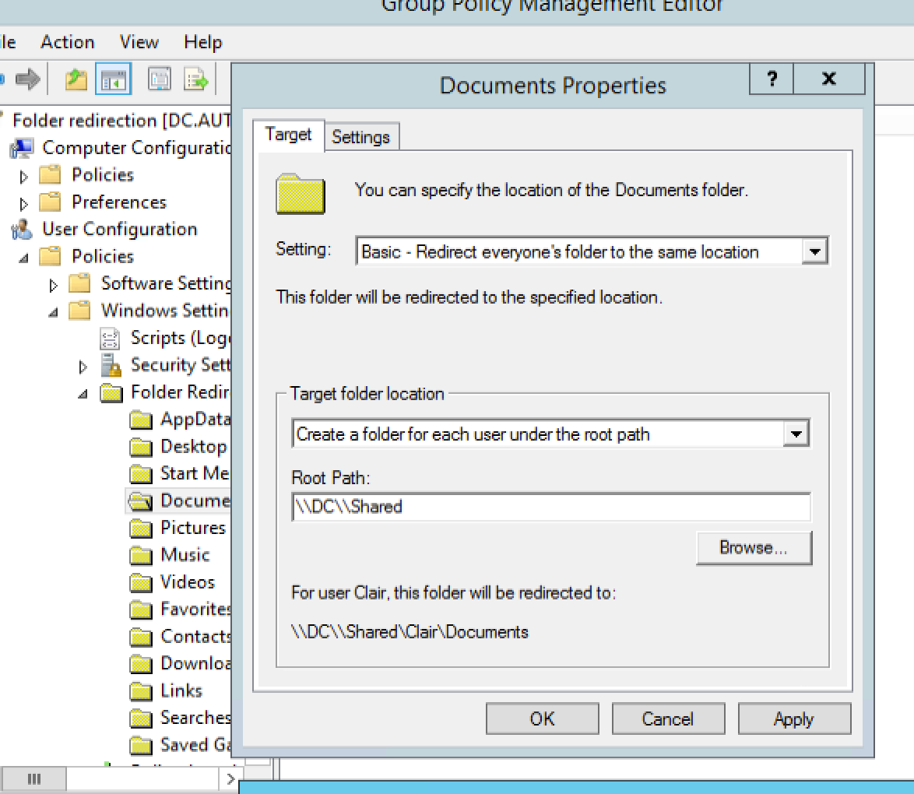
Folder redirection-documents-setting(change to basic) give shared path(root path)-apply-ok gpupdate policy (server as well as client(login to client via hr)) restart both machines

Slide 5
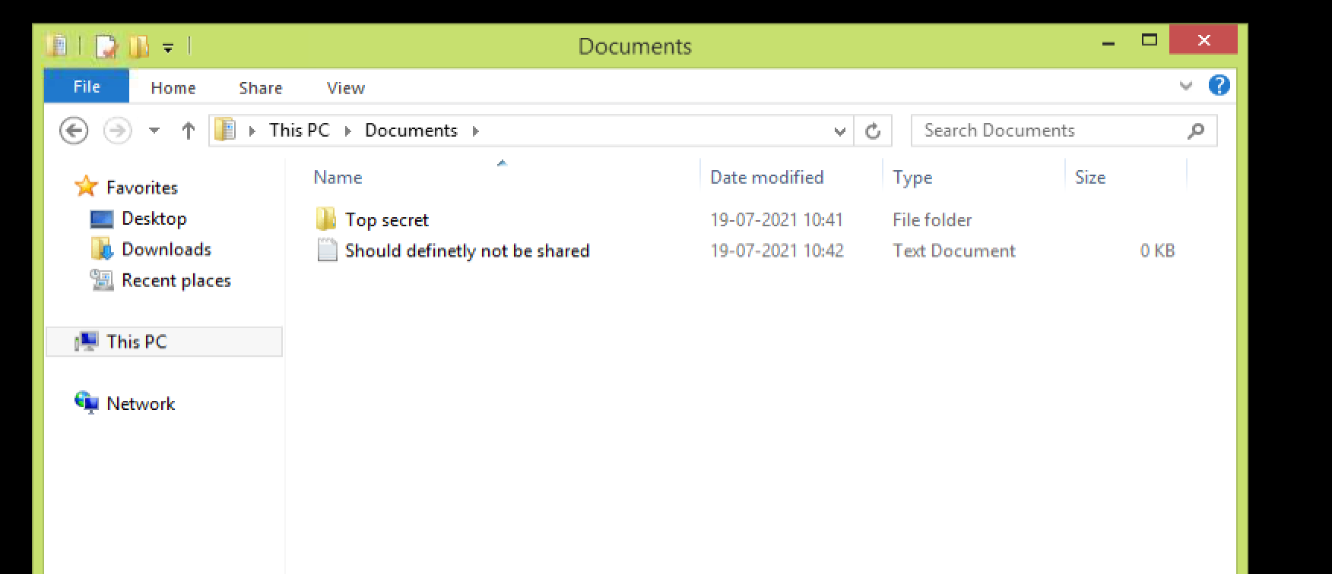
After all update and restart create a folder and/or file in hr profile (client)

Slide 6
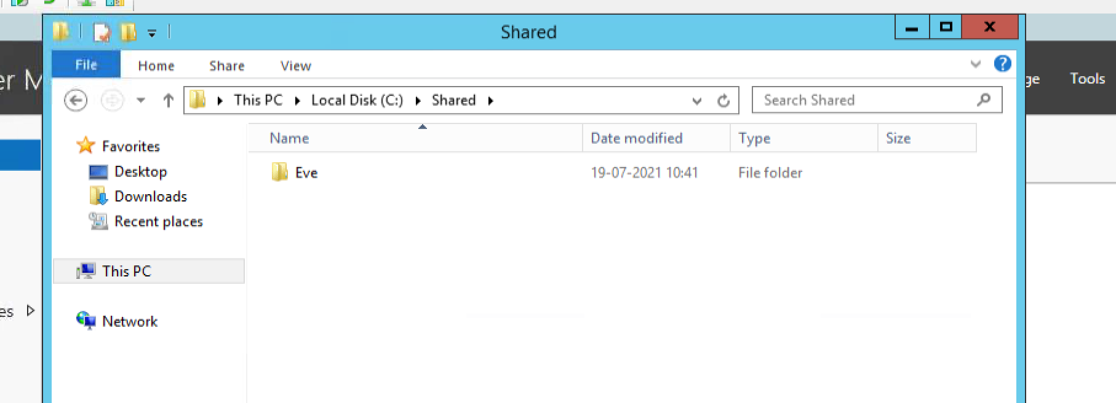
Check in DC-thispc-c-shared-(name of hr profile)- (you cannot access docs)

