Slide 1
Home Folder

Slide 2
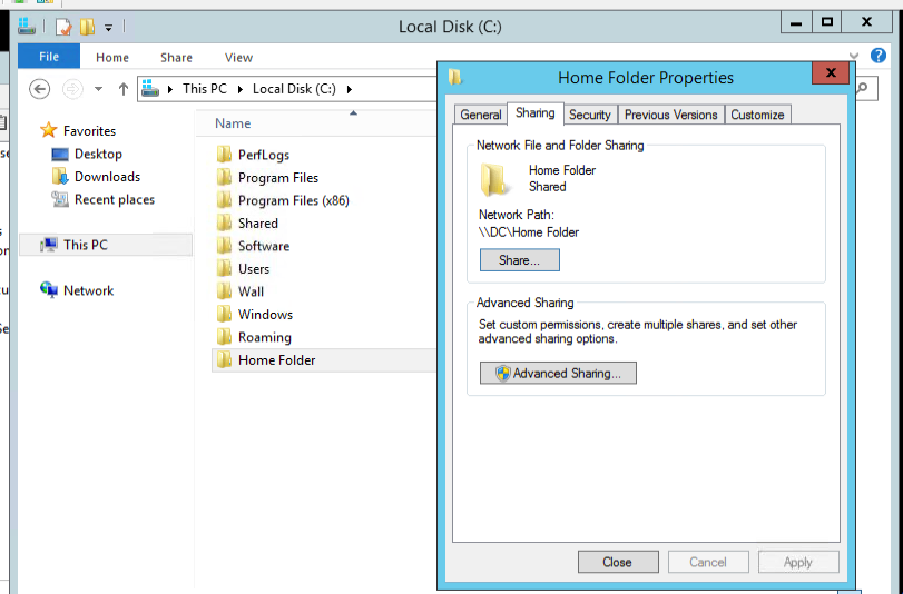

Slide 3
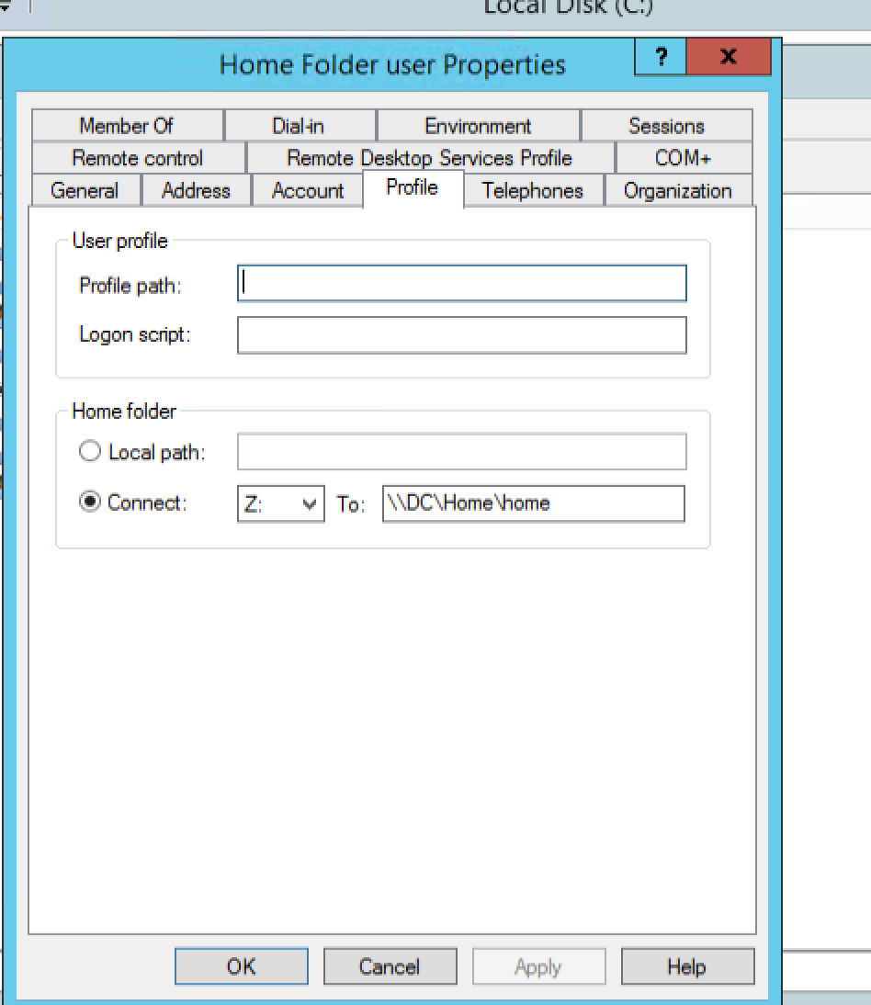
AD user-profile give path.

Slide 4
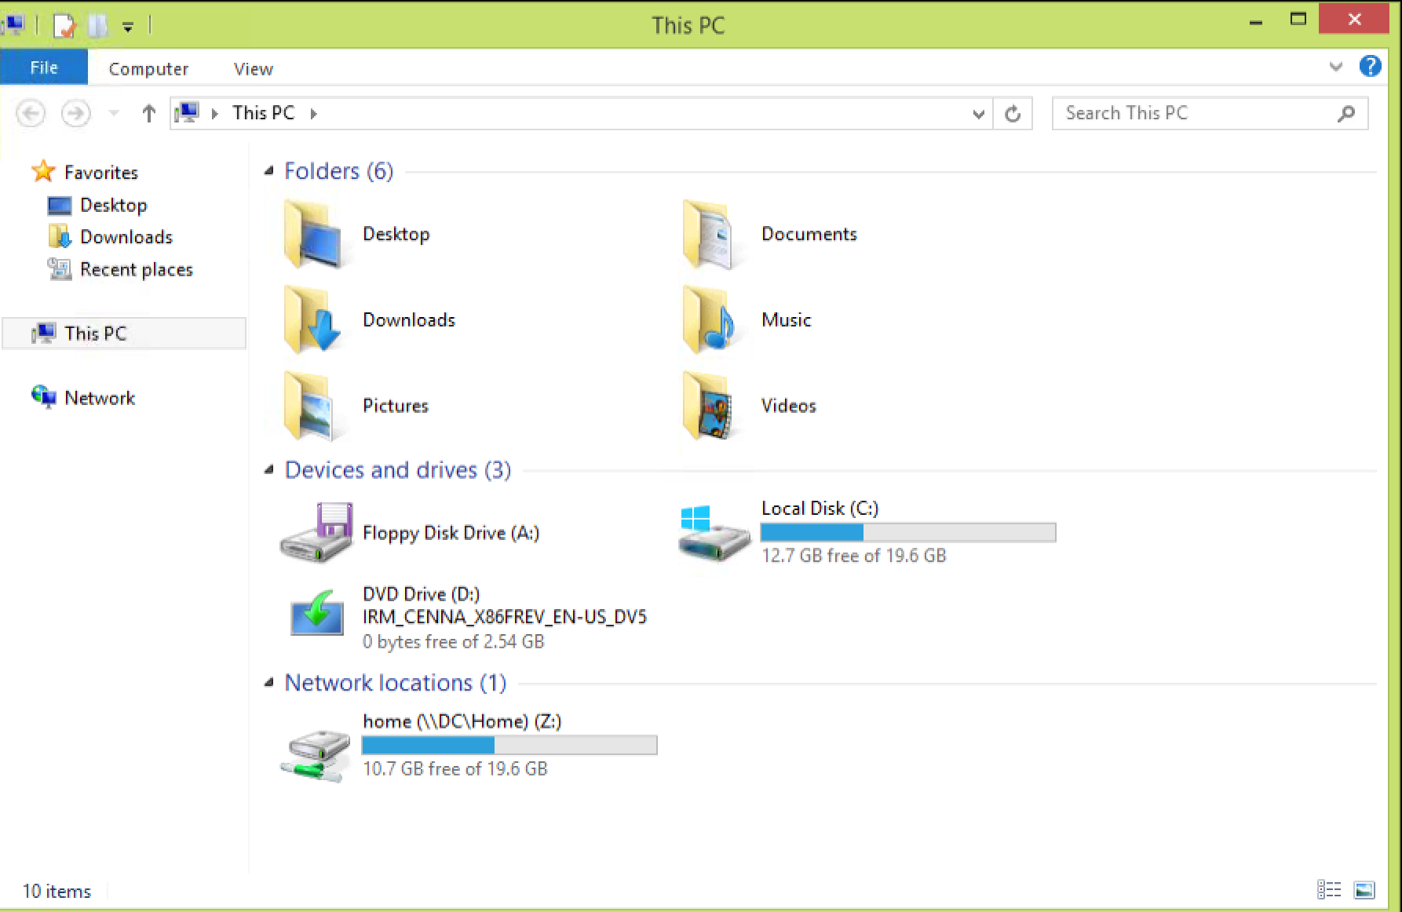

Login to Client machine using hr profile(same one as shared)

