Slide 1
Configuring a Roaming Profile

Slide 2
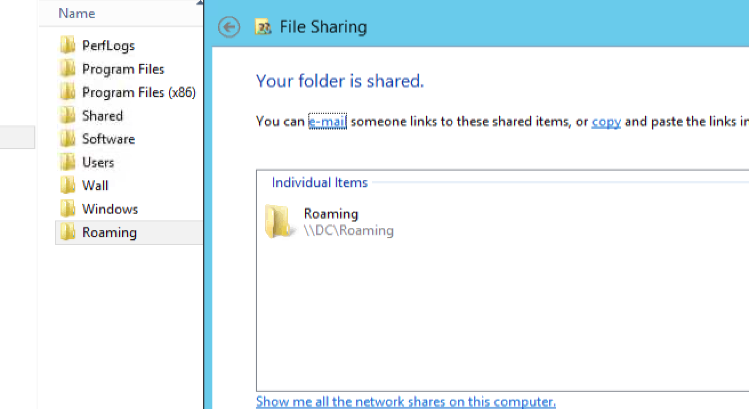
Login to-DC create folder in c and share with everyone

Slide 3
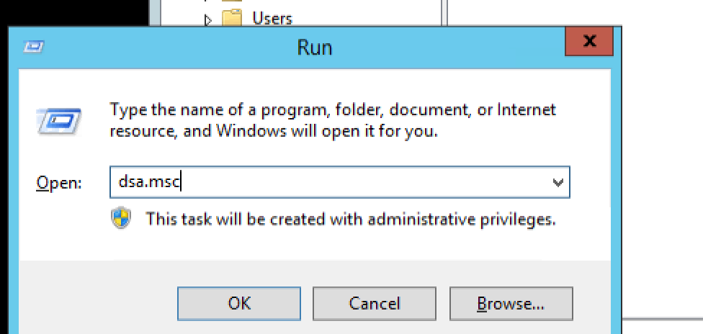

Slide 4
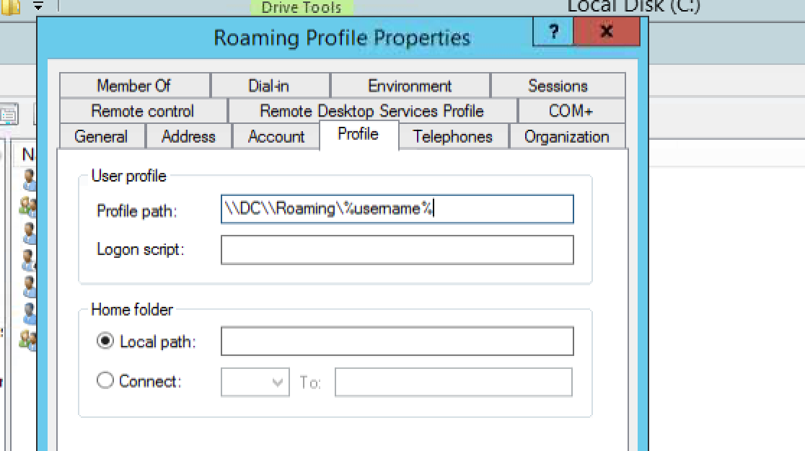
Open any user:

Slide 5
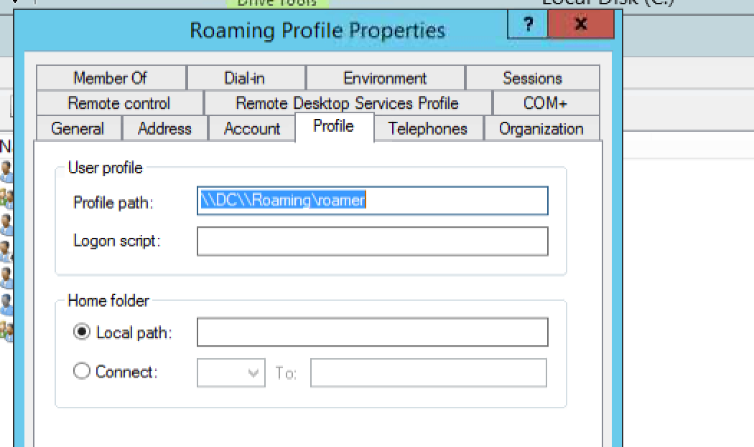
DONE!!

Slide 6
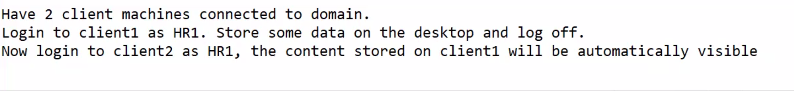
For screen shots in exam:
Slide 5 and shared folder properties path ss
Verify :

