Slide 1
RODC
Read only domain controller

Slide 2
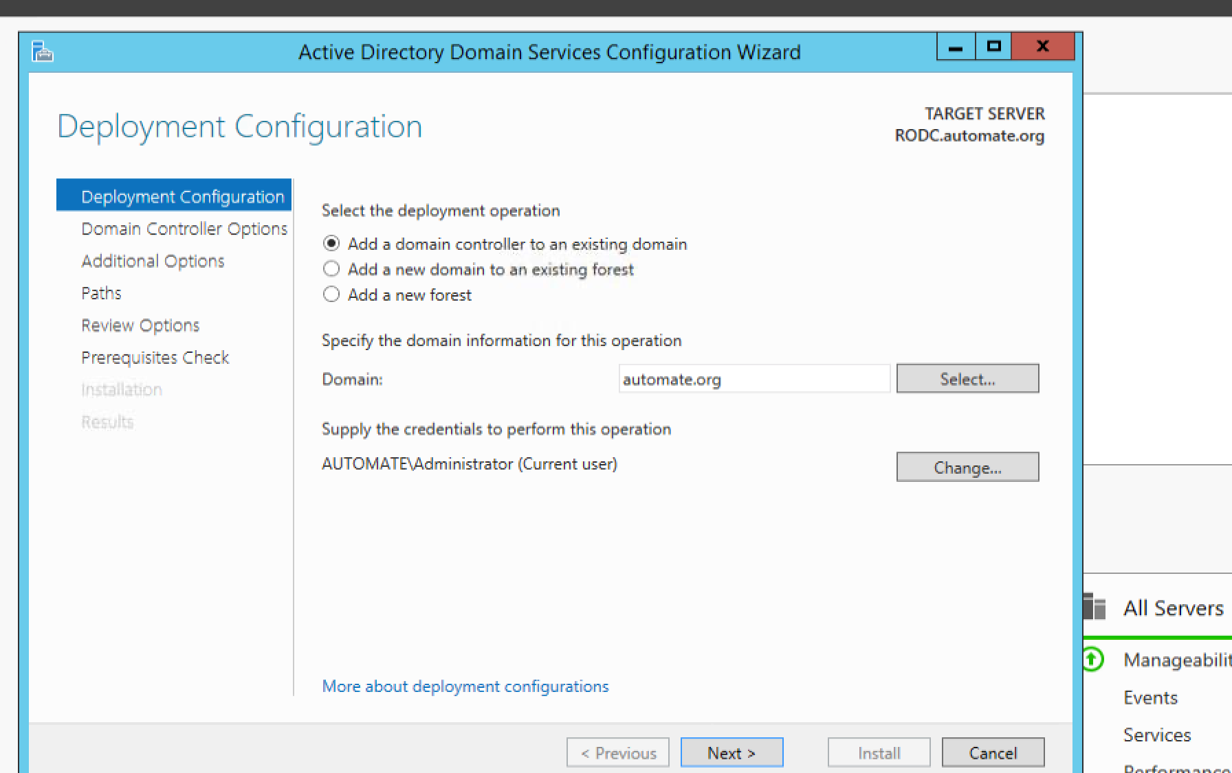
Create a server 2012 …set firewall of, dns ,ip make sure it pings with DC. Then add AD DS roles and features. Then configure (Next next next upto next slide)
Make sure this is Automate(or whatever org you have)

Slide 3
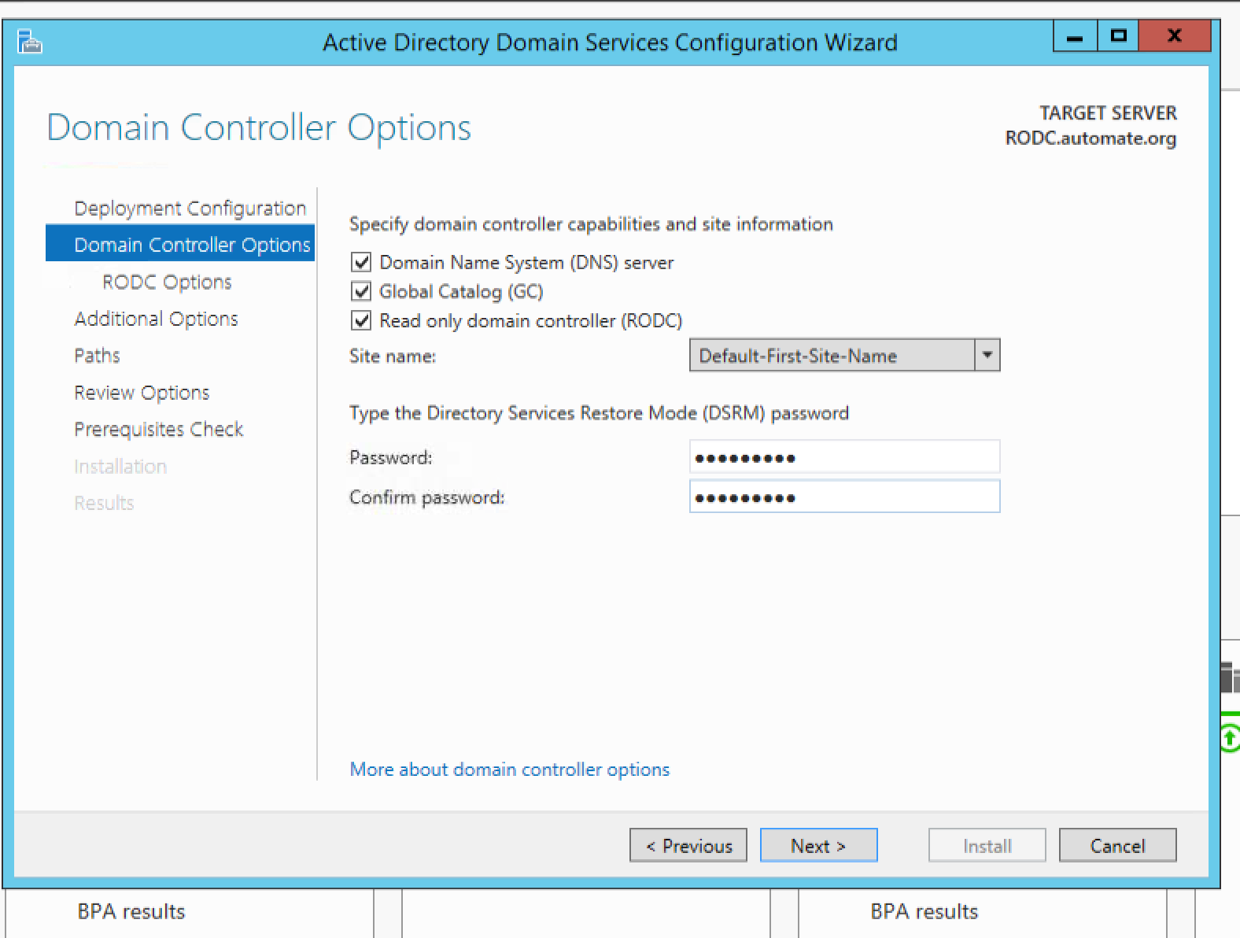
Select Read only
Next next install no changes

Slide 4
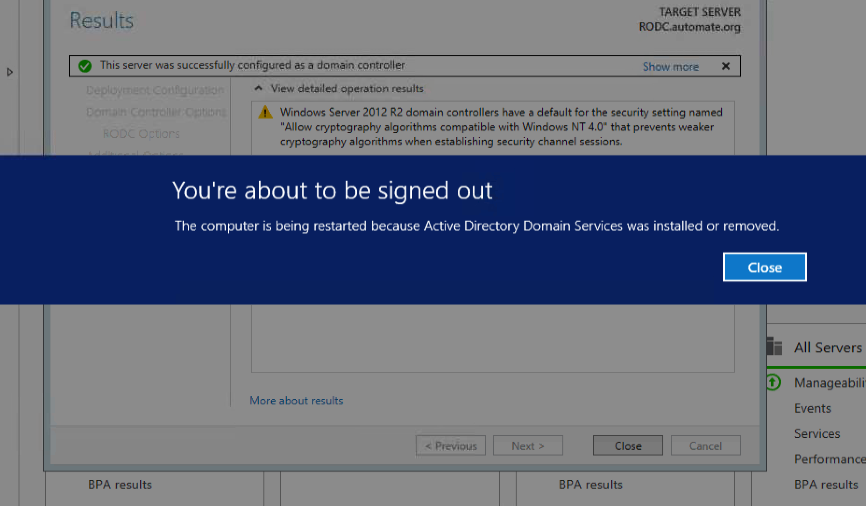
All good Restart..

Slide 5
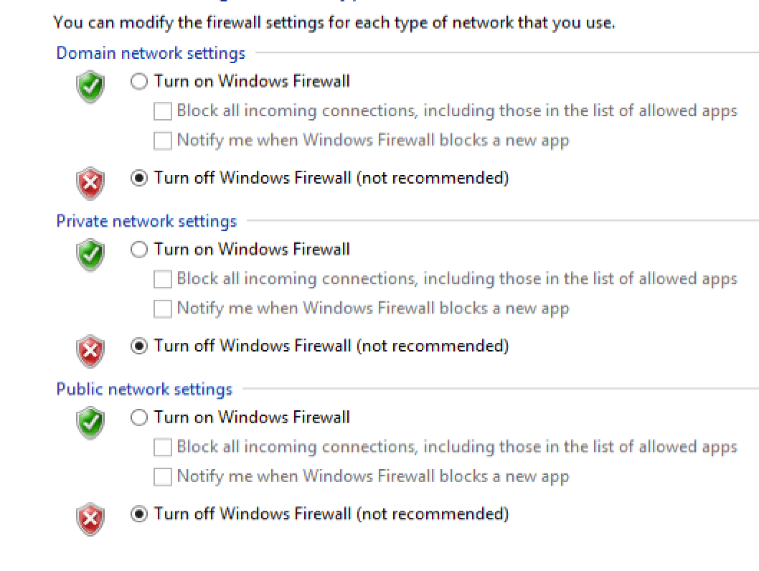
TURN DOMAIN FIREWALL OFF.

Slide 6
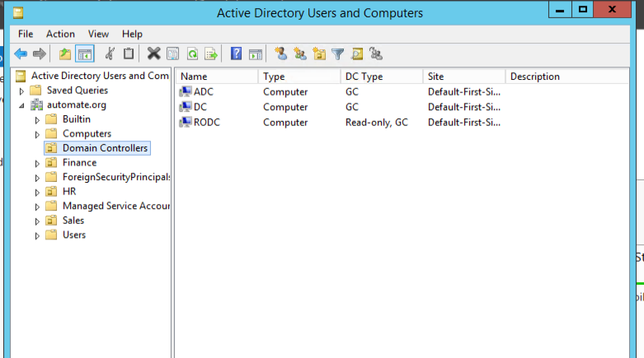
RODC SHOULD SHOW

Slide 7
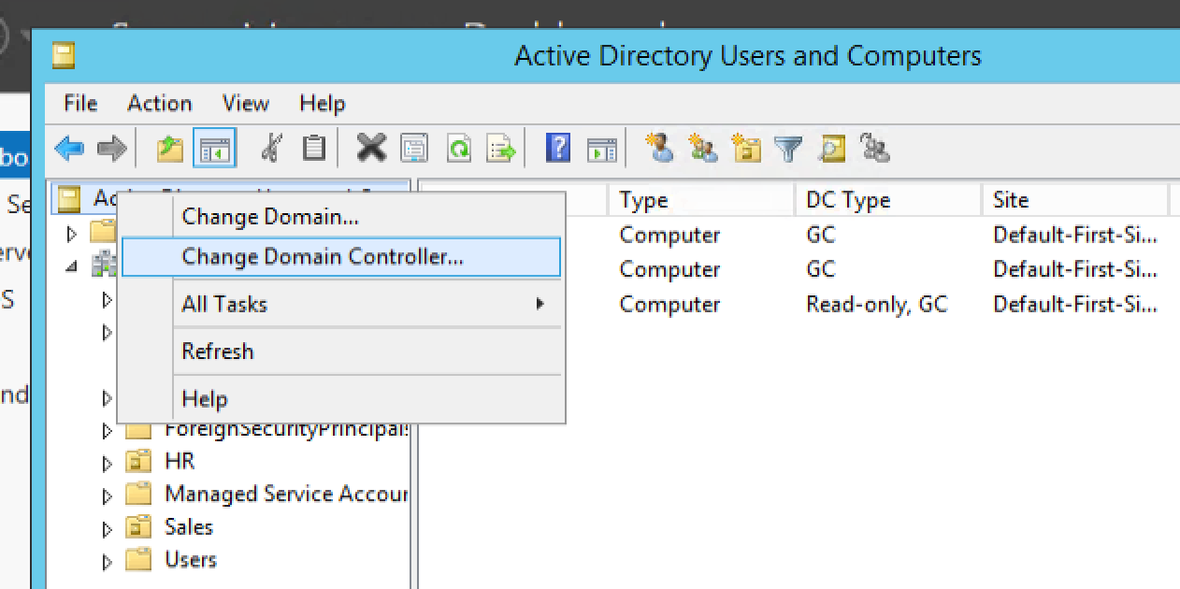

Right click and select

Slide 8
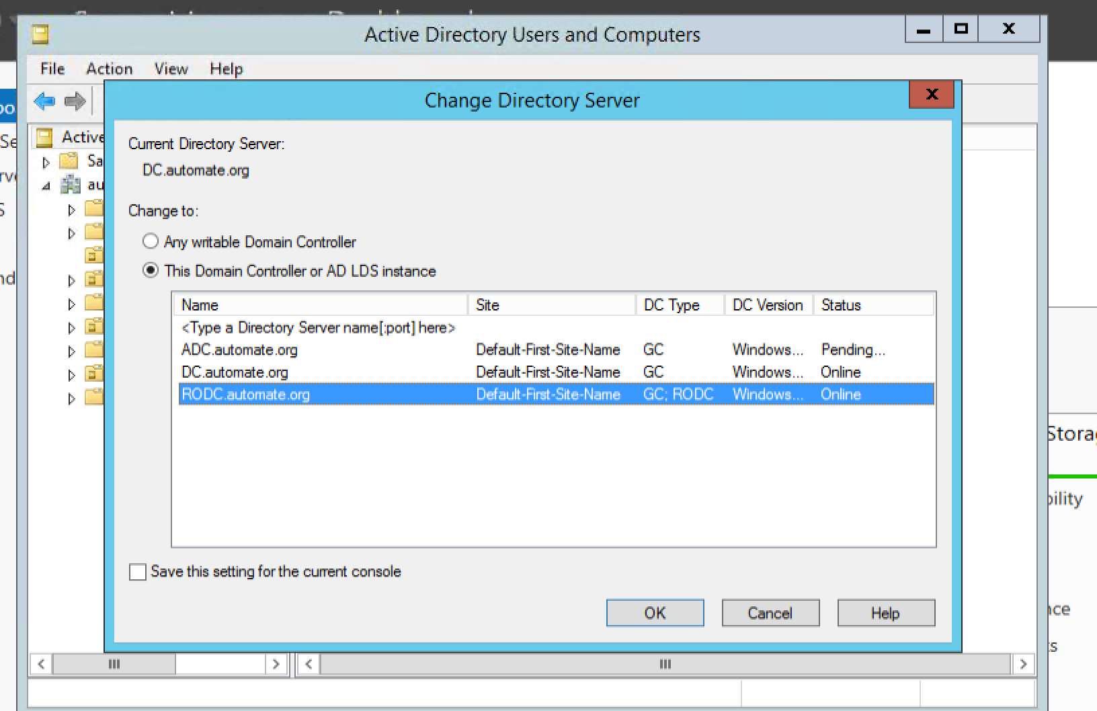
Do this and click okay

Slide 9
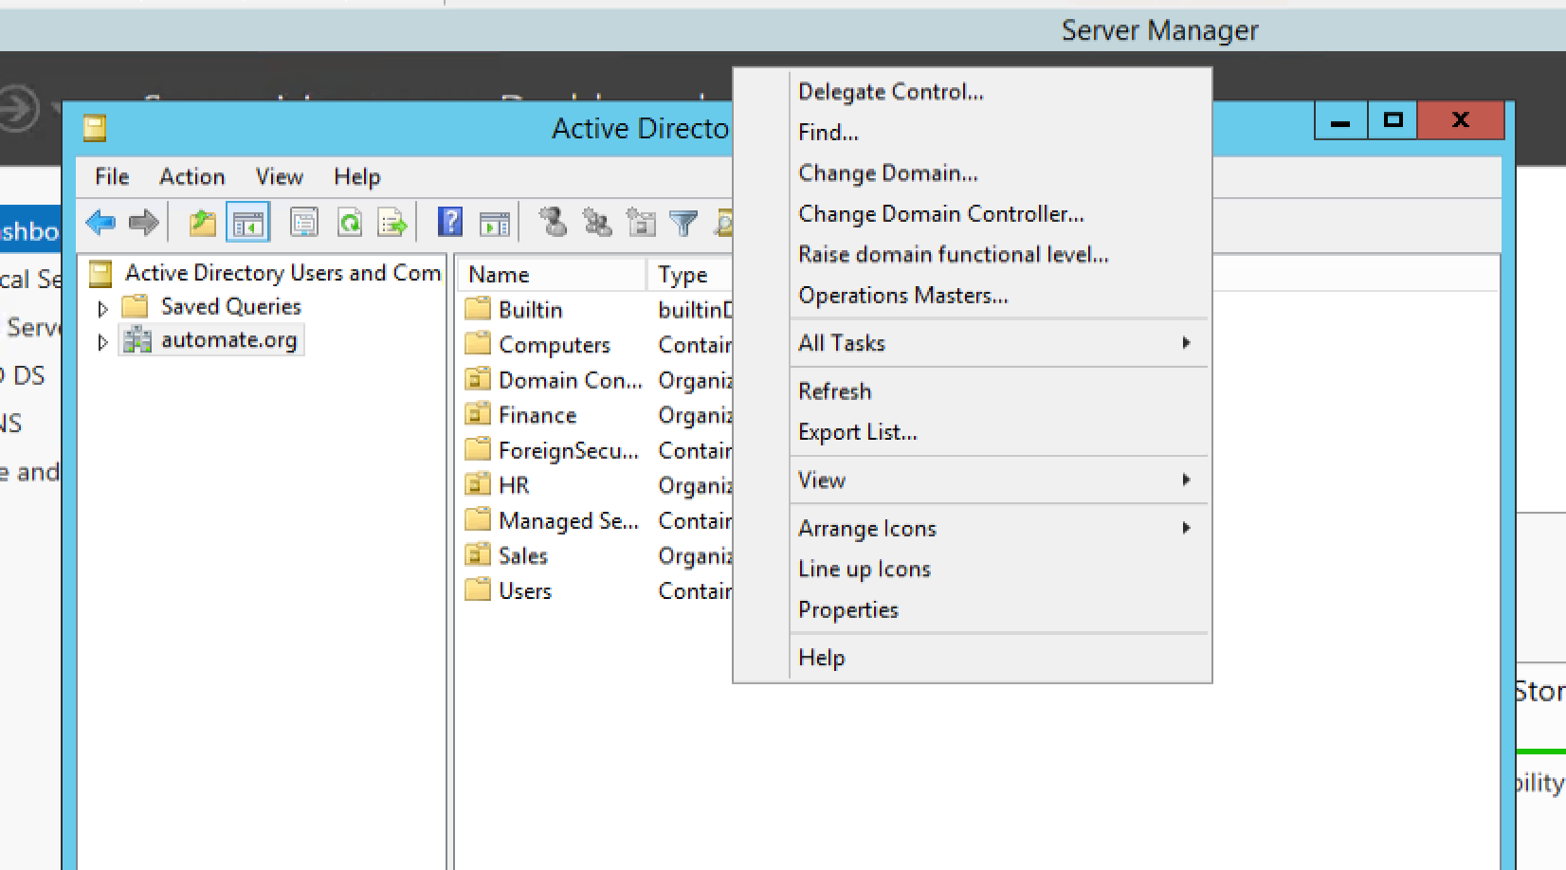
No more New option..

Slide 10
PASSWORD REPLICATION

Slide 11
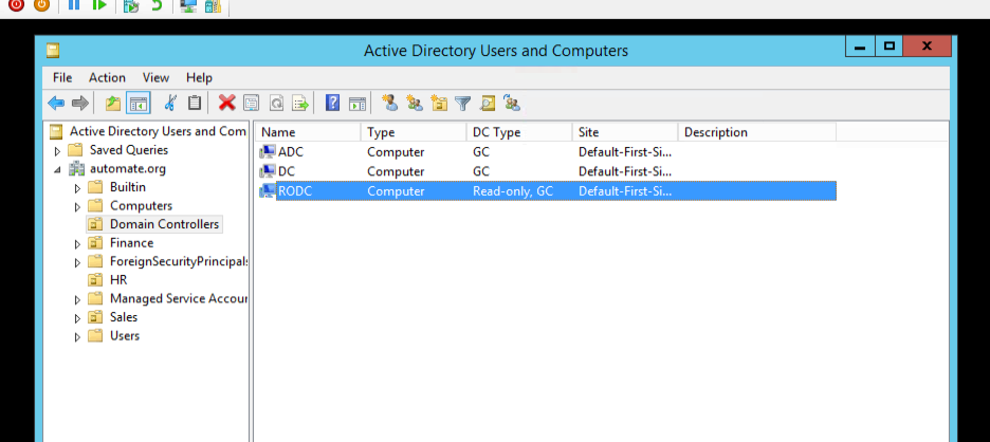
GO TO DC MACHINE. Nav to active dir users

Slide 12
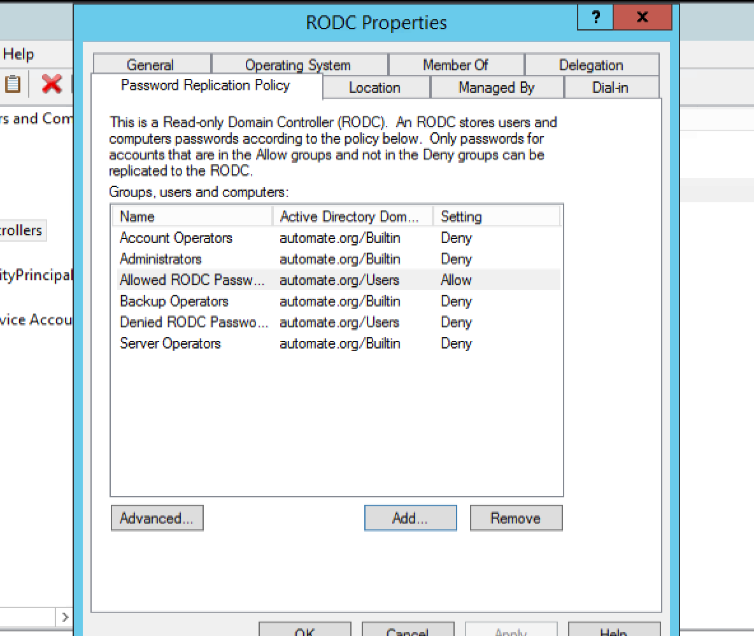
RODC Properties. - ADD

Slide 13
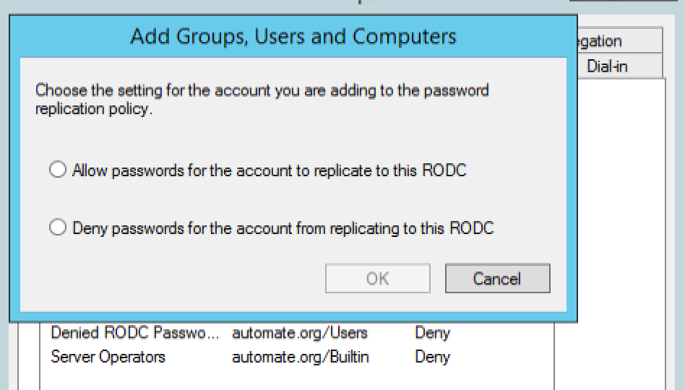
Allow to replicate and deny to not replicate

Slide 14
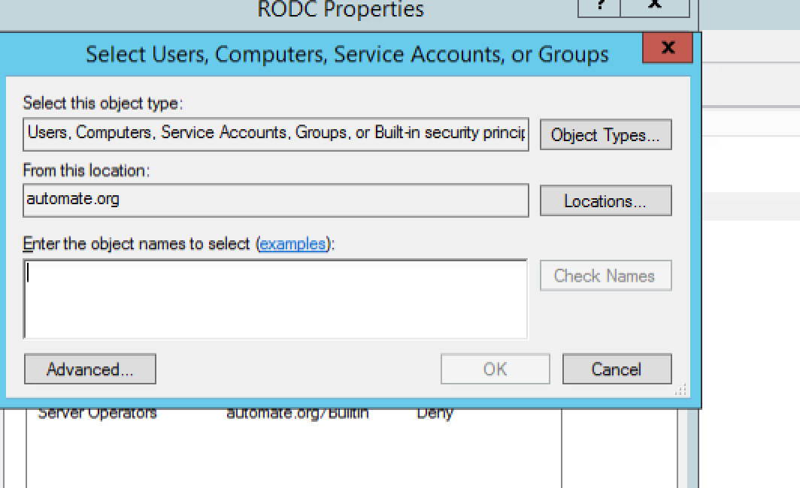
ADD username and ok

Slide 15
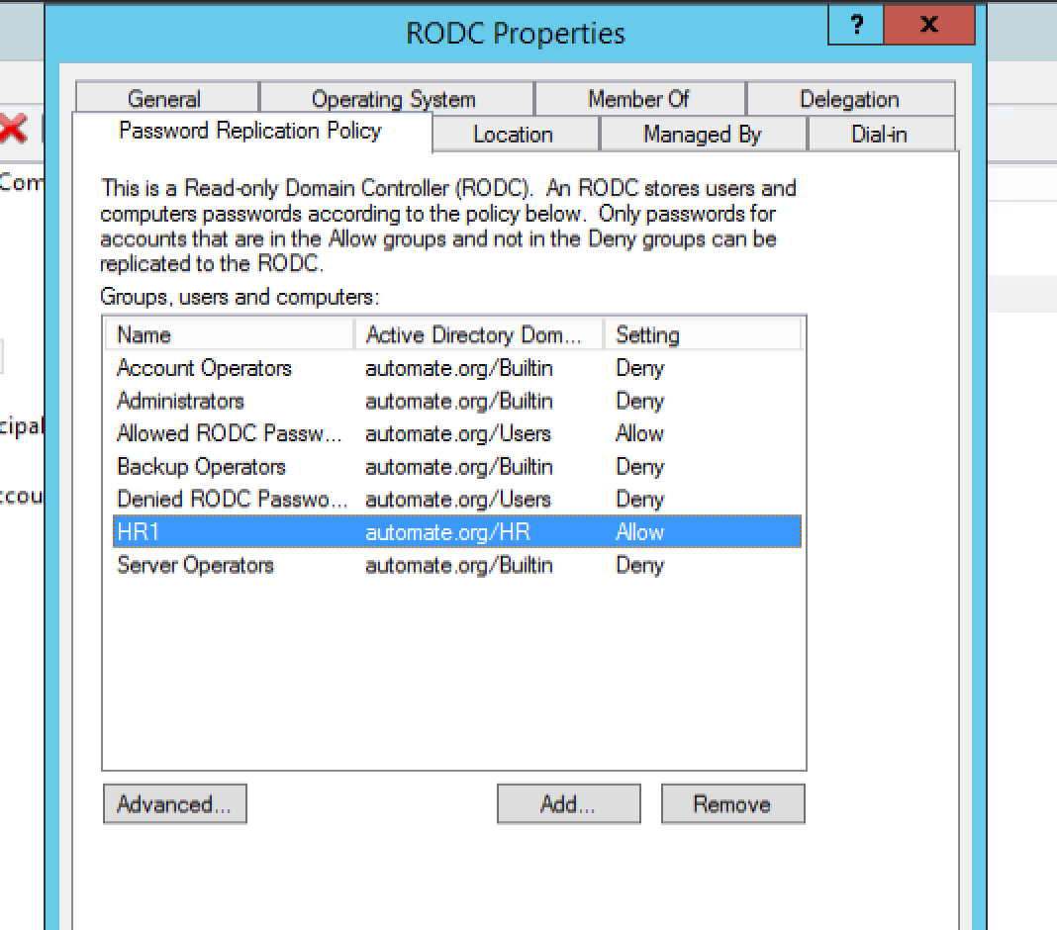
Allowed

