Slide 1
SCCM IMPORT
DEMO

Slide 2
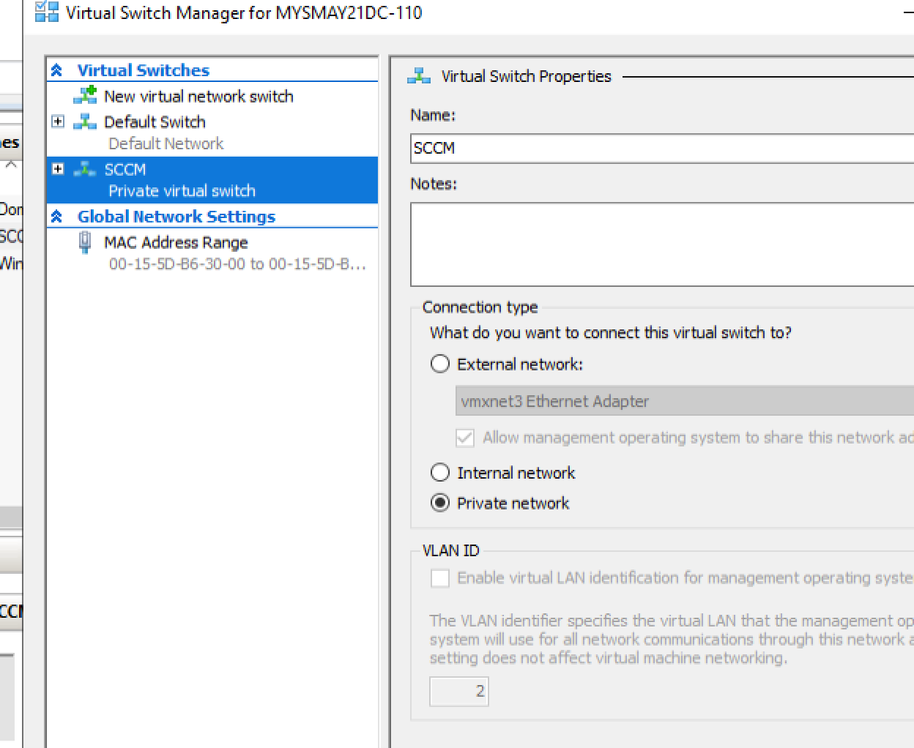
CREATE SWITCH SCCM

Slide 3
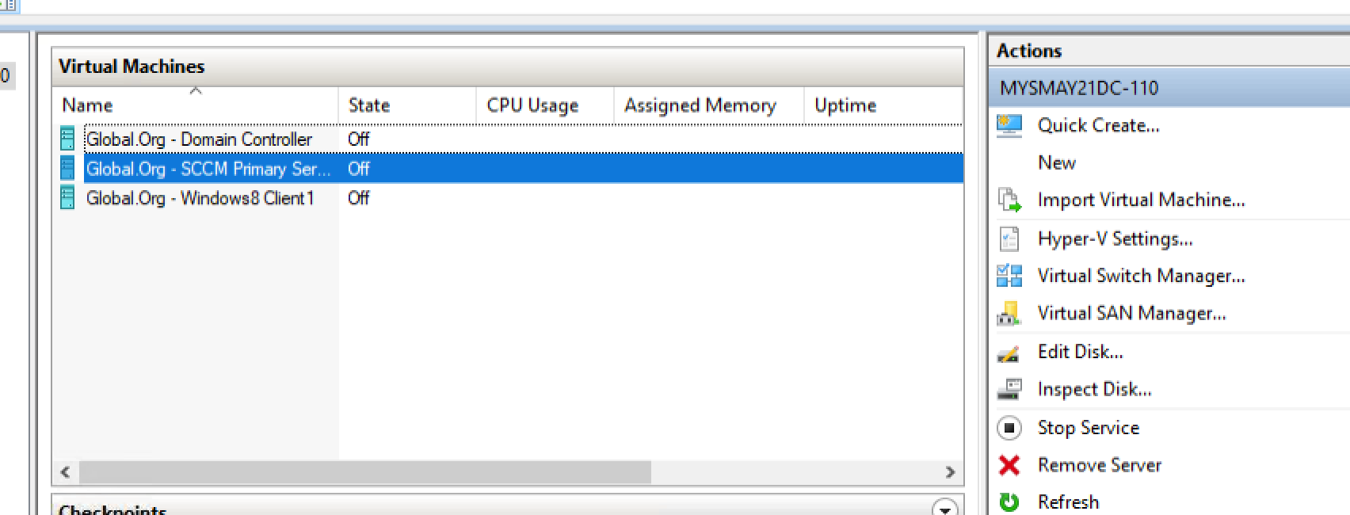
Import all three machines from c drive. (if asked for switch connection give SCCM)

Slide 4
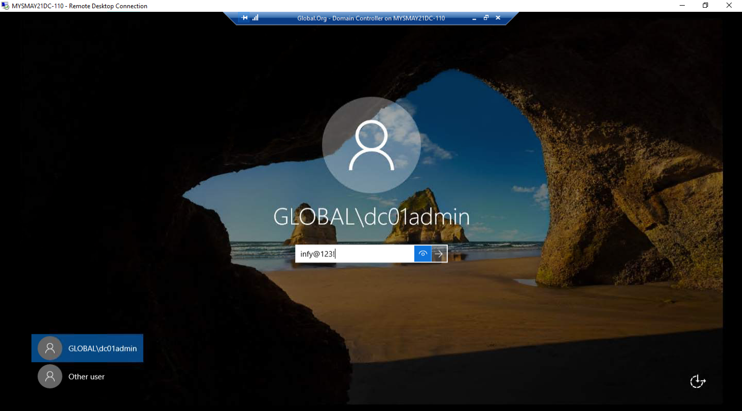
Login into all three vm’s

Slide 5
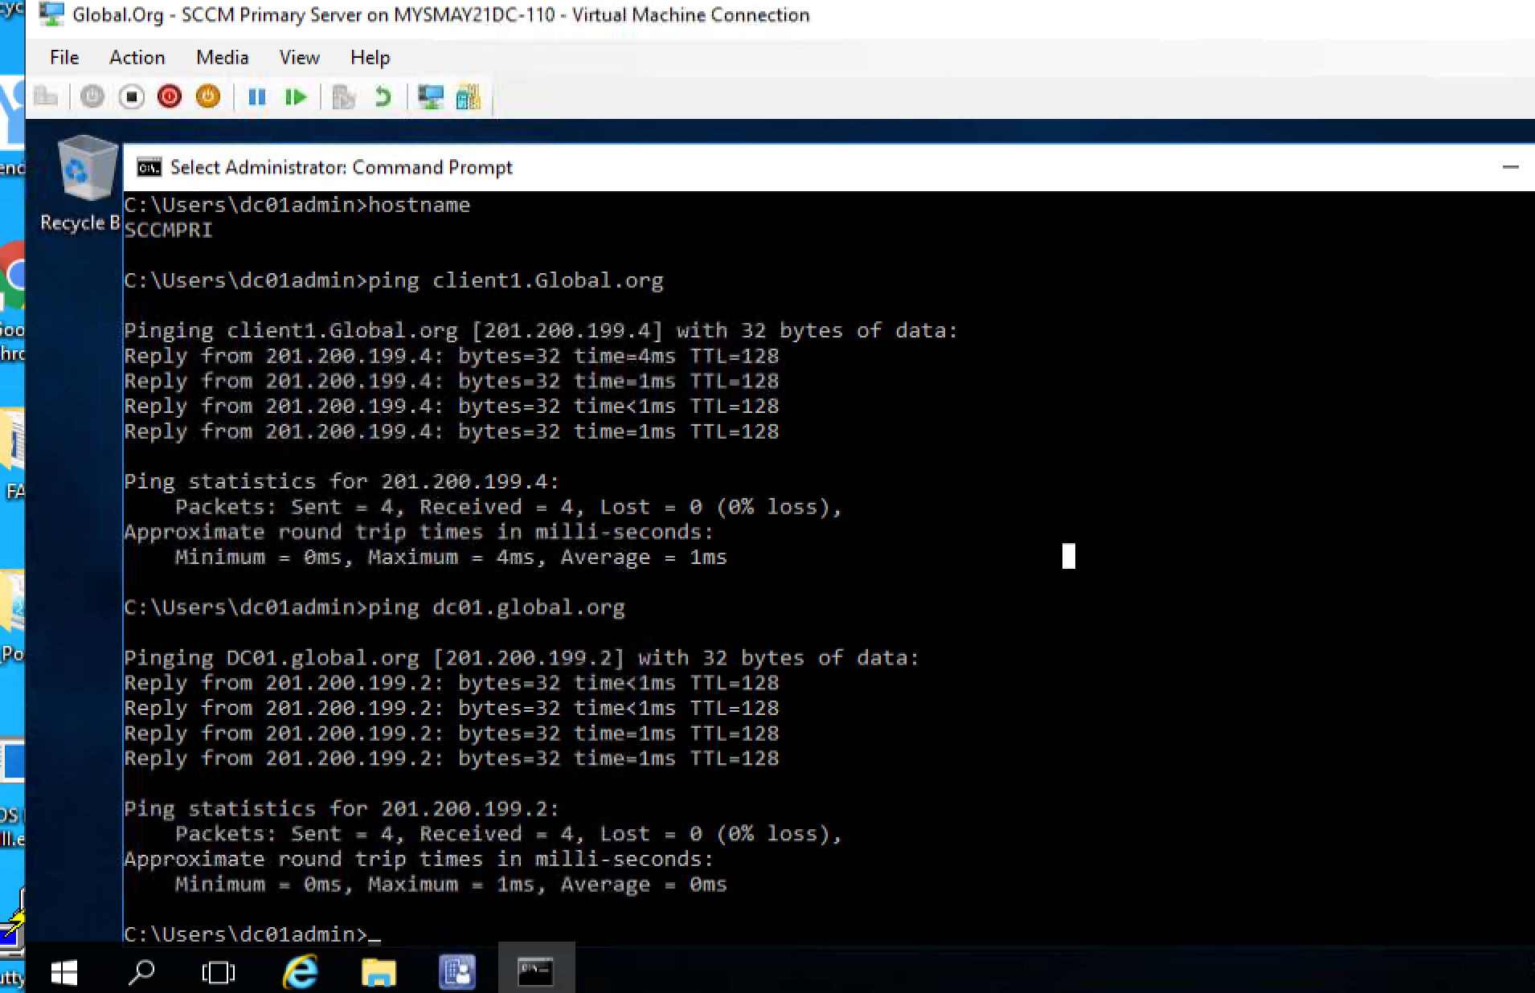
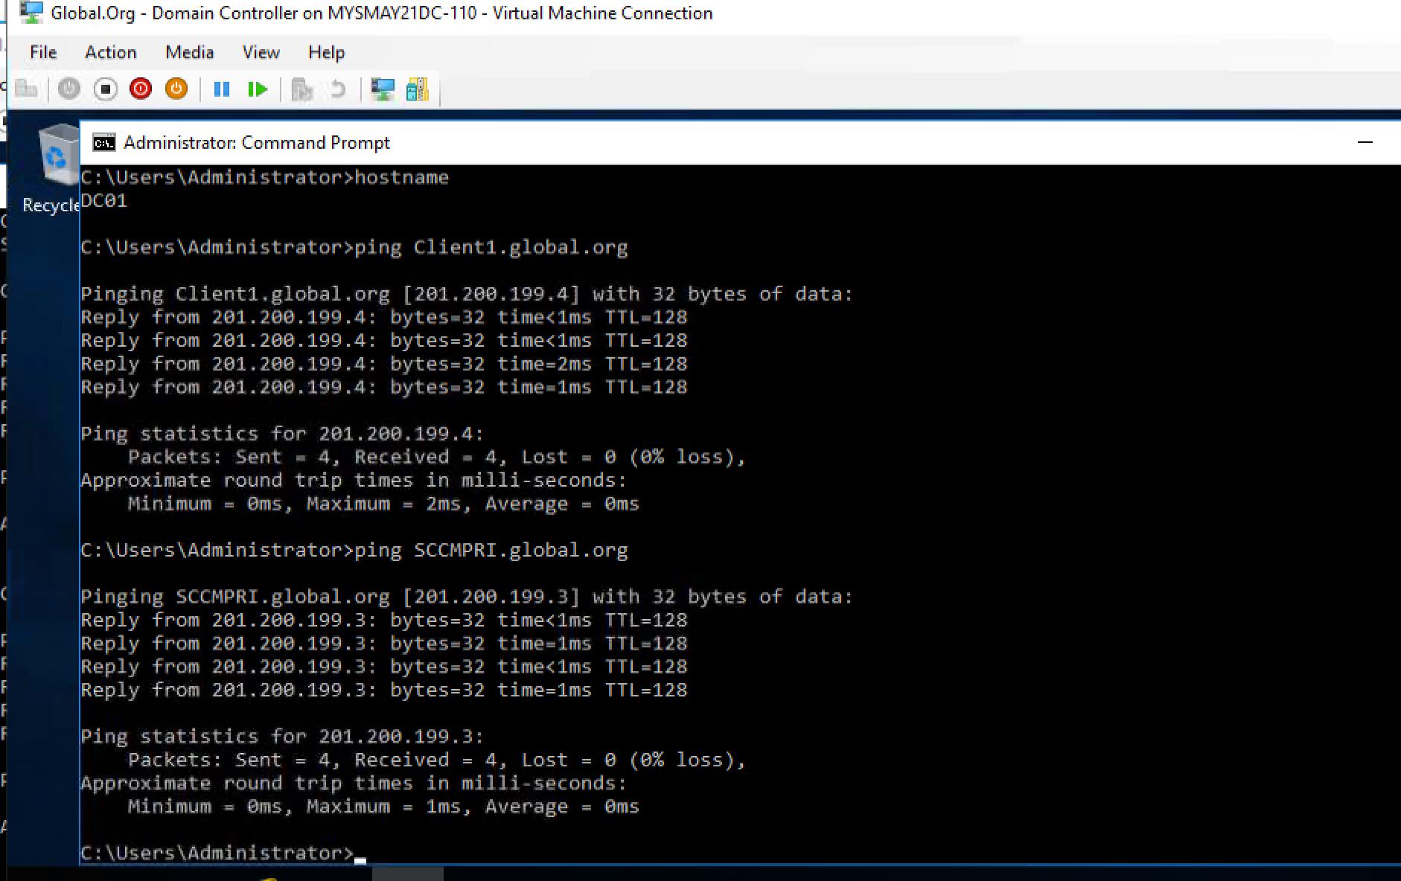
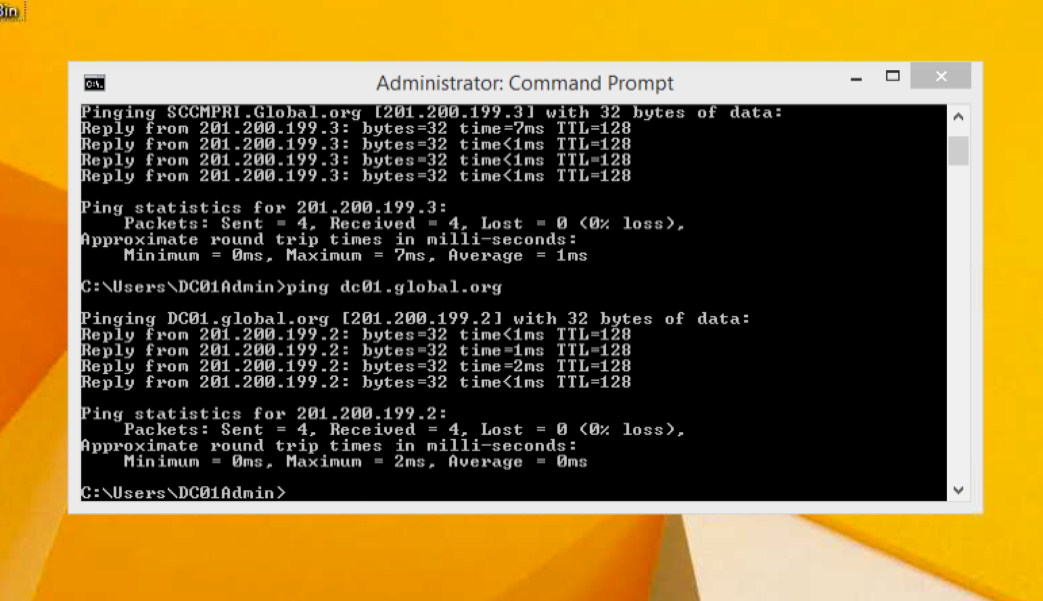
PING EACH OTHER USING HOSTNAME.GLOBAL.ORG TO VERIFY

Slide 6
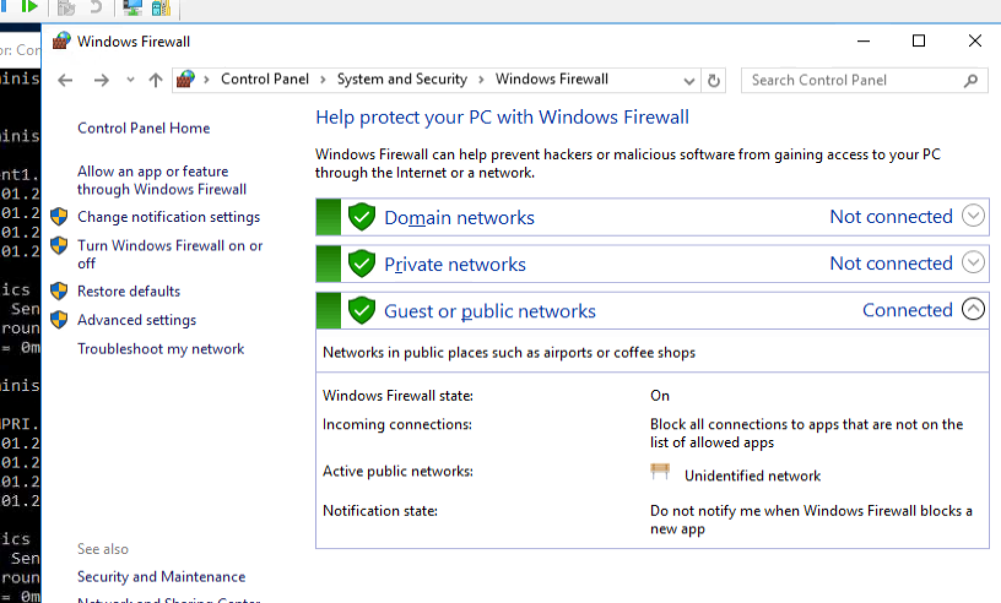
Turn on Firewall

Slide 7
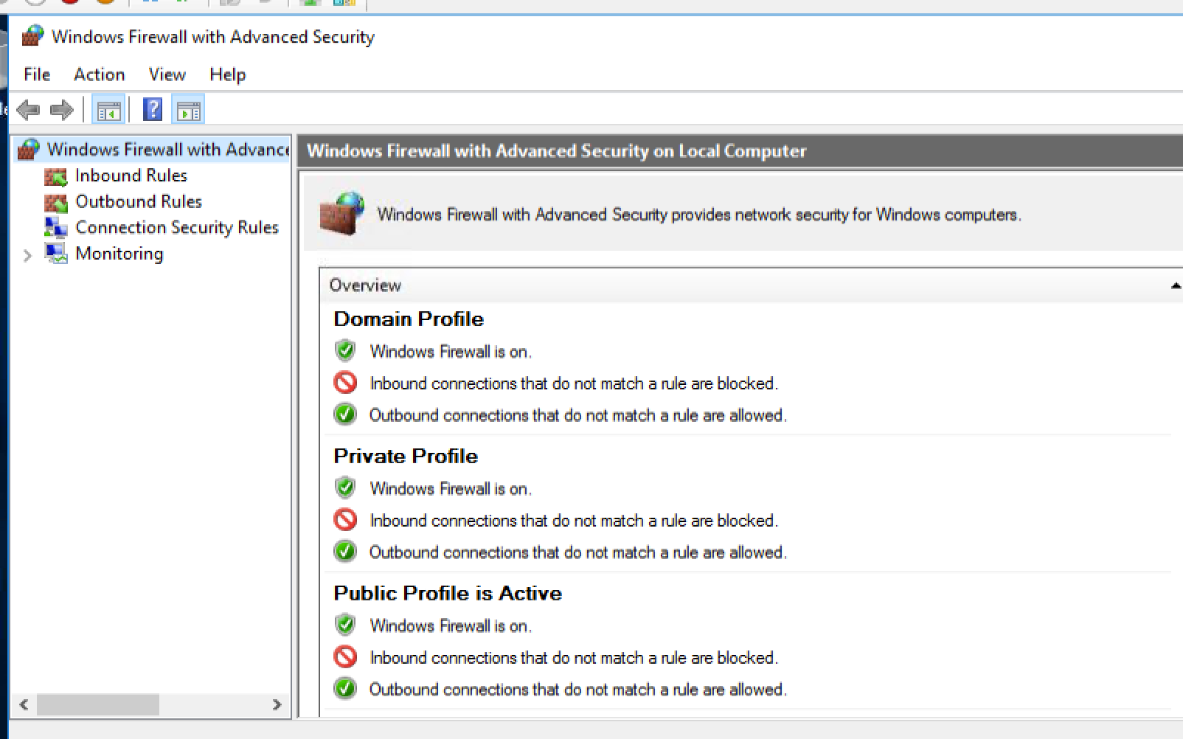

Slide 8
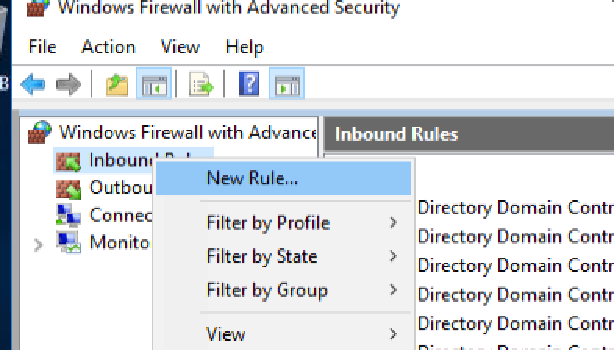
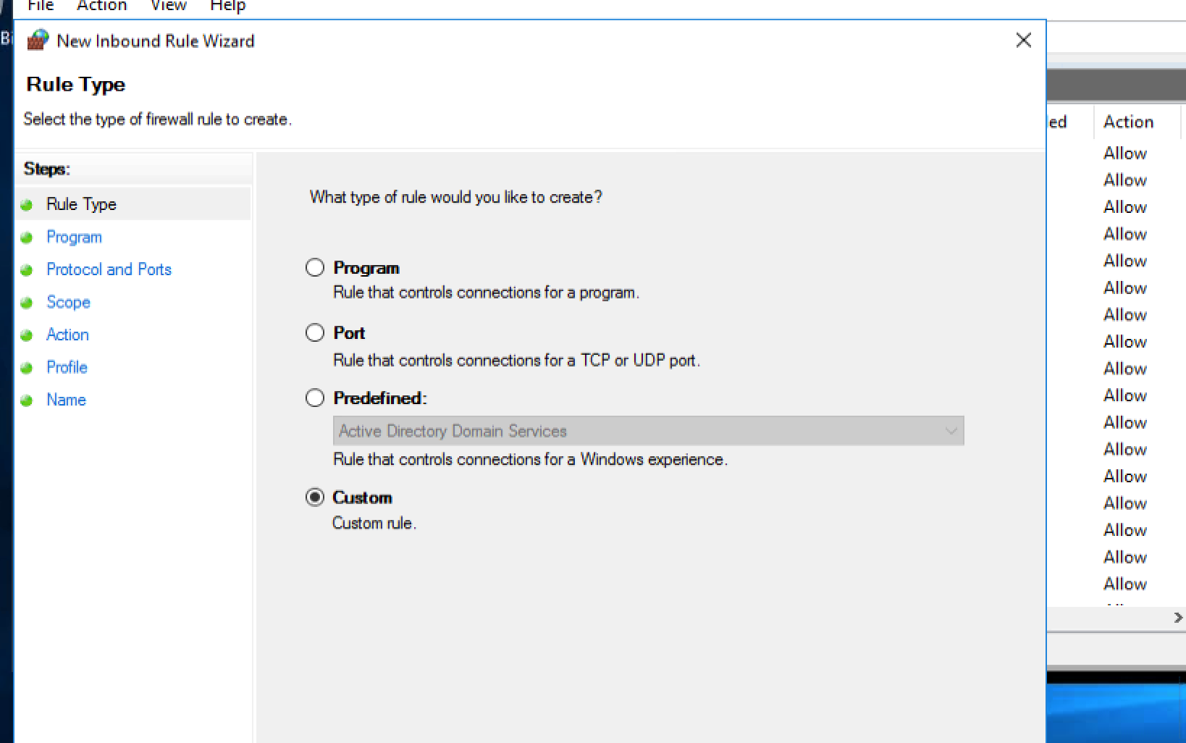
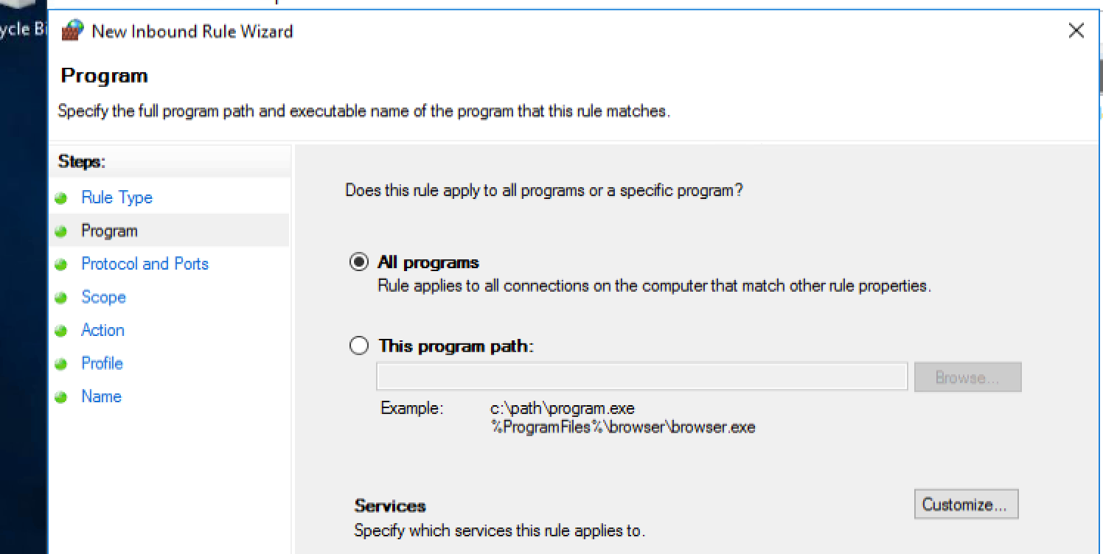
Inbound (Right click)(new rule) – custom – all programs

Slide 9
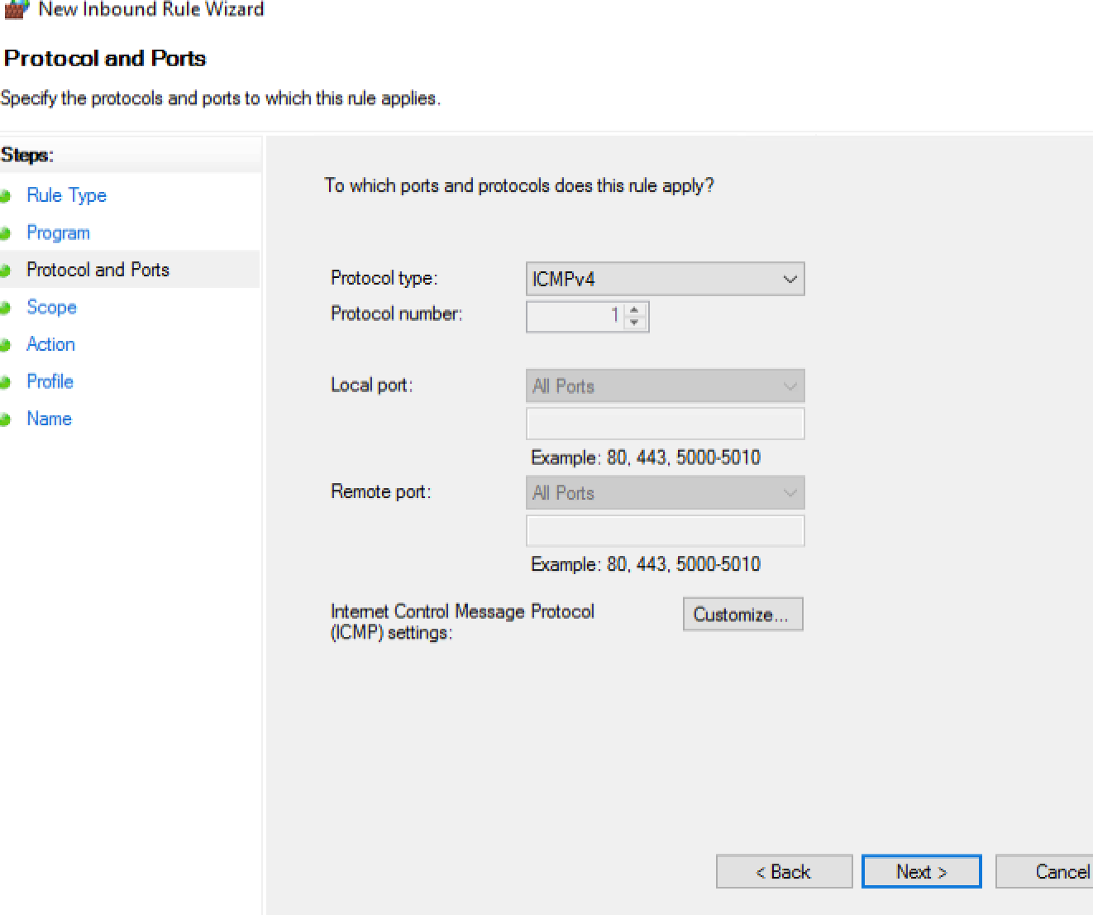
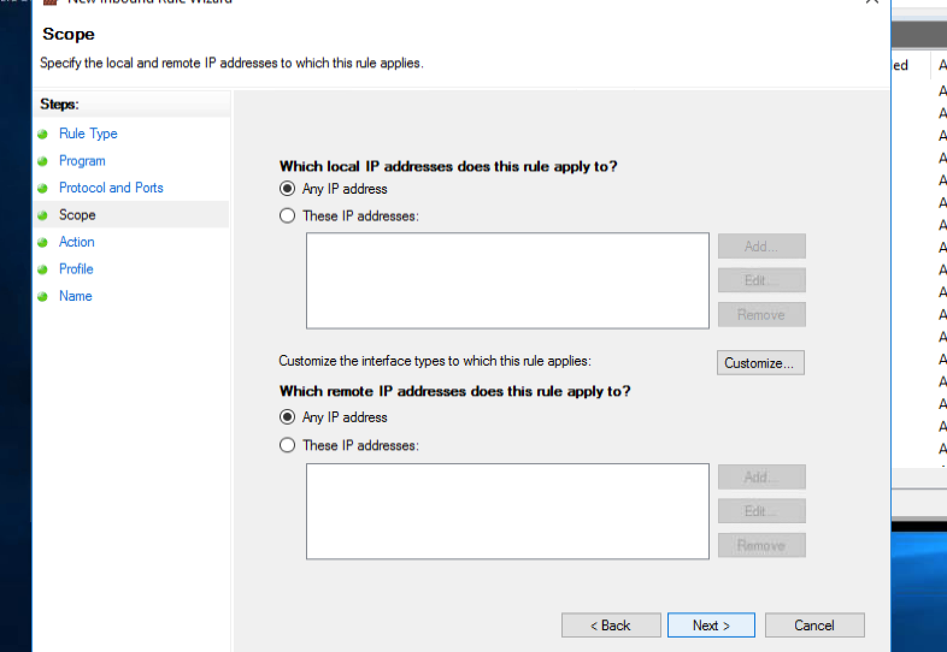
ICMPv4 --- ANY IP ADDRESS

Slide 10
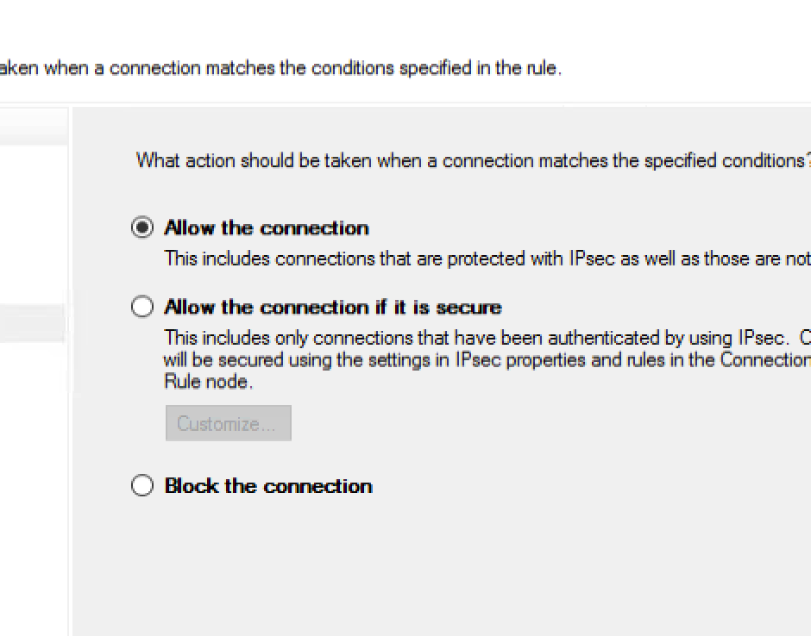
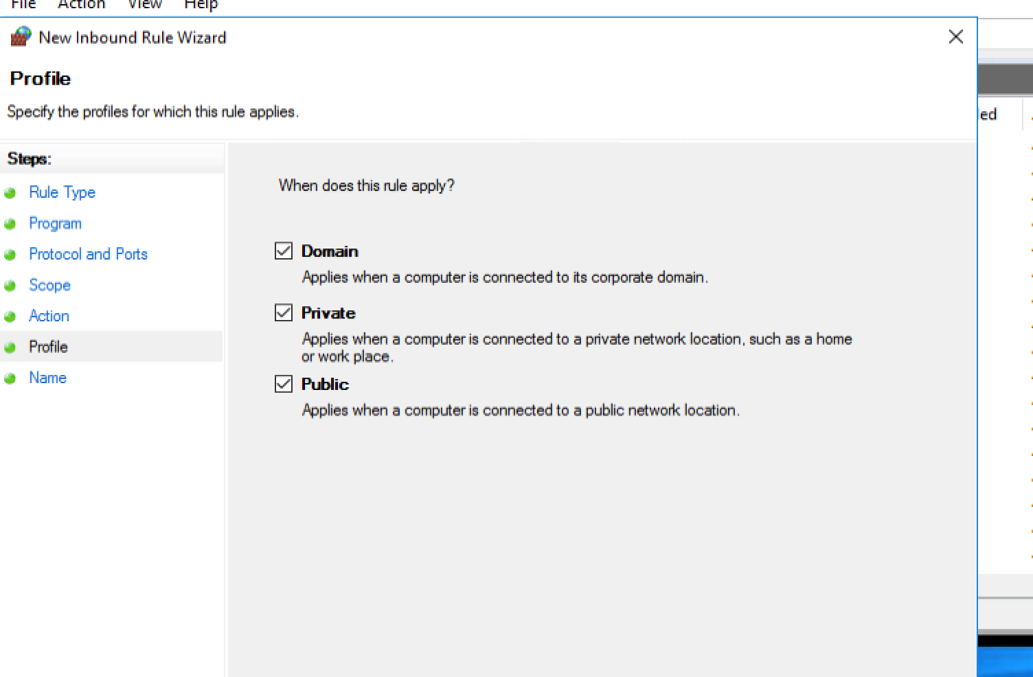
Allow the connection --- All firewalls

Slide 11
Do the same with outbound.
Tip: slide 12-14 is for GPO.
If Not interested skip to 16

Slide 12
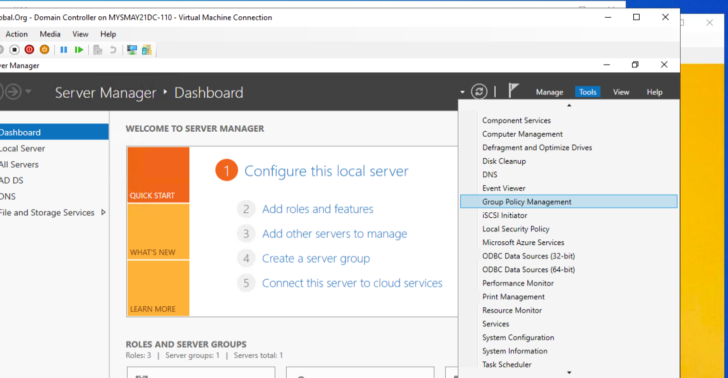
Open Group policy management from

Slide 13
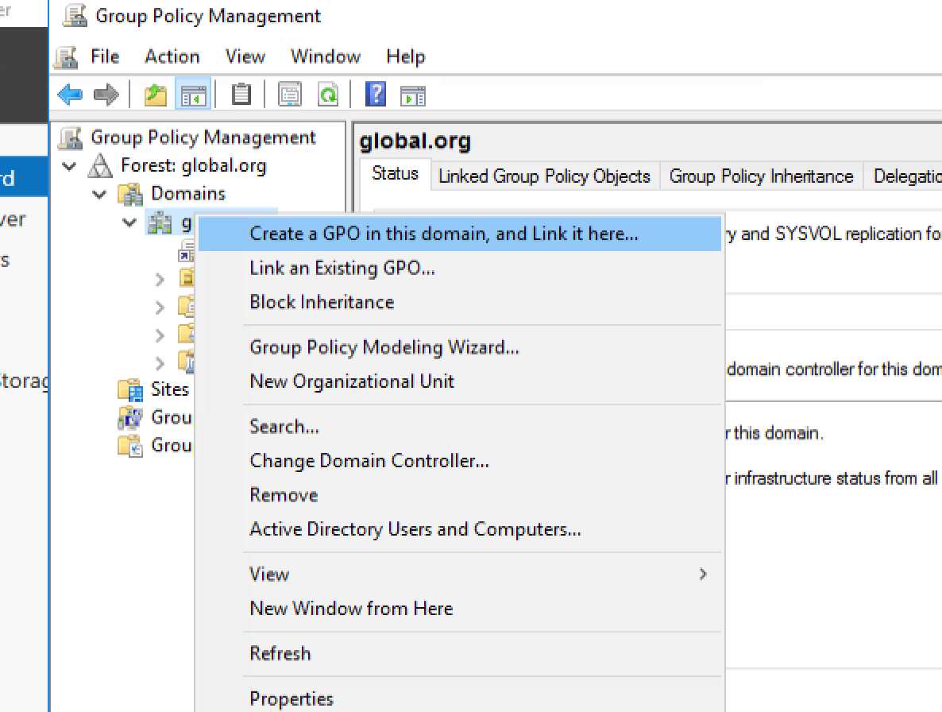
Create GPO for Global.org

Slide 14
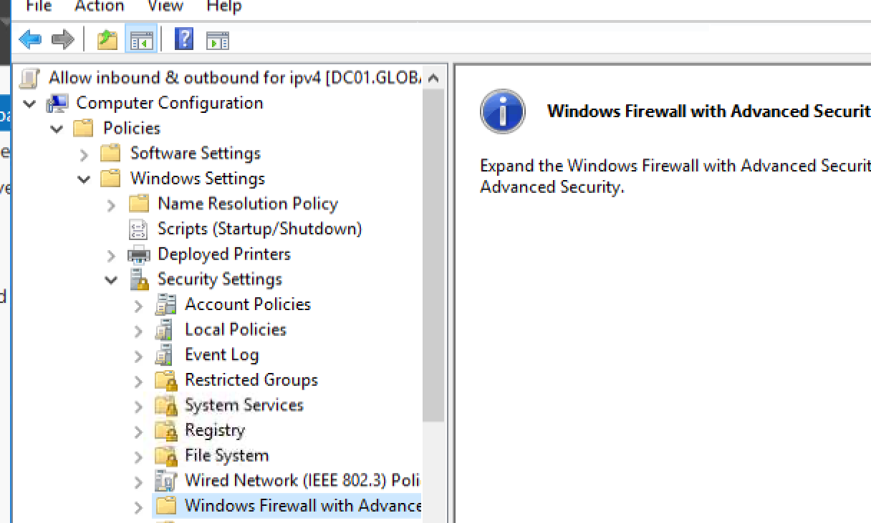
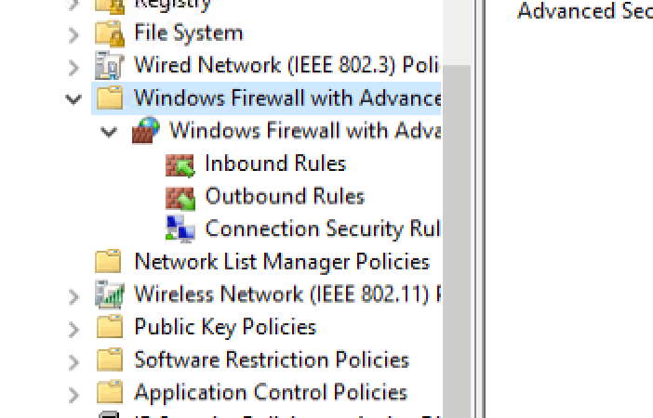
Right click on inbound and outbound and follow slide 8-10

Slide 15
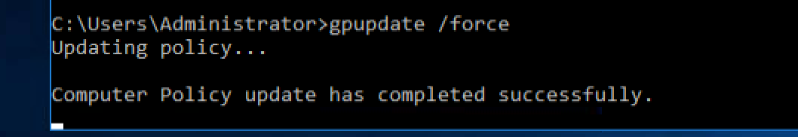
Gpupdate /force

