Slide 1
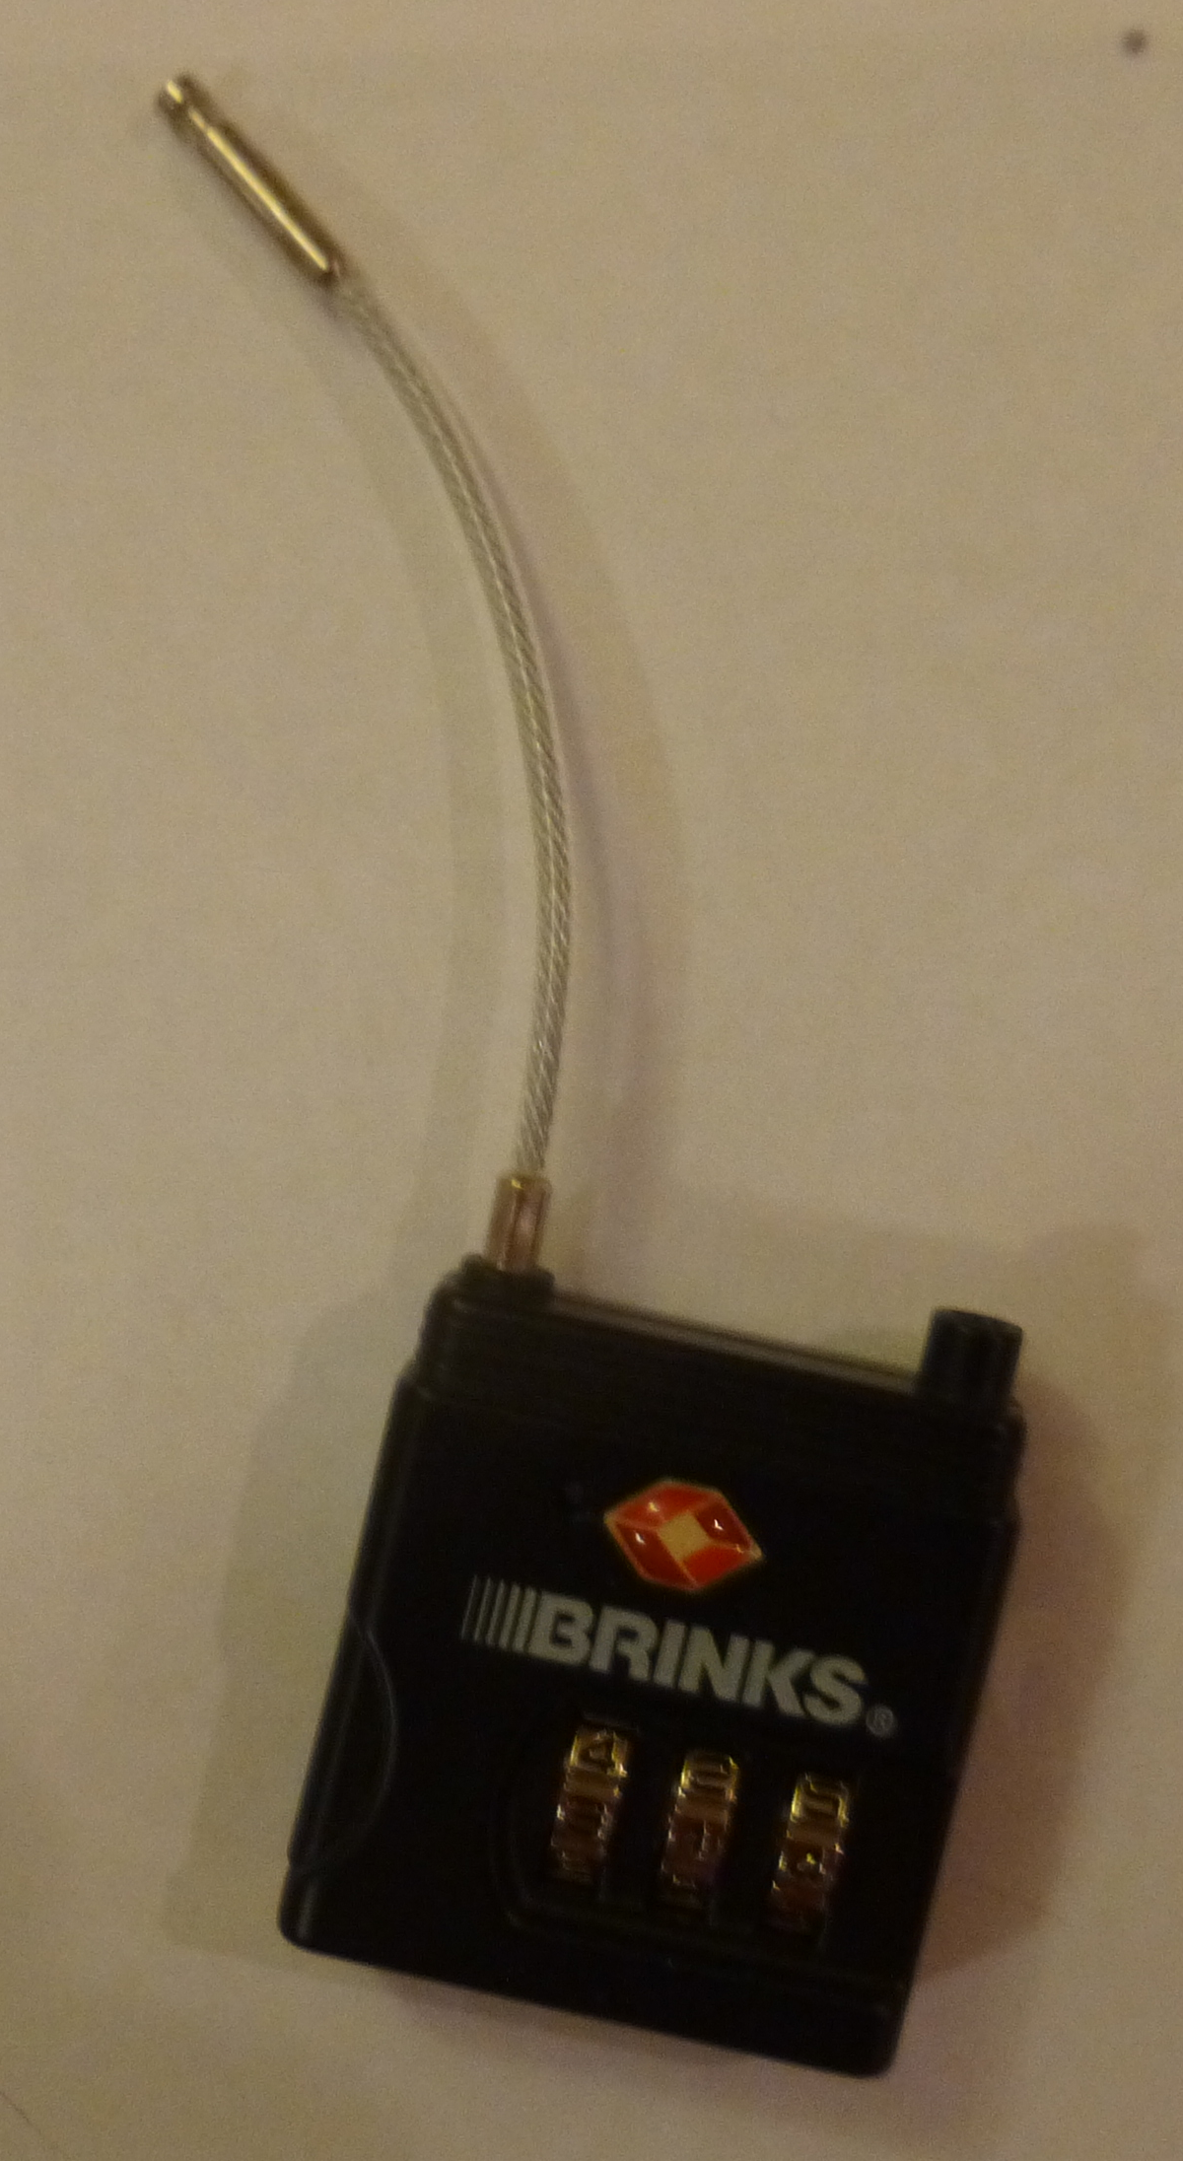
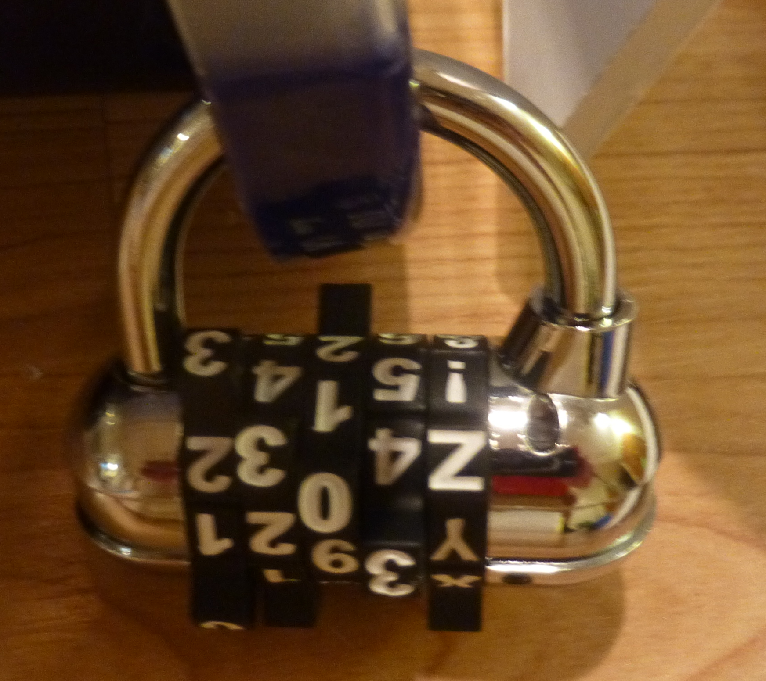
Make sure your numbers are right side up! Once you get the right combination. Click the button on the side to release the cable.
Line up the letters and numbers with the white lines.

Slide 2
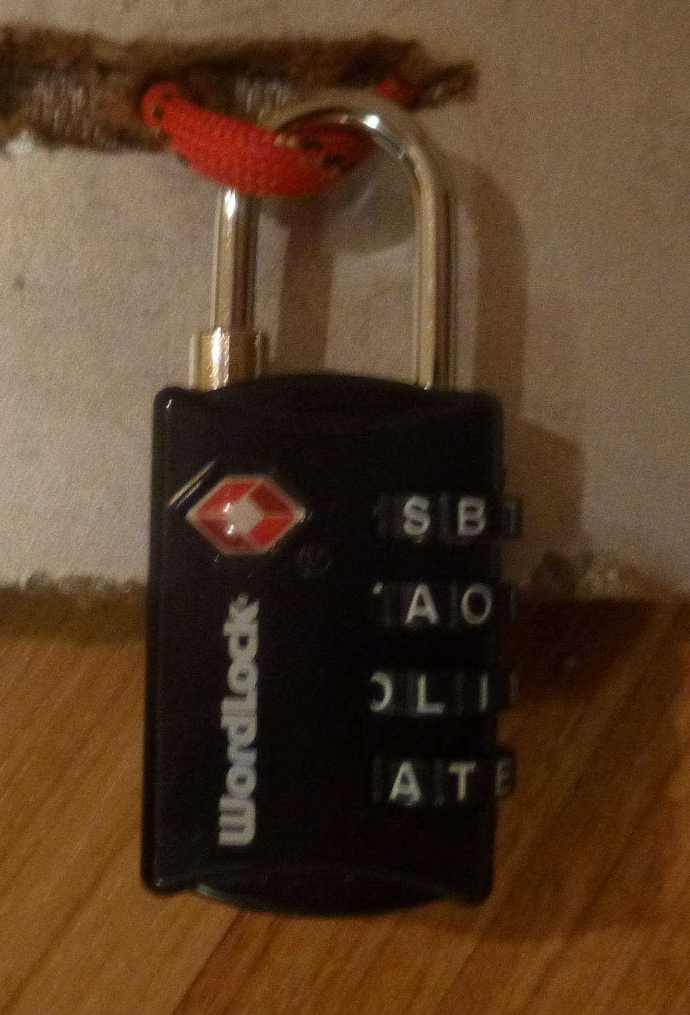
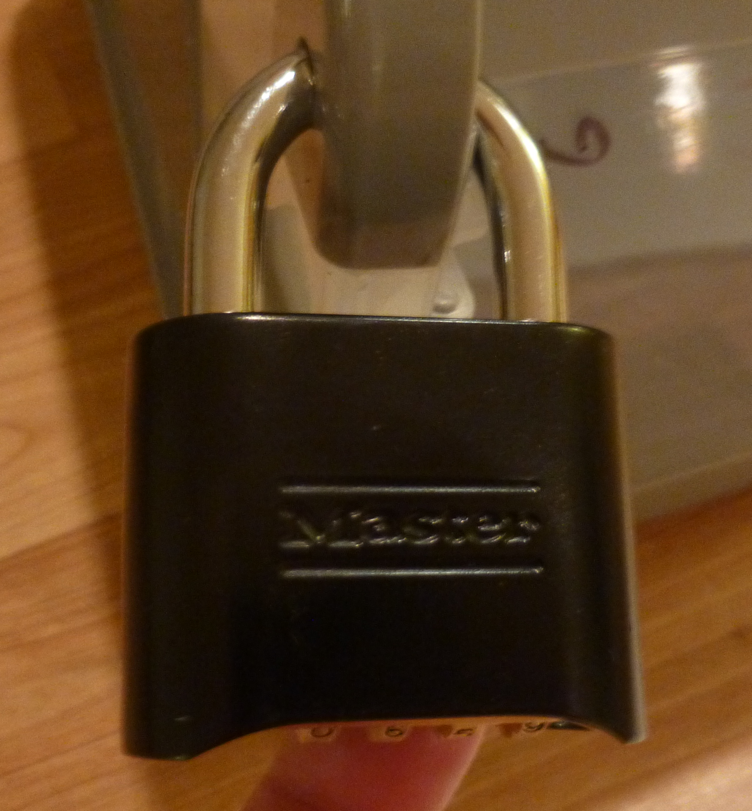
The locks have only four letters.
So the words you are looking for have
4 letters!
Get the correct code. Then push down on the silver loop to click open.

Slide 3
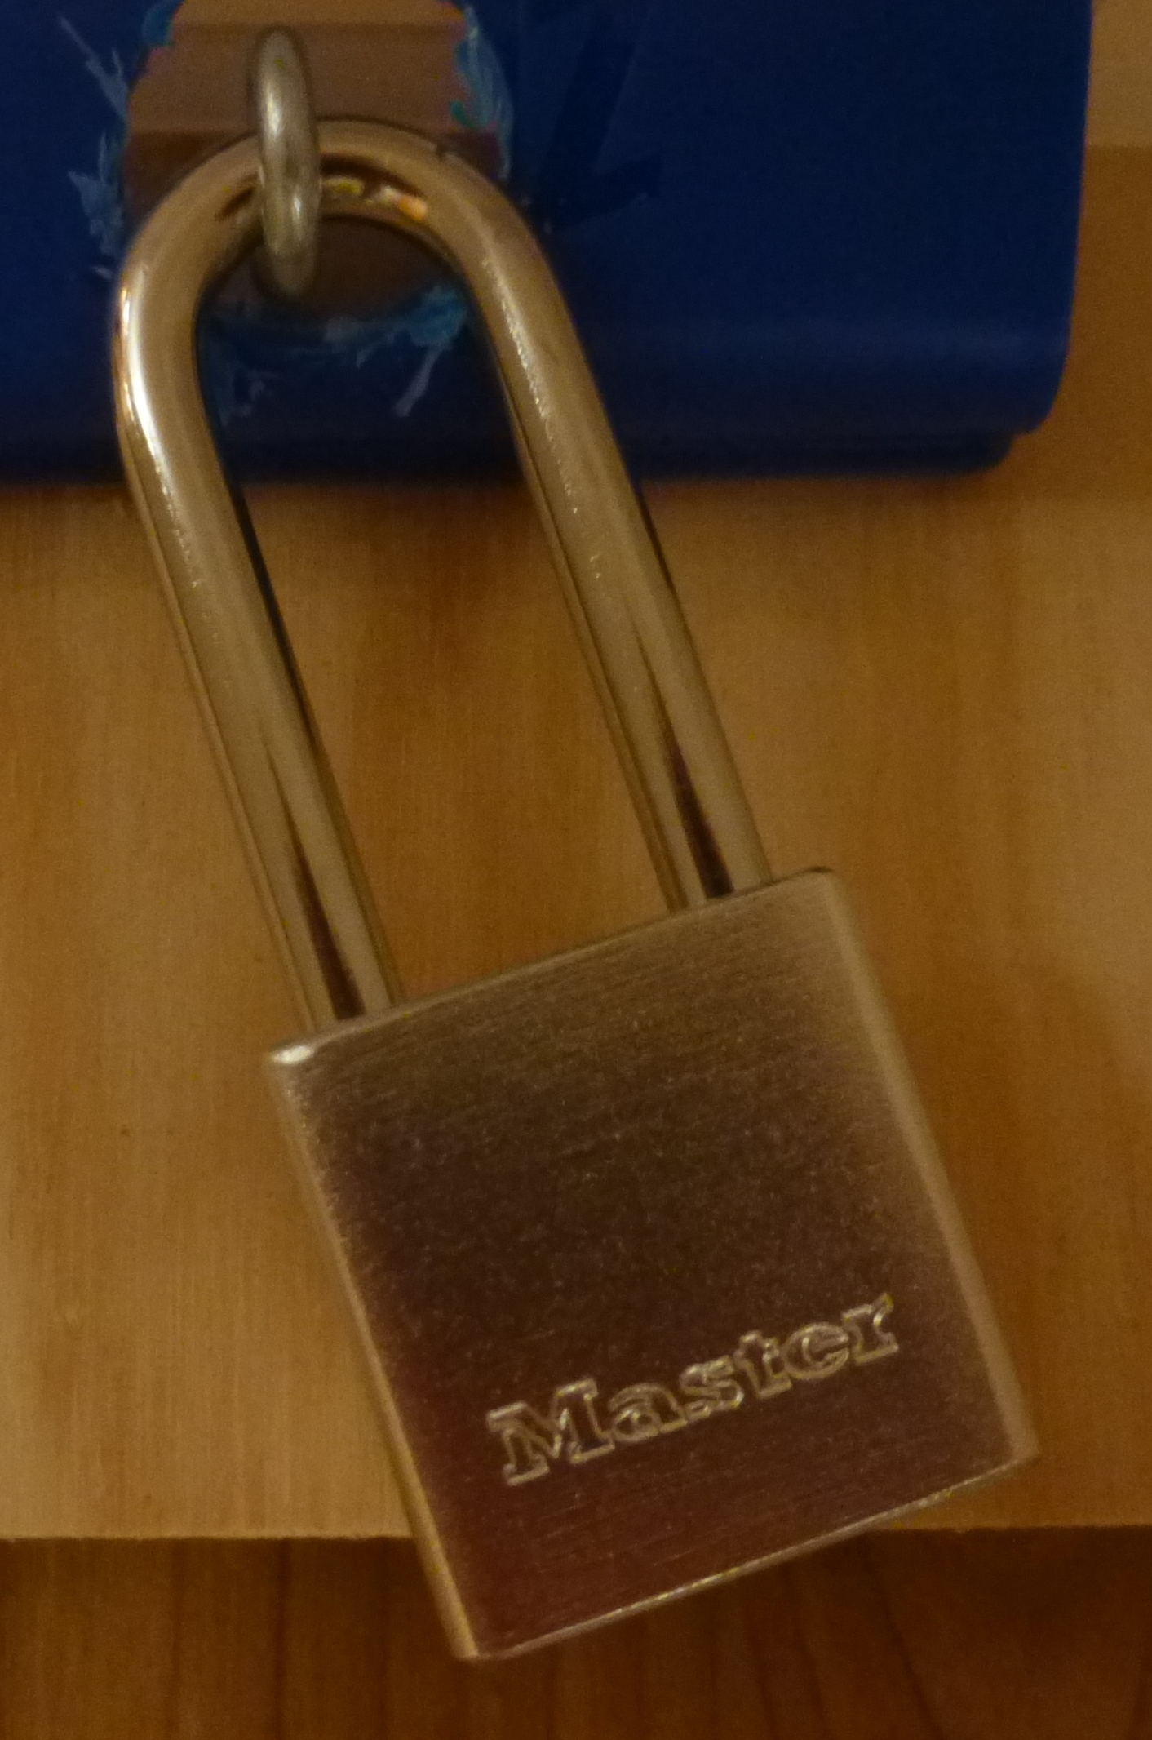
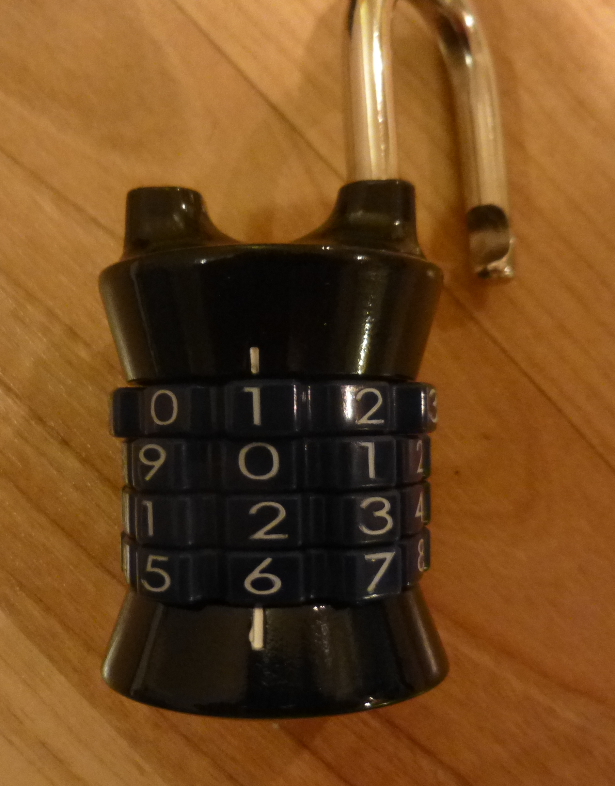
There are four locks. They all open with the same key.
Line up numbers with the little white lines on the top and bottom.

Slide 4
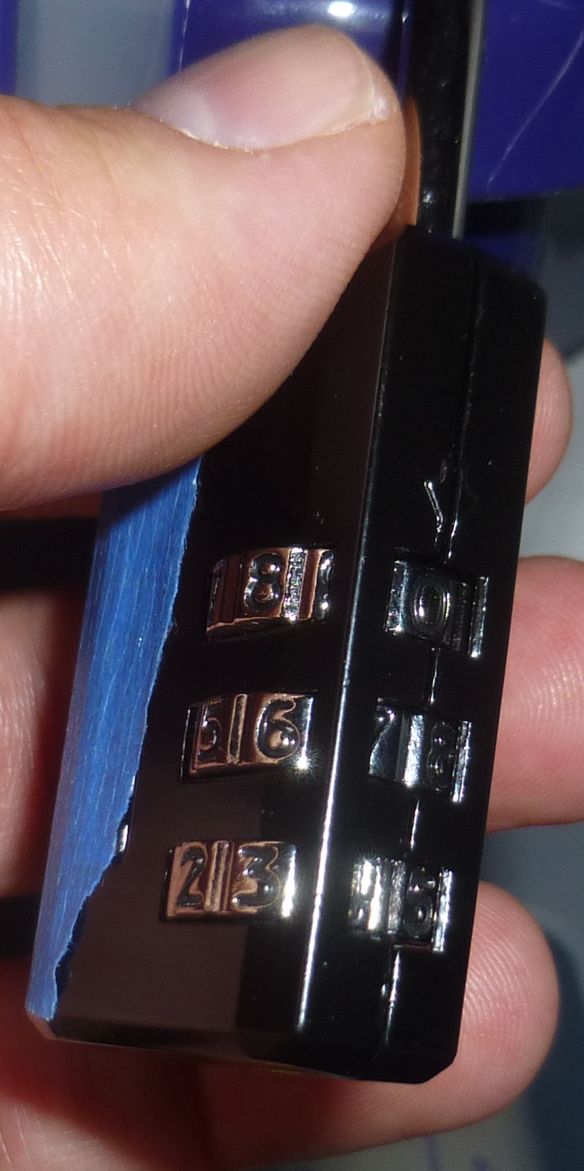
Line up the combination on the side not on the front.

