Slide 1

The Forward-Forward Algorithm: Some Preliminary Investigations
Git: None

Slide 2
Paper Contents
1
2
3
4
5
Abstract
Introduction
Methods
Experiments
Conclusion

Slide 3
Background
Back-propagation

Slide 4
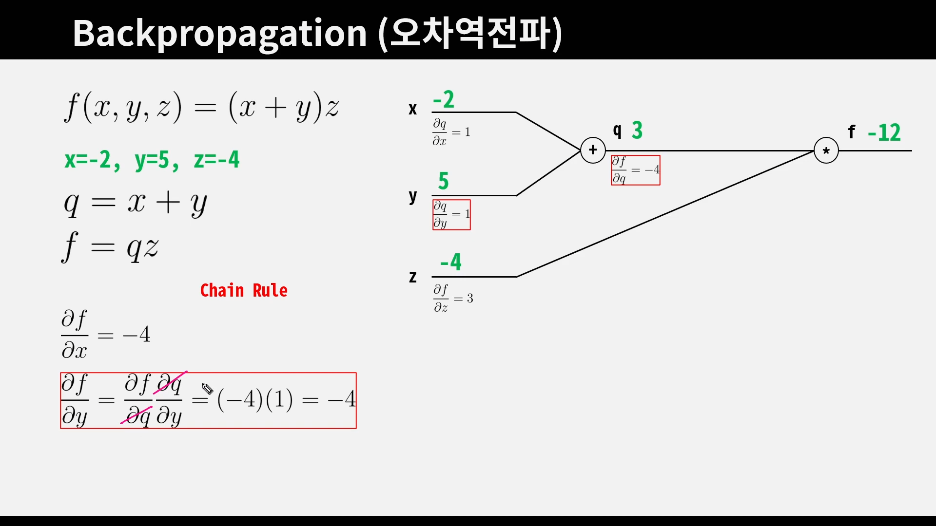
Introduction
Notes:
The big advantage of this is that the FF learning in the wake phase becomes simpler: For the connections to the hidden layers, it just consists of doing a forward pass and raising the goodness of hidden layers that are not good enough. For the connections back to the input, it just consists of learning these connections to maximize the log probability of correctly predicting the next character.

Slide 5
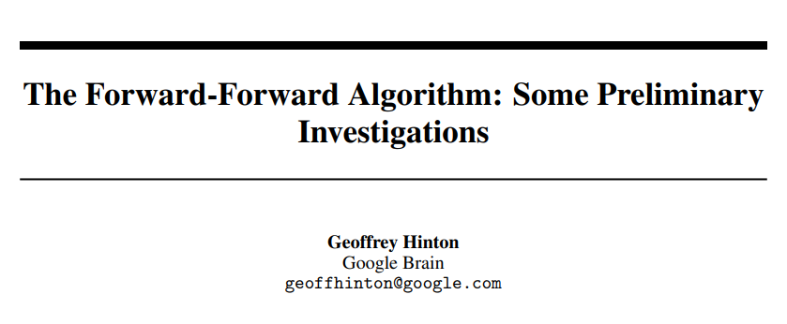

Slide 6
Abstract
The aim of this paper is to introduce a new learning procedure for neural networks and to demonstrate that it works well enough on a few small problems to be worth further investigation.
The Forward-Forward algorithm replaces the forward and backward passes of backpropagation by two forward passes, one with positive (i.e. real) data and the other with negative data which could be generated by the network itself.
Each layer has its own objective function which is simply to have high goodness for positive data and low goodness for negative data.
The sum of the squared activities in a layer can be used as the goodness but there are many other possibilities, including minus the sum of the squared activities.
If the positive and negative passes could be separated in time, the negative passes could be done offline, which would make the learning much simpler in the positive pass and allow video to be pipelined through the network without ever storing activities or stopping to propagate derivatives.

Slide 7
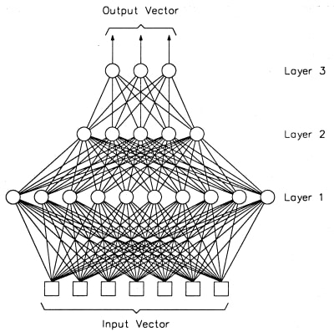
1. What is wrong with backpropagation
As a model of how cortex learns, backpropagation remains implausible.
Backpropagation through time as a way of learning sequences is especially implausible.
A further serious limitation of backpropagation is that it requires perfect knowledge of the computation performed in the forward pass
In the absence of a perfect model of the forward pass, it is always possible to resort to one of the many forms of reinforcement learning.
Notes:
1. There is no convincing evidence that cortex explicitly propagates error derivatives or stores neural activities for use in a subsequent backward pass.
2. It needs a learning procedure that can learn on the fly. The representations in later stages of the pipeline may provide top-down information that influences the representations in earlier stages of the pipeline at a later time step, but the perceptual system needs to perform inference and learning in real time without stopping to perform backpropagation.
3. If we insert a black box into the forward pass, it is no longer possible to perform backpropagation unless we learn a differentiable model of the black box.
4. But reinforcement learning procedures suffer from high variance: it is hard to see the effect of perturbing one variable when many other variables are being perturbed at the same time

Slide 8
1. What is wrong with backpropagation
The Forward-Forward algorithm (FF) has the advantage that it can be used when the precise details of the forward computation are unknown
it can learn while pipelining sequential data through a neural network without ever storing the neural activities or stopping to propagate error derivatives.
The forward-forward algorithm is somewhat slower than backpropagation and does does not generalize quite as well on several of the toy problems investigated in this paper so it is unlikely to replace backpropagation for applications where power is not an issue.
The two areas in which the forward-forward algorithm may be superior to backpropagation are as a model of learning in cortex and as a way of making use of very low-power analog hardware without resorting to reinforcement learning.

Slide 9
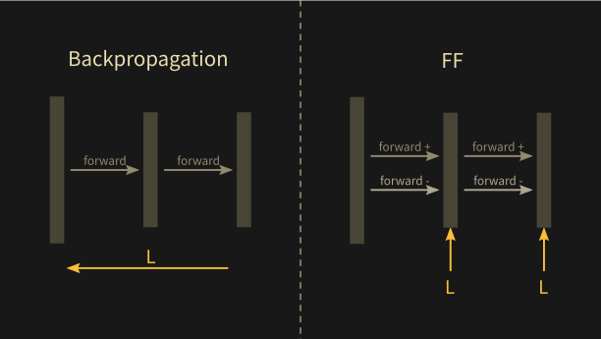
2. The Forward-Forward Algorithm

Slide 10
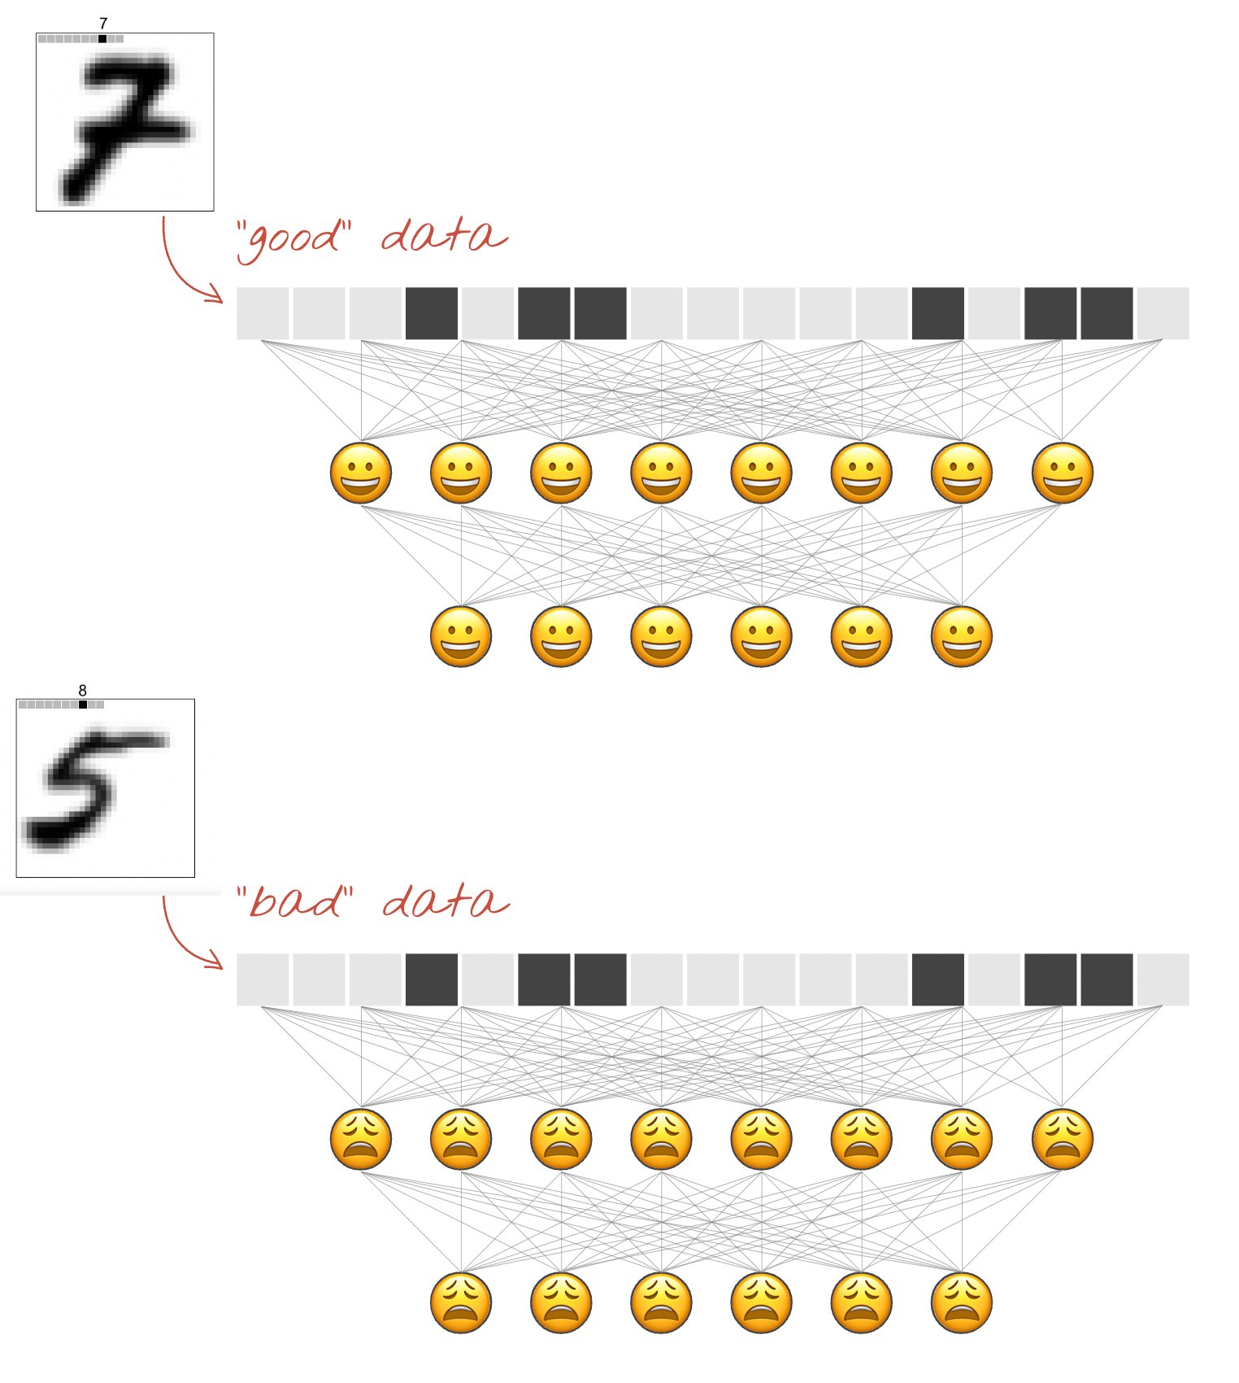
2. The Forward-Forward Algorithm
Good Case
Bad Case
Notes:
Good case

Slide 11

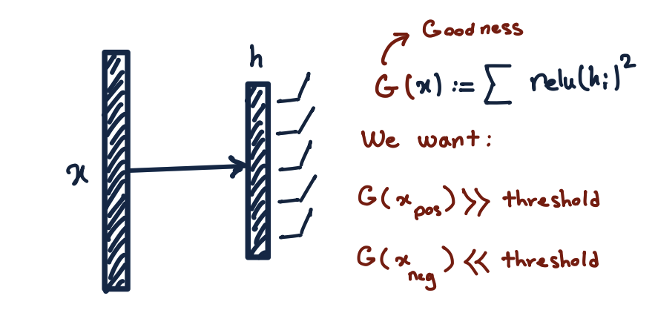
2. The Forward-Forward Algorithm

Slide 12
2. The Forward-Forward Algorithm
But if the activities of the first hidden layer are then used as input to the second hidden layer, it is trivial to distinguish positive from negative data by simply using the length of activity vector in the first hidden layer.
There is no need to learn any new features. To prevent this, FF normalizes the length of the hidden vector before using it as input to the next layer.
This removes all of the information that was used to determine the goodness in the first hidden layer and forces the next hidden layer to use information in the relative activities of the neurons in the first hidden layer. These relative activities are unaffected by the layer-normalization.
To put it another way, the activity vector in the first hidden layer has a length and an orientation. The length is used to define the goodness for that layer and only the orientation is passed to the next layer.

Slide 13
2. The Forward-Forward Algorithm
The Forward-Forward algorithm is a greedy multi-layer learning procedure inspired by Boltzmann machines and Noise Contrastive Estimation.
The idea is to replace the forward and backward passes of backpropagation by two forward passes that operate in exactly the same way as each other, but on different data and with opposite objectives.
The positive pass operates on real data and adjusts the weights to increase the goodness in every hidden layer. The negative pass operates on "negative data" and adjusts the weights to decrease the goodness in every hidden layer.
The aim of the learning is to make the goodness be well above some threshold value for real data and well below that value for negative data.
There are two main reasons for using the squared length of the activity vector as the goodness function. First, it has very simple derivatives. Second, layer normalization removes all trace of the goodness
Notes:
There are two main reasons for using the squared length of the activity vector as the goodness function. First, it has very simple derivatives. Second, layer normalization removes all trace of the goodness

Slide 14
3. Some experiments with FF
MNIST
First, if we have a good source of negative data, does it learn effective multi-layer representations that capture the structure in the data?
Second, where does the negative data come from?
Notes:
First, if we have a good source of negative data, does it learn effective multi-layer representations that capture the structure in the data?
Second, where does the negative data come from?
We start by trying to answer the first question using a hand-crafted source of negative data as a temporary crutch so that we can investigate the first question separately.
we need to create negative data that has very different long range correlations but very similar short range correlations.

Slide 15
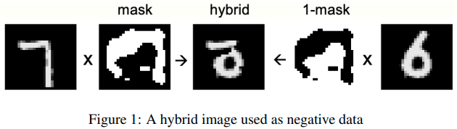
3. Some experiments with FF
A simple unsupervised example of FF
After training a network with four hidden layers of 2000 ReLUs each for 100 epochs, we get a test error rate of 1.37% if we use the normalised activity vectors of the last three hidden layers as the inputs to a softmax that is trained to predict the label.
Using the first hidden layer as part of the input to the linear classifier makes the test performance worse.
Instead of using fully connected layers we can use local receptive fields (without weight-sharing) and this improves the performance. After training for 60 epochs it gave 1.16% test error.
Notes:
After training a network with four hidden layers of 2000 ReLUs each for 100 epochs, we get a test error rate of 1.37% if we use the normalised activity vectors of the last three hidden layers as the inputs to a softmax that is trained to predict the label.
Using the first hidden layer as part of the input to the linear classifier makes the test performance worse.
Instead of using fully connected layers we can use local receptive fields (without weight-sharing) and this improves the performance. Only one architecture was tried. After training for 60 epochs it gave 1.16% test error.

Slide 16
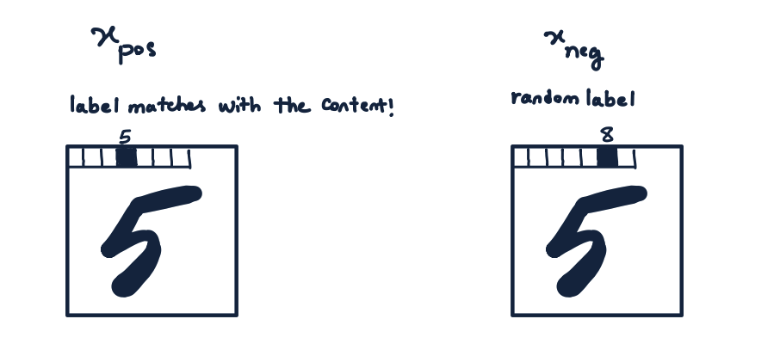
3. Some experiments with FF
A simple supervised example of FF
A network with 4 hidden layers each containing 2000 ReLUs and full connectivity between layers gets 1.36% test errors on MNIST after 60 epochs.
Backpropagation takes about 20 epochs to get similar test performance.
Doubling the learning rate of FF and training for 40 epochs instead of 60 gives a slightly worse test error of 1.46% instead of 1.36%.
Notes:
A network with 4 hidden layers each containing 2000 ReLUs and full connectivity between layers gets 1.36% test errors on MNIST after 60 epochs. Backpropagation takes about 20 epochs to get similar test performance.
Doubling the learning rate of FF and training for 40 epochs instead of 60 gives a slightly worse test error of 1.46% instead of 1.36%.

Slide 17
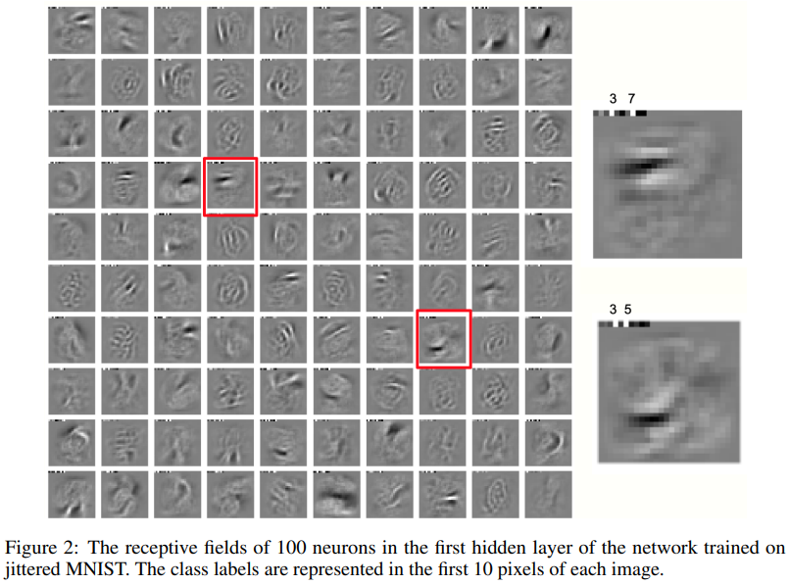
3. Some experiments with FF
A simple supervised example of FF
Notes:
There are two main reasons for using the squared length of the activity vector as the goodness function. First, it has very simple derivatives. Second, layer normalization removes all trace of the goodness

Slide 18
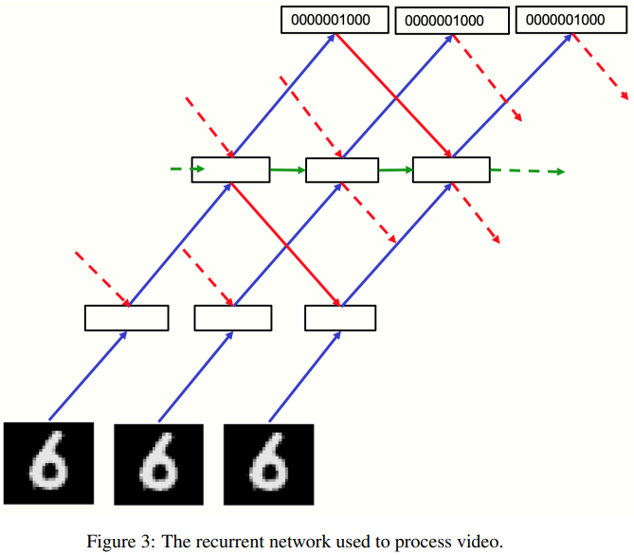
The Forward-Forward Algorithm
3.4 Using FF to model top-down effects in perception
What is learned in later layers cannot affect what is learned in earlier layers. This seems like a major weakness compared with backpropagation.
The key to overcoming this apparent limitation of FF is to treat a static image as a rather boring video that is processed by a multi-layer recurrent neural network.
FF runs forwards in time for both the positive and negative data, but, as figure 3 shows, the activity vector at each layer is determined by the normalized activity vectors at both the layer above and the layer below at the previous time-step.
Notes:
what is learned in later layers cannot affect what is learned in earlier layers. This seems like a major weakness compared with backpropagation.
The and HAT example!

Slide 19
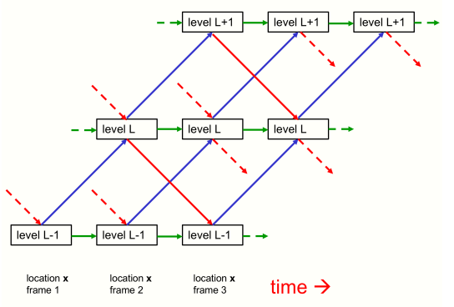
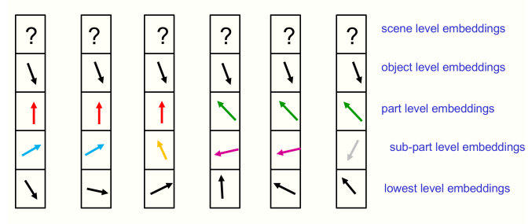
The Forward-Forward Algorithm
3.4 Using FF to model top-down effects in perception
[2021] How to represent part-whole hierarchies in a neural network, Geoffrey Hinton
Notes:
For a large number of labels, a single forward pass could be used to get a candidate list of which labels to evaluate more thoroughly.

Slide 20
The Forward-Forward Algorithm
3.5 Using predictions from the spatial context as a teacher
In the recurrent net, the objective is to have good agreement between the input from the layer above and the input from the layer below for positive data and bad agreement for negative data
The top-down input will be determined by a larger region of the image and will be the result of more stages of processing so it can be viewed as a contextual prediction for what should be produced by the bottom-up input which is based on a more local region of the image.
Notes:
In the recurrent net, the objective is to have good agreement between the input from the layer above and the input from the layer below for positive data and bad agreement for negative data

Slide 21
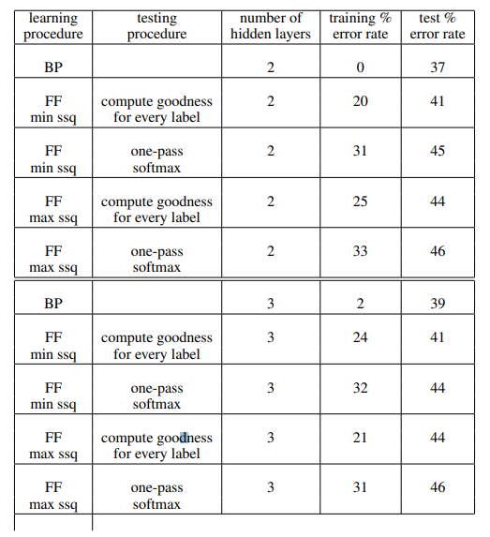
The Forward-Forward Algorithm
4. Experiments with CIFAR-10
Notes:
There are two main reasons for using the squared length of the activity vector as the goodness function. First, it has very simple derivatives. Second, layer normalization removes all trace of the goodness

Slide 22
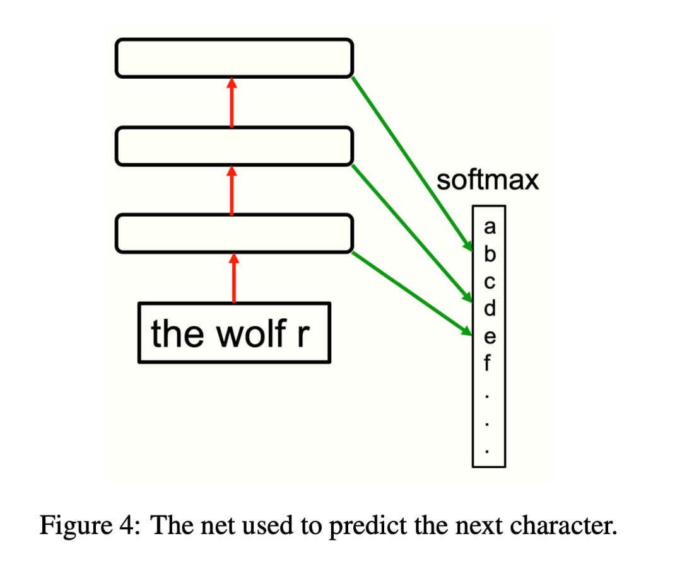
The Forward-Forward Algorithm
4.1 A simple sequence learning example of FF
Consider the task of learning to predict the next character in a string from the previous 10 characters.
One simple way to do this is to use several hidden layers to extract higher-order features of the preceding 10 character string and then to use the activities of the hidden units in these layers as inputs to a softmax that predicts the probability distribution over all possible next characters.
The hidden layers can be trained by using strings of 10 characters from the real data as the positive data and strings in which the last character has been replaced by a prediction from the previous 10 characters as the negative data.
Notes:
The hidden layers can be trained by using strings of 10 characters from the real data as the positive data and strings in which the last character has been replaced by a prediction from the previous 10 characters as the negative data

Slide 23
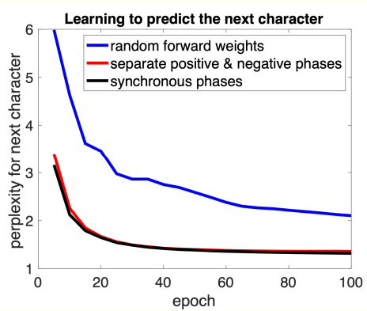
The Forward-Forward Algorithm
4.1 A simple sequence learning example of FF
Notes:
Consider the task of learning to predict the next character in a string from the previous 10 characters. One simple way to do this is to use several hidden layers to extract higher-order features of the preceding 10 character string and then to use the activities of the hidden units in these layers as inputs to a softmax that predicts the probability distribution over all possible next characters.

Slide 24
Reference
https://www.youtube.com/watch?v=rVzDRfO2sgs
Code:
https://github.com/ghadialhajj/FF_unsupervised/blob/master/main.py#L142
https://github.com/mohammadpz/pytorch_forward_forward/blob/main/main.py

Slide 25



Thank you for your Attention….!

