Slide 1

Team Trycilic:
Jordan Babcock
Thomas Uenking
Thomas Sholar

Slide 2

Business Description
10th Street, Greenville, NC
John Babit (Owner & Contact)
Bike Repair
Bike sales
Bike accessories

Slide 3
Current Environment
Paper repair tickets
Website https://www.babitsbikes.com/
Inventory tracking
Multiple POS terminals
Insufficient inventory system

Slide 4

Problems with Current System
No service request submissions
No way to view service records
No low-level indicator
Lack of inventory tracking

Slide 5
Proposed System Requirements
Functional
The system shall notify the customer when service request has been completed
The system shall allow technicians to view service requests
The system shall allow technicians to record services performed
The system shall notify customers when repairs are complete
Non Functional
The system must respond with in 5 seconds
The system must support 25 users at one time
System must be compatible with any web browser
System must be available 24 hours a day
The system must be able to run on the current businesses hardware

Slide 6
Proposed System Constraints
The project must be completed and implemented before December 10th, 2018.
The project must be completed on a budget of $0.00.
The project must be of a scope deemed reasonable by Dr. Kisling.
The project must be a dynamic application with data exchange.
The project must NOT be solely based on Microsoft Access.

Slide 7
Expected Benefits
Increase web and foot traffic
Increase efficiency
Decrease unexpected inventory depletion
Increase profits

Slide 8

Users Involved
Technicians
Customers
NO Admin

Slide 9
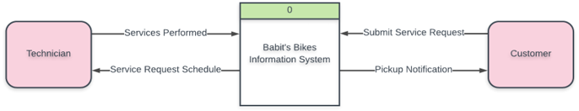
Context Diagram

Slide 10
Problem Analysis
BPI
Online service requests
Digitizing service requests
More proficient inventory system

Slide 11
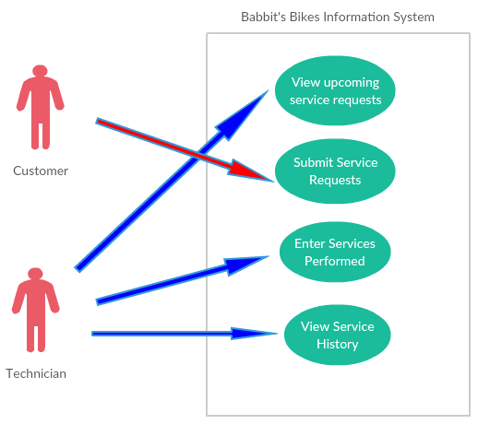
Use Case Diagram

Slide 12
UC Spec: Submit Service Request
Actors: Customers
Trigger: External
User submits a service request with:
Customer contact information
Customer bike information
Postconditions: The system will alert the business of the submitted service request and confirm the request with the customer.

Slide 13
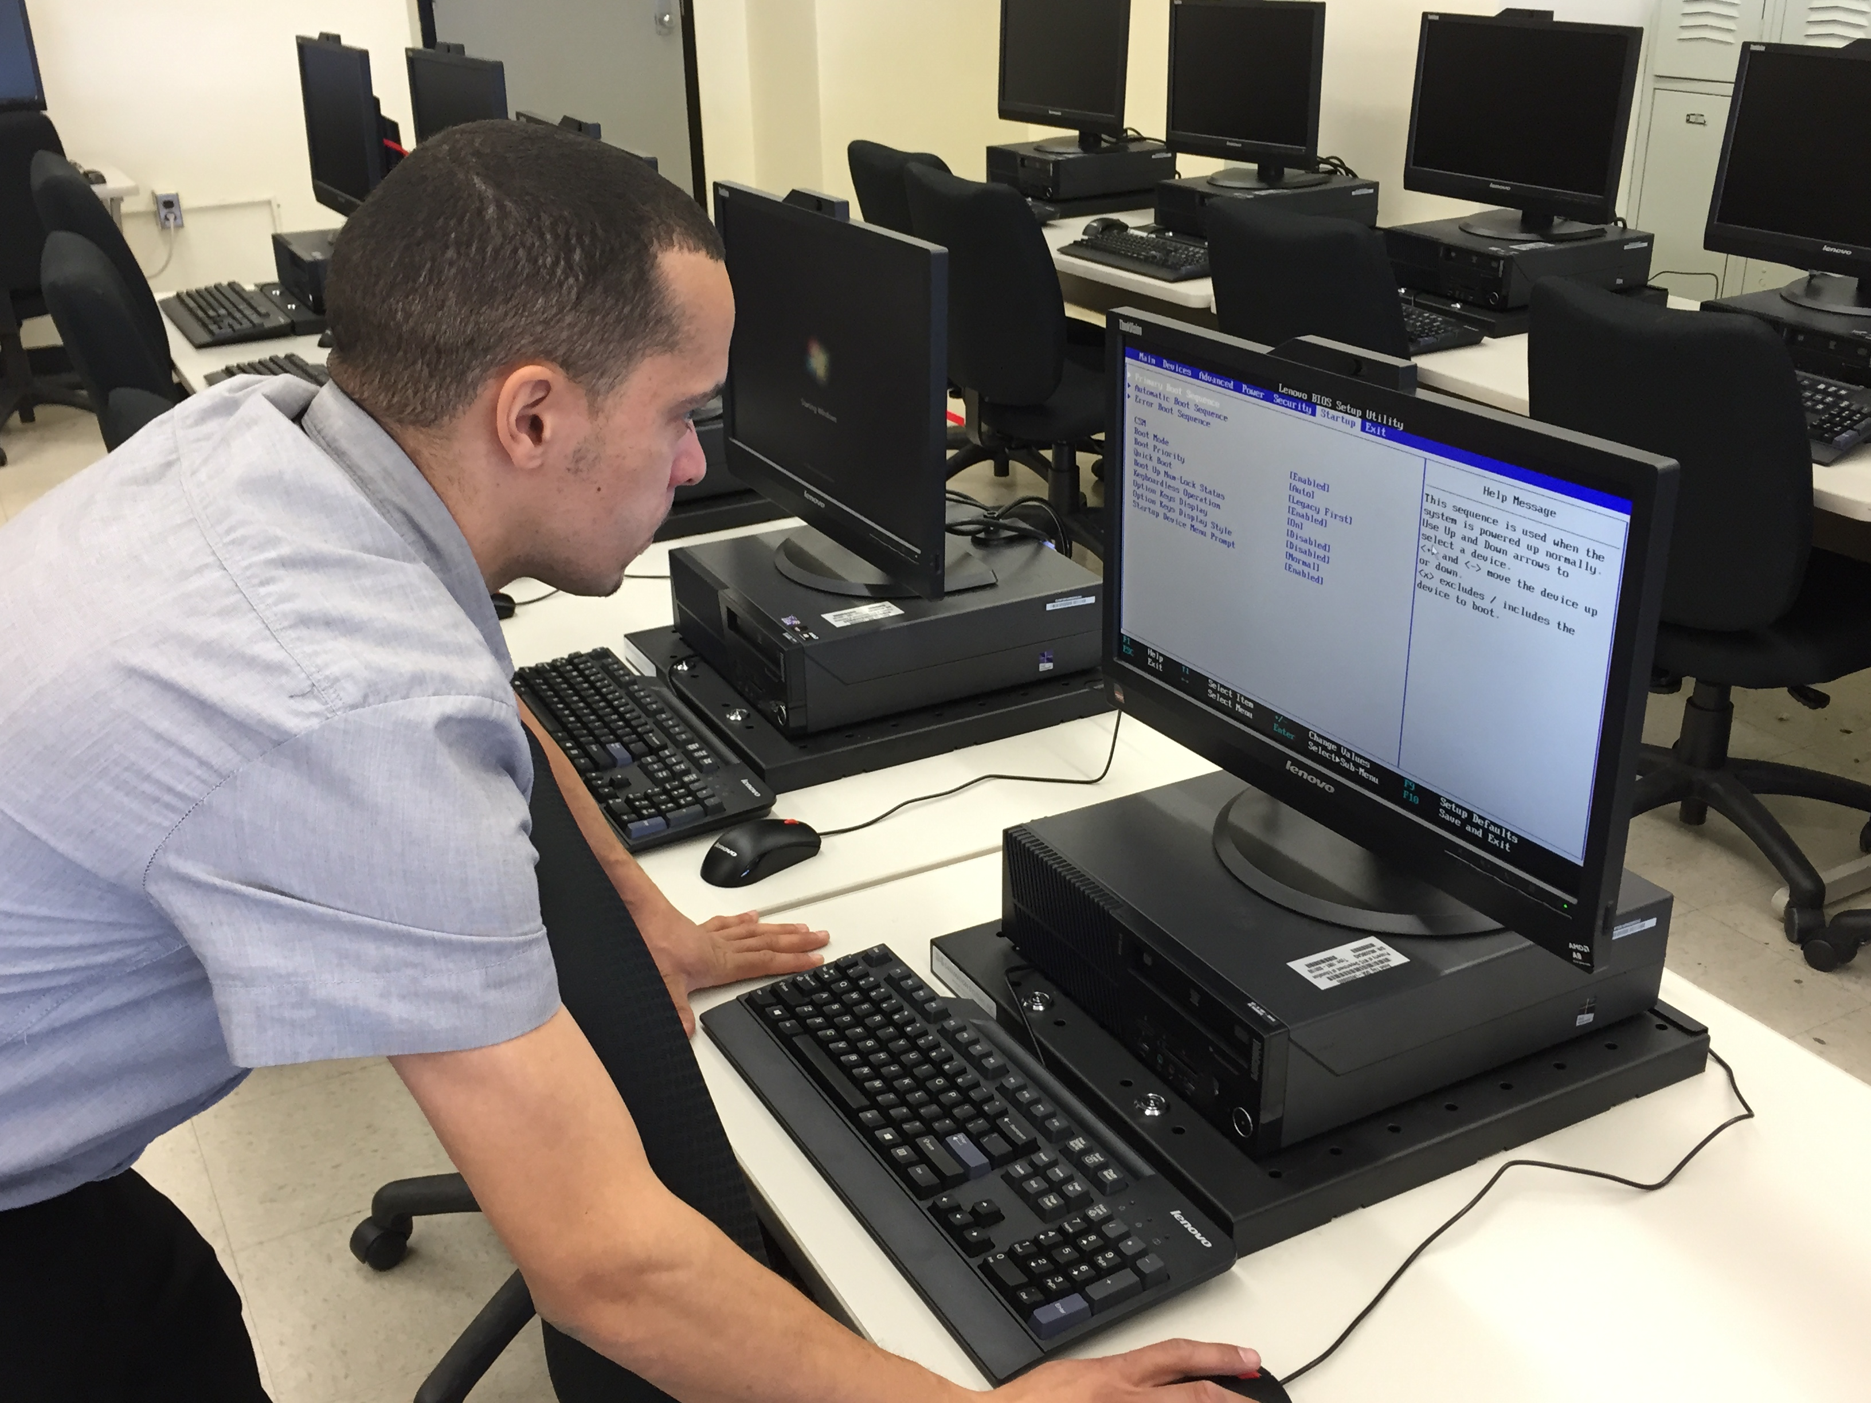
UC Spec: View Upcoming Service Requests
Actors: Technician
Trigger: External
The technician will click on the desired service request to view from a list of upcoming requests.
Postconditions: None

Slide 14
UC Spec: Enter Services Performed
Actor: Technician
Trigger: External
The technician will select the service request they were working on and enter the following:
Services performed
Parts used
Labor spent
Postconditions: The customer will be notified their bike is ready for pickup.

Slide 15

UC Spec: View Service History
Actor: Technician
Trigger: External
The technician will view records of past services performed. The technician can then choose to view and/or print individual service reports.
Post conditions: Service reports will be printed if the technician chooses to do so.

Slide 16
Preliminary Non-Functional Requirements
The system must respond with in 5 seconds
The system must support 25 users at one time
System must be compatible with any web browser
System must be available 24 hours a day
The system must be able to run on the current businesses hardware

Slide 17

Summary
Bottomline: Benefit the business
Customer service submission
Website redesign
Owner priorities
Inventory items
Inventory accoutability

Slide 18
Questions?

