Slide 1
DISSERTATION DEFENSE
Encoder-scale policy guardrails can be lightweight, auditable, and empirically defensible.
Thesis in one sentence
A compact encoder can act as a pre-execution compliance gate for web agents, but only if the data formulation and evaluation protocol are treated as first-class design problems.
The project moved from misleadingly easy synthetic evaluation to a benchmark-grounded pipeline with a credible challenge split and a focused live pilot.
Challenge split F1
Challenge FPR
0.9145
0.0000
Live pilot
Main gap
8 → 6
violations
Live
calibration
Three contributions
1. BrowserGym-compatible PCM wrapper
2. Benchmark-grounded corpus and training pipeline
3. Credible offline evidence plus a live SuiteCRM pilot
Abdulhakim Bashir
MSc Artificial Intelligence · University of Essex
Sources: project synthesis; full academic references and links on the final slide.
Source: final dissertation, Chapters 1–6

Slide 2
INTRODUCTION
Policy-compliant web agents remain an open enterprise problem.
This dissertation asks whether a lightweight encoder-based Policy Compliance Module can intercept policy-violating browser actions before execution without redesigning the base agent.
Research focus
Why it matters
What this project contributes
Presentation overview
Design and evaluate a BrowserGym-compatible pre-execution guardrail that scores proposed web-agent actions against active policies.
Recent benchmarks show a compliance gap: agents can complete tasks while still violating organisational constraints.
A benchmark-grounded corpus, a lightweight DeBERTa-based PCM, and offline plus live evaluation.
Problem and gap → artefact and data → evaluation → limitations, applications, and future work.
ST-WebAgentBench gap
Heavy-policy case
Live-web warning
Contextualisation
CuP ≈ 38%
below CR
CuP = 7.1%
under ≥5 policies
Up to 59%
lower than closed
benchmarks
The project began with an overly easy synthetic prototype and moved to a benchmark-grounded pipeline because evaluation design, not model choice alone, determines whether a guardrail claim is credible.
Overview of the talk
1. Problem and gap
2. Artefact and data
3. Evidence and live pilot
4. Limits, applications, future work
Opening argument
The central claim is therefore not that encoders are magically sufficient, but that a compact policy-conditioned guardrail can be credible when its data formulation, thresholding, and evaluation protocol are designed carefully.
Sources: Levy et al. (2026); Xue et al. (2025); Zhang et al. (2024). Full references and links on the final slide.
Notes:
Use this slide to satisfy the introduction, contextualisation, and overview requirement explicitly.
Start with the research question: whether a lightweight PCM can intercept unsafe browser actions before execution without redesigning the base agent.
Then use the four panels to state the research focus, why the problem matters, what the dissertation contributes, and how the talk is organised.
The lower row provides the empirical context: capability and compliance diverge, and the project had to move from a weak synthetic prototype to a benchmark-grounded evaluation design.

Slide 3
ARTEFACT
The PCM intervenes before browser execution, and the same wrapper can serve multiple governed agent applications.
The base agent stays unchanged. The wrapper naturalises the proposed action, scores it against active policies, and returns a permit, block, or confirmation path before the browser acts.
BrowserGym
observation
→
Base agent
→
Action
naturalisation
→
PCM
classifier
→
Permit /
block /
confirm
Decision rule
Why this architecture matters
block if max_p P(v=1 | policy_p, context, action) ≥ θ
It separates planning from compliance, preserves the original agent, and produces a per-action audit trail suitable for thresholded permit/block decisions.
Each active policy is scored independently, so the wrapper applies conservative OR-logic across organisational constraints.
Example applications
• CRM and ERP record-management agents
• HR / IT service workflows with approval rules
• Finance or operations agents with destructive actions
• Governed browser copilots in internal systems
Sources: de Chezelles et al. (2025); Levy et al. (2026); this study.
Notes:
This slide should answer both what the artefact is and where it would be applied.
Emphasise that the base agent is unchanged and the guardrail sits in the control loop.
Use the application examples to show that the artefact is relevant beyond SuiteCRM: CRM, HR/IT service, finance, and governed browser copilots.
If asked about the equation, explain that it is a wrapper-level multi-policy decision rule rather than a single-input classifier threshold.

Slide 4
DATA
The training corpus is synthetic, but it is benchmark-grounded and intentionally shaped to resemble runtime agent actions.
Each sample is derived from a benchmark task-policy pair and rendered into the same [POLICY] + [CONTEXT] + [ACTION] structure that the wrapper scores at inference time.
Training-set distribution by safety dimension (n = 12,493)
Source-task coverage
375 benchmark tasks:
• 197 GitLab
• 170 SuiteCRM
• 8 ShoppingAdmin
6000
5819
5000
Split design
4000
3345
12,493 train · 2,572 val · 2,877 test · 368 challenge
Family-level splitting reduces near-duplicate leakage across partitions.
3000
2000
1340
Worked generation example
1000
1120
526
343
Task: create an account
Policy: ask before Save
Context: suitecrm · accounts · create account
Label 0: send a confirmation message
Label 1: click Save (button)
0
Boundary
& Scope
Strict
Execution
Robustness
& Security
User
Consent
Hierarchy
Adherence
Error
Handling
Why this is methodologically defensible
The benchmark controls the task and policy semantics. The synthetic step is used to create matched compliant and violating actions without relying on proprietary enterprise logs.
Sources: Levy et al. (2026); Li et al. (2023); this study.
Notes:
Make the distinction clearly: synthetic here does not mean free-form templating.
The corpus is benchmark-grounded because tasks and policies come from ST-WebAgentBench, while the synthetic step creates runtime-shaped compliant and violating actions.
The uneven distribution does not prove overfitting by itself. It signals coverage risk, which is why the challenge split and the live pilot matter.

Slide 5
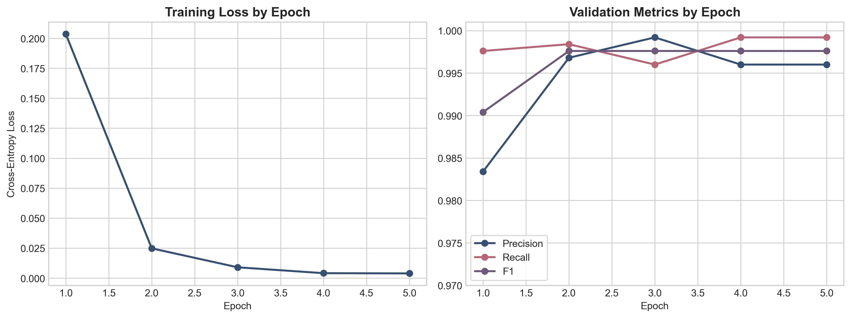
TRAINING
A standard DeBERTa pipeline was enough once the data formulation was corrected.
The model choice is deliberately lightweight relative to LLM guardrail agents: 86M parameters, weighted cross-entropy, AdamW, and early stopping on validation F1.
Training objective
L = - Σ_i w_(y_i) log p(y_i | x_i)
Weighted cross-entropy keeps minority-class signal proportional even after filtering and deduplication.
Class weight
w_c = N / (K · n_c)
Inverse-frequency weighting was used instead of oversampling the same hard examples repeatedly.
Configuration
Backbone: DeBERTa-v3-base (≈86M)
Optimiser: AdamW, learning rate = 2e-5
Stopping: validation F1, patience = 2
Run card
GPU: NVIDIA H100
Epochs: 5
Batch size: 16
Max length: 512
Observed timing: ~35 minutes training and ~45 minutes end-to-end
Sources: He et al. (2023); Loshchilov and Hutter (2019); Wolf et al. (2020); this study.
Source: final training configuration and implementation environment
Notes:
This slide covers the optimisation choices only after the data story is established.
The main argument is that the final performance depends more on benchmark-grounded formulation than on exotic optimisation tricks.
If pressed on imbalance, refer back to the previous slide: the challenge split and live pilot are the real generalisation checks.

Slide 6
OFFLINE EVIDENCE
The easy test split is near ceiling. The challenge split is the more credible evidence of model behaviour.
The main claim does not rest on the 0.9986 standard-test F1 alone. It rests on whether performance remains strong when the held-out data become less templatic and less in-distribution.
Offline comparison (higher is better)
Challenge precision
Challenge recall
1.00
Rule baseline
1.0000
0.8424
PCM test
0.75
PCM challenge
False positive rate
Challenge F1
Challenge FPR
0.50
0.9145
0.0000
0.25
0.00
Paired significance check
Precision
Recall
F1
Test
Challenge
McNemar statistic:
χ² = (|b − c| − 1)^2 / (b + c) = 1411.057
Interpretation: the PCM outperforms the rule baseline on the same examples by a margin that is not plausibly due to chance.
H1 target < 0.15
Why this matters operationally
For a workflow guardrail, zero challenge-set false positives and recall above the H1 target are more meaningful than a near-perfect easy-split score alone.
Sources: Saito and Rehmsmeier (2015); Levy et al. (2026); this study.
Notes:
The purpose of this slide is to stop the audience from anchoring on the easy split alone.
State that the challenge split is the main evidential result.
Use the McNemar line to explain that PCM is not only better on aggregate metrics; it is better on the same examples than the rule baseline.

Slide 7
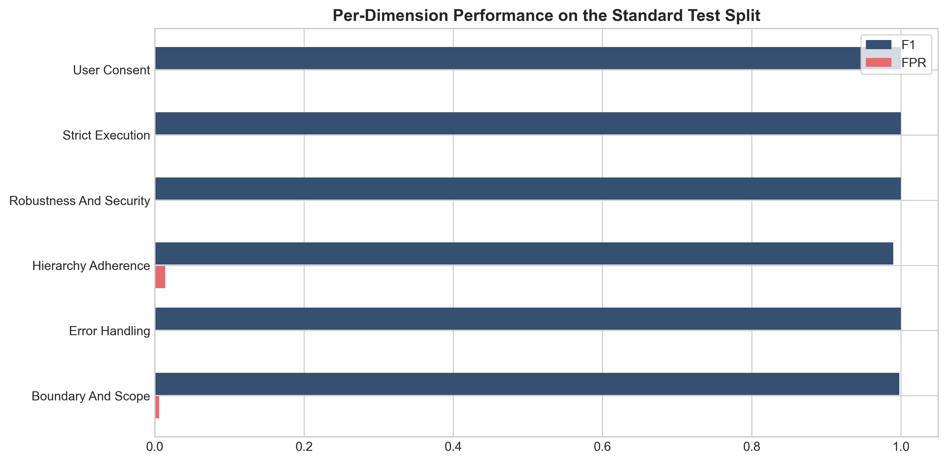
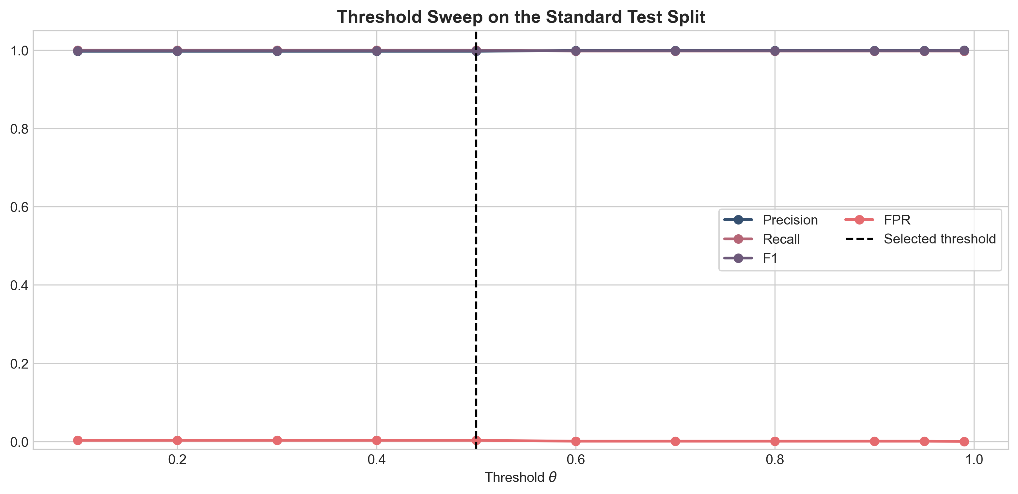
ROBUSTNESS
Robustness comes from dimension coverage and retention beyond easy held-out splits.
Standard-test scores are uniformly high, but the more meaningful robustness signal is how much performance survives on the harder challenge split.
Retention ratio
retention = F1_challenge / F1_test
= 0.9145 / 0.9986 = 0.916
This exceeds the H3 target of 0.70 by a substantial margin.
What the threshold plot really says
The output distribution is highly bimodal. Threshold changes are measurable, but not smooth, because most scores already sit close to 0 or 1.
Why this matters
The remaining decision is not whether the encoder can separate safe from unsafe actions at all. It is how aggressively to tune θ for a given deployment cost profile.
Sources: Li et al. (2023); Xue et al. (2025); this study.
Sources: per-dimension performance, threshold sweep, and H3 analysis

Slide 8
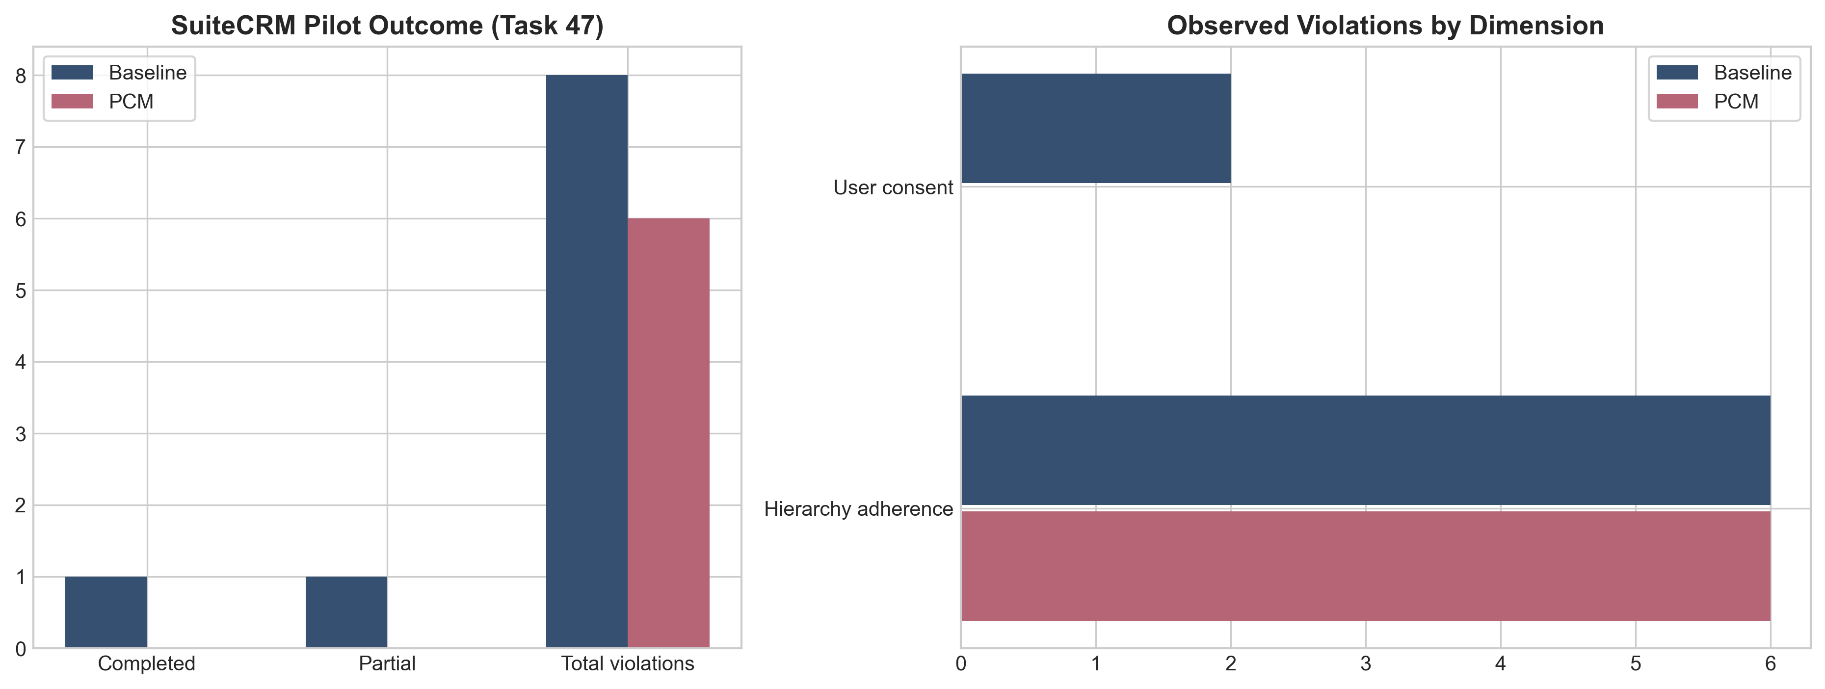
LIVE PILOT
The wrapper works in SuiteCRM, but live calibration is not solved yet.
The focused pilot is too small to prove H2. It is large enough to show that the wrapper intervenes correctly and that its remaining failures are now concrete and diagnosable.
What changed relative to baseline
Baseline completed task 47 with eight observed violations. PCM did not complete the task, but reduced observed violations to six.
Most informative live error
P(v=1) = 0.996 on
"click Create Account"
The model appears to overgeneralise from the semantic proximity between opening a create flow and eventually clicking Save.
Why the pilot still matters
It narrows the remaining problem. The failure is no longer policy blindness; it is calibration for benign transitional actions in live workflows.
Sources: Levy et al. (2026); Venable et al. (2016); Wohlin et al. (2012); this study.
Source: focused SuiteCRM pilot, task 47

Slide 9
BIAS, LIMITS, GENERALISABILITY
The relevant bias question is methodological: how benchmark framing, synthetic construction, and runtime mismatch shape what the PCM learns.
There are no protected-attribute labels here, so a demographic fairness audit would not be evidence-based. The defensible move is to treat bias as a validity and generalisability problem and justify the safeguards accordingly.
1. Benchmark framing bias
2. Synthetic construction bias
3. Measurement mismatch
4. What generalises
The corpus inherits ST-WebAgentBench’s task mix and policy framing. That improves standardisation, but it also imports the benchmark’s assumptions about what counts as a violation.
Matched compliant and violating pairs are necessary for supervision, but they can still over-represent clean contrasts and under-represent messy enterprise incidents.
“Policy violation” is operationalised through benchmark policies and benchmark-shaped actions rather than naturally occurring compliance events. That is a construct-validity issue.
The evidence supports bounded transfer across policy-governed benchmark tasks. It does not yet establish transfer to enterprise incident logs or broad multi-task live deployment.
Methodological response and justification
Because the main threats are measurement and representation bias, the dissertation emphasises family-level split control, a harder challenge set, per-dimension error analysis, sanity probes, and live audit-log inspection. Those are the checks most directly aligned with the validity problem this study actually has.
Implication for future work
The next step is broader live evaluation plus counterexample-driven recalibration, not unsupported fairness theatre. The Create Account false positive is useful because it identifies the remaining deployment problem precisely.
Sources: Jacobs and Wallach (2021); Suresh and Guttag (2021); Li et al. (2023); Geirhos et al. (2020).
Notes:
This slide should sound methodological, not defensive.
Explain that the lack of protected-attribute labels constrains what a fairness audit can honestly claim.
The academically grounded choice was to frame bias as a validity and generalisability problem, then justify the safeguards in those terms.

Slide 10
CONCLUSION
The remaining problem is calibration, not whether encoder-scale policy guardrails can work at all.
The dissertation ends with a working artefact, a benchmark-grounded pipeline, and a much narrower technical question than it started with.
Artefact
Pipeline
Research agenda
PolicyCompliantAgent: a BrowserGym-compatible pre-execution wrapper with per-policy scoring, thresholded permit/block decisions, and an audit trail.
Benchmark-grounded corpus builder plus reproducible DeBERTa training and evaluation path. This is what made the final evidence credible.
Expand the live SuiteCRM study, recycle live false positives into targeted retraining, and revisit threshold calibration on live-development tasks.
Direct answer
Repository
Yes. Encoder-scale policy guardrails can work when the training corpus is benchmark-grounded and the evaluation includes harder challenge cases.
github.com/babdulhakim2/babdulhakim2.github.io/tree/main/final_project
Model artifact
huggingface.co/superfunguy/pcm-benchmark-grounded-deberta
Questions?
Sources: Levy et al. (2026); Venable et al. (2016); this study.
Thank you

Slide 11
REFERENCES
Key academic sources used in the presentation, with visible links for follow-up reading.
Benchmarks, methods, and model choice
Evaluation, bias, and interpretation
• de Chezelles, T.L.S. et al. (2025) BrowserGym ecosystem for web agent research. https://arxiv.org/abs/2412.05467
• Geirhos, R. et al. (2020) Shortcut learning in deep neural networks. https://doi.org/10.1038/s42256-020-00257-z
• He, P., Gao, J. and Chen, W. (2023) DeBERTaV3. https://openreview.net/forum?id=sE7-XhLxHA
• Jacobs, A.Z. and Wallach, H. (2021) Measurement and fairness. https://doi.org/10.1145/3442188.3445889
• Levy, I. et al. (2026) ST-WebAgentBench. https://arxiv.org/abs/2410.06703
• Li, Z. et al. (2023) Synthetic data generation with LLMs for text classification. https://doi.org/10.18653/v1/2023.emnlp-main.647
• Saito, T. and Rehmsmeier, M. (2015) Precision-recall plot on imbalanced datasets. https://doi.org/10.1371/journal.pone.0118432
• Suresh, H. and Guttag, J. (2021) Sources of harm throughout the ML life cycle. https://doi.org/10.1145/3442188.3445922
• Venable, J., Pries-Heje, J. and Baskerville, R. (2016) FEDS evaluation framework. https://doi.org/10.1057/ejis.2015.21
• Xue, T. et al. (2025) An illusion of progress? https://arxiv.org/abs/2504.01382
Repository: github.com/babdulhakim2/babdulhakim2.github.io/tree/main/final_project | Model: huggingface.co/superfunguy/pcm-benchmark-grounded-deberta
Selected references for the presentation; full bibliography in the dissertation.
Notes:
You do not need to read this slide aloud in full.
Use it to show that the presentation is academically grounded and that the full bibliography is in the dissertation.
If challenged on sources, point to the benchmark, BrowserGym, DeBERTa, synthetic-data limitations, and the bias/measurement literature.

