Slide 1

RIP. The Trash

Slide 2
Quotations are commonly printed as a means of inspiration and to invoke philosophical thoughts from the reader.
Why did we design this tool?

Slide 3






Slide 4
Quotations are commonly printed as a means of inspiration and to invoke philosophical thoughts from the reader.
What can this tool do?

Slide 5



1.
Collecting the rubbish
Let’s start with the first set of slides

Slide 6

BIG CONCEPT
COLD
HOT
Bring the attention of your audience over a key concept using icons or illustrations

Slide 7

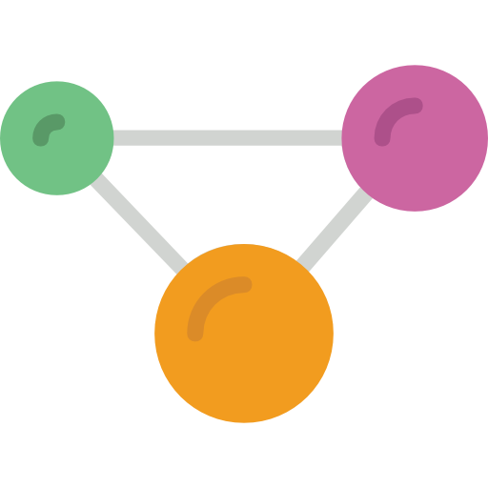
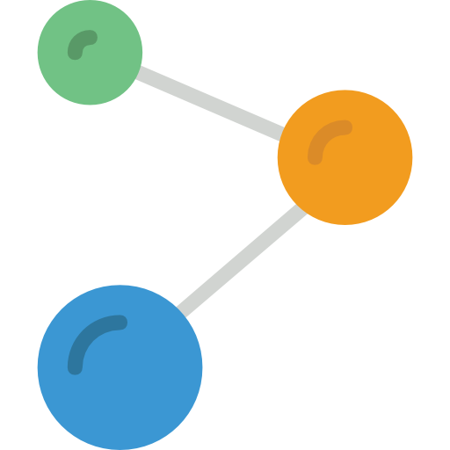
2.
Filter
Let’s start with the first set of slides

Slide 8
Quotations are commonly printed as a means of inspiration and to invoke philosophical thoughts from the reader.
How do we use
this tool?

Slide 9
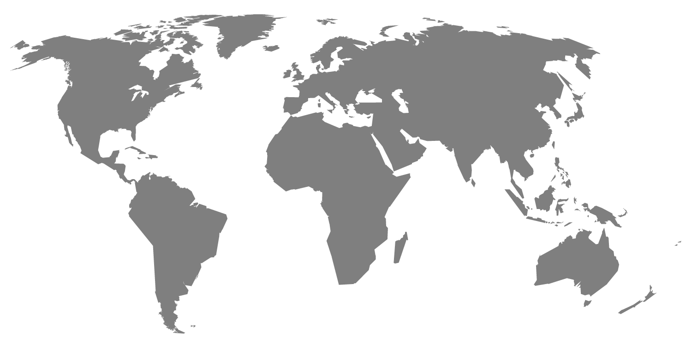
Maps
our tool

Slide 10

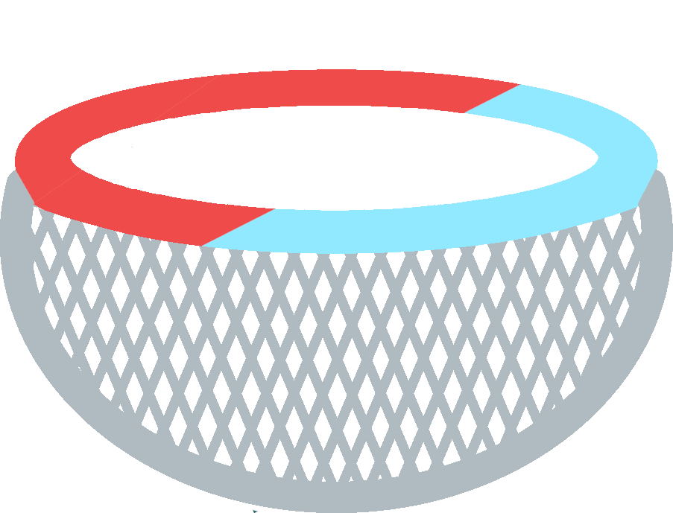

Slide 11
How much does this tool?

Slide 12
How much does this tool?

Slide 13

Are you interested in trying our tool?

Slide 14
Thank You!!!

