Slide 1
발표

Slide 2
X : 꽃받침 길이, 꽃받침 너비, 꽃잎 길이, 꽃잎 너비
Y : Iris-Setosa(0), Iris-Versicolor(1), Iris-Virginica(2)

Slide 3
S V M

Slide 4
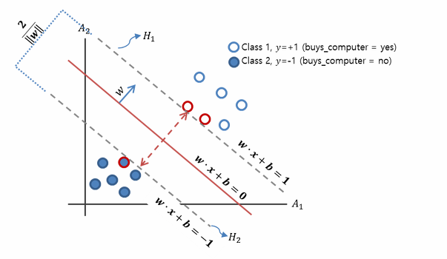
1. SVM

Slide 5

1. SVM

Slide 6
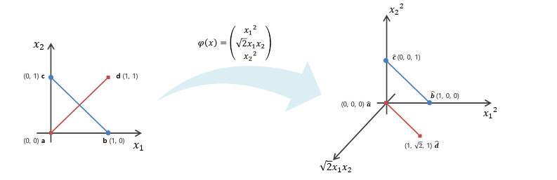
1. SVM

Slide 7
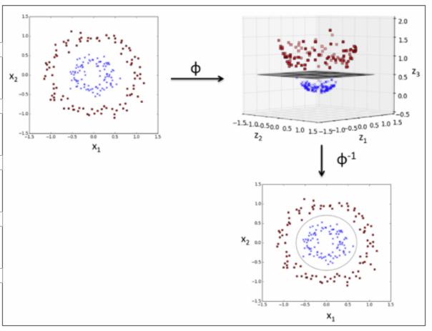
1. SVM

Slide 8

1. SVM

Slide 9
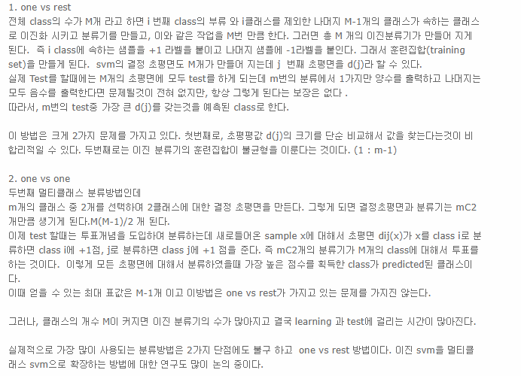
1. SVM

Slide 10
Random Forest

Slide 11
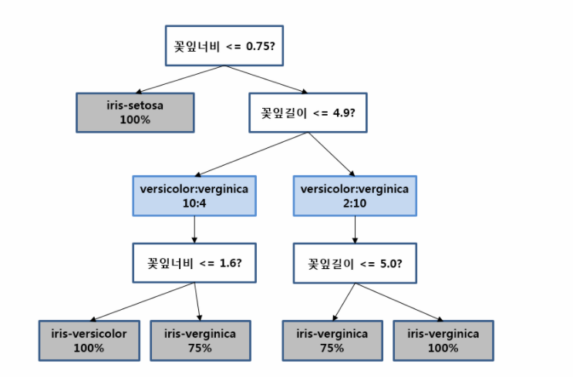
2. Random Forest

Slide 12
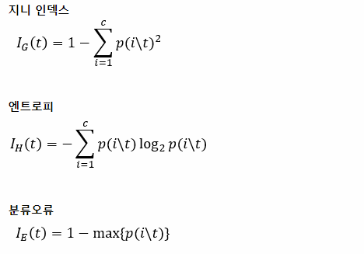

2. Random Forest

Slide 13

2. Random Forest
데이터 불순도 : 데이터가 제대로 분류되지 않고 섞여있는 정도
정보 이득량 :

Slide 14
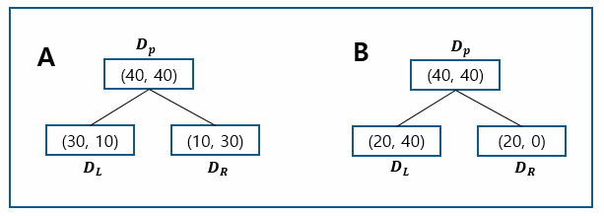
2. Random Forest

Slide 15
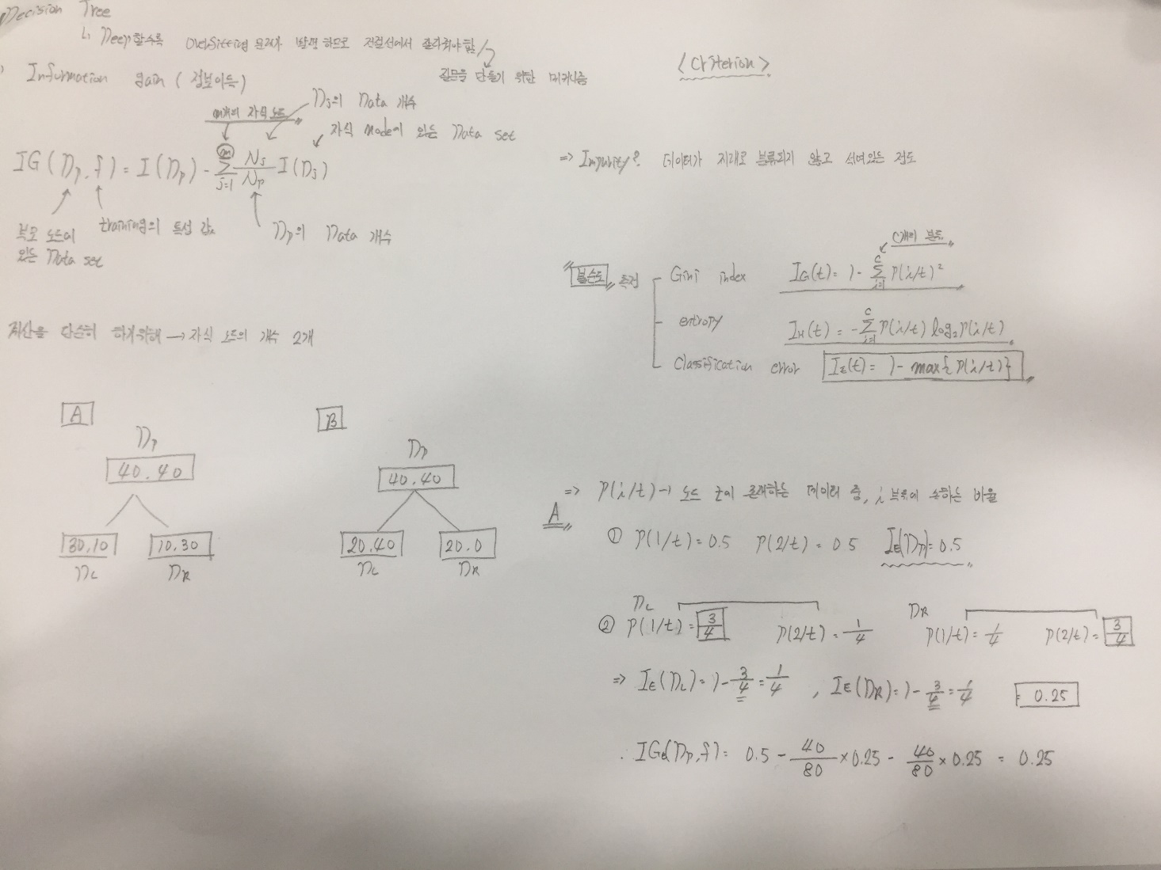
2. Random Forest
Classification error

Slide 16
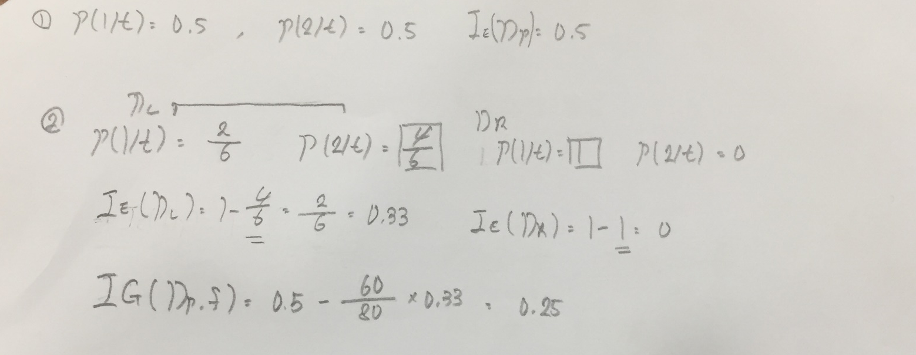
2. Random Forest
Classification error

Slide 17
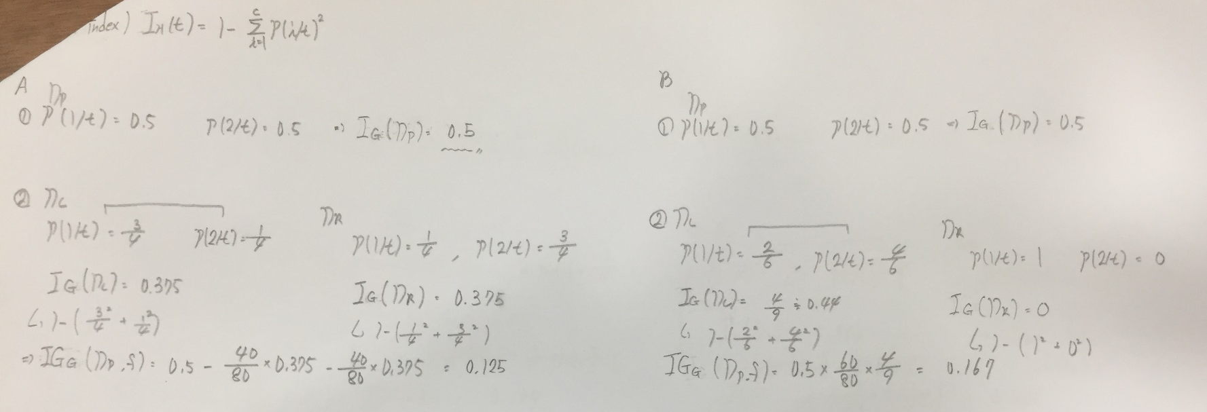
2. Random Forest
Gini index

Slide 18
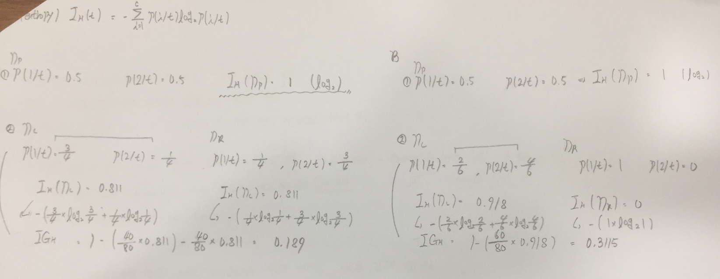
2. Random Forest
entropy

Slide 19
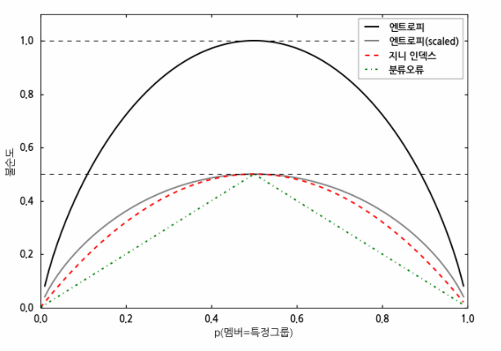
2. Random Forest

Slide 20
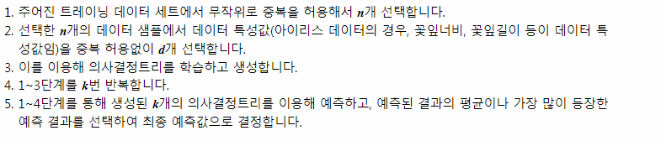
2. Random Forest
http://sams.epaiai.com/220982297456

Slide 21
Cross validation

Slide 22
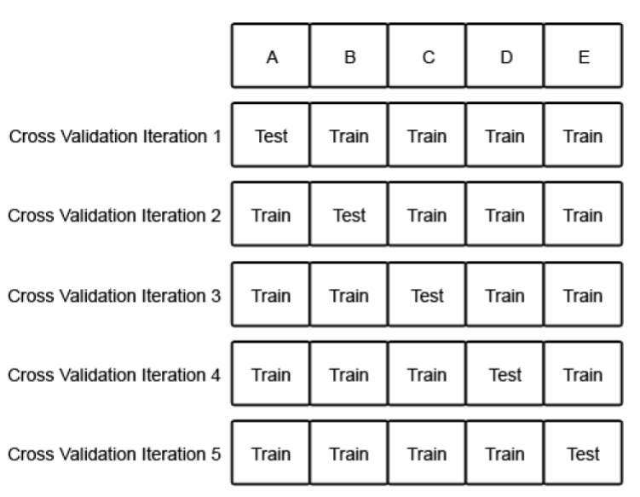
3. Cross Validation

Slide 23
Grid search

Slide 24
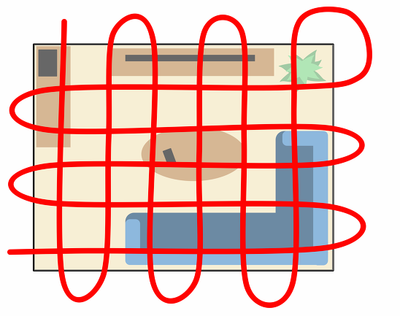
4. Grid_Serach

