Slide 1
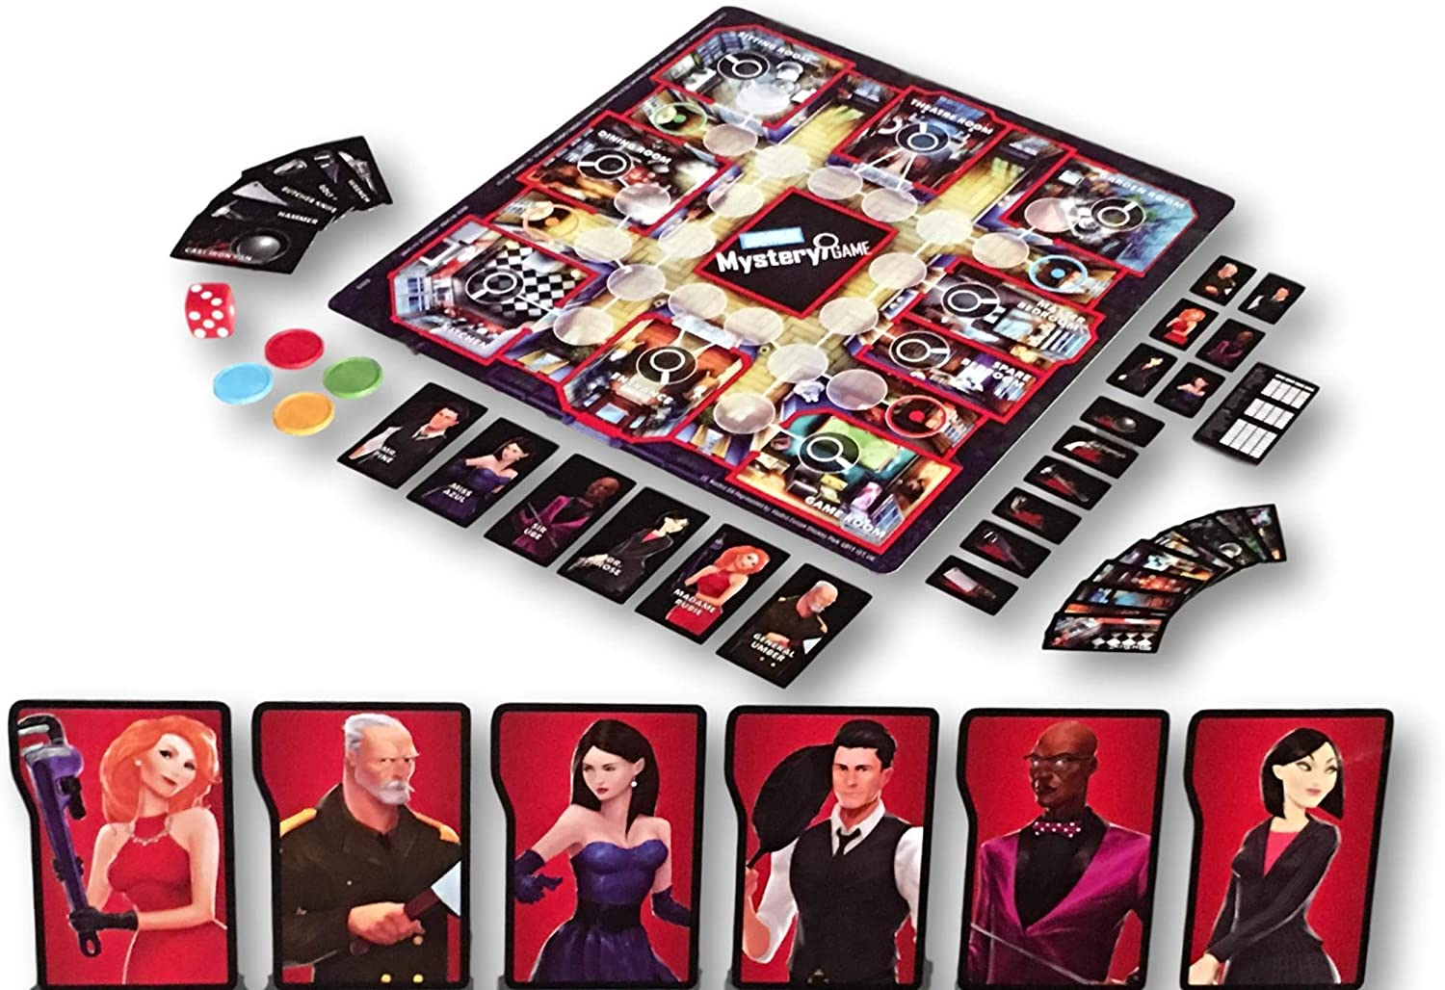
Web Apps Project Idea
Online Board Game
IBT College 2020 Mauricio Lattke

Slide 2
Main Objective
Replicate the Board Game "Mystery Game" from Parker Brothers.
Recreate the basis of the game.
Intent to limit the technologies used to those we've learn in the course.
Play the game in a single workstation.
Play the game online up to 4 players. (same session)
Improve the knowledge of HTML/CSS/JS.

Slide 3
Challenges
Lack of experience creating online games.
Time
Decision to not use a framework.

Slide 4
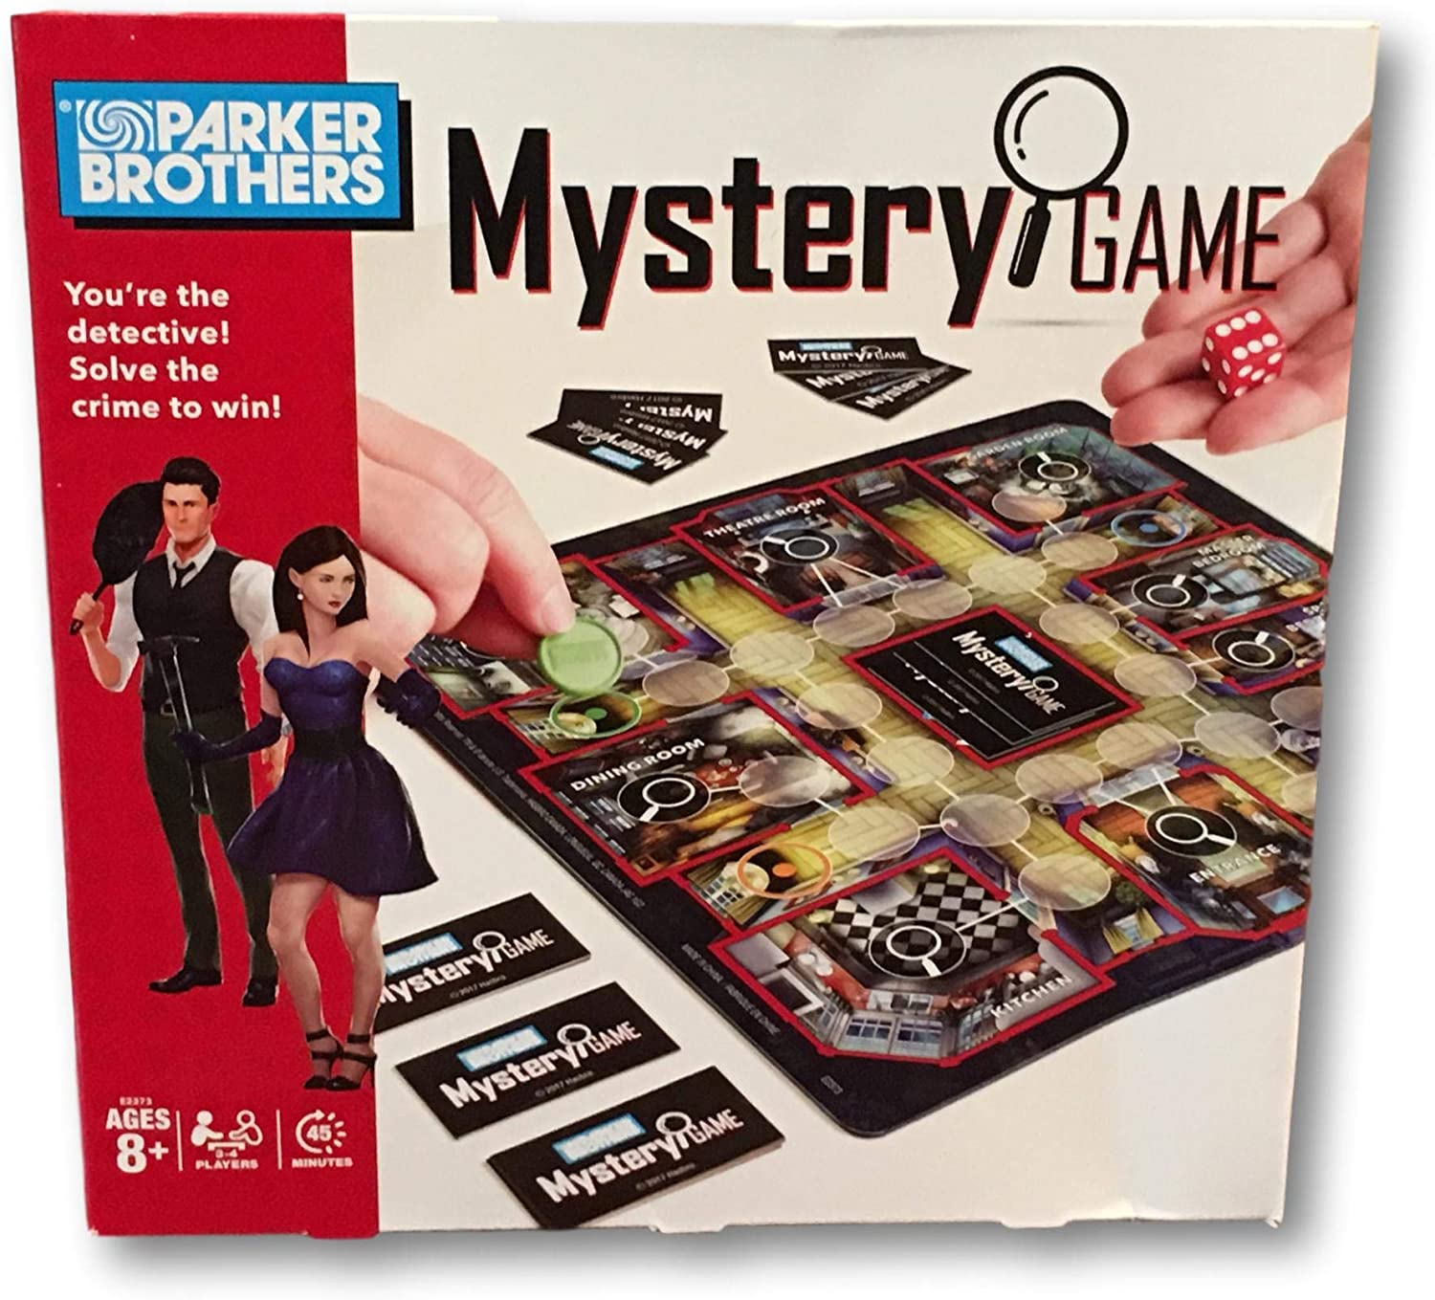
Mystery Game

Slide 5
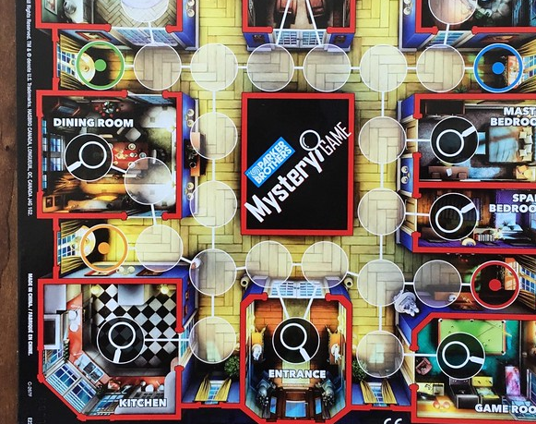
Prototype

Slide 6
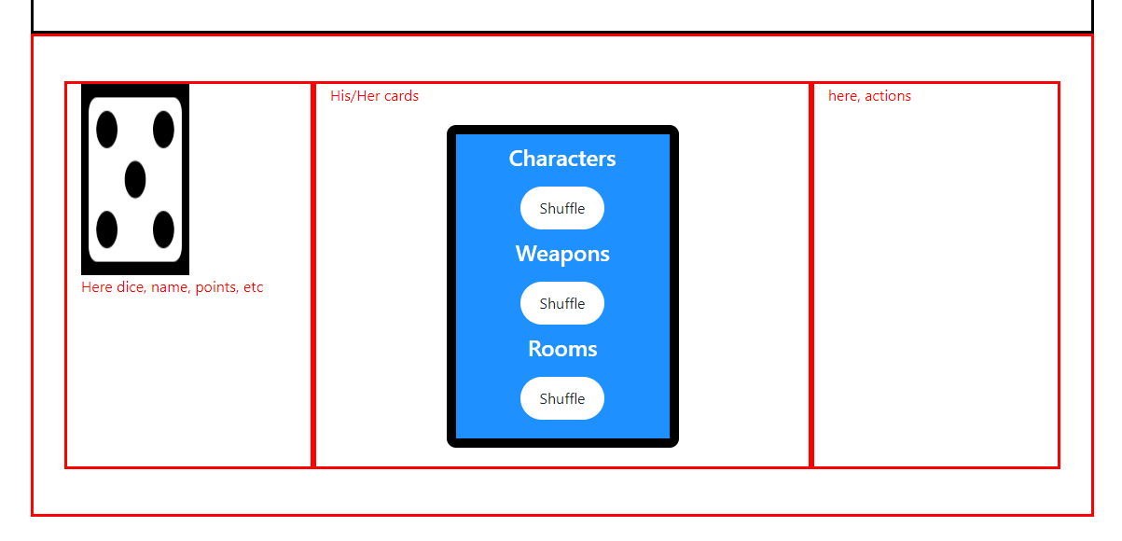
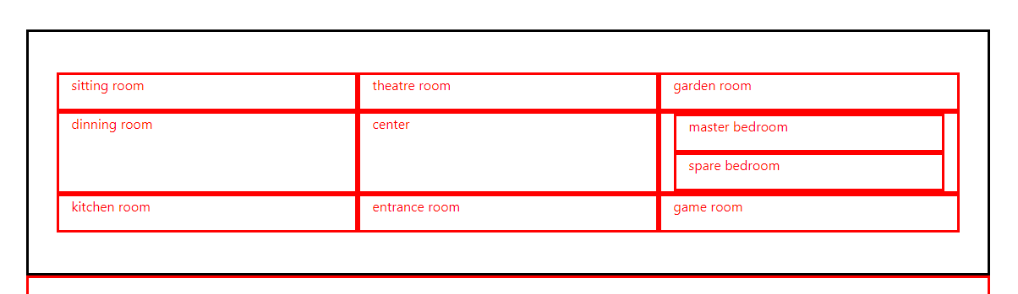
Drafts

Slide 7

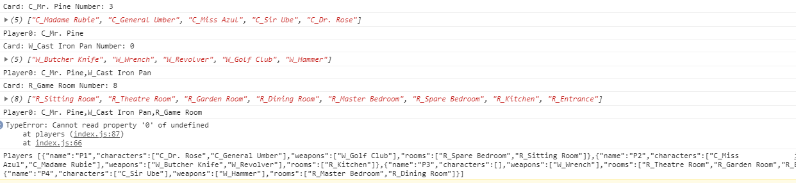

Slide 8
Thanks!

