Slide 1

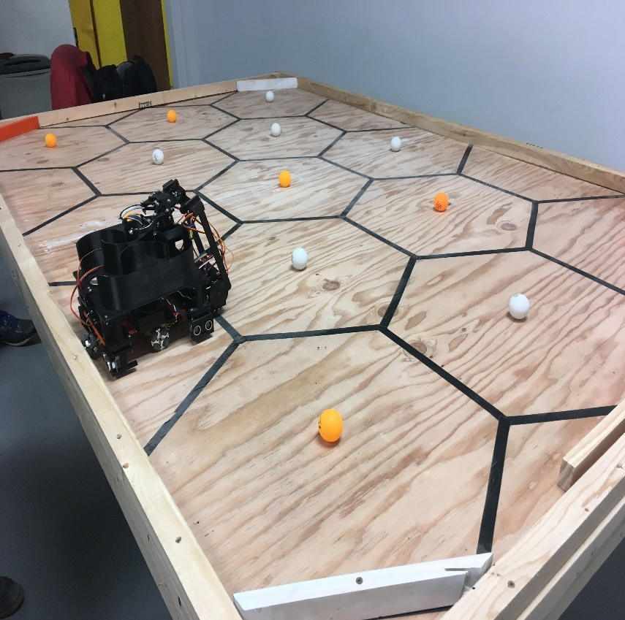
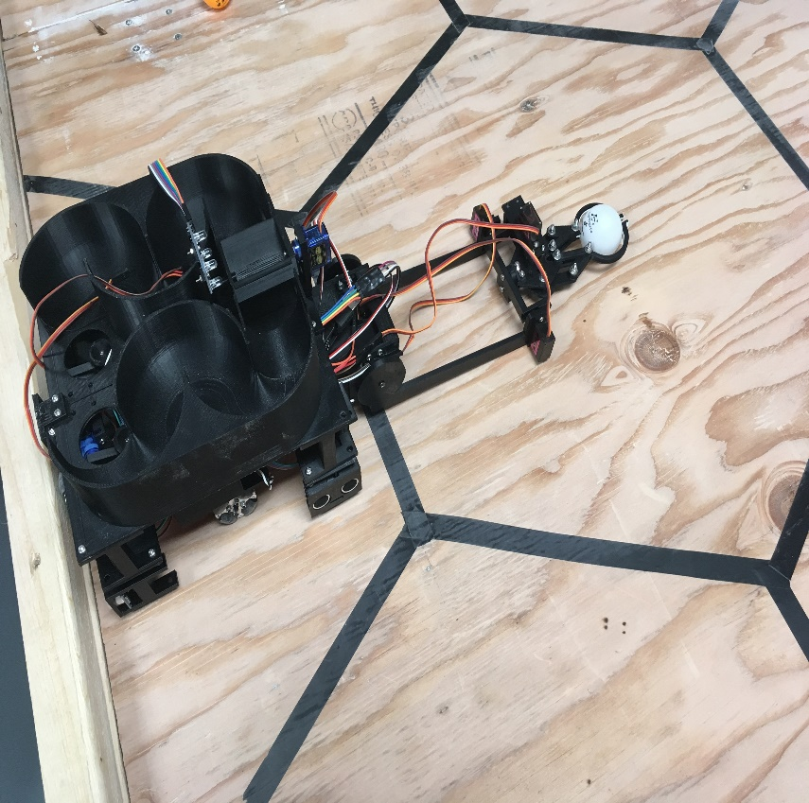
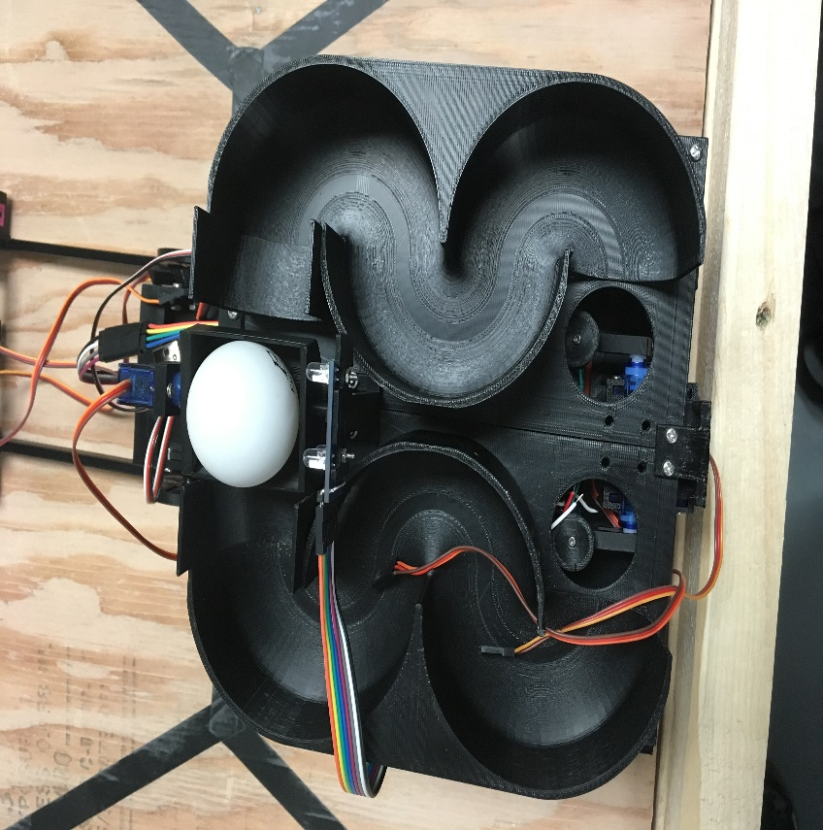
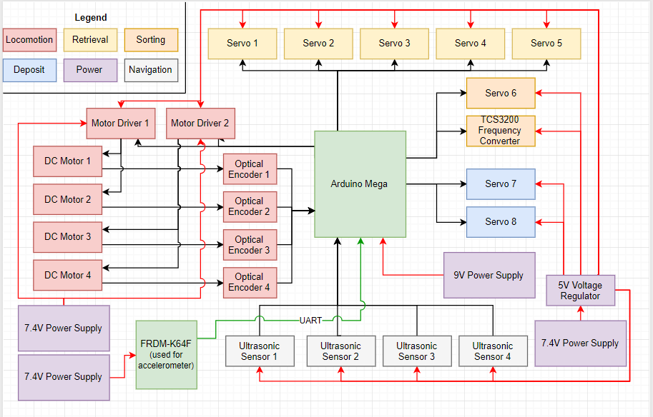
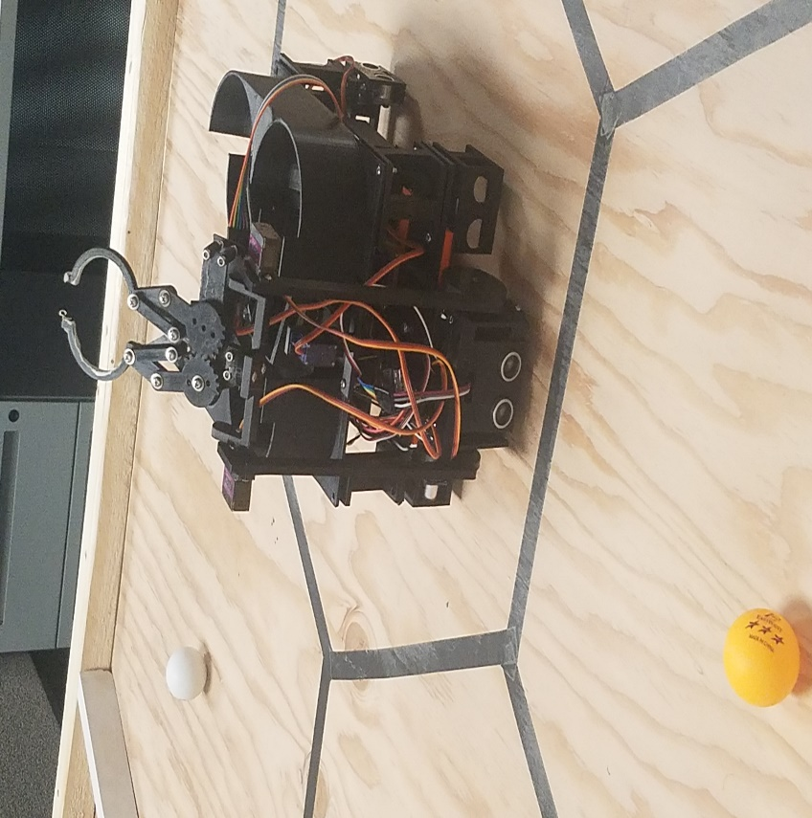
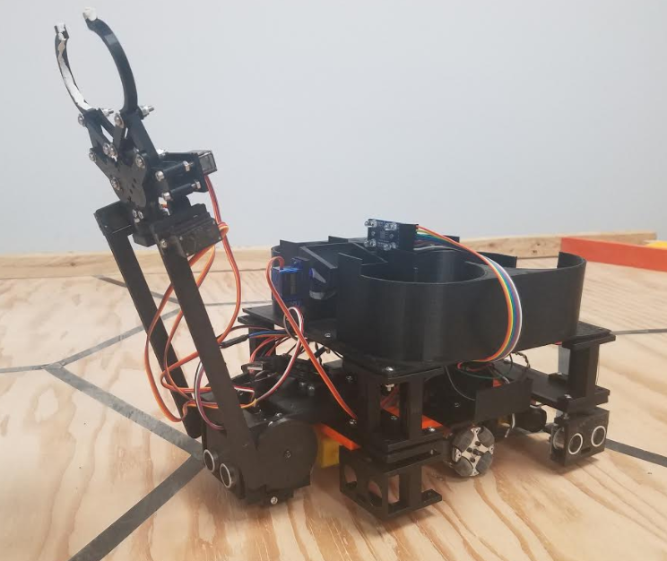
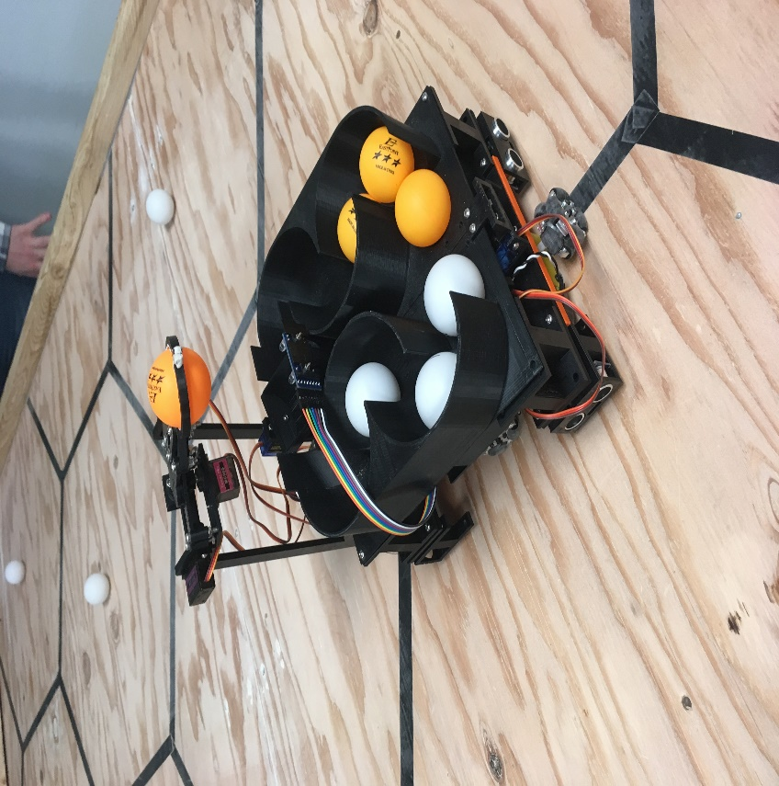
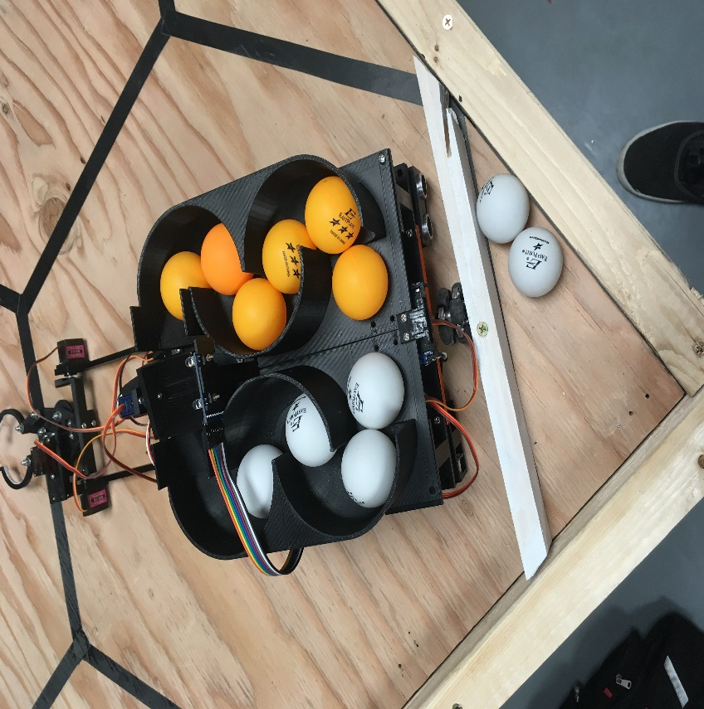
ASEE Robotics Competition: Worker Bots
Blake Bennett, Dallas Thornton, Glenn Haag, Torben Eid
Sponsor: Michael Golub
Overview
Methodology
Design
The American Society for Engineering Education hosts a yearly robotics competition for underclassmen. The purpose of this project is to build an autonomous robot that navigates the competition board, collects the thirteen ping pong balls, sorts them, and deposits them in their respective corners. The secondary purpose is to create lesson plans and teach underclassmen how to build a successful robot for the competition.
Structure
3D printed structure minimizes cost while maximizing robustness
Locomotion
Four omni-directional wheels placed 90 degrees apart; rotary encoders help ensure synchronicity
Navigation
Memory mapping
Ultrasonic sensors for linear motion
FRDM-K64F with accelerometer for rotation
Collection
Pincer with two points of articulation, servo controlled
Sorting
TCS3200 Frequency-to-light converter
Servo controlled pivot cup
Depositing
Two tubes, created with biomimicry in mind, hold the balls; servo motors dump balls into pockets
COLLECT 1st BALL
START
SORT
System Block Diagram
NAVIGATE
COLLECT & SORT
Conclusions & Future Work
IF (BALLS < 13) NAVIGATE
The robot’s rotation is inconsistent. Future testing and improvement is necessary for successful results.
No students volunteered to participate in the competition.
Our lesson plans are generalized and can be used to teach underclassmen in future years.
ELSE DEPOSIT

