Slide 1
WiFi Booster Impact
Stanislav Babenyshev
19.06.2026

Slide 2
Booster rollout is not economically justified for the full customer base
Recommendation
❌ Do not roll out booster to all customers
✅ Consider targeted rollout for Extreme internet users
✅ Validate with randomized A/B test before large investment
Metric | Value
Rollout cost | CHF 52.5M
Estimated ROI | Negative
Strongest beneficiary | Extreme internet users
Confidence | Moderate (observational evidence only)
Initial analysis suggested a large benefit. After correcting for selection bias, the estimated effect is much smaller and concentrated in one segment.

Slide 3
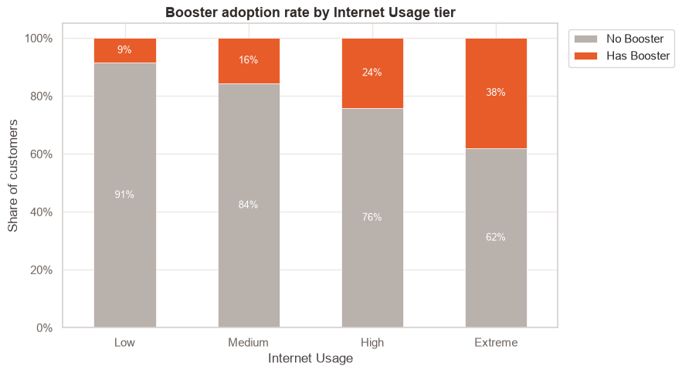
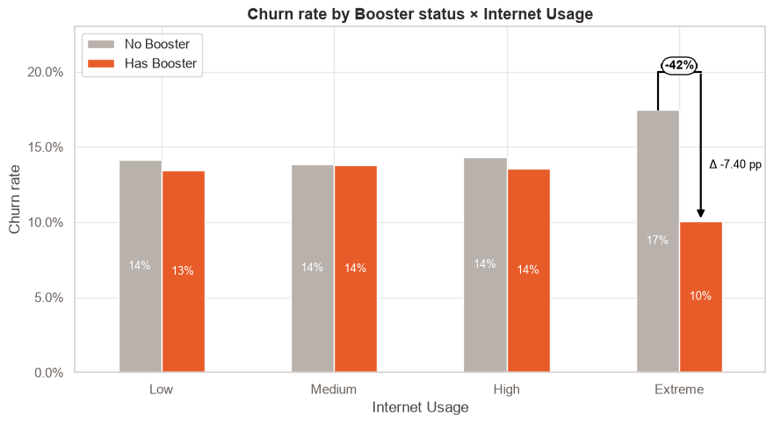
Heavy users self-select into the booster
The apparent overall benefit comes mostly from the fact that heavy users choose the booster.
Comparing raw averages would overestimate the booster effect. So we need to adjust for that.

Slide 4
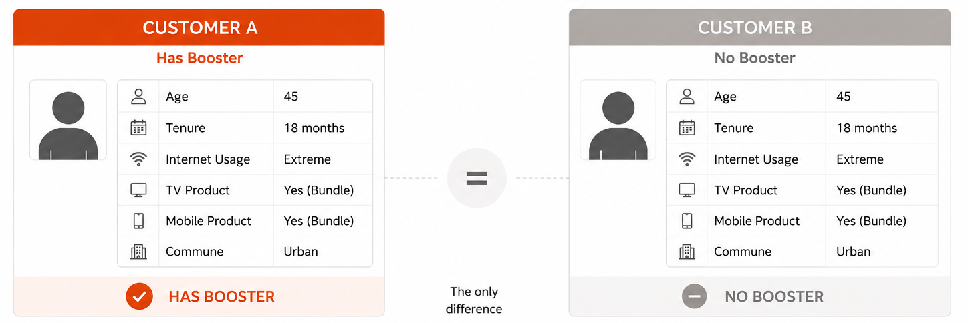
Comparing like-for-like customers
Method | Estimated reduction in churn | What it means
Naive Comparison | -2.0 pp | Biased – heavier users self-select into the booster
Logistic Regression (AME) | -1.0 pp | Controls for differences using a statistical model
Digital Twins (PSM ATT) | -1.6 pp | Compares like-for-like customers (best causal proxy)
Two independent methods produce similar conclusions: the booster effect exists but is substantially smaller than suggested by raw comparisons.

Slide 5
The booster benefits one segment
Customer segment | Customers | Estimated booster effect on churn | 95% CI
Low usage | 29.5k | −0.2 pp | [−1.6, +1.2]
Medium usage | 40.1k | +0.5 pp | [−0.5, +1.3]
High usage | 34.7k | 0.0 pp | [−1.0, +0.8]
Extreme usage | 20.7k | −6.6 pp | [−7.5, −5.5]
Almost the entire benefit comes from Extreme internet users.

Slide 6
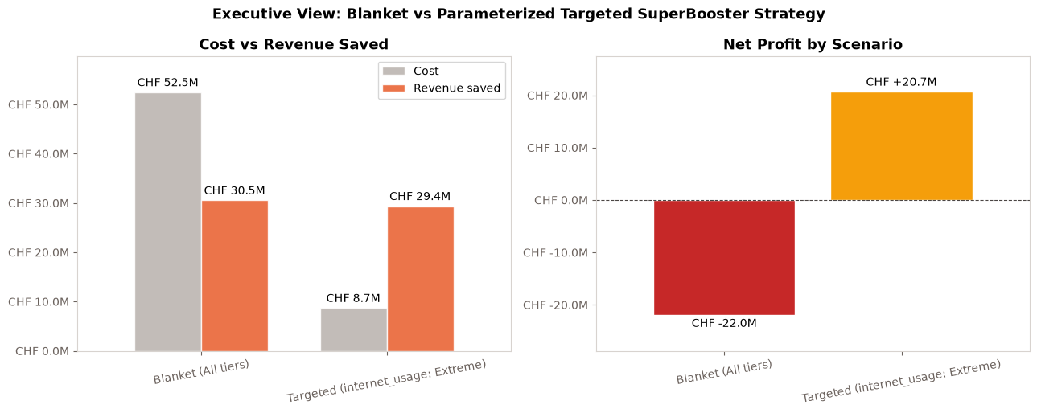
Financial impact

Slide 7
Recommendation
 | Option A: Roll out to all customers | Option B: Target Extreme users | Option C: Run A/B test first
Investment | High (CHF 52.5M) | Moderate (CHF 8.7M) | Low
Expected ROI | ❌ Negative | ✅ Potentially attractive | N/A
Evidence | Weak for most segments | Strongest observed effect | Provides causal evidence
Risk | High risk of overspending | Moderate | Low
Time to decision | Immediate | Short-term | Additional 2–3 months
Recommendation | ❌ Do not pursue | ✅ Preferred business option | ⭐ Recommended before major investment

Slide 8
Appendix: EDA

Slide 9
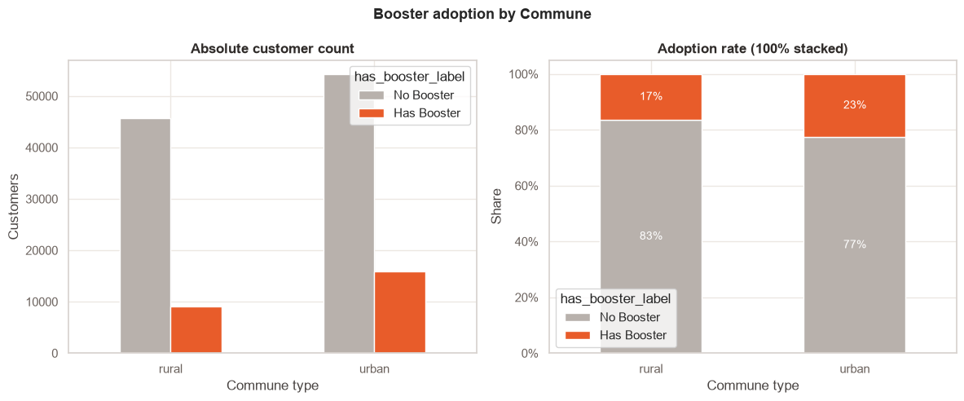
Booster Adoption by Commune (Urban vs Rural)
Adoption by commune → Urban customers request it more than rural

Slide 10
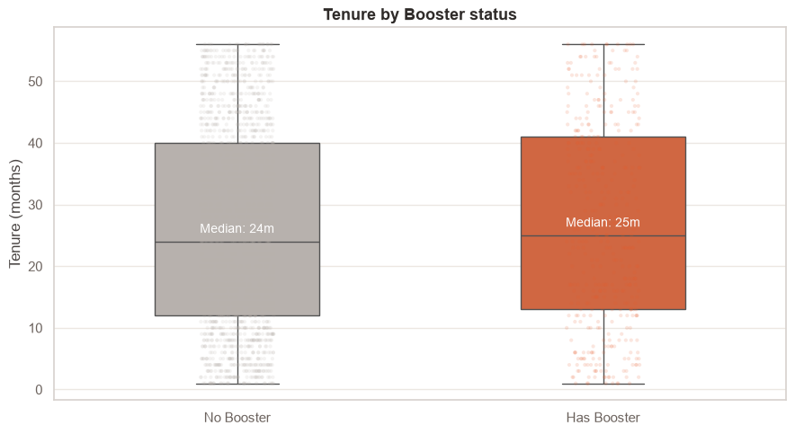
Tenure Distributions: Booster vs No-Booster (Boxplot)
Tenure boxplot → Booster adopters have similar tenure

Slide 11
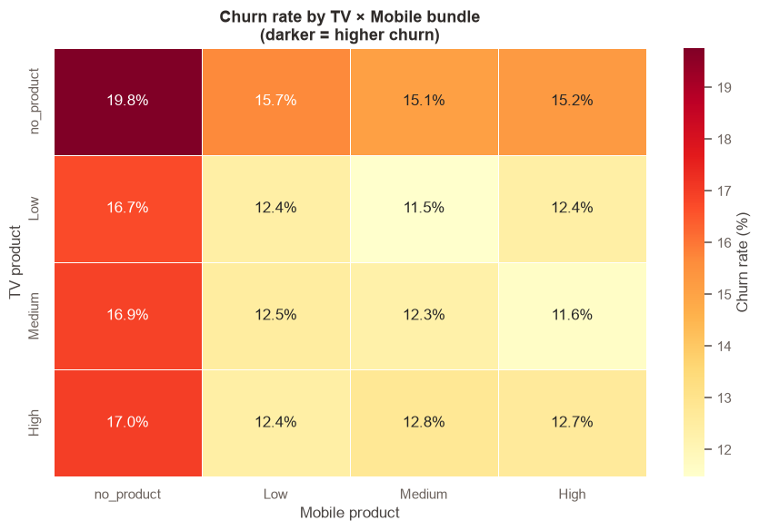
Bundle Stickiness: Churn Rate by TV × Mobile Product
TV × Mobile bundle heatmap → No-bundle customers churn at 20%, vs 12% for bundled (golden handcuffs)

Slide 12
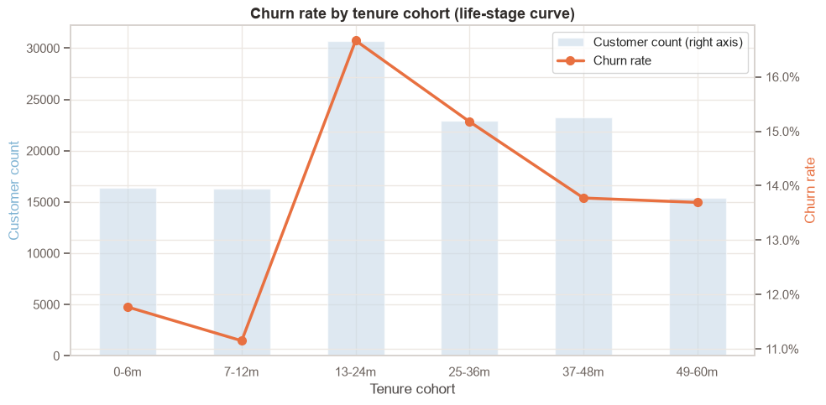
Tenure Cohorts vs Churn Rate (Life-stage Curve)
Life-stage curve → Churn peaks 13–24 months then falls (tenure effect)

Slide 13
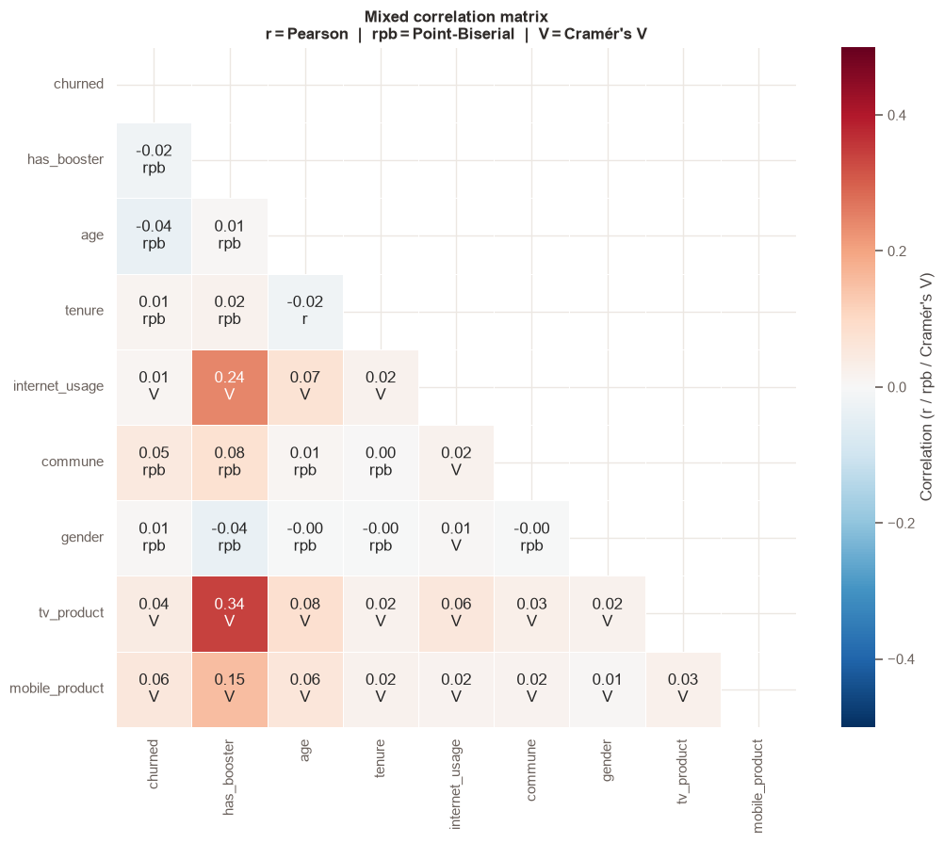
Data Health: Mixed Correlation Heatmap
Mixed correlation heatmap (Pearson / Point-Biserial / Cramér's V) → has_booster ↔ tv_product V=0.34, the key confounder for the logistic model

Slide 14
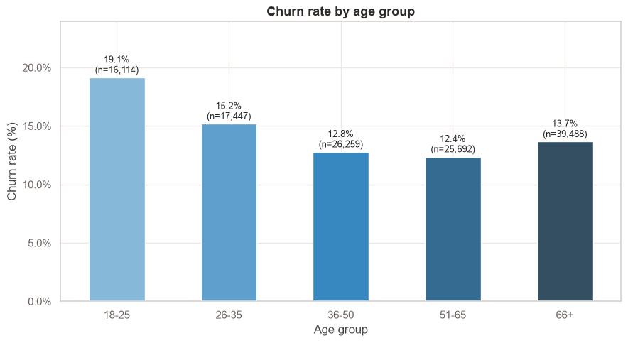
**Non-linear churn by life stage** — does churn peak for young or old customers?
Non-linear Age Check: U-shaped churn curve — young customers (18–25: 19.1%) churn most, drops sharply to 51–65 (12.4%), then rises slightly at 66+ (13.7%). Implication: a linear age term in the logit model would not capture this; the age_group dummy approach is preferable.

Slide 15
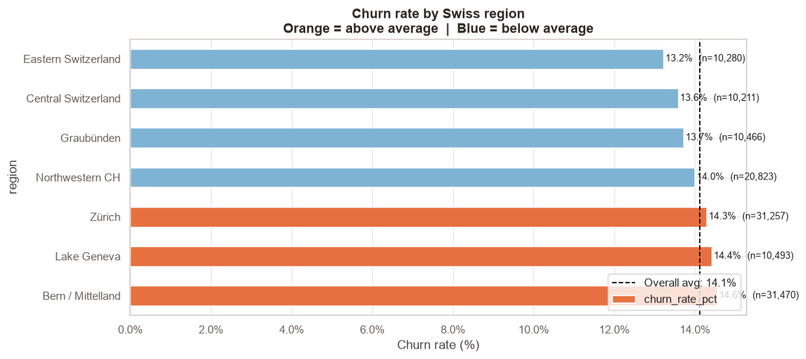
Regional Churn: Average Churned Rate by Swiss Region
Regional Churn: Bern/Mittelland (14.6%), Lake Geneva (14.4%), and Zürich (14.3%) are above the 14.1% average; Eastern Switzerland (13.2%) and Central Switzerland (13.6%) are below. Regional variation is modest (~1.4pp range) but real.

Slide 16
Appendix: AME, ATT

Slide 17
Propensity score matching: Average treatment effect on treated
## Method Overview With Formulas
Let $T_i \in \{0,1\}$ indicate booster adoption, $Y_i \in \{0,1\}$ indicate churn, and $X_i$ be observed covariates.
### 1) Propensity score estimation
We estimate treatment selection with logistic regression:
$$
e(X_i) = P(T_i=1\mid X_i) = \Lambda(X_i^\top\beta), \quad \Lambda(z)=\frac{1}{1+e^{-z}}
$$
### 2) Nearest-neighbor matching in score space
For each treated unit $i$ ($T_i=1$), find control unit(s) $j$ ($T_j=0$) that minimize
$$
d(i,j)=|e(X_i)-e(X_j)|
$$
subject to caliper constraint $d(i,j) \le c$. This notebook uses $k=1$ match per treated unit and caliper $c=0.02$.
### 3) Counterfactual construction and ATT
With matched control set $\mathcal{M}(i)$ for treated unit $i$, estimate its counterfactual outcome as
$$
\widehat{Y_i(0)} = \frac{1}{|\mathcal{M}(i)|}\sum_{j\in\mathcal{M}(i)} Y_j
$$
Then estimate ATT over matched treated units $\mathcal{T}_m$:
$$
\widehat{\mathrm{ATT}} = \frac{1}{|\mathcal{T}_m|}\sum_{i\in\mathcal{T}_m}\left(Y_i-\widehat{Y_i(0)}\right)
$$
### 4) Interpretation
Because $Y=1$ means churn, a negative ATT means boosters reduce churn for users who actually adopted boosters.

Slide 18
Propensity score matching: results
Baseline ATT (caliper=0.02, ratio=1:1): -1.63 pp Matched pairs: 25,000 | Coverage: 100.0% Average match distance: 0.0000

Slide 19
Logistic regression: Average marginal effect (AME) and HTE (heterogenious treatment effect)
Logit allows to estimate the causal effect of booster adoption on churn probability while allowing the effect to vary by internet-usage tier.
Let:
- $Y_i \in \{0,1\}$ be churn
- $T_i \in \{0,1\}$ be booster adoption
- $G_i$ be internet-usage tier
- $X_i$ be control covariates (age, tenure, TV/mobile products, commune)
We fit an interaction logistic model:
$$
\Pr(Y_i=1\mid T_i,G_i,X_i) = \Lambda\left(\beta_0 + \beta_T T_i + \beta_G^\top G_i + \beta_{TG}^\top(T_i\cdot G_i) + \gamma^\top X_i\right),
\quad \Lambda(z)=\frac{1}{1+e^{-z}}
$$
Why interaction matters: $\beta_{TG}$ allows booster impact to differ across tiers instead of forcing one common treatment effect.
Potential-outcome view at unit level:
$$
\widehat{\tau}_i = \hat p_i(1)-\hat p_i(0)
$$
where $\hat p_i(1)$ is predicted churn with $T_i=1$ and $\hat p_i(0)$ with $T_i=0$, holding all other features fixed for the same user.

Slide 20
Logistic regression: Results
Logit Regression Results ============================================================================== Dep. Variable: churned No. Observations: 125000 Model: Logit Df Residuals: 124983 Method: MLE Df Model: 16 Date: Wed, 17 Jun 2026 Pseudo R-squ.: 0.01244 Time: 12:41:40 Log-Likelihood: -50271. converged: True LL-Null: -50905. Covariance Type: nonrobust LLR p-value: 8.079e-260 ============================================================================================================ coef std err z P>|z| [0.025 0.975] ------------------------------------------------------------------------------------------------------------ Intercept -1.9277 0.041 -46.603 0.000 -2.009 -1.847 C(internet_usage)[T.Medium] -0.0265 0.024 -1.120 0.263 -0.073 0.020 C(internet_usage)[T.High] -0.0024 0.025 -0.094 0.925 -0.051 0.047 C(internet_usage)[T.Extreme] 0.2143 0.029 7.285 0.000 0.157 0.272 C(tv_product)[T.Low] -0.0449 0.028 -1.594 0.111 -0.100 0.010 C(tv_product)[T.Medium] -0.0436 0.029 -1.509 0.131 -0.100 0.013 C(tv_product)[T.no_product] 0.2225 0.029 7.772 0.000 0.166 0.279 C(mobile_product)[T.Low] 0.0261 0.023 1.143 0.253 -0.019 0.071 C(mobile_product)[T.Medium] -0.0040 0.024 -0.168 0.867 -0.050 0.043 C(mobile_product)[T.no_product] 0.3365 0.022 15.325 0.000 0.294 0.380 C(commune)[T.urban] 0.3142 0.017 18.694 0.000 0.281 0.347 has_booster -0.0155 0.062 -0.250 0.802 -0.137 0.106 has_booster:C(internet_usage)[T.Medium] 0.0563 0.073 0.769 0.442 -0.087 0.200 has_booster:C(internet_usage)[T.High] 0.0160 0.071 0.224 0.823 -0.124 0.156 has_booster:C(internet_usage)[T.Extreme] -0.5502 0.076 -7.278 0.000 -0.698 -0.402 age -0.0048 0.000 -11.939 0.000 -0.006 -0.004 tenure 0.0021 0.000 4.241 0.000 0.001 0.003 ============================================================================================================

