Slide 1
WiFi Booster Impact
Stanislav Babenyshev
19.06.2026

Slide 2

Executive Summary: Targeted rollout unlocks CHF +20.7M
Recommendation
✓ Roll out booster to Extreme internet users
✗ Do not extend to full customer base
✓ Validate with a randomized A/B test before scaling
 | Cost | Saved rev. | Net
Extreme users | CHF 8.7M | CHF 29.4M | CHF +20.7M
Full base | CHF 52.5M | CHF 30.5M | CHF −22.0M
Extreme users capture 96% of the saved revenue at 17% of the cost.

Slide 3
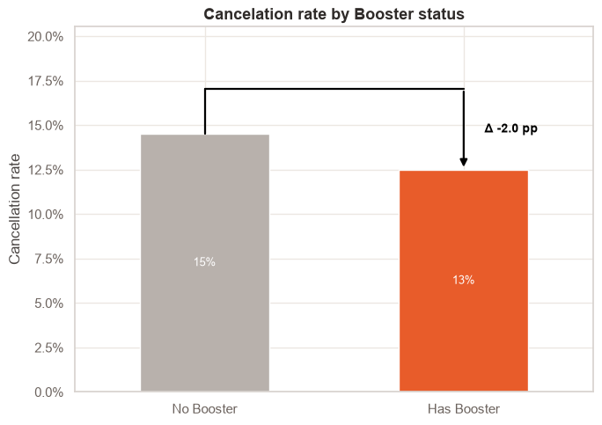
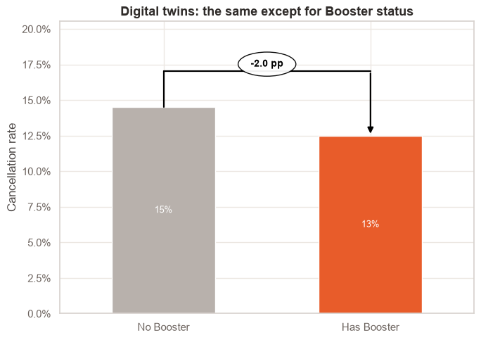
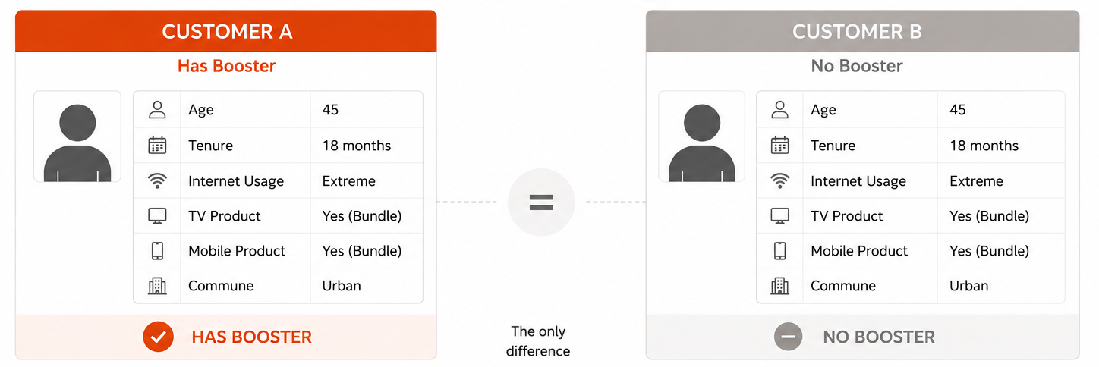
How much does the booster reduce cancelation?
Overall comparison
Raw averages — does not correct for self-selection
Corrected (“Like-for-like”) comparison
Two independent methods cross-check the estimate
Logistic Regression (AME): −1.0 pp
Digital Twins (PSM, ATT): −1.6 pp
Two independent methods confirm: the booster effect is real, but substantially smaller than raw comparisons suggest.

Slide 4
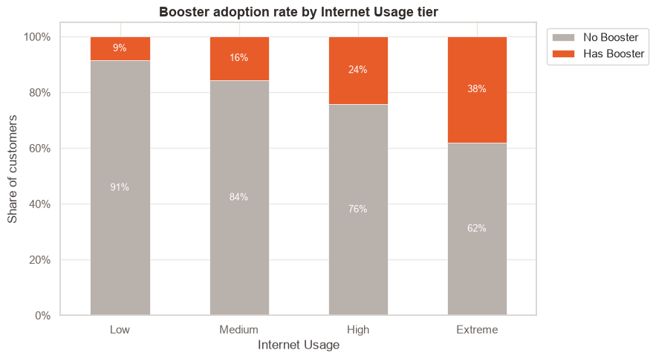
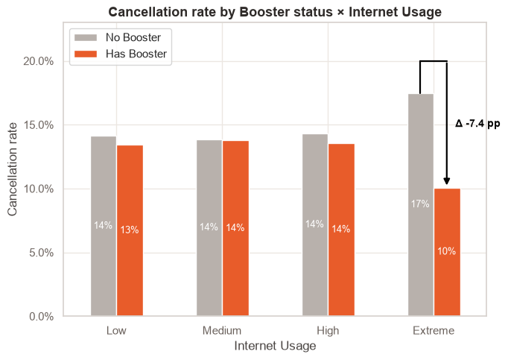
Heavy users self-select into the booster
The apparent overall benefit comes mostly from the fact that heavy users choose the booster.
Raw comparison is misleading — heavy users self-select into the booster, inflating expected benefit.

Slide 5
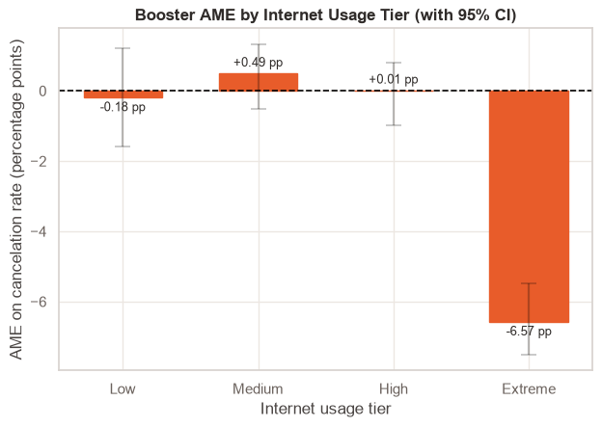
Extreme internet users drive the entire booster benefit
AME (Average Marginal Effect) answers: “On average, how much does a cancelation probability change if the same customer has a booster vs. no booster, while everything else stays the same?”
Segment | Customers | AME
Low usage | 29.5k | −0.2 pp
Medium usage | 40.1k | +0.5 pp
High usage | 34.7k | 0.0 pp
Extreme usage | 20.7k | −6.6 pp
Only Extreme internet users show a statistically significant effect — the other segments show no meaningful cancelation rate reduction.

Slide 6
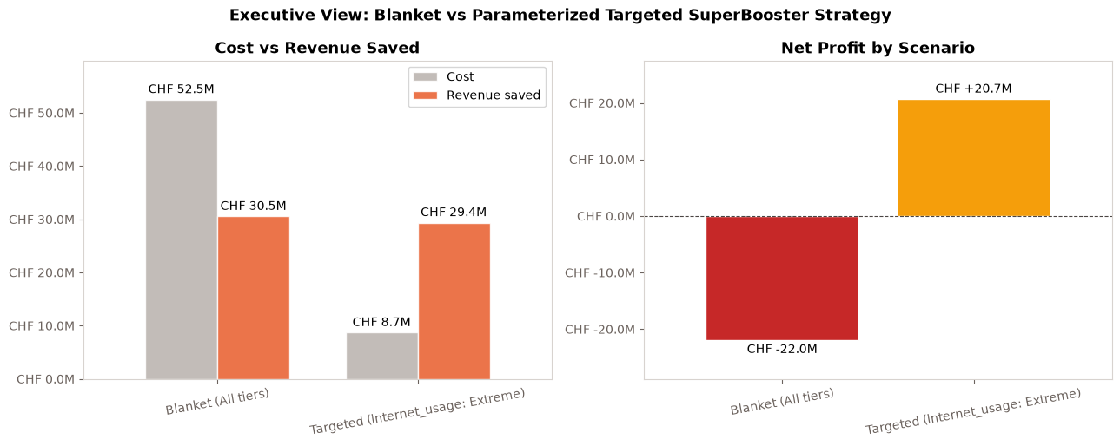
Targeted vs. blanket: CHF +20.7M vs. CHF −22M

Slide 7
Appendix: EDA

Slide 8
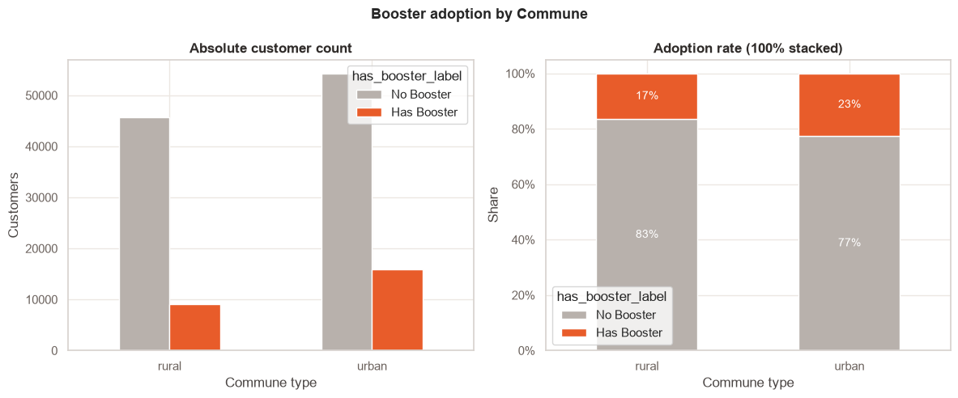
Booster Adoption by Commune (Urban vs Rural)
Adoption by commune → Urban customers request it more than rural

Slide 9
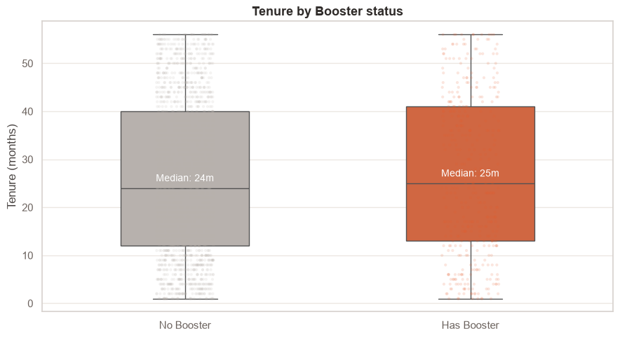
Tenure Distributions: Booster vs No-Booster (Boxplot)
Tenure boxplot → Booster adopters have similar tenure

Slide 10
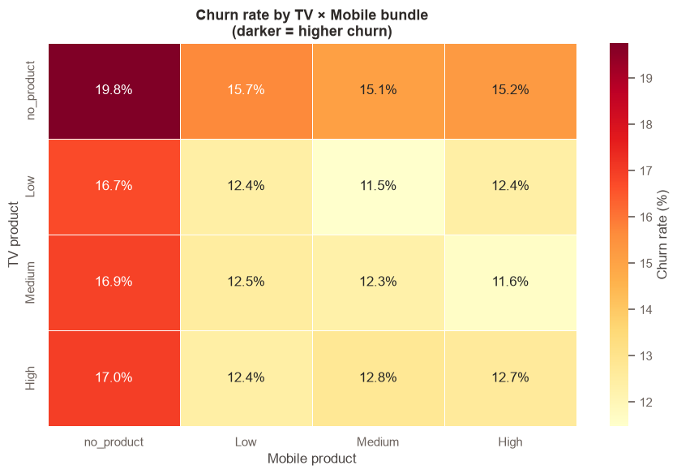
Bundle Stickiness: Churn Rate by TV × Mobile Product
TV × Mobile bundle heatmap → No-bundle customers churn at 20%, vs 12% for bundled (golden handcuffs)

Slide 11
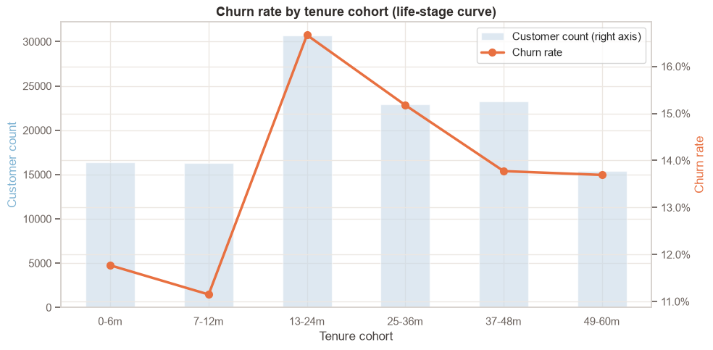
Tenure Cohorts vs Churn Rate (Life-stage Curve)
Life-stage curve → Churn peaks 13–24 months then falls (tenure effect)

Slide 12
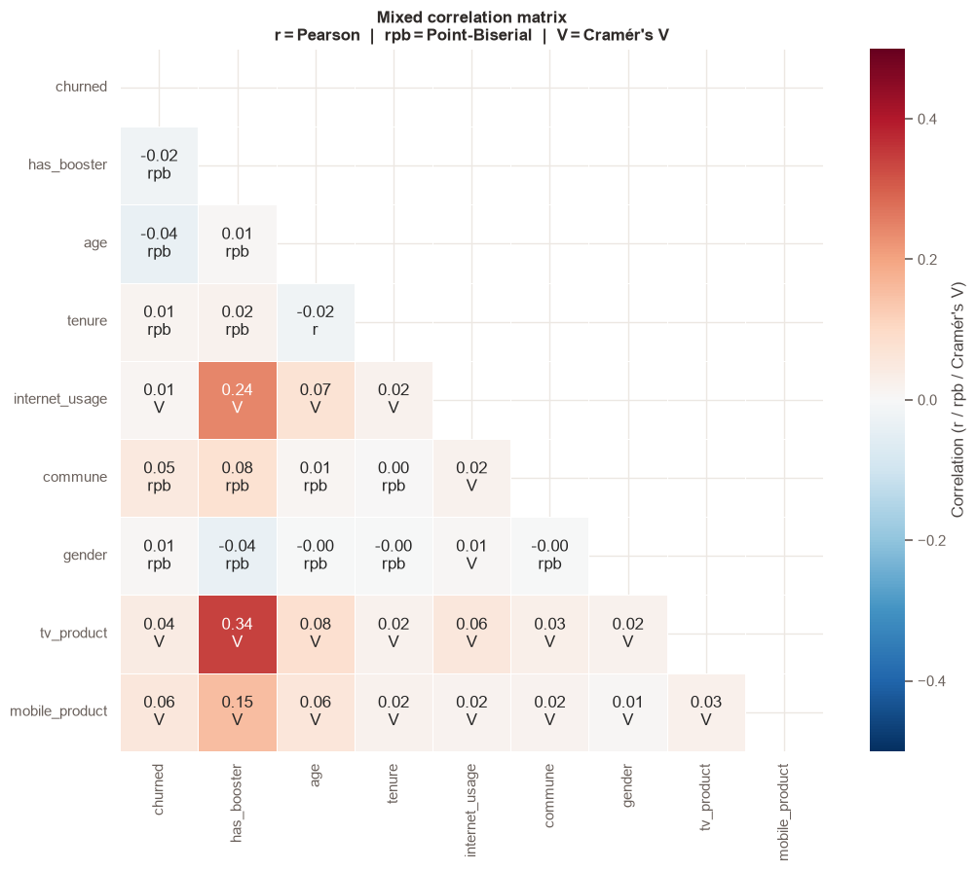
Data Health: Mixed Correlation Heatmap
Mixed correlation heatmap (Pearson / Point-Biserial / Cramér's V) → has_booster ↔ tv_product V=0.34, the key confounder for the logistic model

Slide 13
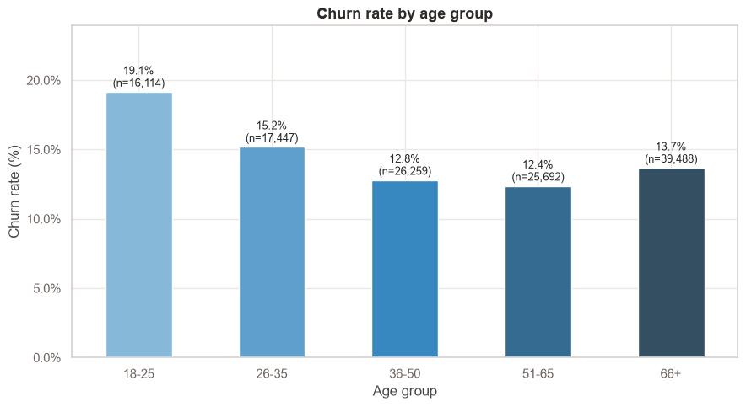
Non-linear churn by life stage — does churn peak for young or old customers?
Non-linear Age Check: U-shaped churn curve — young customers (18–25: 19.1%) churn most, drops sharply to 51–65 (12.4%), then rises slightly at 66+ (13.7%). The age_group dummy approach is preferable.

Slide 14
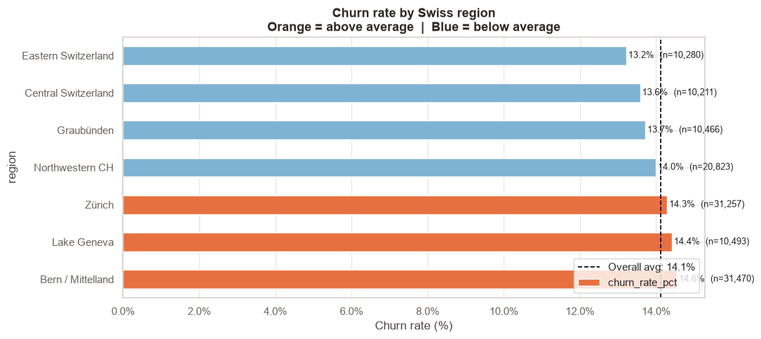
Regional Churn: Average Churned Rate by Swiss Region
Regional Churn: Bern/Mittelland (14.6%), Lake Geneva (14.4%), and Zürich (14.3%) are above the 14.1% average; Eastern Switzerland (13.2%) and Central Switzerland (13.6%) are below. Regional variation is modest (~1.4pp range) but real.

Slide 15
Appendix: AME, ATT

Slide 16
Propensity score matching: Average treatment effect on treated
## Method Overview With Formulas
Let $T_i \in \{0,1\}$ indicate booster adoption, $Y_i \in \{0,1\}$ indicate churn, and $X_i$ be observed covariates.
### 1) Propensity score estimation
We estimate treatment selection with logistic regression:
$$
e(X_i) = P(T_i=1\mid X_i) = \Lambda(X_i^\top\beta), \quad \Lambda(z)=\frac{1}{1+e^{-z}}
$$
### 2) Nearest-neighbor matching in score space
For each treated unit $i$ ($T_i=1$), find control unit(s) $j$ ($T_j=0$) that minimize
$$
d(i,j)=|e(X_i)-e(X_j)|
$$
subject to caliper constraint $d(i,j) \le c$. This notebook uses $k=1$ match per treated unit and caliper $c=0.02$.
### 3) Counterfactual construction and ATT
With matched control set $\mathcal{M}(i)$ for treated unit $i$, estimate its counterfactual outcome as
$$
\widehat{Y_i(0)} = \frac{1}{|\mathcal{M}(i)|}\sum_{j\in\mathcal{M}(i)} Y_j
$$
Then estimate ATT over matched treated units $\mathcal{T}_m$:
$$
\widehat{\mathrm{ATT}} = \frac{1}{|\mathcal{T}_m|}\sum_{i\in\mathcal{T}_m}\left(Y_i-\widehat{Y_i(0)}\right)
$$
### 4) Interpretation
Because $Y=1$ means churn, a negative ATT means boosters reduce churn for users who actually adopted boosters.

Slide 17
Propensity score matching: results
Baseline ATT (caliper=0.02, ratio=1:1): -1.63 pp Matched pairs: 25,000 | Coverage: 100.0% Average match distance: 0.0000

Slide 18
Logistic regression: Average marginal effect (AME) and HTE (heterogenious treatment effect)
Logit allows to estimate the causal effect of booster adoption on churn probability while allowing the effect to vary by internet-usage tier.
Let:
- $Y_i \in \{0,1\}$ be churn
- $T_i \in \{0,1\}$ be booster adoption
- $G_i$ be internet-usage tier
- $X_i$ be control covariates (age, tenure, TV/mobile products, commune)
We fit an interaction logistic model:
$$
\Pr(Y_i=1\mid T_i,G_i,X_i) = \Lambda\left(\beta_0 + \beta_T T_i + \beta_G^\top G_i + \beta_{TG}^\top(T_i\cdot G_i) + \gamma^\top X_i\right),
\quad \Lambda(z)=\frac{1}{1+e^{-z}}
$$
Why interaction matters: $\beta_{TG}$ allows booster impact to differ across tiers instead of forcing one common treatment effect.
Potential-outcome view at unit level:
$$
\widehat{\tau}_i = \hat p_i(1)-\hat p_i(0)
$$
where $\hat p_i(1)$ is predicted churn with $T_i=1$ and $\hat p_i(0)$ with $T_i=0$, holding all other features fixed for the same user.

Slide 19
Logistic regression: Results
Logit Regression Results ============================================================================== Dep. Variable: churned No. Observations: 125000 Model: Logit Df Residuals: 124983 Method: MLE Df Model: 16 Date: Wed, 17 Jun 2026 Pseudo R-squ.: 0.01244 Time: 12:41:40 Log-Likelihood: -50271. converged: True LL-Null: -50905. Covariance Type: nonrobust LLR p-value: 8.079e-260 ============================================================================================================ coef std err z P>|z| [0.025 0.975] ------------------------------------------------------------------------------------------------------------ Intercept -1.9277 0.041 -46.603 0.000 -2.009 -1.847 C(internet_usage)[T.Medium] -0.0265 0.024 -1.120 0.263 -0.073 0.020 C(internet_usage)[T.High] -0.0024 0.025 -0.094 0.925 -0.051 0.047 C(internet_usage)[T.Extreme] 0.2143 0.029 7.285 0.000 0.157 0.272 C(tv_product)[T.Low] -0.0449 0.028 -1.594 0.111 -0.100 0.010 C(tv_product)[T.Medium] -0.0436 0.029 -1.509 0.131 -0.100 0.013 C(tv_product)[T.no_product] 0.2225 0.029 7.772 0.000 0.166 0.279 C(mobile_product)[T.Low] 0.0261 0.023 1.143 0.253 -0.019 0.071 C(mobile_product)[T.Medium] -0.0040 0.024 -0.168 0.867 -0.050 0.043 C(mobile_product)[T.no_product] 0.3365 0.022 15.325 0.000 0.294 0.380 C(commune)[T.urban] 0.3142 0.017 18.694 0.000 0.281 0.347 has_booster -0.0155 0.062 -0.250 0.802 -0.137 0.106 has_booster:C(internet_usage)[T.Medium] 0.0563 0.073 0.769 0.442 -0.087 0.200 has_booster:C(internet_usage)[T.High] 0.0160 0.071 0.224 0.823 -0.124 0.156 has_booster:C(internet_usage)[T.Extreme] -0.5502 0.076 -7.278 0.000 -0.698 -0.402 age -0.0048 0.000 -11.939 0.000 -0.006 -0.004 tenure 0.0021 0.000 4.241 0.000 0.001 0.003 ============================================================================================================

