Slide 1
WiFi Booster Impact
Stanislav Babenyshev
19.06.2026

Slide 2
Booster rollout is not economically justified for the full customer base
Recommendation
✗ Do not roll out booster to all customers
✓ Consider targeted rollout for Extreme internet users
✓ Validate with randomized A/B test before large investment
Metric | Value
Rollout cost | CHF 52.5M
Estimated ROI | Negative
Strongest beneficiary | Extreme internet users
Confidence | Moderate (observational evidence only)
Initial analysis suggested a large benefit. After correcting for selection bias, the estimated effect is much smaller and concentrated in one segment.

Slide 3
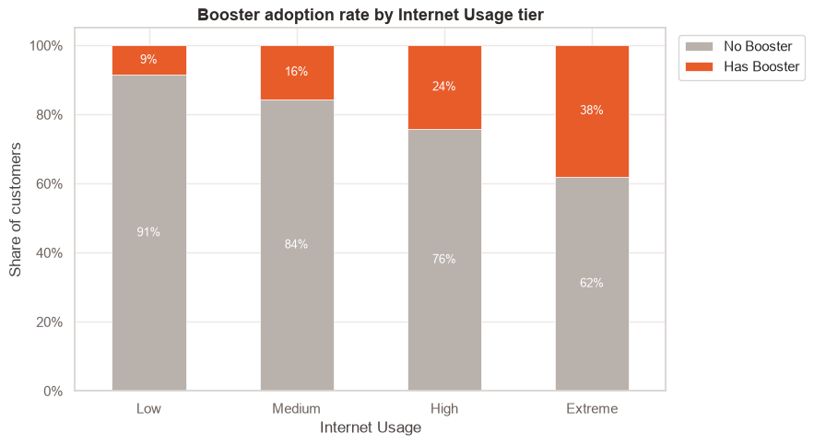
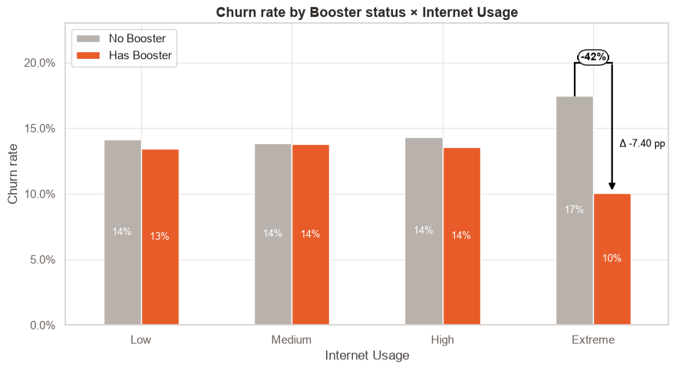
Heavy users self-select into the booster
The apparent overall benefit comes mostly from the fact that heavy users choose the booster.
Comparing raw averages would overestimate the booster effect. So we need to adjust for that.

Slide 4

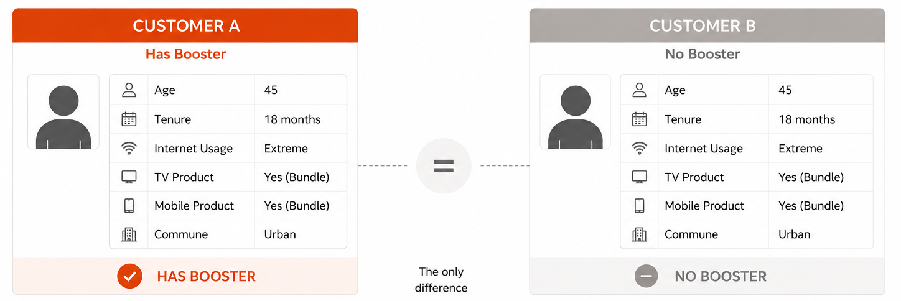
Comparing like-for-like customers
Two independent methods produce similar conclusions: the booster effect exists but is substantially smaller than suggested by raw comparisons.
Method | Estimated churn decrease | What it means
Naive Comparison | -2.0 pp | Biased – heavier users self-select into the booster
Logistic Regression (AME) | -1.0 pp | Controls for differences using a statistical model
Digital Twins (PSM ATT) | -1.6 pp | Compares like-for-like customers (best causal proxy)
Two independent methods produce similar conclusions: the booster effect exists but is substantially smaller than suggested by raw comparisons.

Slide 5
The booster benefits one segment
Customer segment | Customers | Estimated booster effect on churn | 95% CI
Low usage | 29.5k | −0.2 pp | [−1.6, +1.2]
Medium usage | 40.1k | +0.5 pp | [−0.5, +1.3]
High usage | 34.7k | 0.0 pp | [−1.0, +0.8]
Extreme usage | 20.7k | −6.6 pp | [−7.5, −5.5]
Almost the entire benefit comes from Extreme internet users.

Slide 6
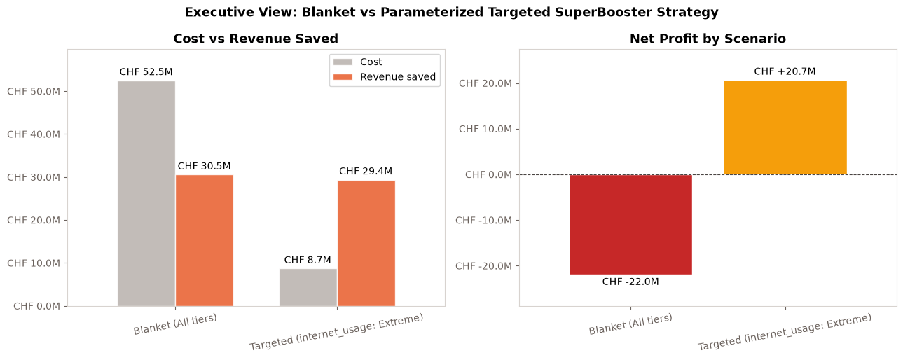
Financial impact

Slide 7
Recommendation
 | Option A: Roll out to all customers | Option B: Target Extreme users | Option C: Run A/B test first
Investment | High (CHF 52.5M) | Moderate (CHF 8.7M) | Low
Expected ROI | ✗ Negative | ✓ Potentially attractive | N/A
Evidence | Weak for most segments | Strongest observed effect | Provides causal evidence
Risk | High risk of overspending | Moderate | Low
Time to decision | Immediate | Short-term | Additional 2–3 months
Recommendation | ✗ Do not pursue | ✓ Preferred business option | ★ Recommended before major investment

