Slide 1

Pollit
Product unlike any other. An industry disrupting polling app built to accommodate user needs and desires to poll info about current affairs or trending topics.

Slide 2
Functionality
Create a user
Create polls as users
Take and participate in polls that others have created
View other peoples responses
Search for polls based on category
Delete user accounts and everything associated

Slide 3


Production
Production was split up into 2 categories.
Front End
Html
CSS
Materialize
JavaScript
Plot.js
Carousel
Handlebars.js
Backend
Sequelize.js
Node.js
Express.js
Crypto
Passport

Slide 4
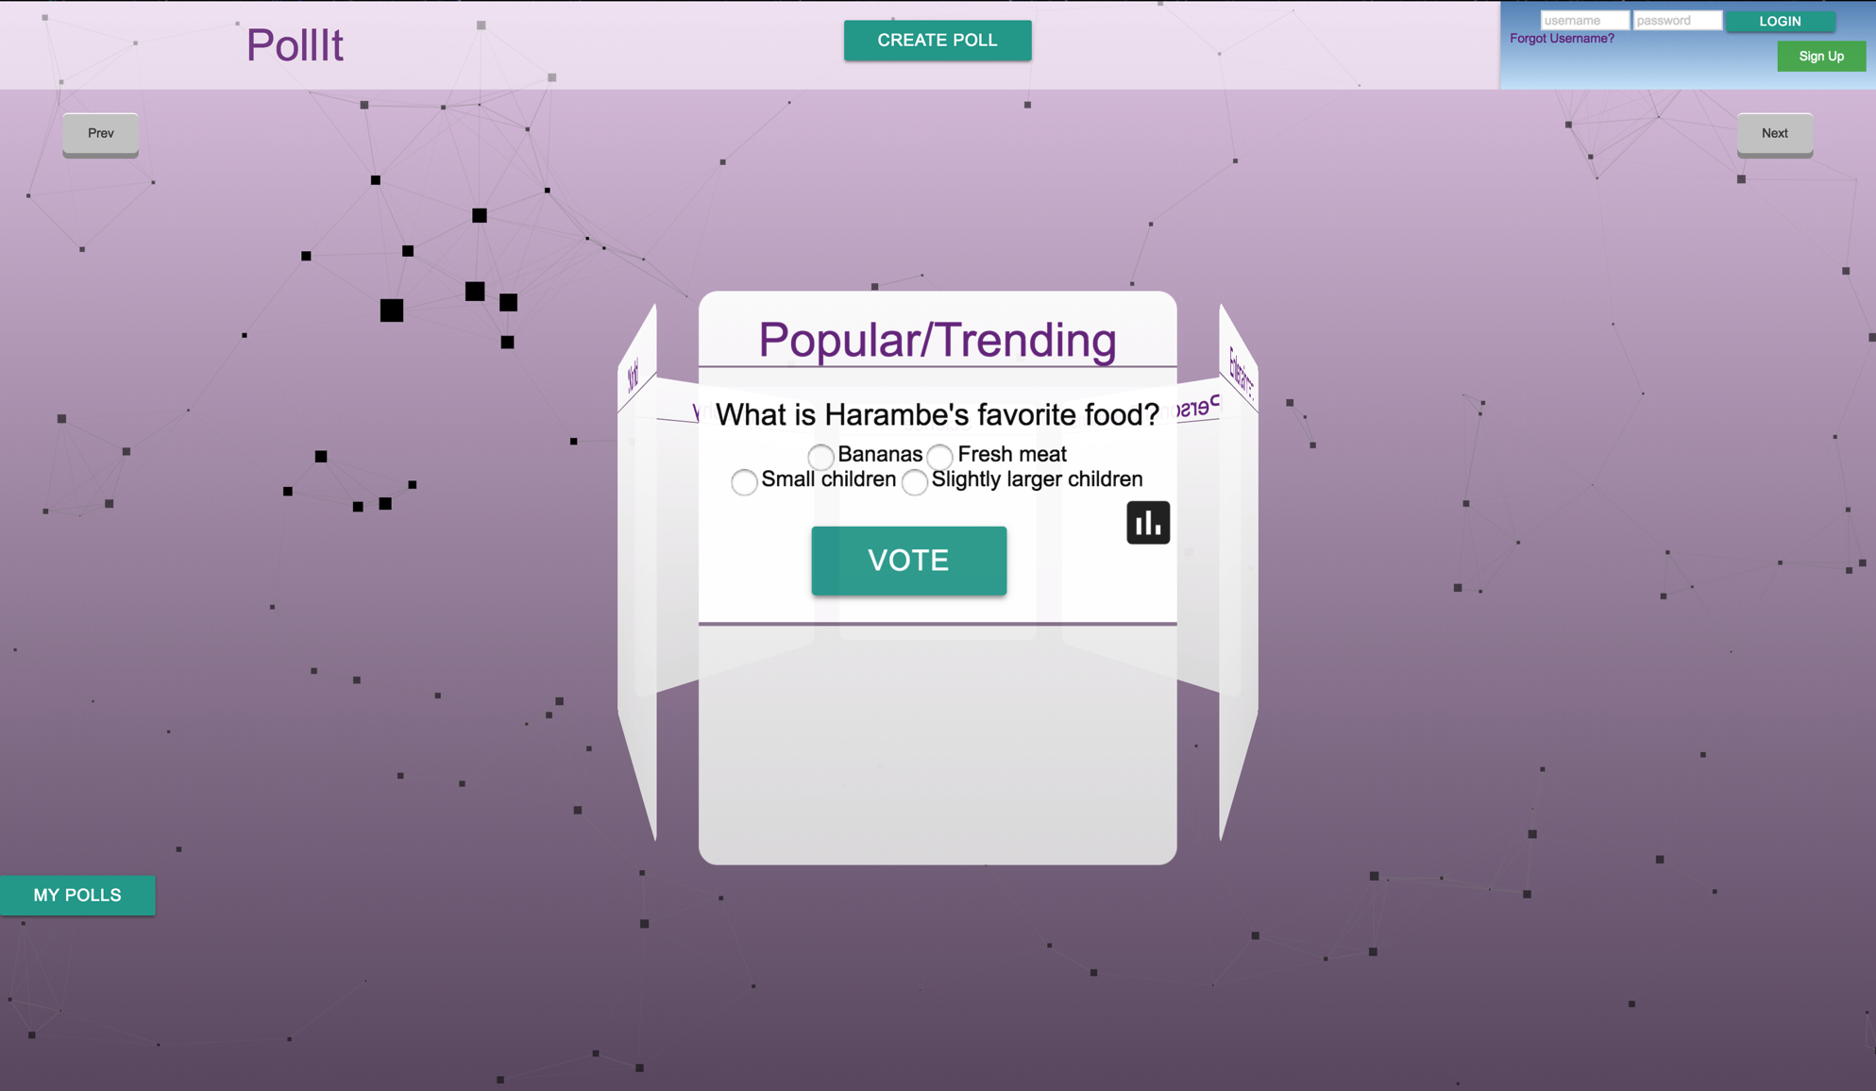
Login Page
With this beautiful login page you are able to get a brief glimpse a the available polls. You are also able to create an account if you do not have one or login in if you do.

Slide 5
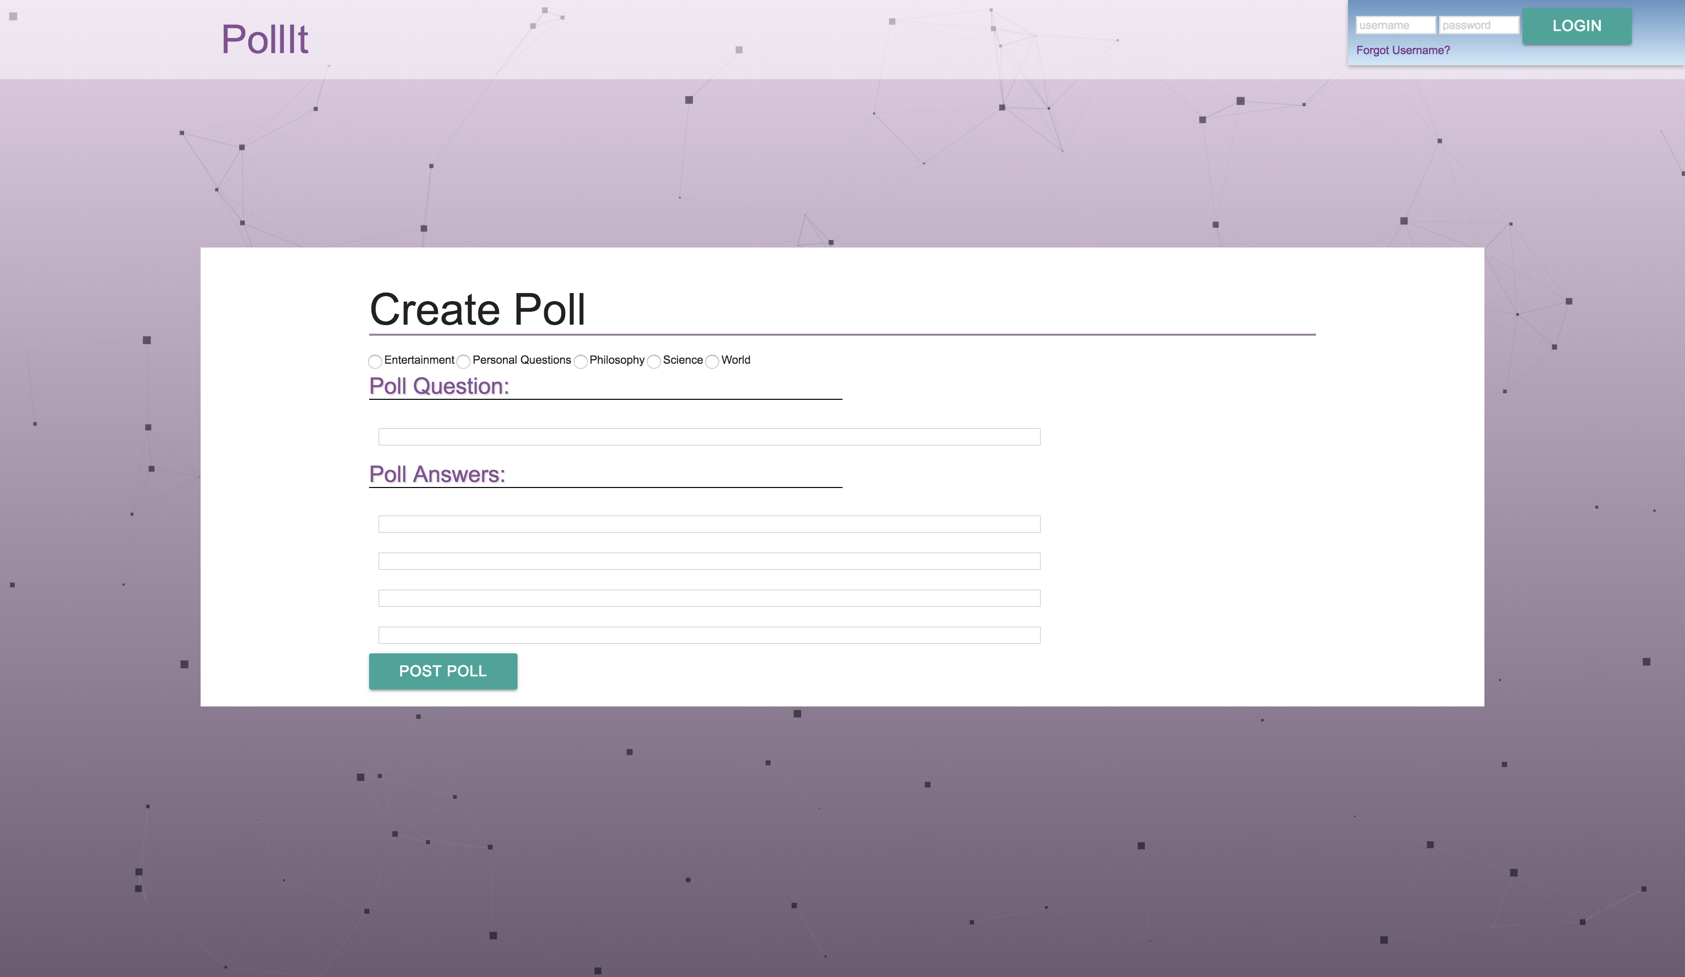
Create a Poll
When creating a poll you will be redirected here. On this wonderful page you will be able to create a poll for others to use and share. You must have at least one question and two answers. Once created, the world will be able to view your poll and chime in with their answers.

