Slide 1
Final Engagement
Attack, Defense, and Analysis of a Vulnerable Network

Slide 2
Table of Contents
This document contains the following sections:
01
Network Topology & Critical Vulnerabilities
02
Traffic Profile
03
Normal Activity
04
Malicious Activity

Slide 3
Network Topology & Critical Vulnerabilities

Slide 4
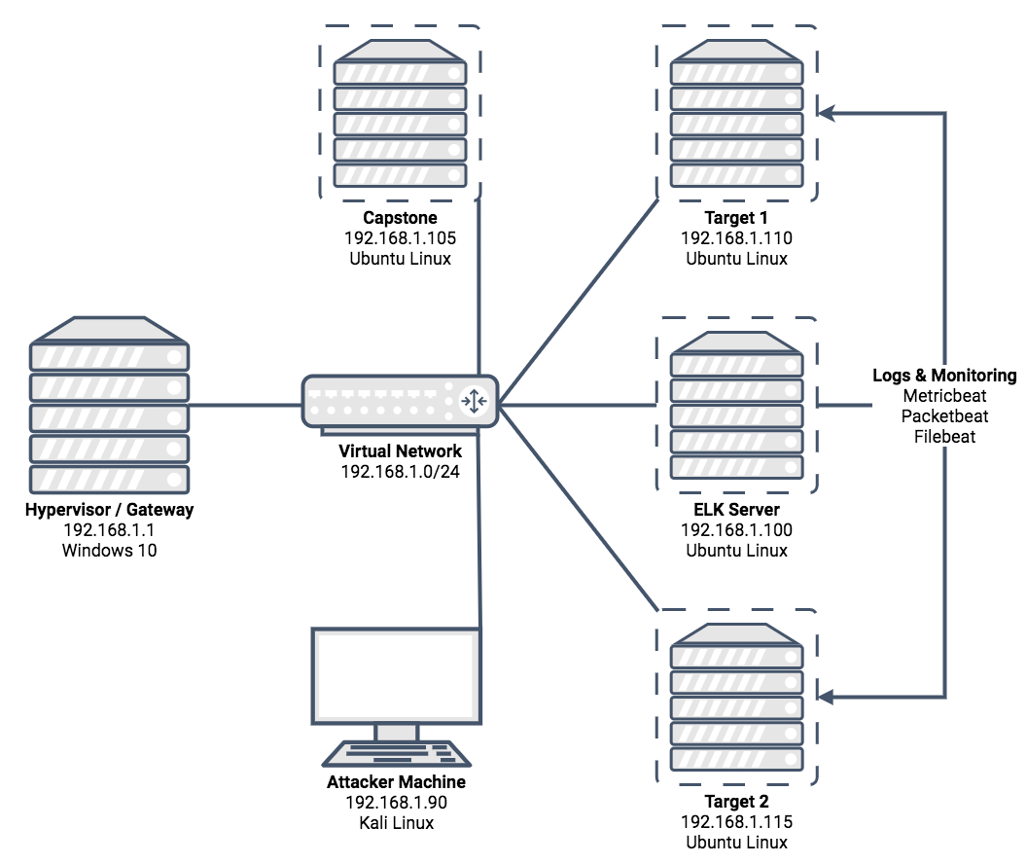
Network Topology
Network
Address Range: | 192.168.1.0-255
Netmask: | 255.255.255.0
Gateway: | 192.168.1.1
Machines
IPV4: | 192.168.1.1
OS: | Windows 10
Hostname: | ML-RefVm-684427
IPV4: | 192.168.1.100
OS: | Ubuntu Linux
Hostname: | ELK
IPV4: | 192.168.1.110
OS: | Debian Linux
Hostname: | TARGET1
IPV4: | 192.168.1.115
OS: | Debian Linux
Hostname: | TARGET2

Slide 5
Critical Vulnerabilities: Target 1
Our assessment uncovered the following vulnerabilities in Target 1
Vulnerability | Description | Impact

Slide 6
Critical Vulnerabilities: Target 2
Our assessment uncovered the following vulnerabilities in Target 2
Vulnerability | Description | Impact

Slide 7
Traffic Profile

Slide 8
Traffic Profile
Our analysis identified the following characteristics of the traffic on the network
Feature | Value | Description
Top Talkers (IP Addresses) |  | Machines that sent the most traffic.
Most Common Protocols |  | Three most common protocols on the network.
# of Unique IP Addresses |  | Count of observed IP addresses.
Subnets |  | Observed subnet ranges.
# of Malware Species |  | Number of malware binaries identified in traffic.

Slide 9
Behavioral Analysis
Purpose of Traffic on the Network
Users were observed engaging in the following kinds of activity:
Normal Activity
Suspicious Activity
For Example:
Watching YouTube
Watching PornHub
Reading the news
Looking at pictures of catboys
For Example:
Sending Malware
Phishing
Fishing
Reading Manga
Playing MTG

Slide 10
Normal Activity

Slide 11
Watching YouTube
Summarize the Following:
What kind of traffic did you observe?
What, specifically, was the user doing?
Include screenshots of packets justifying your conclusions.
Include a description of any interesting files.

Slide 12
Watching PornHub
Summarize the Following:
What kind of traffic did you observe?
What, specifically, was the user doing?
Include screenshots of packets justifying your conclusions.
Include a description of any interesting files.

Slide 13
Looking at Pictures of Catboys
Summarize the Following:
What kind of traffic did you observe?
What, specifically, was the user doing?
Include screenshots of packets justifying your conclusions.
Include a description of any interesting files.

Slide 14
Malicious Activity

Slide 15
Sending Malware
Summarize the Following:
What kind of traffic did you observe?
What, specifically, was the user doing?
Include screenshots of packets justifying your conclusions.
Include a description of any interesting files.

Slide 16
Reading Manga
Summarize the Following:
What kind of traffic did you observe?
What, specifically, was the user doing?
Include screenshots of packets justifying your conclusions.
Include a description of any interesting files.

Slide 17
Playing MTG
Summarize the Following:
What kind of traffic did you observe?
What, specifically, was the user doing?
Include screenshots of packets justifying your conclusions.
Include a description of any interesting files.

Slide 18
Fín

