Slide 1
Zomato Restaurant Reviews
Team: Teal Rabbits
Ashley Drayton
Babette Blanquet
Benedict Nathaniel
Erica Warne

Slide 2
Summary
Our question:
Where are the top 100 Restaurants in Australia?
Our hypothesis:
We expect the majority of the best restaurants to be in Melbourne and Sydney.
Sub-questions:
What do we mean by Top 100? How do we define what the best restaurants are?
Are there any differences between cities?
Is there a correlation between price and user ratings?
Our findings:
XXX

Slide 3

The data
We used Zomato API to gather the data.
Challenges
Search of 100 restaurants maximum per call.
We actually wanted a 1000 per city instead.
Our dataset = 500 restaurants
Top 100 restaurants of Melbourne, Sydney, Brisbane, Adelaide, Perth
Biases
Risk of biases as some other excellent restaurants can be in country Australia.
We were interested in best restaurants where most Australians live.
Cleaning the data
The data was really clean
Removal of three rows due to ‘Average Cost for two’ not relevant
22 missing Zip codes – didn’t remove the rows as we didn’t need them for our analysis

Slide 4
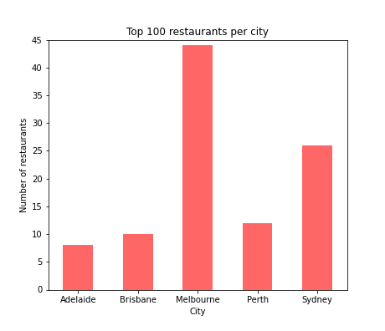
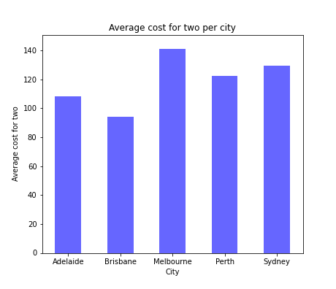
The top 100 restaurants per user ratings
Almost 50% of restaurants are in Melbourne, however they are also the most expensive.

Slide 5
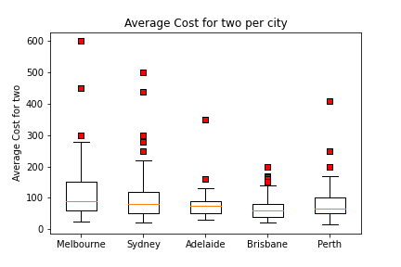
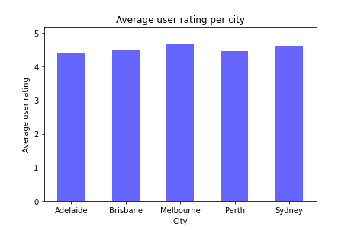
Are Melbourne restaurants really more expensive or is it only the top ones?
Melbourne’s top 100 restaurants are more expensive than in any other city - median is $90 vs $70 for the Australian median
Melbourne and Sydney have a slightly higher rating but are a lot more expensive for very little difference.

Slide 6
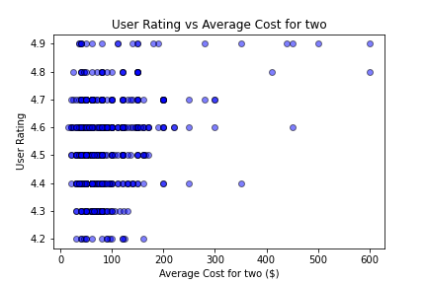
Is there any correlation between price and ratings?
The correlation coefficient between User Rating and Average Cost for two is 0.29
There isn’t any relationship between price and user rating.
This means people already take in account the price when they rate the restaurant.

Slide 7
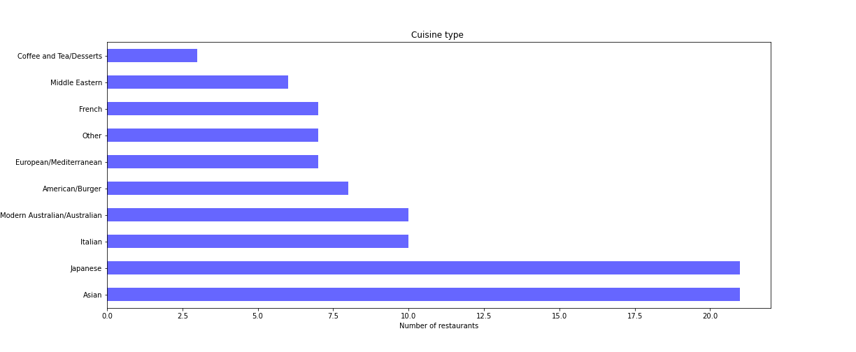
Types of cuisines for the top 100 restaurants

Slide 8
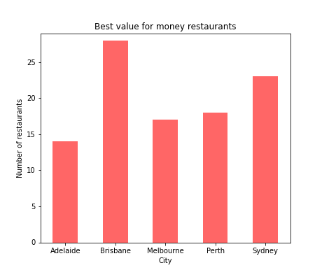
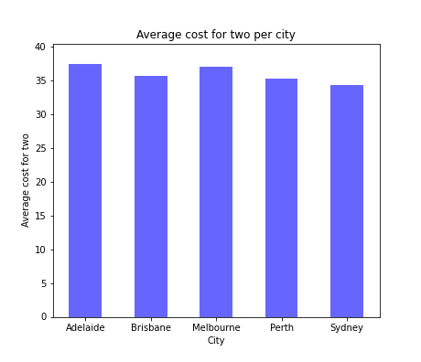
The 100 best value for money restaurants
Factor = Average cost for two / user ratings
30% of restaurants are in Brisbane. The average cost for two is roughly $35 across all cities.

