Slide 1
Twitter Sentiment Analysis
Babette Blanquet

Slide 2
The project
The problem
Social media platforms are essential for businesses to reinforce their brand and connect with their followers and build their community.
Social media platforms like Twitter provide analytics on the performance of your tweets and how to improve their engagement.
However you don’t have a clear picture on tweets mentioning their brand.
2. Our solution
The Twitter sentiment analysis app is designed to provide insights on tweets mentioning your brand.

Slide 3
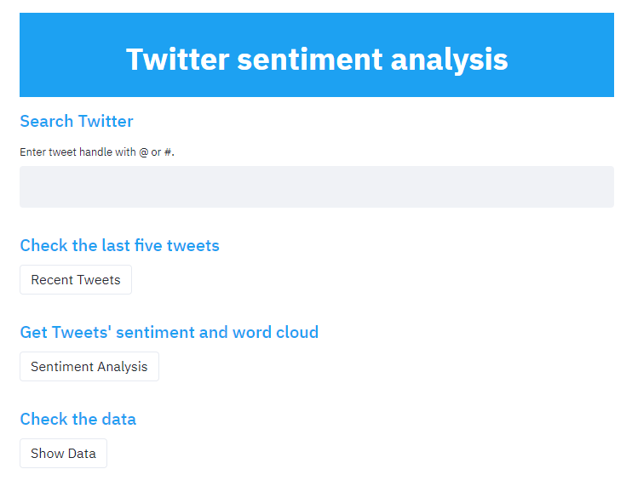
How it works?
When you search Twitter, the app renders the tweets of the last seven days up to 100 tweets.
With the app you can get:
The last five tweets
The sentiment of tweets
The word cloud
The data

Slide 4







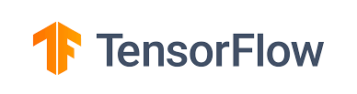

The infrastructure
Source
Machine Learning
Application
Visualisations
Twitter API
1.6M tweets
Recurrent
Neural Networks
wordcloud

Slide 5
Natural Language Processing
Pre-processing steps | Example @chrishas AHHH I HOPE YOUR OK!!!
Clean Tweets: Remove @, #, https://, punctuation | chrishas AHHH I HOPE YOUR OK
Corpus: remove stopwords and use Porter Stemmer, convert to lower case | chrishas ahhh hope ok
One-hot representation: convert words into numbers | [1683, 2168, 2803, 2698]
Word-embedding: all sentences same length | [ 0, 0, 0, 0, 0, 0, 0, 0, 0, 0, 0, 0, 0, 0, 0, 0, 0, 0, 0, 0, 0, 0, 0, 0, 0, 0, 0, 1683, 2168, 2803, 2698]

Slide 6
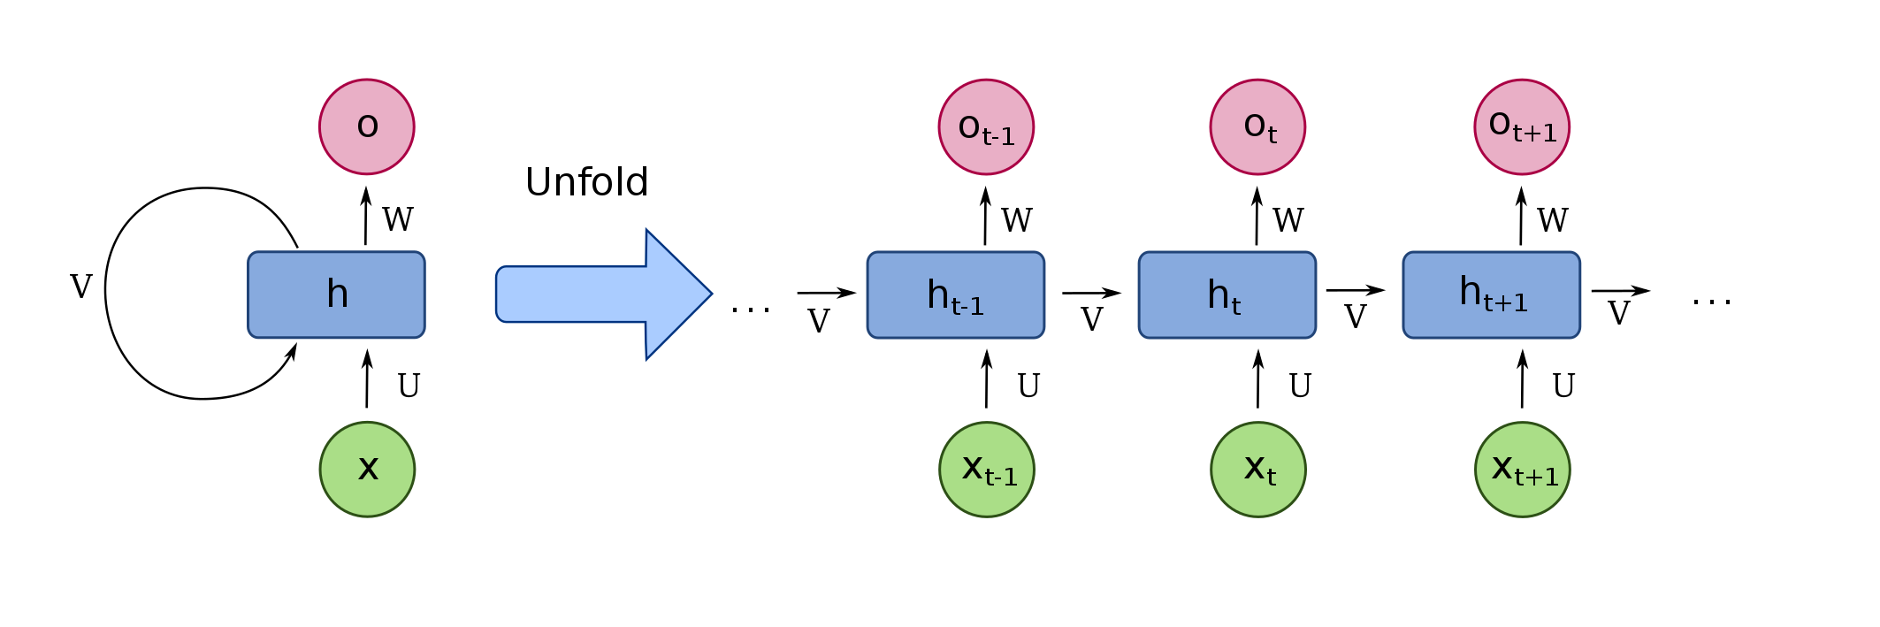
The Recurrent Neural Network
Sequence of information is maintained
100 Bidirectional Long Short Term Memory neurons
Dataset from Kaggle 1.6M tweets
Accuracy score: 77%

Slide 7
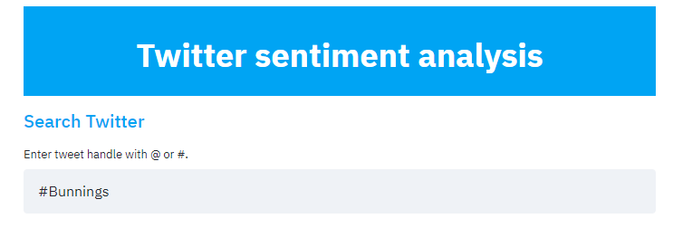
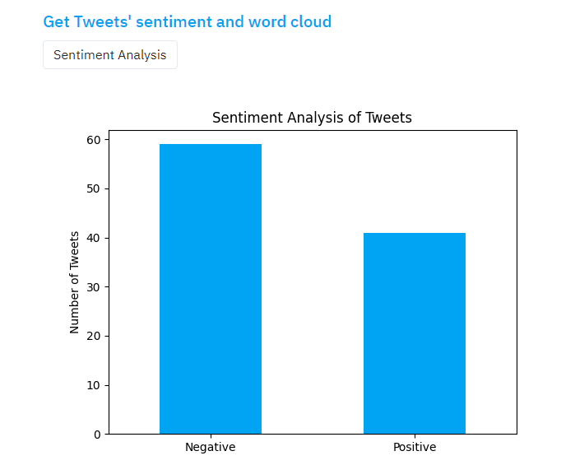

Slide 8
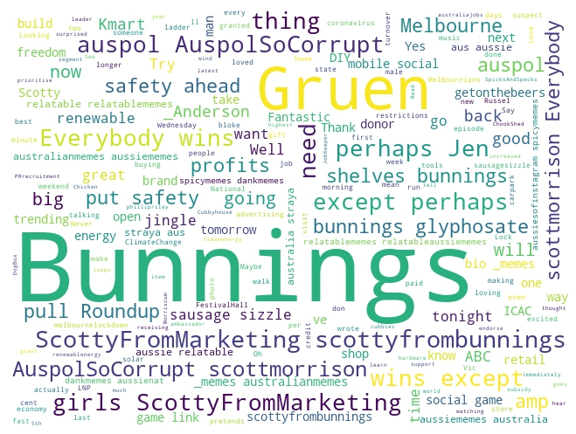
#Bunnings

Slide 9
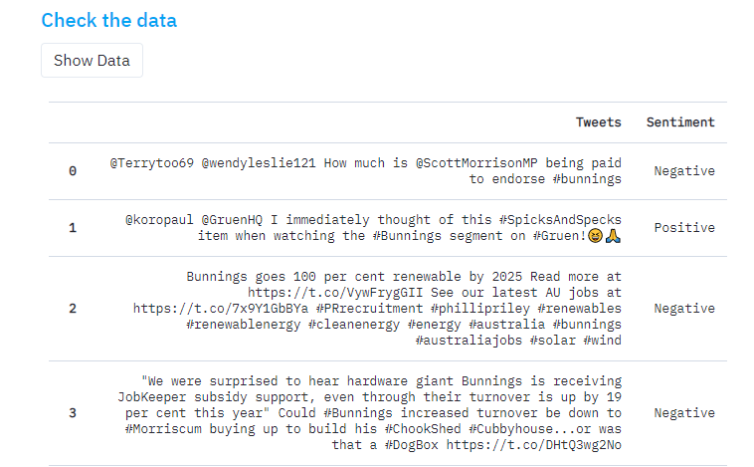

Slide 10
Conclusion
The challenges:
Training the model with the many parameters and different datasets
Training sentiment on tweets – short sentences
If I had more time:
Developing a new model with BERT (Bidirectional Encoder Representations from Transformers) known as state of the art for NLP.
App with more features such as timeline and a filter with positive and negative.

Slide 11
DEMO https://twitter-sentim-analysis.herokuapp.com/

Slide 12
QUESTIONS
&
THANKS

