Slide 1
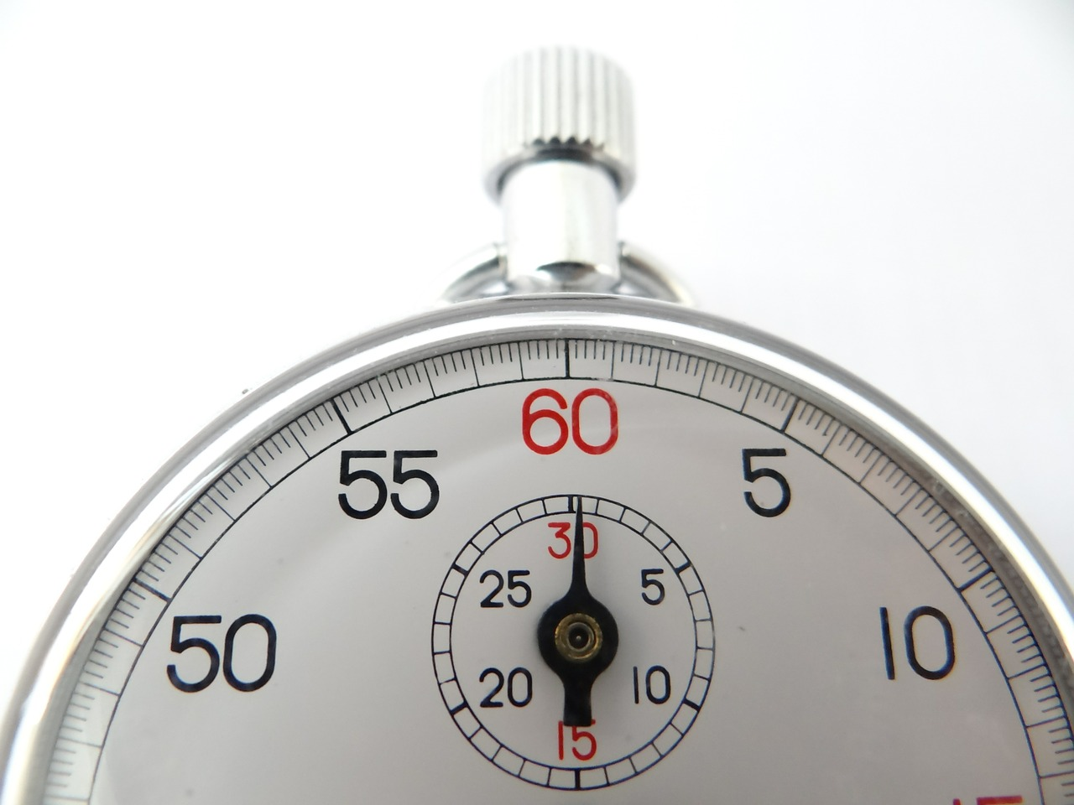


Timers
By: Abdallah Elsayed

Slide 2

Topics
Timer 1 in ATmega32.
What is Input Capture mode?
What is PWM?
What is Duty cycle?
PWM and ATmega32/16.
Control a servo.
Control a DC motor.

Slide 3


Timer 1
organization

Slide 4
Recap
TCNTn: Timer / Counter Register.
TCCRn: Timer Counter Control Register.
OCRn: Output Compare Register.
TOVn: Timer Overflow Flag.
OCFn: Output Compare Flag.

Slide 5
Timer 1 vs Timer 0/2

Slide 6
Timer 1 is a 16 bits timer Timer 0/2 is 8 bits timer

Slide 7




Slide 8


TCCR1A
TCCR1B

Slide 9
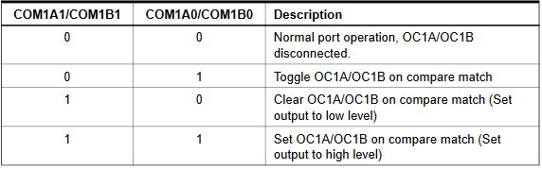
TCCR1A

Slide 10
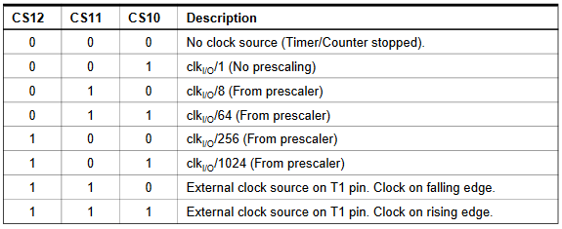
TCCR1B

Slide 11
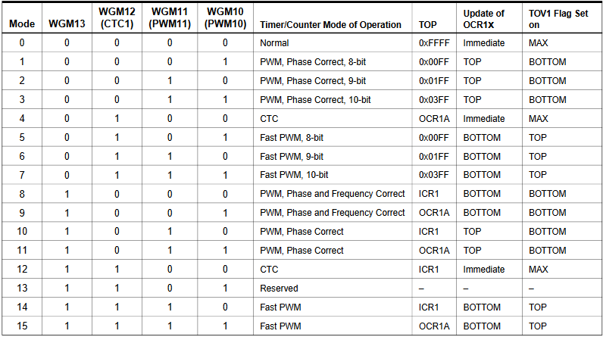

Slide 12
What is Input Capture mode?

Slide 13
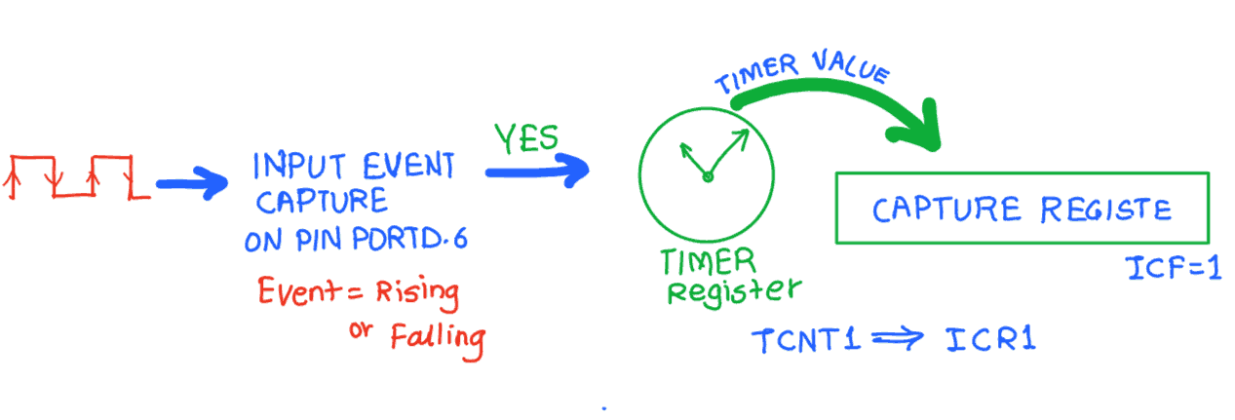

Slide 14
Bit 7 - ICNC1: Input Capture Noise canceller
Setting this bit activates the noise canceller. It causes a delay of 4 clock cycles as it considers a change only if it persists for at least 4 successive system clocks.
Bit 6 - ICES1: Input Capture Edge select
Select edge detection for input capture function.

Slide 15
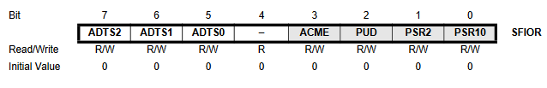
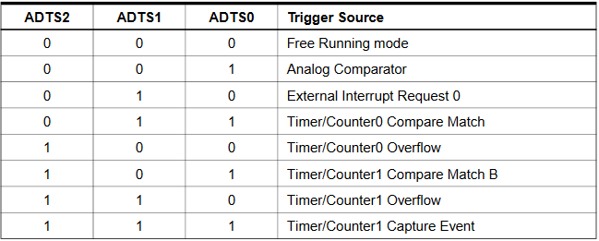

Slide 16
What is PWM?

Slide 17
Pulse-Wave Modulation

Slide 18
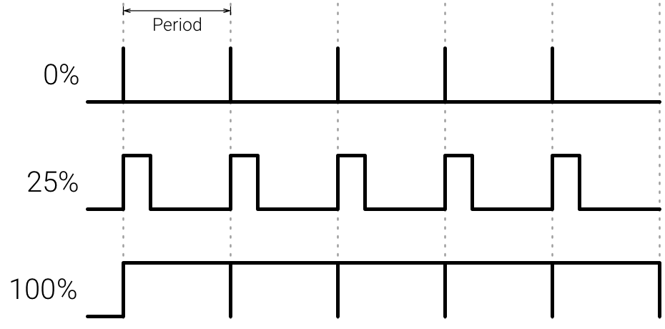

Slide 19
What is Duty Cycle?

Slide 21
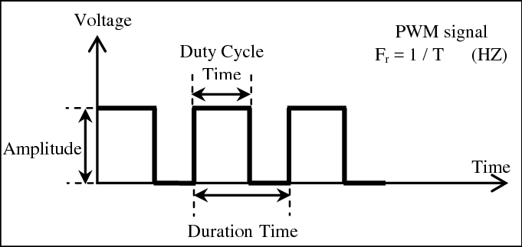

Slide 22

Duty cycle calculation
Duty cycle = $\frac{\text{on} \text{time}}{\text{on}\text{/}\text{off} \text{time}}$ X 100.
Ex:
If a PWM wave frequency is 50Hz and it is on for 100mS of the wave then the Duty cycle is?
Ans:
T = 1/50 = 200mS.
Duty Cycle = $\frac{\text{100}}{\text{200}}$ X 100 = 50%.

Slide 23
PWM and ATmega32/16

Slide 24
Timer Modes
Normal Mode
Output Compare Mode
CTC Mode
Fast PWM Mode
Phase Correct PWM Mode

Slide 25
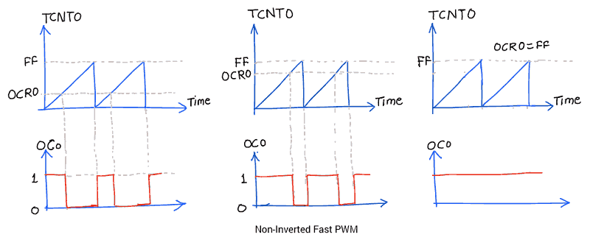
Fast PWM

Slide 26
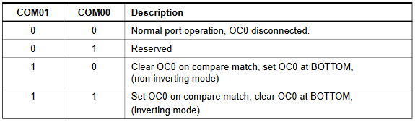
Fast PWM

Slide 27
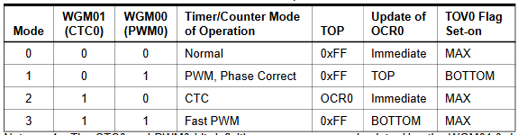
Fast PWM

Slide 28
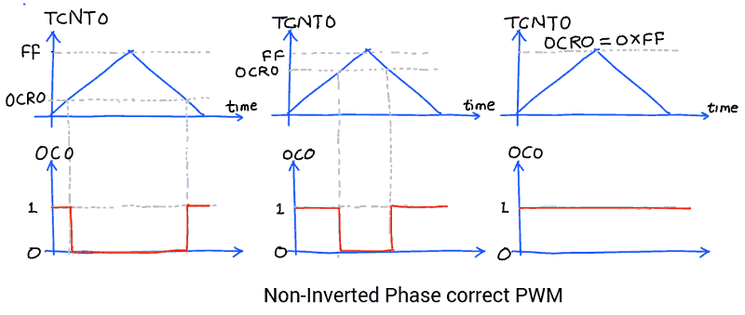
Phase Correct PWM

Slide 29
Phase Correct PWM

Slide 30
Phase Correct PWM

Slide 32
Fast PWM vs Phase Correct PWM

Slide 33
Servo and ATmega32/16

Slide 34
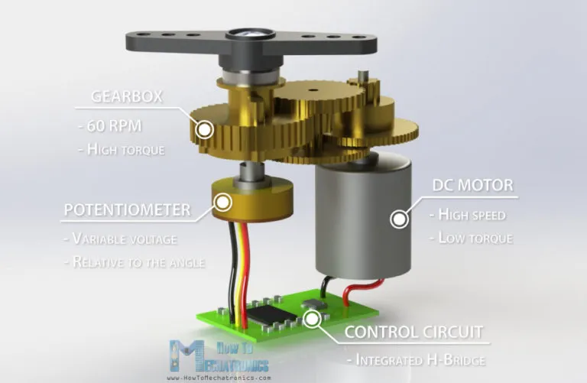
Servo

Slide 35
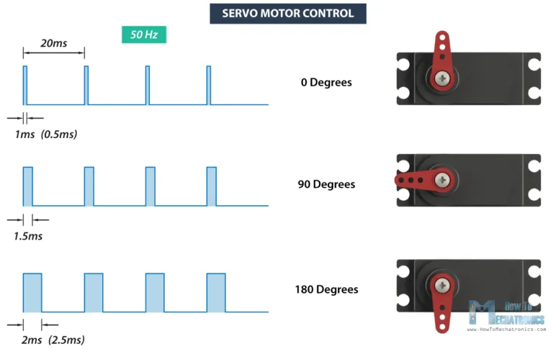
Servo

Slide 36
DC motor and ATmega32/16

Slide 37
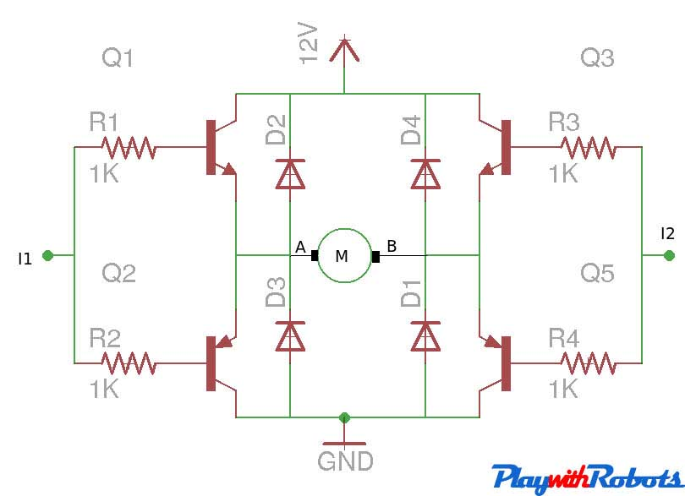
DC motor

Slide 38
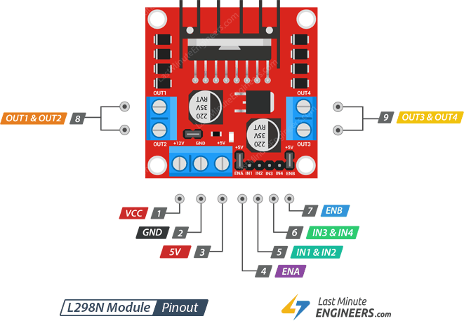
L298N

